Slide 1
Temporary Traffic Control for Concrete Pavement
Sean Laffey, PE
Slaffey.consultant@mdot.maryland.gov
ANNUAL CONCRETE CONFERENCE – MARCH 10, 2020

Slide 2
Outline
MDOT SHA – Office of Traffic and Safety
Concrete Roads
Maintenance of Traffic Standards
Maintenance of Traffic Considerations

Slide 3
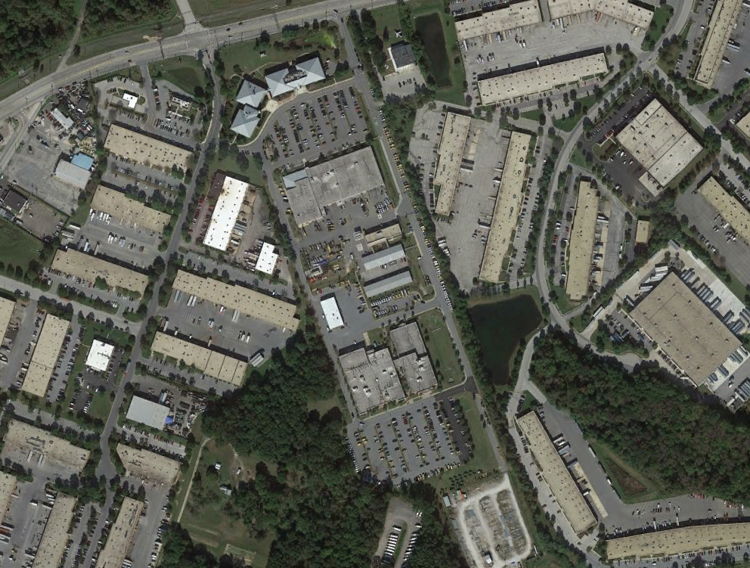
MDOT SHA
Owns and Maintains State Roads
OOTS
Engineering
Operations
Safety

Slide 4
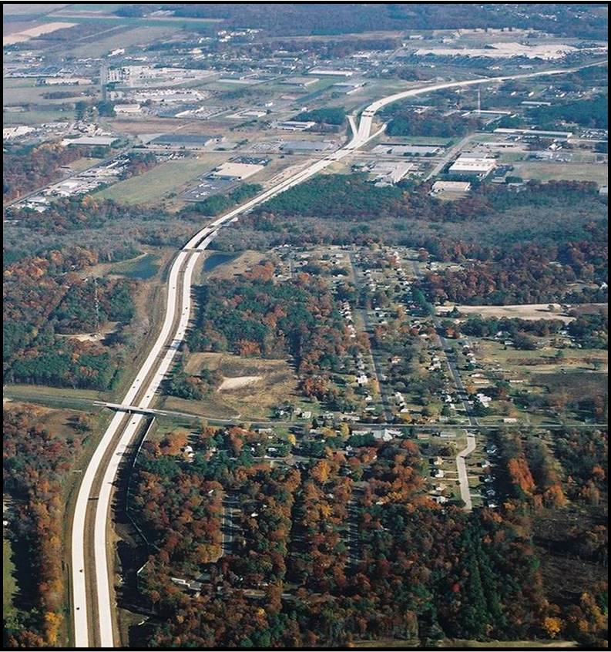
Concrete roads
Durability
Resiliency
Lower Life Cycle Cost
Environmental Benefits
MOT Challenges (that can be managed)

Slide 5
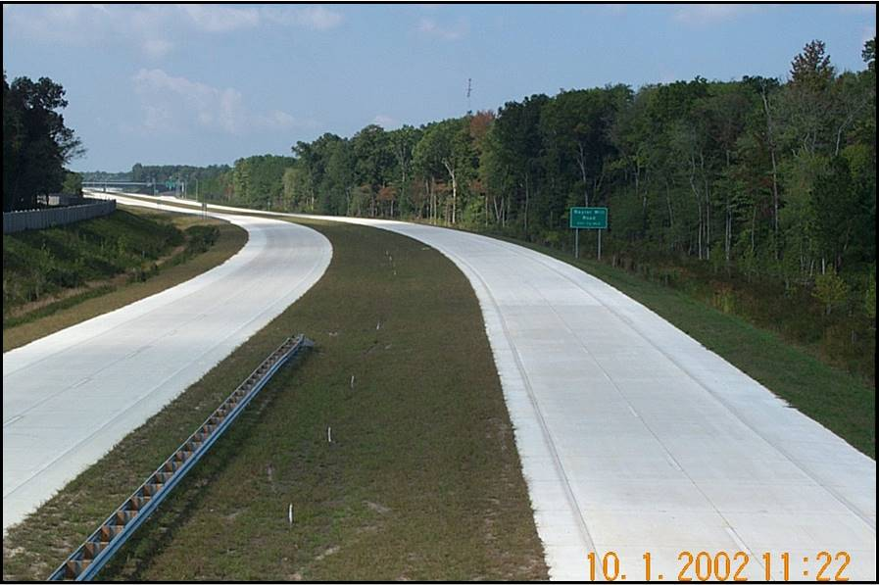
Maryland Concrete Roads
Salisbury Bypass
I-795
I-97
US 50/301 (I-595)
US 40 Corridor (west Baltimore City)
Broening Highway (Baltimore City/County)
US 1 and MD 175 Intersection (Jessup)
I-70/MD 85 Buckeystown Pike Interchange (Frederick)
MD 4/ Suitland Parkway Interchange (Prince George’s County)
Overlay projects (turn lanes, intersections, MD 210, US 50 at US 301, MD 355 at MD 27, I-68 Truck Climbing Lanes)

Slide 6
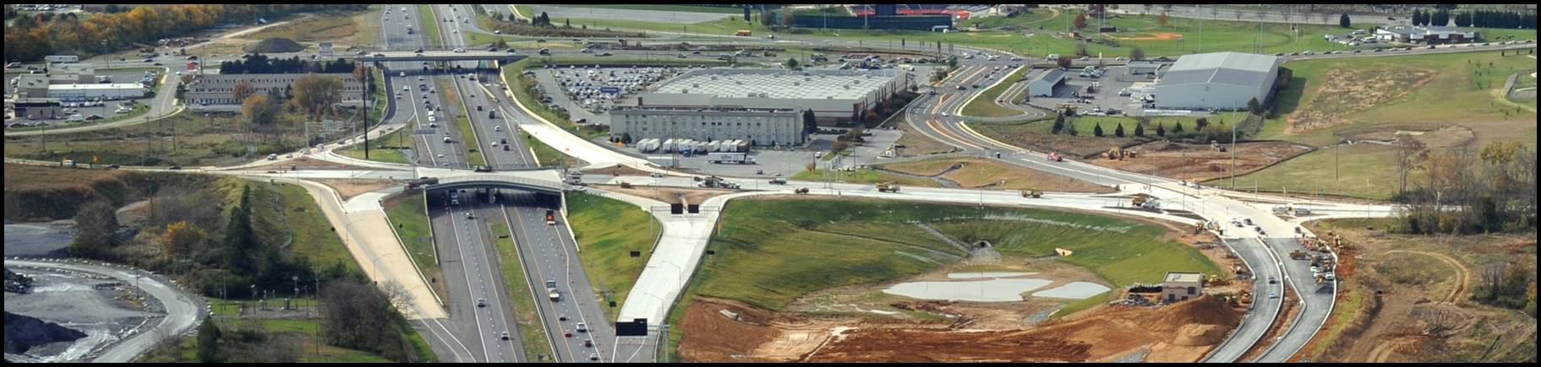
Maintenance of Traffic Standards

Slide 7

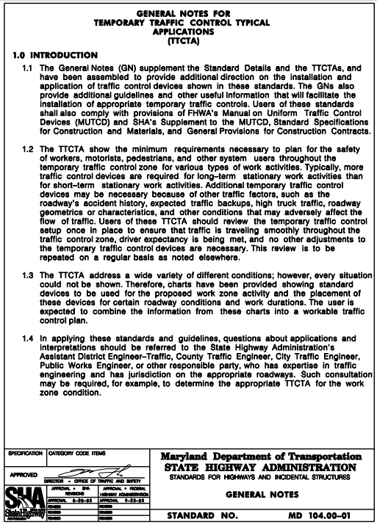
Manuals
https://apps.roads.maryland.gov/BusinessWithSHA/bizStdsSpecs/desManualStdPub/publicationsonline/ohd/bookstd/pdf/category1.pdf
https://www.roads.maryland.gov/mmutcd/2011_rev122011_MDMUTCD_Complete.pdf

Slide 8
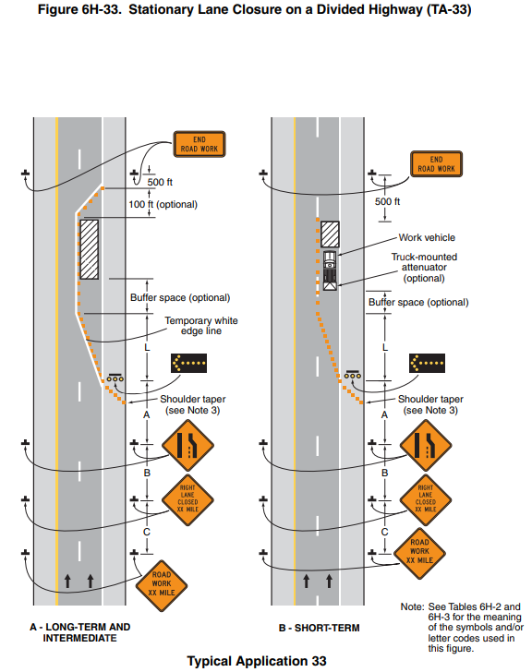
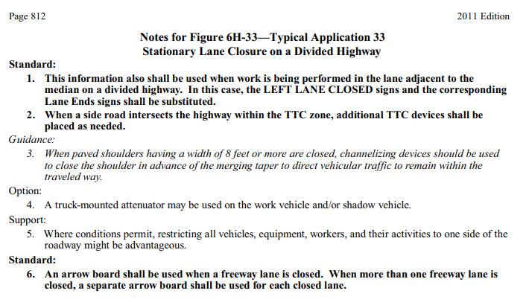
Lane Closure MdMUTCD

Slide 9
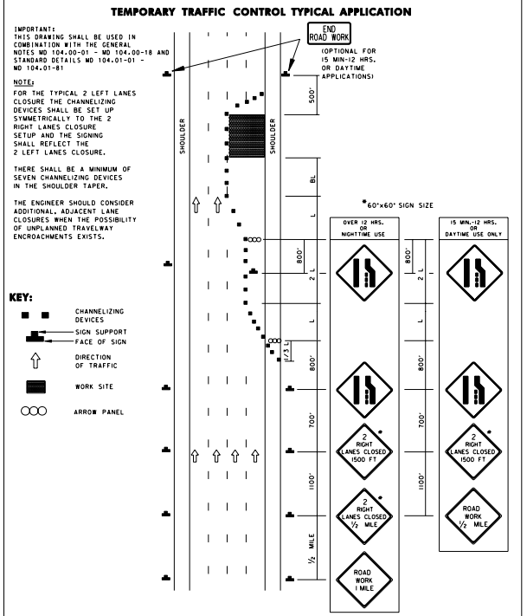
Multiple Lane Closure ttcta

Slide 10
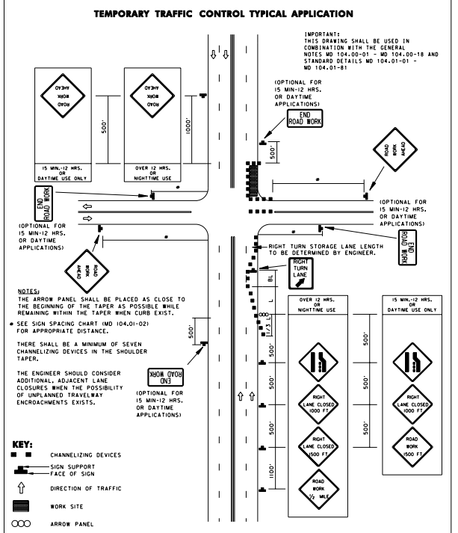
Intersection lane Closure

Slide 11
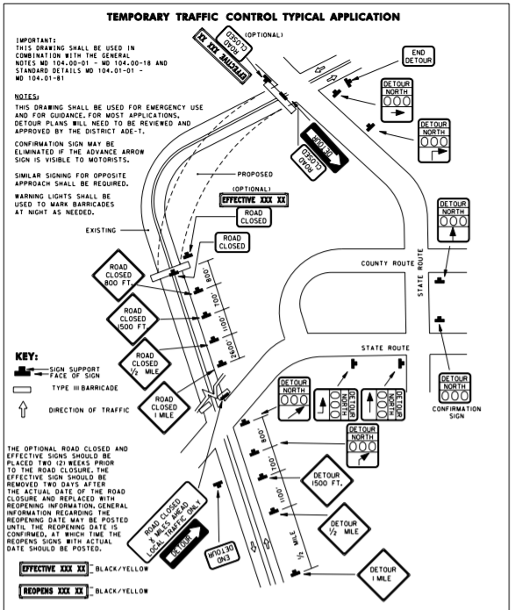
Road Closures
Reduces Cost and Duration of Construction
Increases Safety for Workers
Requires Detours Plans
Impacts Traffic

Slide 12
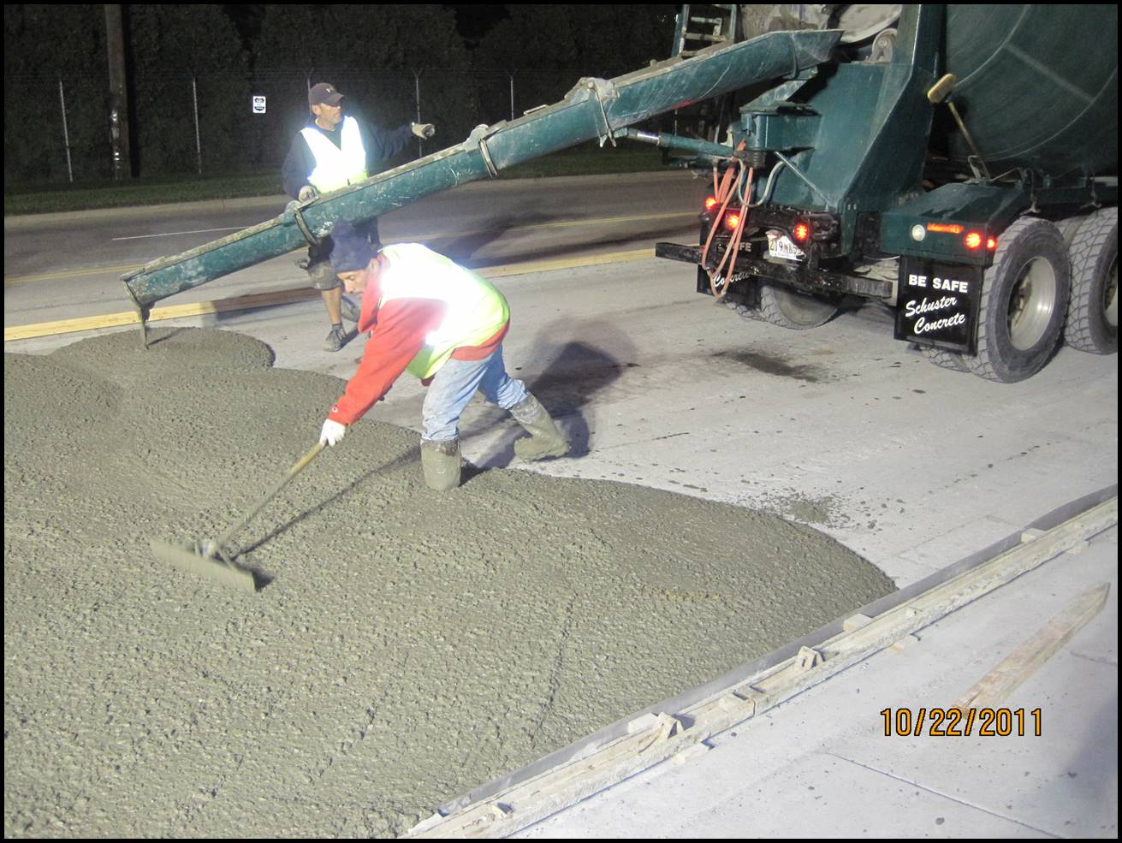
Maintenance of Traffic Case Studies

Slide 13
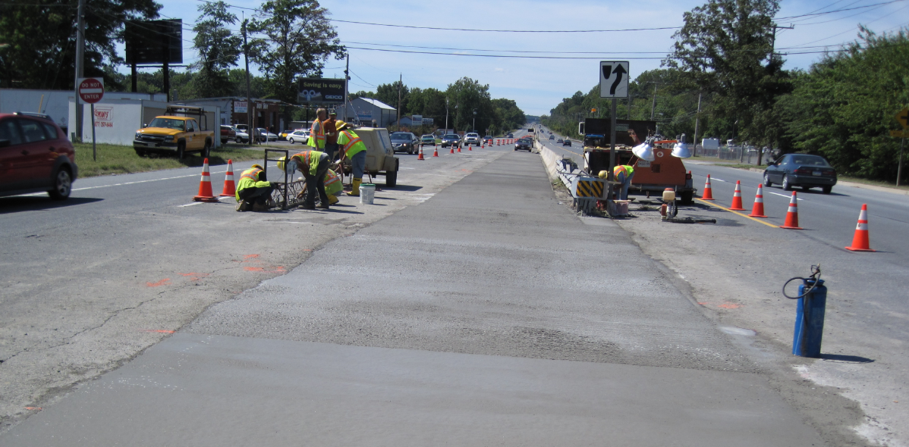
US 40 Left Turn Lane Overlay
Concrete Overlay
Left Turn Lane Concrete Overlay
Duration: 2 Days
Notes:
http://concreteformaryland.com/project/route-40-left-turn-lane-overlay/
September 2010
Worked straight through
Construction sequence was the day, left closed overnight for cure

Slide 14
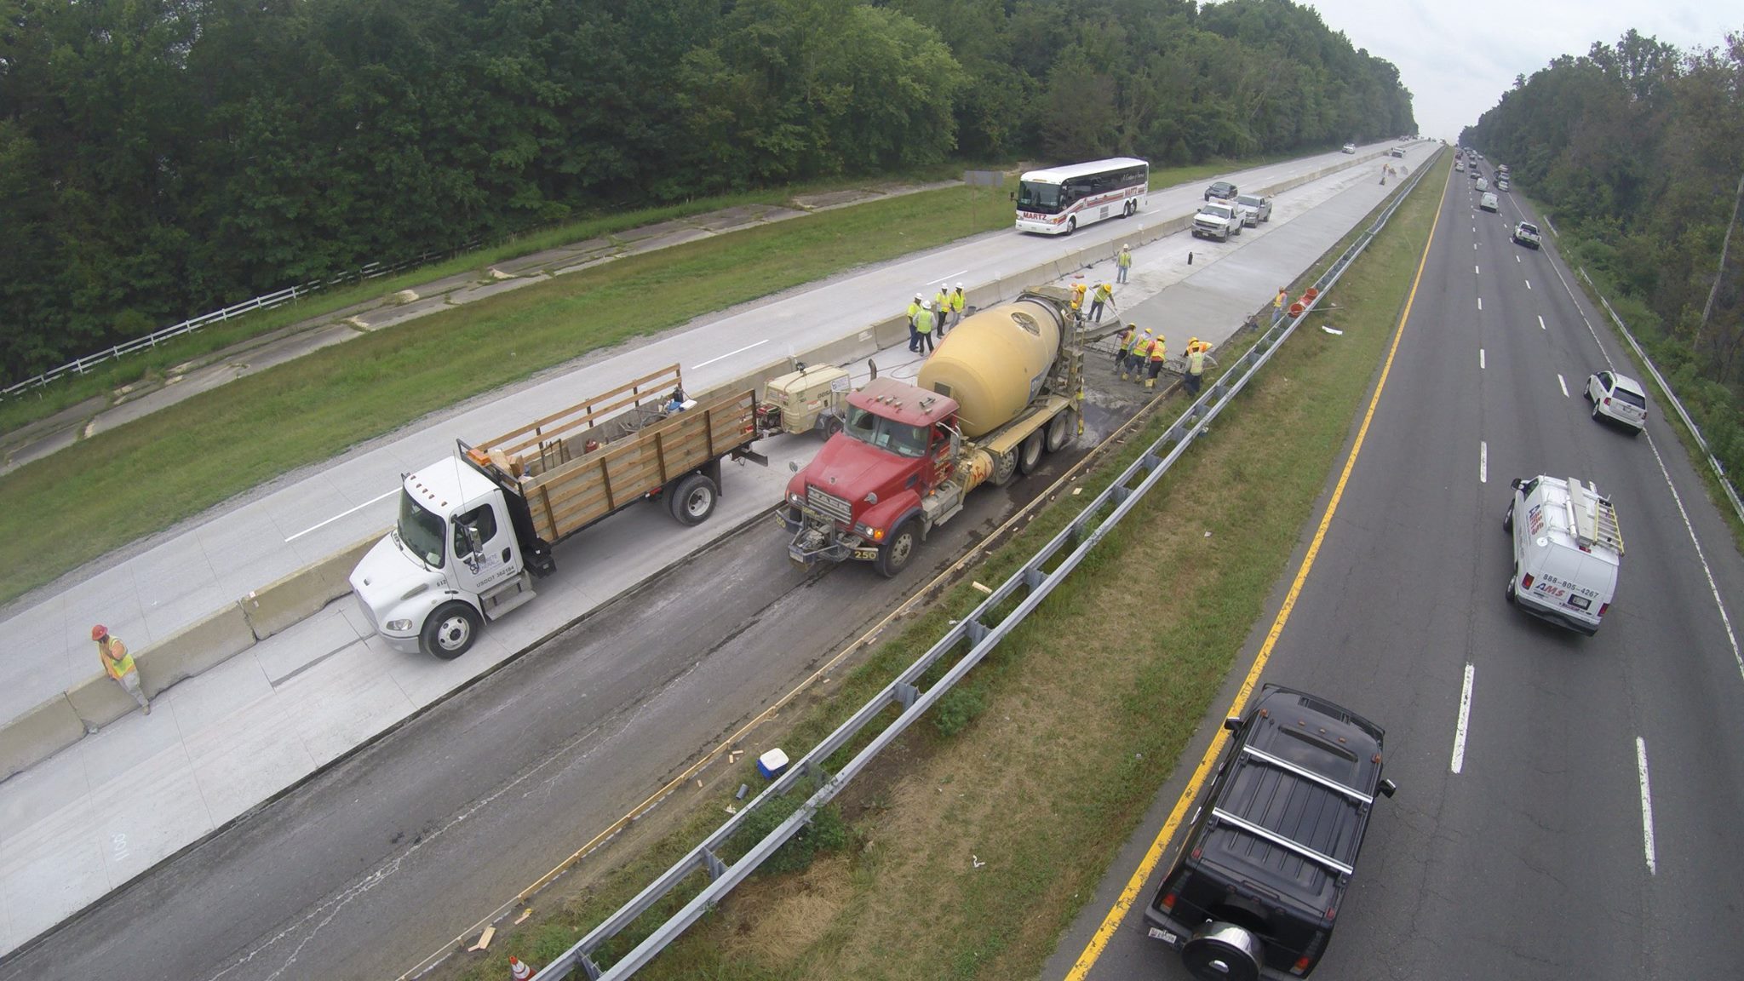
MD 210 Concrete overlay
Concrete Overlay for 1.5 miles
Three lanes from Farmington Road to MD 373
Duration: 1 Month
Notes:
http://concreteformaryland.com/project/maryland-route-210/
Concrete overlays are 6”

Slide 15
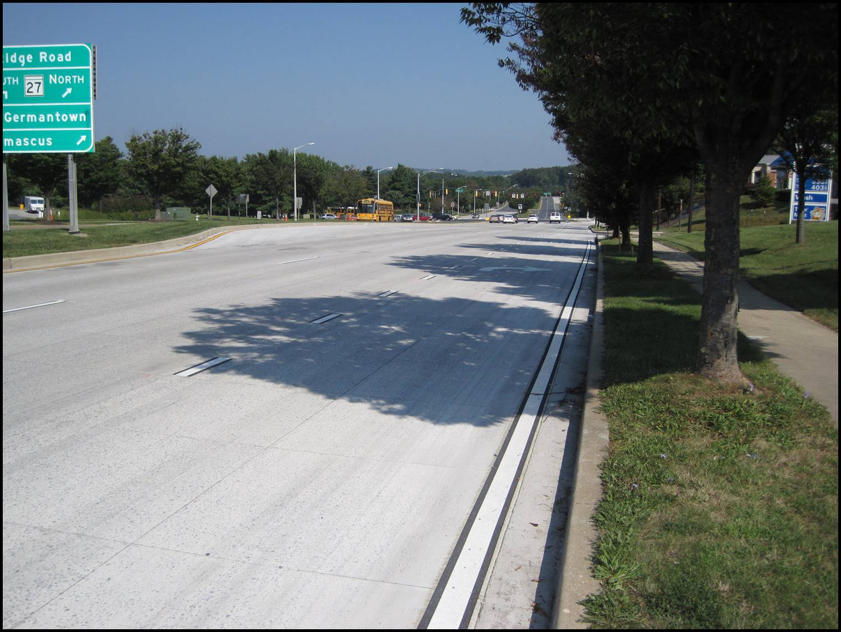
Maintenance of Traffic Considerations

Slide 16
Transportation Management Plan
Required for “Significant” Projects
Used to Evaluate
  Sequence of Construction Alternatives
  Traffic Analysis of Construction Staging Alternatives
  Mitigate Traffic Impact Strategies
  Coordination with Emergency Responders and Other Stakeholders
  Other Adjacent Projects
  Expected Costs

Slide 17
Work Hours
Generally, working hours for MDOT SHA roadway and shoulder closures are restricted to between 9:00 AM and 3:00 PM and 9:00 PM and 5:00 AM.
Hours:
Are Determined by the District Traffic Engineer for MDOT SHA Roads
Vary by Facility Characteristics (e.g., volume and geometric design)
https://www.roads.maryland.gov/OOC/Utility-Permit-General-Provisions.pdf

Slide 18

Mash Standards
New Work Zone Traffic Control Device Standards
2016 Publication
2020 Implementation Begins

Slide 19
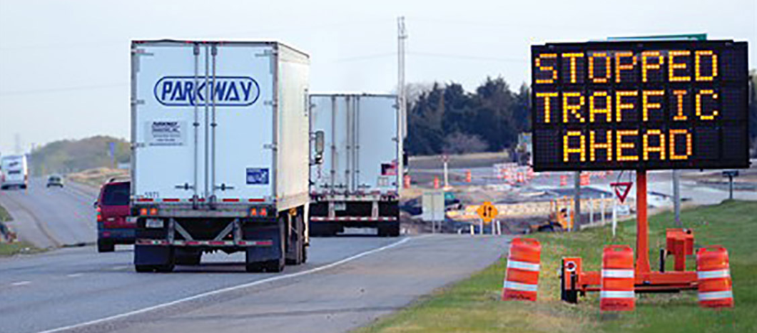
Smart Work Zones
Work Zone ITS Application | Description
Real-time Traveler Information | Drivers are provided information about current travel conditions; can be used to encourage diversion onto less congested routes.
Queue Warning | Signs provide warnings to drivers about stopped or slow traffic ahead.
Entering/Exiting Vehicle Notification | Signs can warn drivers of a slow-moving construction or emergency vehicle(s) entering or exiting the roadway.
Dynamic Lane Merge (early merge, late merge) | Signs encourage drivers to merge at a specified point based on current conditions.
Incident Management | Enables faster detection of incidents for quicker response and clearance time.

Slide 20


Public Outreach
Notes:
https://mdta.maryland.gov/blog-category/mdta-traffic-advisories/avoid-i-895-major-roadwork-coming-i-895-baltimore

Slide 21
Public outreach
Maryland Transportation Authority (MDTA)
Dedicated Team - Office of Communications
Project Purpose
Project Updates
Project Impacts

Slide 22
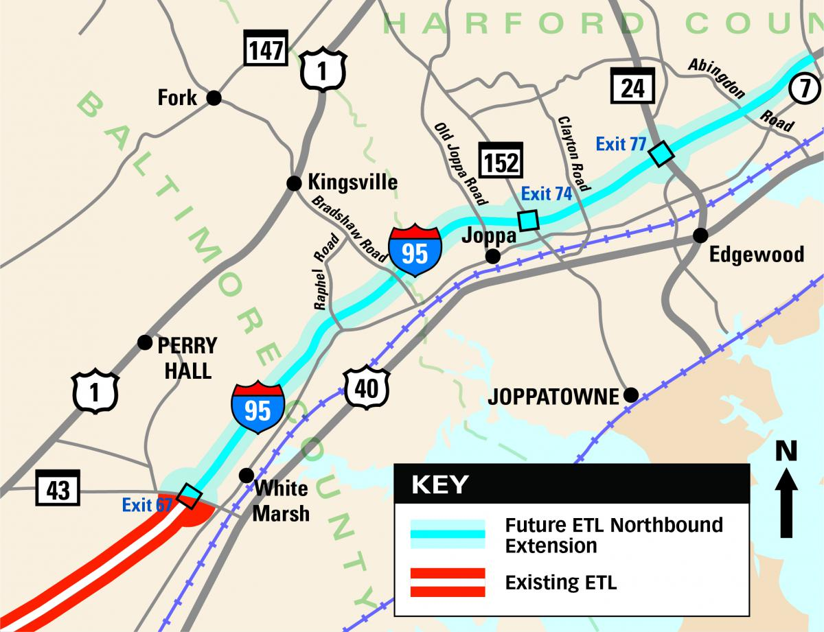
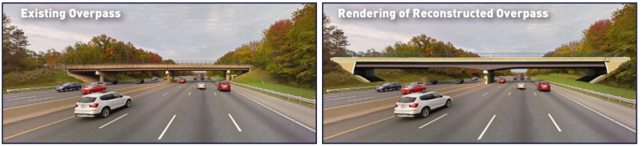
Public Outreach Project Website
I-95 Express Toll Lane Northbound Extension

Slide 23
Work Zone Conclusions
Keep Everyone Safe
Minimize Traffic Impacts
Use MOT Standards
Develop Site Specific MOT Plans
Engage MOT Stakeholders – It’s a Team Effort!

Slide 24
Questions?
Sean Laffey, PE
Slaffey.consultant@mdot.maryland.gov

