Slide 1
Michael Robinson
STALITE – Salisbury, NC
Reid W. Castrodale, PhD, PE
Castrodale Engineering Consultants, PC – Concord, NC
Specifying Lightweight Concrete for Bridges
2017 Maryland Concrete Conference
March 21, 2017
Notes:
ABSTRACT
Many engineers are not familiar with lightweight concrete and are therefore not comfortable designing with or specifying LWC. However, this material has important applications in reducing the dead load of structures, both for new structures (especially for ABC projects with large precast elements) and for superstructure replacement or rehabilitation projects where existing substructure elements are reused. Therefore, engineers need to understand LWC so they can specify it to take advantage of these benefits in projects.
Production of LWA and LWC will be introduced briefly. Selection of reasonable structural design parameters for LWC bridge elements will be considered. Material properties, test methods, and production and construction issues that should be included in project specifications for LWC will then be discussed. Issues that may be encountered during construction that can affect the successful completion of a project will also be presented.

Slide 2
Introduction
Lightweight concrete (LWC) has been used in bridges in the US since commercial production began in 1920
While many designers are still reluctant to use it, others have used it successfully in a variety of applications
  Recent laboratory testing and field experience have demonstrated that the mechanical properties of LWC are well-suited for use in bridges, buildings and other types of structures
  LWC also has enhanced durability

Slide 3
Lightweight concrete
  Lightweight aggregate (LWA)
  Types of LWC
  Properties of LWC

Slide 4
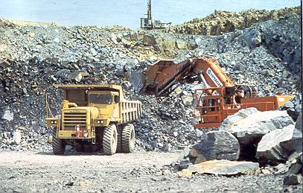
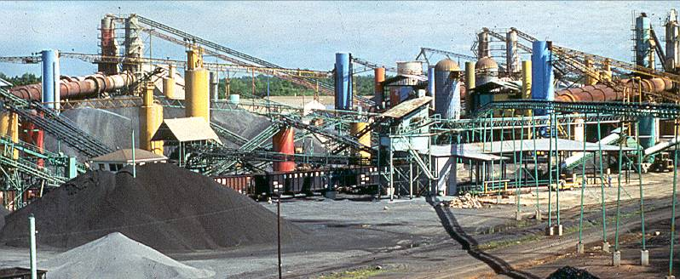

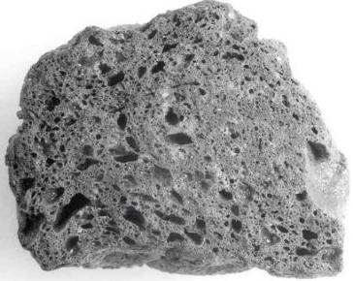
Lightweight Aggregate (LWA)
Manufactured in USA since 1920
Raw material is shale, clay or slate
Heated in rotary kiln to about 1200°C
Gas bubbles form in softened material
Gas bubbles remain after cooling
Clinker is crushed and screened
Notes:
Almost all of the structural lightweight aggregate used in the US is manufactured by expanding raw materials in a rotary kiln, using the same process that was developed by Stephen Hayde nearly a century ago. The raw materials used in the US are shale, clay and slate which are extracted from the ground using standard excavation or mining techniques. The raw material is then fed into a rotary kiln, very similar to those used to manufacture cement. As the material moves through the kiln, it is heated until it reaches 1900 to 2200 deg. F at the lower end of the kiln. At these temperatures, the material softens and gas bubbles form within it. The soft material is thick enough that the gas bubbles do not escape. When the heated material exits the kiln and is cooled, the bubbles remain as the material hardens, producing a porous lightweight ceramic aggregate.

Slide 5
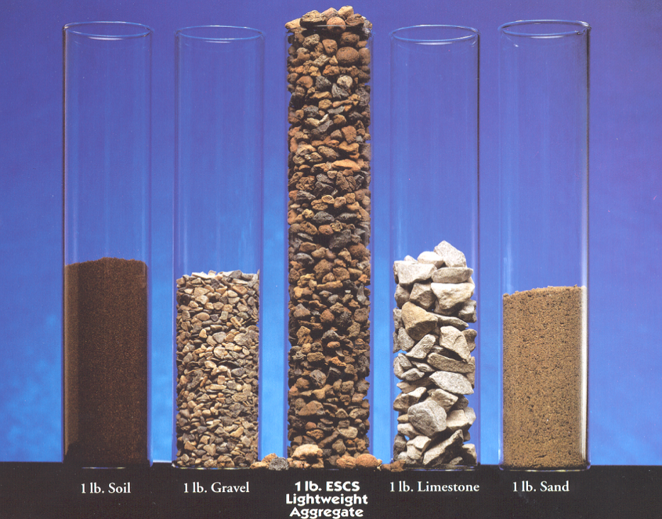
Relative Density of LW vs. NW Aggregate
Relative density for rotary kiln expanded lightweight aggregates
  Range from 1.3 to 1.6
Relative density for normal weight aggregates
  Range from 2.6 to 3.0
Twice the volume for same mass
Half the mass for the same volume
Soil
Gravel
Sand
ESCS LWA
Limestone
0.45 kg of each aggregate
Notes:
Relative density = specific gravity

Slide 6
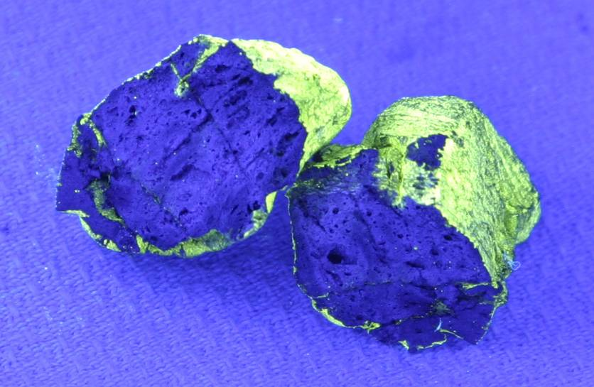
Physical Properties of LW Aggregates
Vitrified ceramic material
  Hardness equivalent to quartz
Pores with limited connectivity reduce density
  Results in increased absorption
  Absorption of US aggregates ranges from 6% to 25% or more at 24 hrs
STALITE LWA particle soaked in water with fluorescent yellow dye for 180 days, then split open.
Absorption at time of test was 8% by mass.
19mm

Slide 7
LWA is a lighter rock
When LWA is used to make LWC
  Same batch plants and mixing procedures
  Same admixtures
  Can use same mix design procedures
  “Roll-o-meter” for measuring air content
LWA has higher absorption than NWA
  Prewet aggregate, especially for pumping
  Density is specified & checked, so more QC attention
Visit ESCSI website or contact LWA supplier for more info on properties of LWA and LWC
Notes:
It is important to realize that after expansion, structural lightweight aggregate is just a lighter rock! The high temperature firing of the raw materials converts them into a vitrified ceramic material that has a hardness equivalent to quartz.
Lightweight aggregate should satisfy the requirements for normal weight aggregates. The only exception is that the gradations are defined differently. The AASHTO materials specification for structural lightweight aggregate is M 195, which covers both coarse and fine gradations.
Lightweight aggregate has a higher absorption than normal weight concrete. Because of this, prewetting of the aggregate is important, especially when lightweight concrete will be pumped.
When lightweight aggregate is used in concrete, lightweight concrete results. The same batch plants and mixing procedures are used for lightweight concrete. The same admixtures can also be used for lightweight concrete. Mix design procedures can also be the same as for normal weight concrete. The absorbed moisture does not participate as mix water since it will not be released into the concrete until after hydration is underway.
A final notable difference between lightweight and normal weight concrete is that the air content of lightweight concrete is tested using the “roll-o-meter”, or the volumetric method.

Slide 8
Spectrum of Concrete Density
Definitions for “All LWC” and “Sand LWC” in 7th Edition of AASHTO LRFD Specs and in ACI 318
  Density ranges shown are approximate (kcf)
  Sand LWC is most common type of LWC
    Density depends on LWA type & other mix requirements
All LWC | Sand LWC | NWC
0.090 – 0.105 | 0.110 - 0.125 | 0.135 - 0.155
LW Fine | NW Fine | NW Fine
LW Coarse | LW Coarse | NW Coarse
Notes:
This slide illustrates the concept that there is a range of concrete densities that can be achieved using lightweight aggregate.
The lightest concrete is “all lightweight concrete” which can have densities as low as 90 pcf for structural concrete mixtures.
The intermediate density concrete is “sand lightweight concrete” which typically has densities in the range of 110 to 125 pcf.
Strictly speaking, “specified density concrete” is any type of concrete which contains lightweight aggregate and is not “all lightweight” or “sand lightweight” concrete. But the term is most often used to achieve densities between sand lightweight and normal weight concrete.
The types of aggregate used to make the different types of concrete are also shown in this table.
The density ranges are approximate and depend on aggregate type, specified compressive strength and other mix parameters. Consult lightweight aggregate suppliers for densities that can be achieved for a specific project.
Please note carefully that the densities shown here are for plain concrete. The designer must add an allowance for reinforcement when determining the density to be used for reinforced concrete in dead load computations. This allowance is often taken as 5 pcf, but this may not be enough for heavily reinforced elements.
8

Slide 9
Spectrum of Concrete Density
  New definition for LWC has been adopted for LRFD Specs: LWC contains LWA (AASHTO M 195/ASTM C330)
  No more types: “all LWC” and “sand LWC”
  Designer specifies the density
    Ready mix supplier develops mix to meet requirements
    Depends on LWA type & other mix requirements
Lightweight Concrete | NWC
[0.095 to] < 0.135 | 0.135 - 0.155
LW Fine ⇔ NW Fine | NW Fine
LW Coarse ⇔ NW Coarse | NW Coarse
Notes:
This slide illustrates the concept that there is a range of concrete densities that can be achieved using lightweight aggregate.
The lightest concrete is “all lightweight concrete” which can have densities as low as 90 pcf for structural concrete mixtures.
The intermediate density concrete is “sand lightweight concrete” which typically has densities in the range of 110 to 125 pcf.
Strictly speaking, “specified density concrete” is any type of concrete which contains lightweight aggregate and is not “all lightweight” or “sand lightweight” concrete. But the term is most often used to achieve densities between sand lightweight and normal weight concrete.
The types of aggregate used to make the different types of concrete are also shown in this table.
The density ranges are approximate and depend on aggregate type, specified compressive strength and other mix parameters. Consult lightweight aggregate suppliers for densities that can be achieved for a specific project.
Please note carefully that the densities shown here are for plain concrete. The designer must add an allowance for reinforcement when determining the density to be used for reinforced concrete in dead load computations. This allowance is often taken as 5 pcf, but this may not be enough for heavily reinforced elements.
9

Slide 10
Density of LWC for design & construction
"Equilibrium density" of LWC usually specified
  Density after moisture loss has occurred
  Defined in ASTM C567
    Method to compute from mix design is given
"Fresh density" needed for QC during casting
  Supplier may establish fresh density
  Designer may specify a fresh density
    Must correspond to specified equilib. density
  Use for handling loads at early age
Allowance for reinforcement must be added when computing dead loads (typically taken as 5 pcf)
Notes:
Density = unit weight

Slide 11
Some Benefits of LWC for Bridges
  Reduced dead load of structure
    Longer spans
    Reduced foundation loads
    Reuse of substructures
    Reduce seismic loads
  Reduced weight of precast concrete elements
    Reduced transportation costs
    Reduced erection and handling loads
  Enhanced durability
    Reduced permeability
    Reduced shrinkage and early age cracking
  Improved fire resistance

Slide 12
Enhanced durability of LWC
  Reduced cracking tendency
  Reduced permeability
  Good resistance to freezing and thawing
  Internal curing
Sources of enhanced durability
  Improved bond between LWA and paste
  Improved quality of paste at LWA surface
  Similar stiffness of paste and LWA
  Reduced modulus of elasticity
  Reduced shrinkage
  Reduced coefficient of thermal expansion

Slide 13
Material properties for design using LWC
Using LWC will affect these material properties
  Density
  Modulus of elasticity
  Tensile strength
  Creep & shrinkage
  Coefficient of thermal expansion
Cementitious content may need to be adjusted when NWA is replaced with LWA in a mix
  LWC can be designed to achieve design compressive strengths up to 10 ksi
Notes:
Last points – LWA can increase or decrease strength.
Stalite mixes can achieve 10 ksi design strengths.

Slide 14
Items to address in Special Provisions
  Lightweight aggregate
  LWC properties
  LWC test methods
  Mixing, placing and finishing of LWC
  Resources
  Examples of specifications

Slide 15
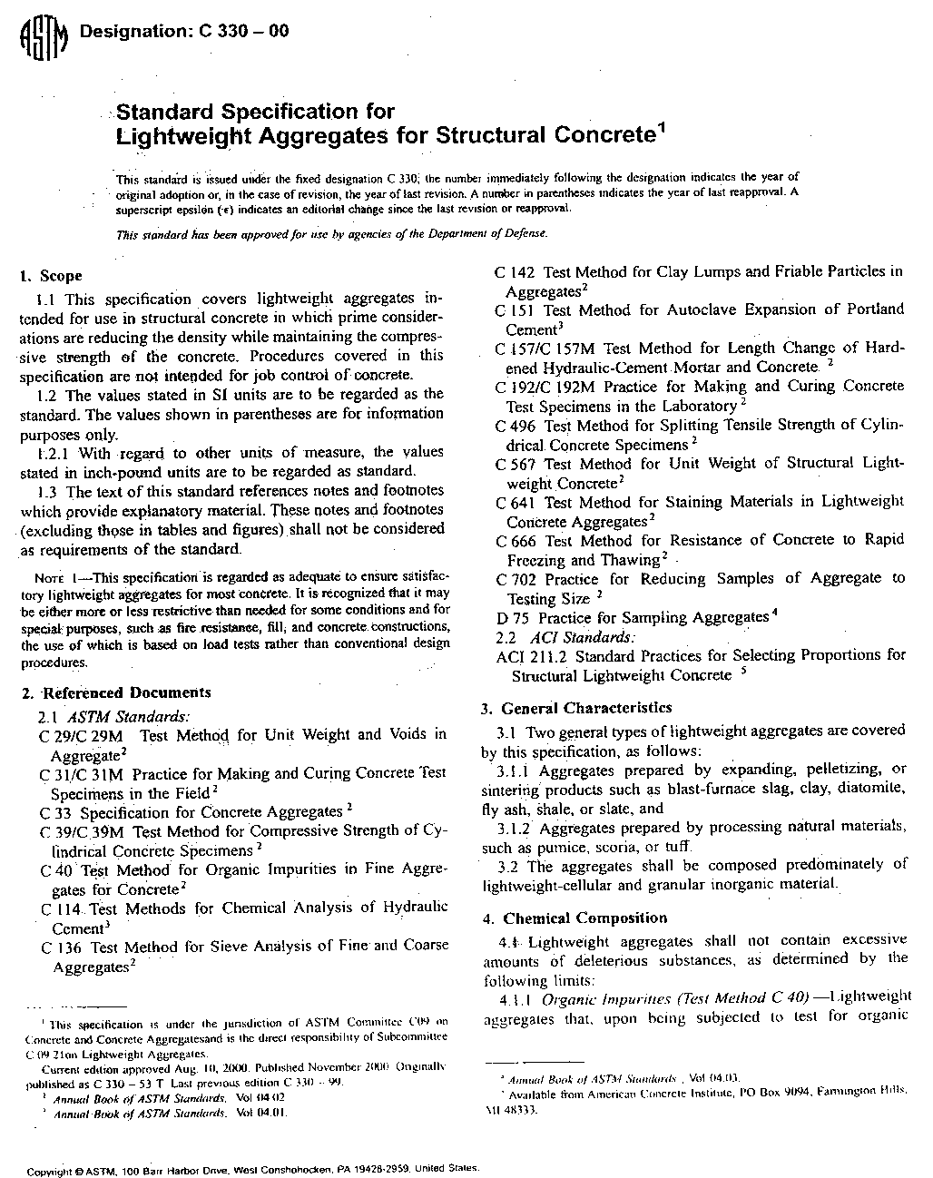
LWA Specifications for Structural Concrete
LWA aggregate properties for structural concrete are governed by AASHTO M 195 or ASTM C330
“Standard Specification for Lightweight Aggregates for Structural Concrete”
  Covers manufactured and natural LWAs
  NOT a specification for LW concrete

Slide 16
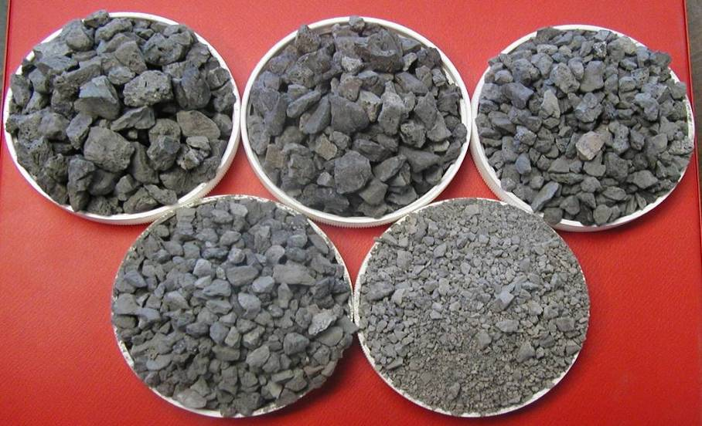
LWA Specifications
  The four coarse aggregate gradations are as shown in figure below
  The gradation for fine LWA is not a typical specification for manufactured sand
  Gradations are fairly wide, especially for fine LWA
¾"
½"
3/8"
5/16"
Fines

Slide 17
AASHTO M 195 / ASTM C330
Minimum requirements for LWA
  Grading
  Bulk density
  Minimum splitting tensile strength *
  Minimum compressive strength *
  Maximum limit on drying shrinkage *
* - Limits given are intended to qualify LWA, not to provide limits for concrete mixtures used in the field
Notes:
A very useful resource. Should have copies!

Slide 18
LWA Specifications
Some DOT specifications indicate maximum absorption for LWA
  This is not necessary or recommended
  Performance of LWA and LWC is not directly related to absorption of LWA
  LWC should simply satisfy the appropriate design and performance requirements

Slide 19
LWC Properties

Slide 20
Specifying Properties of LWC
Specifications for LWC should not be more stringent than NWC for same application
LWA should be required to meet requirements for NWA – except for grading
  Weights retained on sieves differ from quantities for NWA because smaller particles have higher specific gravity
Notes:
A very useful resource. Should have copies!

Slide 21
Specifying Properties of LWC
The major difference for LWC specifications
  Density (with type, i.e., equilibrium or fresh)
    Not necessary to specify the type of LWC, i.e., "all" or "sand" LWC
    Concrete supplier may use blends of aggregate to achieve target densities
Generally, the only structural properties that need to be specified are density and compressive strength
Notes:
A very useful resource. Should have copies!

Slide 22
Specifying Properties of LWC
Other structural properties may be specified as required for the design, such as modulus of elasticity or splitting tensile strength, f_{ct}
  Specifying f_{ct} can avoid use of concrete density reduction factor, λ
Specify only material properties required for the particular design
  Over-specifying concrete properties will drive up the cost of the project
Beware of copied specifications!
Notes:
Copied specs – can be misapplied. Like the Benicia Martinez spec for a 200m span segmental box girder bridge that was used for 25 ft long DTs in Seattle.

Slide 23
Specifying Properties of LWC
If properties other than density and compressive strength are specified …
The owner or designer should consult a LWA supplier to ensure that the properties specified can be achieved
  economically
  using reasonable mixtures
  with available materials
Mix performance may be significantly affected by other constituents, such as sand
Notes:
Last point is referring to Benicia-Martinez bridge where the sand was an important factor in achieving performance targets.

Slide 24
Specifying Density of LWC
Contract documents must clearly indicate intended type of density being specified
  Equilibrium and/or fresh
Tolerances for concrete density
  Maximum limit with no minimum is preferred
  Any +/- limit needs to realistically account for variation in other constituents like air & water
Plans and specifications should indicate LWC density used for dead load calculations
  Typical allowance for reinforcement is 5 pcf
  Allowance is greater for heavily reinforced sections
Notes:
Density = unit weight

Slide 25
Specifying Density of LWC
Comments on “equilibrium density”
  Typically computed using the mix proportions when qualifying a mix design
  May be determined from oven dry density
    Add 3 pcf to oven dry to obtain equilibrium density
  Equilibrium density is rarely measured
  For equilibrium or oven-dry density testing, the drying must not be stopped too soon
    Density continues to change at a very slow rate
    Test methods were established for more typical floor slab mixtures without SCMs so may not be applicable for current DOT mixtures
Notes:
Density = unit weight

Slide 26
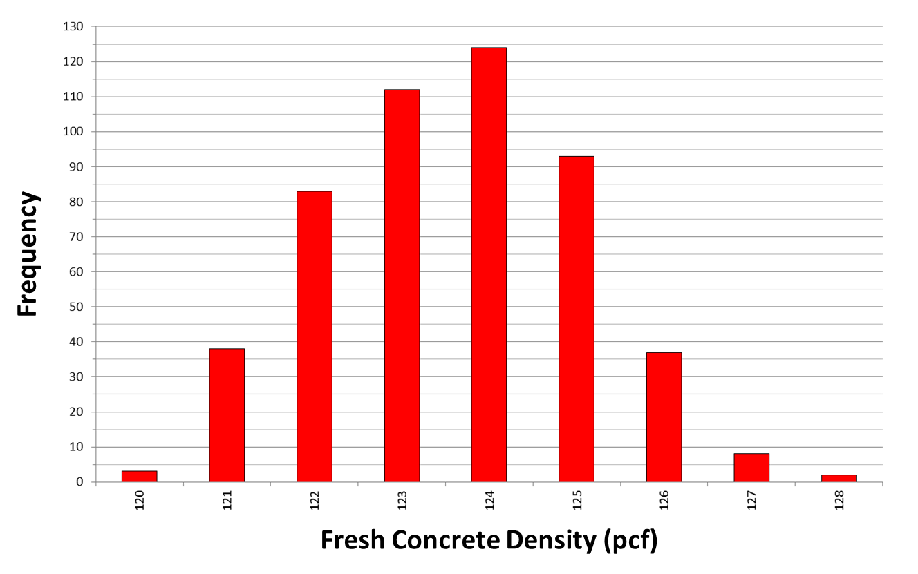
Specifying Density of LWC
Successful approach - Concrete Tech, Tacoma, WA
  Design fresh density = 123 pcf
  Max. fresh density = 128 pcf (specified)
From paper by Chapman & Castrodale at PCI National Bridge Conference in March 2016

Slide 27
LWC Test Methods

Slide 28
Typical Testing Issues for Special Provisions
Density testing
  Many Std Specs may not include density testing and consequences of lack of conformance
LA Abrasion Test Modification
  Recommend modifying test method to charge cylinder with volume of LWA that is equal to typical volume of NWA
  If adjustment is not made, balls cannot fall freely in cylinder and results may not be representative
Entrained air testing
  Roll-o-meter is required

Slide 29
Freezing and Thawing Requirements
AASHTO M 195 / ASTM C330
  These specifications include revised testing procedures for ASTM C666 tests with LWC
    Allow specimens to dry before testing
    Neglecting these procedures can lead to poor test results that do not reflect field performance
Notes:
A very useful resource. Should have copies!

Slide 30
Freezing and Thawing Requirements
ASTM C666
7.4 For this test the specimens shall be stored in saturated lime water from the time of their removal from the molds until the time freezing-and-thawing tests are started. …
8. Procedure
8.1 Molded beam specimens shall be cured for 14 days prior to testing unless otherwise specified. …

Slide 31
Freezing and Thawing Requirements
ASTM C330 includes modification to ASTM C666
  14 days wet curing
  14 days drying in 50% RH
  Submerge for a day prior to beginning test
  Consider mentioning in specifications to alert testing lab to different requirements

Slide 32
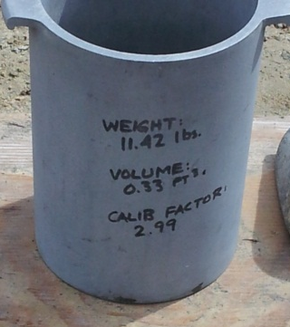
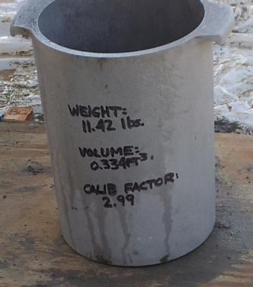
QC in Field – Unit Weight
Density is a specified quantity, so the unit weight bucket should be carefully calibrated
Example – 105 pcf fresh density specified
  1/3 CF bucket with 105 pcf concrete = 35 lbs
  35 lbs / 0.33 = 106.1 pcf
  35 lbs x 2.99 = 104.7 pcf
  1 / 2.99 = 0.334
  35 lbs / 0.334 = 104.8 pcf
ASTM gives density of water to 5 significant digits, so bucket calibration factors should reflect this

Slide 33
QC in Field – Air Content
Roll-o-meter is specified
  Pressure meter is not allowed
With good control of batching, can get good indication of air content with unit weight
In some cases, using both roll-o-meter and pressure meter has been successful
  Use both initially to obtain a calibration
  Use pressure meter for periodic checks
  If pressure meter gives questionable result, then run roll-o-meter

Slide 34
QC in Field – Slump & Density
Slump values will be slightly less for LWC than for NWC with same workability
  Reduced density means less “driving force” to make concrete slump
Testing labs and engineers should be aware of the difference in density between unit weight bucket and cylinders
  Cylinders have a greater density because of greater compaction effort

Slide 35
Mixing, Placing and Finishing LWC

Slide 36
Prior to Construction
Pre-pour meeting should include LWA supplier
  Discuss all aspects of delivery, placement and field testing
A trial LWC placement is recommended
  Include LWA supplier
  Use concrete placement equipment
  Place in mockup
  Whole team needs to understand the few special issues related to LWC

Slide 37
Moisture Conditioning
Some specs indicate how long to sprinkle and how long to drain
Instead, simply require that the minimum absorption recommended by LWA supplier be consistently achieved within the stockpile
  Especially important for concrete placed by pumping
  If not adequately prewetted, slump loss may occur
Method for prewetting LWA is not critical
  Some LWA is vacuum saturated or may require soaking
  Other LWA can be prewetted just by sprinkling

Slide 38
Batching
Air content is key to achieving specified density
  Must take care to ensure target air content is reached and maintained
The quantity of mix water affects the density
  Concrete supplier should not hold back water when batching
Aggregate bins must be well-cleaned before loading LWA
  Common source of first loads being heavy

Slide 39
Batching
Absorbed water affects batch weights
  Another reason to make sure that the target absorption has been achieved
Batching prewetted LWA can be a challenge in freezing weather
  It has been done in Norway with protected stockpiles
  Some concrete suppliers batch dry in the winter and add water to account for absorption during batching and transport

Slide 40
Batching
Procedure for making free moisture corrections for LWA is identical to NWA
  Absorbed water does NOT affect batch water, so is not included in adjustment
  Absorbed water does not come out of LWA until after set
  Towel dry method is an effective way to achieve WSD condition for coarse LWA

Slide 41
Wetted Surface-Dry Condition for Fine LWA
From ASTM C1761 Section 10.2.2
LWA is in the wetted surface-dry condition (WSD) after:
  the prescribed soaking period (72 hrs) and
  the removal of surface moisture
Analogous to the saturated surface-dry condition (SSD) for normal weight aggregate
LWA particles do not reach saturation (maximum absorption) even after soaking for 72 hours

Slide 42
Wetted Surface-Dry Condition for Fine LWA
Consistently getting LWA fines to the wetted surface-dry condition can be challenging
Currently available methods
  NYS DOT Test Method No.: NY 703-19 E
    Brown paper towel method
    Can be done in field, but some variability
  Centrifuge method – “new” approach
    Purdue study-2,000 rpm for 3 minutes
    More consistent – more operator independent
    INDOT has a std test method – ITM 222

Slide 43
Contractor Experience with LWC
Many bridge engineers are not familiar with LWC
They often assume that ready mix suppliers and contractors are also not familiar with LWC
Over 3 M CYs of LWC is produced in US each year in ready mix and precast/prestressed concrete industries
Most is for building products, but there is also significant experience with LWC bridge decks in some parts of the country
Notes:
From PCI NBC Durability paper 2008

Slide 44
Contractor Experience with LWC
Where LWC is used in metropolitan areas for floor slabs in multi-story buildings, concrete suppliers should be familiar with using LWC
LWA manufacturers provide technical support for concrete suppliers & contractors who may not be familiar with LWA and LWC
Many successful LWC bridges have been built in the past using low tech concrete suppliers who had no previous experience with LWC – so it can be done
Notes:
From PCI NBC Durability paper 2008

Slide 45
Pumping
LWC has been pumped successfully for many bridges and buildings
  Can be pumped vertically to top of tall buildings
LWC does not always have to be vacuum or thermally saturated for successful pumping as mentioned in FHWA report (1985)
  Consult LWA supplier for guidelines for required moisture conditioning and absorbed water for successful pumping

Slide 46
Pumping
Since density is a specified quantity, the air content is doubly important
  Good technique must be used to prevent loss of air
  Do not allow vertical drop without control of falling concrete
Some states disallow pumping of LWC
  This is not necessary and limits the application of LWC

Slide 47
Finishing LWC
Contractors have occasionally approached a DOT to request changing a LWC deck to NWC because of concerns about finishing.
However, ACI Committee 213 reports:
“There is little or no difference in the techniques required for placing LWC from those used in properly placing NWC.”
“A well-proportioned LWC mixture can generally be placed, screeded, and floated with less effort than that required for NWC.”
Notes:
From PCI NBC Durability paper 2008

Slide 48
Finishing LWC
An NCDOT resident engineer commented on the finishing of the LWC deck for the Virginia Dare Bridge (5.2 miles of LWC deck):
“LW does present a few new wrinkles, but I do not find it to be a negative for the product. Aggregates have to be handled with more care, and air testing is a little more cumbersome, but I don't think we should shy away from designing bridges with LW decks for those reasons. They work themselves out in about two or three pours. Normal weight has just as many nuances.”
Notes:
From PCI NBC Durability paper 2008

Slide 49
Finishing LWC
LWA may tend to rise to surface, especially if over-vibrated or not adequately prewetted
Notes:
From PCI NBC Durability paper 2008

Slide 50
Grinding & Grooving LWC Decks
LWA appears porous or soft, so it seems reasonable to expect that a LWC deck should not be ground or grooved, which is standard practice in many states
  It is thought that when grinding exposes the interior of LWA particles, the penetration of moisture and contaminants into the deck would increase, thus degrading freeze – thaw resistance
  Others suggest that LWC is too weak to retain grooves cut in the deck, or would wear excessively
Laboratory and field experience has shown that these concerns are unfounded.
Notes:
From PCI NBC Durability paper 2008

Slide 51
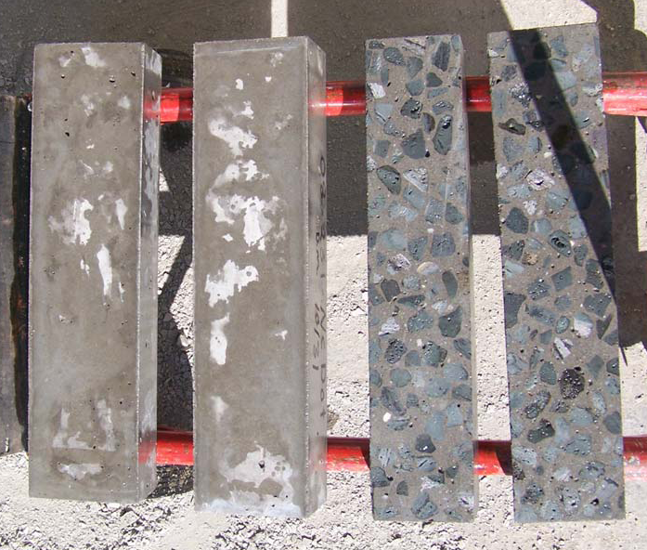
Freezing-Thawing Resistance
Independent lab tested NCDOT sand LWC mix
  Side faces for 2 specimens were cut off to simulate grinding & grooving
Difference for cut specimens was minor
After 307 cycles
  2 un-cut specimens had a relative dynamic modulus of 102
  2 cut specimens had relative dynamic moduli of 100 & 98
  Typical minimum requirement is 80

Slide 52
Grinding & Grooving LWC Decks
The Virginia Dare Bridge in NC is 5.2 miles long and has a LWC deck for the entire length of the bridge.
The specifications required that the entire surface of the deck be diamond ground during construction.
The good condition of the bridge deck after several years in service was described earlier.
Notes:
From PCI NBC Durability paper 2008

Slide 53
Grinding & Grooving LWC Decks
An NCDOT resident engineer on the project gave the following response to a question about the use of LWC on the deck of the bridge:
We grooved the Chowan River Bridge [another bridge in the area which used LWC for a portion of its deck]. I have seen no problems with wearing surface there. We diamond ground the entire deck surface on Manteo Bypass [aka, the Virginia Dare Bridge] for rideability reasons. We were a little worried about the lightweight being so exposed, but found favorable research elsewhere across the country.
So far, (5 years), I don't think we have seen any problems with the ground lightweight. Pop outs from entrapped water being frozen in the deck surface seem plausible in theory, and I was worried it could happen, but we have not seen anything to support it.
Notes:
From PCI NBC Durability paper 2008

Slide 54
Grinding & Grooving LWC Decks
The Route 33 Bridge over the Mattaponi River in Virginia was constructed with a LWC deck for much of its length
The bridge deck was ground where needed for smoothness, then the entire surface of the deck was grooved transversely
This bridge has been in service since 2006
Notes:
From PCI NBC Durability paper 2008

Slide 55
FHWA Report by T.Y. Lin Int'l (1985)
Appendix 2: “Structural Lightweight-Concrete Bridge Guide Specifications”
  Good source of information
Appendix 3: “Suggested Structural Lightweight-Concrete Bridge Field Control Procedures”
  Has some good information that could be useful in developing specifications and understanding field issues

Slide 56
Other Reports with Info for Specifications
Holm & Bremner, “State-of-the-Art Report on High-Strength, High-Durability Structural Low-Density Concrete for Applications in Severe Marine Environments,” USACE, ERCD/SL TR-00-3 (TR INP-00-2), Aug. 2000
  Guide Specifications in appendix
Hoff, “Guide for the Use of Low-Density Concrete in Civil Works Projects,” USACE, ERDC/GSL TR-02-13 (TR INP-02-7), Aug. 2002
  A comprehensive discussion of issues related to the use of LWC

Slide 57
Examples of Project Specifications

Slide 58
DOT Specifications
Sand LWC for Bridge Decks
  TennDOT, DC DOT Standard Specifications
  NCDOT, UDOT, etc., standard special provisions
  Other states have project special provisions
All LWC
  Few states have project special provisions
Sand LWC for Girders
  GDOT special provisions (10 ksi at 120 pcf)
  VDOT special provisions (8 ksi at 125 pcf)

Slide 59

New Benicia-Martinez Bridge, California
High level crossing of I-680 over the Carquinez Strait near San Francisco
Cross-section is a cast-in- place single-cell box
  82-ft wide deck
  Depth varies from 37 ft to 15 ft at midspan
  Maximum spans are 658 ft
Opened to traffic in August 2007

Slide 60
New Benicia-Martinez Bridge, California
Field results have exceeded specifications
This was a long-span box girder bridge so additional requirements were justified
Property | Specified | Provided
Compressive Strength | 6.5 ksi | 10.0 ksi
Equilibrium Density | 125 pcf | 125 pcf
Modulus of Elasticity | ≥ 3.4 x 10⁶ psi | 3.8 x 10⁶ psi
Specific Creep | ≤ 70x10⁻⁶/ MPa | 30x10⁻⁶/ MPa
Shrinkage Strain | ≤ 0.05% | 0.03%
Tensile Strength | ≥ 450 psi | 450 psi

Slide 61
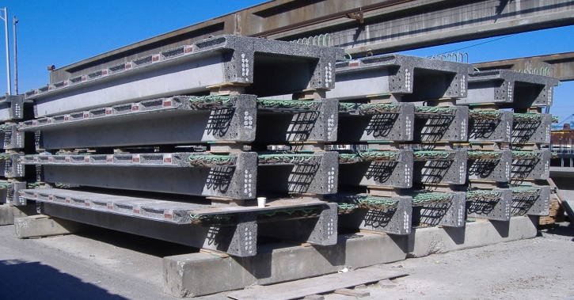
New Benicia-Martinez Bridge, California
These specs for a long-span box girder were copied for these 25 ft double-tee beams!
Property | Specified | Provided
Compressive Strength | 6.5 ksi | 10.0 ksi
Equilibrium Density | 125 pcf | 125 pcf
Modulus of Elasticity | ≥ 3.4 x 10⁶ psi | 3.8 x 10⁶ psi
Specific Creep | ≤ 70x10⁻⁶/ MPa | 30x10⁻⁶/ MPa
Shrinkage Strain | ≤ 0.05% | 0.03%
Tensile Strength | ≥ 450 psi | 450 psi

Slide 62
Woodrow Wilson Bridge, Washington, DC
Dual bridges carrying I-495 over the Potomac River near Washington, DC
Cross-section is a CIP deck on steel girders
LWC used for
  Deck on the bascule lift spans
  Deck on bascule pier
First bridge opened to traffic in June 2006
Deck on previous structure was LWC precast full-depth deck panels
Notes:
From paper "Redecking and Widening of the Woodrow Wilson Bridge" by Thomas D. Jenkins, PE, Greiner, Inc. In the proceedings of the International Symposium on Lightweight Concrete Bridges sponsored by Caltrans & Pacific Custom Materials, Sept. 10, 1996. Reported to have performed well after 13 years in service (in the paper).

Slide 63
Woodrow Wilson Bridge, Washington, DC
Requirements for NWC deck
  Minimum f'_{c} = 5,000 psi
  Water/cementitious material ratio ≤ 0.45
  Permeability (RCPT) < 2000 coulombs
  Shrinkage (ASTM C157) < 400με
Additional requirements for LWC deck
  Maximum density = 120 pcf
  Minimum f'_{c} = 4,500 psi
  Water/cementitious material ratio ≤ 0.40
  Modulus of elasticity E_{c} ≥ 3.39 x 106 psi
Notes:
From paper "Redecking and Widening of the Woodrow Wilson Bridge" by Thomas D. Jenkins, PE, Greiner, Inc. In the proceedings of the International Symposium on Lightweight Concrete Bridges sponsored by Caltrans & Pacific Custom Materials, Sept. 10, 1996. Reported to have performed well after 13 years in service (in the paper).

Slide 64
Virginia Dare Bridge, Manteo, NC
NCDOT Standard Specifications
Requirements for LWC include
  Sand-lightweight concrete
  Minimum f'_{c} = 4,500 psi
  Water/cementitious material ratio ≤ 0.42
  Minimum cement content = 715 pcy
  Gradation for lightweight coarse aggregate

Slide 65
Virginia Dare Bridge, Manteo, NC
NCDOT Standard Project Special Provisions
Requirements for LWC include
  Maximum plastic density = 120 pcf
  Maximum dry density = 115 pcf
  Minimum relative dynamic modulus = 80% (freezing & thawing - AASHTO T 161, Procedure A)
  Maximum drying shrinkage of 0.07%
    Not for actual mix, but for qualifying aggregate
  Soundness loss ≤ 10% in 5 cycles

Slide 66
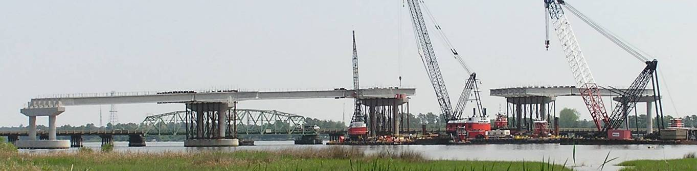
VA Route 33 Bridges at West Point, VA
Bridges carry VA Rte 33 over the Mattaponi and Pumunkey Rivers at West Point, VA
Approach spans are continuous for Live Load
Each bridge has two 200'-240'-240'-200' spliced units with haunched pier segments
LWC was used to reduce foundation loads
Completed in 2006 and 2007

Slide 67
Route 33 Bridges at West Point, VA
LWC used for
  Bulb tee girders with spans ≥ 120 ft long
    Including 880 ft long spliced girders
  Decks on LWC girders
  Fill for grid-decks on bascule spans
Type of Concrete | Design Compressive Strength (psi) | Maximum Density (pcf) | Air Content (%)
PS Girders | 8,000 | 125 | 4½ ± 1½
Deck | 5,000 | 120 | 5½ ± 1½

Slide 68
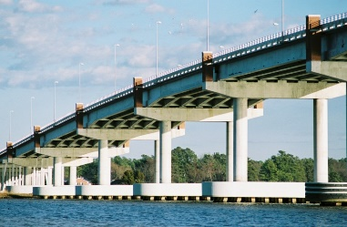
Route 33 Bridges at West Point, VA
Additional requirements for LWC
Type of Concrete | Creep Notional Coeff. | Shrinkage Notional Coeff. (με) | Mod. of Elasticity (ksi) | Permeab. (coul.)
PS Girders | 4.2 | 450 | 3,400 | 1,500
Deck | 3.5 | 550 | 2,700 | 2,500
VTRC sampled materials & monitored construction & performance
  Additional tests were required because this was a demonstration project for LWC
Specs were re-used on a later project where additional testing was unnecessary

Slide 69
Bridge over I-85 in Coweta County, GA
Four-span bridge carries a ramp over I-85 near Newnan, GA (SW of Atlanta)
LWC PCI-BT girders with CIP NWC deck
  Nominal maximum spans are 110 ft
  Girder design required LWC for this bridge
Design follows research by Georgia Tech on high-strength LWC for pretensioned girders
  Developed mix designs
  Tested material and structural properties
Girders erected 3/09; bridge load tested 1/10

Slide 70
Bridge over I-85 in Coweta County, GA
Special provisions requirements for LW HPC
  Maximum air-dry density is 120 pcf
  Size of LW coarse aggregate = ½ in.
  Minimum cement factor = 650 lbs/cy
  Maximum water-cement ratio = 0.330
  Slump acceptance limits = 4½ ± 2½ in.
  Entrained air acceptance limit = 5 ± 1½ %
  Max. chloride permeability = 3,000 coulombs
Same as for NW HPC, except density & aggr. size
Compressive strength and chloride permeability to be determined at 56 days
Notes:
NW HPC spec allows 67 stone, which is ¾" max size.

Slide 71
Specifying Density of Lightweight Concrete
Recommendation for VDOT - Sept. 2008
The maximum fresh concrete density of air-entrained LWC shall be
  For decks - 120 pcf
  For beams with 28 day design compressive strength of 8,000 psi or less - 123 pcf
Notes:
Density = unit weight

Slide 72
Specifying Density of Lightweight Concrete
Recommendation for VDOT - Sept. 2008
The recommended densities are typical min. values for "sand lightweight" concrete
Densities greater than these, up to NWC, can also be specified
When greater densities are used, design computations shall be performed using the requirements for "sand lightweight" concrete
Notes:
Density = unit weight

Slide 73
Specifying Density of Lightweight Concrete
Recommendation for VDOT - Sept. 2008
For computing design loads at any stage in the life of the structure, the specified fresh density of LWC shall be used
As with NWC, an appropriate increment of density that represents the additional weight of reinforcement shall be added to the fresh concrete density for use as the density of reinforced LWC for computing design loads
Notes:
Density = unit weight

Slide 74
Specifying Density of Lightweight Concrete
Comments on VDOT Recommendations
This is a conservative approach
It works reasonably well when using a low absorption LWA
If higher absorption LWA is used, or if the greatest density reduction is needed, the equilibrium density should be used for computing dead loads
Notes:
Density = unit weight

Slide 75
Specifications for LWC
Special provisions have been included in contract documents when LWC has been used for a project
Provisions for the VDOT standard specifications on LWC are being developed
Requirements for LWA are given in the VDOT Road and Bridge Specifications (2016) in Section 206

Slide 76
Specifications for LWC
After moving to the use of corrosion resistant reinforcement for all bridge decks, VDOT has developed a low shrinkage concrete specification to further improve the performance of bridge decks
  Section 217.12 in Standard Specifications (2016)
Contractors are given two options for providing low shrinkage concrete when specified

Slide 77
Specifications for LWC
Options when low shrinkage concrete is specified:
  Option 1:
    Cementitious materials content < 600 lb/yd³
    28-day drying shrinkage < 0.035%.
    If shrinkage limit is exceeded, shrinkage reducing admixture (SRA) must be added to the mix
  Option 2:
    Use sand LWC mixture
    Maximum cementitious content = 650 lb/yd³
    Maximum fresh density of LWC = 120 lb/yd³ or as specified in the plans
    Shrinkage testing is not mentioned for LWC option

Slide 78
Questions?
Michael Robinson
STALITE
mrobinson@stalite.com
Reid W. Castrodale, PhD, PE
Castrodale Engineering Consultants, PC
reid.castrodale@castrodaleengineering.com

