Slide 1
Scaling: Causes and Prevention
Larry Sutter
Materials Science & Engineering
Michigan Technological University

Slide 2
Introduction
“Those who cannot remember the past are condemned to repeat it.”
George Santayana (1863 –1952)

Slide 3
Introduction
“You can observe a lot by watching.”
Yogi Berra (1925 – 2015 )

Slide 4


Slide 5
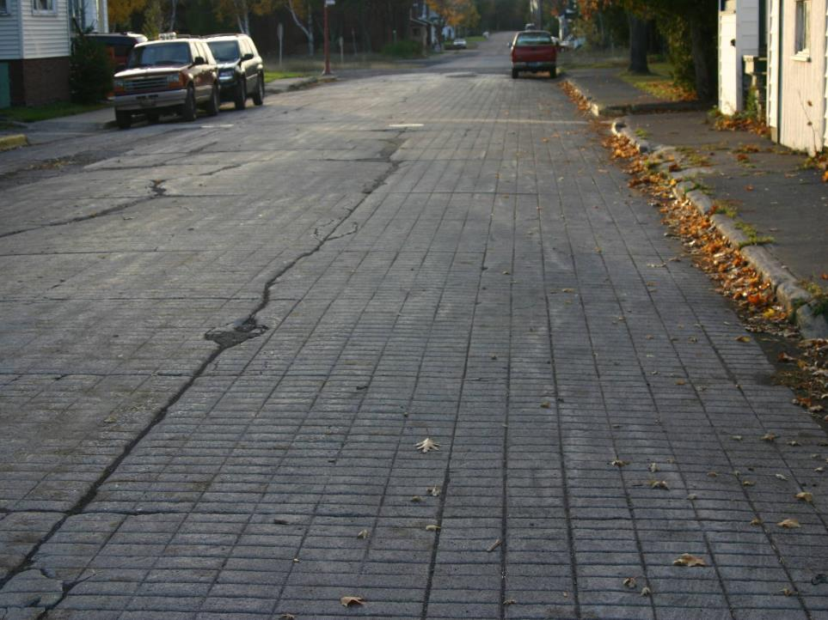

Slide 6
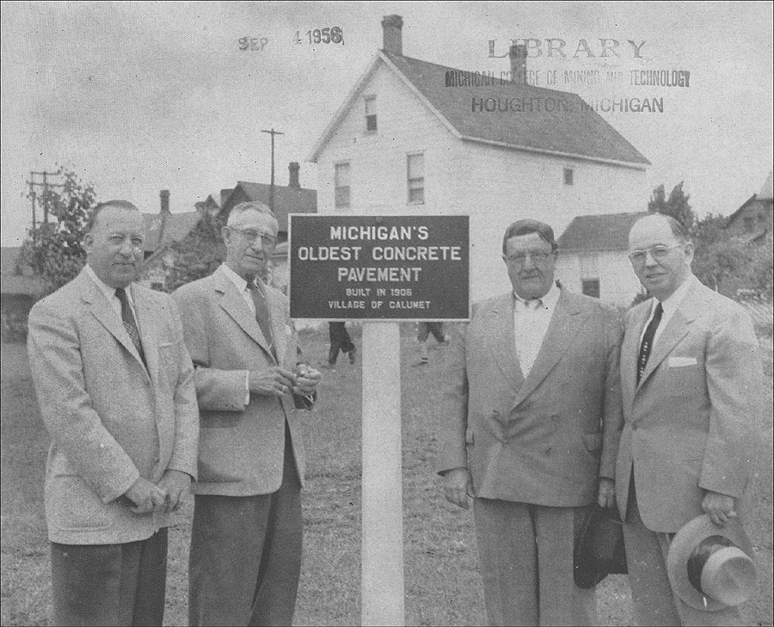
The 1956 unveiling of historical marker

Slide 7
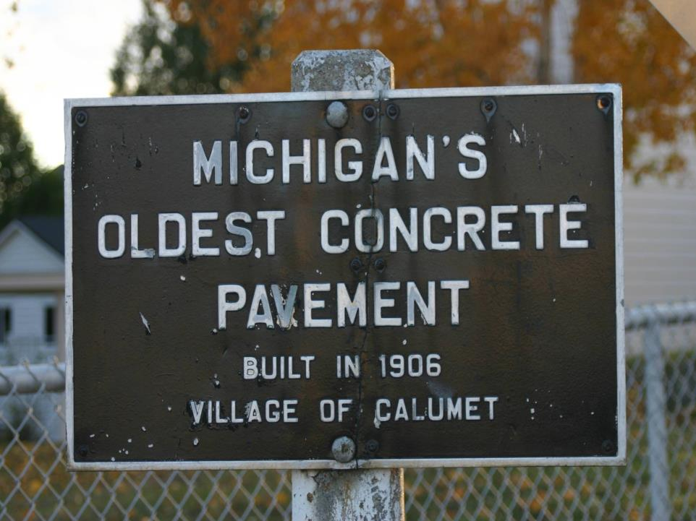

Slide 8
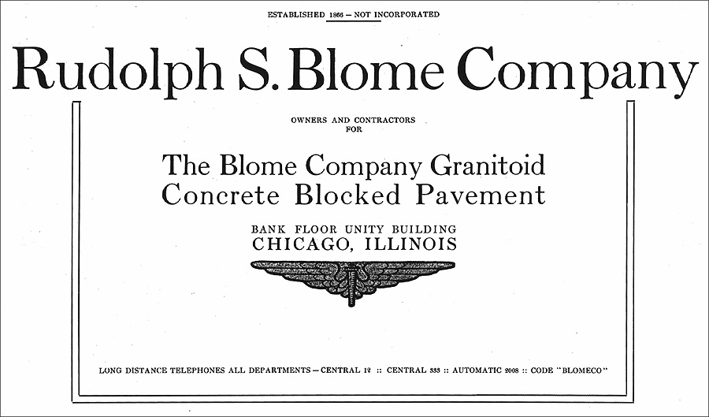
Granitoid was favored by the Village Council due to its low cost and durability
  Pavements constructed in Chicago were still in good condition after 8 years of service!

Slide 9
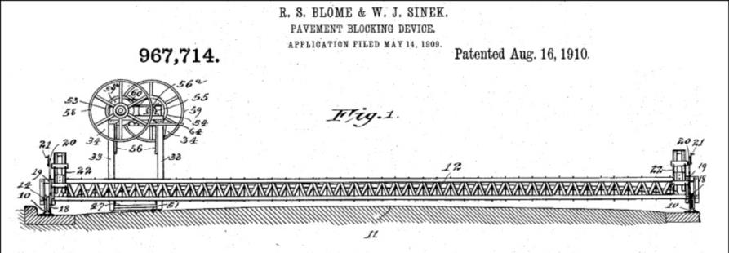
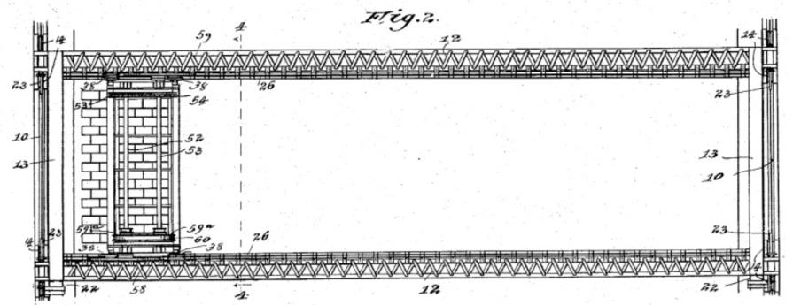

Slide 10
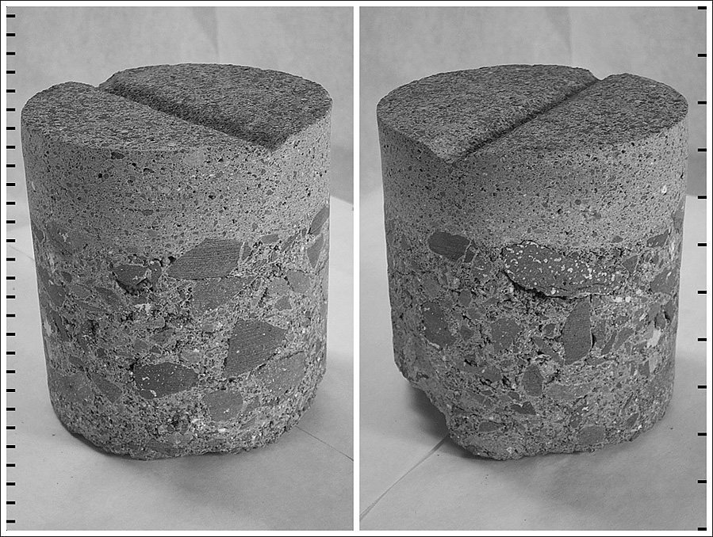

Slide 11
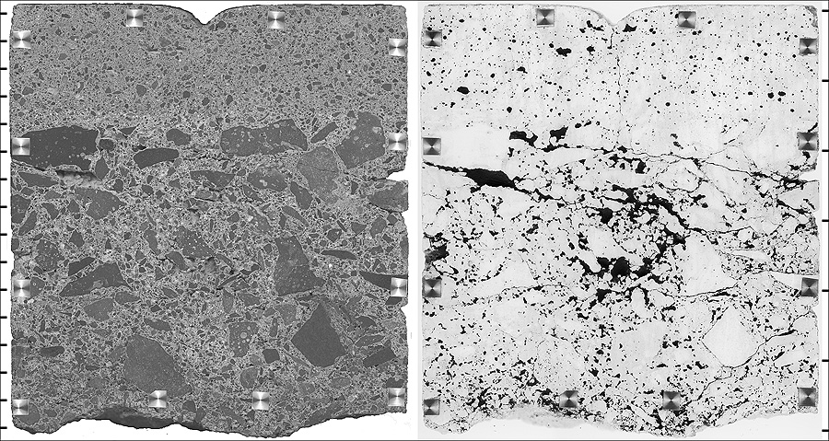

Slide 12
Significance?
Why was this concrete so durable given it had no entrained air and it was in a severe F-T environment?
  The surface mortar was extremely dense and impermeable
    Low w/c, good densification, and wet cured
    Similar capillary porosity to UHPC
    High belite cement – similar to the use of SCMs
  Mortar layer protected lower quality concrete layer

Slide 13
Important Considerations
The concrete constituents, proportions, and construction all influence durability
Water is needed for deleterious expansion to occur (permeability)
Severe environments are major contributors
  freezing and thawing, deicer applications, high sulfate soils, etc.
Strength does not equal durability – but it matters

Slide 14
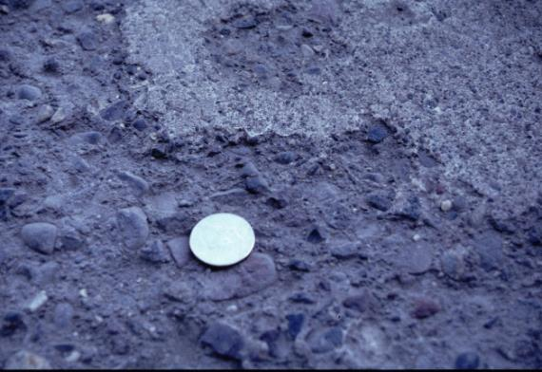
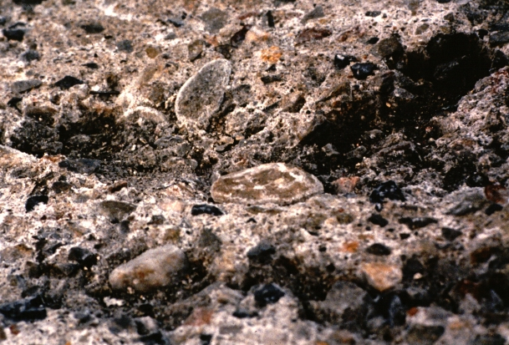
Deicer Scaling
Notes:
Close-ups of pavement scaling showing exposed aggregate and delamination.

Slide 15
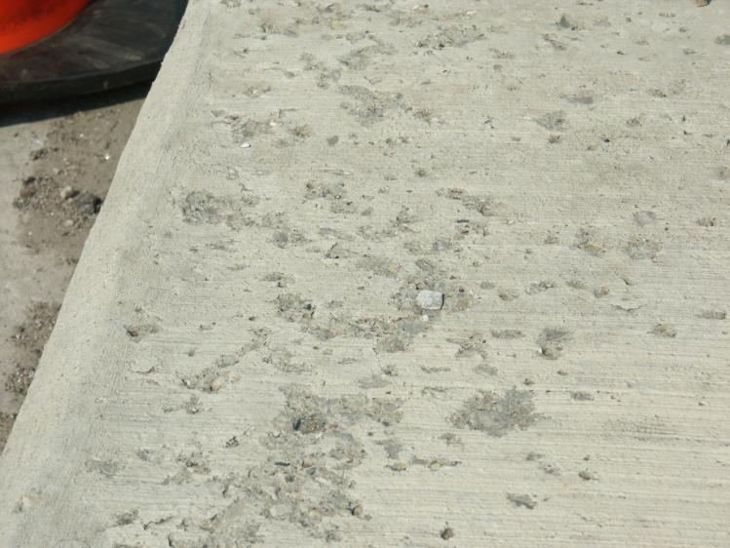
Deicer Scaling
Notes:
Close-ups of pavement scaling showing exposed aggregate and delamination.

Slide 16
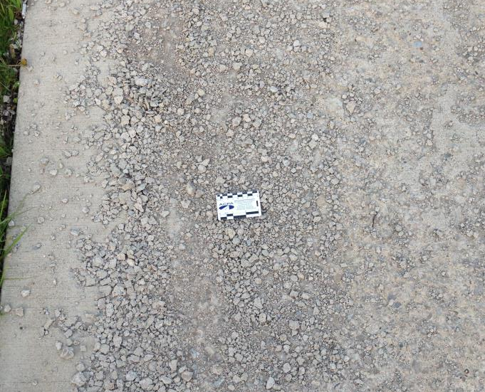
Deicer Scaling
Notes:
Close-ups of pavement scaling showing exposed aggregate and delamination.

Slide 17
Scaling
Typically appears within 1 to 5 years after construction
Deicer chemicals play a role
  Will amplify scaling deterioration (physical attack)
  Deicers can chemically react with hydrated paste constituents and degrade strength AND cause expansion (chemical attack)
Scaling prevented through proper air entrainment (hardened concrete) and a relatively low water-to-cement ratio
Minimize finishing, which can reduce air content at surface

Slide 18
Scaling
Mechanism
  Not well understood

Slide 19
Scaling
Mechanism
  Not well understood
  MORE RESEARCH IS NEEDED!!!

Slide 20
Scaling
Mechanism
  Not well understood
  MORE RESEARCH IS NEEDED!!!
  Just kidding… but not really...
  Key need is to better understand prevention (sealers)

Slide 21
Scaling
Mechanism
  Not well understood
  Predominately a physical attack
  Chemical attack (deicers) is also a contributor

Slide 22
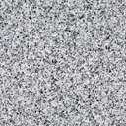
Mechanism
  Physical Attack
  Current research indicates scaling is due to tensile forces developed in the surface layer of concrete due to expansion of the ice layer (glue spalling)†
  The expansive forces of the ice are at a maximum when the solution freezing on the surface contains ~3% dissolved salt, and the type of salt is not a factor† (for physical attack)
† Valenza, J. J., and G. W. Scherer. 2007. A Review of Salt Scaling: II. Mechanisms, Cement and Concrete Research. 37(7), 1022-1034.

Slide 23
Mechanism
  Physical Attack
  The mechanical properties of the ice layer are affected by brine pockets in the ice layer – expansive forces maximized with dilute brine solutions present†
  The strength of the concrete surface (resistance to expansion forces) is key to resisting the expansion
    High w/c = lower strength (blessing the concrete)
† Valenza, J. J., and G. W. Scherer. 2007. A Review of Salt Scaling: II. Mechanisms, Cement and Concrete Research. 37(7), 1022-1034.

Slide 24
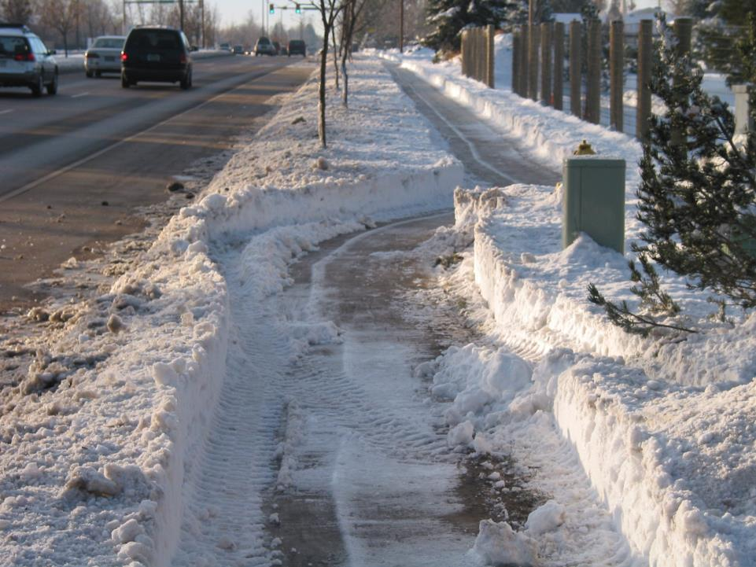

Slide 25
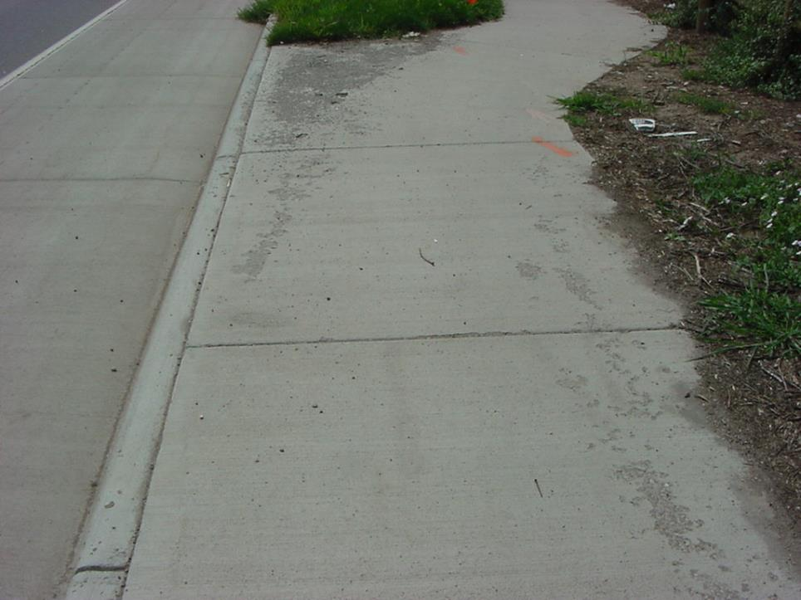
0.45 w/c
0.50 w/c

Slide 26
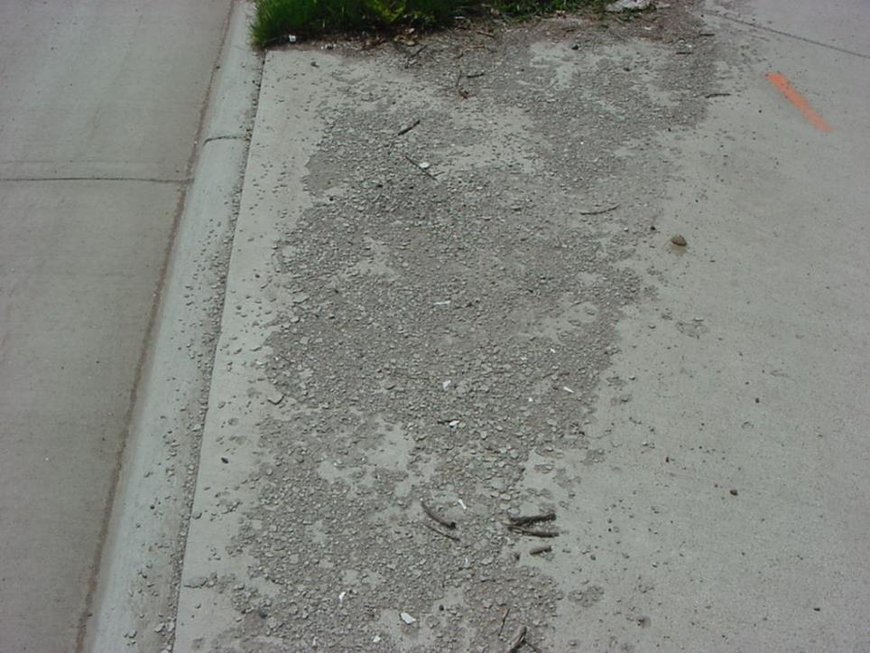
0.45 w/c
0.50 w/c

Slide 27
Role of Entrained Air
First a quick review of hardened cement paste microstructure

Slide 28


Slide 29
Cement Hydration
Water
Cement Grains

Slide 30
Cement Hydration
Early Hydration Products

Slide 31
Cement Hydration
Later Hydration Products or “Outer Product”

Slide 32
Cement Hydration
Capillary Pores

Slide 33
Cement Hydration
Hydration products are porous (gel pores) causing permeability at a nano-scale

Slide 34
Cement Hydration
Entrained Air Voids

Slide 35
Role of Entrained Air
Air entrainment reduces bleeding
  Bleeding will increase the w/c in the surface layer
Ice formation in air voids sucks water from the surrounding capillary pores
  Creates a compression force that resists the tensile forces of the ice layer
  DON’T WORK THE AIR OUT OF THE SURFACE

Slide 36
Small Bubbles, Lots of Them

Slide 37
Impact of Poor Finishing
0.5 to 1 inch

Slide 38
Take Aways – Physical Attack
Minimize potential for scaling attacks by reducing w/c
Recommend 0.45 maximum
Strongly suggest 0.42 maximum
MINIMIZE WATER ADDED TO SURFACE FOR FINISHING
Now…. chemical attack...

Slide 39
Scaling
Mechanism
  Not well understood
  Predominately a physical attack
  Chemical attack (deicers) is also a contributor
    Again we need to discuss some basics of hydration chemistry…

Slide 40


Slide 41
Portland Cement Reaction
  Cement + Water -> CSH + CH

Slide 42
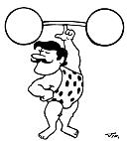
Portland Cement Reaction
  Cement + Water -> CSH + CH
CSH - Calcium Silicate Hydrate
  Provides strength
  In a perfect world cement hydration would be 100% CSH…

Slide 43

Portland Cement Reaction
  Cement + Water -> CSH + CH
CH- Calcium Hydroxide
  Weak link
  Platy structure (like book pages), low strength
  Soluble in water
  Solubility maximum at the freezing point of water
  Dissolution of CH increases permeability

Slide 44
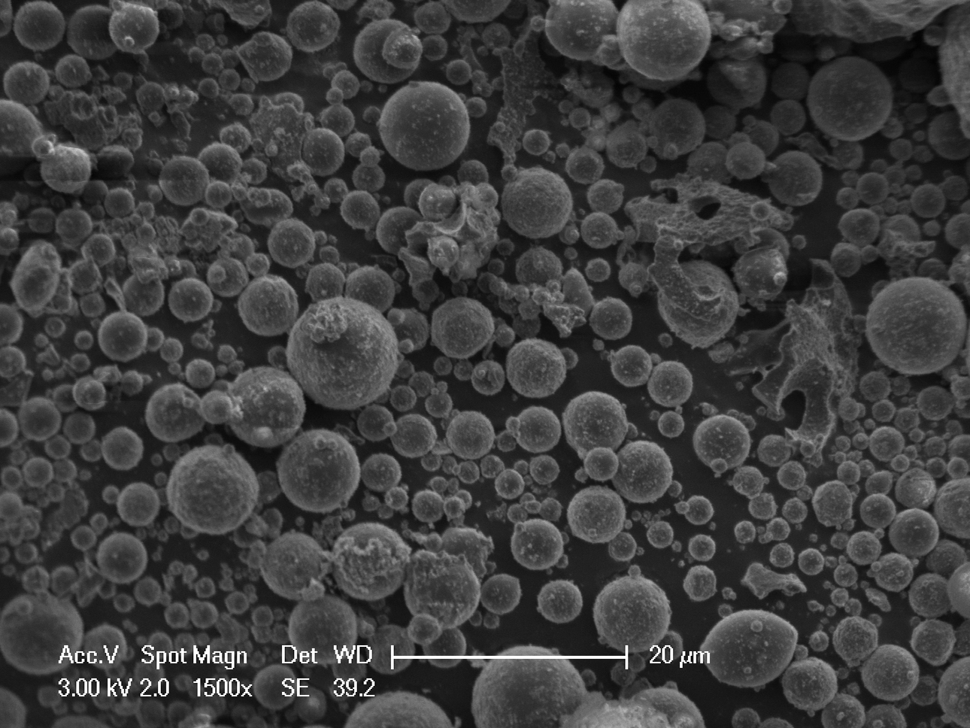
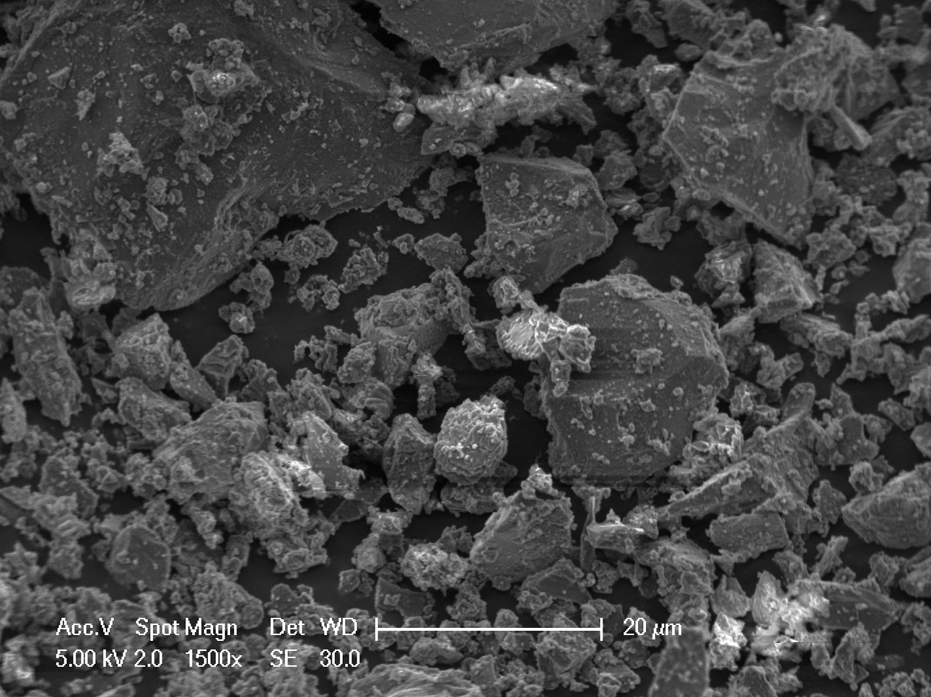
Supplementary Cementitious Materials
Fly Ash Particles
Most less than 10 microns
Cement Particles
Most less than 45 microns

Slide 45
Fly ash densifies hardened cement by physical effects (filler) and chemical effects (pozzolan)
Portland Cement Reaction
  Cement + Water -> CSH + CH
Pozzolanic Reaction
  CH + Pozzolan + Water -> CSH
  Pozzolanic reaction consumes (reduces) CH, produces CSH

Slide 46
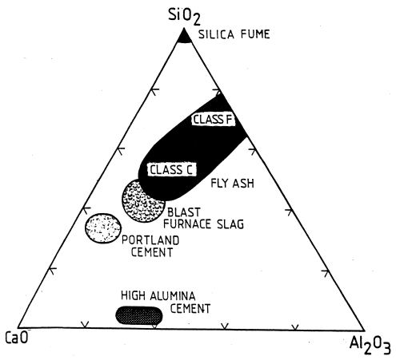
Supplementary Cementitious Materials
Slag Cement
  Similar to cement in composition
  Quenched > Glass > Reactive
  Produces less CH and consumes CH in its hydration reaction
Silica Fume
  Very fine particle size
  Very reactive
  $$

Slide 47
Okay so why does all this talk about calcium hydroxide matter?

Slide 48
Okay so why does all this talk about calcium hydroxide matter?
Calcium hydroxide is at the center of chemical deicer attack

Slide 49
Cylinders exposed to MgCl₂ solution after 84 days of constant low temperature test. From left to right: 0.40, 0.50, and 0.60 w/c

Slide 50
Cylinders exposed to CaCl₂ solution after 84 days of constant low temperature test. From left to right: 0.40, 0.50, and 0.60 w/c

Slide 51
Cylinders exposed to NaCl solution after 84 days of constant low temperature test. From left to right: 0.40, 0.50, and 0.60 w/c

Slide 52
Cylinders exposed to Ca(OH)₂ solution after 84 days of constant low temperature test. From left to right: 0.40, 0.50, and 0.60 w/c

Slide 53
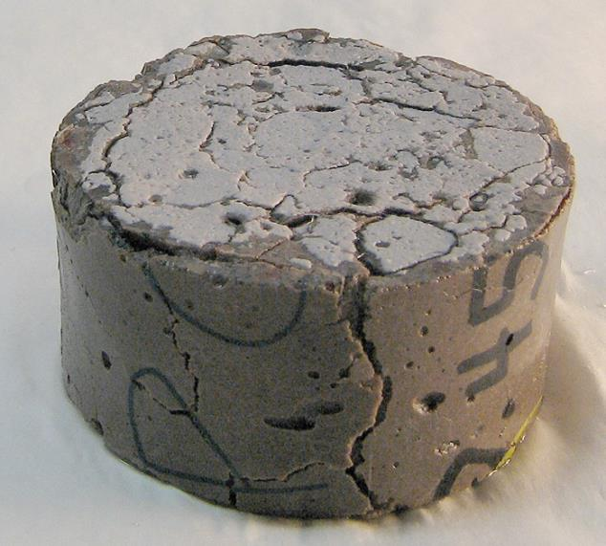
Hi conc. CaCl₂ – 500 days – 40 ºF

Slide 54
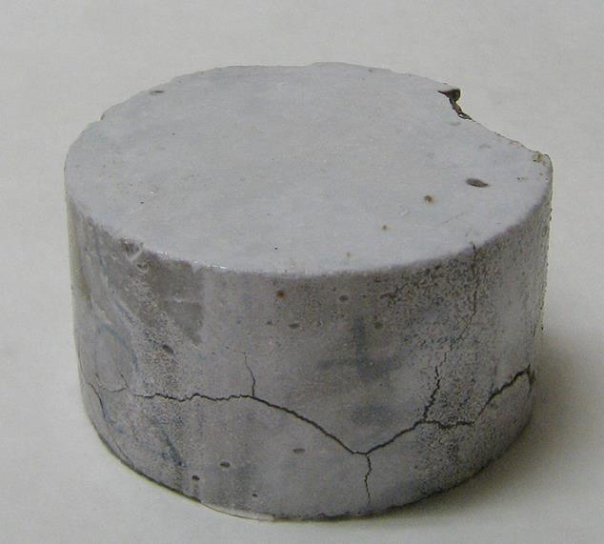
Hi conc. MgCl₂ – 500 days – 40 ºF

Slide 55
Chemical Mechanisms of Deicer Attack
CaCl₂ (Monosi & Collepardi, 1990)
  3Ca(OH)₂ + CaCl₂ + 12H₂O → 3CaO·CaCl₂·15H₂O
NaCl (Marchand 1994)
  2NaCl + Ca(OH)₂ → CaCl₂ + 2NaOH
MgCl₂ (Mindess, Young and Darwin, 2002)
  Ca(OH)₂ + MgCl₂ → CaCl₂ + Mg(OH)₂
  C-S-H + MgCl₂ → CaCl₂ + M-S-H

Slide 56
Chemical Mechanisms of Deicer Attack
How Calcium Chloride (CaCl₂) Attacks
  3Ca(OH)₂ + CaCl₂ + 12H₂O → 3CaO·CaCl₂·15H₂O
NaCl (Marchand 1994)
  2NaCl + Ca(OH)₂ → CaCl₂ + 2NaOH
MgCl₂ (Mindess, Young and Darwin, 2002)
  Ca(OH)₂ + MgCl₂ → CaCl₂ + Mg(OH)₂
  C-S-H + MgCl₂ → CaCl₂ + M-S-H
“Calcium Hydroxide”

Slide 57
Chemical Mechanisms of Deicer Attack
How Calcium Chloride (CaCl₂) Attacks
  3Ca(OH)₂ + CaCl₂ + 12H₂O → 3CaO·CaCl₂·15H₂O
NaCl (Marchand 1994)
  2NaCl + Ca(OH)₂ → CaCl₂ + 2NaOH
MgCl₂ (Mindess, Young and Darwin, 2002)
  Ca(OH)₂ + MgCl₂ → CaCl₂ + Mg(OH)₂
  C-S-H + MgCl₂ → CaCl₂ + M-S-H
“Calcium Chloride”

Slide 58
Chemical Mechanisms of Deicer Attack
How Calcium Chloride (CaCl₂) Attacks
  3Ca(OH)₂ + CaCl₂ + 12H₂O → 3CaO·CaCl₂·15H₂O
NaCl (Marchand 1994)
  2NaCl + Ca(OH)₂ → CaCl₂ + 2NaOH
MgCl₂ (Mindess, Young and Darwin, 2002)
  Ca(OH)₂ + MgCl₂ → CaCl₂ + Mg(OH)₂
  C-S-H + MgCl₂ → CaCl₂ + M-S-H
“Water”

Slide 59
Chemical Mechanisms of Deicer Attack
How Calcium Chloride (CaCl₂) Attacks
  3Ca(OH)₂ + CaCl₂ + 12H₂O → 3CaO·CaCl₂·15H₂O
NaCl (Marchand 1994)
  2NaCl + Ca(OH)₂ → CaCl₂ + 2NaOH
MgCl₂ (Mindess, Young and Darwin, 2002)
  Ca(OH)₂ + MgCl₂ → CaCl₂ + Mg(OH)₂
  C-S-H + MgCl₂ → CaCl₂ + M-S-H
“Calcium Oxychloride”

Slide 60
Chemical Mechanisms of Deicer Attack
How Calcium Chloride (CaCl₂) Attacks
  3Ca(OH)₂ + CaCl₂ + 12H₂O → 3CaO·CaCl₂·15H₂O
NaCl (Marchand 1994)
  2NaCl + Ca(OH)₂ → CaCl₂ + 2NaOH
MgCl₂ (Mindess, Young and Darwin, 2002)
  Ca(OH)₂ + MgCl₂ → CaCl₂ + Mg(OH)₂
  C-S-H + MgCl₂ → CaCl₂ + M-S-H
EXPANSIVE PHASE !!!

Slide 61
Chemical Mechanisms of Deicer Attack
How Calcium Chloride (CaCl₂) Attacks
  3Ca(OH)₂ + CaCl₂ + 12H₂O → 3CaO·CaCl₂·15H₂O
How Sodium Chloride (NaCl) Attacks
  2NaCl + Ca(OH)₂ → CaCl₂ + 2NaOH
How Magnesium Chloride (MgCl₂) Attacks
  Ca(OH)₂ + MgCl₂ → CaCl₂ + Mg(OH)₂
  C-S-H + MgCl₂ → CaCl₂ + M-S-H

Slide 62
Chemical Mechanisms of Deicer Attack
How Calcium Chloride (CaCl₂) Attacks
  3Ca(OH)₂ + CaCl₂ + 12H₂O → 3CaO·CaCl₂·15H₂O
How Sodium Chloride (NaCl) Attacks
  2NaCl + Ca(OH)₂ → CaCl₂ + 2NaOH
How Magnesium Chloride (MgCl₂) Attacks
  Ca(OH)₂ + MgCl₂ → CaCl₂ + Mg(OH)₂
  C-S-H + MgCl₂ → CaCl₂ + M-S-H

Slide 63
Chemical Mechanisms of Deicer Attack
How Calcium Chloride (CaCl₂) Attacks
  3Ca(OH)₂ + CaCl₂ + 12H₂O → 3CaO·CaCl₂·15H₂O
How Sodium Chloride (NaCl) Attacks)
  2NaCl + Ca(OH)₂ → CaCl₂ + 2NaOH
How Magnesium Chloride (MgCl₂) Attacks
  Ca(OH)₂ + MgCl₂ → CaCl₂ + Mg(OH)₂
  C-S-H + MgCl₂ → CaCl₂ + M-S-H

Slide 64
Chemical Mechanisms of Deicer Attack
How Calcium Chloride (CaCl₂) Attacks
  3Ca(OH)₂ + CaCl₂ + 12H₂O → 3CaO·CaCl₂·15H₂O
We did not find evidence of NaCl attack
How Magnesium Chloride (MgCl₂) Attacks
  Ca(OH)₂ + MgCl₂ → CaCl₂ + Mg(OH)₂
  C-S-H + MgCl₂ → CaCl₂ + M-S-H
We found strong evidence of the magnesium chloride mechanism shown here

Slide 65
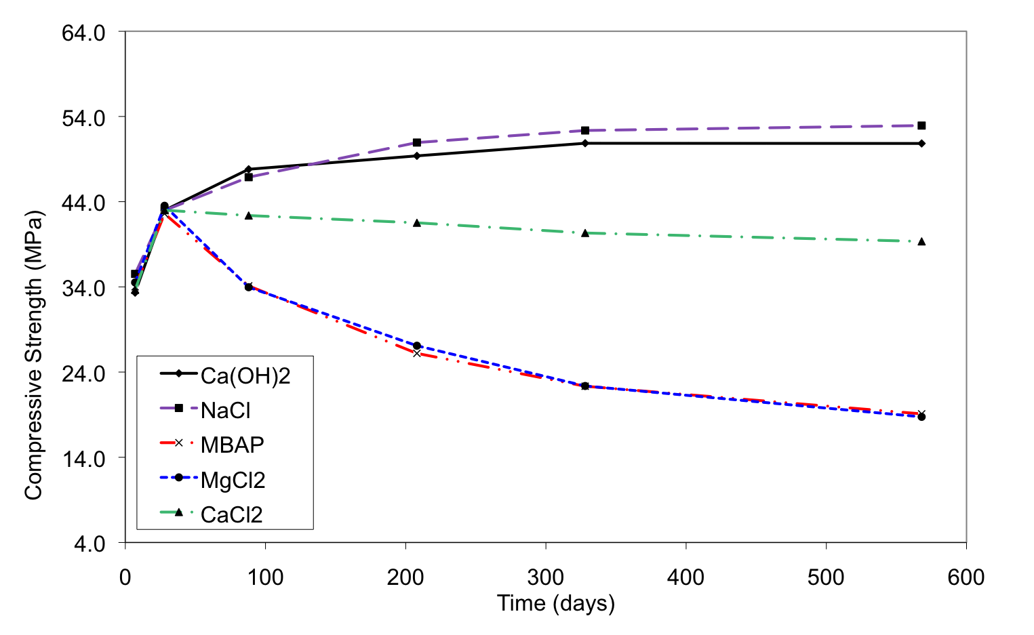
Compressive strength evolution with time of mortar cubes
NaCl & Control
CaCl₂ ~10% loss
MgCl₂ & MBAP ~60% loss

Slide 66
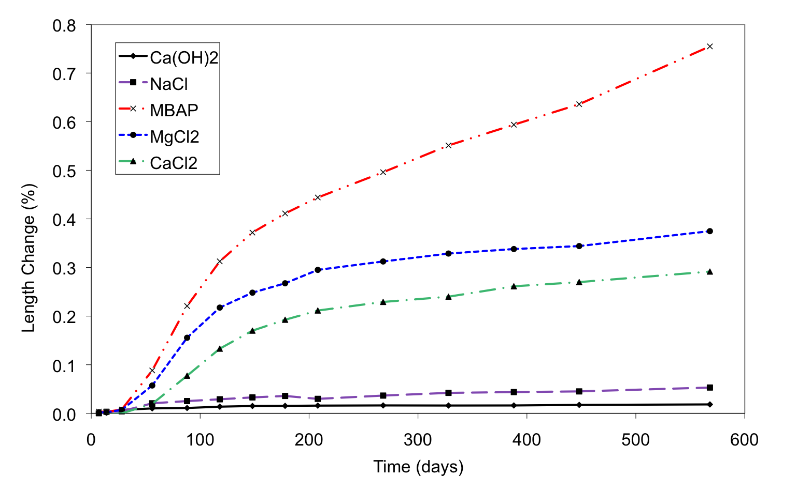
Length change of mortar bars
~0.8% expansion MBAP
~0.4% expansion MgCl₂
~0.3% expansion CaCl₂

Slide 67
X-ray Diffractogram for Mortars Exposed to CaCl₂ – 30 days @ 40 ºF
Calcium Oxychloride

Slide 68
Typical Concrete Sorptivity with Different Fluids ( 0.55 w/c)
Water
NaCl
CaCl₂
MgCl₂

Slide 69
Sorptivity of 15% MgCl₂ into
Different 0.45 w/c Concrete Mixtures
Type I PC
15% Fly Ash
35% slag

Slide 70
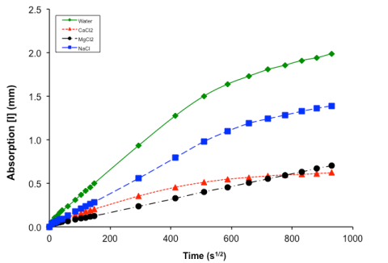
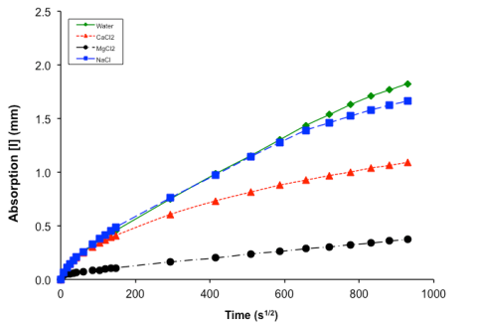
SCM Effects on Permeability
0.45 w/c OPC
0.45 w/c OPC + 15% Class F

Slide 71
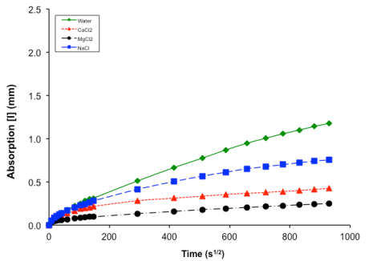
SCM Effects on Permeability
0.45 w/c OPC + 15% Class F
0.45 w/c OPC + 35% GBFS

Slide 72
Take Aways – Chemical Attack
Brines of magnesium and calcium chloride have been demonstrated to react deleteriously with hydrated cement paste
  Expansive calcium oxychloride forms
  Reaction is slower than physical attack mechanisms

Slide 73
Take Aways – Chemical Attack
Use of SCMs reduces susceptibility of concrete for chemical attack
  Reduces CH available to react
  Permeability of concrete not compromised by CH leaching
  Improves concrete strength (affects physical and chemical attack)

Slide 74
Take Aways – Chemical Attack
The various brines penetrate concrete at different rates (sorptivity)
Sorptivity will impact chemical and physical attack
Although NaCl brines have demonstrated no chemical attack – they are the most sorptive, which impacts physical attack

Slide 75
Curing Requirements
Adequate moisture
Adequate temperature
Adequate time

Slide 76
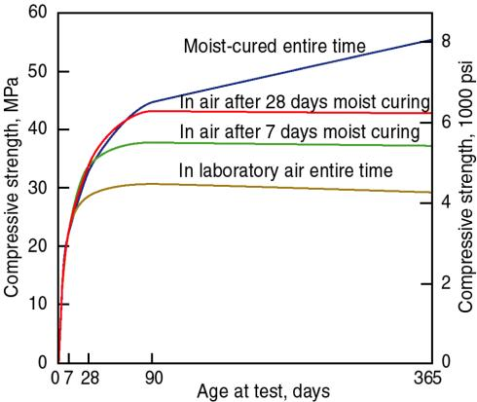
Curing Affects Strength & Durability
Curing affects strength but for pavement or harsh exposures the affects on durability are more important
Curing critical when SCMs are used – slower to hydrate
PCA

Slide 77
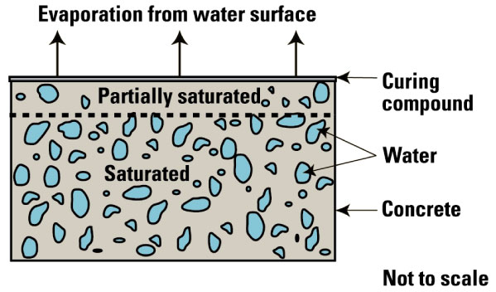
Curing Compounds
Reduce the rate of evaporation from the surface to a rate less than the rate water can move up through the concrete
PCA

Slide 78
Moisture Retention
Curing compounds
  Reduce the rate of moisture loss
  Other physical materials (wet burlap, wet straw) will likely give better protection but are normally not practical for large, fast moving operations
  Depends on quality of film (membrane)
  Film thickness
  Requires complete coverage…

Slide 79
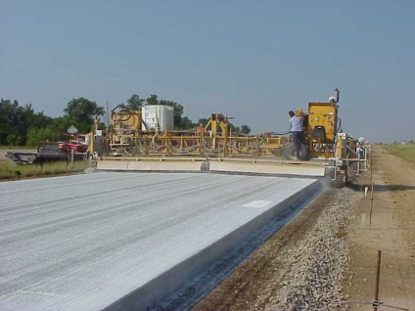
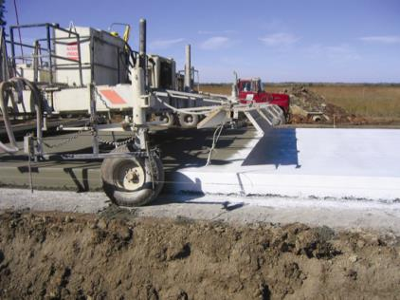
Paint my house?

Slide 80
Curing Effects
Protect the surface, which is most vulnerable to moisture loss (affects cement hydration at surface – strength)
Water moving up out of the concrete (loss) creates capillary pores increasing porosity and permeability
Increased hydration (water retained) results in lower permeability

Slide 81
Curing Take Aways
Keep the water in so hydration occurs
The more complete hydration, the lower the permeability and higher strength
Not all curing compounds are equal in performance – unless you don’t use them

Slide 82
Sealants

Slide 83
Two General Classes
Film Formers
  Epoxies
  Polyurethanes
  Polyesters
  Waxes
  Acrylics
Chemically Reactive
  Silicates
  Silanes
  Siloxanes
Penetrate and react with CH to form calcium silicate

Slide 84
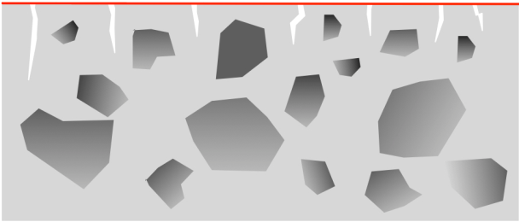
Film Formers
Form complete surface barrier with little penetration
Do not react with concrete
Susceptible to wear and abrasion
In some cases susceptible to UV
Can be removed
Capable of penetrating and sealing large cracks
May be applied with aggregate top coat to improve friction
May be thinned (pore blocker)
Ex. epoxies, polyurethanes, methacrylates, waxes, acrylics

Slide 85
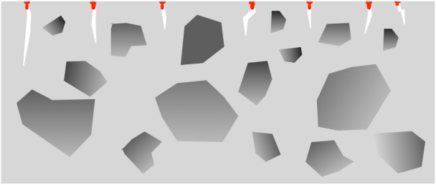
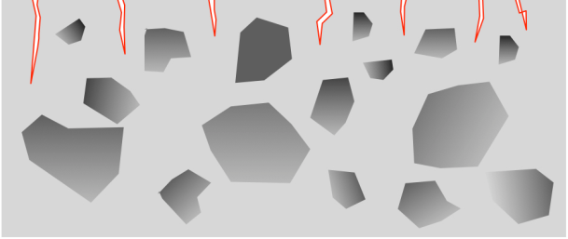
Chemically Reactive – Water Repellent
React with cement paste (depending on chemistry) by bonding with Si
  methoxy vs ethoxy
In some cases susceptible to UV
Water enters pore but the water repellent coating prevents ingress into the cement paste
Allow moisture transport out of concrete
Ex. silanes, siloxanes

Slide 86
Application Requirements
Affected by
  Climatic Conditions
  Surface Preparation
  Application Rates

Slide 87
Application Requirements
Climatic Conditions
  Temperature (~40 – 90 ºF) at the concrete surface
  Wind can affect volatilization and curing rates
  Moisture: most not compatible with water
    Two days drying is a typical requirement
  Most sealers require curing time
    24 hrs typical

Slide 88
Application Requirements
Surface Preparation
  Cure concrete adequately (28 days)
    Application at 3 – 6 months age often recommended
  Badly deteriorated concrete cannot be saved with a sealer
  Remove dirt/debris
    Avoid sandblasting the surface – increase permeability
  Silanes/siloxanes best applied to new concrete surface before carbonation has occurred – improves bond – sealant requires alkalinity to react

Slide 89
Application Requirements
Application Rates
  Varies widely (100 - 300 ft²/gal)
    Film sealers may require more than recommended if aggregate is placed for friction
  Water repellent sealers must be applied to near saturation conditions at the surface
Other Considerations
  VOCs
    Most sealers are in an organic liquid form and the volatization of the organic media contributes VOCs

Slide 90
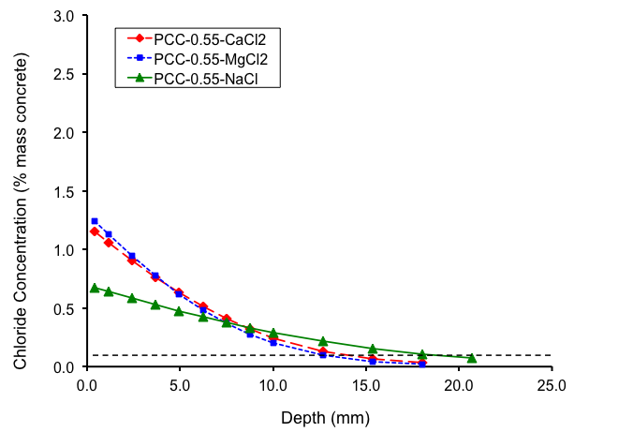
Salt Ingress for OPC mixture

Slide 91
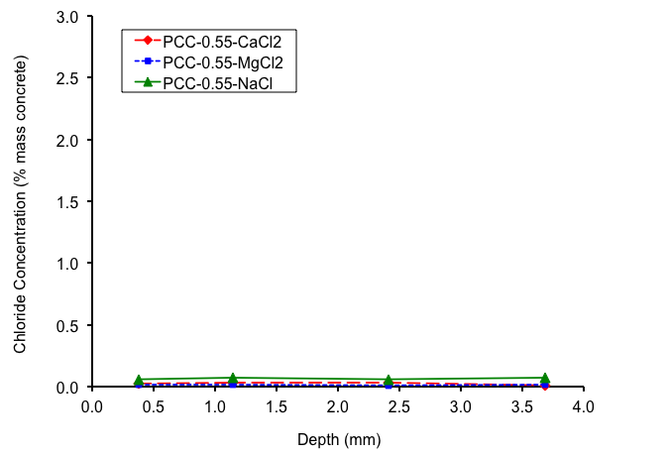
Tri-siloxane 12% (aliphatic hydrocarbon)
PCC Mixtures

Slide 92
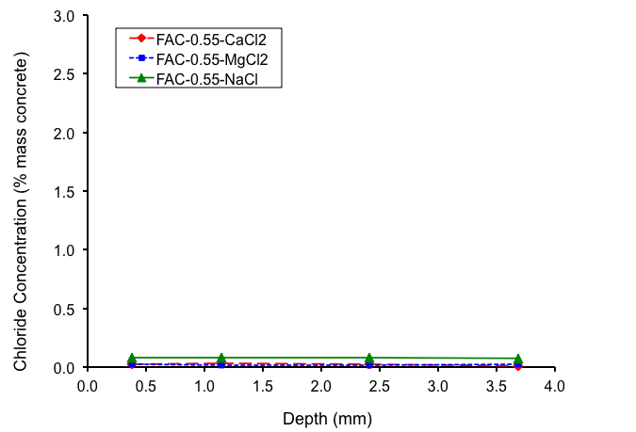
Tri-siloxane 12% (aliphatic hydrocarbon)
Fly Ash Mixtures

Slide 93
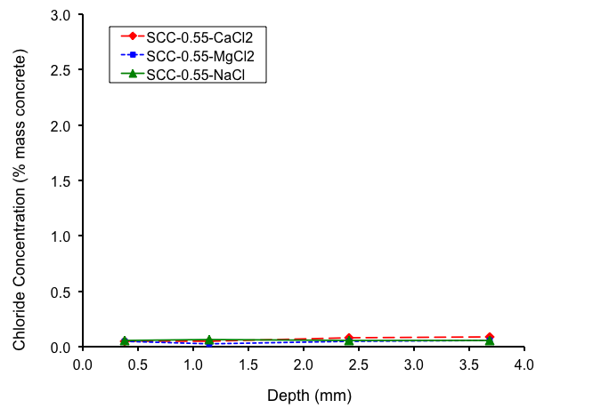
Tri-siloxane 12% (aliphatic hydrocarbon)
GBFS Mixtures

Slide 94
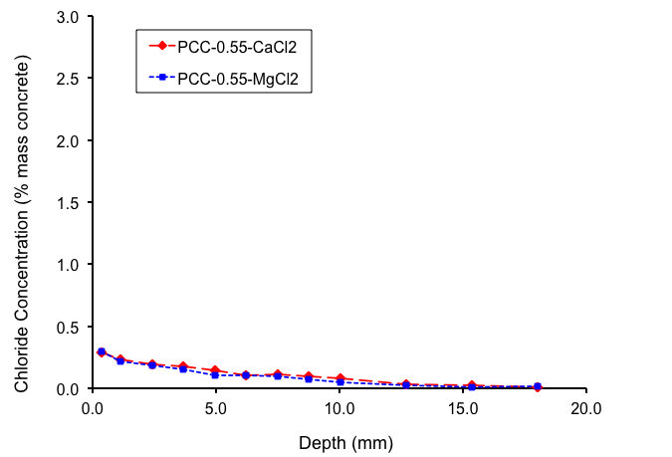
Tri-silane 40% (2-propanol)
OPC Mixtures

Slide 95
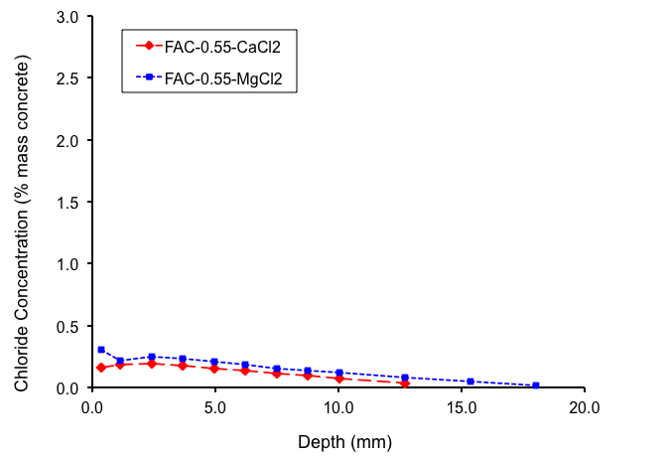
Tri-silane 40% (2-propanol)
Fly Ash Mixtures

Slide 96
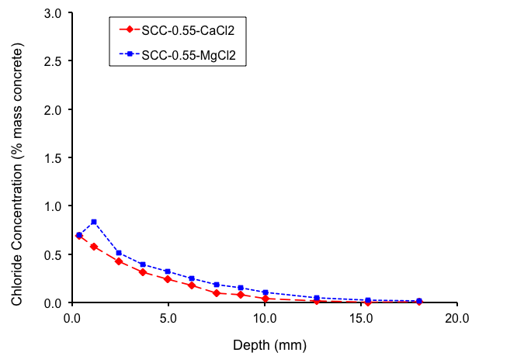
Tri-silane 40% (2-propanol)
GBFS Mixtures

Slide 97
Summary
Keep fluids out of concrete and all materials-related distress is minimized
Materials selection is very important
  Low w/c
  Low paste content
  Use SCMs
Curing is essential
  Keep the mixture water in and allow the materials time to form dense, impermeable, hydration products

Slide 98
Summary
Deicing chemicals are a serious concern
  Contribute to physical attack
  Contribute to chemical attack
Sealants may be required to offset deicing fluids
  Keep brines out
  Slow ingress of salt solutions

Slide 99
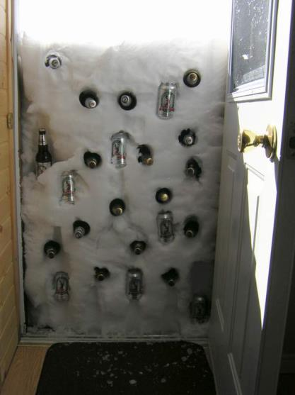
Questions?
Contact:
Larry Sutter
Michigan Tech
Houghton MI
llsutter@mtu.edu

