Slide 1
MD SHA Specifications Update
Vicki Stewart
Concrete Assistant Division Chief
Notes:
Proportioning pervious concrete is a little different compared to conventional concrete.
Pervious mixture proportions are somewhat less forgiving than conventional concrete mixtures.
When developing pervious concrete mixtures, the goal is to obtain a target and design void content that will allow for the infiltration of water. Pervious concrete is typically designed for a void content in the range of 15% to 30%.
Infiltration is influenced by Void Content, and Void Content is influenced by:
Aggregate Gradation
Water Cement Ratio
Compaction Effort during construction
At times, when proportioning pervious concrete; even though the design void content maybe 20%, after the mixture is proportioned, the experimentally measured void content may be considerably different.
For reasons such as those mentioned, it is even more important to verify Pervious Concrete mixtures through trial batches to achieve the characteristics assumed or targeted when developing mixture proportions

Slide 2
Terminology/ Definitions
SP
SPI
Current spec book - 2008
Notes:
Proportioning pervious concrete is a little different compared to conventional concrete.
Pervious mixture proportions are somewhat less forgiving than conventional concrete mixtures.
When developing pervious concrete mixtures, the goal is to obtain a target and design void content that will allow for the infiltration of water. Pervious concrete is typically designed for a void content in the range of 15% to 30%.
Infiltration is influenced by Void Content, and Void Content is influenced by:
Aggregate Gradation
Water Cement Ratio
Compaction Effort during construction
At times, when proportioning pervious concrete; even though the design void content maybe 20%, after the mixture is proportioned, the experimentally measured void content may be considerably different.
For reasons such as those mentioned, it is even more important to verify Pervious Concrete mixtures through trial batches to achieve the characteristics assumed or targeted when developing mixture proportions

Slide 3
Standard Specifications for Construction and Materials
The MDSHA Standard Specifications for Construction and Materials is one of the Contract Documents that governs the performance of work; including the furnishing of labor, equipment and materials, by which a Contractor is bound to comply with, upon the awarding of a Contract for work to be performed for the Administration.
The Standard Specifications manual (Gray Book – 2008) is divided into three parts:
Part I – General Provisions
Part II – Terms and Conditions
Part III - Technical Requirements

Slide 4
Types of Standard Specifications
Special Provisions (SP)
Are prepared for all projects to cover an item of work that is not addressed in the Spec Book or to modify a spec in the Book.
* Type A - Used for items which have no specifications pertaining to them in the Spec Book.
* Type B - Used for items that have specifications pertaining to them in the Spec Book.

Slide 5
Special Provisions (SP) (SHELF SPECS)
Project specific.
Any Project Engineer or Division can write one.
The Project Engineer or Division (Initiator) has complete ownership of their specs. (SP’s)
There is no review or approval process.
Use any existing SP (or SPI) as a template.
The Spec Review Team will review an SP (or provide a template) upon request.

Slide 6
Types of Standard Specifications
Special Provision Inserts (SPI)
SPIs are revisions to the current Spec Book that have been formatted, approved (FHWA) and published by the SPI Clearinghouse
Changes to an existing SP/SPI should have new language in red. Completely new SP/SPI should be in black.
.

Slide 7
TC-3.01 Governing Order of Contract Documents
In the event of any discrepancy between the drawings and figures (in the Plans):
The figures, unless obviously incorrect, will govern over scaled dimensions.
In the event of any discrepancy between the various Contract Documents, the governing order from highest to lowest are:
Special Provisions
Plans
Special Provisions Inserts
Standard Specifications.
General Provisions will govern over all Contract Documents unless expressly provided for in the Contract.

Slide 8
The SPI Clearinghouse Committee
The SPI Clearinghouse Committee is responsible for reviewing specifications that are to be included in Contract Documents or adopted as supplements to the SHA 2008 Standard Specifications for Construction and Materials manual.
Committee members are from the following areas: OMT, CID, OOM, OOTS, OBD, OED, OHD, MTBMA & FHWA.
Meetings are held on the first Wednesday of the month to review specifications (SPs/SPIs) being submitted for inclusion on the network.

Slide 9
522 PCC Pavement Repairs
522 updated for CRCP repairs and to include match cure as an option to open to traffic for High Early (HE) mix or mix 9
Patching concrete pavements from April – October – no exceptions
Opening to traffic at 2500 psi.
Acceptance cylinders are field cured and tested on weekdays at 24 hrs. or 3 days. The cylinders must reach 3000psi/24 hr or 3600psi/3days

Slide 10
HE (High Early) Mix and Mix 9
HE is a performance based mix rather then prescriptive based like mix 9.
HE design approval is based on match curing and obtaining 2500psi in 6 hours.
Mix 9 specifies 800 # minimum cementitious and HRWR. Design approval is based on std. cure and 2500 psi/12 hrs.
Notes:
Proportioning pervious concrete is a little different compared to conventional concrete.
Pervious mixture proportions are somewhat less forgiving than conventional concrete mixtures.
When developing pervious concrete mixtures, the goal is to obtain a target and design void content that will allow for the infiltration of water. Pervious concrete is typically designed for a void content in the range of 15% to 30%.
Infiltration is influenced by Void Content, and Void Content is influenced by:
Aggregate Gradation
Water Cement Ratio
Compaction Effort during construction
At times, when proportioning pervious concrete; even though the design void content maybe 20%, after the mixture is proportioned, the experimentally measured void content may be considerably different.
For reasons such as those mentioned, it is even more important to verify Pervious Concrete mixtures through trial batches to achieve the characteristics assumed or targeted when developing mixture proportions

Slide 11
I-795 patching project
Pilot project comparing HE mix and mix 9. Both mixes performed well on this project.
Another part of the project was Dowel Bar Retrofit (DBR). I-795 has 40 ft. joint spacing and during inspection it was noted that there was mid slab cracking, but the cracks were tight making it a good candidate for DBR. DBR allowed for the joints to work together.
After all the patching and DBR was completed, the project was diamond ground for improved ride quality.
Notes:
Proportioning pervious concrete is a little different compared to conventional concrete.
Pervious mixture proportions are somewhat less forgiving than conventional concrete mixtures.
When developing pervious concrete mixtures, the goal is to obtain a target and design void content that will allow for the infiltration of water. Pervious concrete is typically designed for a void content in the range of 15% to 30%.
Infiltration is influenced by Void Content, and Void Content is influenced by:
Aggregate Gradation
Water Cement Ratio
Compaction Effort during construction
At times, when proportioning pervious concrete; even though the design void content maybe 20%, after the mixture is proportioned, the experimentally measured void content may be considerably different.
For reasons such as those mentioned, it is even more important to verify Pervious Concrete mixtures through trial batches to achieve the characteristics assumed or targeted when developing mixture proportions

Slide 12
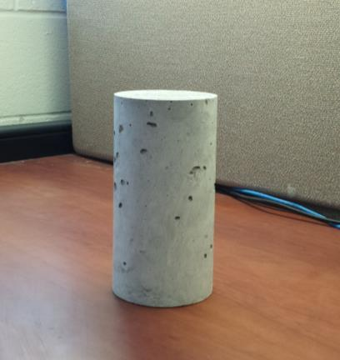
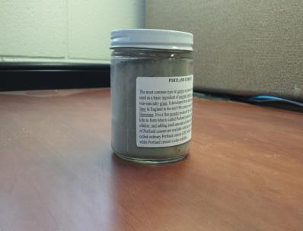
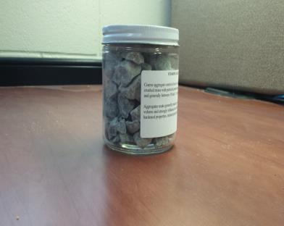
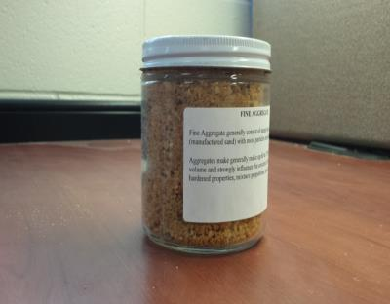
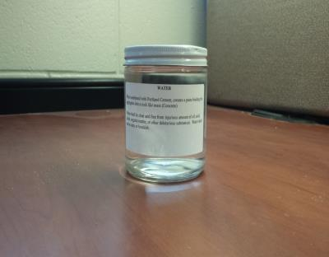
What Is Pervious Concrete
Conventional Concrete
Notes:
We all know what conventional concrete is. A mixture of :
Cements
Coarse Aggregates
Fine Aggregates
Water
Chemical Admixtures

Slide 13
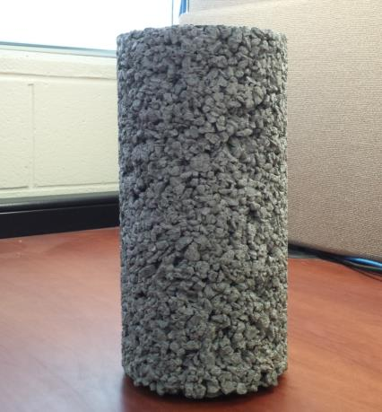
What is Pervious Concrete
ACI 522 definition - Near zero-slump Open-graded material Consisting of
Hydraulic cement
Coarse aggregate
Little or no fine aggregate
Admixtures
Water
Sometimes called no-fines concrete
Notes:
Pervious concrete uses the same materials as conventional concrete, with the exceptions that:
The fine aggregate is either removed all together or used in VERY sparse amounts.
The size distribution (grading) of the coarse aggregate is generally kept narrow or to a single size [allowing for relatively little particle packing].
Simply put, Pervious concrete is a mixture of:
Cements
Coarse Aggregates
Fine Aggregates
Water
Chemical Admixtures
ACI Committee 522 defines Pervious Concrete as:
A near zero-slump, open-graded material consisting of hydraulic cement, coarse aggregate, little or no fine aggregate, admixtures, and water.

Slide 14
Quick History Lesson
Started in 1800’s Europe
Used for 2 story homes in 1920’s (England and Scotland)
Gained popularity after WWII because of war torn countryside
Not popular in the U.S. until 1970’s
Notes:
Pervious concrete was first used structurally in 1800s Europe as load bearing walls and single story homes.
It became popular again in the 1920s, being used for two story homes in Scotland and England.
The popularity of Pervious Concrete increased in Europe after World War II, as the technology was used to rebuild residential housing previously destroyed by the war throughout Europe.
Pervious Concrete did not become as popular in the US until the 1970s were it has been used primarily in pavement applications.

Slide 15
Direct Benefit
Federal Clean Water Act:
States, Counties, and Local Municipalities to adopt procedures addressing stormwater runnoff and associated pollutants
Pervious Concrete is instrumental in:
Recharging Groundwater
Reducing Stormwater Runnoff
Meeting EPA Stormwater Regulations
Notes:
Further interest in pervious concrete is being driven by the direct benefit provided in stormwater management. The Federal Clean Water Act, requires States, Counties and Municipalities to adopt procedures that will address stormwater runoff and the pollution associated with it. As a result transportation agencies from the State level down to local county and municipalities have adopted methods of complying with Federal regulations.
Pervious Concrete Pavement is an application that satisfies these requirements, permitting the treatment of pollutants on site.
By capturing stormwater and allowing it to percolate into the ground, pervious concrete is instrumental in
recharging groundwater,
reducing stormwater runoff, and
meeting U.S. Environmental Protection Agency (EPA) stormwater regulations.

Slide 16



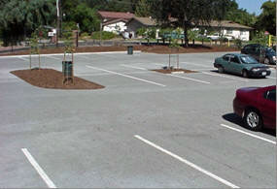
Typical Pervious Concrete Applications
Parking Lots
Driveways
Residential Streets
Sidewalks
Notes:
Some of the more popular applications used for pervious concrete include parking lots, driveways, low volume residential streets and sidewalks.
Other Pervious Concrete applications can include:
Roadway Base Course
Greenhouse Flooring
Pavement Edge Drains
Tennis Courts

Slide 17
Test Parameters
Fresh Density
Void Content
Infiltration Rate
Tested per C1688 and C1707
Test panels must be accepted before final pervious pavement
Notes:
Proportioning pervious concrete is a little different compared to conventional concrete.
Pervious mixture proportions are somewhat less forgiving than conventional concrete mixtures.
When developing pervious concrete mixtures, the goal is to obtain a target and design void content that will allow for the infiltration of water. Pervious concrete is typically designed for a void content in the range of 15% to 30%.
Infiltration is influenced by Void Content, and Void Content is influenced by:
Aggregate Gradation
Water Cement Ratio
Compaction Effort during construction
At times, when proportioning pervious concrete; even though the design void content maybe 20%, after the mixture is proportioned, the experimentally measured void content may be considerably different.
For reasons such as those mentioned, it is even more important to verify Pervious Concrete mixtures through trial batches to achieve the characteristics assumed or targeted when developing mixture proportions

Slide 18

SHA Projects
Notes:
Maryland State Highway Administration completed 3 projects involving Pervious Concrete during 2014:
2 Park & Ride Expansions
I-83 at MD 439
MD 4 at MD749 and MD 408 (Waysons Corner)
1 Footpath/Trail Way
MD 51, Paw Paw Tunnel Shared Path
The projects are located in 3 different corners of the State:
I-83 at MD 439 – District 4
MD 4 at MD749 and MD 408 (Waysons Corner) – District 5
MD 51, Paw Paw Tunnel Shared Path- District 6
Pervious applications for these projects included the installation of
2 Pervious Parking lots
1 Pervious Sidewalk
1 Pervious Shared Path Park Trail
We’ll begin with I-83

Slide 19


I-83 Park & Ride
Pervious Concrete Location
Notes:
The I -83/MD 439 Park & Ride is located in District 4’s Baltimore County just a few miles from the Pennsylvania line.
This project included a
6” Thick Pervious Pavement
Variable Depth Stone Base (57s) – minimum depth of stone base 24”
Sand Layer Subbase
The Pervious mix used set target:
Density of 122.3 lbs/ft3
Void Content of 20%

Slide 20
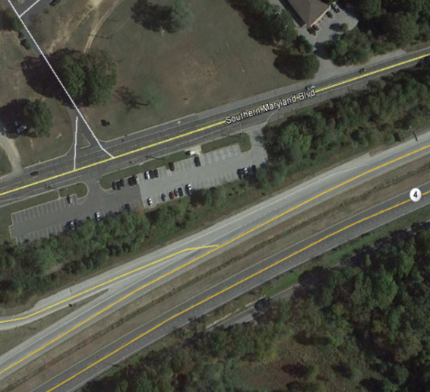

Wayson’s Corner
Pervious Concrete Location
Notes:
The MD 4 at MD 794/MD408 (Wayson’s Corner) Park & Ride is located in District 5’s Ann Arundel County just a few miles from the PG County line.
The Park & Ride extension included:
6” Thick Pervious Pavement
Variable Depth Stone Base (57s) – minimum depth of stone base 12”
Sand Layer Subbase
And
5” Thick Pervious Sidewalk
Varible Depth Stone Base (57s) – Minimum depth of stone base 12”
The Pervious mix used set target:
Density of 120.4 lbs/ft³
Void Content of 20%

Slide 21
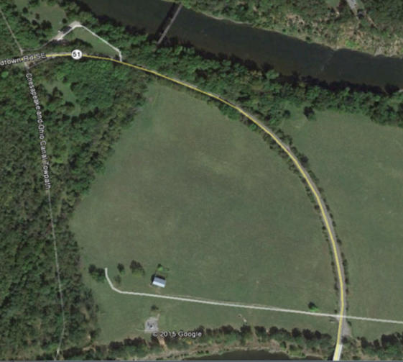

Paw Paw Tunnel Trail
Pervious Concrete Location
Notes:
The Paw Paw Tunnel Shared Path is located in District 6’s Allegany County literally a stone’s throw away from West Virginia .
This project included a
6” Thick Pervious Pavement
Variable Depth Stone Base (57s) – minimum depth of stone base 3”
Variable Depth Stone Base (2s) – minimum depth of stone base 12”
The Pervious mix used set target:
Density of
Void Content of 15%

Slide 22
RCC – Roller Compacted Concrete
Recently became “Ready to Use”
No projects identified yet.
Working on adding it to the Pavement Design Guide
Developed because it was identified as a top priority by the Concrete Pavement Leadership Partnering Team.
Other state specs and the RCC Guide published by PCA were used to develop our spec.
Notes:
Proportioning pervious concrete is a little different compared to conventional concrete.
Pervious mixture proportions are somewhat less forgiving than conventional concrete mixtures.
When developing pervious concrete mixtures, the goal is to obtain a target and design void content that will allow for the infiltration of water. Pervious concrete is typically designed for a void content in the range of 15% to 30%.
Infiltration is influenced by Void Content, and Void Content is influenced by:
Aggregate Gradation
Water Cement Ratio
Compaction Effort during construction
At times, when proportioning pervious concrete; even though the design void content maybe 20%, after the mixture is proportioned, the experimentally measured void content may be considerably different.
For reasons such as those mentioned, it is even more important to verify Pervious Concrete mixtures through trial batches to achieve the characteristics assumed or targeted when developing mixture proportions

Slide 23
Possible Project Sites
Shoulder replacement
Toll Plaza areas
Low volume roads such as municipalities where you can’t keep the road closed.
Notes:
Proportioning pervious concrete is a little different compared to conventional concrete.
Pervious mixture proportions are somewhat less forgiving than conventional concrete mixtures.
When developing pervious concrete mixtures, the goal is to obtain a target and design void content that will allow for the infiltration of water. Pervious concrete is typically designed for a void content in the range of 15% to 30%.
Infiltration is influenced by Void Content, and Void Content is influenced by:
Aggregate Gradation
Water Cement Ratio
Compaction Effort during construction
At times, when proportioning pervious concrete; even though the design void content maybe 20%, after the mixture is proportioned, the experimentally measured void content may be considerably different.
For reasons such as those mentioned, it is even more important to verify Pervious Concrete mixtures through trial batches to achieve the characteristics assumed or targeted when developing mixture proportions

Slide 24
Whitetopping
A thin overlay placed on a pavement. After the overlay is completed, the pavement is diamond ground for the best ride quality.
Spec was developed with industry and it is based on the “guide to concrete overlays” by National Concrete Pavement Technology Center.
WT Mix is similar to a mix 9 with the addition of fibers.
Notes:
Proportioning pervious concrete is a little different compared to conventional concrete.
Pervious mixture proportions are somewhat less forgiving than conventional concrete mixtures.
When developing pervious concrete mixtures, the goal is to obtain a target and design void content that will allow for the infiltration of water. Pervious concrete is typically designed for a void content in the range of 15% to 30%.
Infiltration is influenced by Void Content, and Void Content is influenced by:
Aggregate Gradation
Water Cement Ratio
Compaction Effort during construction
At times, when proportioning pervious concrete; even though the design void content maybe 20%, after the mixture is proportioned, the experimentally measured void content may be considerably different.
For reasons such as those mentioned, it is even more important to verify Pervious Concrete mixtures through trial batches to achieve the characteristics assumed or targeted when developing mixture proportions

Slide 25
Whitetopping Projects
4 projects completed to date:
I-68 at Friendsville is a mile long truck climbing lane.
Rt. 50 at 301 is a large cloverleaf interchange
MD 355 at Rt 27 is three approach lanes at the intersection
Most recent project is MD 210
Next project: next section of MD 210
Notes:
Proportioning pervious concrete is a little different compared to conventional concrete.
Pervious mixture proportions are somewhat less forgiving than conventional concrete mixtures.
When developing pervious concrete mixtures, the goal is to obtain a target and design void content that will allow for the infiltration of water. Pervious concrete is typically designed for a void content in the range of 15% to 30%.
Infiltration is influenced by Void Content, and Void Content is influenced by:
Aggregate Gradation
Water Cement Ratio
Compaction Effort during construction
At times, when proportioning pervious concrete; even though the design void content maybe 20%, after the mixture is proportioned, the experimentally measured void content may be considerably different.
For reasons such as those mentioned, it is even more important to verify Pervious Concrete mixtures through trial batches to achieve the characteristics assumed or targeted when developing mixture proportions

Slide 26
ASR- Alkali Silica Reactivity
Updating the ASR spec was prompted by FHWA and AASHTO PP65
Currently under review
Notes:
Proportioning pervious concrete is a little different compared to conventional concrete.
Pervious mixture proportions are somewhat less forgiving than conventional concrete mixtures.
When developing pervious concrete mixtures, the goal is to obtain a target and design void content that will allow for the infiltration of water. Pervious concrete is typically designed for a void content in the range of 15% to 30%.
Infiltration is influenced by Void Content, and Void Content is influenced by:
Aggregate Gradation
Water Cement Ratio
Compaction Effort during construction
At times, when proportioning pervious concrete; even though the design void content maybe 20%, after the mixture is proportioned, the experimentally measured void content may be considerably different.
For reasons such as those mentioned, it is even more important to verify Pervious Concrete mixtures through trial batches to achieve the characteristics assumed or targeted when developing mixture proportions

Slide 27
ASR New Addition- ASTM C 1293
ASTM C 1260 is recognized as a fairly aggressive method to determine ASR status.
ASTM C 1293 (The year long concrete prism test) is recommended for ASR results > 0.10%. Recommended, not mandatory.
If ASTM C 1293 is to be run we would also require an ASTM C 1260 be run on a split sample basis. This provides comparable data on the difference between the two tests. Timing of the comparable tests at the producers discretion. OMT to be provided with a reference sample of the splits.
Coarse and Fine aggregates to be tested separately.
Without a ASTM C 1293 split sample result only ASTM C 1260 will be considered applicable.
Test frequency for ASTM C 1293 remains the same as 1260, once every 3 years.
OMT will not run ASTM C 1293. Testing to be done by an accredited facility.

Slide 28
ASTM C 1293 Acceptance Limits
If the result is;
≤ 0.04% then the aggregate is considered innocuous. No mitigation is necessary. Class R0.
> 0.04% but ≤ 0.12% then the aggregate is considered moderately reactive requiring mitigation as a Class R1 aggregate.
>0.12% but ≤ 0.24%. Aggregate may not be used for structural applications and if used at all must be mitigated as a Class R2 aggregate.
> 0.24% may not be used in any PCC.

Slide 29
ASR Table 1- Reactivity Class
Reactivity Class | ASTM C 1260 | ASTM C 1293
R0 | Expansion ≤ 0.10% | Expansion ≤ 0.04%
R1 | Expansion> 0.10% to ≤ 0.20% | Expansion > 0.04% to ≤ 0.12%
R2 | Expansion > 0.20% to ≤ 0.30% OK for structural applications. | Expansion> 0.12% to ≤ 0.24% Not for structural applications.
ASR Mitigation Chart- Table 2
SCM Replacement | Low Alkali (≤0.7%) R1 | Low Alkali (≤0.7%) R2 | Normal Alkali (>0.7- ≤ 1.0%) R1 | Normal Alkali (>0.7- ≤ 1.0%) R2
Class F Fly Ash | 20% | 25% | 25% | 25%
Slag (GGBFS) | 35% | 50% | 50% | 50%
Ternary Blends | tbd | tbd | tbd | tbd

Slide 30
Overlays - Mix 8
Used for structures; can be thicker than an LMC overlay
Adding polypropylene fibers to help reduce shrinkage cracks
Notes:
Proportioning pervious concrete is a little different compared to conventional concrete.
Pervious mixture proportions are somewhat less forgiving than conventional concrete mixtures.
When developing pervious concrete mixtures, the goal is to obtain a target and design void content that will allow for the infiltration of water. Pervious concrete is typically designed for a void content in the range of 15% to 30%.
Infiltration is influenced by Void Content, and Void Content is influenced by:
Aggregate Gradation
Water Cement Ratio
Compaction Effort during construction
At times, when proportioning pervious concrete; even though the design void content maybe 20%, after the mixture is proportioned, the experimentally measured void content may be considerably different.
For reasons such as those mentioned, it is even more important to verify Pervious Concrete mixtures through trial batches to achieve the characteristics assumed or targeted when developing mixture proportions

Slide 31
SCC – Self Consolidating Concrete
SCC was used for beams as a pilot project on the ICC
All beams are now made with SCC rather than conventional concrete
Notes:
Proportioning pervious concrete is a little different compared to conventional concrete.
Pervious mixture proportions are somewhat less forgiving than conventional concrete mixtures.
When developing pervious concrete mixtures, the goal is to obtain a target and design void content that will allow for the infiltration of water. Pervious concrete is typically designed for a void content in the range of 15% to 30%.
Infiltration is influenced by Void Content, and Void Content is influenced by:
Aggregate Gradation
Water Cement Ratio
Compaction Effort during construction
At times, when proportioning pervious concrete; even though the design void content maybe 20%, after the mixture is proportioned, the experimentally measured void content may be considerably different.
For reasons such as those mentioned, it is even more important to verify Pervious Concrete mixtures through trial batches to achieve the characteristics assumed or targeted when developing mixture proportions

Slide 32
Chloride Spec
History: This spec became necessary because of an issue that arose with post tensioning grout. A manufacturer of a bagged grout mix had a malfunction at their plant that compromised the integrity of their product. An excess amount of chlorides were added to the bagged material and was not noticed until a few days later after the bagged material had been shipped out. When we received notification, we had already used the product in a structural element.
Notes:
Proportioning pervious concrete is a little different compared to conventional concrete.
Pervious mixture proportions are somewhat less forgiving than conventional concrete mixtures.
When developing pervious concrete mixtures, the goal is to obtain a target and design void content that will allow for the infiltration of water. Pervious concrete is typically designed for a void content in the range of 15% to 30%.
Infiltration is influenced by Void Content, and Void Content is influenced by:
Aggregate Gradation
Water Cement Ratio
Compaction Effort during construction
At times, when proportioning pervious concrete; even though the design void content maybe 20%, after the mixture is proportioned, the experimentally measured void content may be considerably different.
For reasons such as those mentioned, it is even more important to verify Pervious Concrete mixtures through trial batches to achieve the characteristics assumed or targeted when developing mixture proportions

Slide 33
Chloride Spec
SHA, VADOT, FHWA and several concrete experts met in DC to decide what course of action needed to be taken. The Woodrow Wilson Bridge was one of our bridges that was affected. Virginia and other states had several bridges that were affected. This new spec helps us to be proactive in the future so that we can test the product prior to its use.
Notes:
Proportioning pervious concrete is a little different compared to conventional concrete.
Pervious mixture proportions are somewhat less forgiving than conventional concrete mixtures.
When developing pervious concrete mixtures, the goal is to obtain a target and design void content that will allow for the infiltration of water. Pervious concrete is typically designed for a void content in the range of 15% to 30%.
Infiltration is influenced by Void Content, and Void Content is influenced by:
Aggregate Gradation
Water Cement Ratio
Compaction Effort during construction
At times, when proportioning pervious concrete; even though the design void content maybe 20%, after the mixture is proportioned, the experimentally measured void content may be considerably different.
For reasons such as those mentioned, it is even more important to verify Pervious Concrete mixtures through trial batches to achieve the characteristics assumed or targeted when developing mixture proportions

Slide 34
Chloride Spec
“NEW” spec for concrete and mortars
Test per C1218
SP -902 and Include SP 420.02 AND SP 440 with this specification
Notes:
Proportioning pervious concrete is a little different compared to conventional concrete.
Pervious mixture proportions are somewhat less forgiving than conventional concrete mixtures.
When developing pervious concrete mixtures, the goal is to obtain a target and design void content that will allow for the infiltration of water. Pervious concrete is typically designed for a void content in the range of 15% to 30%.
Infiltration is influenced by Void Content, and Void Content is influenced by:
Aggregate Gradation
Water Cement Ratio
Compaction Effort during construction
At times, when proportioning pervious concrete; even though the design void content maybe 20%, after the mixture is proportioned, the experimentally measured void content may be considerably different.
For reasons such as those mentioned, it is even more important to verify Pervious Concrete mixtures through trial batches to achieve the characteristics assumed or targeted when developing mixture proportions

Slide 35
Chloride Spec
902.10.11 Concrete Chloride Content. C1218. Water soluble chloride ion content contributed from the water, aggregates, cementitious materials and admixtures used shall not exceed the maximum chloride ion content listed in the table below.
Maximum Water Soluble Chloride Content percent by weight of cement
Non Reinforced Concrete N/A
Reinforced Concrete 0.15
Prestressed Concrete 0.06
Notes:
Proportioning pervious concrete is a little different compared to conventional concrete.
Pervious mixture proportions are somewhat less forgiving than conventional concrete mixtures.
When developing pervious concrete mixtures, the goal is to obtain a target and design void content that will allow for the infiltration of water. Pervious concrete is typically designed for a void content in the range of 15% to 30%.
Infiltration is influenced by Void Content, and Void Content is influenced by:
Aggregate Gradation
Water Cement Ratio
Compaction Effort during construction
At times, when proportioning pervious concrete; even though the design void content maybe 20%, after the mixture is proportioned, the experimentally measured void content may be considerably different.
For reasons such as those mentioned, it is even more important to verify Pervious Concrete mixtures through trial batches to achieve the characteristics assumed or targeted when developing mixture proportions

Slide 36
Chloride Spec
902.11 MORTAR FOR GROUT.
902.11.01 Chloride Ion Content. C1218. Refer to Items (a), (b) and (c) above. Water soluble chloride ion content for each lot of grout shall not exceed 0.06 percent by weight of cement when tested. Chloride ion content shall be independently tested prior to placement.
Perform chloride ion concentration testing on the grout (before the addition of water) at least once per project and a minimum of every 40 000 lb of material produced.
Notes:
Proportioning pervious concrete is a little different compared to conventional concrete.
Pervious mixture proportions are somewhat less forgiving than conventional concrete mixtures.
When developing pervious concrete mixtures, the goal is to obtain a target and design void content that will allow for the infiltration of water. Pervious concrete is typically designed for a void content in the range of 15% to 30%.
Infiltration is influenced by Void Content, and Void Content is influenced by:
Aggregate Gradation
Water Cement Ratio
Compaction Effort during construction
At times, when proportioning pervious concrete; even though the design void content maybe 20%, after the mixture is proportioned, the experimentally measured void content may be considerably different.
For reasons such as those mentioned, it is even more important to verify Pervious Concrete mixtures through trial batches to achieve the characteristics assumed or targeted when developing mixture proportions

Slide 37
Noise Wall Spec
Office of Highway Design is currently working on updating this spec.
Notes:
Proportioning pervious concrete is a little different compared to conventional concrete.
Pervious mixture proportions are somewhat less forgiving than conventional concrete mixtures.
When developing pervious concrete mixtures, the goal is to obtain a target and design void content that will allow for the infiltration of water. Pervious concrete is typically designed for a void content in the range of 15% to 30%.
Infiltration is influenced by Void Content, and Void Content is influenced by:
Aggregate Gradation
Water Cement Ratio
Compaction Effort during construction
At times, when proportioning pervious concrete; even though the design void content maybe 20%, after the mixture is proportioned, the experimentally measured void content may be considerably different.
For reasons such as those mentioned, it is even more important to verify Pervious Concrete mixtures through trial batches to achieve the characteristics assumed or targeted when developing mixture proportions

Slide 38
902 PCC Materials
902 mix table being updated and compiled to include different versions for HE, WT, and Pervious into one.
Notes:
Proportioning pervious concrete is a little different compared to conventional concrete.
Pervious mixture proportions are somewhat less forgiving than conventional concrete mixtures.
When developing pervious concrete mixtures, the goal is to obtain a target and design void content that will allow for the infiltration of water. Pervious concrete is typically designed for a void content in the range of 15% to 30%.
Infiltration is influenced by Void Content, and Void Content is influenced by:
Aggregate Gradation
Water Cement Ratio
Compaction Effort during construction
At times, when proportioning pervious concrete; even though the design void content maybe 20%, after the mixture is proportioned, the experimentally measured void content may be considerably different.
For reasons such as those mentioned, it is even more important to verify Pervious Concrete mixtures through trial batches to achieve the characteristics assumed or targeted when developing mixture proportions

Slide 39
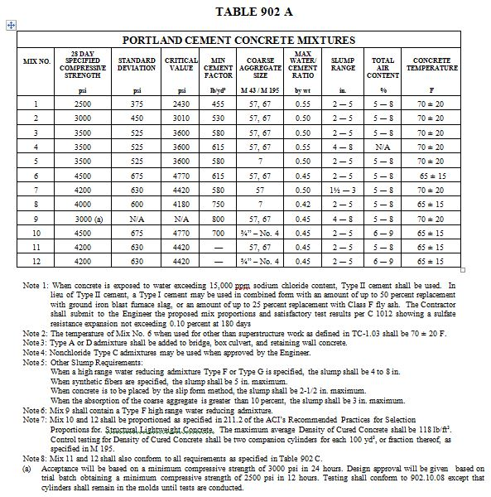

Slide 40
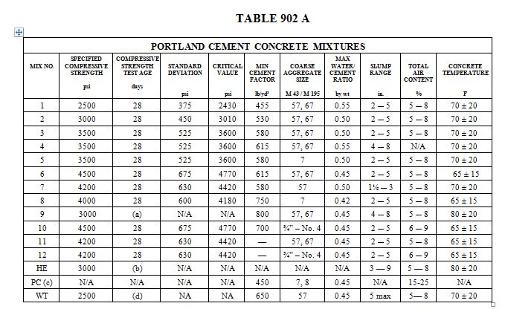
Proposed 902 A Table

Slide 41
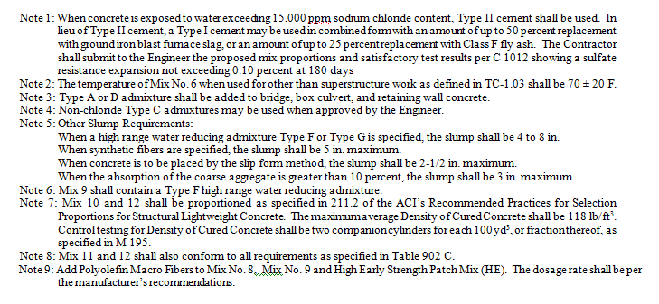

Slide 42
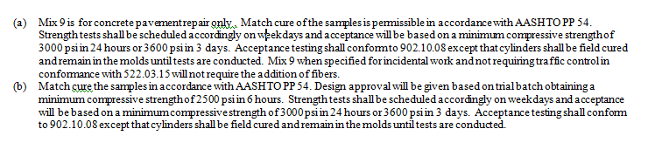


Slide 43
915 Plants
Updated to include precast/prestressed along with Ready Mix plants.
One of the biggest changes is to allow plants to have the option of using National Ready Mixed Concrete Association (NRMCA) to perform their annual plant inspection.
Notes:
Proportioning pervious concrete is a little different compared to conventional concrete.
Pervious mixture proportions are somewhat less forgiving than conventional concrete mixtures.
When developing pervious concrete mixtures, the goal is to obtain a target and design void content that will allow for the infiltration of water. Pervious concrete is typically designed for a void content in the range of 15% to 30%.
Infiltration is influenced by Void Content, and Void Content is influenced by:
Aggregate Gradation
Water Cement Ratio
Compaction Effort during construction
At times, when proportioning pervious concrete; even though the design void content maybe 20%, after the mixture is proportioned, the experimentally measured void content may be considerably different.
For reasons such as those mentioned, it is even more important to verify Pervious Concrete mixtures through trial batches to achieve the characteristics assumed or targeted when developing mixture proportions

Slide 44
What else is new?
More tools in our tool box!!!
New spec book is coming soon… possibly by the end of the year!
Notes:
Proportioning pervious concrete is a little different compared to conventional concrete.
Pervious mixture proportions are somewhat less forgiving than conventional concrete mixtures.
When developing pervious concrete mixtures, the goal is to obtain a target and design void content that will allow for the infiltration of water. Pervious concrete is typically designed for a void content in the range of 15% to 30%.
Infiltration is influenced by Void Content, and Void Content is influenced by:
Aggregate Gradation
Water Cement Ratio
Compaction Effort during construction
At times, when proportioning pervious concrete; even though the design void content maybe 20%, after the mixture is proportioned, the experimentally measured void content may be considerably different.
For reasons such as those mentioned, it is even more important to verify Pervious Concrete mixtures through trial batches to achieve the characteristics assumed or targeted when developing mixture proportions

Slide 45
Questions?
Thank you!
Notes:
Proportioning pervious concrete is a little different compared to conventional concrete.
Pervious mixture proportions are somewhat less forgiving than conventional concrete mixtures.
When developing pervious concrete mixtures, the goal is to obtain a target and design void content that will allow for the infiltration of water. Pervious concrete is typically designed for a void content in the range of 15% to 30%.
Infiltration is influenced by Void Content, and Void Content is influenced by:
Aggregate Gradation
Water Cement Ratio
Compaction Effort during construction
At times, when proportioning pervious concrete; even though the design void content maybe 20%, after the mixture is proportioned, the experimentally measured void content may be considerably different.
For reasons such as those mentioned, it is even more important to verify Pervious Concrete mixtures through trial batches to achieve the characteristics assumed or targeted when developing mixture proportions

