Slide 1

Boosting Resilience
Annual Maryland Concrete Conference
March. 10, 2020
Hunt Valley, MD
Gina Ahlstrom
Office of Preconstruction, Construction, and Pavements

Slide 2
Environmental Impacts on Pavements
Environmental Factors Contribute to Pavement Distresses - blowups, buckling, rutting, thermal cracking
Long-Term Pavement Performance Program Impact of Environmental Factors on Pavement Performance*
24% of total damage for rigid pavements
Pavements designed using climatic data
However, engineers typically assume stationarity
*www.fhwa.dot.gov/publications/research/infrastructure/pavements/ltpp/16078/16078.pdf

Slide 3
Potential Consequences with Assuming Stationarity for Rigid Pavements
Higher Average
Temperature
Increased potential for concrete temperature-related curling and moisture warping
Higher Extreme Temperatures
Increased risk of concrete pavement “blow ups” due to excessive slab expansion.
Wetter Winters and Drier Summers
Increase risk of concrete saturating during critical freezing cycles and increased deicer use
Impacts concrete curing during construction and thus good curing practices must be followed
https://www.fhwa.dot.gov/pavement/sustainability/hif15015.pdf

Slide 4
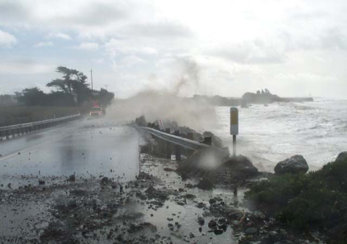
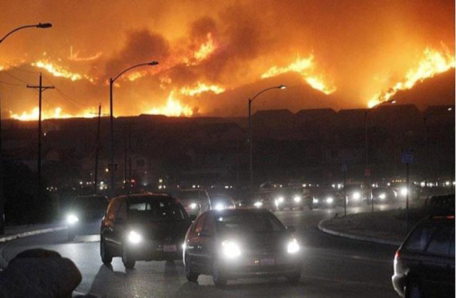
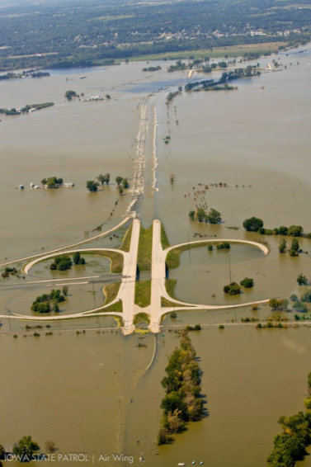
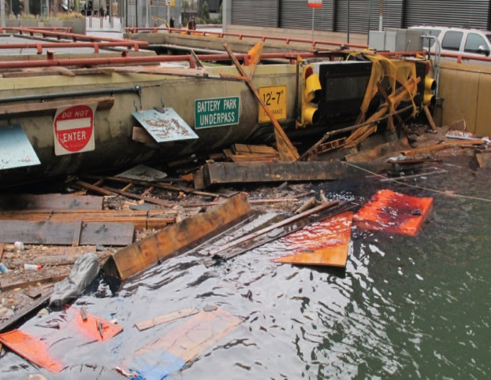
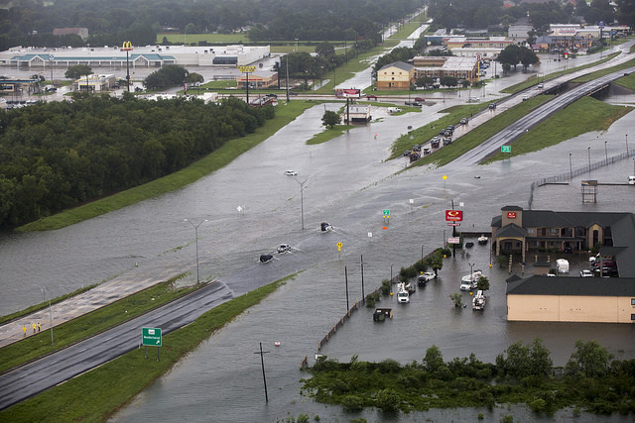
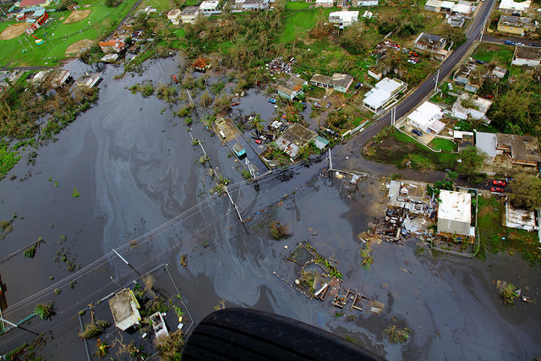
What Is Resilience?
Resilience: the ability to anticipate, prepare for, and adapt to changing conditions and withstand, respond to, and recover rapidly from disruptions (FHWA Order 5520)
Photo credit: CalTrans
Photo credit: CO DOT
Photo credit: Iowa State Patrol
Photo credit: NYCDOT
Photo credit: US CBP
Photo credit: US CBP

Slide 5
Presentation Key Takeaways
FHWA approach
Tools & Resources
Application to Pavements

Slide 6
Program and Policies
FHWA Resilience

Slide 7
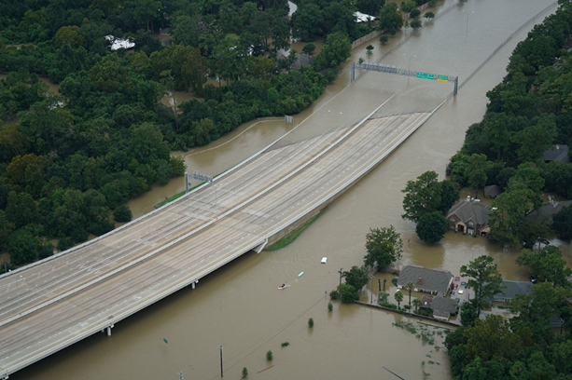
Extreme Weather Resilience Policy
USDOT FY 2018-22 Strategic Plan: “DOT will increase its effectiveness in ensuring that infrastructure is resilient enough to withstand extreme weather”
FHWA Order 5520 commits FHWA to integrating extreme weather risk consideration into programs
Extreme weather resilience eligible for FHWA funds
Flooding from Harvey, Credit TTI

Slide 8
Extreme Weather Resilience-Related Regulations
Risk-based asset management plans must address risks associated with current and future environmental conditions (23 CFR 515)
Assets requiring repeated repair require evaluation of alternatives (23 CFR 667)
State and metropolitan transportation planning should now include resilience as a planning factor (23 USC 134, 23 CFR 450)
Metropolitan transportation plans shall include an assessment of capital investment and other strategies to… reduce the vulnerability of the existing transportation infrastructure to natural disasters (23 CFR 450.324(f)(7))

Slide 9
Approaches to Incorporating Resilience in Asset Management
Include resilience focus in two sections of required State Transportation Asset Management Plans (TAMPs):
Risk management plan: identifies at a minimum risks associated with current and future environmental conditions, extreme weather events, etc. (23 CFR Part 515.7(c))
Life-cycle planning: should include a range of factors that could affect whole life cost of assets, including current and future environmental conditions, extreme weather events, etc. (23 CFR Part 515.7(b))
First TAMPs completed June 2019

Slide 10
Integrating Resilience
Goal: Integrate consideration of resilience in transportation decision making
In support of 23 U.S.C. § 503(b)(3)(B)(viii), which directs the U.S. Department of Transportation “to carry out research and development activities … to study vulnerabilities of the transportation system to … extreme events and methods to reduce those vulnerabilities.”
Planning
Long Range Transportation Plans
Project Level
Environmental Processes
Operations and Maintenance
Asset Management Plans
Engineering
Design
Emergency Response
Credit: WSDOT
Photo credit: CO DOT
Photo credit: DEL DOT

Slide 11
Integrating Resiliency – Planning & Operations Level Resources
Planning
Handbook to Integrating Resilience into the Transportation Planning Process (Spring 2020)
Identify, evaluate, and adopt strategies to address vulnerabilities
Asset Management
Guidebook on addressing resilience in Asset Management (Summer 2020)
Culverts, Bridges, Pavements
Emergency Relief
FHWA Emergency Relief Manual & ER and Resilience FAQ. ER funds can be used to improve resilience when repairing/rebuilding damaged highway: (1) Bring up to current standard (2) Cost-effective betterment (would save FHWA ER program money over time)

Slide 12
Integrating Resiliency – Project Level Resources
Tools
Vulnerability Assessment Framework
Adaptation Decision-Making Assessment Process
Adaptation for Pavements Tech Brief
Technical Guidance for Pavements
Coupled Model Intercomparison Project (CMIP) Climate Data Processing Tool
Case Studies
Transportation Engineering Approaches to Climate Resiliency (TEACR)
TEACR Synthesis Report

Slide 13
Tools
FHWA Resilience

Slide 14
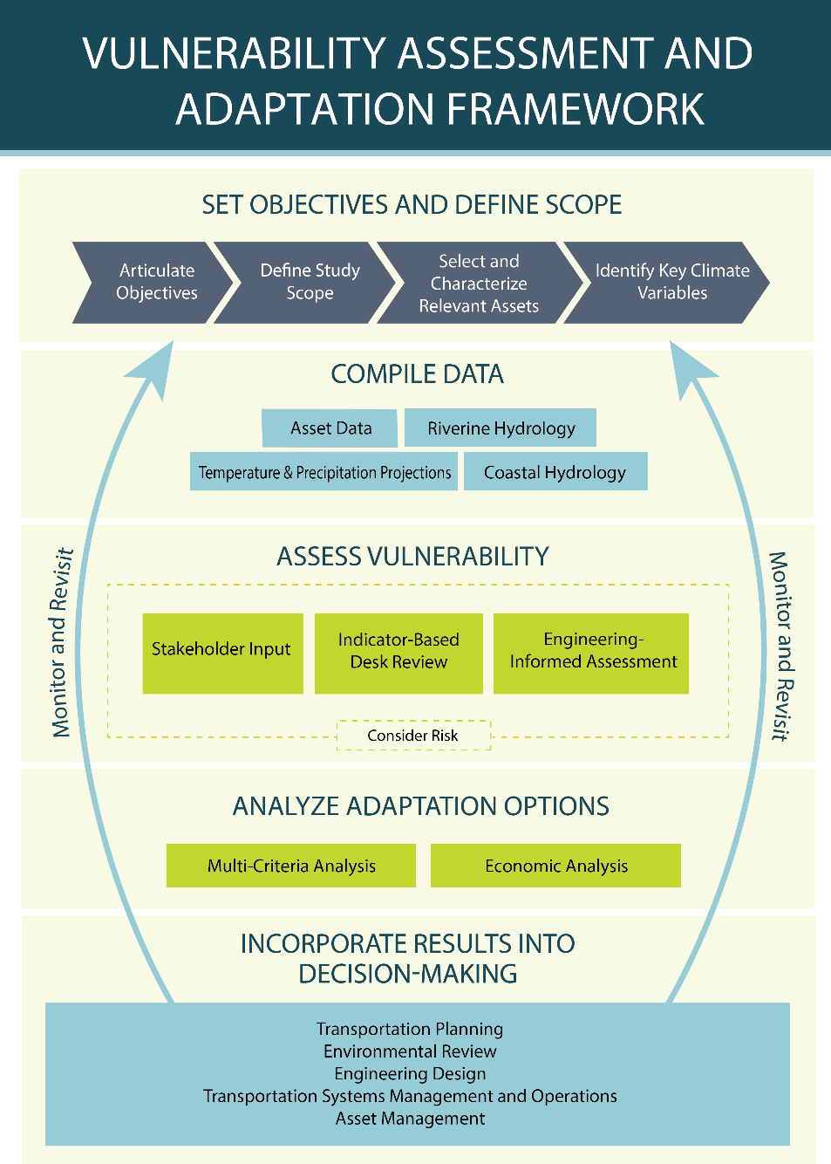
Vulnerability Assessment & Adaptation Framework
Provides an in-depth and structured process for conducting a vulnerability assessment.
Features examples from assessments conducted nationwide.
Includes links and references to related resources and tools.
Vulnerability Assessment Scoring Tool
Downscaling tool
Image: FHWA

Slide 15
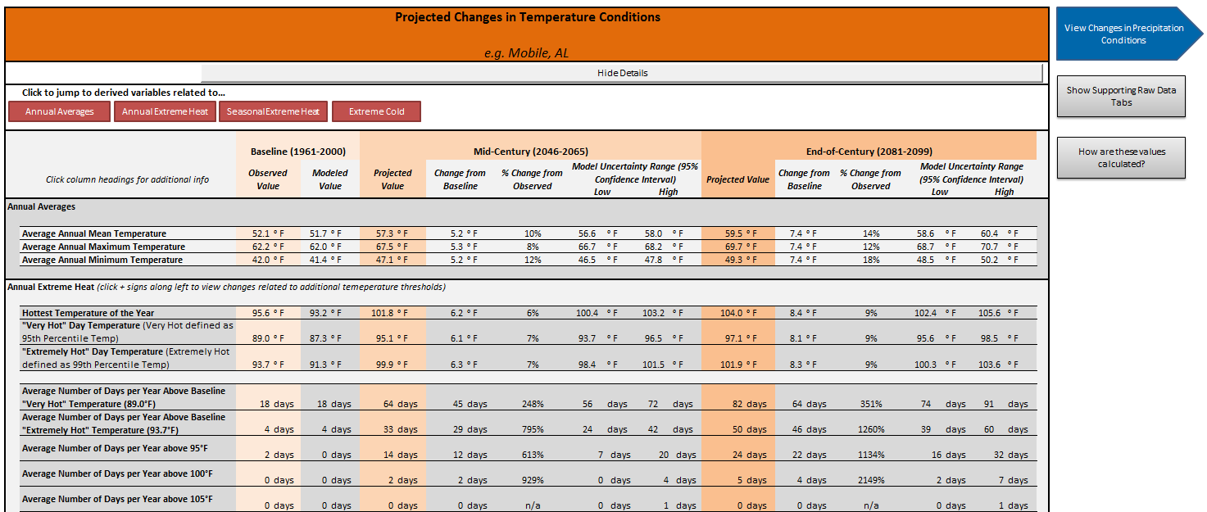
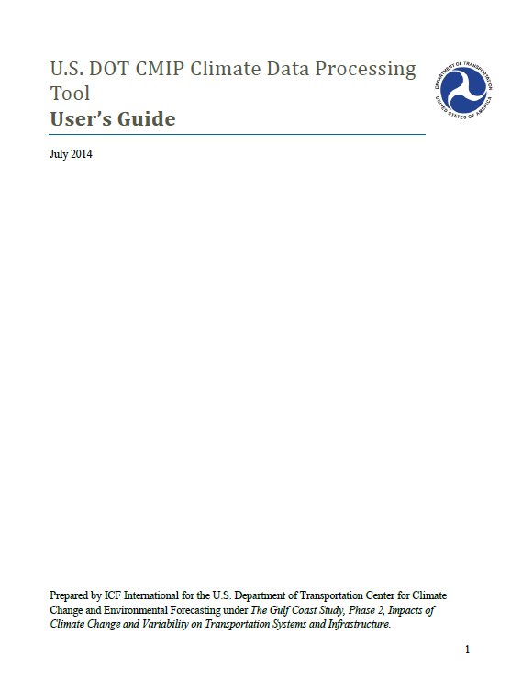
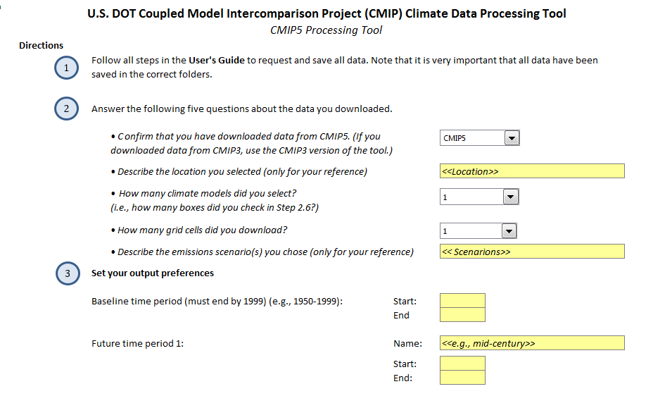
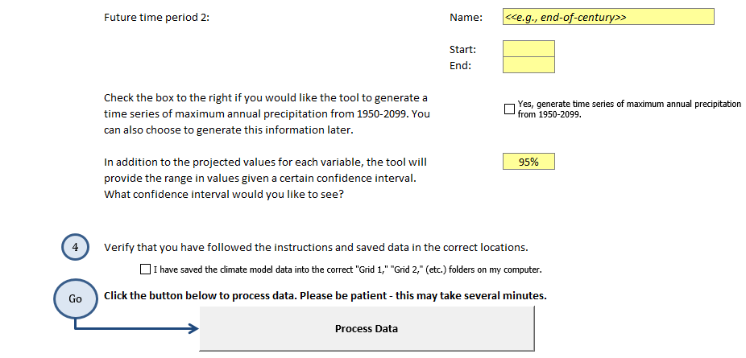
CMIP Climate Data Processing Tool

Slide 16
Engineering-informed Adaptation Study Process (ADAP)
Understand the site context
Document Existing or Future Base Case Facility
Identify Climate Stressors
Develop Climate Scenarios
Assess Performance of the Facility
Develop Adaptation Option(s)
Assess Performance of the Adaptation Options
Conduct an Economic Analysis
Evaluate additional decision-making considerations
Select a course of action
Develop a Facility Management Plan
Understand site context, future conditions
Test asset against future scenarios
Develop, Evaluate, select adaptation options
Review additional considerations
Monitor and revisit

Slide 17
Application to Pavements
FHWA Resilience

Slide 18
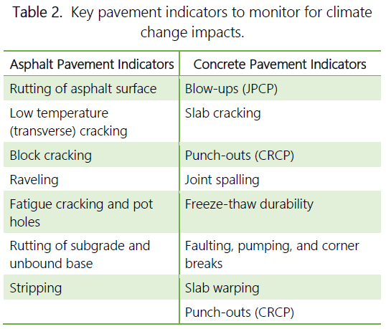

Pavement Adaptation Strategies: 1. Monitor Trends
Most predicted changes to environmental variables are projected to occur relatively slowly in relation to a typical pavement lifecycle
https://www.fhwa.dot.gov/pavement/sustainability/hif15015.pdf

Slide 19
When Trends Differ: 2. Evaluate Vulnerability
Objective
Identify if pavement assets are more vulnerable than other system assets
Prioritize potential vulnerabilities for system
Approach
Use Vulnerability Assessment Scoring Tool
Input local asset data
Output relative vulnerability score per asset

Slide 20
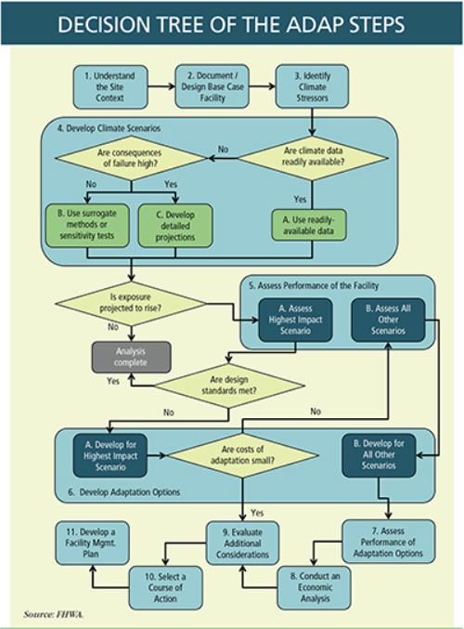
3. Plan and Design Infrastructure to Meet Future Conditions
Adaptation Decision-Making Assessment Process (ADAP)
Risk-based approach for planners, designers, or engineers
Tailored to state
Aids decisionmakers in determining which project alternative best (life cycle costs, resilience, regulatory and political settings)
www.fhwa.dot.gov/environment/sustainability/resilience/tools

Slide 21
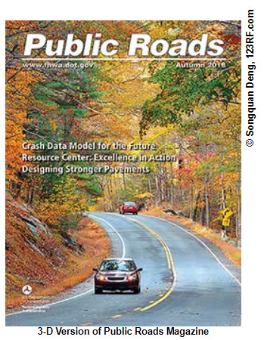
More Information
Adaptation for Pavements Tech Brief
www.fhwa.dot.gov/pavement/sustainability/hif15015.pdf
https://www.fhwa.dot.gov/publications/publicroads/19autumn/index.cfm

Slide 22
Case studies
FHWA Resilience

Slide 23
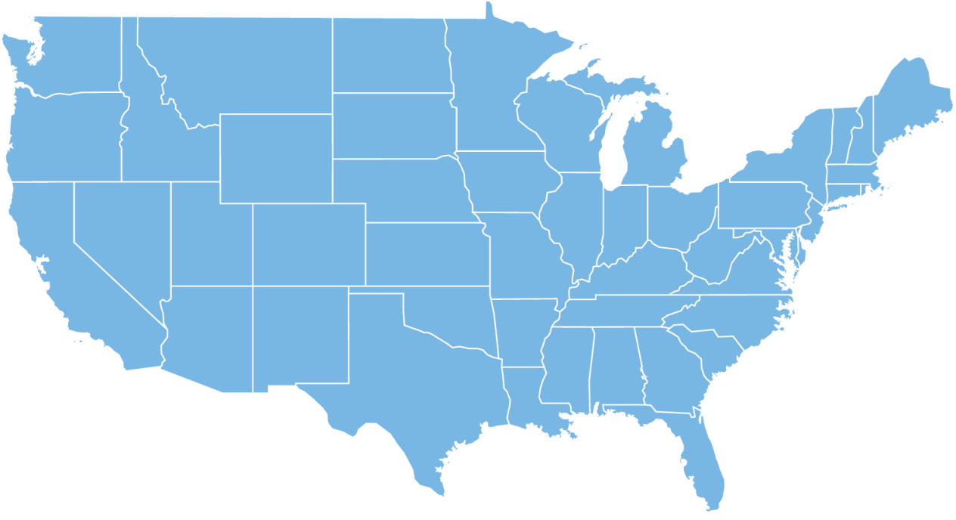

Approaches to Integrating Resilience in Project Design
Engineering-Focused Case Studies
Gulf Coast 2 Study
Adaptation Pilots
Post-Sandy Resiliency Study
Transportation Engineering Approaches to Climate Resiliency (TEACR)

Slide 24
Pavements: Adaptation Case Studies
Study Name | Location | Stressor(s) Studied
TEACR Pavement Shrink-Swell | State Highway 170, near Dallas, Texas | Temperature, precipitation
TEACR Pavement Freeze-Thaw | St. Rte. 6/ St. Rte. 15/ St. Rte. 16, Guilford, Piscataquis County, Maine | Temperature, precipitation
GC2 Pavement | Mobile, Alabama | Temperature
WFLHD/Alaska DOT&PF Pilot | Dalton Highway Mile Post (MP) 9 to MP 11, Alaska | Temperature, precipitation
TEACR Slope Stability | I-77, MP 1.8 to MP 6.3, Carroll Co. Virginia | Precipitation, temperature

Slide 25
Texas SH 170 – Case Study
Study Focus
Evaluate temperature and precipitation affect on pavement performance.
Project Scope
Dallas, Texas – area expansive soils
Proposed project – new construction
Approach
Estimated pavement performance using mechanistic empirical pavement performance prediction models
Used projected climate data for temperature and precipitation

Slide 26
SH 170 – Future Temperature Changes
20-Year Moving Average of Annual Mean Temperature at Fort Worth, Texas
Increase in annual mean temperature by 4 to 6°F for RCPs 4.5 and 6.0 and by 9 to 10°F for RCP 8.5

Slide 27
SH 170 – Future Moisture Changes
20-Year Moving Average of Thornthwaite Moisture Index at Fort Worth, Texas
Annual TMI will decrease to -18 by 2099 for RCPs 4.5 and 6.0 and -30 for RCP 8.5

Slide 28
SH 170 – Impacts to Rigid Pavements
Drying Shrinkage
Increase 2.5% per 1% decrease in ambient relative humidity
Warping Stresses
No difference
Curling Stresses
Accelerated by increasing ambient temperature
Ambient temperature increases expected to increase temperature gradient
Increased curling, 1% increased strains per 1°F increase in temperature
Crack Width
6% increase due to 3.7% decrease in relative humidity and 3.1°F increase in annual mean air temperature
Higher steel in Continuously Reinforced Concrete Pavements will be required

Slide 29

SH 170 – Lessons Learned
Increasing temperature and aridity will affect material properties
Drying of soils – increased subgrade support
Shrinkage in concrete – increased crack width
Study Limitations:
Effect of soil shrink/swell on pavement roughness
Shrinkage cracking in concrete due to drying
Vegetation-induced cracking due to arid weather
More Resilient Pavements Strategies Exist
Not major cost increase

Slide 30
Current Efforts
FHWA Pavement Resilience

Slide 31

Sustainable Pavements Road Map
What are the current gaps and future needs?
Tools to incorporate more
sustainable practices into pavement design process
➔Pavement Resiliency Guidelines
https://www.fhwa.dot.gov/pavement/sustainability/hif17029.pdf
31

Slide 32
Pavement Resiliency Workshops
Joint Project with Office of Planning, Environment, & Realty
Project Duration: 2018-2021
Literature Review & Gap Analysis
Spring 2020, Fall 2020 Workshop
Guidebook: Summary Best Practices (2021)

Slide 33
Pavement Resiliency Workshops
Educate Pavement Engineers on Resiliency
Identify Specific Approaches for More Resilient Pavements
Document State of Knowledge
Scope limited to pavements but must connect to broader issue
Other critical assets
Reference Non-Pavement Specific Strategies

Slide 34
Other Pavement Resiliency Efforts
World Road Association, PIARC
2020-2023 Strategic Plan
TC 4.1 Resilient Infrastructure – Pavements
National Highway Institute (NHI) Course
Pavement Element
12 International Conference on Concrete Pavements, International Society for Concrete Pavements
Aug. 30-Sept. 3, 2020, Minneapolis, MN
Workshop on Resiliency

Slide 35
Other Ongoing Projects
Incorporating Resilience into the Transportation Planning Process Case Studies and Guidebook
Integrating Resilience into the Transportation Planning Process-White Paper on Literature Review Findings
Nature-based Resilience for Coastal Highways Guidebook
White Paper: Nature-based Solutions for Coastal Highway Resilience
Asset Management, Extreme Weather, and Proxy Indicators Pilot Projects and Guidebook
HEC-25 update
CMIP Climate Data Processing Tool update

Slide 36
How Can You Help?
Encourage Agencies to Consider Resiliency in Planning, Designs, and Operations
Reference, Follow, & Help Disseminate FHWA Resiliency Resources
Case Studies
Vulnerability Assessment
Adaptation Decision-Making Assessment Process
Continue Research

Slide 37
Contact Information
Gina Ahlstrom
Preconstruction, Construction, & Pavements gina.ahlstrom@dot.gov
Heather Dylla Preconstruction, Construction, & Pavements heather.dylla@dot.gov
http:www.fhwa.dot.gov/pavement/sustainability

