Slide 1

The Successes and Challenges of Delivering a P3 – The Purple Line – Maryland’s New Light Rail System
March 10, 2020

Slide 2
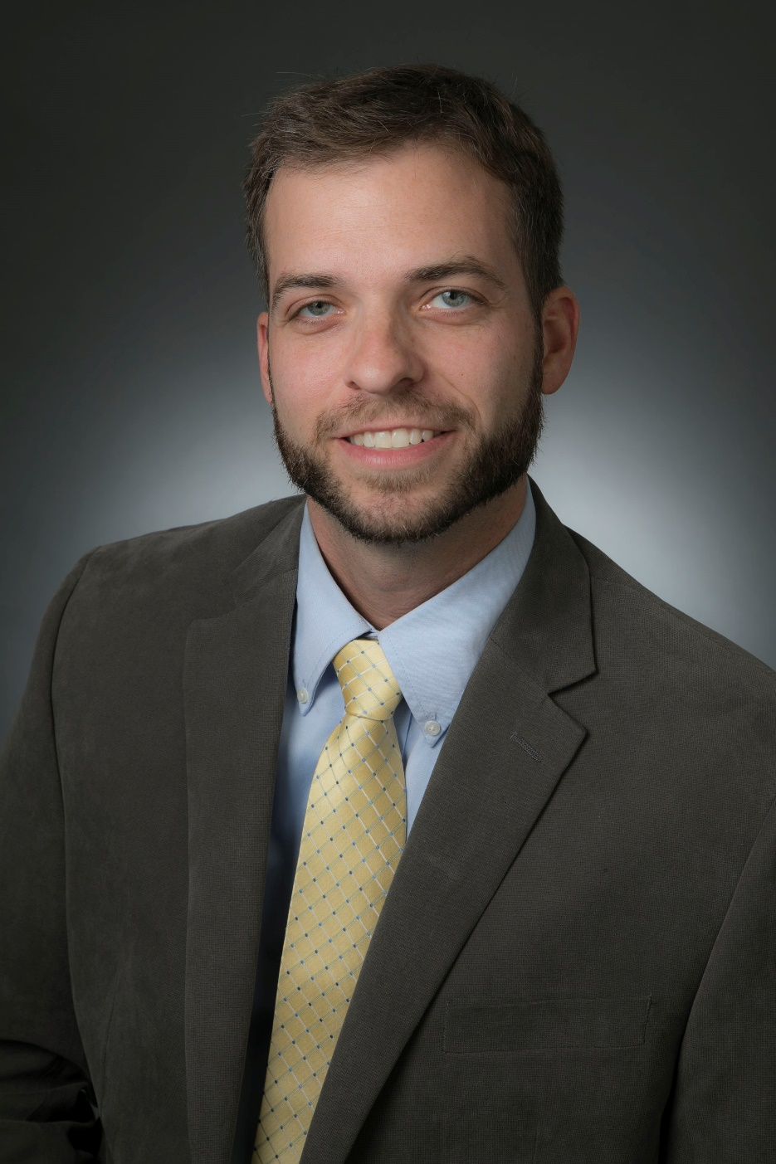
PRESENTER
Kevin Oberheim, PE, CCM
PMC Construction Manager
Maryland Transit Administration/Program Management Consultant
Project Manager, RK&K

Slide 3
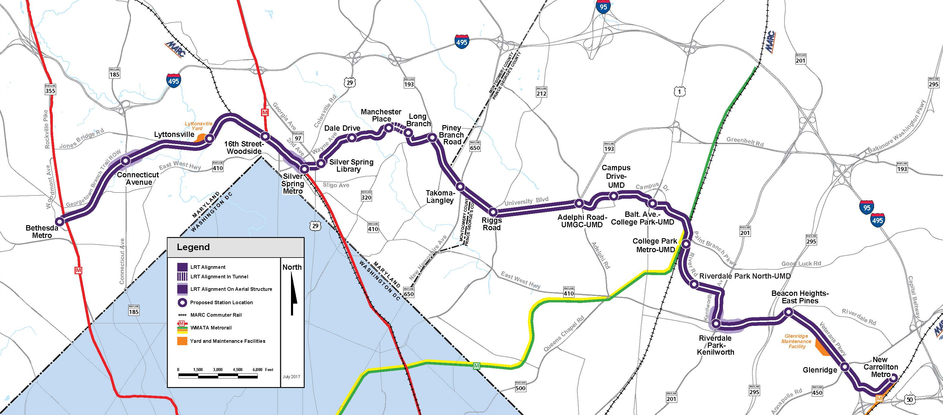
WHAT IS THE PURPLE LINE?
Bethesda, MD
New Carrollton, MD
16.2 Miles
(Measured along Alignment)

Slide 4
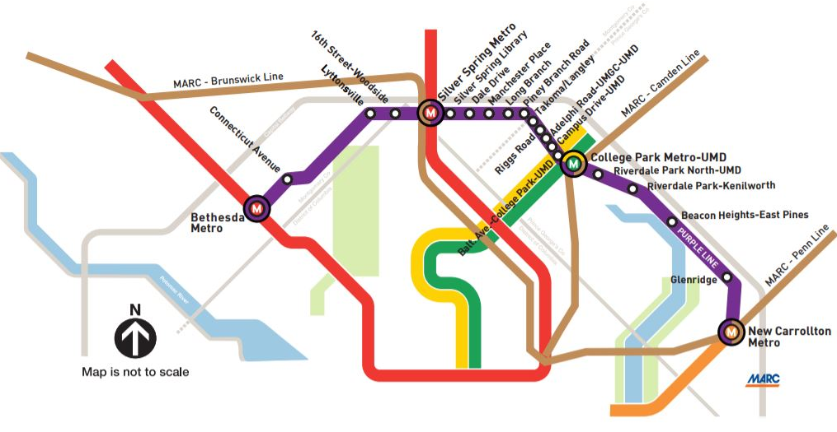
THE GREAT CONNECTOR
The Purple Line will connect:
  4 Metrorail Stations
  All 3 MARC Lines
  Amtrak’s NE Corridor
  Multiple local and regional bus services
  Region’s largest transit centers
  MD’s flagship university – 5 stations
    Adelphi Road UMGC – UMD
    Campus Drive – UMD
    Balt. Ave. College Park – UMD
    College Park Metro – UMD
    Riverdale Park North – UMD

Slide 5






PROJECT SCALE
32
26
18
>10
33
>250
Miles of Track
Miles of
Drainage Construction
Miles of Water/Sewer/ Gas Utility Relocations
Miles of New Bike Lanes
& Trails
Bridges
Walls

Slide 6
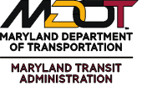
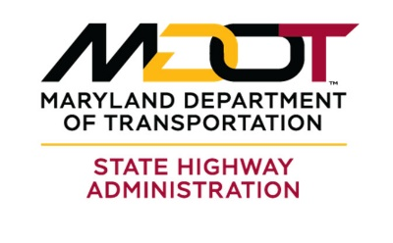
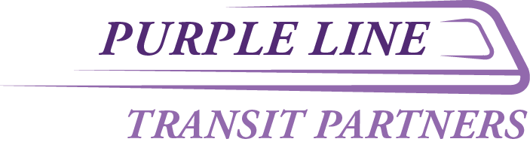



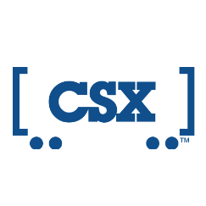
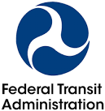
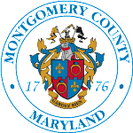








KEY PROJECT PARTICIPANTS
Key Stakeholders Include:
MDOT SHA
University of Maryland
Montgomery County
Prince George’s County
WMATA
CSXT
Utility Companies (17+)

Slide 7
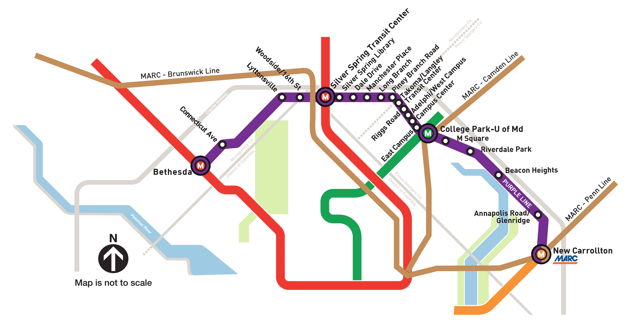
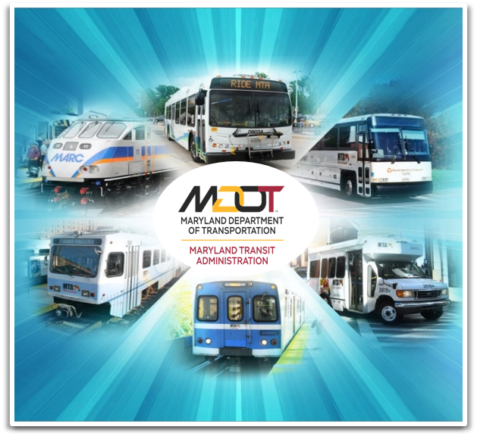
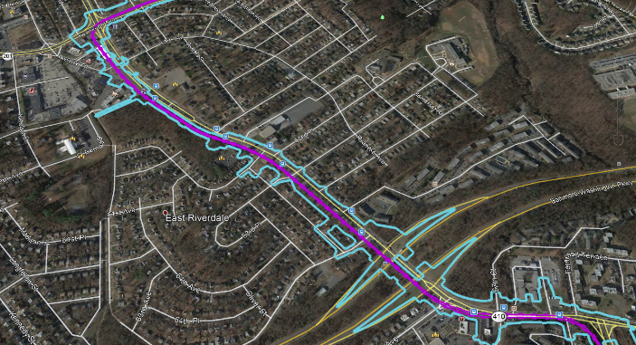
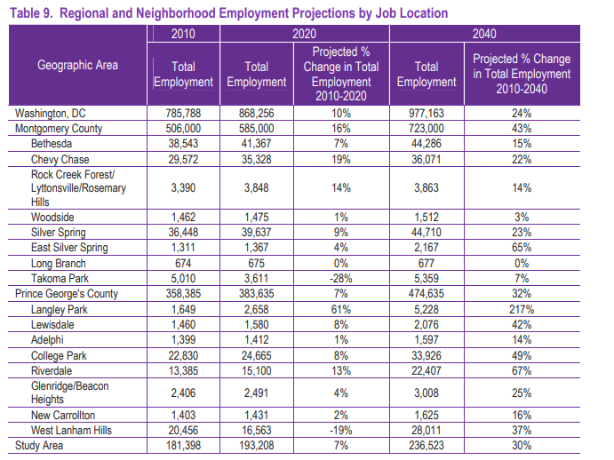
PROJECT PURPOSE AND NEED
Reliable & Rapid East-West Transit
Relief for Bus Services
Access to Metro System
Changing Land Uses & Job Growth

Slide 8
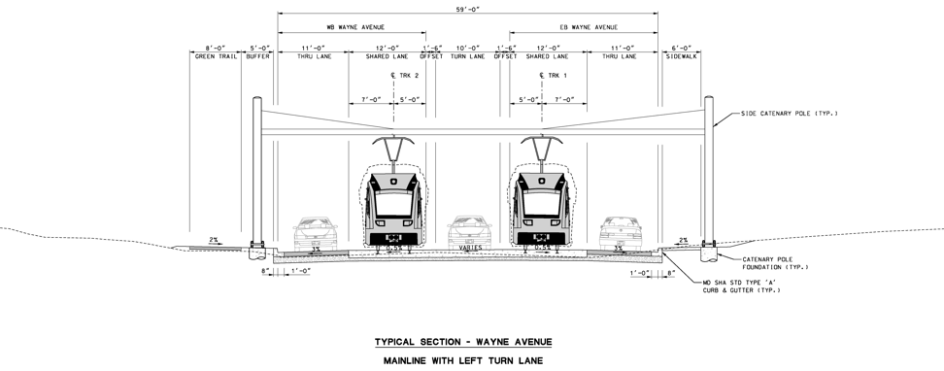
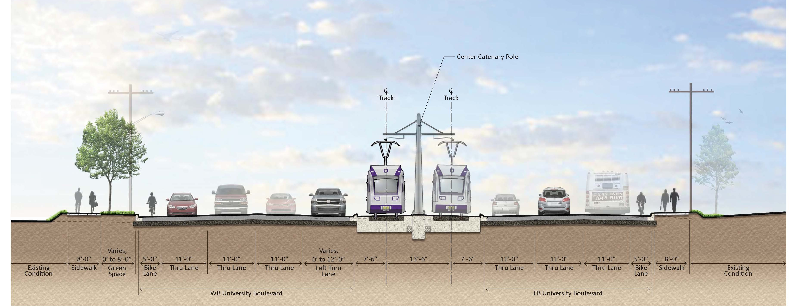
LIGHT RAIL SYSTEM

Slide 9



PROJECT CHARACTERISTICS
Headways
  Peak: 7 ½ minutes
  Off-Peak: 10-15 minutes
Service
  Similar to Metrorail hours
  ≈ 30% of riders to use Metro
  Just over an hour
  Short trips vs end to end ridership
Daily Riders
  Year 2030 → 69,000
  Year 2040 → 74,000

Slide 10
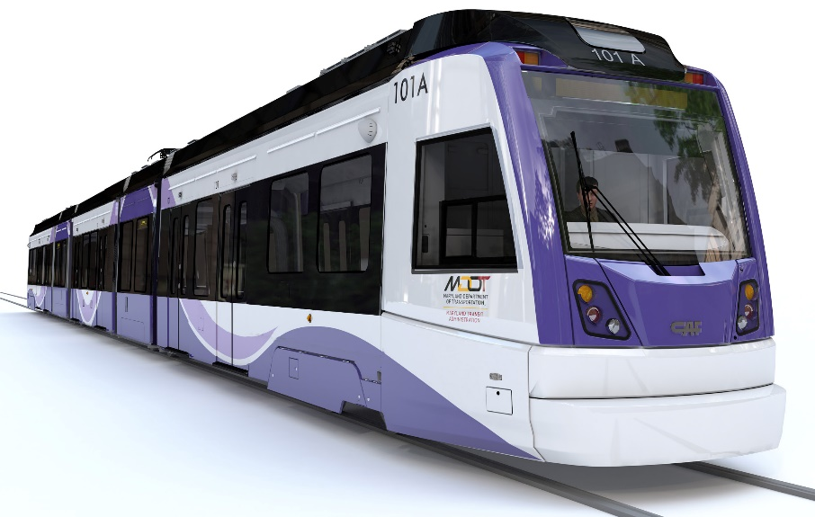
PUBLIC PRIVATE PARTNERSHIP (P3) AGREEMENT – DELIVERY MODEL

Slide 11
CONTEXT – SOME OF THE CHALLENGES
MTA already operates rail lines, but…
  MTA’s first rail service in the Washington region
    More than 30 miles from core service area of Baltimore
  Largest project in MTA history
  MTA hasn’t constructed a new rail line in more than 20 years
    Rail construction, integration, and startup is challenging
Dense corridor with 800+ utility relocations, 600+ property acquisitions
Extensive third-party coordination required
  MOAs with 17 utility companies, 2 counties, WMATA, UMD-College Park, CSX
Sophisticated stakeholders and communities with high expectations

Slide 12
MDOT MTA’S PURPLE LINE DELIVERY APPROACH: DBFOM P3
Combines the design, construction, financing, operations and maintenance into one umbrella contract with a “concessionaire”
  6 year design & construction + 30 year O&M period
  Shares risk between MTA and the Concessionaire
  Based on performance standards, not detailed specifications
  “Pay for performance” – Payments linked to availability & outcomes
  30-year handback provisions protect long-term public interest
Status: P3 contract awarded 2016; Construction began summer 2017, approximately 25% complete to date
First Light Rail Vehicles (LRV) being tested at CAF facility in Elmira, NY

Slide 13
OVERVIEW OF PURPLE LINE P3 STRUCTURE
Approach: Design-Build-Finance-Operate-Maintain (DBFOM) Public-Private Partnership (P3) Concession with Availability Payments (APs)
Design & Construction
O&M and Capital Renewal
  6 Years
  Concessionaire responsible for final design, construction of Purple Line and some 3rd party improvements and financing the project (in part using public funding contributions)
  MTA (“Owner”) responsible for right-of- way acquisition, public outreach and quality assurance oversight
  30-Year Period
  Concessionaire responsible for operations, maintenance, and capital renewal/replacement; asset handback requirements at end of P3 term
  MTA (“Owner”) responsible for fare policy, specification of minimum amount of service, ridership & fare revenue risk, electricity costs, and policing

Slide 14
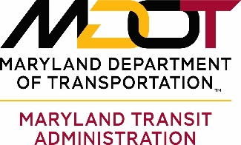




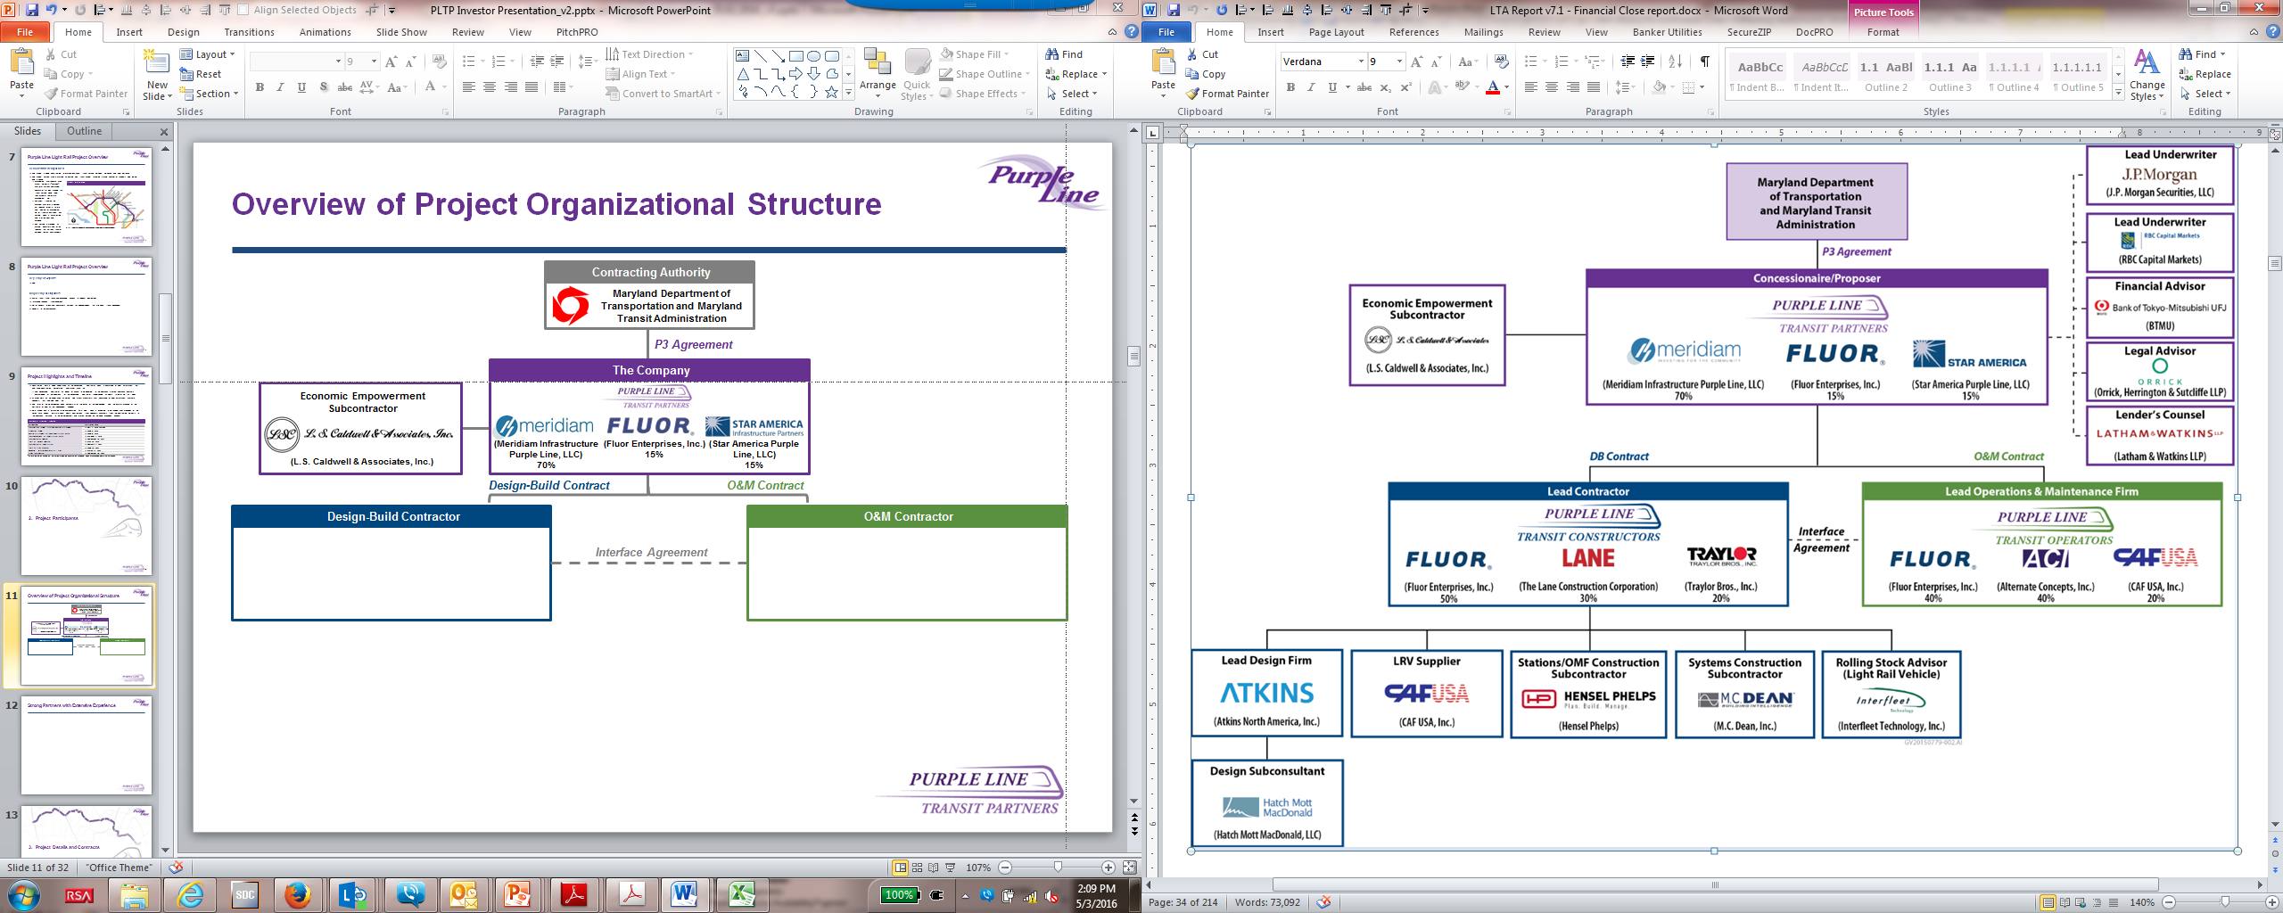


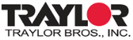



CONTRACTING STRUCTURE
Contracting Authority
P3 Agreement and Performance Specifications
Lenders
The Company and Equity Investors
PLTP PAB Holders
TIFIA
Loans
(Meridiam Infrastructure
Purple Line, LLC)
70%
(Fluor Enterprises, Inc.)
15%
(Star America Purple
Line, LLC)
15%
Design-Build Contract
O&M Contract
Design-Build Contractor
O&M Contractor
Interface Agreement
(Fluor Enterprises, Inc.)
50%
(The Lane Construction
Corporation)
30%
(Traylor Bros., Inc.)
20%
(Fluor Enterprises, Inc.)
40%
(Alternate
Concepts, Inc.)
40%
(CAF USA, Inc.)
20%

Slide 15
REAL ESTATE ACQUISITIONS

Slide 16
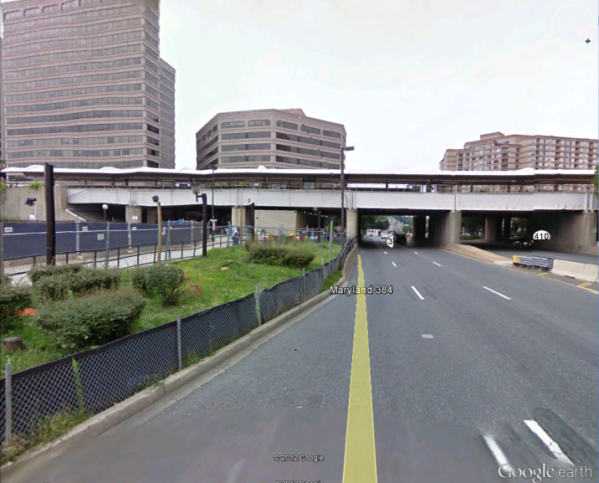
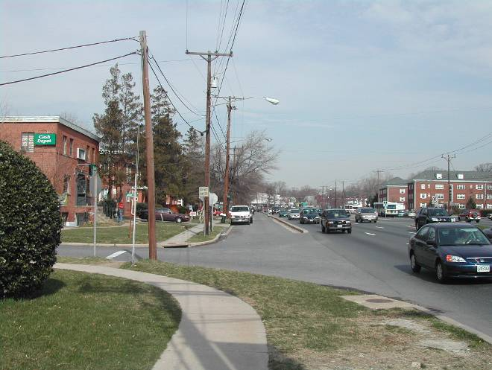
PURPLE LINE CORRIDOR
Developed urban/suburban corridor
Mix of residential and commercial areas
Purple Line would generally operate on or adjacent to existing streets
West segment former B&O railroad corridor

Slide 17
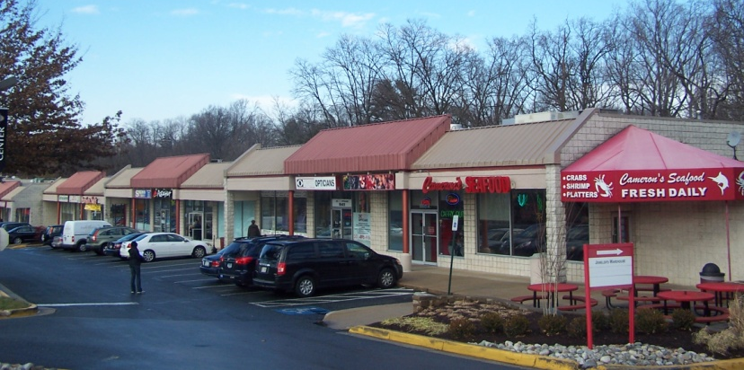
PROPERTY ACQUISITION CHALLENGES
Large Number of Acquisitions
Long Term Construction
Acquisitions at 30% Design
Project Schedule and MTA Risk
Lack of Quick-Take Condemnation
Railroad Property Acquisition
Team Organization
MD 384/Colesville Road
View of CSX railroad bridge
16th Street Shopping Center

Slide 18
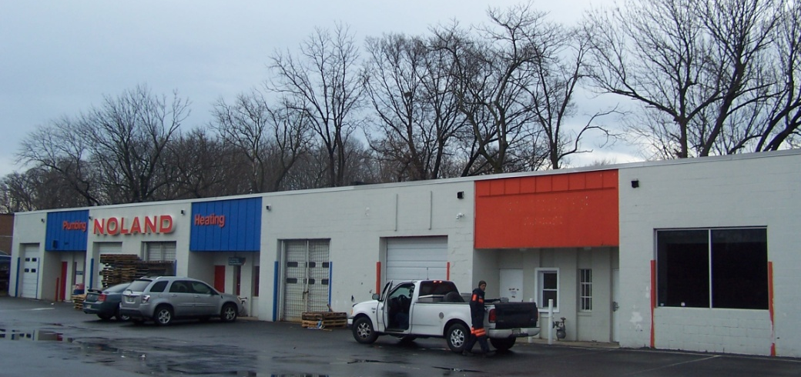
PURPLE LINE ACQUISITIONS
Over 600 properties impacted by the Purple Line requiring acquisitions totaling approximately 86 acres.
Partial Acquisitions: 82%
Full Acquisitions: 18%
85% of Purple Line acquisitions located adjacent to State-owned Right of Way
Total Acquisitions include:
  Gas Stations
  Apartment Units
  Strip Retail Centers
  Office Properties
  Single Family Dwellings
Business Acquisitions at Brookville Road

Slide 19
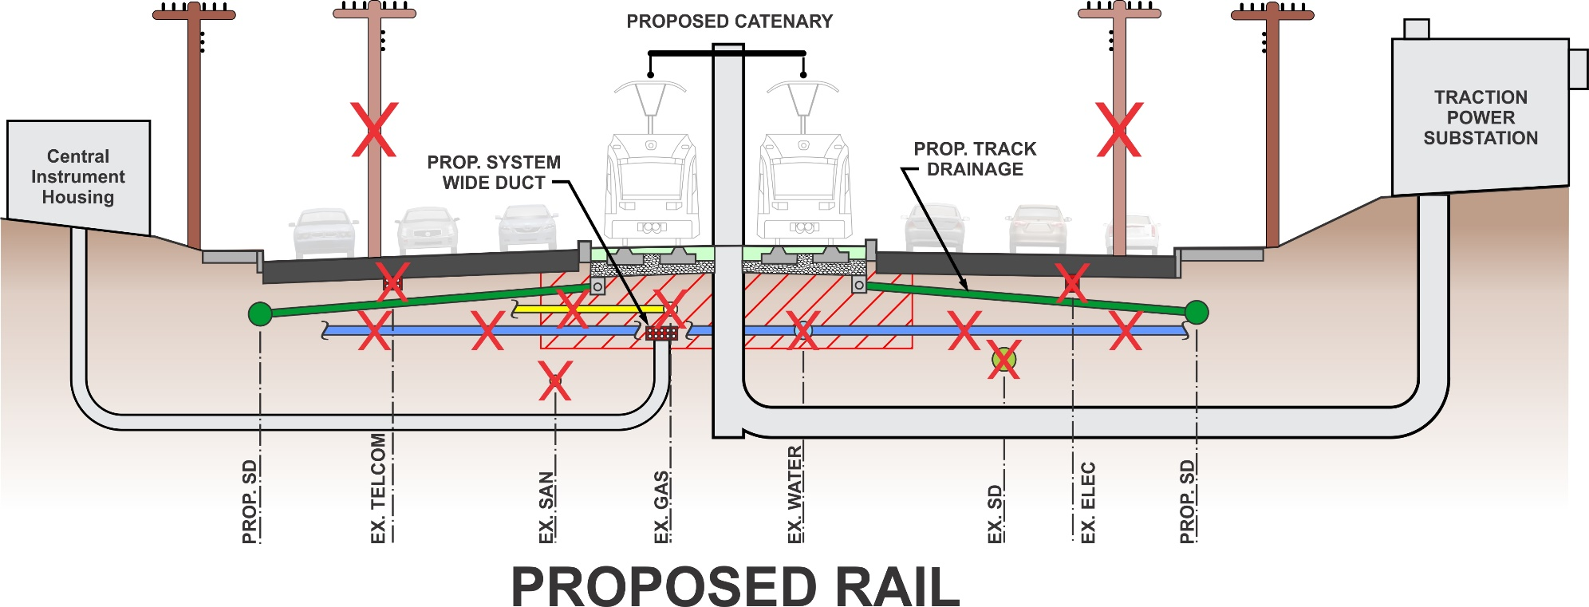
UTILITY RELOCATIONS

Slide 20
CONSTRUCTION & PROJECT HIGHLIGHTS

Slide 21
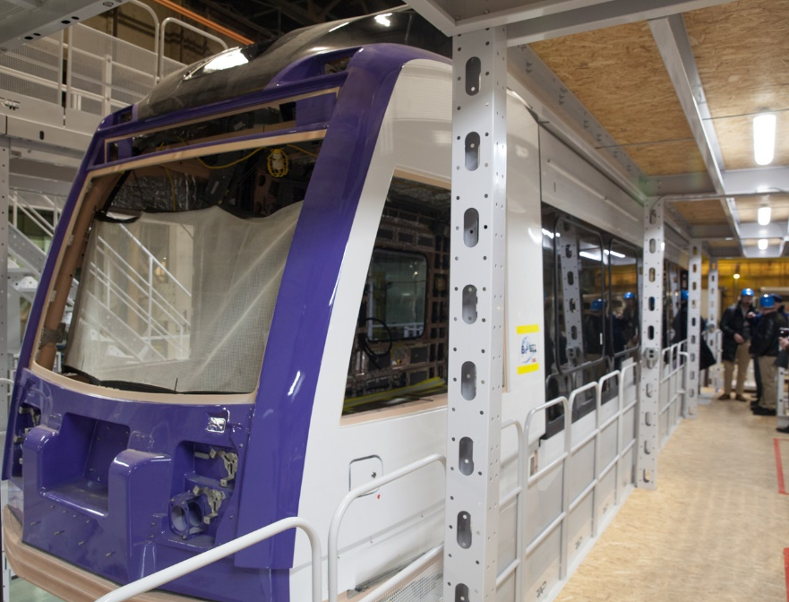
PROJECT STATUS UPDATE
Construction is underway throughout the 16.2 mile corridor
Approximately 15 of 16 miles are under construction
  Design: 95% complete
  Construction: 25% complete
Right-of-way acquisitions are complete
Utility relocations underway along entire alignment
LRV Update:
  68 carshells (13 carsets, working on 14th) complete
  33 carshells have been painted
  LRV #1 and #2 are undergoing static and dynamic testing in Elmira, NY
Community Outreach – key element of the project
Art-in-Transit

Slide 22
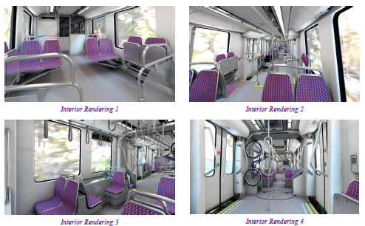
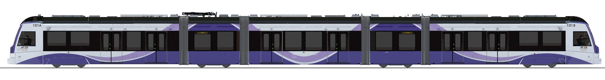
LIGHT RAIL VEHICLE (LRV)
Quiet and modern, vehicles are 5 modules each spanning a total of 140 feet long (longest in the USA)
80 seats are provided
80% low floor and wide doorways specifically designed to meet ADA requirements
Eight wheelchairs and eight bicycles can be accommodated on board simultaneously
Comfortable, well-lit interiors

Slide 23
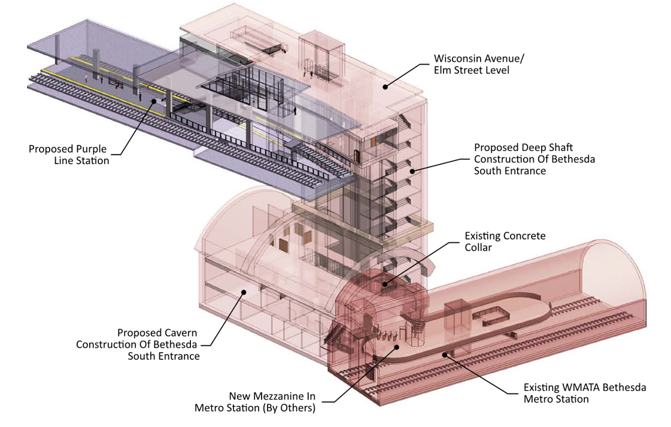
CONSTRUCTION HIGHLIGHT – BETHESDA
The Bethesda Shaft (elevator) & Bethesda Purple Line Station:
Connects two transit systems – Purple Line and
WMATA’s Red Line
Adds (6) high speed elevators for Red Line
Connects to the new mixed use tower currently
under construction
Construction Challenges:
  Depth of shaft is currently greater than 100 feet
  (31m), concrete lining is being placed
  Complex Support of Excavation (SOE) System due to existing geotechnical conditions and WMATA requirements
  – strut and waler system
  Multi-lift concrete liner
  Complex work zone – WMATA, Purple Line, & Carr Properties all sharing the same work zone

Slide 24
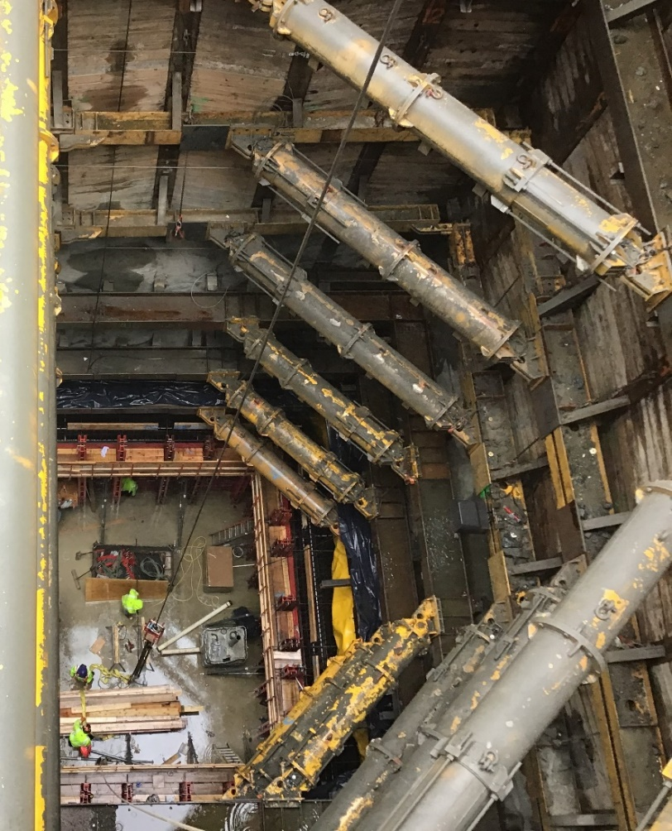
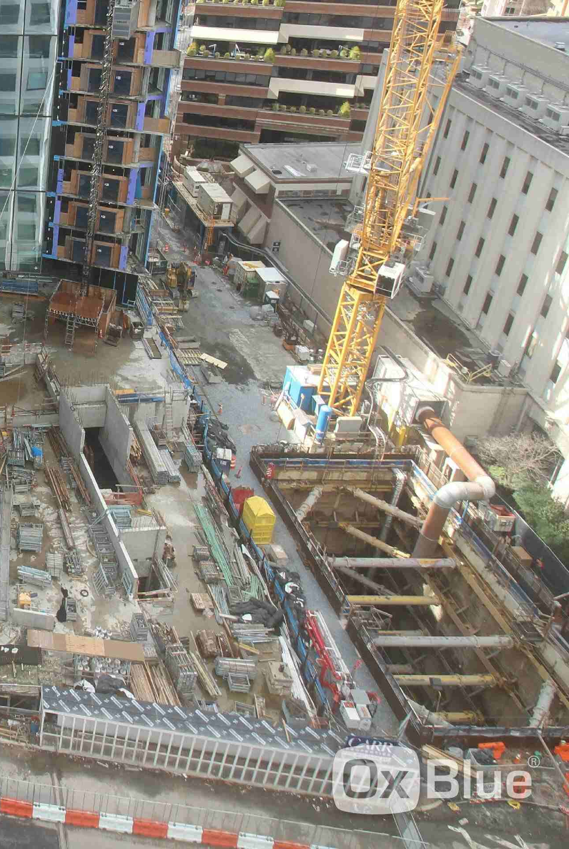
CONSTRUCTION HIGHLIGHT – BETHESDA SOE
Hydraulic SOE System
  Addressed pressure transfer between vertical beams
  Supports are quickly installable and reusable
  Ease of use adds, mitigates many issues often encountered with the large, steel beam systems traditionally used in such situations
Construction Work to be Undertaken
  Excavation of cavern in bedrock
  Widening the shaft footprint
  Mined cavern to the WMATA station
The cavern excavation will use classical drill-and-blast excavation and shotcrete support
Work is adjacent to WMATA Red Line, close coordination with WMATA during blasting to minimize disruption to Red Line service

Slide 25
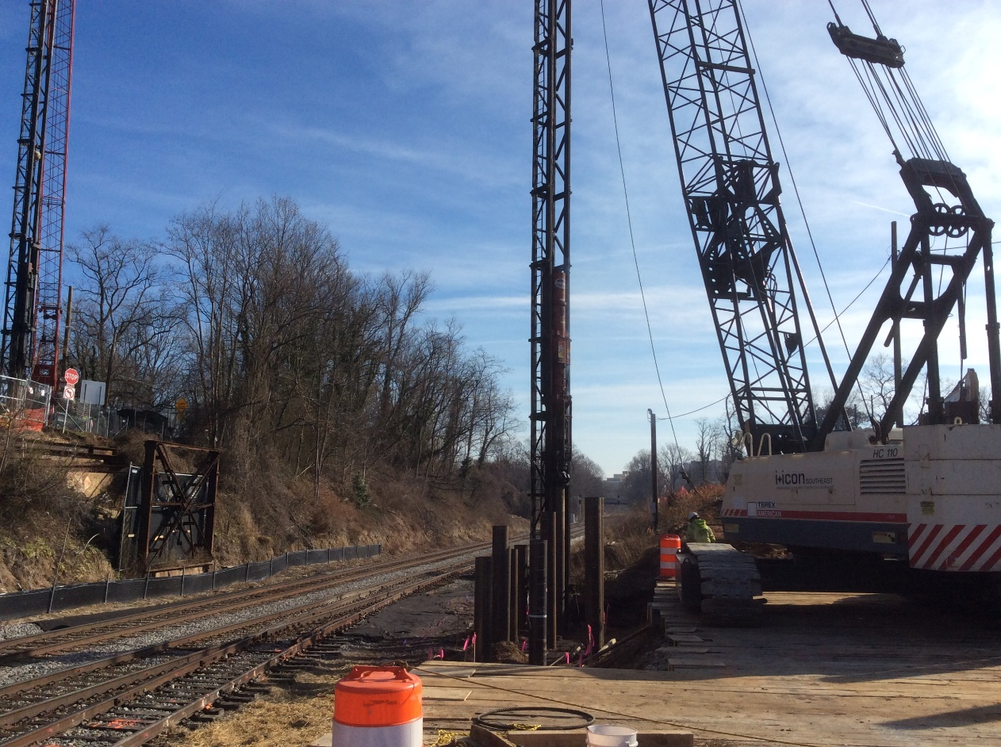
CONSTRUCTION HIGHLIGHT – LYTTONSVILLE
June 4, 2019 the Talbot Ave. Bridge was deconstructed to make way for a modern and wider bridge with sidewalks. The Purple Line will pass under the new Talbot Ave. Bridge next to the CSX tracks. Pile driving for the new bridge abutments was completed in December of 2019. The new Talbot Bridge is scheduled to be open by the end of 2020.

Slide 26
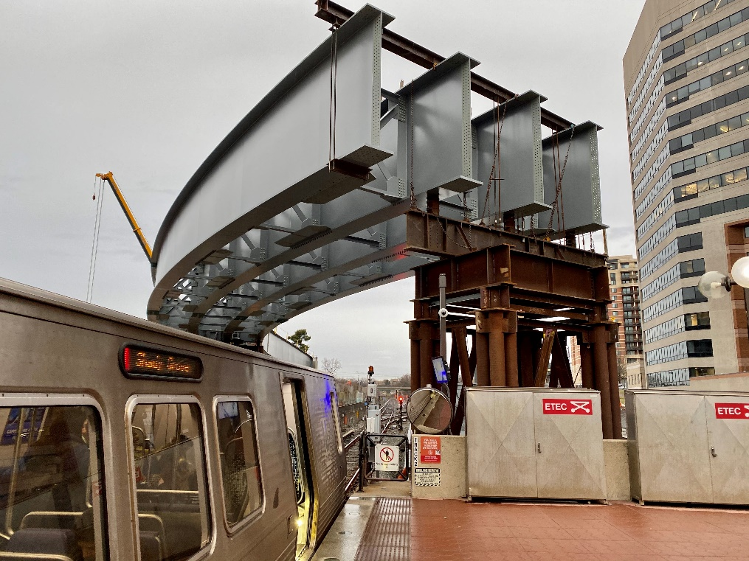
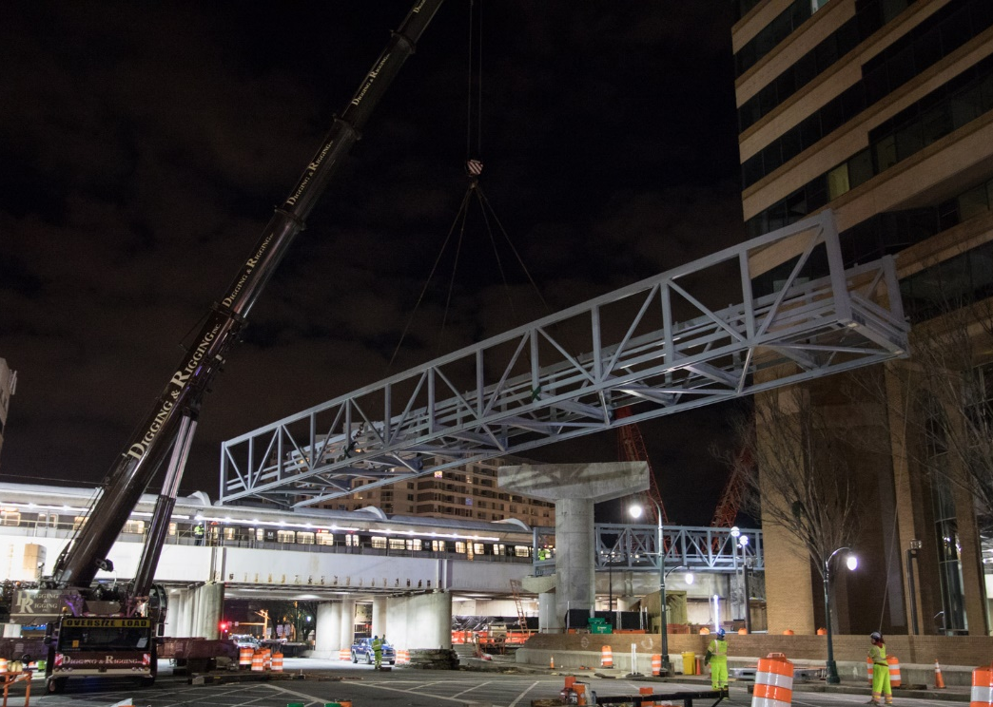
CONSTRUCTION HIGHLIGHT – SILVER SPRING
Extensive coordination with Montgomery County, WMATA, CSX, and other agencies has been ongoing to set the first girders for the LRV bridge over WMATA and CSX tracks in Silver Spring in January of 2020. Additionally the Capital Crescent Trail (CCT) trestle was set over Colesville Rd. in January of 2020.
LRV Girders over WMATA’s Metro Red Line
CCT trestle being erected

Slide 27
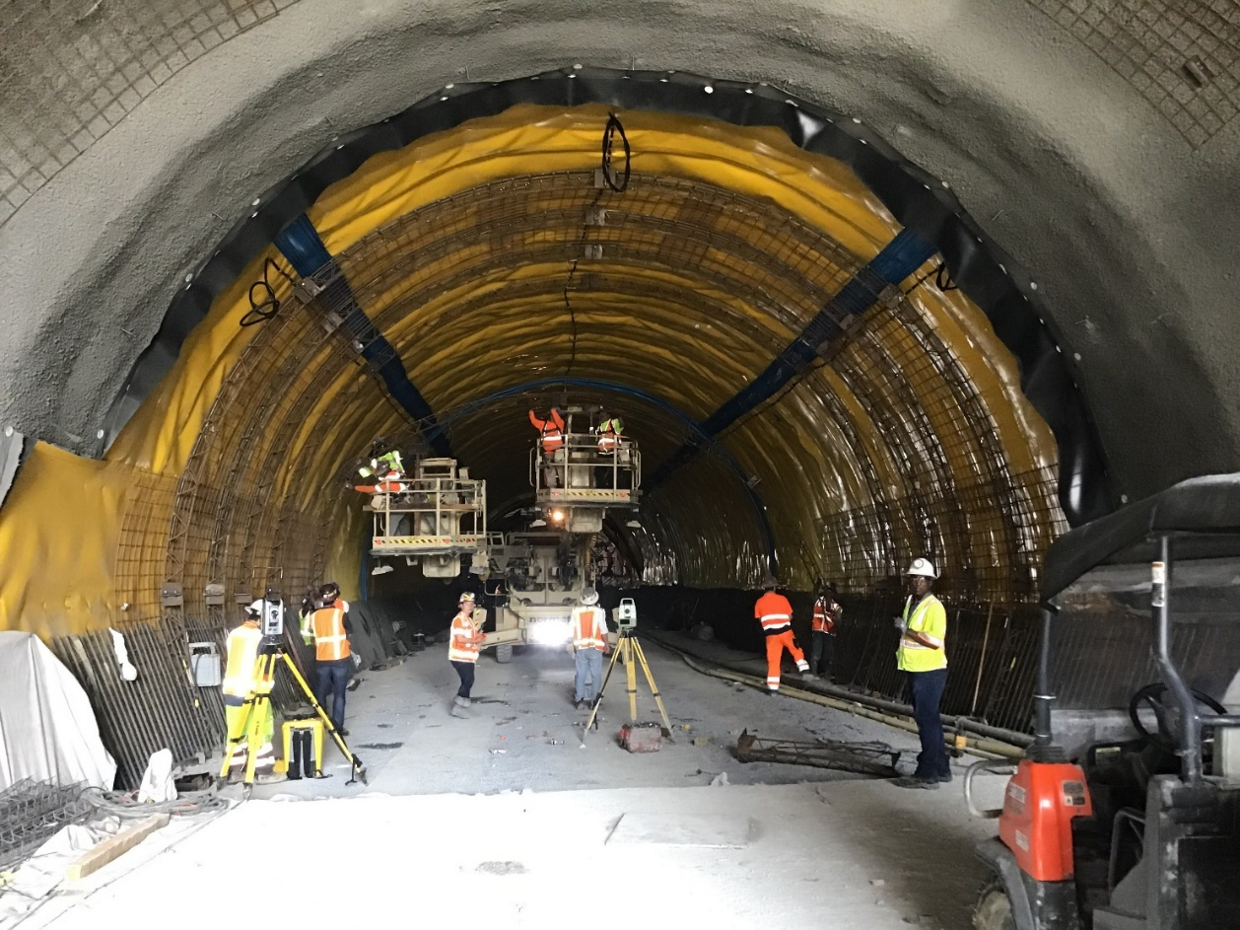
CONSTRUCTION HIGHLIGHT – LONG BRANCH
Plymouth Tunnel:
Length - 1,100 ft. (335m) under a suburban neighborhood
Tunnel excavation completed in March of 2019
PVC sheet waterproofing membrane and final lining installed
Shotcrete liner in lieu of form-and-pour
Geotechnical conditions - soft ground in the top heading and relatively hard rock in the bench and invert
Extensive noise and vibration monitoring during construction

Slide 28
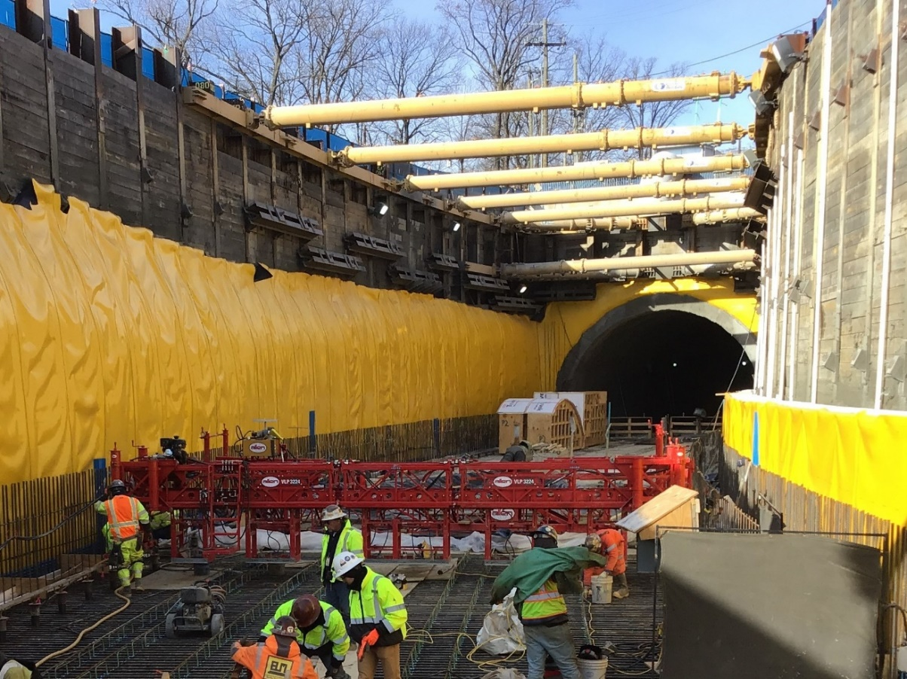
CONSTRUCTION HIGHLIGHT – LONG BRANCH
Plymouth Tunnel:
Sequential Excavation Method (SEM) tunneling method used due to mixed face conditions
Economical for relatively short tunnels
Groundwater control required throughout construction to maintain the heading
Portal of the mined section is supported by a secant pile wall

Slide 29
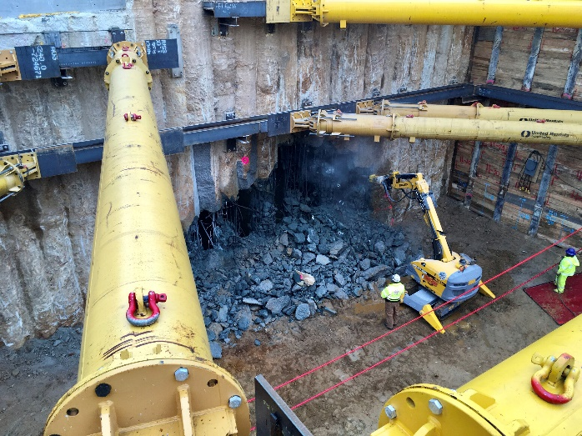
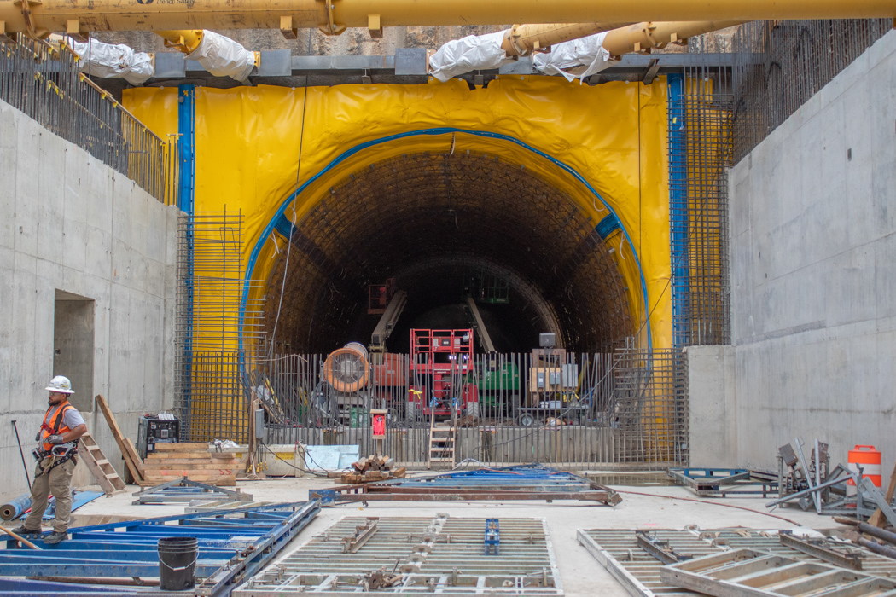
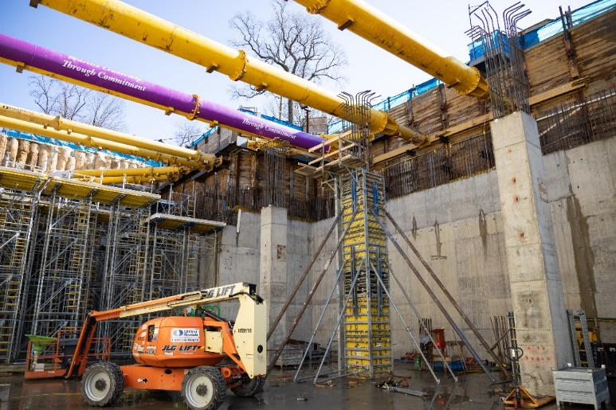
CONSTRUCTION HIGHLIGHT – LONG BRANCH
Manchester Place Station
West of the Plymouth Tunnel
Continues in the open cut section
SOE is comprised of soldier piles and lagging and a secant pile wall at the tunnel portal
Station structure is cast-in-place concrete

Slide 30
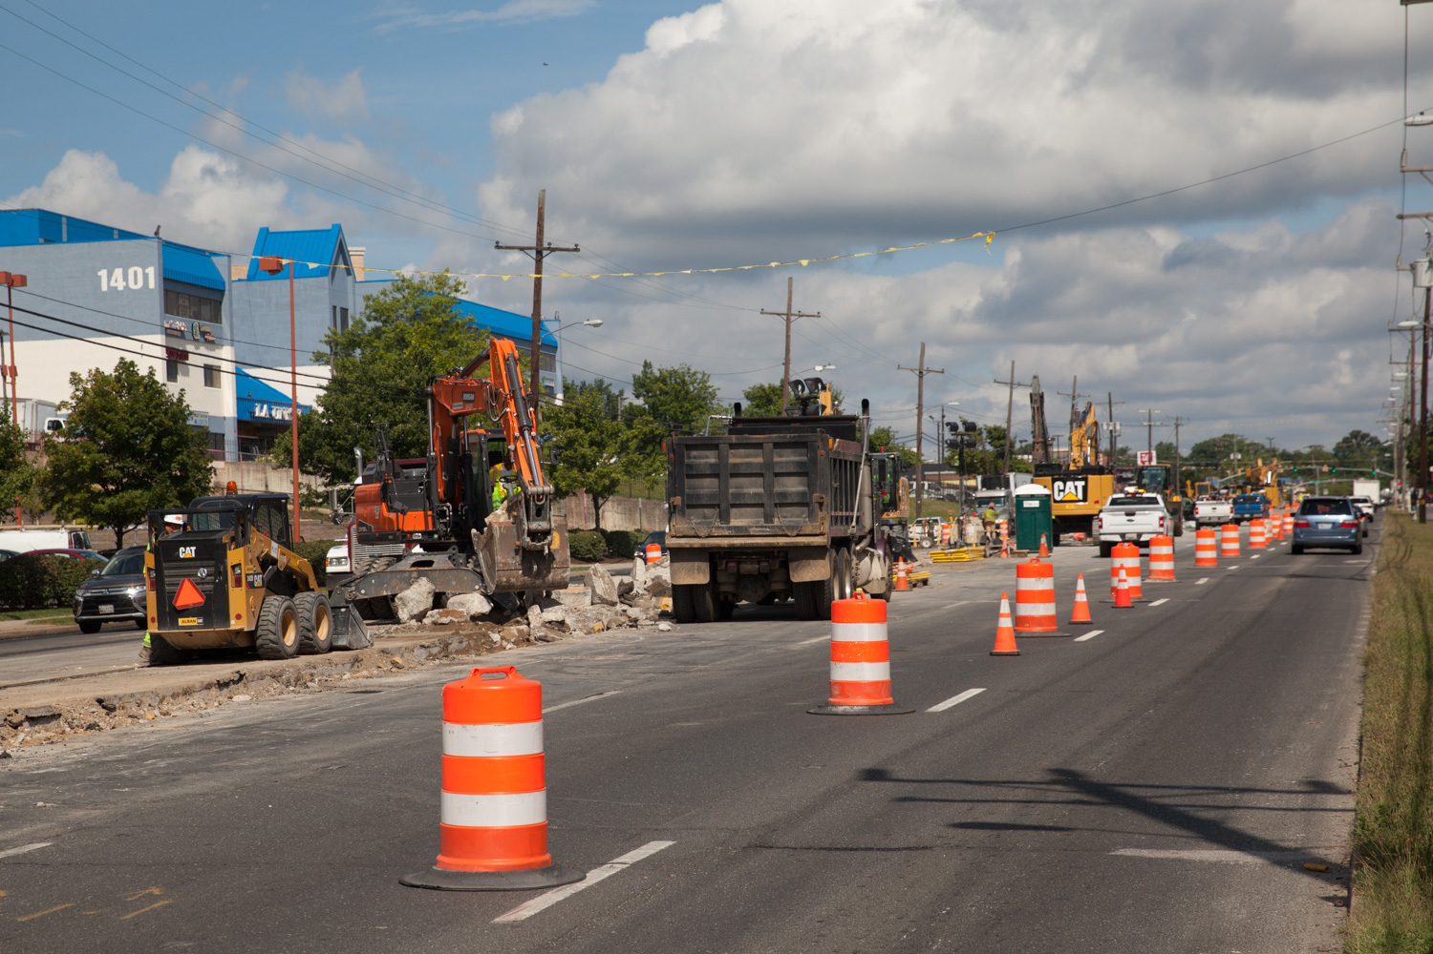
CONSTRUCTION HIGHLIGHT – UNIVERSITY BLVD.
Work on University Blvd. continues to progress with the removal of medians and utility relocations to make way for the Purple Line tracks that will be in the center of the road alongside vehicular traffic.

Slide 31
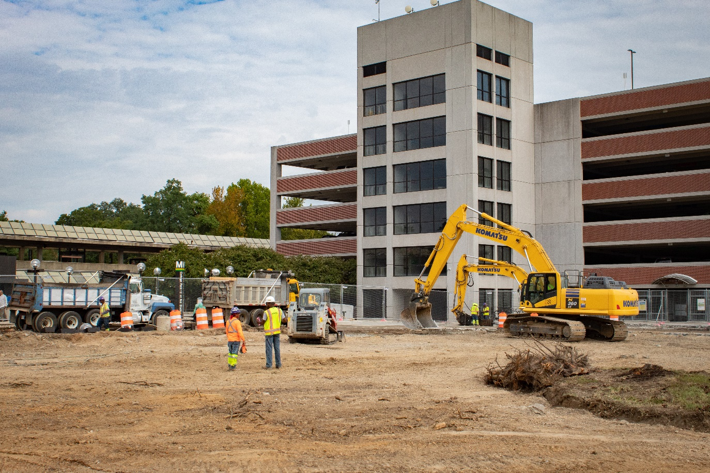
CONSTRUCTION HIGHLIGHT – COLLEGE PARK
Work is underway on the Purple Line College Park Metro Station on River Rd. Pictured is site work and the removal of the asphalt bus loop.

Slide 32
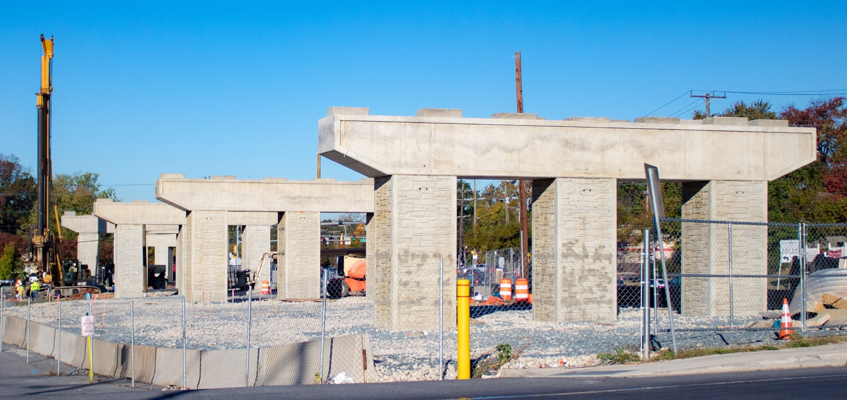
CONSTRUCTION HIGHLIGHT – RIVERDALE PARK
Riverdale Rd. bridge piers have been constructed that will support the Riverdale Park-Kenilworth aerial station. The first girders are scheduled for erection late February of 2020.

Slide 33
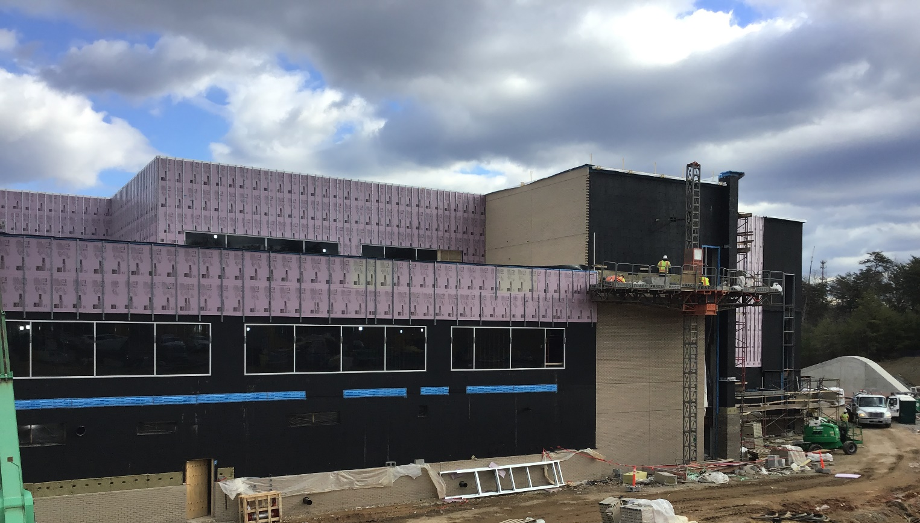
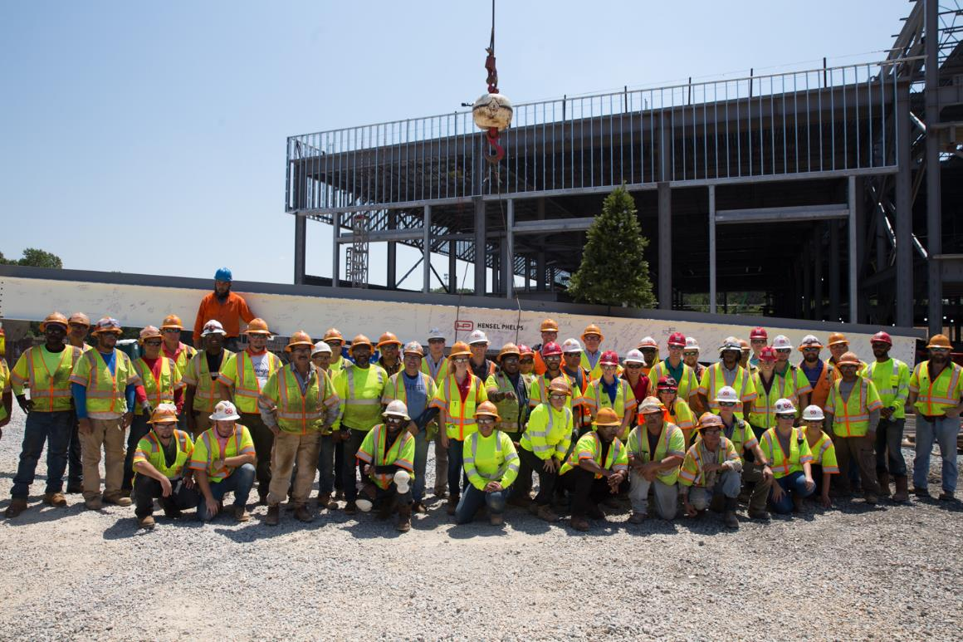
CONSTRUCTION HIGHLIGHT – GLENRIDGE
Steel framing of the Glenridge Operations and Maintenance Facility (OMF) was completed in July of 2019. This facility will maintain and clean the Light Rail Vehicles (LRVs) as well as house the Purple Line administration and operational staff. First LRV scheduled to arrive October 2020.

Slide 34
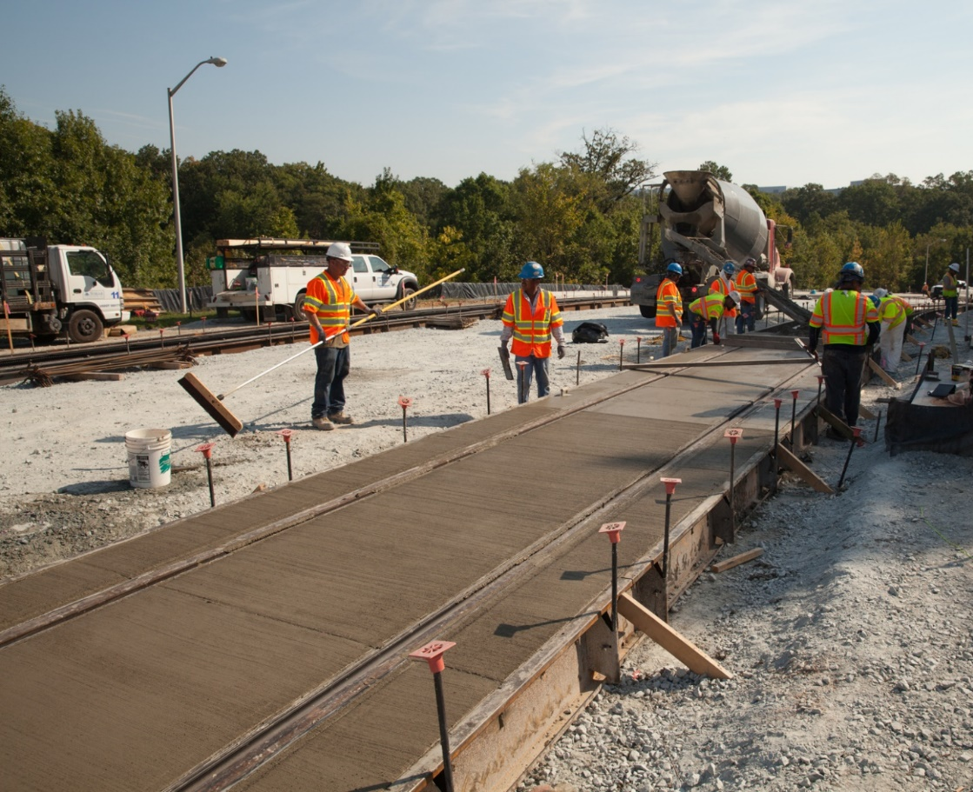
CONSTRUCTION HIGHLIGHT – NEW CARROLLTON
The first section of rail for the Purple Line was installed on Ellin Rd. in September of 2019. This is embedded track where the Purple Line will run on Ellin Rd. with vehicular traffic.

Slide 35
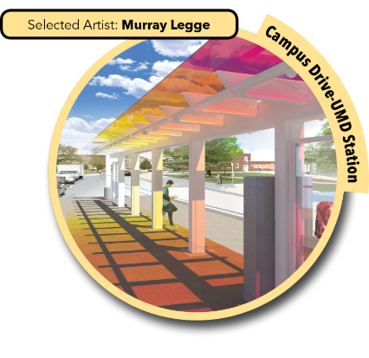
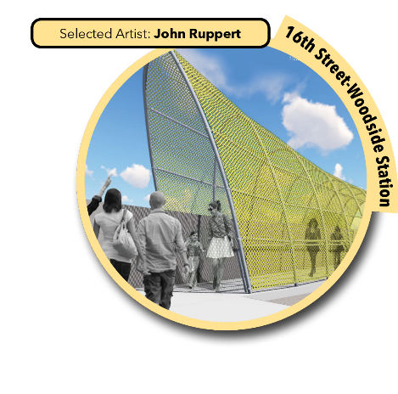
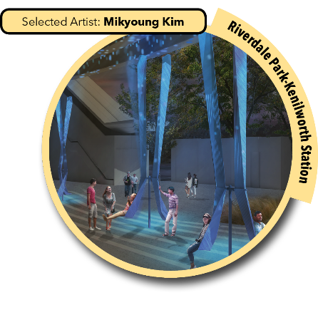
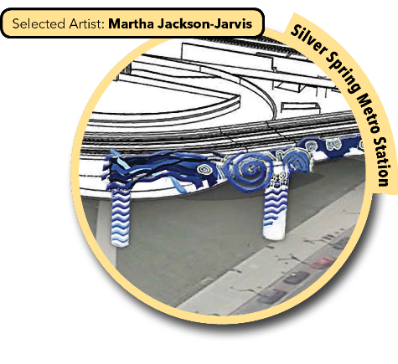
ART-IN-TRANSIT PROGRAM
The mission of the Purple Line Art-In-Transit program is to make public art an integral element of the project
Art will be incorporated into stations to enrich the aesthetics of the light rail system and support neighborhood identities
Artists have been selected, art proposals have been refined based on input received, and contracts are being negotiated
$6M for artwork at 21 stations, allocated equally among 2 counties
Station artwork to be installed between 2020 – 2021

Slide 36
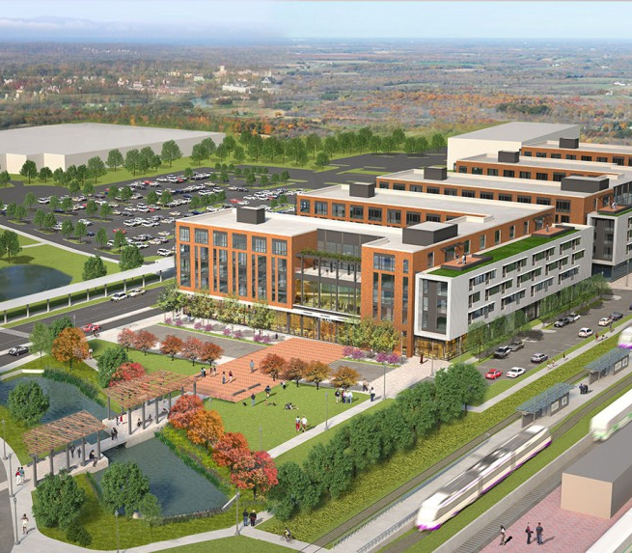
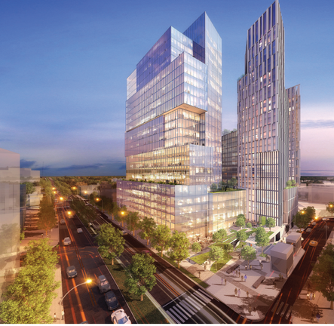
ADJACENT DEVELOPMENT AND CHALLENGES
Gilbane – Planned Development in Prince George’s County
Adjacent Development
  At least 36 development projects planned or underway along the alignment
  Contractor coordination with adjacent contractors
  Shared Work Sites
Regional Construction
  I-66 Widening - $3.7 Billion
  I-395 - $0.5 Billion
  Silver Line Phase II - $2.7 Billion
  DC Water Boundary Tunnel - $0.5 Billion
  DDOT South Cap Bridge $0.4 Billion
  WMATA Station Rehabilitation - $1.5 Billion
Carr Properties – Planned Development Montgomery County

Slide 37


WHAT ABOUT CONCRETE?
Glenridge OMF – Slab-On-Grade Shop Floor
Uses Throughout the Project
  Bridge substructures and superstructures
  10 bridges with concrete girders (11,000+ LF)
  70,000+ LF of embedded or direct fixation track
  Shotcrete
  500,000+ SF Precast MSE Wall Panels
To Date
  55,000 CY delivered
  7500 test cylinders cast
  2100 field tests performed
Silver Spring LRT Aerial – Pier 3 Cap Placement

Slide 38


WHAT ABOUT SHOTCRETE?
Plymouth Tunnel Final Shotcrete Liner
Plymouth Tunnel
  11,500+ CY silica fume shotcrete produced on site
  NRMCA Certified Batch Plant
  Used for both primary and secondary liners
  Fireproofing polymer fibers used in secondary liner
  Special regulating layer (modified gradation) for smoothness
Other Uses
  Rock Creek Slope Stabilization
  Soil Nail Walls
On-Site NRMCA Certified Batch Plant

Slide 39
QUESTIONS?

Slide 40



CONTACT US
Kevin Oberheim, PE, CCM
PMC Construction Manager| kevin.oberheim@purplelinemd.com
Tel: +1 410.241.1120
Follow us on Social Media
Visit our website: www.purplelinemd.com
@PurpleLineMD
/MarylandPurpleLine

