Slide 1
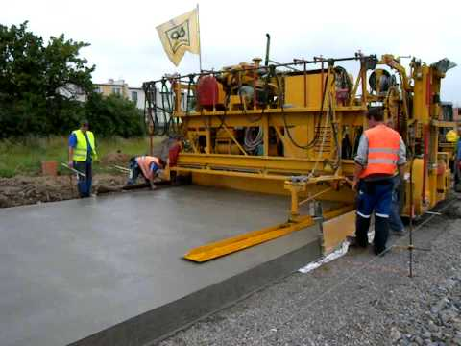
Moving to Performance Specifications for Concrete
Gina Ahlstrom
Team Leader- Pavement Design & Analysis
FHWA Office of Asset Management, Pavements, and Construction
Notes:
Welcome the audience

Slide 2
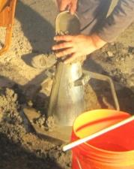
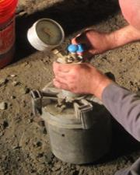
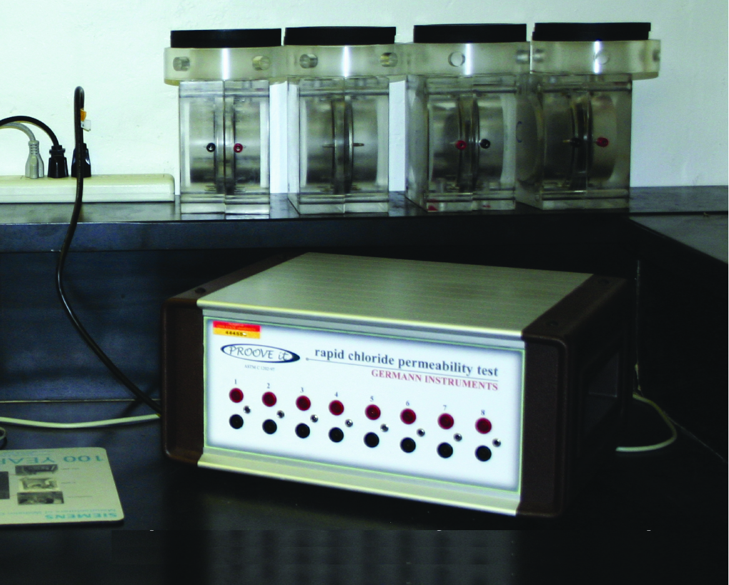




How Things Change!…or Have They?
Slump Cone
Pressure Meter
Rapid Chloride Permeability Test
Concrete
1922
1949
1981
ASTM C143
ASTM C231
FHWA/PCA
Cars
1920
1940
1960
1980
2000

Slide 3
Performance Vs. Prescriptive
Specifications
Performance specifications are different from Prescriptive specifications
Performance specifications communicate the desired characteristics of the material or product.
Prescriptive specifications communicate how the material or product is to be formulated and constructed.
Notes:
Performance based specifications for the following:
Materials:
Cementitious materials
Aggregates
Admixture
Water
Reinforcing Steel
Dowel Bars
Fibers
Subbase materials
Joint materials
Designs and Systems:
Pavement Life without major reconstruction
Pavement Life with limited maintenance
Pavement Life with cars only loads
Pavement Life with heavy loads
Prefabricated Pavement Systems

Slide 4

Why Move to a Performance Approach?
MAP-21
  Greater Federal emphasis on performance
  Linking investments to outcomes
Demographics in “Our World”
Public agency and industry desire
  It’s a natural evolution
  Improved durability and mix design
  Sustainability
Completed research and new tests Innovation
Notes:
Welcome the audience

Slide 5
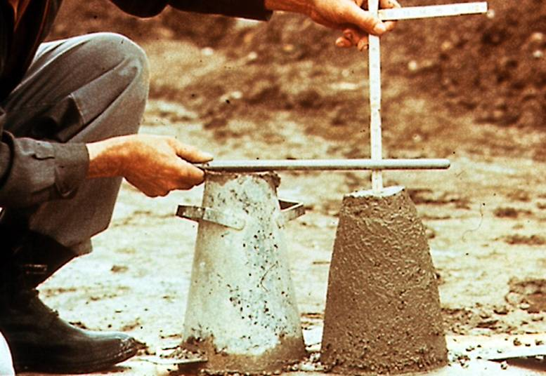


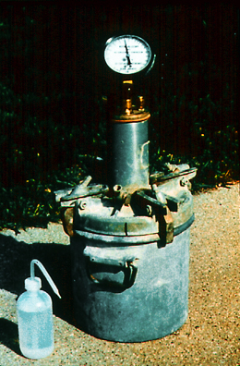
Concrete Mixture Design
Cement
Sand
+ Enough
Stone
Is there a better way?
Notes:
This is another transition slide that helps layout where we are headed. Do we really have to do things the old way? Can’t we try something different? Our materials have changed a lot since these early times. We must be ready to change with them.

Slide 6
Concept
Performance Engineered Mixture (PEM)
Understand what makes concrete last and identify what failure mechanisms we see
Specify the critical properties and test for them
Prepare mixtures to meet those specifications
This is a starting point for a performance-driven QA specification and acceptance program for states and other owner agencies

Slide 7
Why are PEM specifications needed?
Pavements do not always perform as designed (or do we have incompatibilities?)
Premature pavement distress have become more severe with changes in cements, SCMs, and new de-icing materials/practices
Allow/encourage innovation
Increase sustainability in our mixture designs

Slide 8

PEM: A Better Specification
Require the things that matter
Strength (everywhere)
Shrinkage (dry locations)
Cold weather resistance (cold locations)
Transport properties/permeability (everywhere)
Aggregate stability (everywhere)
Workability (everywhere)

Slide 9
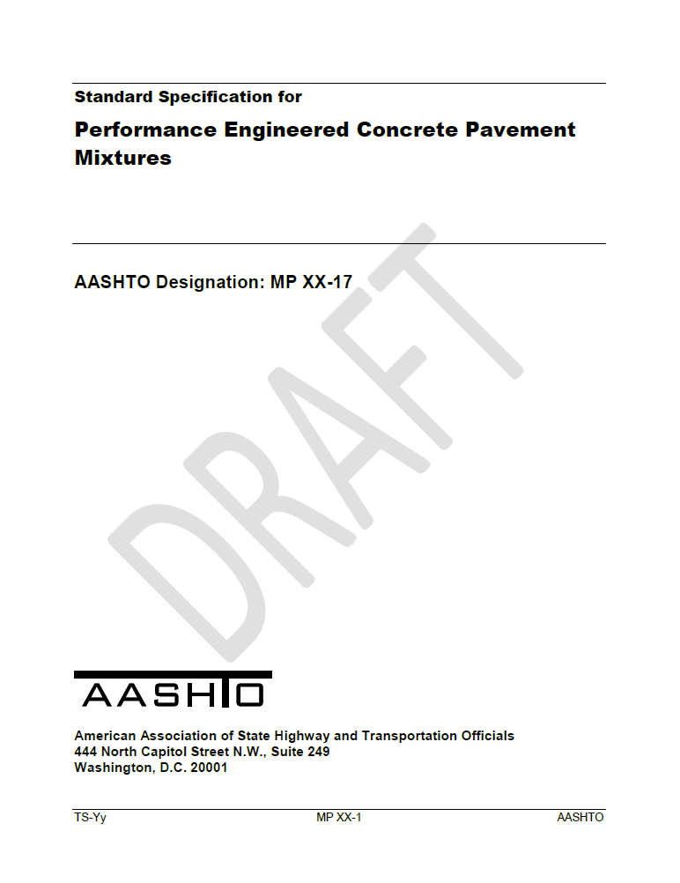
AASHTO MP 84-17

Slide 10
Concrete Strength (6.3)
Section | Property | Specified Test | Specified Value | Mixture Qualification | Acceptance | Selection Details | Special Notes
6.3.1 | Flexural Strength | AASHTO T 97 | 600 psi | Yes | Yes | Choose either or both
6.3.2 | Compressive Strength | AASHTO T22 | 3500 psi | Yes | Yes

Slide 11
Reducing Unwanted Cracking Due to Shrinkage (6.4)
Section | Property | Specified Test | Specified Value | Mixture Qualification | Acceptance | Selection Details | Special Notes | Section
6.4 Reducing Unwanted Cracking Due to Shrinkage
6.4.1.1 | Volume of Paste |  | 25% |  | Yes | No | Choose only one
6.4.1.2 | Unrestrained Volume Change | ASTM C157 | 420 με | at 28 day | Yes | No
6.4.2.1 | Unrestrained Volume Change | ASTM C157 | 360, 420, 480 με | at 91 days | Yes | No
6.4.2.2 | Restrained Shrinkage | AASHTO T 334 | crack free | at 180 days | Yes | No
6.4.2.3 | Restrained Shrinkage | AASHTO T ??? | σ < 60% f'r | at 7 days | Yes | No
6.4.2.4 | Probability of Cracking | ~ | 5, 20, 50% | as specified | Yes | No

Slide 12
Hardened Cement Paste Freeze-Thaw Durability (6.5)
Section | Property | Specified Test | Specified Value |  | MQ | AC | Selection Details |  |  | Special Notes
6.5 Durability of Hydrated Cement Paste for Freeze-Thaw Durability
6.5.1.1 | Water to Cement Ratio | AASHTO T 318 | 0.45 | ~ | Yes | Yes | Choose Either 6.5.1.1 or 6.5.2.1
6.5.1.2 | Fresh Air Content | AASHTO T 152, T196, TP 118 | 5 to 8 | % | Yes | Yes |  | Choose only one
6.5.1.3 | Fresh Air Content/SAM | AASHTO T 152, T196, TP 118 | ≥ 4% Air; | %, psi | Yes | Yes
 |  |  | SAM ≤ 0.2
6.5.2.1 | Time of Critical Saturation | "Bucket Test" Specification | 30 | Years | Yes | No | Note 1 | Note 2 | Variation controlled with mixture proportion observation or F Factor and Porosity Measures
6.5.3.1 | Deicing Salt Damage | ~ | 35% | SCM | Yes | Yes | Choose one |  | Are calcium or magnesium chloride used
6.5.3.2 | Deicing Salt Damage | ~ | ~ | ~ | Yes | Yes |  |  | Are calcium or magnesium chloride used, needs a use of specified sealers
6.5.4.1 | Calcium Oxychloride Limit | Test sent to AASHTO | < 0.15g CaOXY/g paste |  | Yes | No |  |  | Are calcium or magnesium chloride used

Slide 13
Transport Properties/Permeability (6.6)
Section | Property | Specified Test | Specified Value |  | Mixture Qualification | Acceptance | Selection Details | Special Notes
6.6 Transport Properties
6.6.1.1 | Water to Cement Ratio | AASHTO T 318 | 0.45 | ~ | Yes | Yes | Choose Only One
6.6.1.2 | RCPT Value | AASHTO T 277 | 2000 | ~ | Yes | Yes
 |  |  |  |  |  |  |  | Other criteria could be selected
6.6.1.3 | Formation Factor/Resistivity | AASHTO xx | 500 | ~ | Yes | through ρ
 |  |  |  |  |  |  |  | * Note this is currently based on saturated curing and an adjustment is needed to match with AASHTO Spec
6.6.2.1 | Ionic Penetration, F Factor | AASHTO xx | 25 mm at 30 year |  | Yes, F | through ρ

Slide 14
Aggregate Stability (6.7)
Section | Property | Specified Test | Specified Value |  | Mixture Qualification | Acceptance | Selection Details | Special Notes
6.7 Aggregate Stability
6.7.1 | D Cracking | AASHTO T 161, ASTM C 1646 | ~ | ~ | Yes | No
6.7.2 | Alkali Aggregate Reactivity | AASHTO PP 65 | ~ | ~ | Yes | No

Slide 15
Workability (6.8)
Section | Property | Specified Test | Specified Value | Mixture Qualification | Acceptance | Selection Details | Special Notes
6.8 Workability
6.8.1 | Box Test | ~ | <6.25 mm, < 30% Surf. Void | Yes | No
6.8.2 | Modified V-Kelly Test | ~ | 15-30 mm per root seconds | Yes | No

Slide 16
Quality Assurance Defined
23 CFR 637
Agency Acceptance
Contractor Quality Control
Qualified (certified) Personnel
Qualified Laboratories
Independent Assurance
Dispute Resolution for Test Results
}
State processes, independent of material

Slide 17
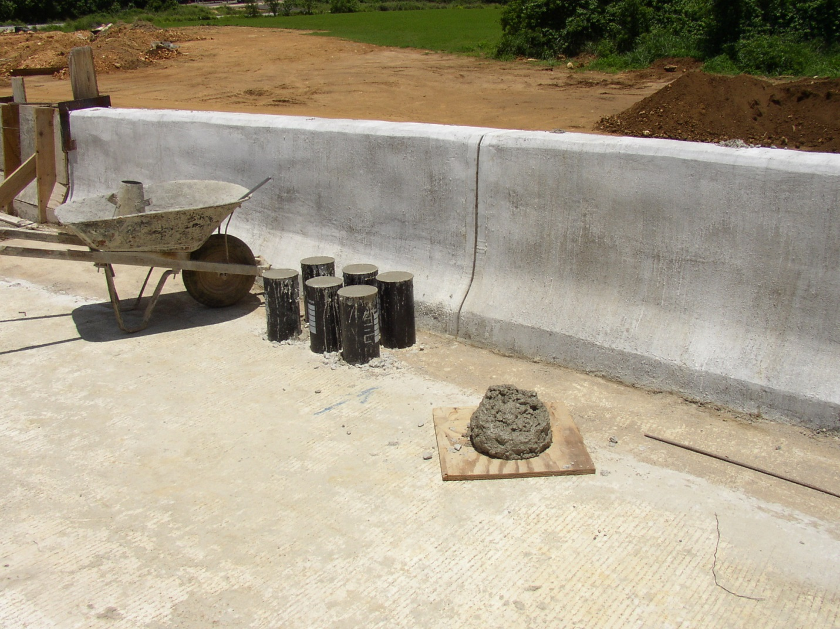
“…Protect cylinders from direct sunlight…”

Slide 18
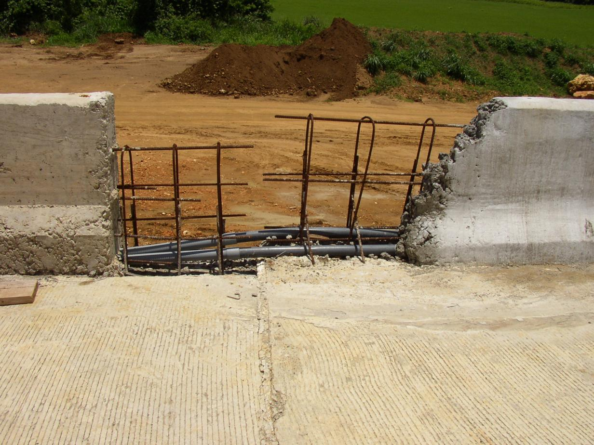

Slide 19

Quality Control
PEM acknowledges the key role of QC in a performance specification
Requires an approved QC Plan
Requires QC testing and control charts
  Unit weight
  Air content/SAM
  Water content
  Formation Factor (via resistivity)
  Strength
QC
  Testing targets, frequency, and action limits
  New technical guidance will expand on this
Notes:
Welcome the audience

Slide 20
Quality Control
Uses real time feedback
A good Contractor QC system:
  Doesn’t just echo Agency requirements
  Implements QC procedures as standard practice
  Isn’t just paperwork…it’s a mindset

Slide 21

Long-Term Implementation of PEM
Demonstration through shadow specification and pilot projects
    Pooled Fund Solicitation 1439 (FHWA, PA, OH, IA, KS, NY, SD, WI)
    ACPA Chapters, ACPA National, NRMCA, PCA, ACI, involved
Fill in research gaps
Guidance on specification, tests, and quality control
Build on PEM to establish a model concrete acceptance program

Slide 22
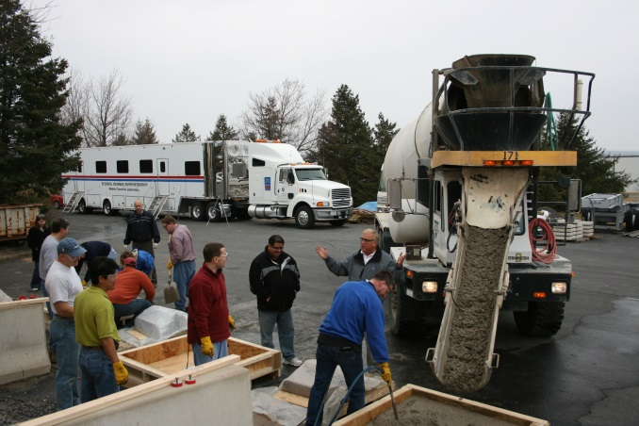
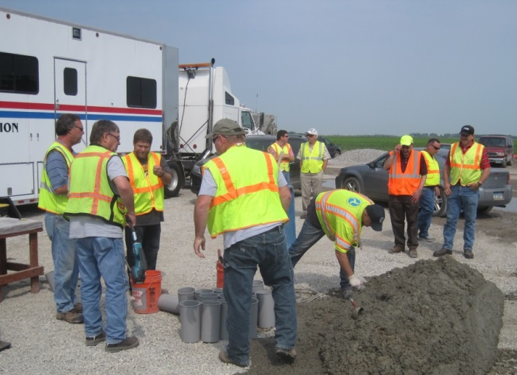
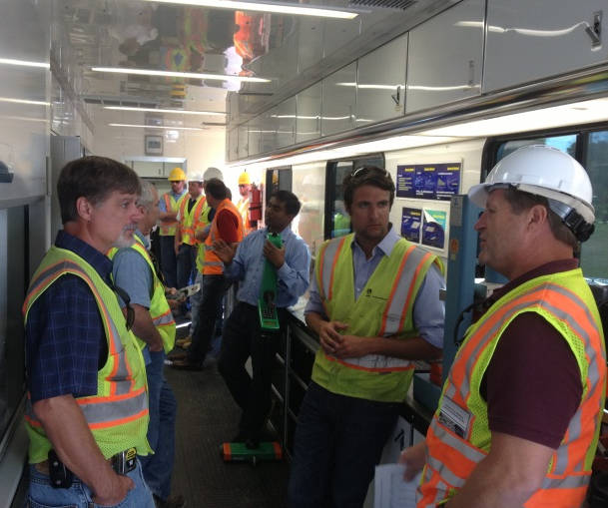
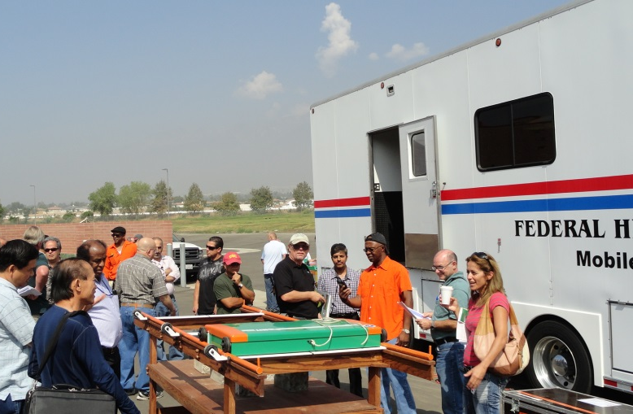
FHWA Mobile Concrete Trailer
Mission
Technology Transfer to SHA’s
  Field demos on active projects
  Equipment loan
  Training of staff
  Conferences and workshops

Slide 23

Concrete Pavement Performance System
Coordinated effort to provide guidance and tools to states and industry to advance concrete Quality Assurance programs in the direction of performance.
QA Toolkit
  Videos
  Testing guidance
QC framework
Implementation Workshops
FHWA Mobile Concrete Trailer

Slide 24
A Coordinated Approach to Implementation
Agencies
FHWA
Performance Engineered Mixes
Academia
Industry

Slide 25

Notes:
Welcome the audience

Slide 26
CPPS Tests
Super Air Meter
Unit weight
Strength
Surface Resistivity
MIT Scan
MIT Scan T2
Maturity
Microwave water content
Box Test
V-Kelly
Formation factor
Coefficient of thermal expansion
Calorimetry

Slide 27
Performance Engineered Mixture (PEM) Development
The Team
  Dr. Peter Taylor, Director, CP Tech Center
  Dr. Jason Weiss, Oregon State University
  Dr. Tyler Ley, Oklahoma State University
  Dr. Tom VanDam, NCE
  Mike Praul, FHWA
  Cecil Jones, Diversified Engineering
  Tom Cackler, CP Tech Center
Industry Participants/Reviewers
  Champion States & ACPA Chapter Execs
  ACPA National
  PCA
  NRMCA

