Slide 1


21st Annual
Maryland Concrete Conference

Slide 2

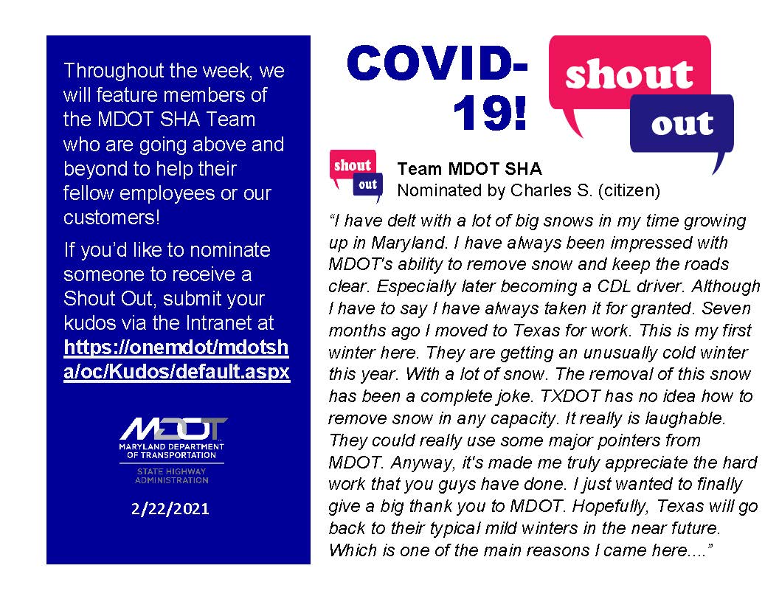
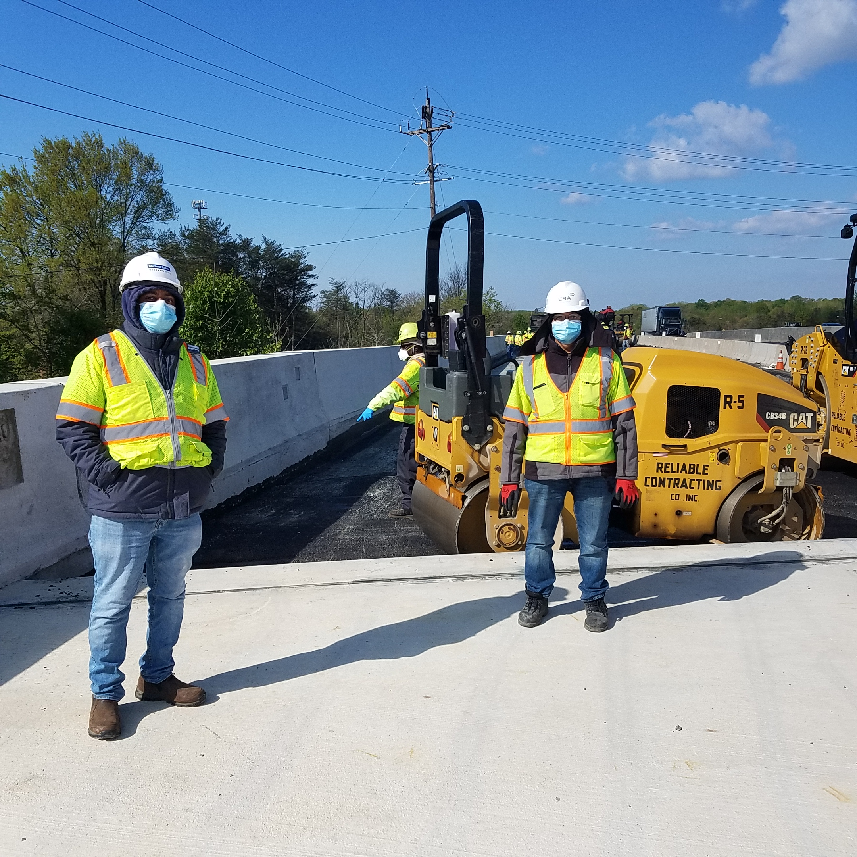
COVID-19 AND THE WORKPLACE

Slide 3
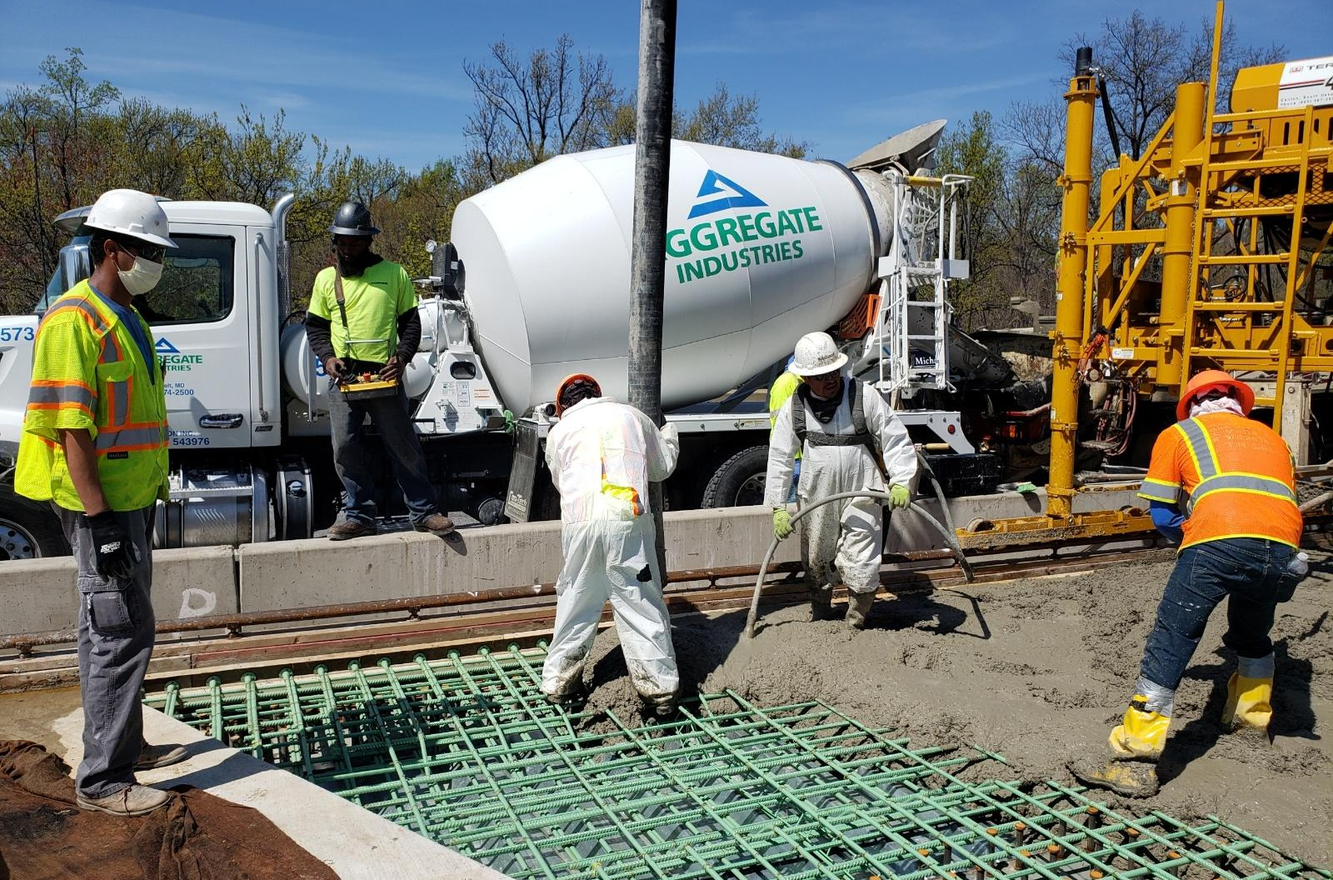
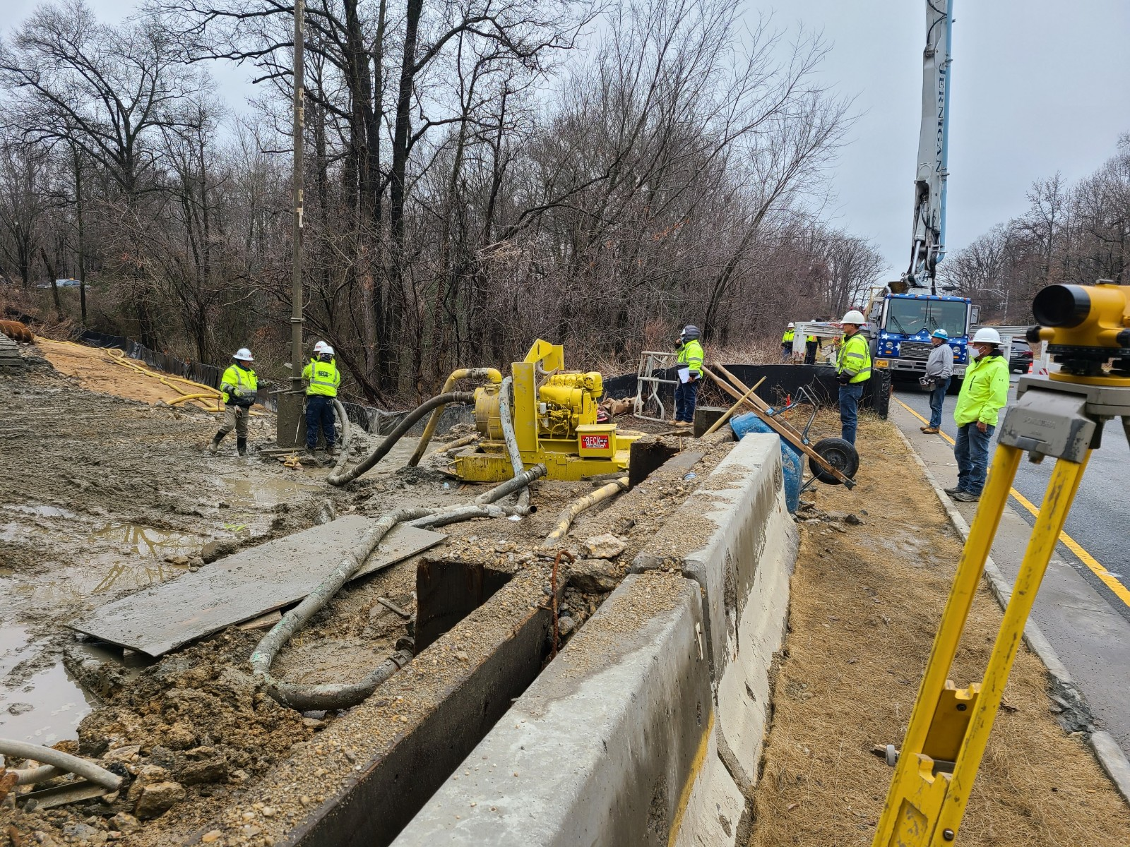
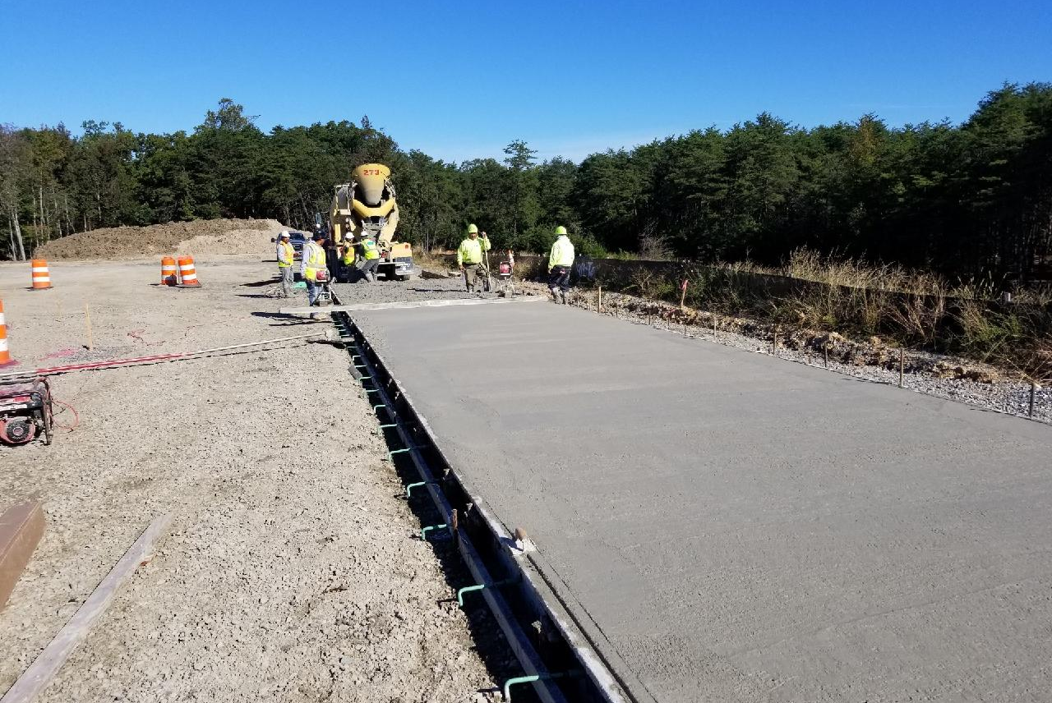
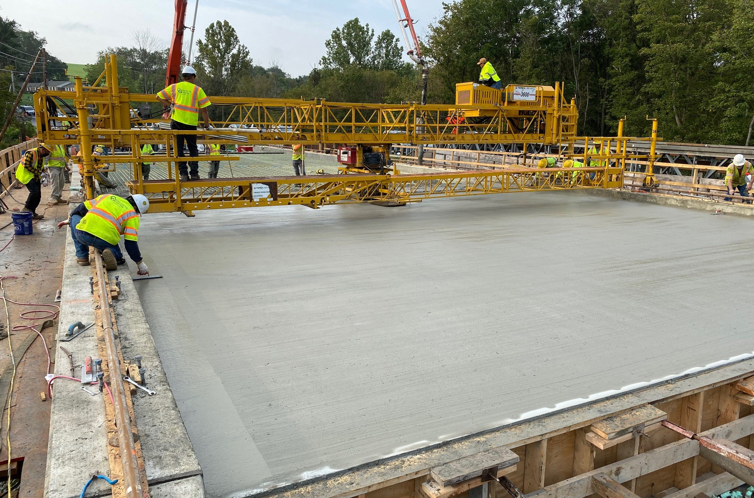
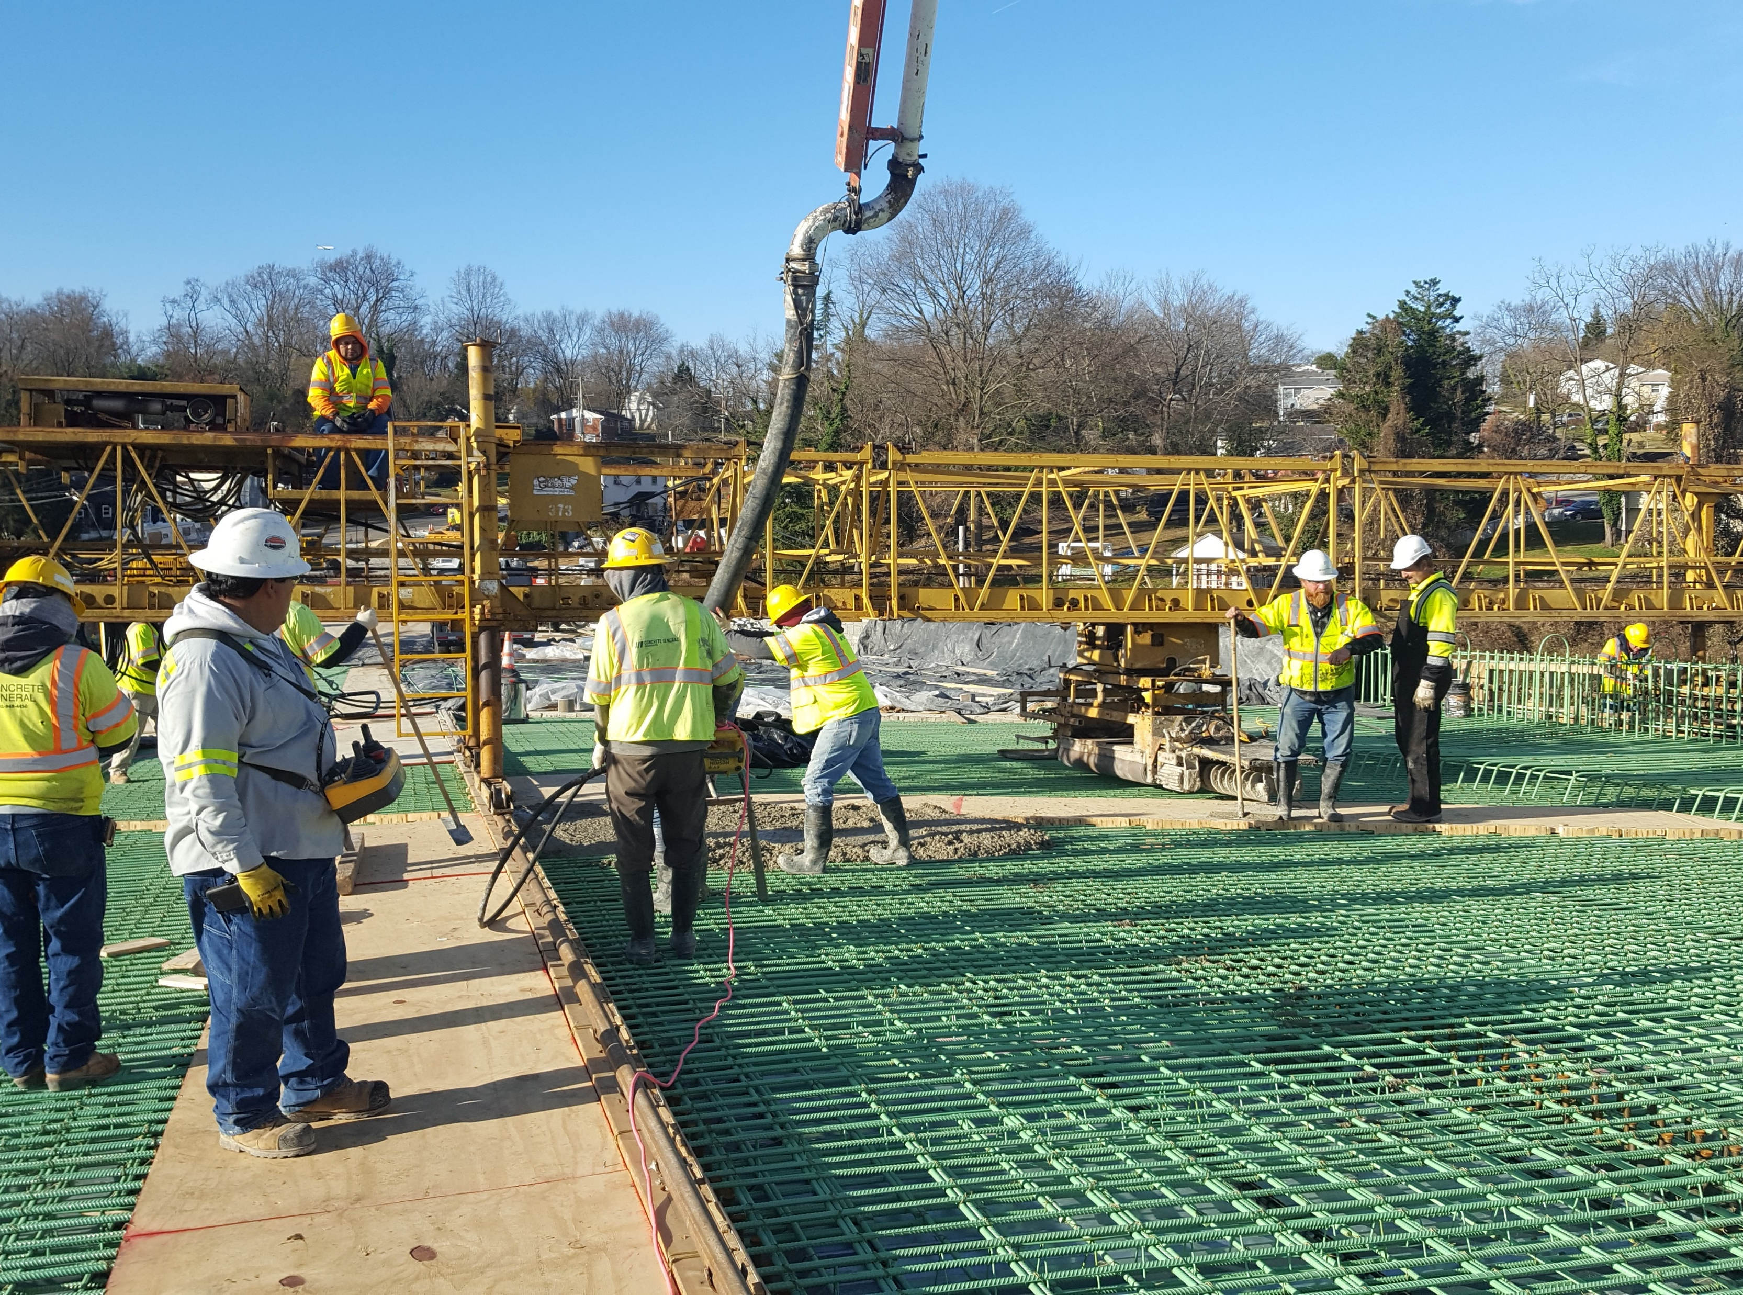
COMPLETED 144 PROJECTS
Work continues on 342 active construction projects
MD 210
I-495
MD 5
MD 355
And more!

Slide 4
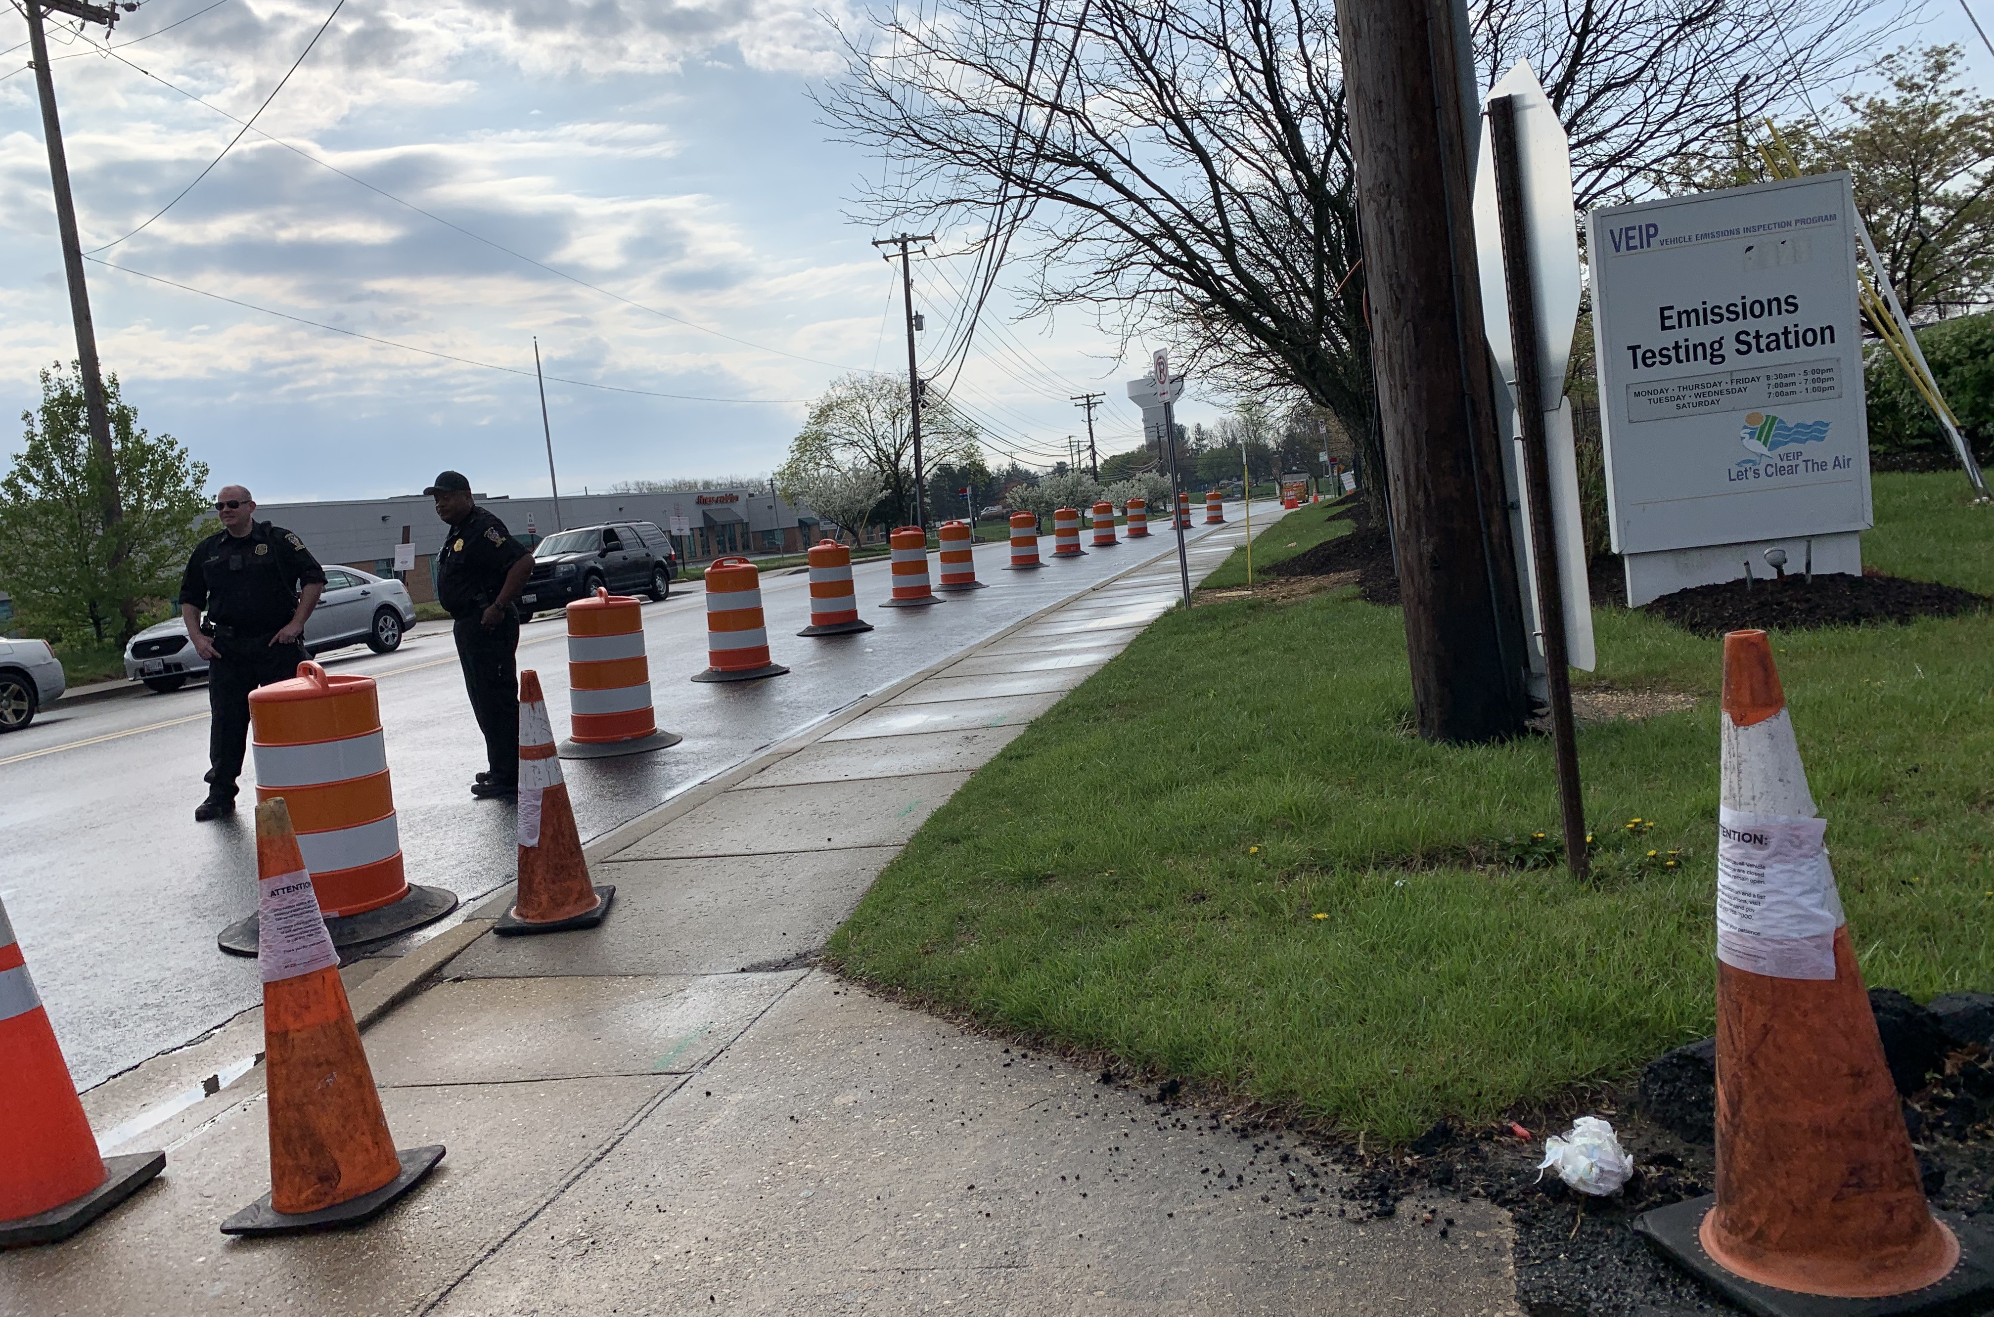
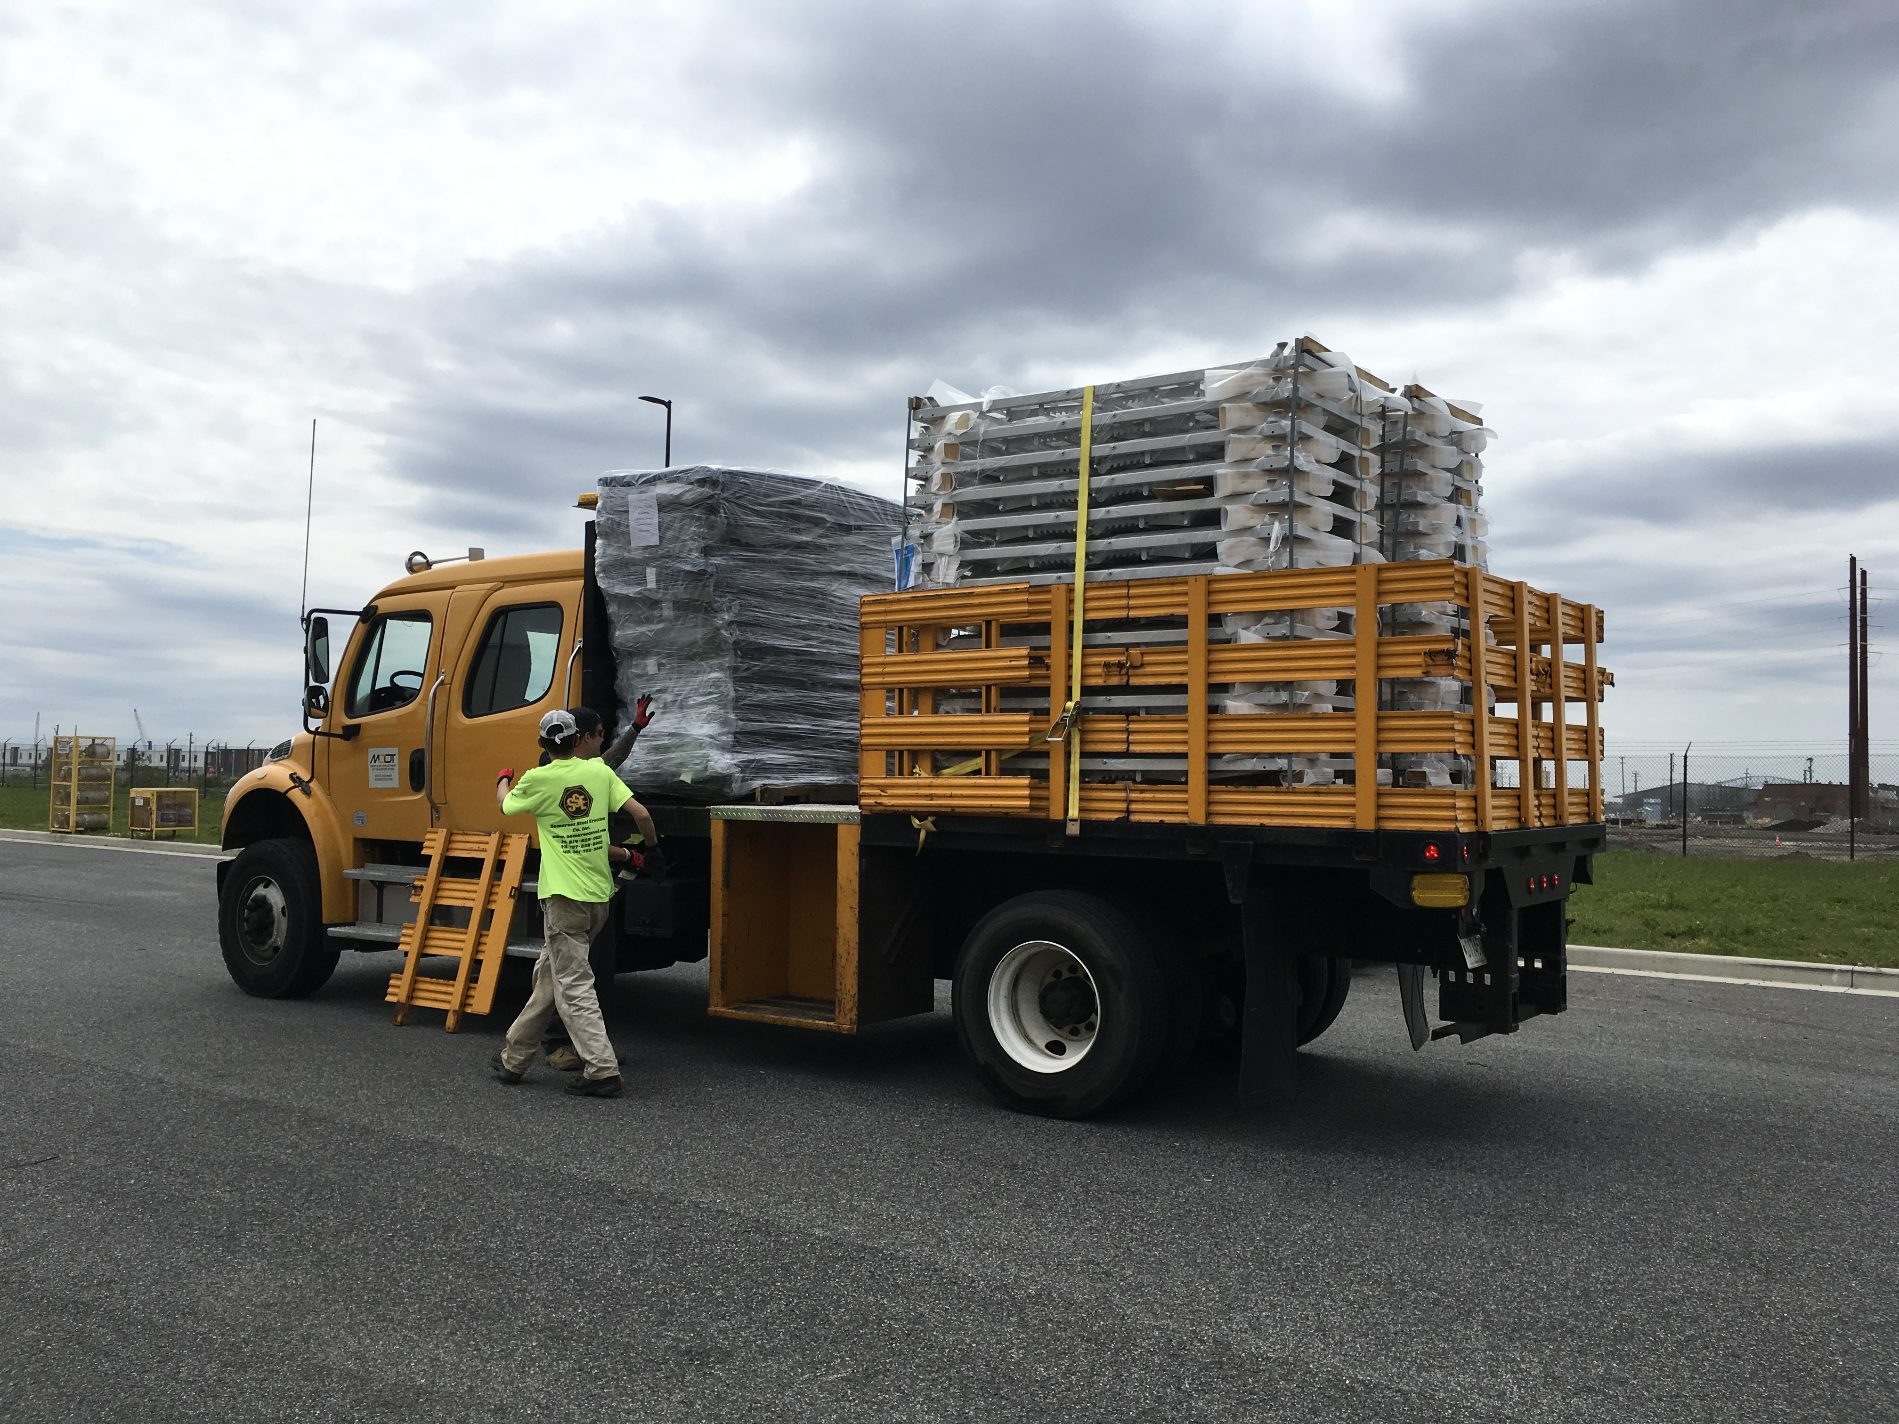
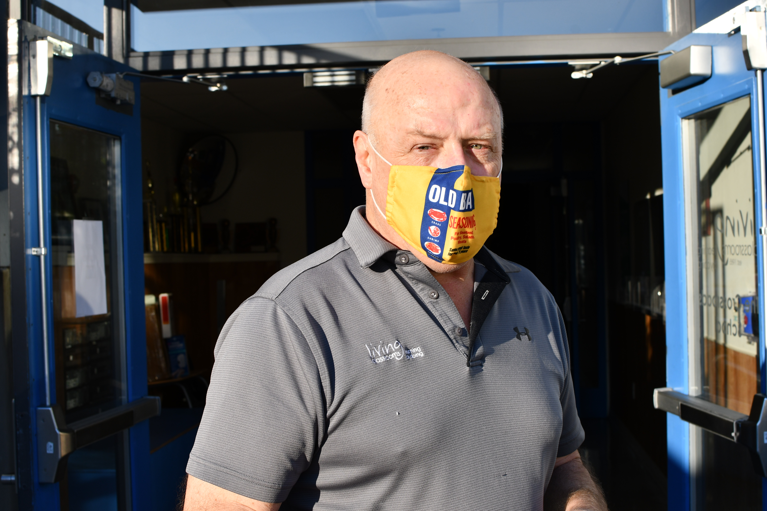
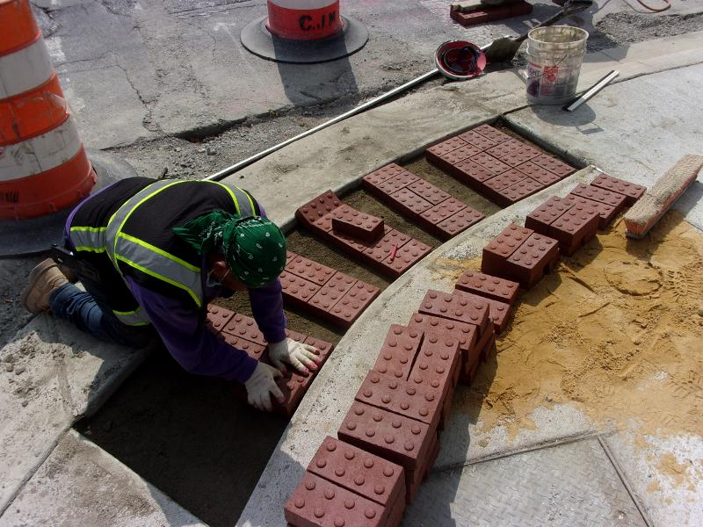
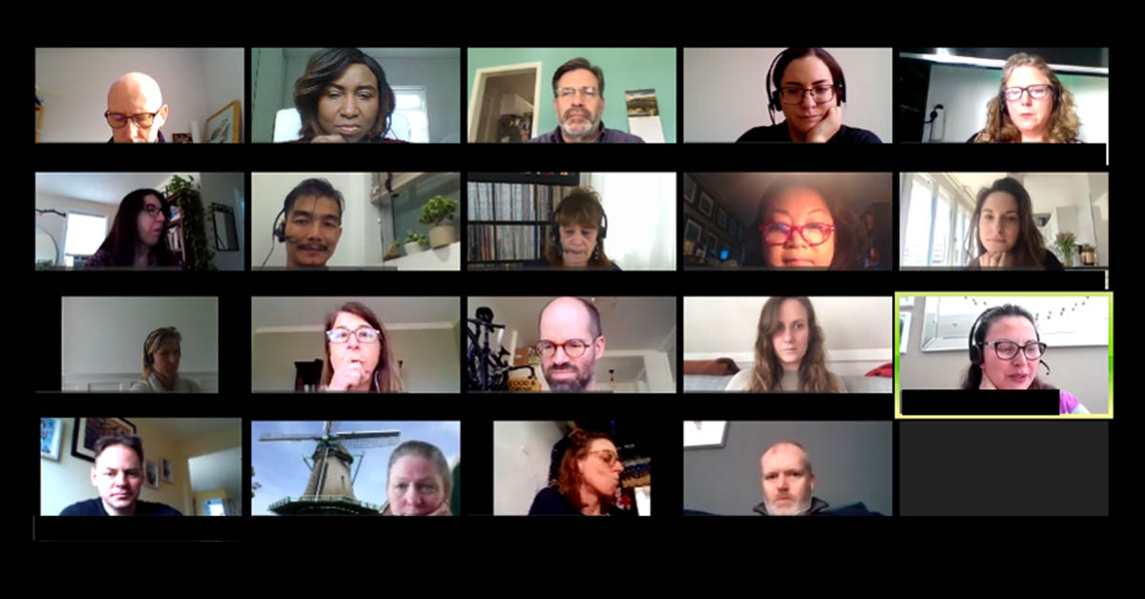
FRONT LINE WORKERS DELIVER
Almost 3,000 Team Members Never Stopped Working
Helping set-up COVID-19 testing sites
Delivering supplies to hospitals
And more!

Slide 5
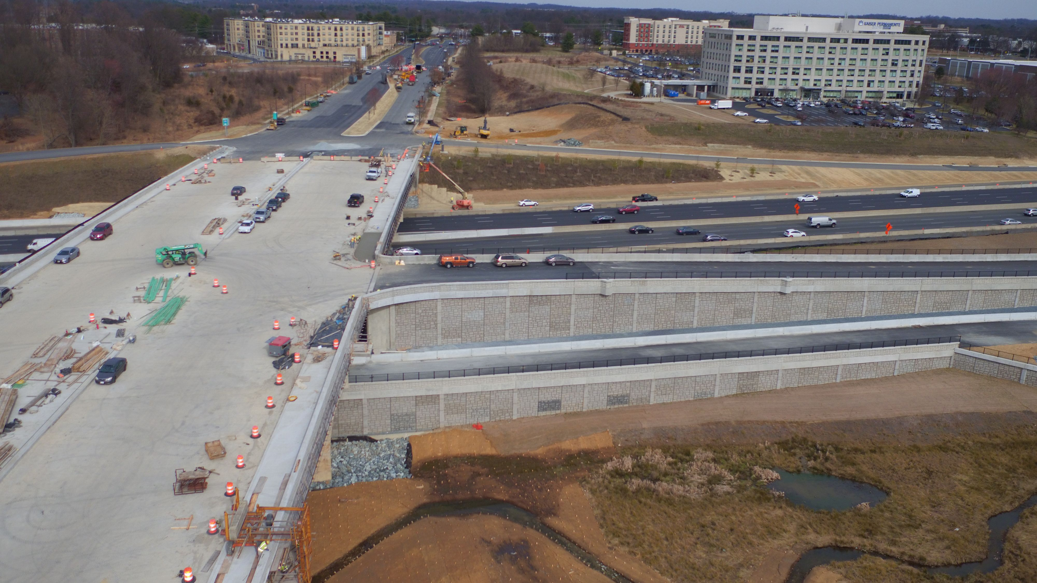
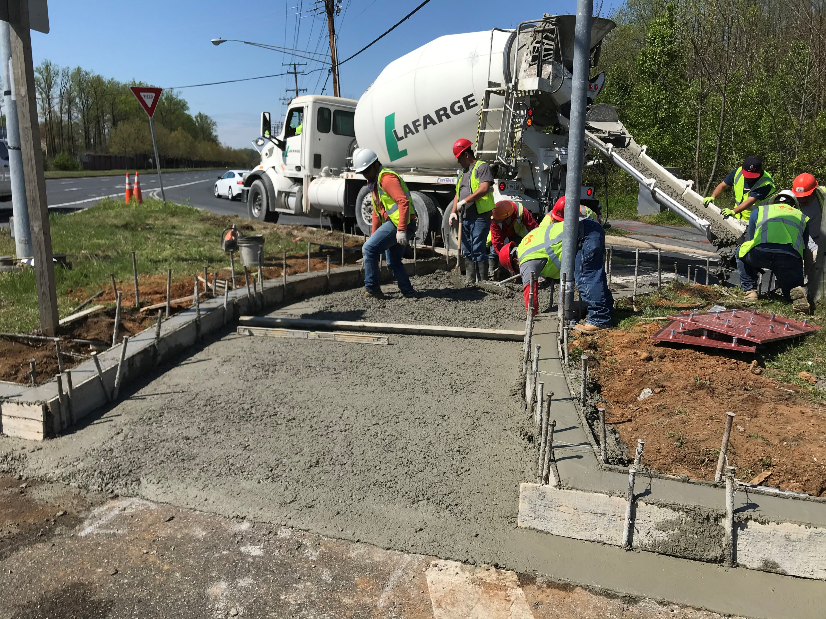
WATKINS MILL INTERCHANGE
Enhanced Accessibility for Bicyclists and Pedestrians

Slide 6
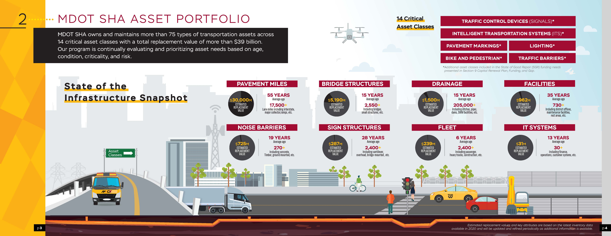
FOCUS ON ASSET MANAGEMENT
Roadway Assets Critical to Infrastructure

Slide 7
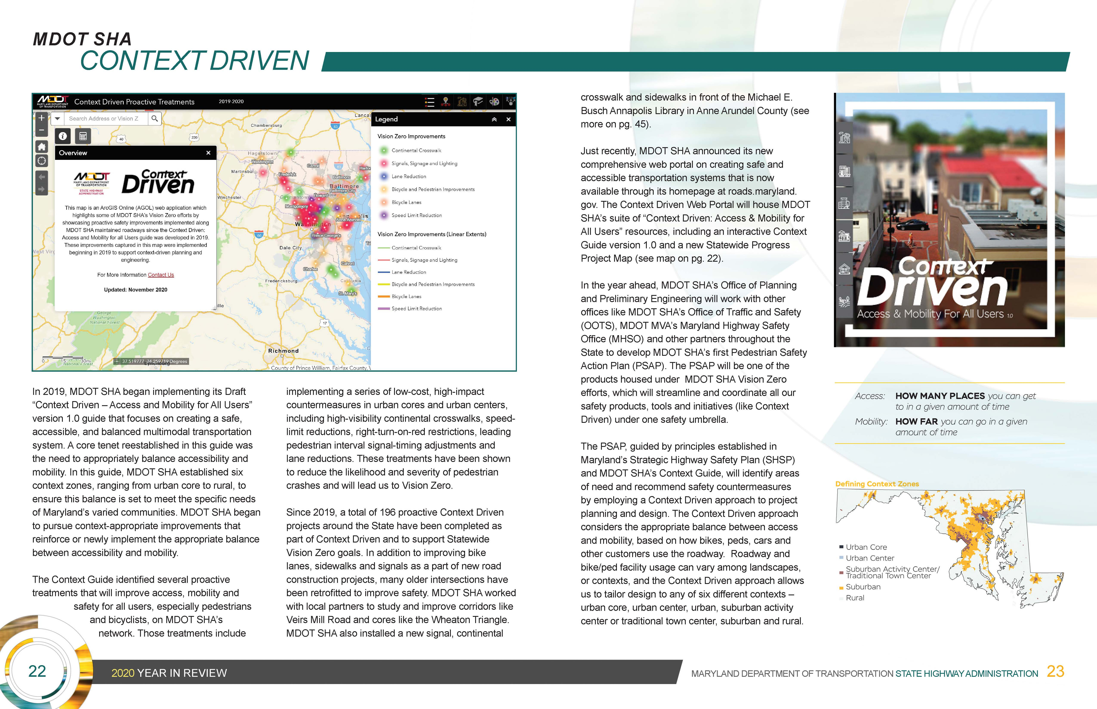
VISION ZERO/CONTEXT DRIVEN
200+ Spot-Location Improvements

Slide 8
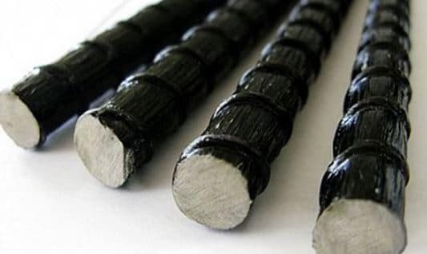
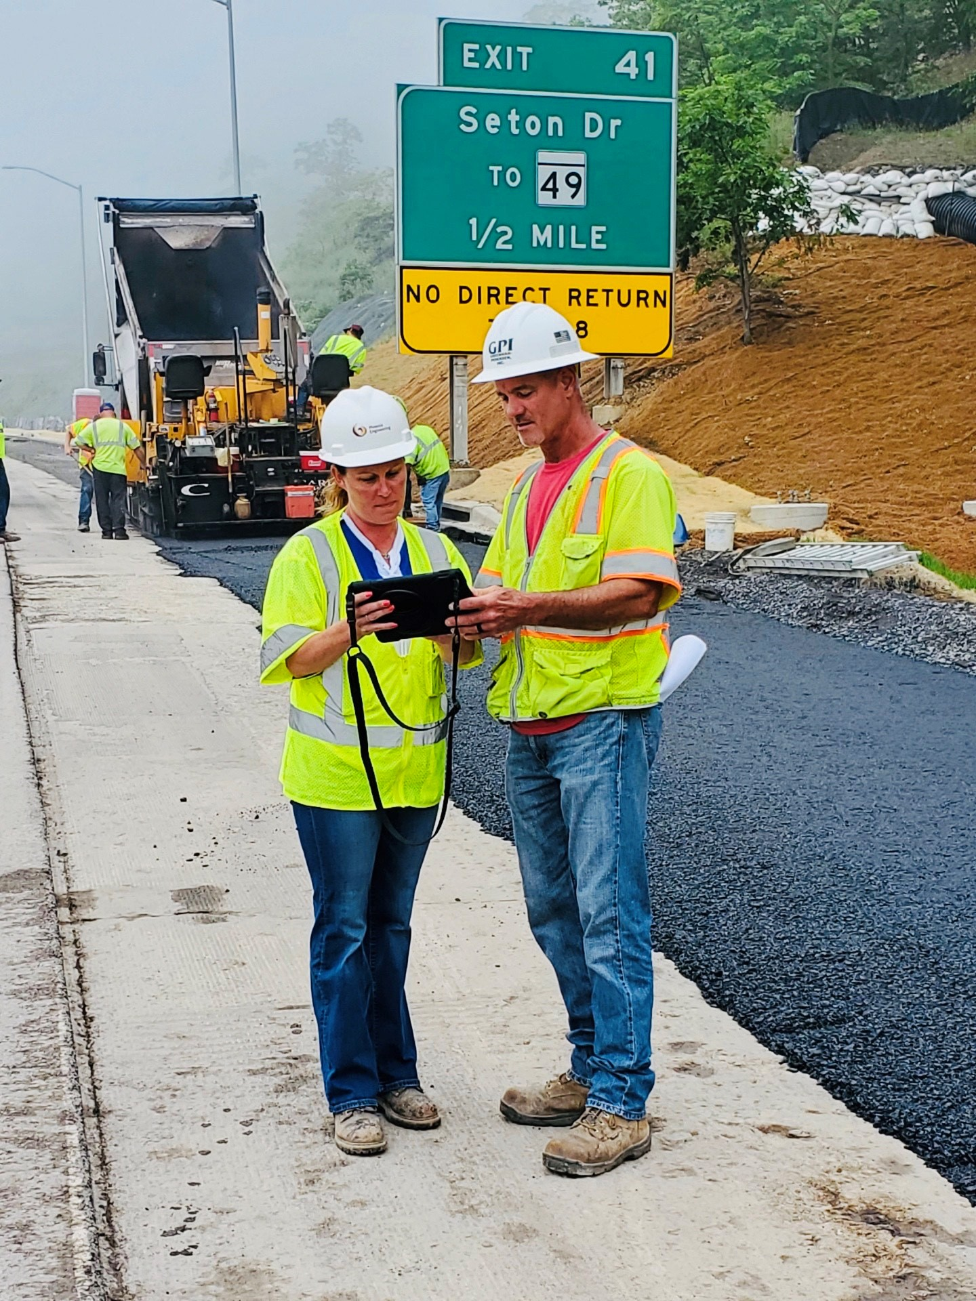
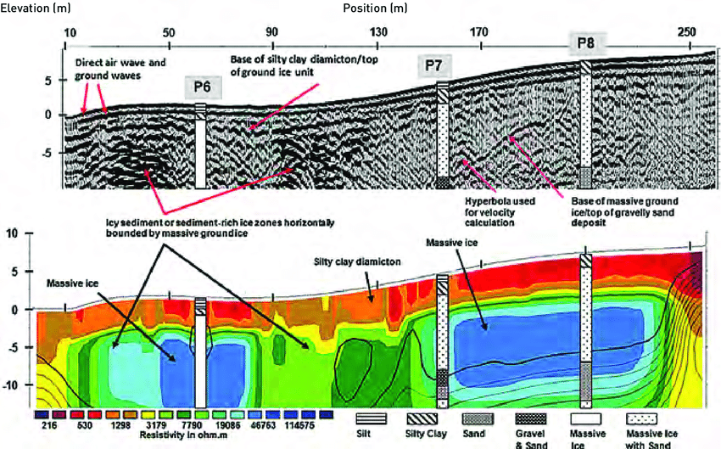
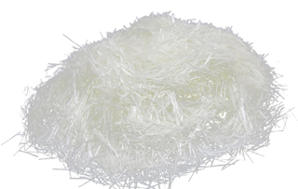
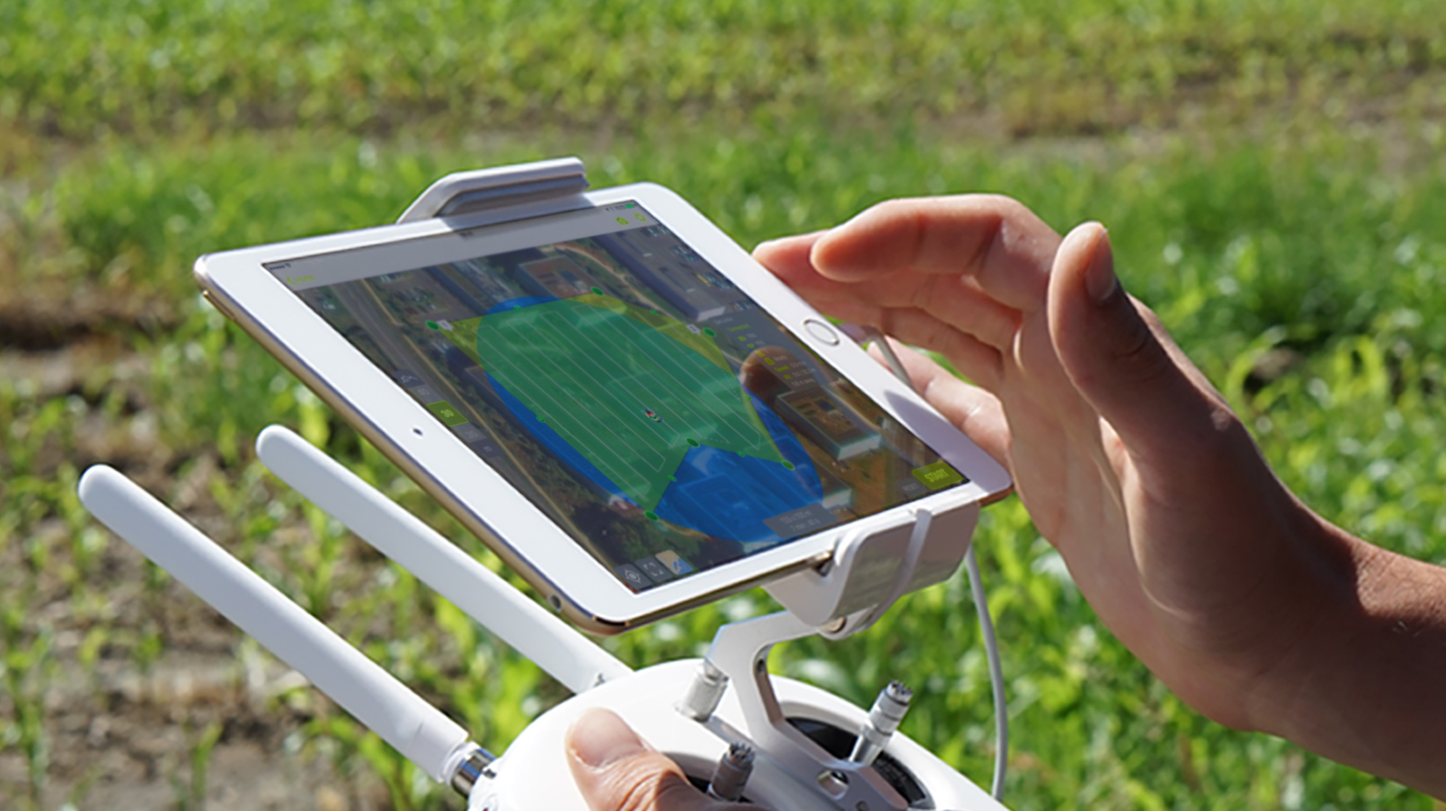
EXPLORING NEW INNOVATIONS
Seeking Creative Ways to How We Do Business

Slide 9
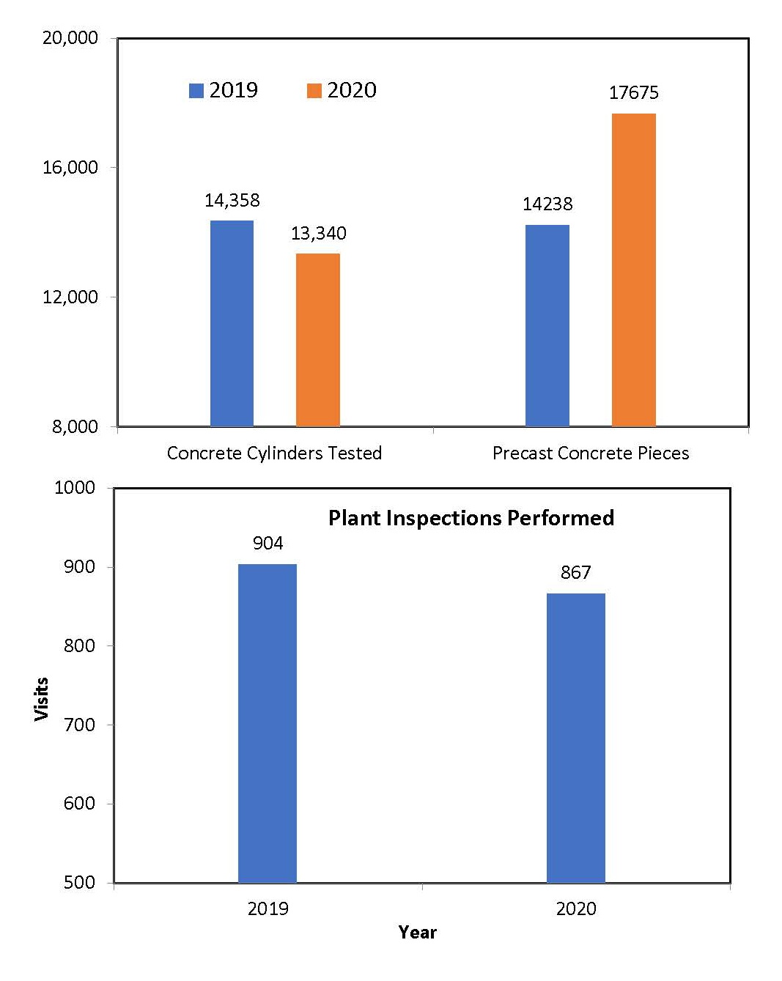
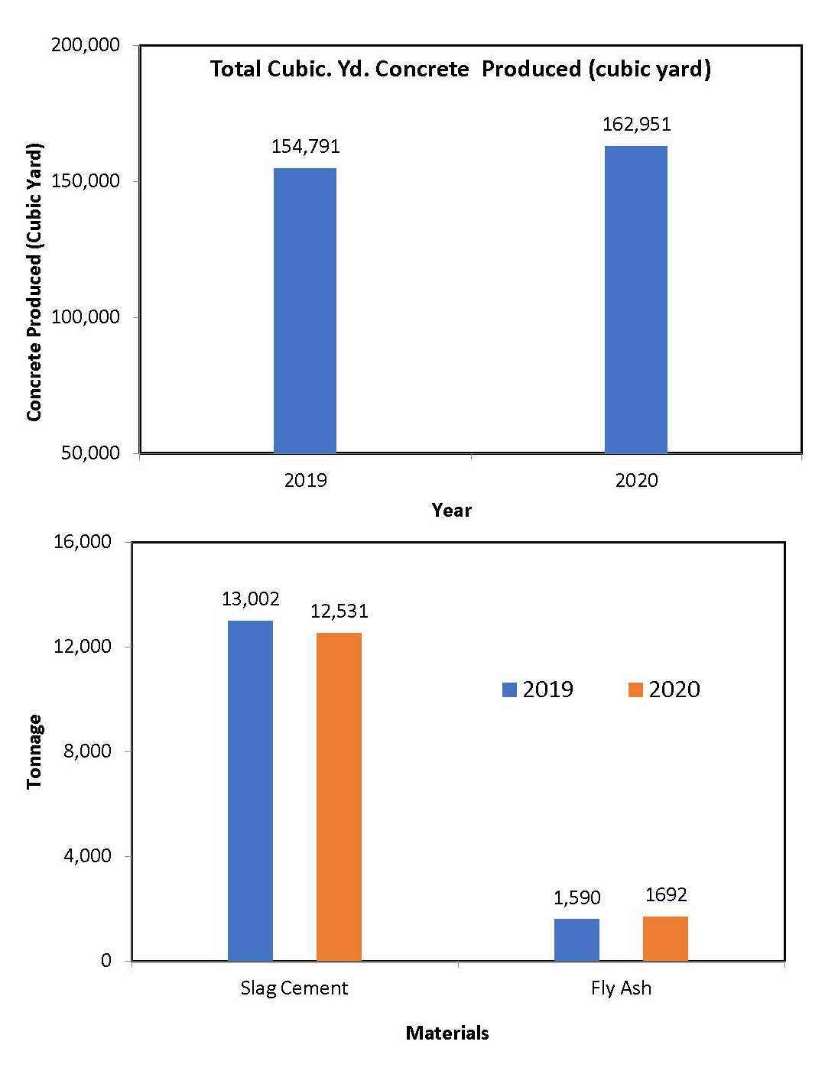
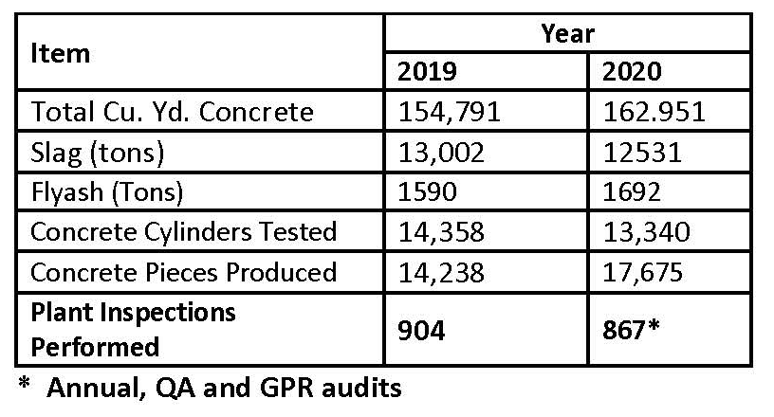
2020: BY THE NUMBERS
How Do We Stack Up?

Slide 10
THANK YOU!

