Slide 1
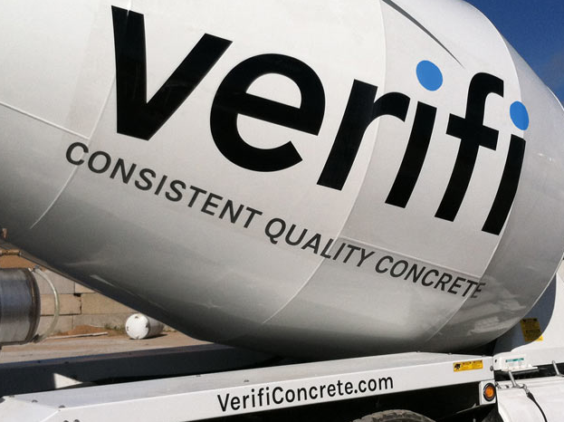
VERIFI®: Revolutionizing the concrete industry
Notes:
Thank you for taking the time today to discuss VERIFI®, GCP’s in-transit concrete management system that is revolutionizing the concrete industry.

Slide 2

THE CHALLENGE
The challenge & opportunity for ready-mix producers
Margins are slim and efficiency is critical
Ready-mix producers operate on razor-thin profit margins, making operational efficiency paramount to making money
VERIFI® can help you operate your business more efficiently
In-transit management of concrete, end-to-end oversight over your product, improved data analytics, and GCP expertise provides opportunity to improve efficiency and decrease risk
2
Notes:
A major challenge ready-mix producers face is slim margins. Razor-thin profit margins are common across the industry and require ready-mix producers to be as operationally efficient as possible.
With VERIFI®, this challenge becomes an opportunity. VERIFI® has the potential to help maximize the efficiency and effectiveness of your business, significantly increasing your profitability.

Slide 3
VERIFI® delivers the data and expertise you need to increase your profitability
THE SOLUTION
VERIFI® In-transit concrete management system
Data science and analytics capabilities
VERIFI®
GCP expertise in materials science & concrete construction
Enabled by internet of things (IoT) technology
3
Notes:
What is VERIFI®? VERIFI® is an in-transit concrete management system exclusive to GCP that helps you manage your concrete quality from the plant to the jobsite in ways never before seen in the industry.
VERIFI® brings together GCP’s deep expertise in materials science and concrete construction with its revolutionary data science and analytics capabilities, all enabled by cutting-edge internet-of-things technology. This allows GCP to improve all facets of your operation, driving your profitability more than a single product ever could.

Slide 4


THE SOLUTION
What is VERIFI® In-transit?
Notes:
This video introduces the basics of VERIFI® In-transit.
https://vimeo.com/289292583

Slide 5
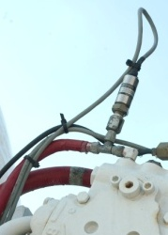

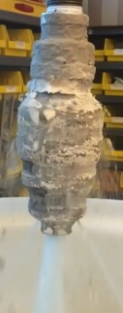

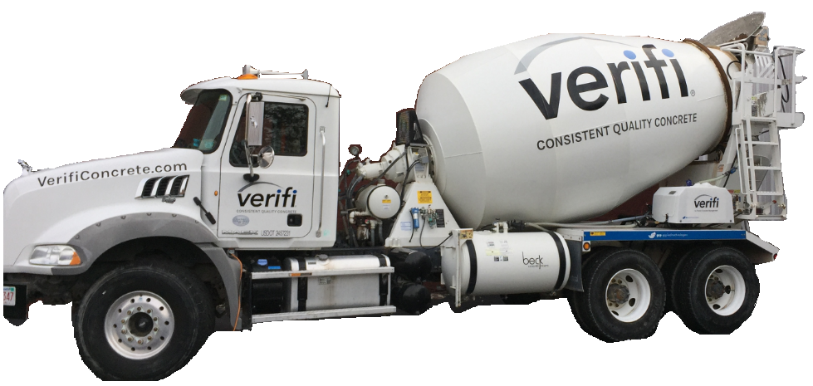

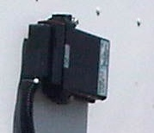
Truck Components
Temperature and Drum Speed Sensor
Water and Admixture Nozzles
Hydraulic Pressure Sensors
Driver Interface
Slump Display
Integrated Admixture Tank with Flow Valves
and Meters
Processor, GPS, and Cellular Modem
Notes:
Common Questions:
What is the reliability of the components?
Overall our systems have upwards of 99% up-time. We own it, maintain it, and are responsible for keeping systems working. We monitor real time all of the major components on the truck, and are able to see when a component goes down, and do triage on the truck easier.
What happens when something breaks?
When we see or are notified of a component failure, a technician will arrive to fix the truck. Most commonly this is done in off peak hours so to not take the truck off of the road. Most common issues can be fixed in 15-20 minutes.
What is the life of the steel probe that goes in the drum?
In analyzing field returned probes there was minimal wear on the steel probe that is in the drum after upwards of 18 months. The batteries will die before the device fails due to wear inside the drum.
What is the battery life of WDS?
The Wireless Drum Sensor batteries consist of 4 lithium batteries inside a rubber casing. Batteries generally last anywhere from 6 to 18 months depending on use and climate.
What is the accuracy of temp sensor?
It is accurate within 2 F or 1C
How accurate are the meters?
The meters are designed to comply with DOT regulations on meter accuracy which is generally +/- 3%
How often are the meters calibrated?
Meters will be calibrated per guidelines set forth in local specifications. This is generally once a year
What networks do you use?
We use A&TT and Verizon in the US
What happens if there is no network coverage?
If there is no network coverage the truck will get its programming instructions following being batched. These instructions are set on the trucks computer, and do not require a network connection. The truck will continue to follow these instructions until reset by another load. Once the truck gets a network connection all information will be uploaded and visible.
What is the capacity of the tank?
12 US Gallons
How does the rev counter work?
There are 12 magnets on the drum and a drum rotation sensor.
Is the rev counter approved by any DOTs?
We are currently working on getting everything officially approved by DOTs.

Slide 6
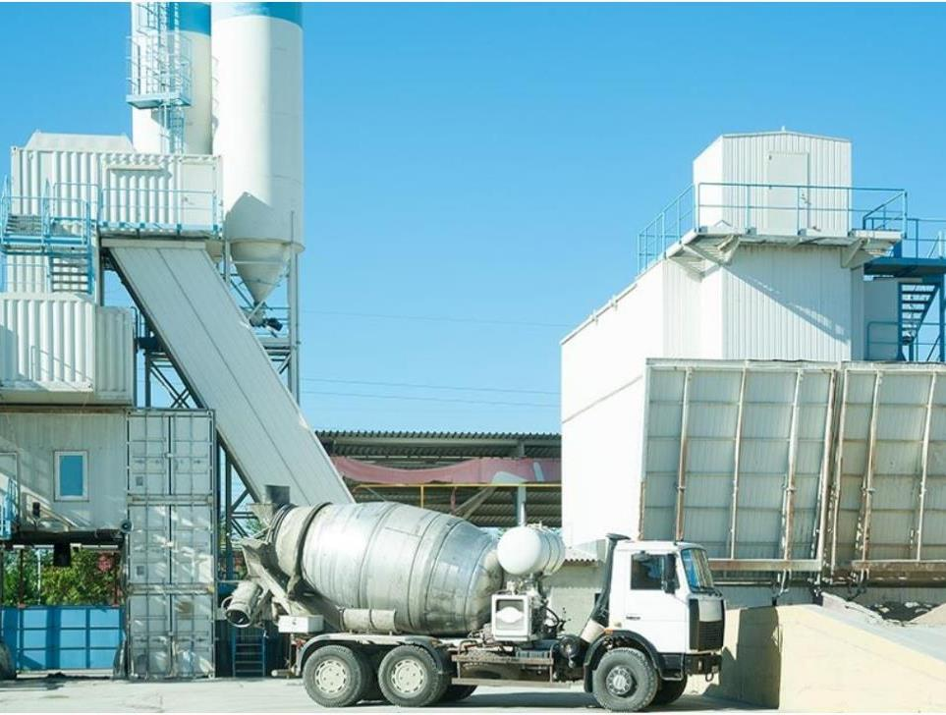
THE SOLUTION
GCP’s tech-enabled solution: VERIFI® In-transit concrete management system
VERIFI® In-transit
Monitors, measures, and manages your product in-transit
Delivers product in-spec every time
Enables improved materials management, operational efficiency, and commercial leverage
VERIFI® In-transit comes packaged with GCP expert services & technical support
POTENTIAL PROFIT ENHANCEMENT¹
~ $2-6 USD / YD³
1 Average-value load, not net of VERIFI® price
Notes:
VERIFI® In-transit will help you improve your materials management, operational efficiency, and commercial leverage by monitoring, measuring, and managing your concrete in-transit.
Enabled by GCP expert services and technical support, VERIFI® In-transit can drive 2 to 6 US dollars per cubic yard of concrete in potential profit.

Slide 7

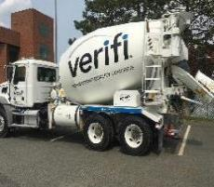
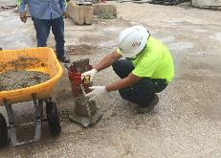
VERIFI® In-transit addresses many operational challenges at the plant, on the road, and at jobsite
THE CHALLENGE & SOLUTION: DEEP DIVE
CHALLENGES WITHOUT VERIFI®
SOLUTIONS WITH VERIFI®
At the plant
Manual slump adjustments at the plant delay truck departure
Trucks can leave plant faster since slump can be adjusted in-transit
Batch personnel have no visibility into slump
Batch personnel can “see” the slump as it’s batched and adjust as needed to hit target slump
On the road
Low fleet visibility hampers productivity
Fleet tracking system & scorecards drive productivity improvements
Dispatch and driver cannot effectively monitor slump
Concrete properties are managed by VERIFI®, so driver never has to play the role of QC tech
Superplasticizer addition at plant is sub-optimal since it is added during batching
Delayed admixture addition greatly improves its dosage efficiency
At the jobsite
Customer doesn’t always pay for long wait times and returned concrete
Automated tracking allows RMPs to charge for overordered concrete, driver wait time, and increased slump sold on site
@Dustin / Susan: photo of VERIFI® personnel?
Variable slump leads to job-site delays, back charges, rejected loads, and wasted cement
Reduced variability in slump greatly minimizes back charges, rejected loads, and job-site waiting time
7
Notes:
The value of VERIFI® comes from the fact that it addresses many challenges that RMPs face. For example:
At the plant, manual slump adjustments often delay truck departure. With VERIFI®, however, slump can be adjusted in-transit, allowing trucks to leave the plant faster.
Additionally, batch personnel currently don’t have visibility into slump after batching. With VERIFI®, however, batch personnel gain that visibility, allowing for better batch control.
Also, it can be difficult to track the status and productivity of your fleet without VERIFI®. But since VERIFI® provides improved monitoring capabilities such as driver scorecards and the Verifi portal, management can better track and encourage performance.
Currently, RMPs use more superplasticizer than they need to. VERIFI helps to reduce this cost by dosing admixture in-transit, late in the delivery process.
Finally, variable slump at the jobsite leads to jobsite delays, backcharges, rejected loads and wasted cement. VERIFI helps to minimize these costly challenges by helping trucks arrive with slump in spec and ready to pour, every time.

Slide 8


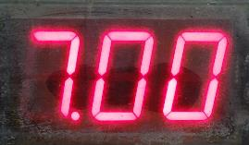


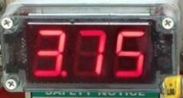
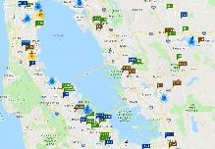


How does VERIFI® address operational challenges? By monitoring, measuring, and managing concrete in-transit
HOW VERIFI® WORKS
How VERIFI® monitors
How VERIFI® measures
How VERIFI® manages
GPS and Cellular Modem to track truck in real time
Exterior Slump Display for measuring slump In-transit
VERIFI® portal displays insights on admixture, slump data
Onboard computer continuously transmits data from the truck to the VERIFI® Portal via the cloud, providing insights into how to improve fleet productivity and more
Using GCP’s proprietary algorithm and sensors fitted on the truck, VERIFI® continuously measures concrete slump and other properties to let you know what is delivered
VERIFI® manages your concrete in-transit to ensure the slump you deliver is that slump that was ordered
8
Notes:
How does VERIFI® address operational challenges? By monitoring, measuring, and managing your concrete in-transit.
VERIFI monitors your concrete and transmits data from trucks to the VERIFI® portal so that you are constantly informed about where your concrete is and how long it has been there.
Using GCP’s proprietary algorithm and sensors fitted on the truck, VERIFI® measures concrete slump to let you know exactly what is being delivered.
But most importantly, VERIFI® manages your concrete in-transit to ensure the slump you deliver is the slump that was ordered, every time.

Slide 9





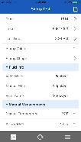
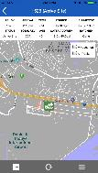


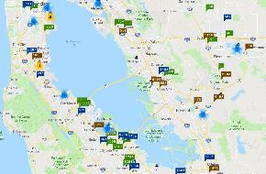

Easy-to-use reporting tools can help you and your customers identify new value opportunities
HOW VERIFI® MONITORS
EXECUTIVE DASHBOARD
Performance Summary
VERIFI® APP FOR GENERAL CONTRACTORS
Daily Loads
Daily Concrete Volume
Top Customer Sites (yd*)
Top Plants by Volume (yd*)
Fenway Plant
Common Plant
Brighton Plant
Charles Plant
Dalton Ready Mix
Roberts Concrete
Alfaro Technologies
Kleider Mix
500
400
300
200
600
700
600
500
Productivity
Avg. Trip Time (mins)
Avg. On-Site Wait Time (mins)
Daily Avg. Loads per Truck
Daily Avg. Load Size
VERIFI® PORTAL
Quality
% Loads Batched Too Wet
% Loads Arrived Site Too Wet
% Loads Discharged Too Wet
% Loads Discharged Too Dry
VERIFI® executive dashboard, portal and mobile app include full set of customizable reports and analyses to give deep visibility into business productivity and performance relative to peers
VERIFI® specialists will support you in understanding new data and using it to drive mix design decisions, driver performance tracking and contractor discussions
9
Notes:
VERIFI® also monitors your operations and helps reveal real insights to improve your business.
Easy-to-use customizable reporting helps you to understand your data and make actionable decisions.
The executive dashboard gives you a snapshot of your day-to-day performance.
The Portal allows you to track every load in-detail.
And the App allows you to engage your contractors in being more efficient.
GCP specialists will support you in understanding and using all of this new data in ways that improve your profitability and capture value for your business.

Slide 10

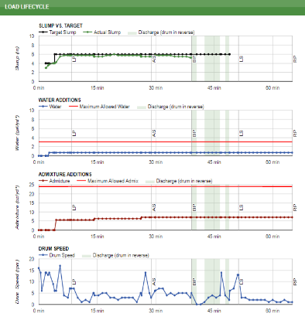

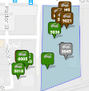
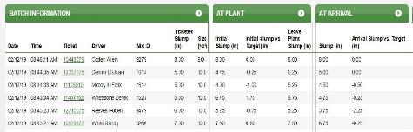
VERIFI® portal provides detailed, live visibility into truck status and load properties
HOW VERIFI® MONITORS
VERIFI® portal offers detailed view into truck location and status during batching, in-transit & at jobsite
Portal functionality provides information on slump, water additions, admixture additions, and drum speed
Loaded
Slump vs. target
Discharging
At plant
Slump (in)
Ignition off
Water additions
Water (gal/cyd)
Admixture additions
Admixture (oz/cyd)
Drum speed
Drum speed (rpm)
10
Notes:
The VERIFI® portal in particular allows users to gain deep visibility into truck status and concrete load properties – including slump, any water additions, admixture additions, and drum speed throughout the delivery process. Drivers and managers can gain real time access to this data via the portal’s easy-to-use cloud-based functionality.

Slide 11

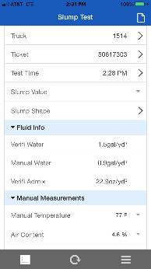
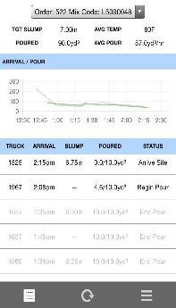
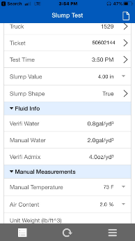
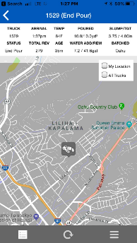
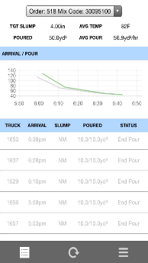
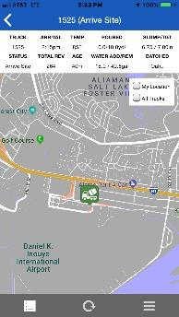
VERIFI® mobile app for contractors allows on-the-go monitoring of pours
HOW VERIFI® MONITORS
VERIFI® mobile app provides slump and truck location data, as well as other relevant information, making it easy for general contractors to access data about the pour real-time, which ultimately helps everyone operate more efficiently
11
Notes:
In addition to a browser based portal and reporting tools for your business, VERIFI® offers customers a mobile application to access their concrete information. The mobile app offers real time jobsite information including truck location and status, slump, temperature, and fluid additions. Ready mix producers have the ability to share the application with their customers so they can see jobsite information real time.
For the technical departments, there is a built in QC app which allows information to be entered on field test results.

Slide 12
VERIFI® manages concrete with precise slump control using water & admixture
HOW VERIFI® MEASURES & MANAGES
Histogram of average discharge slump
Slump is continuously measured and managed with admix or water throughout the delivery process
Ghost¹
Live²
Slump vs. target (illustrative)
150
Leaving plant
At site
100
Slump (mm)
-4.8
-3.2
-1.6
0.0
1.6
3.2
4.8
50
Value: Average discharge slump
Target slump
Admix is added
Admix is added
Actual slump
Slump is continuously measured and managed with admix or water throughout the delivery process
Discharge
0
0 min
30 min
60 min
1 Ghost mode happens immediately after installation but before VERIFI® starts managing concrete as the system is calibrating
2 Go-live marks the end of Ghost mode and beginning of active concrete management
Notes:
VERIFI will give you confidence that your product will be delivered in-spec. It measures slump continuously in-transit, and if slump ever differs from target, it adjusts the slump using water or admixture.
The end result of this process is that concrete is delivered to the job site within slump targets, adhering to limits on water and admixture.

Slide 13
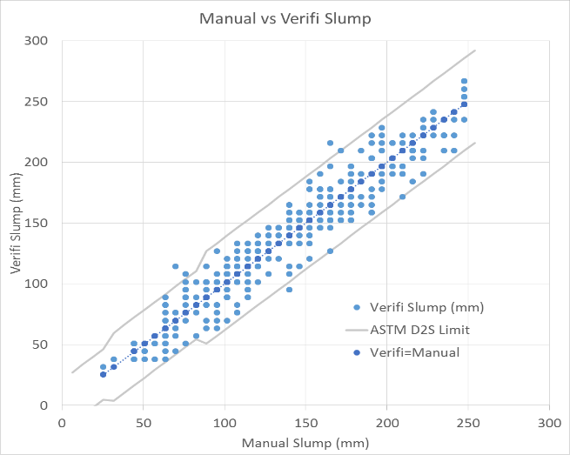
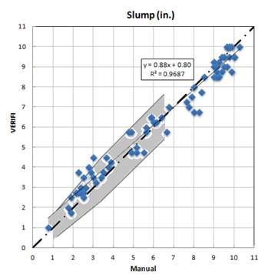
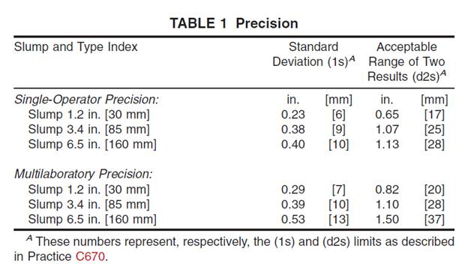
Accurate slump measurement
HOW VERIFI® MEASURES
Validation from GCP
Validation from Outside GCP
Data represents all parallel Verifi and manual slumps for the month of March from four customers in North America with extensive QC programs
386 separate comparisons
Manual Slumps were entered into the Verifi App and paired automatically to Verifi calculated slump
75% of the manual slump data came from customer QC departments; the remainder from GCP technicians
Property Ranges
Cement factor: 250 – 500 kg/m3
Slump range: 25 – 250 mm
Load Size: 2.5 to 7.65 m3 Pure OPC to ternary cementitious systems
“Automated Measurement and Control of Concrete Properties in a Ready Mix Truck with VERIFI”
Kamal H. Khayat, Ph.D. (PI) Nicolas Ali Libre, Ph.D. (Co-PI)
“Compared to current industry practices, VERIFI provides more accurate and complete documentation of concrete properties, including all additions of water…”
Khayat and Libre
ASTM Precision Data
http://transportation.mst.edu/media/research/transportation/ documents/R335%20Final%20Report.pdf
Notes:
VERIFI will give you confidence that your product will be delivered in-spec. It measures slump continuously in-transit, and if slump ever differs from target, it adjusts the slump using water or admixture.
The end result of this process is that concrete is delivered to the job site within slump targets, adhering to limits on water and admixture.

Slide 14
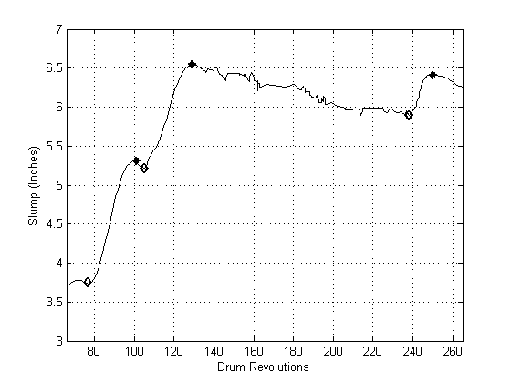
What about water outside the system?
HOW VERIFI® MEASURES
Verifi “knows” how many revolutions it takes to mix in water
Slump increase of X requires Y water
Suspicious increase in slump
Using data collected throughout deliveries where water was added Verifi can accurately predict how much water is being added from outside sources
Notes:
VERIFI will give you confidence that your product will be delivered in-spec. It measures slump continuously in-transit, and if slump ever differs from target, it adjusts the slump using water or admixture.
The end result of this process is that concrete is delivered to the job site within slump targets, adhering to limits on water and admixture.

Slide 15
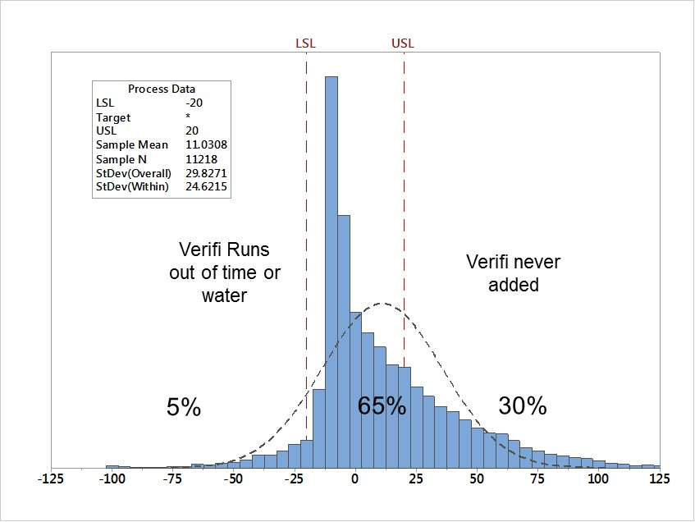
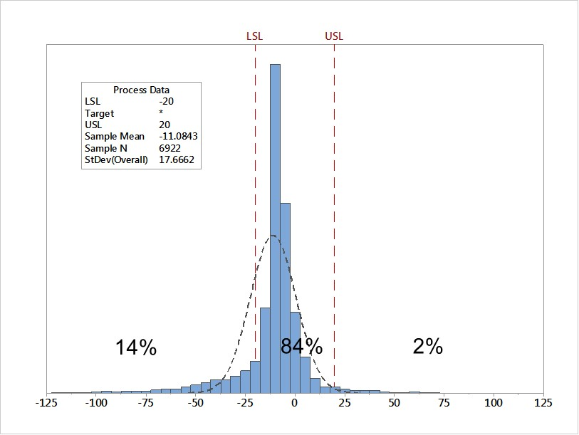
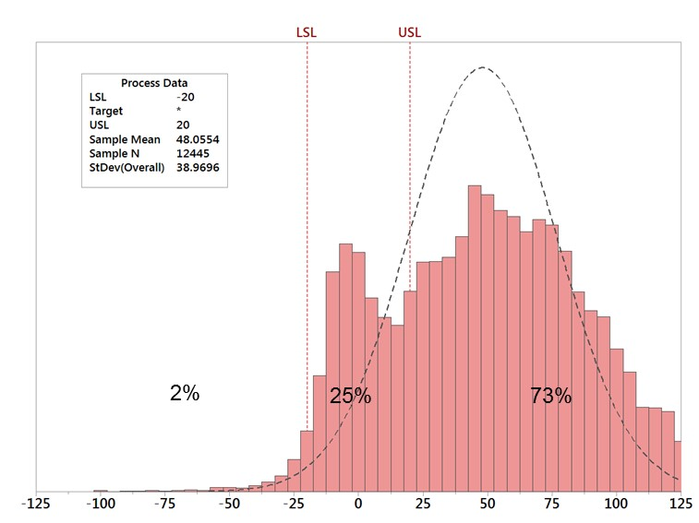
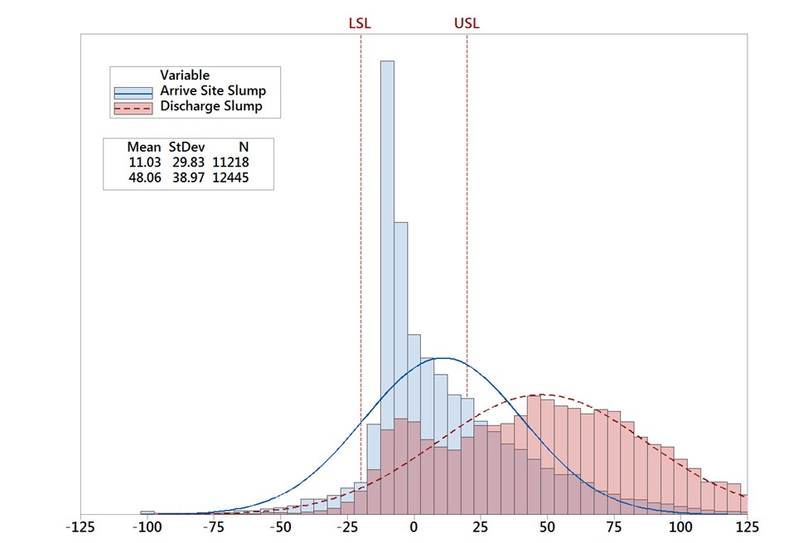
100mm slump data
HOW VERIFI® MEASURES & MANAGES
100mm slumps; N = 11,000 loads
100mm slumps; only loads managed by Verifi
± 20mm slump target
After Job Site Water Additions
Comparing Arrive Site to Discharge Slumps
Notes:
VERIFI will give you confidence that your product will be delivered in-spec. It measures slump continuously in-transit, and if slump ever differs from target, it adjusts the slump using water or admixture.
The end result of this process is that concrete is delivered to the job site within slump targets, adhering to limits on water and admixture.

Slide 16
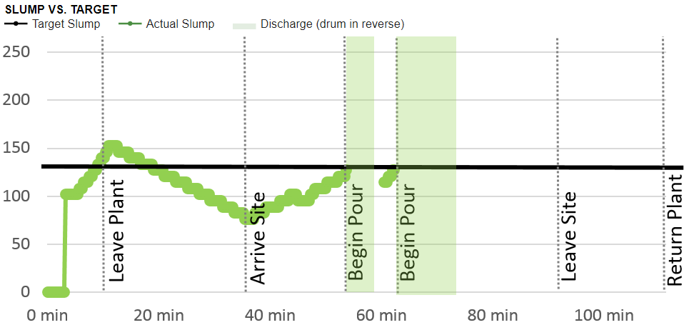
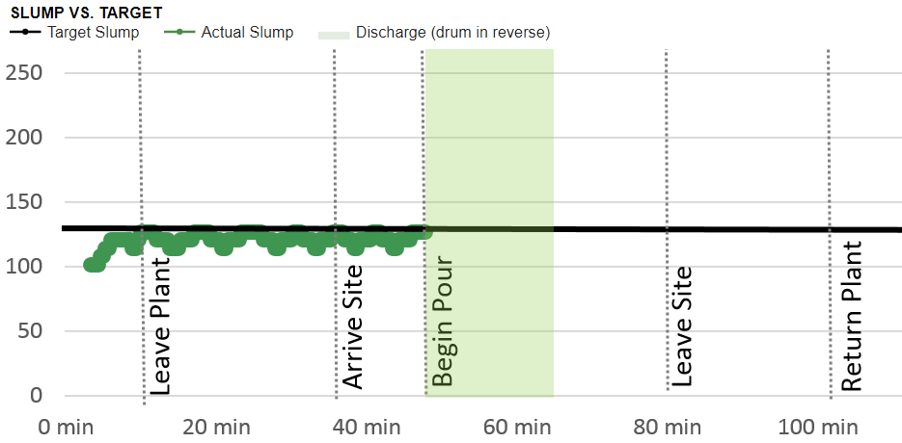
VERIFI® can help you reduce delivery time
HOW VERIFI® DRIVES VALUE: OPERATIONAL EFFICIENCY
Eliminating water additions at the batching plant, water additions at the job site, and job site slump tests reduces overall delivery times which improves your productivity
At the peak production periods, even 10-15 minute time savings/trip means more deliveries with a fixed number of trucks
Notes:
VERIFI® also helps you improve your productivity by reducing your round-trip delivery time.
By eliminating slump adjustments at the plant and arriving at the jobsite ready to pour, trucks require less time to complete the same trip.
Here, we show the range of round-trip times that have been measured with Verifi, with best potential improvement of delivery time reduction at 20%.
This can substantially impact your productivity – even 10 to 15 minute savings for each trip means more deliveries with a fixed number of trucks. Taking even 5 trucks off the road can result in savings of around 60 cents per cubic yard for a 100 truck operation.

Slide 17
HOW VERIFI® DRIVES VALUE: COMMERCIAL LEVERAGE
VERIFI® can help you reduce rejected loads
Histogram of average discharge slump
VERIFI® will reduce the number of loads rejected for being out of tolerance for slump or w/c ratio
Eliminating manual water additions at the batching plant also reduces delivery time, and thereby reduces rejections due to late arrival at the job site
Profit is enhanced through revenue assurance and avoided disposal costs of rejected load
Ghost
Live
-4.8
-3.2
-1.6
0.0
1.6
3.2
4.8
Value: Average discharge slump
Notes:
VERIFI® also helps make sure that you get paid for every cubic yard of concrete you produce.
By reducing the variability of slump arriving at the jobsite, VERIFI ensures that the slump you deliver is within the target slump specifications needed, thereby reducing rejected loads.
Here, we show the discharge slump distribution before and after Verifi goes live. You can see the distribution becomes much narrower with Verifi.
As shown in this example, this could translate to as much as 50 cents per cubic yard in value, due to a reduction in the frequency of rejected loads by 50%.

Slide 18
VERIFI® can help you reduce admixture usage
HOW VERIFI® DRIVES VALUE: MATERIALS MANAGEMENT
VERIFI® adds admixture in a delayed-addition mode, which uses materials more efficiently than the traditional process
In this case, VERIFI® used 20% less admixture to achieve a higher slump than the traditional upfront addition method
Slump, mm
VERIFI® managed – 80% dose
300
Upfront 100% dose
250
200
150
100
50
0
0
10
20
30
40
50
Time, min
VOLUME WITH HRWR (%) | AVG HRWR USAGE ($/CYD) | VERIFI® REDUCTION (%) | SAVINGS ACROSS ALL YARDS ($/CYD)
45% | 3.25 | 20% | ~0.30
Volume with HRWR (%)
Avg HRWR usage ($/cyd)
VERIFI® Reduction (%)
Savings across all yards ($/cyd)
45%
$3.25
20%
~$0.30
Value estimates based on reasonbale midpoints within $2-6 / cyd In-transit range
18
Notes:
Let’s talk more about each source of value.
One way in which VERIFI® can help you manage your materials is by helping you reduce your admixture usage. Since VERIFI® uses a delayed-addition process, it uses materials more efficiently than the traditional method. As an example, the graph you see here displays that VERIFI® used 20 percent less admixture to achieve a higher slump than the traditional method would have.
For an RMP that uses superplasticizer on 45 percent of loads, this can mean around 30 cents per cubic yard in admixture savings across all loads.

Slide 19
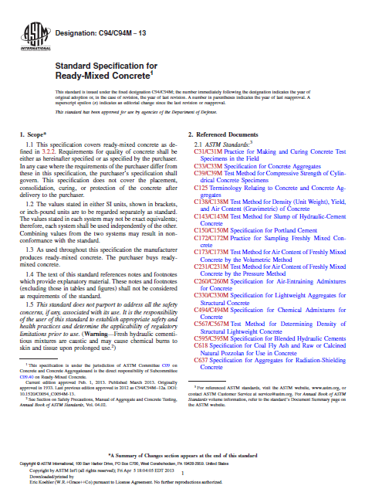
Industry Changes
ASTM C-94 update
What Changed?
ASTM C94 now allows water additions in transit
on trucks equipped with automated slump and
water management systems. The maximum
w/c cannot be exceeded.
Why Did This Change?
Previously, any water added on the truck needed
to be added at the jobsite so that an inspector could
be present.
What Are The Benefits?
Concrete arrives ready to pour. Water additions are automated and documented, on every load.
What Can I do?
Ensure specifications indicate that: “Water shall be added in accordance with ASTM C94.”
Notes:
VERIFI® also helps make sure that you get paid for every cubic yard of concrete you produce.
By reducing the variability of slump arriving at the jobsite, VERIFI ensures that the slump you deliver is within the target slump specifications needed, thereby reducing rejected loads.
Here, we show the discharge slump distribution before and after Verifi goes live. You can see the distribution becomes much narrower with Verifi.
As shown in this example, this could translate to as much as 50 cents per cubic yard in value, due to a reduction in the frequency of rejected loads by 50%.

Slide 20
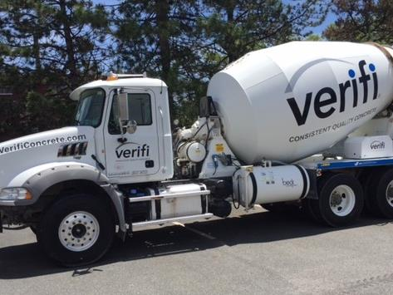
How do we know this? GCP has data from across the industry, and knows how you can improve your business
WHY WE KNOW IT WORKS
VERIFI® is installed on trucks across the globe, helping customers understand and improve performance
Use GCP’s industry benchmarks to understand where you can improve
GCP’s proprietary knowledge offers a competitive advantage
3000+
trucks
50M+
cubic yards of concrete
100+
patents globally
20
Notes:
We know this value is real because we’ve seen it in the field. VERIFI® is currently driving benefits on more than 3000 trucks, which have collectively poured more than 50 million cubic yards of concrete. We also have 100 plus patents globally.
Partner with us, and we can bring this experience and expertise to your operation. We know how to make your operation best-in-class.

Slide 21
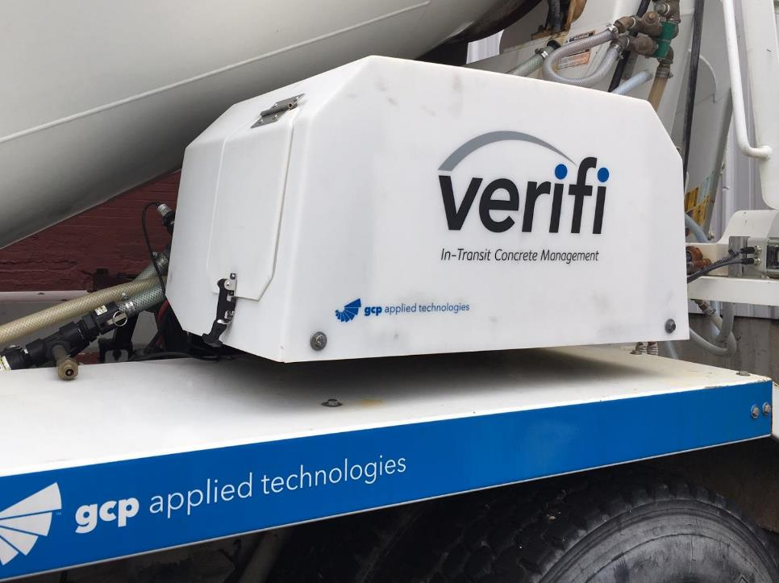
Questions?
Thank you
Matthew Nazarenko
Business Manager- Verifi
Cambridge, MA
21
Notes:
If you’re interested, please discuss next steps with our sales representatives!

