Slide 1
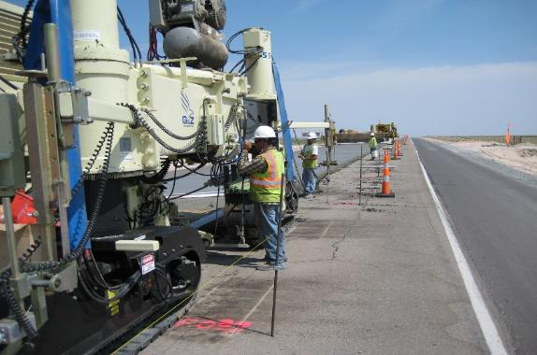
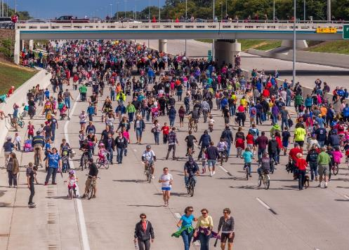
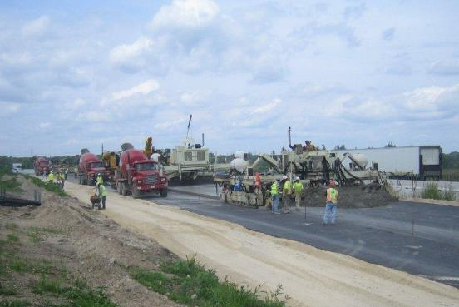
MOT Innovations Beyond Maryland!
17th Annual
Concrete Conference
Timonium, MD
March 15th, 2016
Leif G. Wathne, P.E.
American Concrete Pavement Association

Slide 2
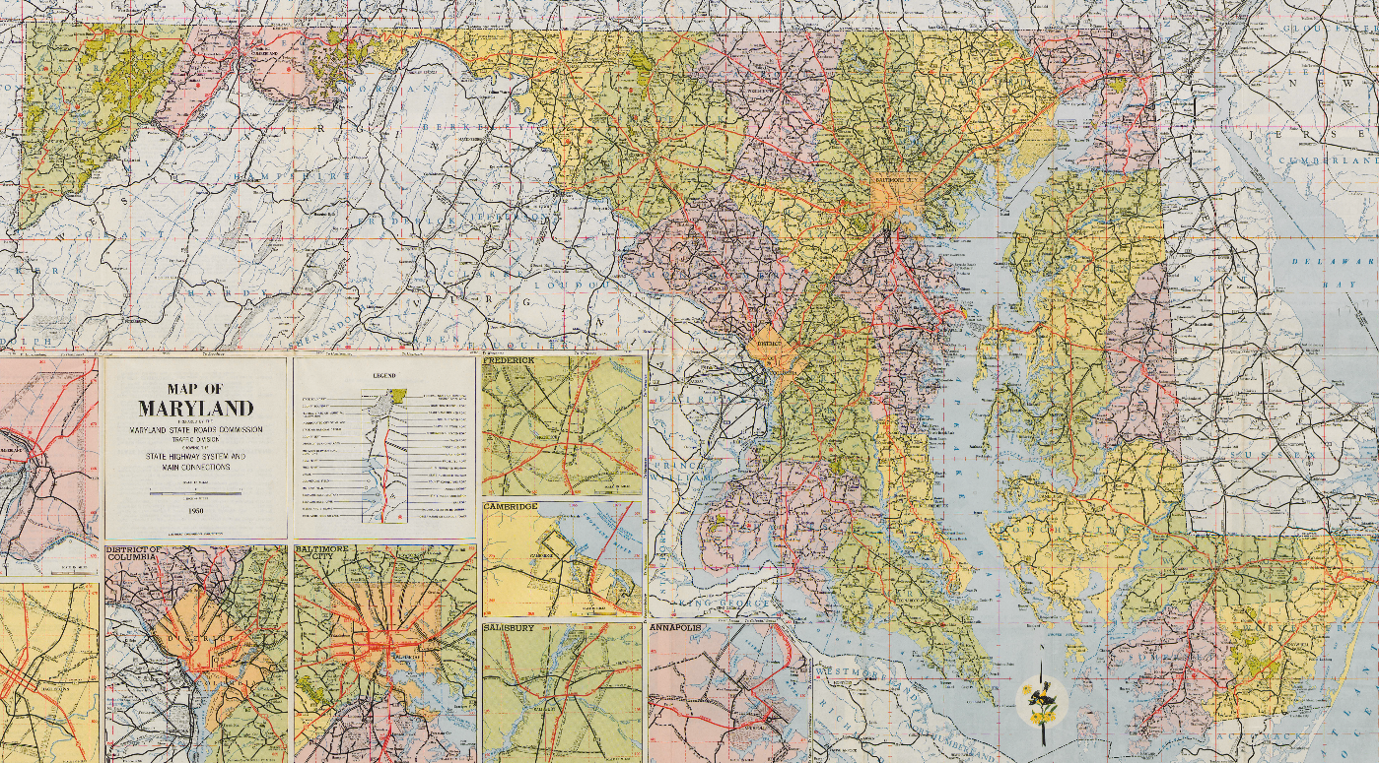
Maryland
Road Test ONE-MD
Where, When, What, Why..?

Slide 3
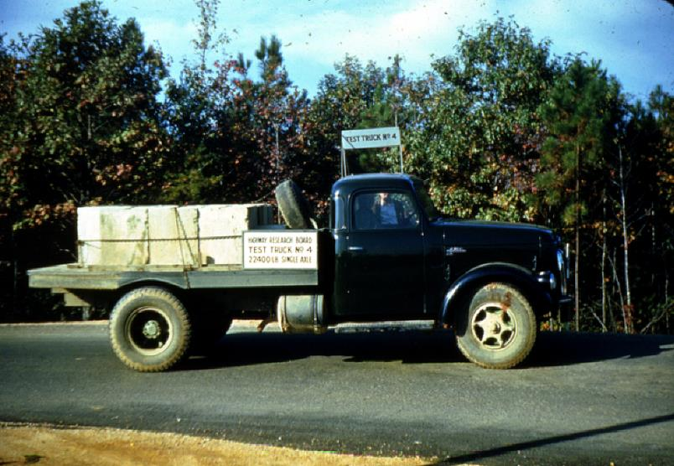
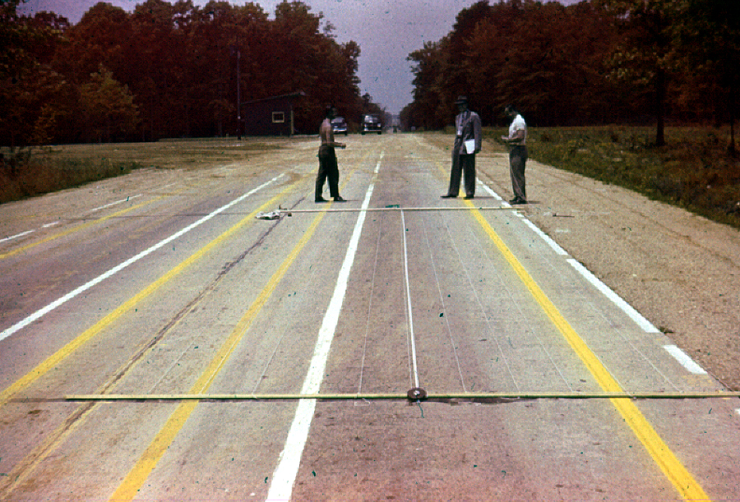

Slide 4

Challenge
Lots of movement of people and goods
System is saturated
System is TIRED!
Need to do significant
  Rehab
  Resurfacing
  Reconstruction & New
What is Concrete Pavement’s role?

Slide 5

Sometimes hear…
We’d love to do concrete pavement, but we can’t, because of MOT (Maintenance of Traffic) issues…
CAN do concrete – its done routinely elsewhere…
  Urban
  Rural
  2-lane roadways
  Multilane divided highways

Slide 6
Examples…
www.acpa.org/MOT

Slide 7

Some Myths about Concrete and MOT
Concrete takes too long to open to traffic
Concrete pavement requires different MOT considerations
Concrete pavement is too hard to build
If concrete pavement is opened to traffic too soon, durability suffers
Fast track concrete deals only with materials
Its better to inconvenience public only a little even if it takes longer to finish
[ myth - a widely held but false belief or idea ]

Slide 8
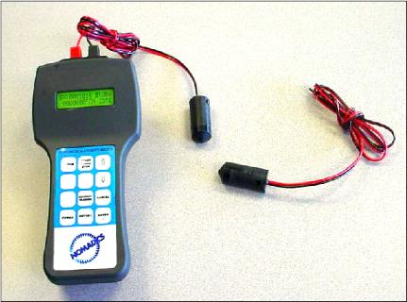
Myth: Concrete takes too long to open to traffic
Conventional concrete can meet strength in less than 12 hours
Fast setting mixtures in 4 hours.
Strength, not time, should be specified
  Use of maturity is helpful
  Use of blankets where appropriate
Different mixtures for different needs…

Slide 9
Myth: Opening to traffic too soon will compromise concrete durability
Early opening to traffic affects neither concrete’s ultimate strength nor its durability.
Durability is related to other factors of concrete – mostly mixture related.
Ensure opening strength is high enough to support traffic – in most cases 300 psi flex.

Slide 10

Myth: Its better to inconvenience the public only a little even if it takes longer to finish.
Regarding duration and impact of a project, the public would rather be bothered a lot for a short period of time, than a little for a long period of time.
Prefer reducing number of work periods as well. Get in, get out, stay out!
Communication is critical
When public engaged – approval goes up! ALL ABOUT EXPECTATIONS

Slide 11

Challenge
Optimizing
  Project Life Cycle Cost
  Societal Cost
  Highway (public) Safety
  Traffic Work Zones
  Constructability
Considering
  Owner’s, Contractor’s and User’s concerns

Slide 12
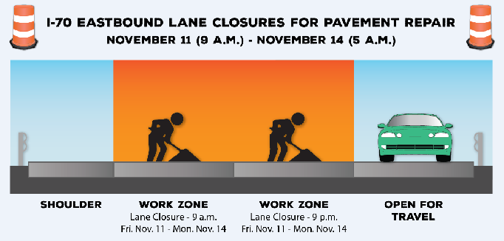
Major Factors…
Setting Expectations
  Communication
  Public information programs
  Social Media
Accelerating Construction/Fast Track
  Planning and contracting
  Appropriate concrete mixtures, and construction
  Curing and temperature management
  Appropriate opening to traffic criteria – maturity.

Slide 13

Setting Expectations…
Explain the what, where, when, how and why! Also ASK!
Engage community in decision-making – don’t just react to perceived wants/needs
  Surprised at outcomes!
Information is power
Predictability has value

Slide 14
Accelerated Construction (Fast-Track)
[Strategies to shorten construction time]
Planning (allow for engineering solutions)
  Partnering-based project management
  A+B+C contracting, Lane Rental, Night Construction
  Allow “innovative” procedures to expedite
    Stringless, “zero-clearance” pavers, on-site recycling, multiple mixtures, DBIs, private agreements, etc.
  Provide for accelerated approvals, staffing, etc.
  Specify construction period needed
  Avoid sweeping statements like (unless necessary):
  “Owners shall have access at all times”

Slide 15
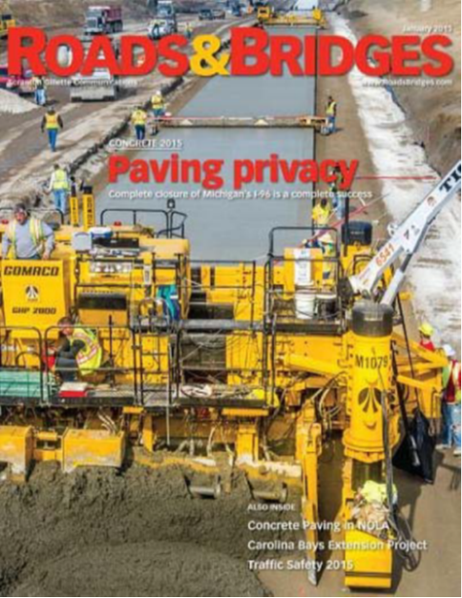
Accelerated Construction (Fast-Track), cont…
[Strategies to shorten construction time]
Concrete Materials
  Use conventional mixtures when possible
  Multiple mixtures available
  Optimized gradations
  Accelerated testing (maturity curves)
Early age sawing, sealant?

Slide 16
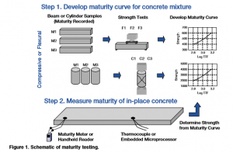
Accelerated Construction (Fast-Track), cont…
[Strategies to shorten construction time]
Concrete curing and temperature management
  Curing blankets when beneficial
  Elevate concrete temperatures
  Admixtures
  In-situ/non-destructive testing to supplement or replace conventional testing.

Slide 17
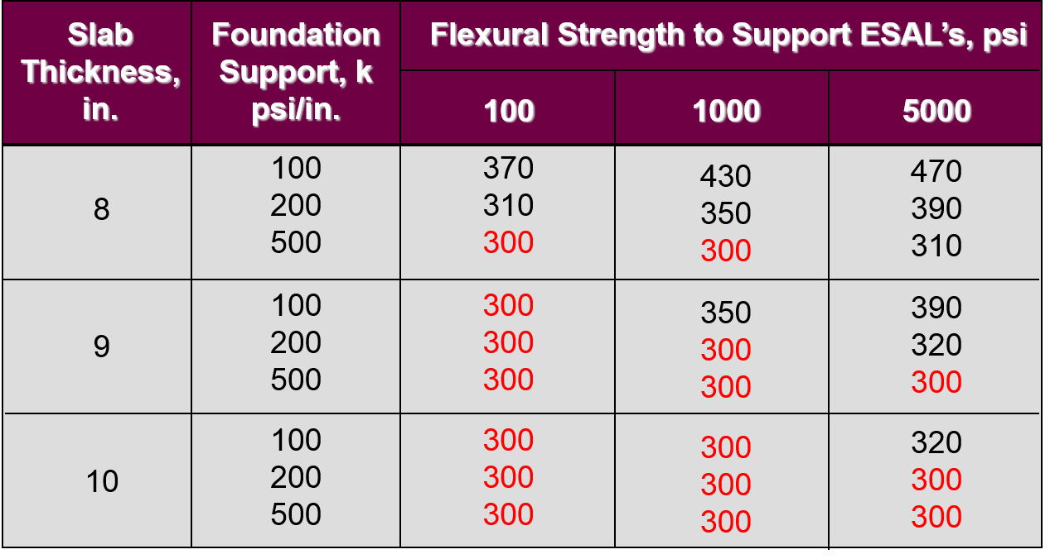
Accelerated Construction (Fast-Track), cont…
[Strategies to shorten construction time]
Traffic Opening Criteria
  Revise from time to in-place strength
  Channel traffic away from slab edges
  Restrict to car traffic during early stages
  300 flex ~ 1,200 comp
  6” overlays ~ 2,000psi
FHWA-SA-94-080

Slide 18
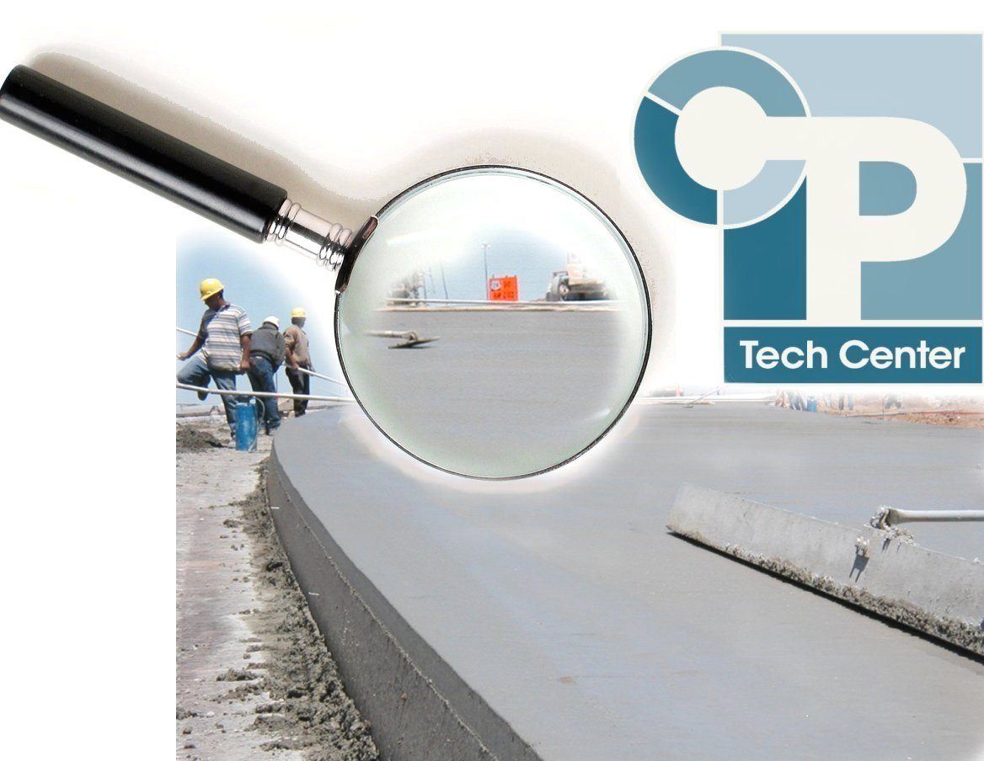
Examples of MOT for concrete
MOT Innovations Beyond Maryland

Slide 19
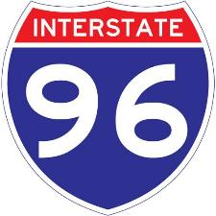
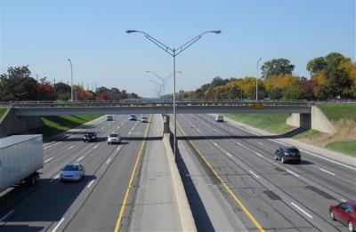
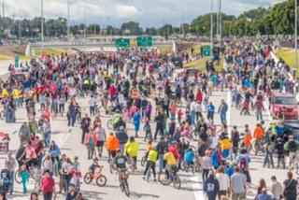
Recent MOT Example #1
fixed
7 mile freeway in Detroit Suburb
140,000-163,000 ADT
40 year old concrete/composite
7 interchanges, 37 bridges
700,000 SY concrete pavement
$148M in 167 days
Partnering, multiple innovations
Stakeholder Engagement
Apr 7, 2014
Sep 21, 2014

Slide 20
Recent MOT Example #1
fixed
It CAN be done!
Allowed for accelerated timeline
Significant taxpayer savings

Slide 21

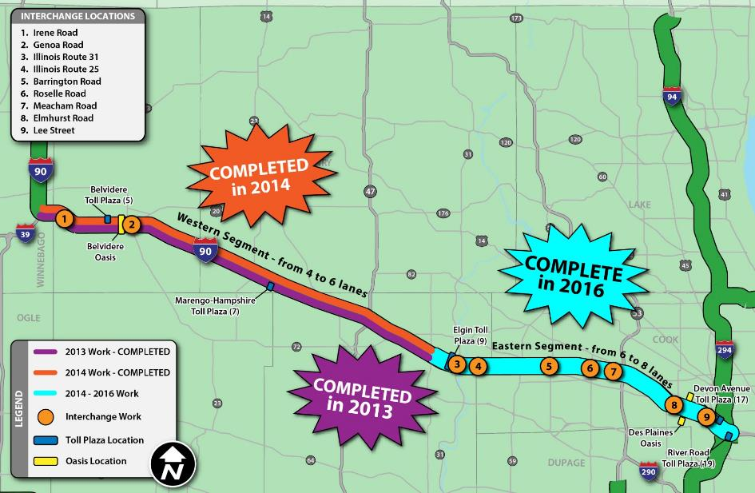
Recent MOT Example #2
Jane Addams Memorial Tollway
$2.5 billion reconstruction and widening of 62 mile corridor

Slide 22

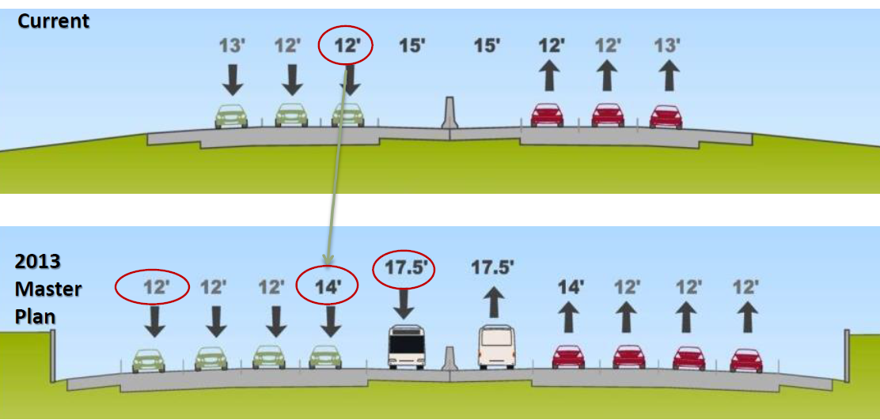
Recent MOT Example #2
Adds a lane in each direction while reconstructing
Wider inside shoulder and lane 1
Reconstruct outside lanes ‘15 and inside lanes ‘16

Slide 23
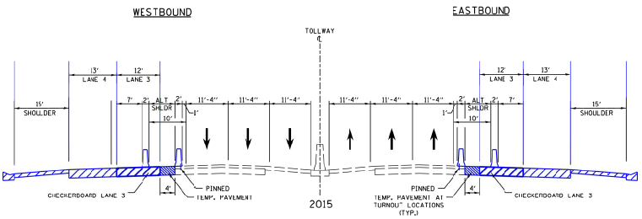
Recent MOT Example #2
2015 MOT – traffic on existing lanes 1 and 2 and inside shoulder (maintain 3 lanes throughout)
Construction of outside lanes 3 and 4
Entire length barrier wall pinned
Emergency turnouts every ½ mile (no shoulder)
[Switch to outside lanes in 2016]

Slide 24
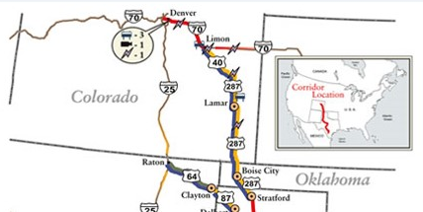
Recent MOT Example #3
US 287 in Colorado - 120 mile asphalt “Ports to Plains” truck corridor converted from asphalt to concrete overlay
Typical 10.75” concrete overlay on milled hma
Chose pilot car over detour and 3-phase option

Slide 25
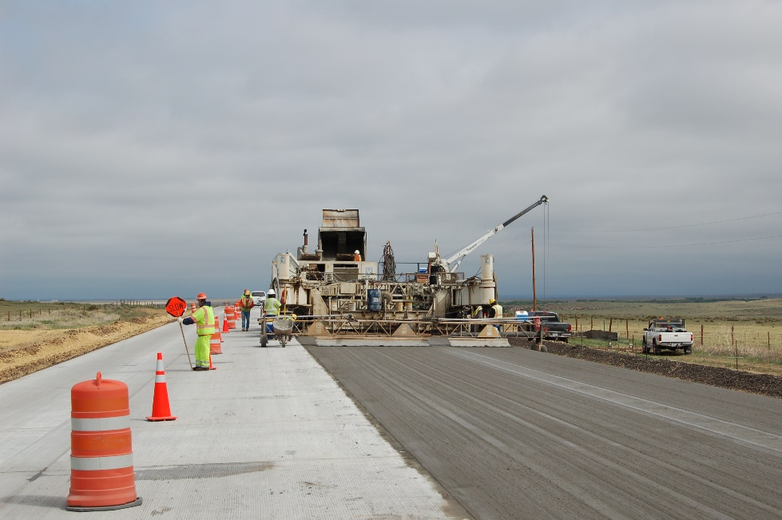
Recent MOT Example #3
8.3 miles, 40’ wide, 20’ paving pass
212,000 SY doweled concrete overlay
Lane rental in effect, once in pilot car operation
25 minute max traffic stoppage (i.e. 25 minute cycle time)
Length of closure dictated by 25 minute limit
Daytime work only

Slide 26
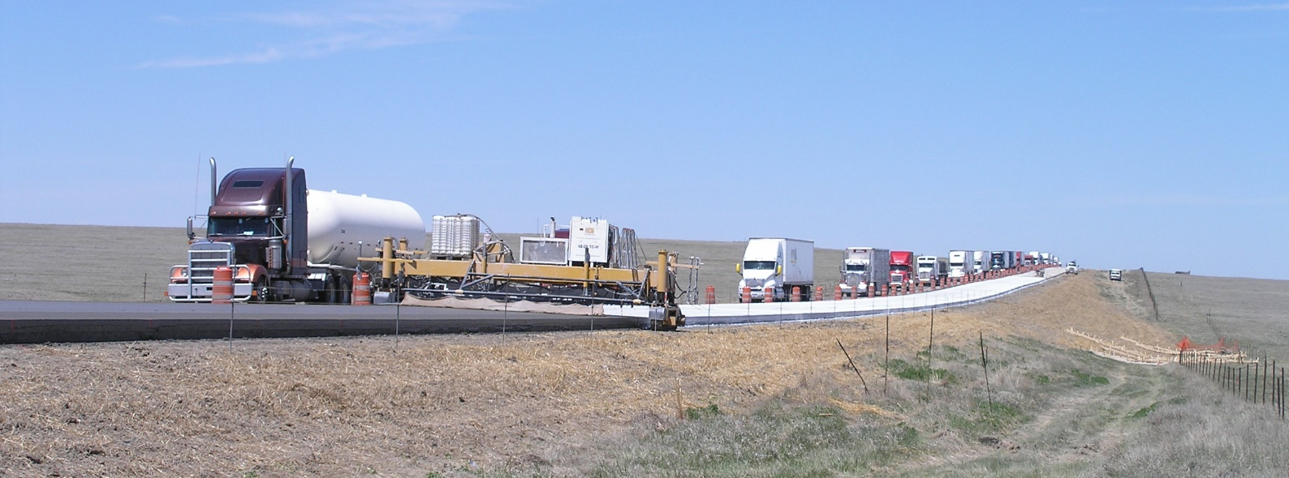
Recent MOT Example #3
Flagger station at each end
Advance warning set up 3 miles in advance, variable message boards, centerline controls, radar speed board, rumble strips, UTC, to slow speed from 65mph to stop.
Pilot car very effective way to construct 2-lane rural roads
Controls work zone and controls speeds – enhances safety

Slide 27
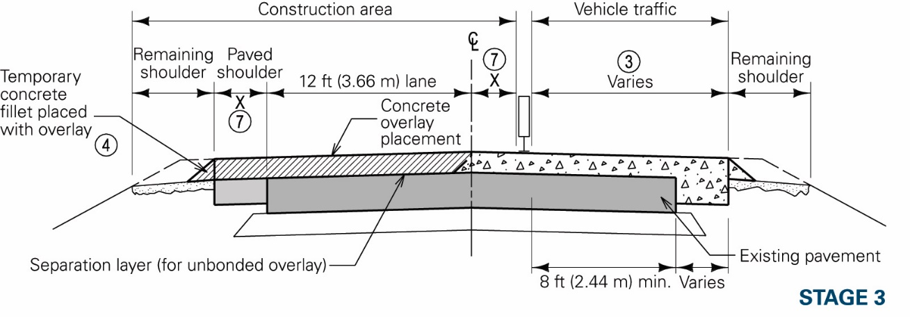
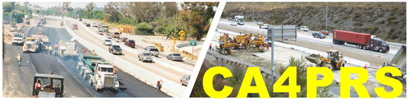
Tools and Resources
MOT Fact Sheets
Traffic Management, FHWA/ACPA EB213
Guide to Concrete Overlays
CA4PRS…

Slide 28

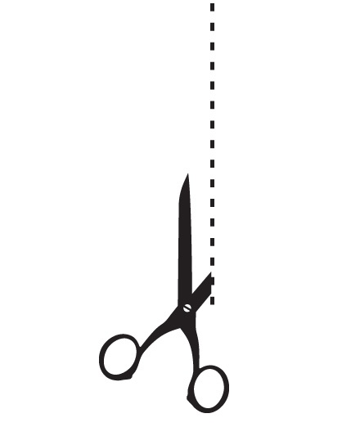
Closing Thoughts
CAN do concrete!
Mostly about setting expectations and finding ways to accelerate construction, for long lasting solutions
  Using effective communications to build buy-in
  Leveraging innovation to engineer solutions
SHA has deep talent pool of innovators
Maybe part of stewardship is to optimize amount of investment into asset…
GOES INTO
THE ASSET
SUNK
COST

Slide 29


Thank You!
www.cptechcenter.org
www.acpa.org
apps.acpa.org | ACPA Application Library
cal.acpa.org | ACPA-affiliated Chapter
resources.acpa.org | Resource Center
wikipave.org | ACPA’s paving wiki

