Slide 1


Maryland Construction & Materials Conference June 2016
MOSH UPDATE
Jim Reilly
Compliance Safety & Health Officer
MOSH Outreach Unit
Hunt Valley, MD

Slide 2

The MOSH Program
The mission of the MOSH program is:
To assure, as far as possible, every working man and woman in the State of Maryland, safe and healthful working conditions; and,

Slide 3

The MOSH Program
To assure, in so far as practicable, that no employee will suffer diminished health, functional capacity, or life expectancy as a result of his or her work experience.

Slide 4
To Accomplish these Goals, MOSH…
• Encourage employers and employees to reduce safety and health hazards at their workplace and to create or improve existing safety and health programs;
• Provides on request to qualified employers, free of charge consultants to review the employer's worksite to identify hazardous conditions;

Slide 5

To Accomplish These Goals, MOSH…
• Develops and adopts occupational safety and health standards;
• Provides effective compliance and enforcement programs;
• Establishes and administers reporting procedures for job injuries, illnesses, and Fatalities;

Slide 6

Who Is Covered By MOSH ?
Every employer in the State of Maryland that has at least one employee
State and local governments
NOTE: Federal employees and DOD contractors are not covered by MOSH

Slide 7

The MOSH Programs
Compliance and Enforcement
Consultation Services
MOSH Training and Education
Research and Statistics

Slide 8
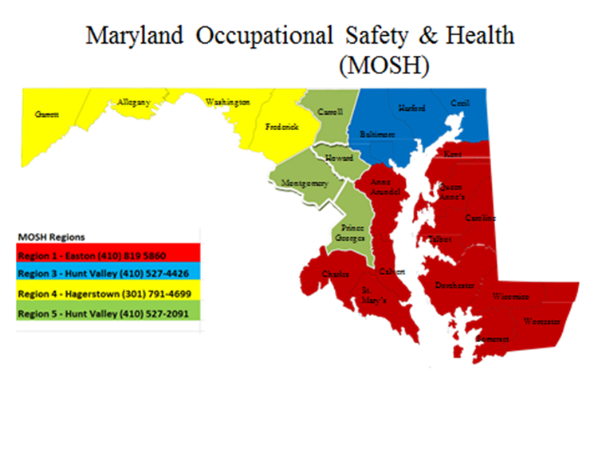

Slide 9

MOSH Staffing
Assistant Commissioner (1)
Enforcement Chief (1)
Assistant Chief Operations (1)
Program Managers (2)
Supervisors (9)
Compliance Officers (33)
New Compliance Officers (19) hired on 5/27
Admin Support Staff (19)
Total Agency personnel 85

Slide 10

Compliance and Enforcement Inspections
Imminent danger
Fatality / catastrophe
Complaints and Referrals
Accidents
OTS Complaints and Referrals
Follow-up
General schedule inspections

Slide 11

What can MOSH do for you?

Slide 12
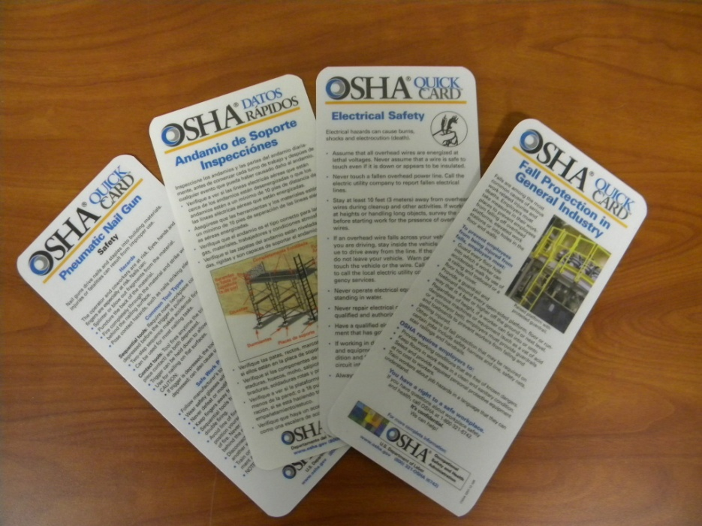
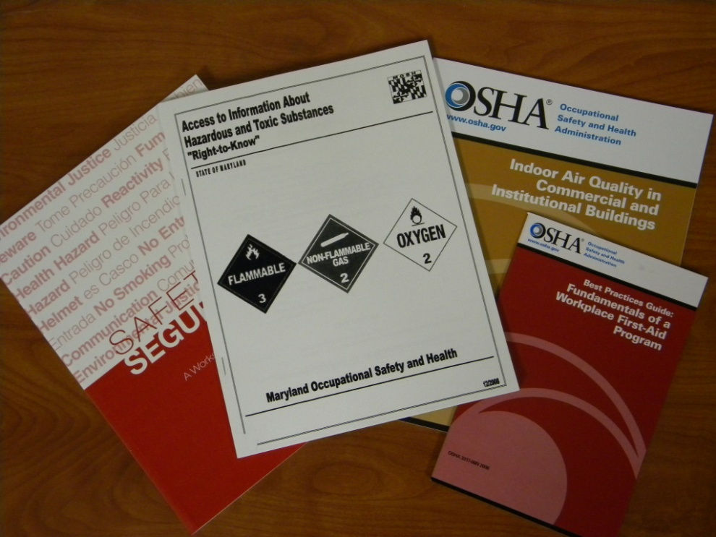
Training and Education
Free seminars
Publications
Speaker Request
Notes:
Currently there are over 50 seminars scheduled through the end of June. They are being offered at various regional locations throughout the state of Maryland (Baltimore, Central Maryland, Eastern Shore, Southern MD, and Western MD. The public seminars cover MOSH standards and some general interest topics such as workplace violence prevention and Characteristics of an effective safety and health program. You must pre-register using online registration, mail or fax. Please be aware that this training does not relieve employers from providing the training required by specific standards. It provides a general overview of the requirements. A certificate of completion will be provided to registered attendees.
Publications on various safety and health topics as well as model programs are available with some in Spanish.
Speakers are provided to professional trade associations, employer and employee organizations and other groups. The requests must be made in writing and are provided on an as available basis. A speaker request form is located on the MOSH Outreach web site.

Slide 13

Free Seminars
Occupational Exposure to Noise
Permit Required Confined Space
Intro to OSHA Recordkeeping
Respiratory Protection
Fall Protection - Construction
This is MOSH
Workplace Hazard Assessment
Workplace Violence Prevention
Tree Care and Removal
Powered Industrial Trucks Safety
General Industry I
General Industry II
Machine Guarding & Preventing Amputations
Personal Protective Equipment (PPE)
Accident Investigation
Bloodborne Pathogens
Characteristics of an Effective Safety & Health Program
Crane Safety Awareness
Construction Site Safety I
Construction Site Safety II
Construction Site Safety - Scaffolding
Excavation Safety
Electrical Safety & Lockout/Tagout
Emergency Response and Disaster Preparedness
Hand & Power Tool Safety
Hazard Communication (GHS)

Slide 14
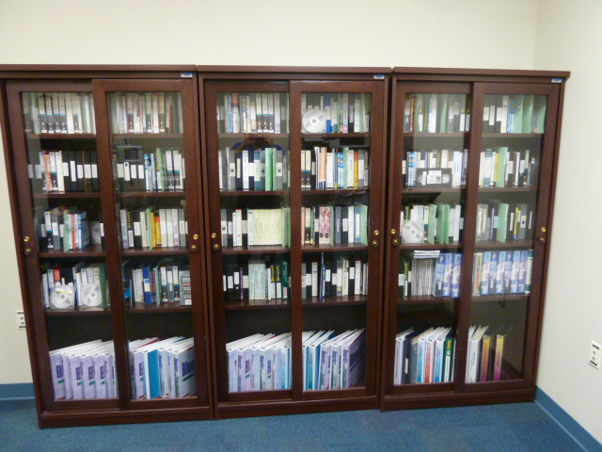
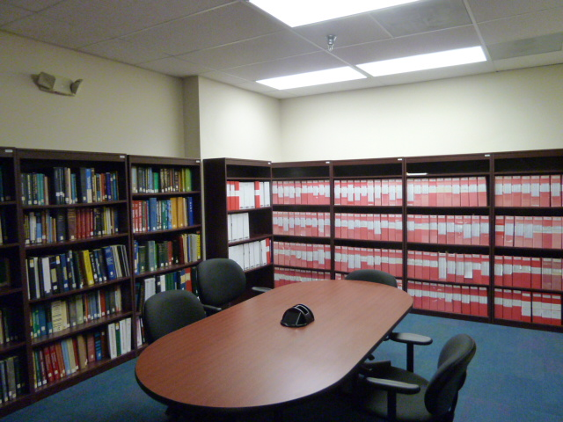

Free Lending Library
Audiovisual materials
Reference materials
Notes:
The MOSH library, located in our Hunt Valley office has Audio Visual materials available for loan to employers.
And also has reference materials such as consensus standards that can be viewed in our safety and health library but cannot be lent out.

Slide 15



Research and Statistics
MOSH Research and Statistics
resource for Maryland employers for recordkeeping issues
BLS Reporting – Maryland injury and illness statistics

Slide 16




Consultation Services
Voluntary program by employer’s request
Program priority – 250 employees or less; high hazard industries
Safety or Health or Both
No citations or penalties
Free of charge; confidential
May request survey of entire worksite or specific area
SHARP Program

Slide 17
Cooperative Programs
Cooperative Compliance Partnerships (CCP) Construction 78
Voluntary Protection Programs (VPP) General Industry 14
Safety & Health Achievement Recognition Program (General Industry) 6

Slide 18
Cooperative Compliance Partnership (CCP) program
The purpose of a CCP is to recognize General Contractors in construction with proactive safety and health programs and, in turn, have MOSH work with the employer to ensure employees are not exposed to hazards.

Slide 19
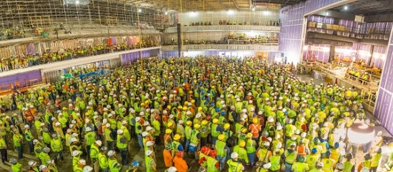
Together we can make a Difference
A MOSH CCP partnership was selected by OSHA to kick off the 2016 National Stand Down to prevent Falls. We had the honor of standing with over 1,900 men and women and their employers at the MGM casino construction project near National Harbor to raise awareness of fall hazards at worksites.

Slide 20
Voluntary Protection Program
VPP is designed to:
Recognize the outstanding achievements of participating employers who have successfully incorporated comprehensive safety and health management programs into their total management system.
Enable employers to establish a cooperative relationship with MOSH.

Slide 21
Safety & Health Achievement Recognition Program (SHARP)
SHARP is a recognition program administered by MOSH for smaller, high-hazard employers who operate exemplary safety and health programs.
SHARP rewards businesses with exemplary programs by removing their company's name from MOSH's Programmed Inspection Schedule.

Slide 22

Regulatory Update
Recordkeeping requirements
Confine Space in Construction
Globally Harmonized System for Hazard Communication

Slide 23


Record Keeping Update
OSHA 300 Injury and Illness Logs
OSHA's updated recordkeeping rule expands the list of severe injuries that employers must report to OSHA.
All work-related fatalities/catastrophes within 8 hours.
All work-related inpatient hospitalizations
All amputations.
All losses of an eye within 24 hours.

Slide 24
Confined Space in Construction
On May 4, 2015, OSHA issued a new standard for construction work in confined spaces, which will be effective starting August 3, 2015.
The new standard, Subpart AA of 29 CFR 1926 will help prevent construction workers from being hurt or killed by eliminating and isolating hazards in confined spaces at construction sites similar to the way workers in other industries are already protected.

Slide 25
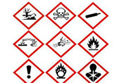
Hazard Communication Standard
June 1, 2016 , Update alternative workplace labeling and hazard communication program as necessary, and provide additional employee training for newly identified physical or health hazards.

Slide 26

Contact Us
General Information (410) 527-4499
Report Fatality/Catastrophes (888) 257-MOSH
Outreach-Training & Education (410) 527-2091
Consultation (410) 527-4472
Region 1 (Easton) (410) 819-5860
Region 2 (Hunt Valley) (410) 527-4442
Region 3 (Hunt Valley) (410) 527-4426
Region 4 (Hagerstown) (301) 791-4699
Region 5 (Hunt Valley) (410) 527-4424
Region 00 (Hunt Valley) (410) 527-2066

Slide 27


HELPFUL WEBSITES/REFERENCES
Web Sites:
www.dllr.maryland.gov/labor/mosh/
www.osha.gov
www.mema.state.md.us
www.cdc.gov/niosh/

Slide 28

Questions
?

