Slide 1

MD 97 – Brookeville Bypass Construction Management at Risk (CMAR) Project
Presented By:
Sean Campion P.E.
Assistant Division Chief,
Innovative Contracting Division

Slide 2
Overview
MD 97 – Brookeville Bypass Overview
Construction Management at Risk Project Delivery Overview
Overview of the Procurement Process

Slide 3
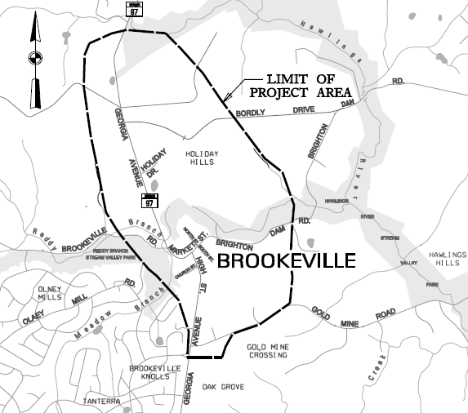
Project Study Area

Slide 4
Background
MD 97 is an arterial highway serving the east Montgomery County corridor and central Maryland from Washington, D.C. and the Capital Beltway (I-495) to I-70 in Howard County.
MD 97 functions as a major north-south commuter route between the employment areas in and surrounding Washington, D.C., and the residential communities north of Brookeville, including northern Montgomery County, Howard, and Frederick Counties.

Slide 5
Need for improvement
Roadway deficiencies
“dog-leg” or “S” curve located along MD 97 (High Street, Market Street, and Georgia Avenue)
Increasing traffic volumes
ADT: 2013(10,400) 2033(12,700)
Truck: 5%
Need to preserve the historical character of the town
Brookeville is recognized as a historic district and was listed on the National Register of Historic Places in 1979.

Slide 6
MD 97 Brookeville Bypass
Purpose and Need –
To remove the continually increasing traffic volumes from the Town of Brookeville, improve traffic operations and safety conditions on existing MD 97, and preserve the historic character of the town.
Project Objectives –
Construct a two-lane roadway to move the traffic from the town.
Minimize environmental impacts (stream, wetland, forest, parkland, archeological features etc.).
Preserve the historic character of the town.

Slide 7
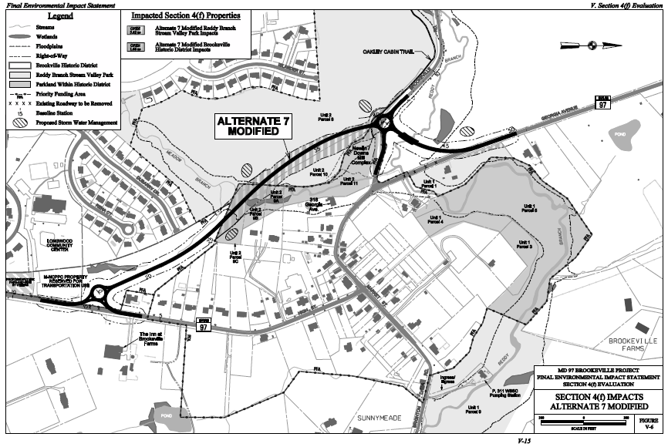
Selected Alternative

Slide 8
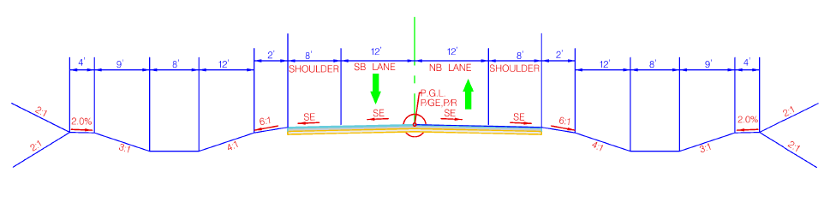
Typical Section

Slide 9
Project Elements:
Construction is anticipated to consist of the following major elements:
Construction of 0.72 mile long roadway pavement
Two roundabouts at the southern and northern termini
Two bridges crossing Reddy Branch stream and Meadow Branch stream
SWM and ESC
Retaining walls
Removal of a bridge
Replacement of the culvert at Brookeville Road
Traffic barrier
Landscaping
Signing and pavement marking
Stream relocation, wetland mitigation, forest mitigation.

Slide 10
Project Challenges:
Watercourse 1 (Reddy Branch) and Watercourse 2 (Meadow Branch) are Class IV-P waters (Recreational Trout Waters and Public Water Supply). Structures are proposed to cross these two streams.
Intermittent Watercourse 3 and Perennial Watercourse 4 are tributaries to Meadow Branch. Watercourse 3 is expected be impacted and would require mitigation. Impacts to Watercourse 4 needs to be avoided.
In-stream work is not permitted from March 1 through May 31.
The alignment goes through M-NCPPC parkland and ESD facilities for SWM were not considered in original study. Avoidance and minimization of additional of increased impacts to parkland and forest is desired.
Archeological sites are expected to be impacted and the impacts should be minimized.
Avoidance and minimization of temporary impacts to natural resources during construction is desired.

Slide 11
Major Stakeholders
Montgomery County
Maryland-National Capital Park and Planning Commission
Town of Brookeville
Maryland Department of the Environment
Maryland Department of Natural Resources
US Army Corps of Engineers
US Fish & Wildlife Service
US Environmental Protection Agency

Slide 12
Construction Management at Risk (CMAR) Project Delivery

Slide 13
What is CMAR?
A project delivery method where SHA utilizes a two-phase construction contract with a General Contractor to:
Provide Preconstruction Services which may include, but are not limited to, constructability analysis, value analysis, scheduling, site assessments, and cost estimating;
Construct the project based on final design plans (or design packages) at an agreed Guaranteed Maximum Price (GMP)

Slide 14
Authority
State – Code of Maryland Regulations (COMAR) 21.05.10
Federal – Moving Ahead for Progress in the 21st Century (MAP-21) – Construction Manager/General Contractor (CM/GC)

Slide 15
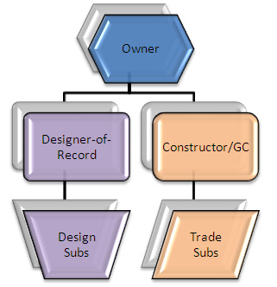

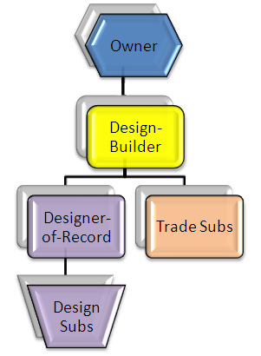
Project Delivery Methods
Design-Bid-Build
CMAR
Design-Build

Slide 16
Project Development
Design-Bid-Build
(DBB)
CMAR
Design-Build
(DB)
Preliminary Design
Detailed/Final Design
Bid
Construction
Preliminary Design
Detailed/Final Design
Construction
CMAR
Procurement
Preliminary Design
Detailed/Final Design
Construction
Design-Build
Procurement

Slide 17
Reasons for choosing CMAR
Shorten Project Delivery
Project Complexity
Contractor Input During Design
High Number of Potential Risks/Risk Allocation
Scope Flexibility/Maximizing Dollars
Cost Analysis of Multiple Design Options
Informed Owner Decision Making

Slide 18
CMAR – Risk Allocation
DBB DB CMAR

Slide 19
CMAR Expectations
Meet Project Goals
Fair Market Price
At or Below Proposed Price
Improved Schedule
Fewer Change Orders

Slide 20
CMAR Benefits
Opportunity to bring on contractor during the design phase to work as an integrated team with the owner and its consultant/engineer to deliver the most efficient, and cost effective design
Promotes innovation & collaboration
Owner maintains decision making authority
Greater cost certainty through GMP and reduction in change orders
Still allows phased construction similar to design-build resulting in accelerated completion times. Phases must be severable.
Risk identification & management during design phase and controlled by the team
Owner gets up front benefit of value engineering
CMAR design documents are biddable packages, not necessarily full set of biddable contract documents

Slide 21
CMAR Potential Risks
Transparency – Technical Qualifications and Approach are Main Elements for Selection
Cost Validation – “Negotiated” vs. Bid
Culture – New Process for All (SHA, Consultants, Contractor, Regulatory Agencies, Etc.)
Risk – Limited Historical Usage for Heavy Highway Construction

Slide 22
Procurement of General Contractor
Best Value Selection
One Step Process
Technical Ratings - Adjectival
Method of Selection – Best Value
Technical Proposal – Qualifications/Past Performance & Project Approach
Price Proposal – Preconstruction Fee/Other Elements
Technical Proposal is significantly more important than Price

Slide 23
CMAR Project Team
Owner (SHA)
Engineer under separate Contract with owner to provide all design services for the project.
Two Phase Contract with General Contractor (GC)
Phase 1 – Preconstruction Services - GC considered part of the design team providing constructability, cost, schedule and risk management input.
Phase 2 – GC and Owner agree on GMP to construct the project based upon final design plans (or design packages). If GMP cannot be agreed upon, then advertise as design-bid-build.

Slide 24
Independent Cost Estimator
Independent party hired by SHA to prepare a series of detailed estimates.
Estimates are performed independently from Contractor and SHA’s Designer.
Estimates are utilized as a basis of comparison for review of Contractor’s GMPs and award of Construction Contract.

Slide 25
Cost Model Development
Develop Cost Model for Project
Opinion of Probable Construction Cost (OPCC)
Guaranteed Maximum Price (GMP)
Elements of Cost Model
Profit and Indirect Overhead Percentage
Equipment Types and Rates
Material Sources
Subcontractor Items of Work
Risk Agreement and Assignment
Schedule

Slide 26
Cost Model Development
OPCC
To be submitted at various Design Completion milestones
Blind Estimate Comparison
Report of Items Outside of Tolerance (>10%)
Reconciliation Meeting to discuss differences in bidding assumptions

Slide 27
Once Design is Complete
Contract documents have been developed collaboratively by team
Follow typical procedures
DBE goals established for construction
2008 Standard Specifications and current SP/SPIs
GMP - Contractor and ICE will independently price project

Slide 28
Once GMP is Submitted
Contractor and ICE prices
Price Reconciliation Meetings as needed
Up to 3 GMP Submittals allowed
Accept GMP and Award Contract
Terminate Contract and Bid Project as DBB

Slide 29
Questions/Feedback?
Sean Campion P.E.
Assistant Chief, Innovative Contracting Division
Maryland State Highway Administration
scampion@sha.state.md.us
(410) 545-8863

