Slide 1



Florida Concrete and Products Association Amy Wedel, Director of Concrete Pavements
Jim Mack, P.E. Director of Market Development – Infrastructure February 2020
Notes:
Info Sources
https://apps.trb.org/cmsfeed/TRBNetProjectDisplay.asp?ProjectID=4741

Slide 2
IMPROVING PAVEMENT RESILIENCY
& DISASTER RECOVERY
A Case for Concrete Pavements to Counteract Flooding Impacts
Jim Mack, P.E. Director of Market Development – Infrastructure February 2020
Maryland Concrete Conference
March 9, 2021
Notes:
Info Sources
https://apps.trb.org/cmsfeed/TRBNetProjectDisplay.asp?ProjectID=4741

Slide 3
Agenda
The Need for Resilient Pavements
Defining Resiliency
Improving a Pavement’s Flood Resiliency

Slide 4
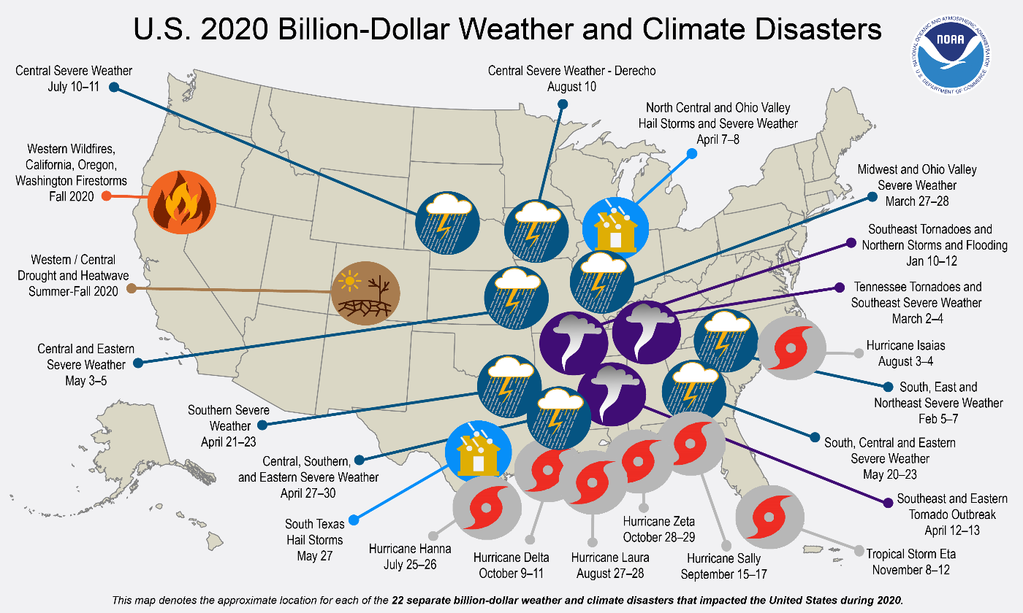
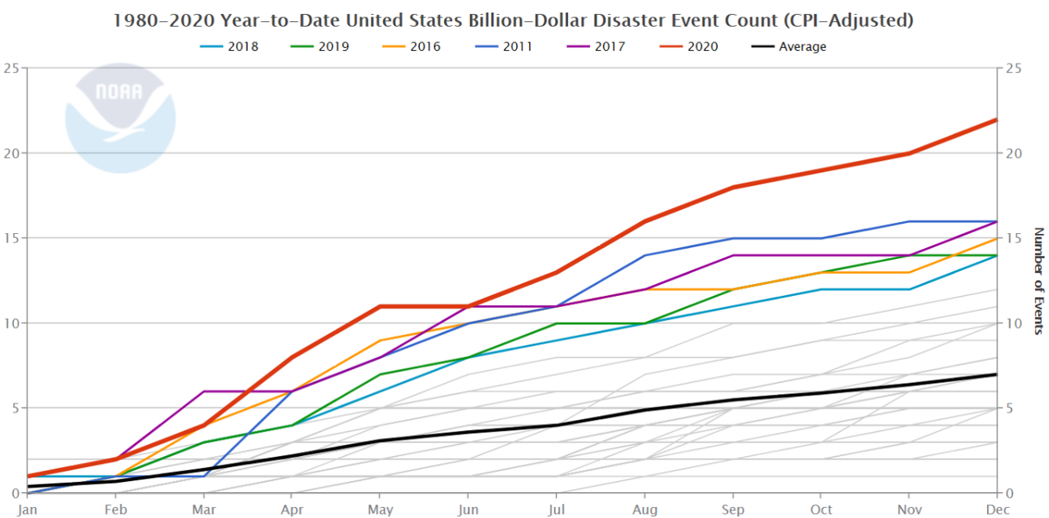
EXTREME FLOOD EVENTS ARE INCREASING IN BOTH FREQUENCY AND MAGNITUDE
Billion-Dollar Disasters Shattered U.S. Record in 2020
U.S. experienced 22 disasters coasting over $1 billion

Slide 5
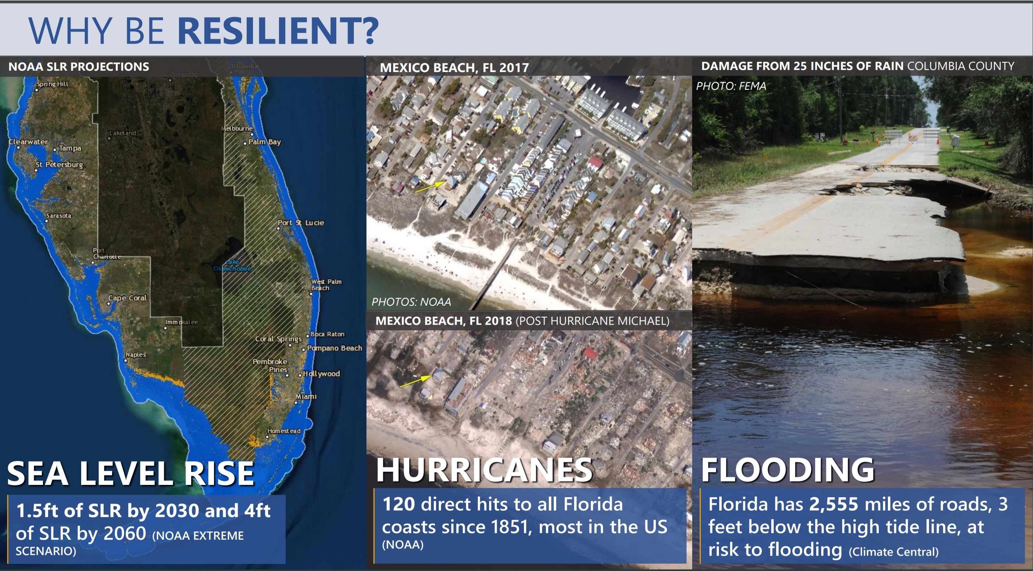

Slide 6

Hurricane Dorian spent 3 days over the Bahamas with 185mph sustained winds. September 2019
Notes:
Most recent was Tropical storm immelda

Slide 7
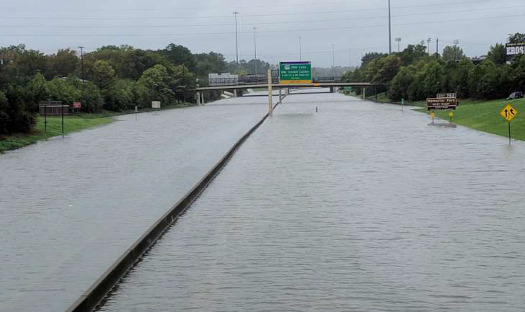
HOUSTON TEXAS HAS BEEN HIT BY 4 FLOOD EVENTS IN THE LAST SEVERAL YEARS – THE WORST WAS HURRICANE HARVEY
Notes:
Most recent was Tropical storm immelda

Slide 8
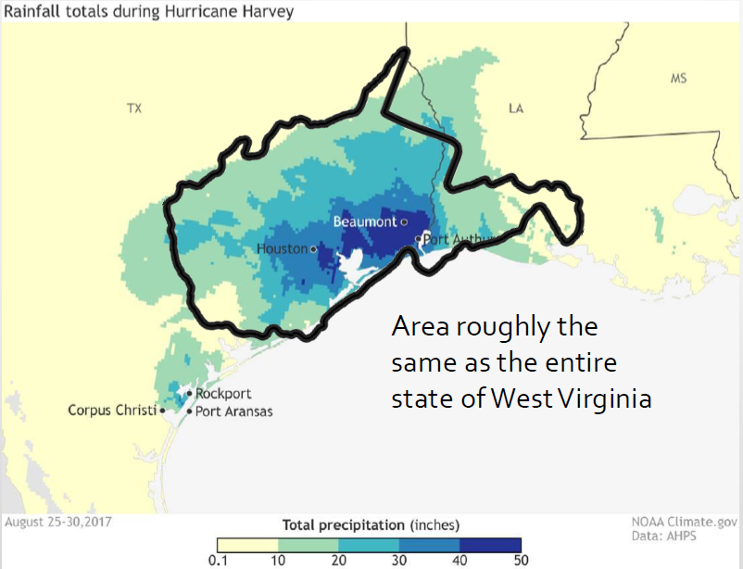
HOUSTON TEXAS HAS BEEN HIT BY 4 FLOOD EVENTS IN THE LAST SEVERAL YEARS – THE WORST WAS HURRICANE HARVEY
Notes:
Most recent was Tropical storm immelda

Slide 9
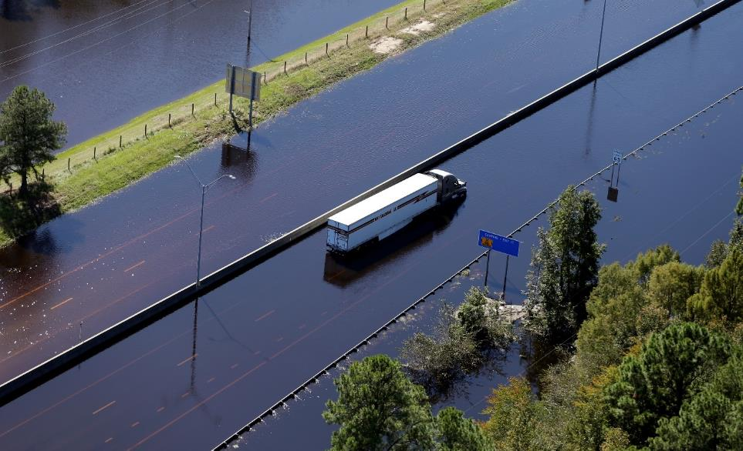

NORTH CAROLINA HAS BEEN HIT BY TWO 500 YEAR FLOOD EVENTS
Hurricane Matthew (2016) & Hurricane Florence (2018)
Lumberton, NC (2016)
With Hurricane Florence, NC had over 2500 road closures
With Hurricane Florence, NC had over 2500 road closures

Slide 10
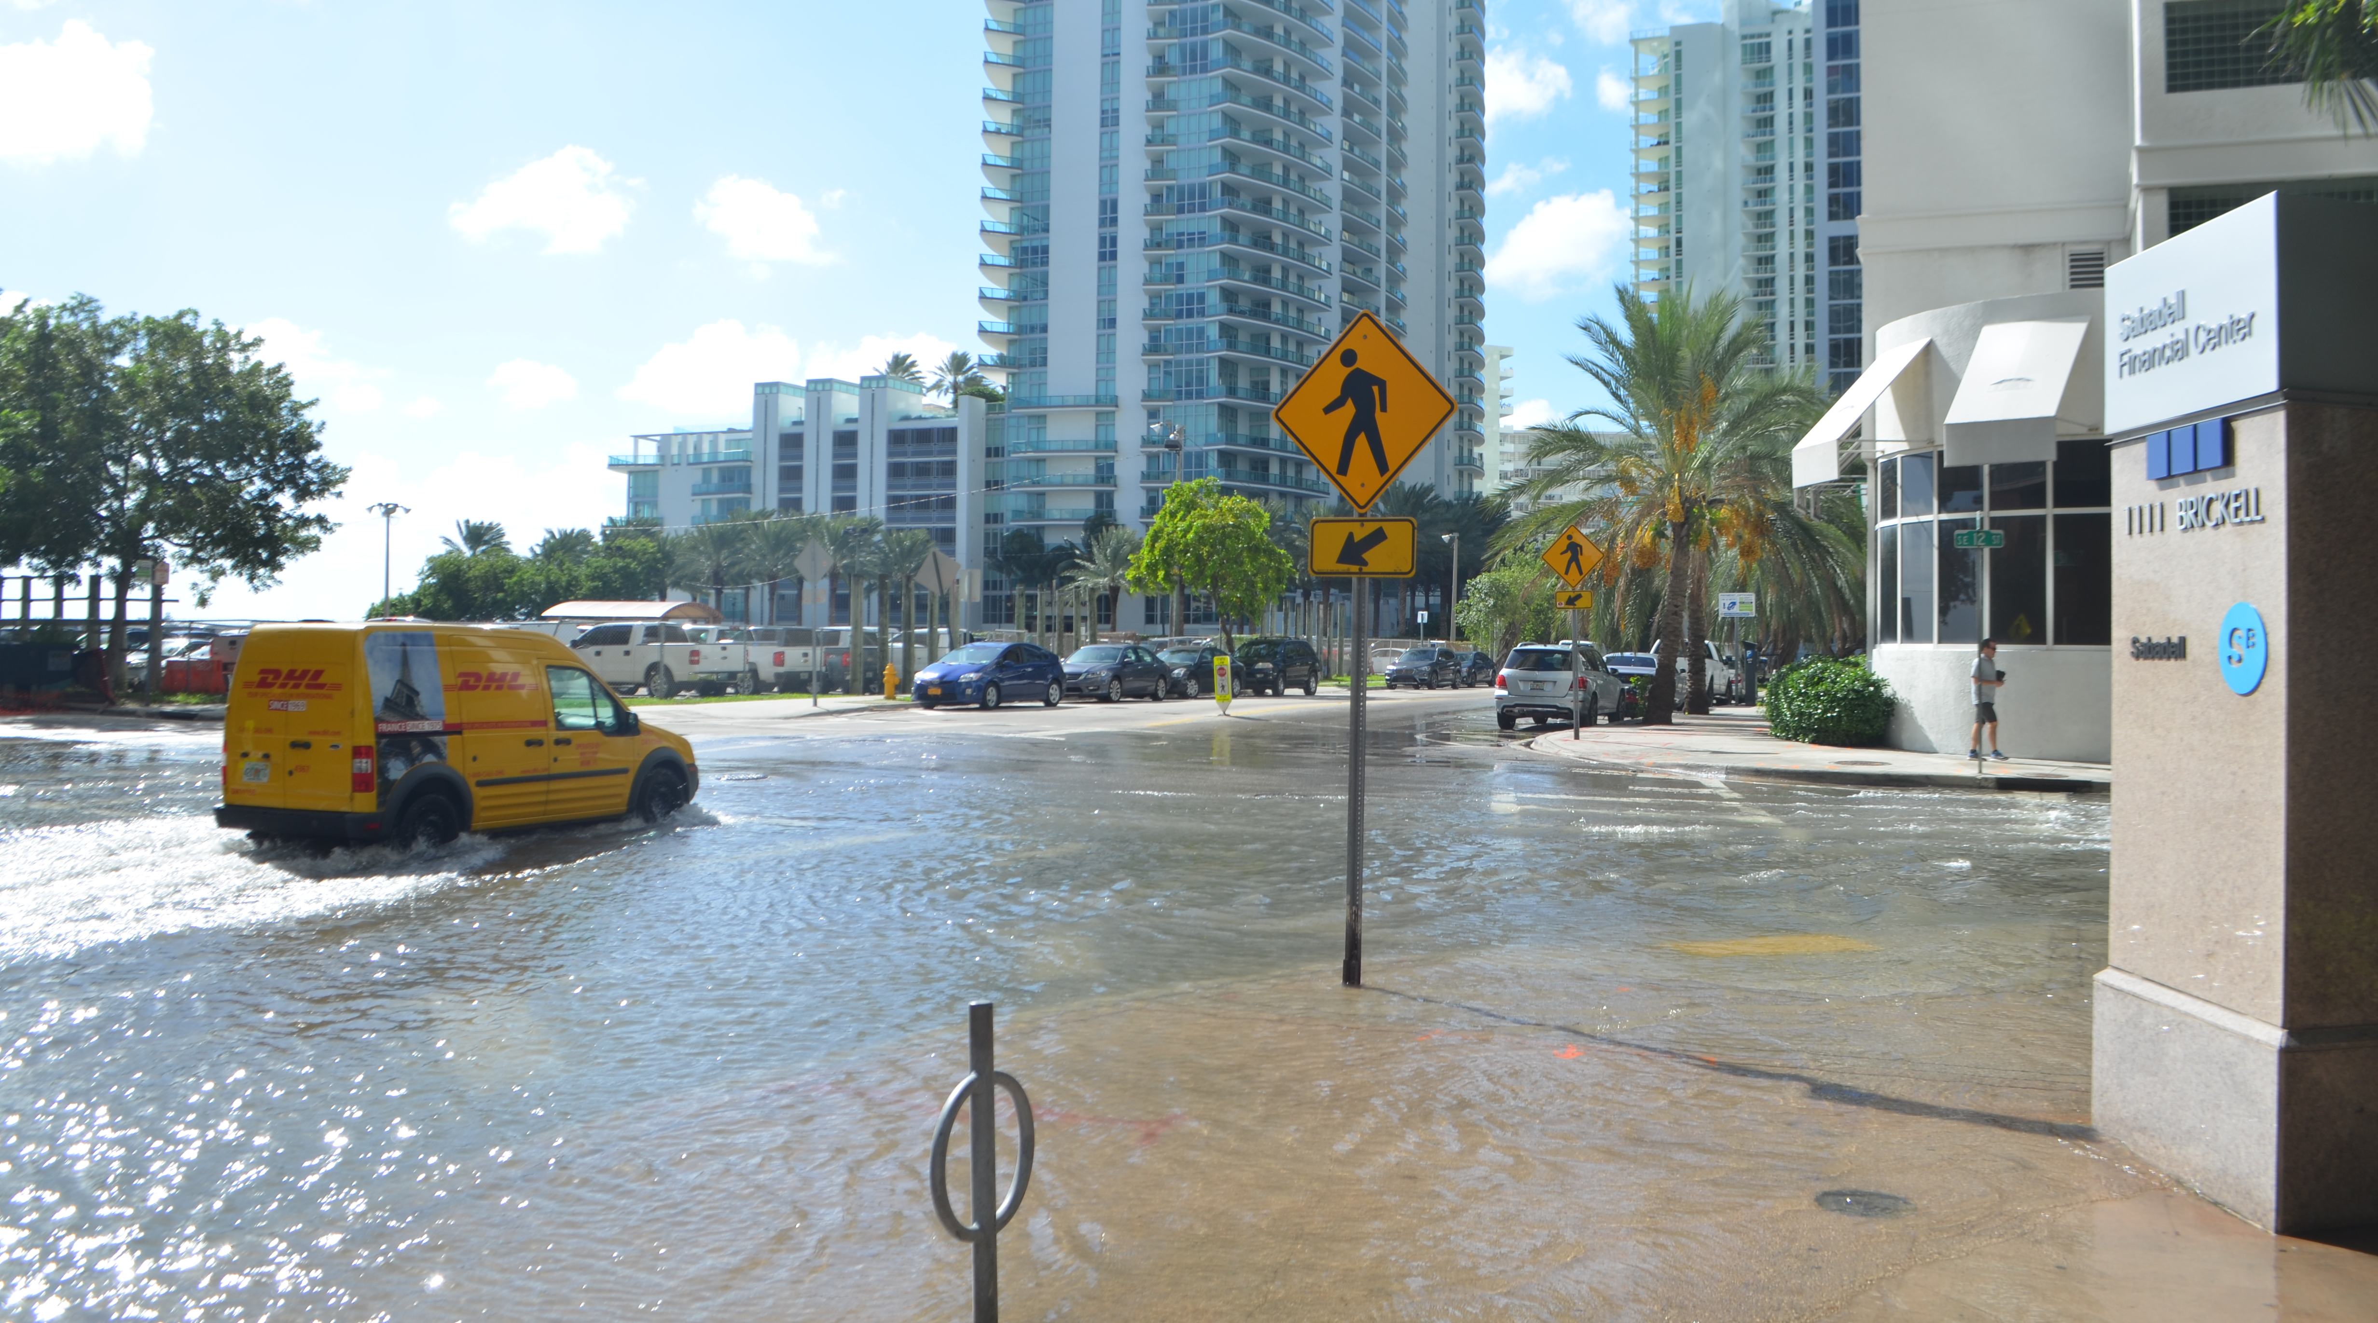
SEA LEVEL RISE IS ALREADY IMPACTING COASTAL ZONES Sunny day flooding is a daily occurrence during king tides
South Bowers Beach , DE
Downtown Miami
Miami, FL
Notes:
From 2000 to 2019, these “sunny-day flooding” events jumped by 190 percent in the Southeast, and by 140 percent in the Northeast, according to a report by NOAA released July 10, 2019

Slide 11
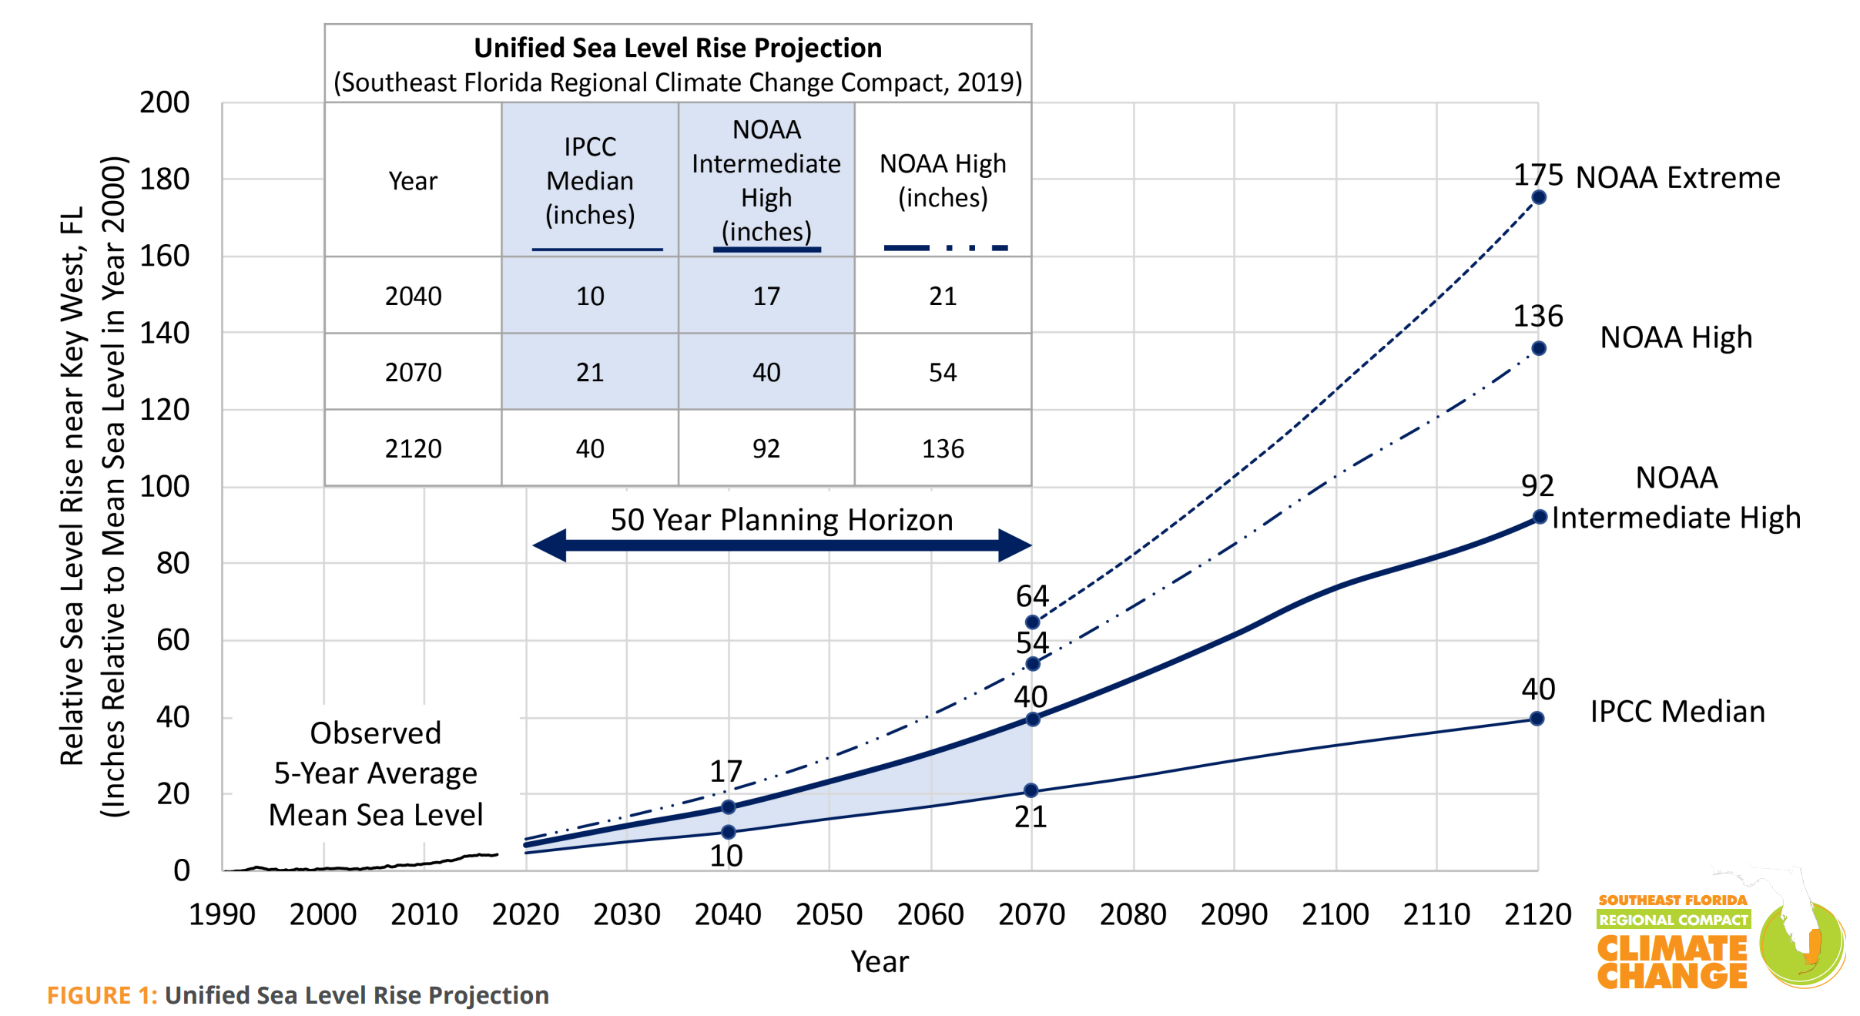
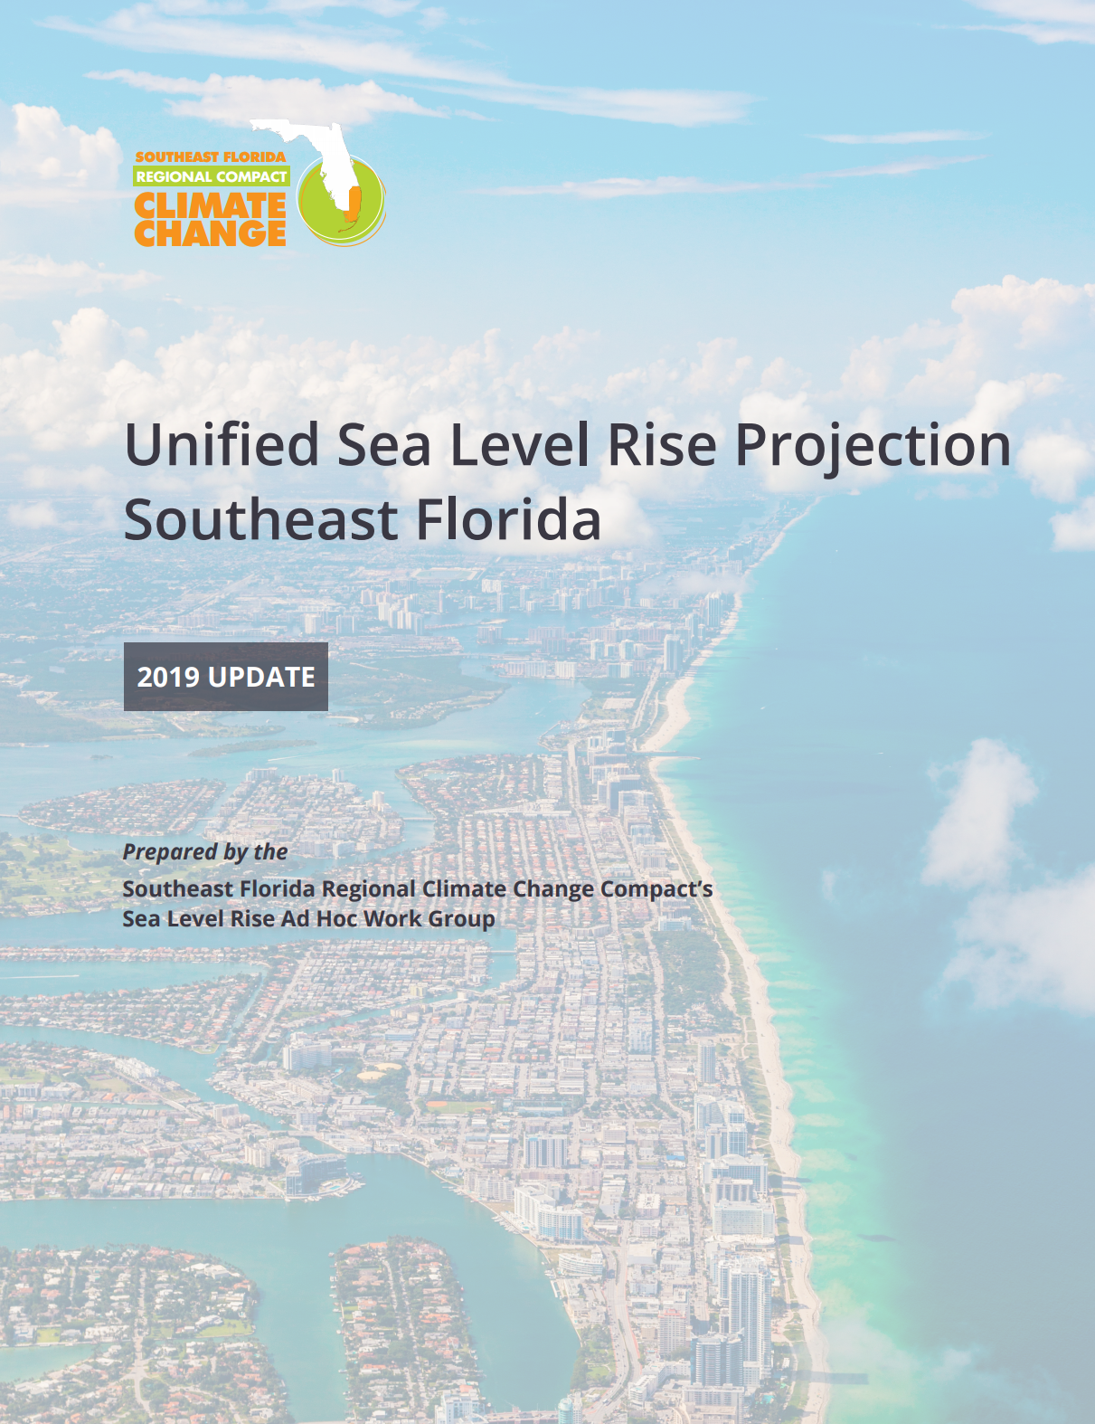
Unified Sea Level Rise Projection
These projections start from zero in year 2000 and are referenced to mean sea level at the Key West tide gauge. Based on the 5-year average of mean sea level, approximately 3.9 inches of sea level rise has occurred from 2000 to 2017 (see historic sea level section of guidance document). The projection includes global curves adapted for regional application: the median of the IPCC AR5 RCP 8.5 scenario (Growing Emissions Scenario) as the lowest boundary (solid thin curve), the NOAA Intermediate High curve as the upper boundary for short-term use until 2070 (solid thick line), the NOAA High curve as the upper boundary for medium and long-term use (dash dot curve). The shaded zone between the IPCC AR5 RCP 8.5 median curve and the NOAA Intermediate High is recommended to be generally applied to most projects within a short-term planning horizon. Beyond 2070, the adaptability, interdependencies, and costs of the infrastructure should be weighed to select a projection value between the IPCC Median and the NOAA High curves. The NOAA Extreme curve (dash curve) brackets the published upper range of possible sea level rise under an accelerated ice melt scenario. Emissions reductions could reduce the rate of sea level rise significantly

Slide 12
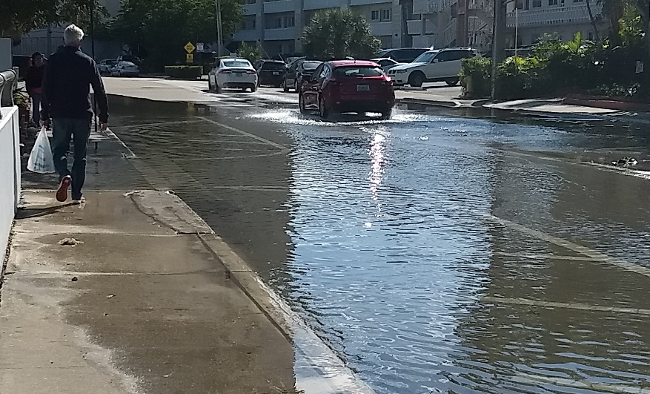
King Tides October 2019, Hallandale Beach Florida

Slide 13
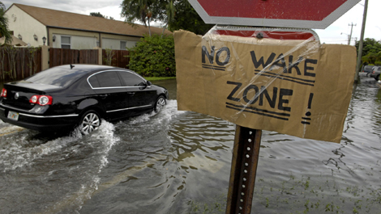
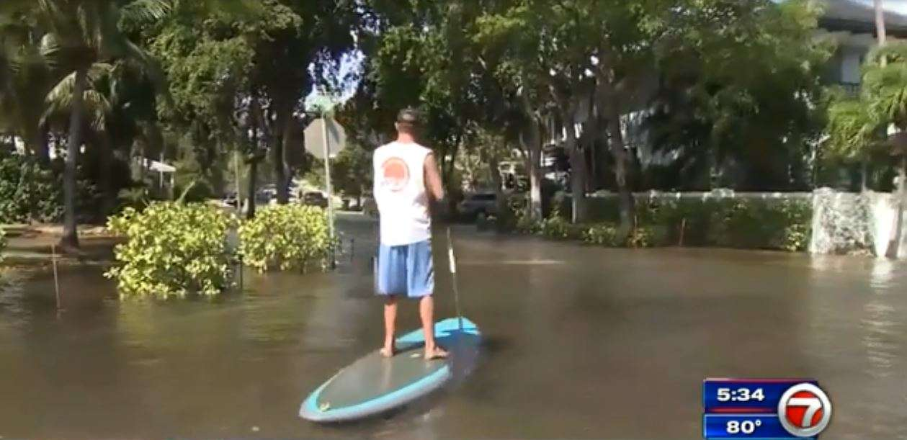
Tidal flooding has increased 352% since 2000 Source NOAA

Slide 14
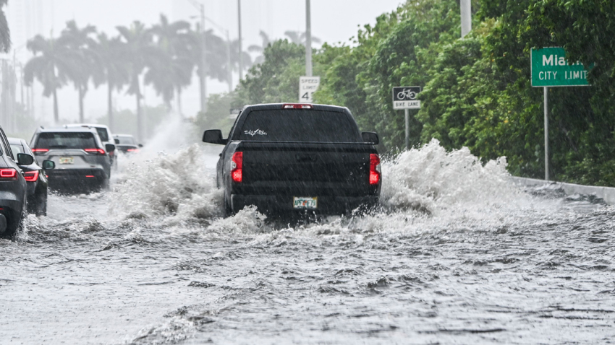
ETA Hits South Florida November 2020
King Tide - Sunny Day Flooding
Eta November 2020
Notes:
Most recent was Tropical storm immelda

Slide 15
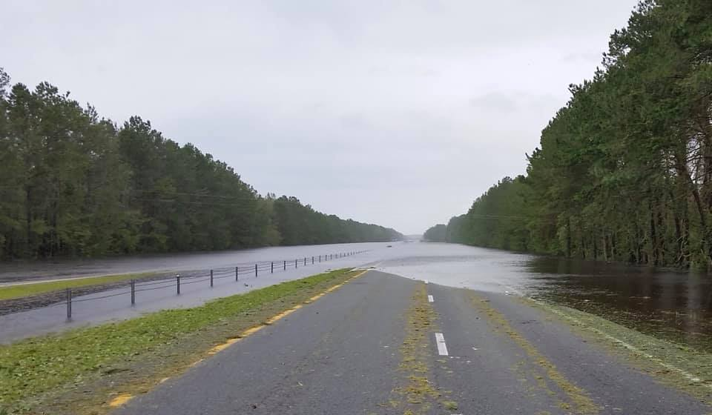
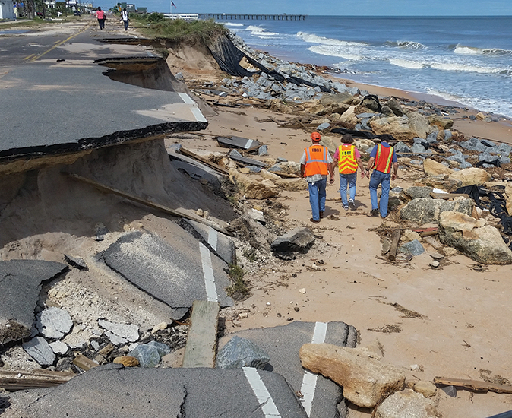
INCREASED FLOODING IS IMPACTING OUR PAVEMENT STRUCTURES Need to distinguish between Inundation and Washout Impacts
WASHOUT
INUNDATION
Rapid flow of flood water/high current that scours and washes out the pavement structure.
The rise of water that submerges the pavement.
No rapid flow or current
Pavement type does have an impact
Pavement type has little impact

Slide 16
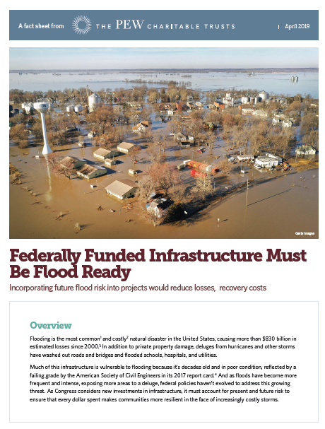
THERE ARE MANY ARTICLES BEING PUBLISHED ON THE NEED FOR CREATING FLOOD RESISTANCE INFRASTRUCTURE
This recent PEW article recognized the need to make our infrastructure “Flood Ready
Existing policies fall short
Costs due to flooding are increasing, and will likely continue to increase
Rebuild the same asset multiple times
Higher population density / more damage
Flood-ready investments are cost-effective
Did not specifically touch on the WAYS to increase the resilience of pavements and roadway infrastructure

Slide 17
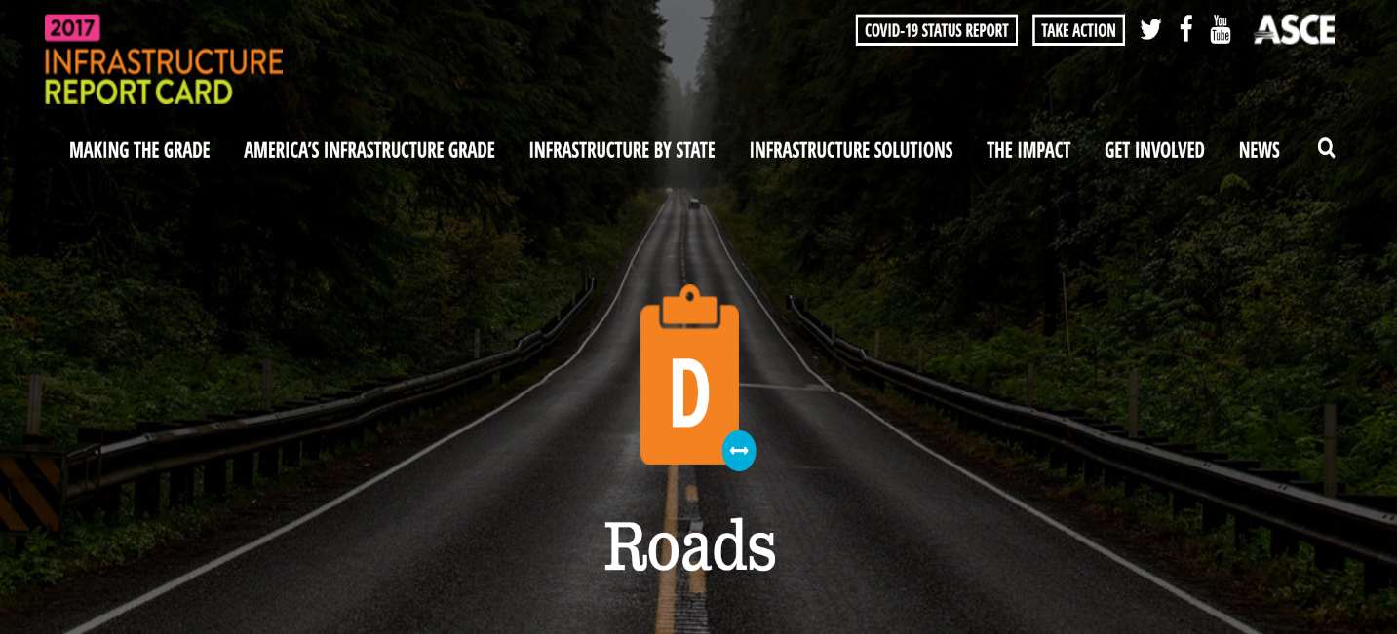
Resilience Revolving Loan Fund Act STORM “Safeguarding Tomorrow through Ongoing Risk Mitigation” Signed into law January 1, 2021
The legislation authorizes $200 million for the RRF and allows states to offer low-interest loans to counties and cities for disaster mitigation projects

Slide 18
Agenda
The Need for Resilient Pavements
Defining Resiliency
Improving a Pavement’s Flood Resiliency

Slide 19
ADDRESSING RESILIENCY AND THE ENVIRONMENT
The ability … to resist, absorb, accommodate, and recover from the effects of a hazard in a timely and efficient manner ¹
Resilience
UN-International Strategy for Disaster Reduction

Slide 20
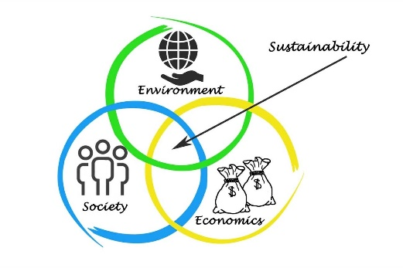
RESILIENCY & SUSTAINABILITY ARE DIFFERENT, BUT RELATED Resilience is the Ultimate Sustainability
Sustainability
Resilience
The ability … to resist, absorb, accommodate, and recover from the effects of a hazard in a timely and efficient manner²
A resilient system (building, pavement, etc.) is a sustainable system. Reduced waste –if not damaged or destroyed, it does not need to be replaced
Development that meets the needs of the present without compromising the ability of future generations to meet their own needs¹
Triple Bottom Line –Environmental, Societal and Economic
1.World Commission on Environment and Development (1987)
2. UN-International Strategy for Disaster Reduction

Slide 21
ADDRESSING RESILIENCY AND THE ENVIRONMENT
Prevention: stop a … manmade or natural disasters
Protection: secure against …manmade or natural disasters
Mitigation: reduce …. by lessening the impact of disasters
Response: … meet basic human needs after an incident
Recovery: …assist communities affected by an incident to recover effectively`
Resiliency Planning Fundamentals²
Policies should focus on items 1, 2 & 3 so that they do the job 99% of the time
UN-International Strategy for Disaster Reduction
AASHTO. Fundamentals of Effective All Hazards Security and Resilience for State DOTs, 2015.

Slide 22
INTRODUCTION TO PAVEMENT RESILIENCE The ability … to resist, absorb, accommodate, & recover … in a timely and efficient manner¹
Green is more resilient than Red
faster recovery time
Higher level of service
Blue is a hardened ² system as it has a higher final performance level
Performance
1) Drop in Performance
Pavement Resilience with respect to an event (eg. Flooding) is characterized by two parameters:
Drop in performance, induced by the event (eg. reduced ability to carry load).
Recovery time to reinstate or improve performance.
2) Recovery time (full, partial or improvement)
Time
UN-International Strategy for Disaster Reduction
Hardening Infrastructure – Elevating, upgrading, relocating assets, flood walls, berms and levees, etc.
Notes:
Hardening Infrastructure – Elevating, upgrading, relocating assets, flood walls, berms and levees, etc.

Slide 23

CONCRETE AND ASPHALT PAVEMENTS ARE DIFFERENT
DUE TO HOW THEY TRANSMIT LOADS TO THE SUBGRADE
7000 lbs load
Asphalt Pavements are Flexible
Asphalt
Base
Subbase
Subgrade
Load - more concentrated & transferred to the underlying layers
Higher deflection
Subgrade & base strength are important
Requires more layers / greater thickness to protect the subgrade
pressure ∼ 15 - 20 psi
7000 lbs load
Concrete Pavements are Rigid
Concrete
Subbase
Subgrade
Load – Carried by concrete and distributed over a large area
Minor deflection
Low subgrade contact pressure
Subgrade uniformity is more important than strength
pressure ~3 - 7 psi
Concrete’s rigidity spreads the load over a large area & keeps pressures on the subgrade low
Notes:
Need to talk about how we design roads for optimum moisture conditions and optimum density. When flooded, we lose that
Much more of the load on a rigid pavement section is carried in the pavement.
In a flexible pavement section, the base and subgrade are integral in carrying the load.

Slide 24
FLOODING CAUSES THE SUBGRADE TO BECOME SUPERSATURATED Moisture infiltrates base, pushes the subgrade particles apart and weakens the system
Asphalt Pavements are Flexible
Concrete Pavements are Rigid
Lowered subgrade strength & reduced modulus
Reduced load carrying capacity
Takes ~1 year to regain strength
Loading during this times accelerates pavement damage / deterioration
Reduced pavement life
Maintains high level of strength / stiffness
Subgrade is weak, but still uniform
Spreading of the load means subgrade is not overstressed
Little impact on the serviceability / life
7000 lbs load.
7000 lbs load.
Asphalt
Base
Subbase
Subgrade
Flooding does not impact the concrete’s load carrying capacity to the same degree as asphalt’s.
Concrete
Subbase
Subgrade
pressure ~3 - 7 psi
pressure ∼ 15 - 20 psi
Notes:
Need to talk about how we design roads for optimum moisture conditions and optimum density. When flooded, we lose that
Much more of the load on a rigid pavement section is carried in the pavement.
In a flexible pavement section, the base and subgrade are integral in carrying the load.

Slide 25
SOAKING REDUCES STRENGTH OF SOILS BY 20 TO 40% Different Soils (clays, silts, sands, clay sands, etc) all react differently but all decrease
Percent Decrease
Avg = 32.5%
Hi = 49.1%
Lo = 7.6%
Percent Decrease
Avg = 21.5%
Hi = 34.7%
Lo = 2.7%
Un-soaked CBR
4-day soaked CBR
California Bearing Ratio (CBR) Value
Inorganic Clays (CL Type Soil)
Clayey Sands (SC Type Soil)
Percent Decrease
Avg = 30.5%
Hi = 48.9%
Lo = 0.7%
Percent Decrease
Avg = 42.1%
Hi = 65.4%
Lo = 3.9%
Inorganic Silts (ML Type Soil)
Silty Sands (SM Type Soil)
Source: Comparison Between Soaked and Unsoaked CBR, Sathawara Jigar K & Prof. A.K.Patel; International Journal of Advanced Engineering Research and Studies E-ISSN2249–8974

Slide 26
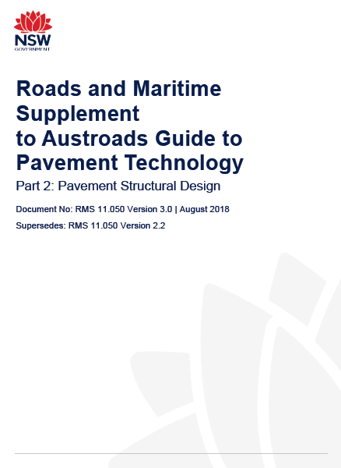
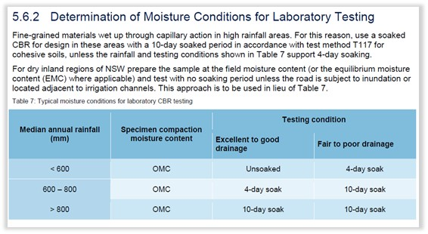
AGENCIES SHOULD MODIFY “DESIGN STANDARDS” TO BE BASED ON WEAKENED SUBGRADE CONDITION Almost All Pavement Designs in Australia are based on soaked subgrade conditions
Does not require any changes to current design practices
other than changing the subgrade input.
(Especially important in flood prone areas)
Notes:
Note this does not require any changes to current design practices other than changing the SG input.

Slide 27
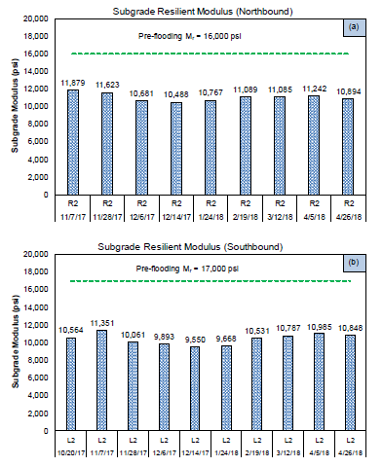
ALSO NEED TO ACCOUNT FOR LONG TERM LATENT EFFECTS WHEN DISCUSSING RESILIENCE TO FLOODING After the flood waters recede, the pavements are structurally vulnerable
Research Findings Indicate it takes up to a year for the subgrade to recover
For this case, this strength loss is a 40 to 60% reduction load carrying capacity and about 3 years of life
Sources:
Decision Support Criteria for Flood Inundated Roadways: A Case Study, A. Gundla, Ph.D., E. Offei, Ph.D. G. Wang, Ph.D., P.E. C.Holzschuher, P.E. and B>Choubane, Ph.D., P.E., Presented at the 2020 TRB Annual Mtg
Western Iowa Missouri River Flooding— Geo-Infrastructure Damage Assessment, Repair, and Mitigation Strategies; Center for Earthworks Engineering Research, Iowa State University, Report No. IHRB Project TR-638
US 441 in Alachua County, Florida between MP 7.960 to MP 9.680
Notes:
This reduction in strength is not a linear function in reduced traffic carrying capacity – these reductions represent about a 40% load carrying reduction for the northbound and a 60% reduction in the southbound
In total, it is estimated that these reduced strengths knocked off 3 years of life from this road

Slide 28
WHEN LOOKING AT PAVEMENT’S RESILIENCY, NEED TO RECOGNIZE DAMAGE CAN HAPPEN AT 2 DIFFERENT TIMES
To have resilient system requires the pavement be able to withstand both
Impact Types / Timing
Primary Impacts –alters the pavement structural or functional capabilities
Secondary Impacts –Impacts due to recovery activities
Rescue and Emergency response during the disaster
Recovery activities (clean up and rebuilding) after the disaster
Notes:
Hardening Infrastructure – Elevating, upgrading, relocating assets, flood walls, berms and levees, etc.

Slide 29
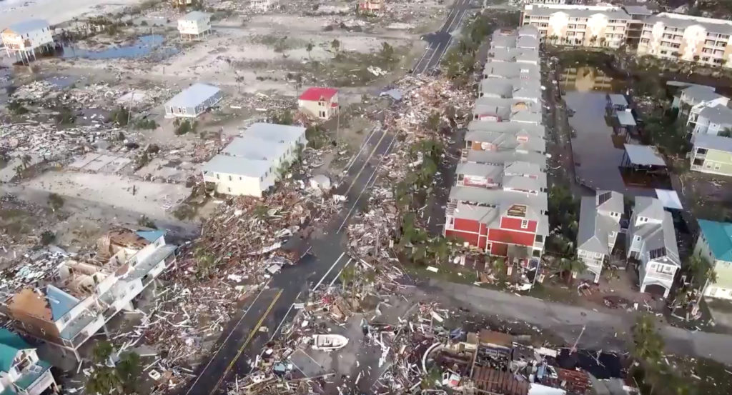

1,584 of the town's 1,692 buildings were reported damaged more than 800 were destroyed
Hurricane Michael, Storm surge of 14 feet Mexico Beach, Florida 2018
Notes:
Rescued: 47 helped out of hard-hit areas along Florida’s coastline
Food and water: 2 million ready-to-eat meals, 1 million gallons of water and 40,000 10-pound bags of ice ready for distribution in Florida.
1,584 of the town's 1,692 buildings were reported damaged; more than 800 were destroyed.

Slide 30
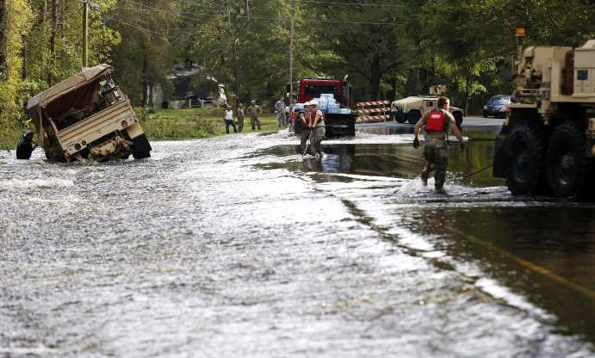
RELIEF AND RESCUE EFFORTS WILL TAKE PLACE Loading weakened Pavements will shorten their lives
Hurricane Michael 2018, 2 million ready-to-eat meals
1 million gallons of water and
40,000 10-pound bags of ice

Slide 31
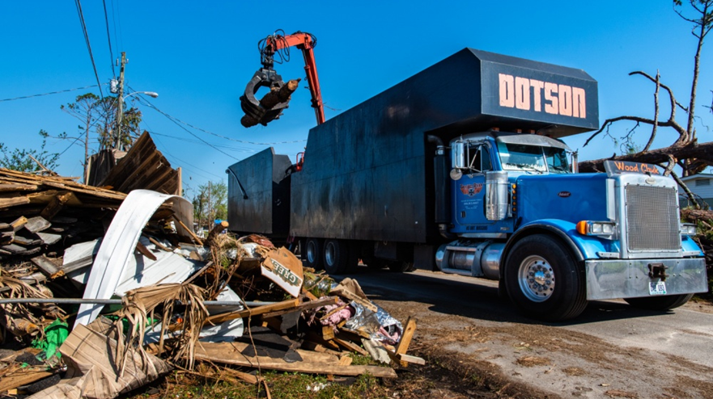
1,190,800 cubic yards of vegetative debris and 1,105,132 cubic yards of construction and demolition debris
Capacity = 10 to 17 cubic yards
1MCY ~ 65,000 Dump Trucks
Hurricane Michael
Mexico Beach, Florida 2018
Notes:
In Mexico Beach, 1,584 of the town's 1,692 buildings were reported damaged; more than 800 were destroyed.
The money will reimburse the city for clean up of 1,190,800 cubic yards of vegetative debris and 1,105,132 cubic yards of construction and demolition debris. FEMA says the city also removed 9,858 handing limbs and 10,696 damaged, leaning trees that posed a threat to public health and safety.

Slide 32
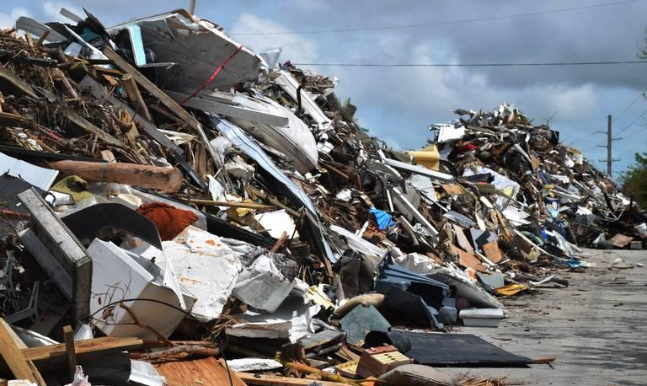
DEBRIS REMOVAL CAN TAKE PLACE FOR MONTHS Further exacerbating the pavement damage while weakened
Hurricane Irma 2017
4 M Miami Dade
3 M Palm Beach
3.6 M CY Collier
2.7 M CY Lee

Slide 33
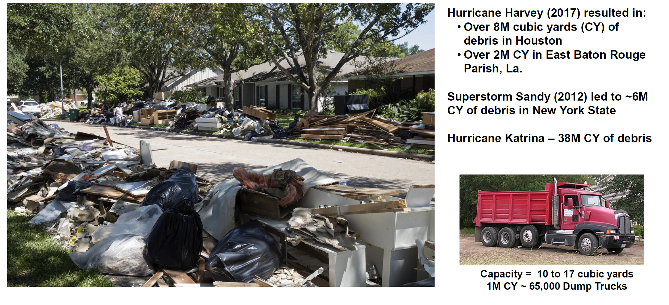
DEBRIS REMOVAL CAN TAKE PLACE FOR MONTHS Further exacerbating the pavement damage while weakened

Slide 34
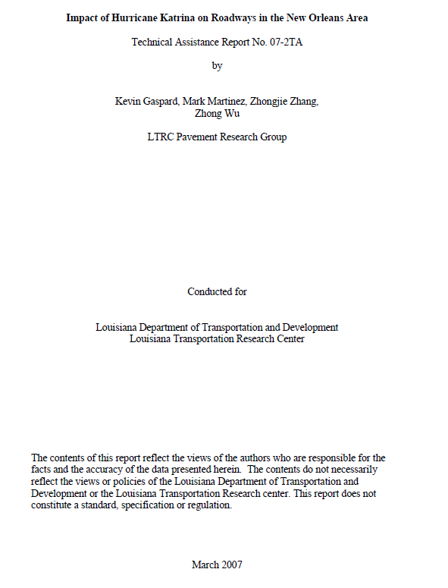
KEY FINDINGS FOR PAVEMENTS
THAT WERE SUBMERGED BY HURRICANE KATRINA
Submerged pavements were weaker
than non-submerged pavements
Asphalt pavements
Overall strength loss ≈ two inches of new asphalt concrete
Damage occurred regardless of the length of time the pavement was submerged
Cost: $50 million to rehabilitate 200 miles of submerged asphalt roads
Concrete Pavements
Little relative loss of strength due to flooded conditions
Resilient modulus(Mr) is similar for submerged and non-submerged pavements
No information given on repairs or repair costs
Impact of Hurricane Katrina on Roadways in the New Orleans Area, Technical Assistance Report No. 07-2TA
Kevin Gaspard, Mark Martinez, Zhongjie Zhang, and Zhong Wu; LTRC Pavement Research Group, March 2007

Slide 35
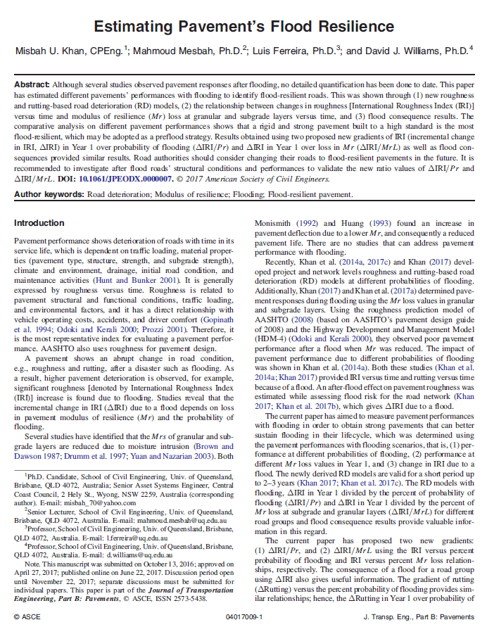
FLOODED PAVEMENTS RESEARCH
IN AUSTRALIA FOUND SIMILAR RESULTS Road authorities may want consider changing their roads into flood-resilient pavements.
A rigid pavement performs better
than composite and flexible road groups
Composite and flexible road groups show similar performance up to 2–3 years.
Rigid pavement performs the best at any probability of flooding, and flooding effect is not critical
A pavement’s strength may be enhanced by:
Strengthening with an overlay
Layer stabilization.
Converting the road into a rigid or composite pavement through granular layers’ stabilization.
It’s settled that a rigid pavement is the more flood-resilient.” (p-5)
Estimating Pavement’s Flood Resilience; Misbah U. Khan, CPEng; Mahmoud Mesbah, Ph.D.; Luis Ferreira, Ph.D.; and David J. Williams, Ph.D.; American Society of Civil Engineer's Journal of Transportation Engineering, Part B Pavements, 2017

Slide 36


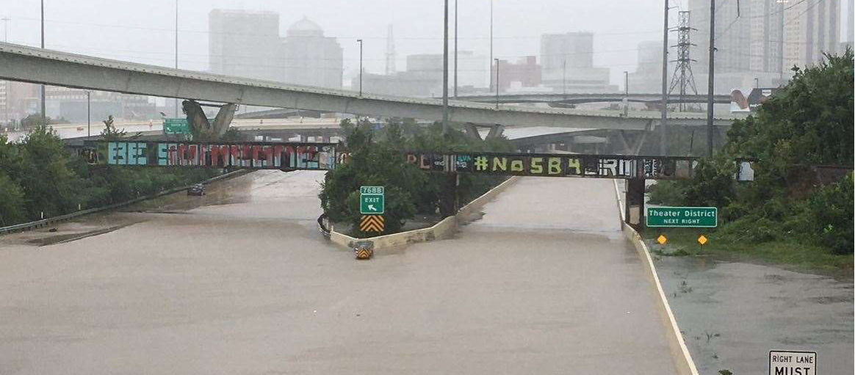
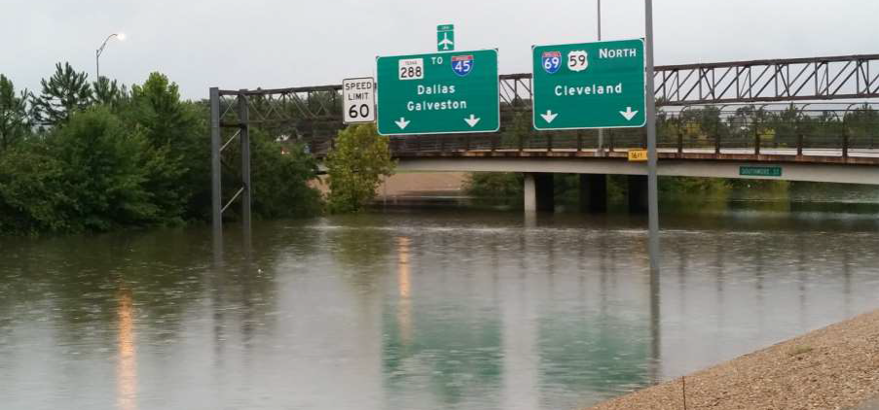
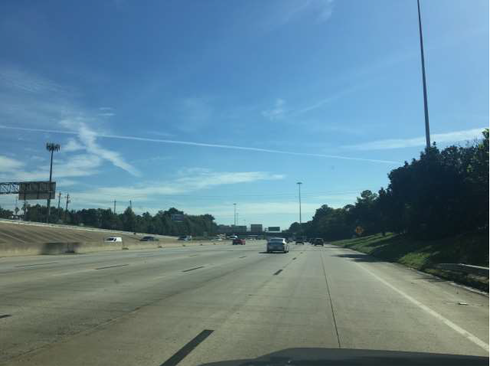
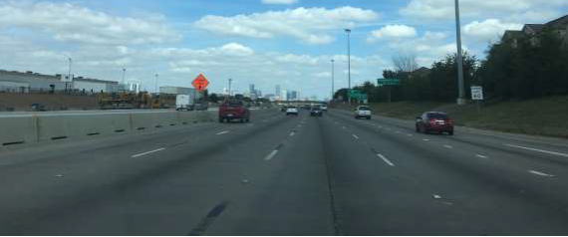
PAVEMENTS IN HOUSTON HAVE BEEN FLOODED SEVERAL TIMES But roadways are opened as soon as water has receded
I-610 to I-45
11” CRCP UBOL & 14” CRCP (Const = 1995-2000)
Design= 43M ESALS, Carried = 92M ESALS
Southmore to Yellowstone
9” CRCP (Const = 1983 & 1984)
Design = 7M ESALS, Carried = 22M ESALS
Opened roadway shortly after Hurricane Harvey
Both sections have been flooded at least three times since original construction
ESALS – Equivalent Single Axle Loads. It is how pavement engineering defines traffic
Notes:
Houston is a city of concrete roads and it helped.

Slide 37
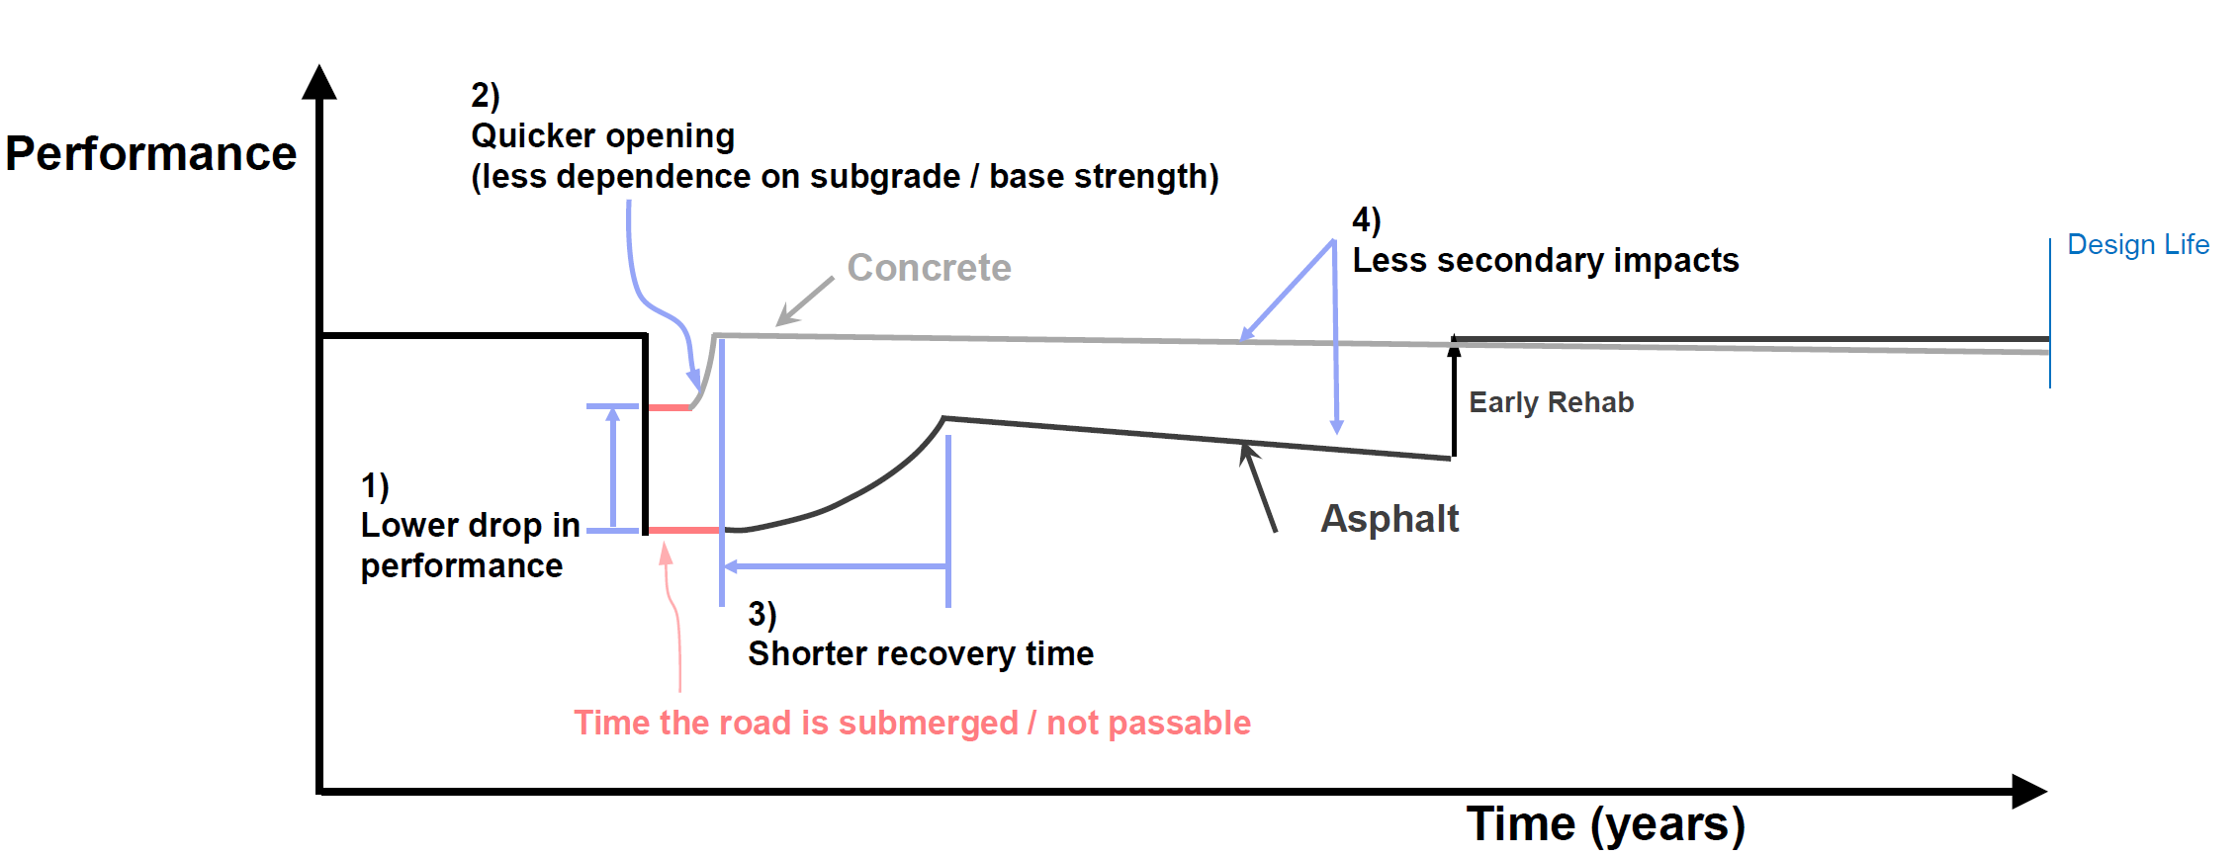
STIFFER PAVEMENTS ARE MORE RESILIENT TO INUNDATION FLOODING
2) Quicker opening (less dependence on subgrade / base strength)
Concrete
Design Life
Early Rehab
1) Lower drop in performance (Both Short and long term)
Asphalt
3) Shorter recovery time
Time the road is submerged / not passable
Time (years)
Stiffer Pavements are less impacted by sub grade strength loss and recover faster
(stiffer = concrete, cement stabilized bases, increased asphalt thickness)

Slide 38
Agenda
The Need for Resilient Pavements
Defining Resiliency
Improving a Pavement’s Flood Resiliency

Slide 39
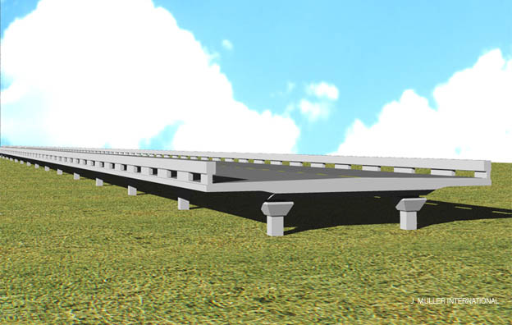
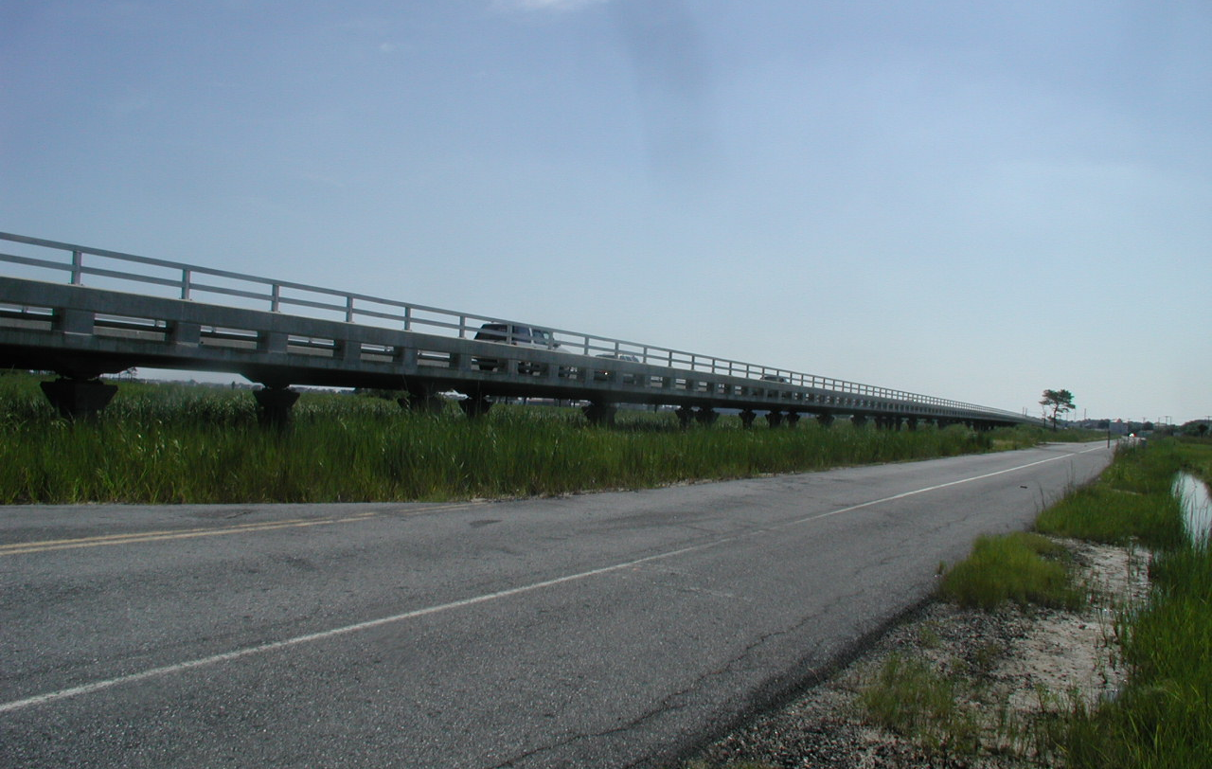
ONE OFTEN DISCUSSED APPROACH IS ELEVATING THE ROAD ABOVE FLOODING ELEVATION
Elevation View of SR54 Viaduct
From Old SR54 Alignment, Fenwick DE
Cost = $16 M in 2001
Schematic and Photo courtesy of Jim Pappas, DELDOT
Elevating the roadway is not cheap and it is not possible to raise all roadways

Slide 40
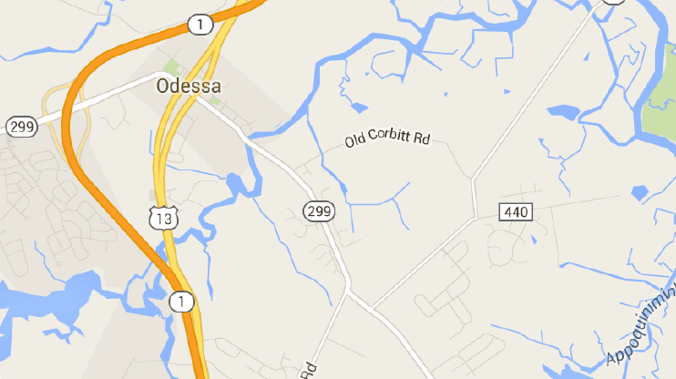
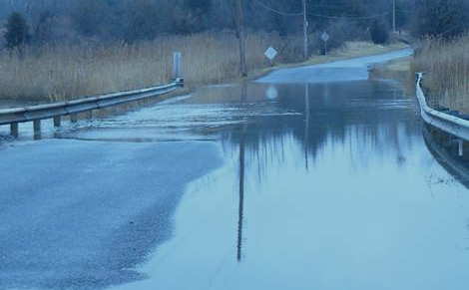
ANOTHER APPROACH IS ROAD ABANDONMENT Old Corbitt Road – Odessa, Delaware
Overtops daily due to tides
340 Avg Daily Traffic (ADT)
Traveling time will be slightly increased by approximately 2 to 3.5 minutes.
Alternate - 250’ long concrete structure. Estimated cost = $2.5M
Schematic and Photo courtesy of Jim Pappas, DELDOT
Abandoning the roadway is not always possible

Slide 41


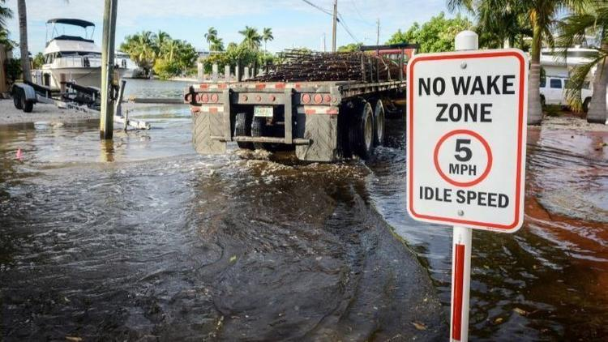
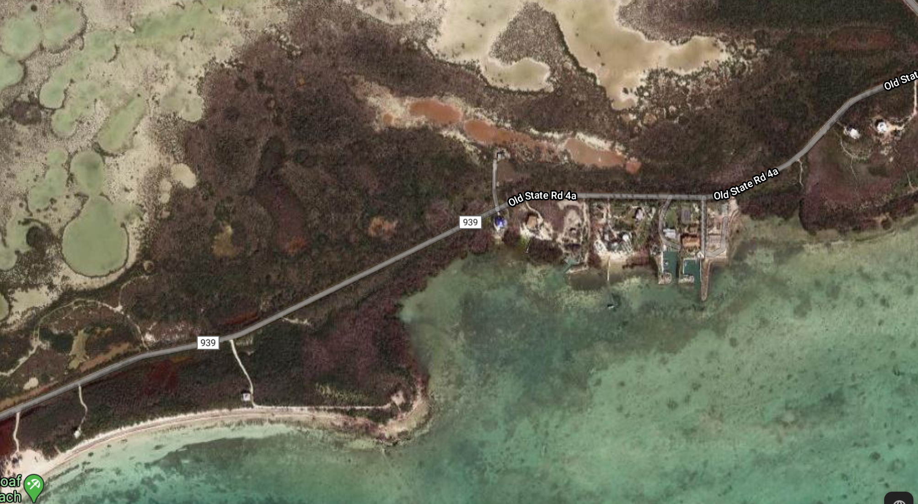
Elevating less than three miles of Old State Road 4A on Sugarloaf Key to withstand sea rise and king tide by 2025 could cost $75 million
4A Sugarloaf Key, Florida
Notes:
“Are we really going to spend $128 million to elevate three miles of road where 30 people live? It’s not up to me, but I don’t think so,” said Rhonda Haag, Monroe County’s head of resilience.

Slide 42
THERE ARE WAYS TO IMPROVES A HIGHWAY’S / PAVEMENTS RESILIENCE
Modifications before disruptive events that improve system performance
Performance
Actions to consider when dealing with flood prone pavements:
Hardening Activities
Stiffen the system
Improve Designs by using soaked subgrade strength values
Lost
Performance
Aging
System
Repairs after disruptive event to restore system functionality
Event
Adapted from Bruneau, 2003 and McDaniels, 2008
Time to Full Recovery
Time
Adaptive resilience - Capacity to learn and make decisions to avoid future loss based on the type of disturbance

Slide 43
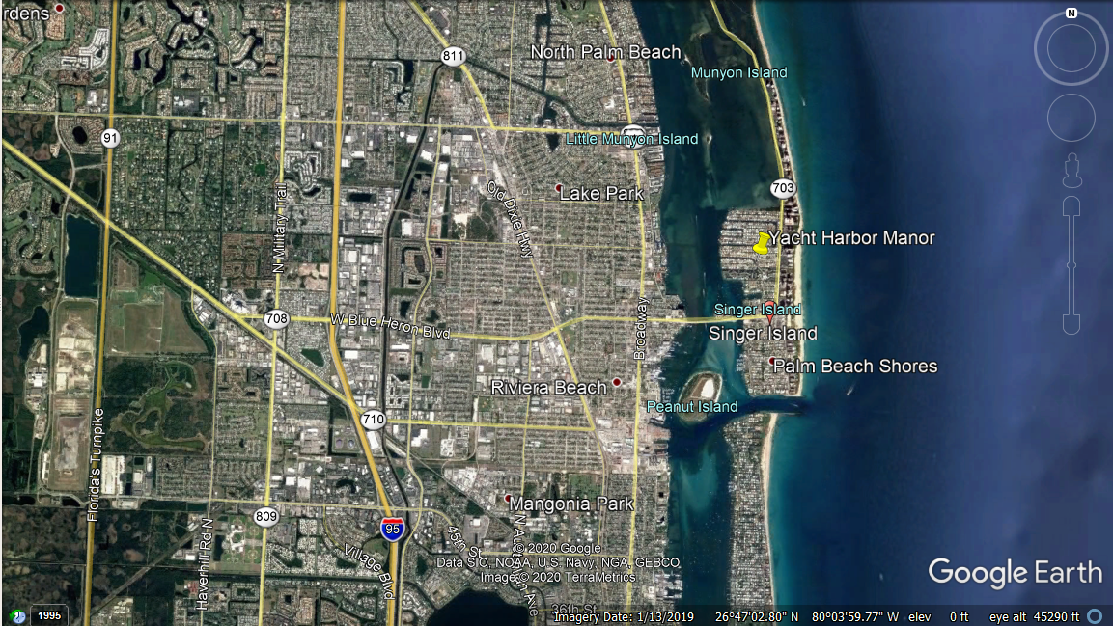

Slide 44
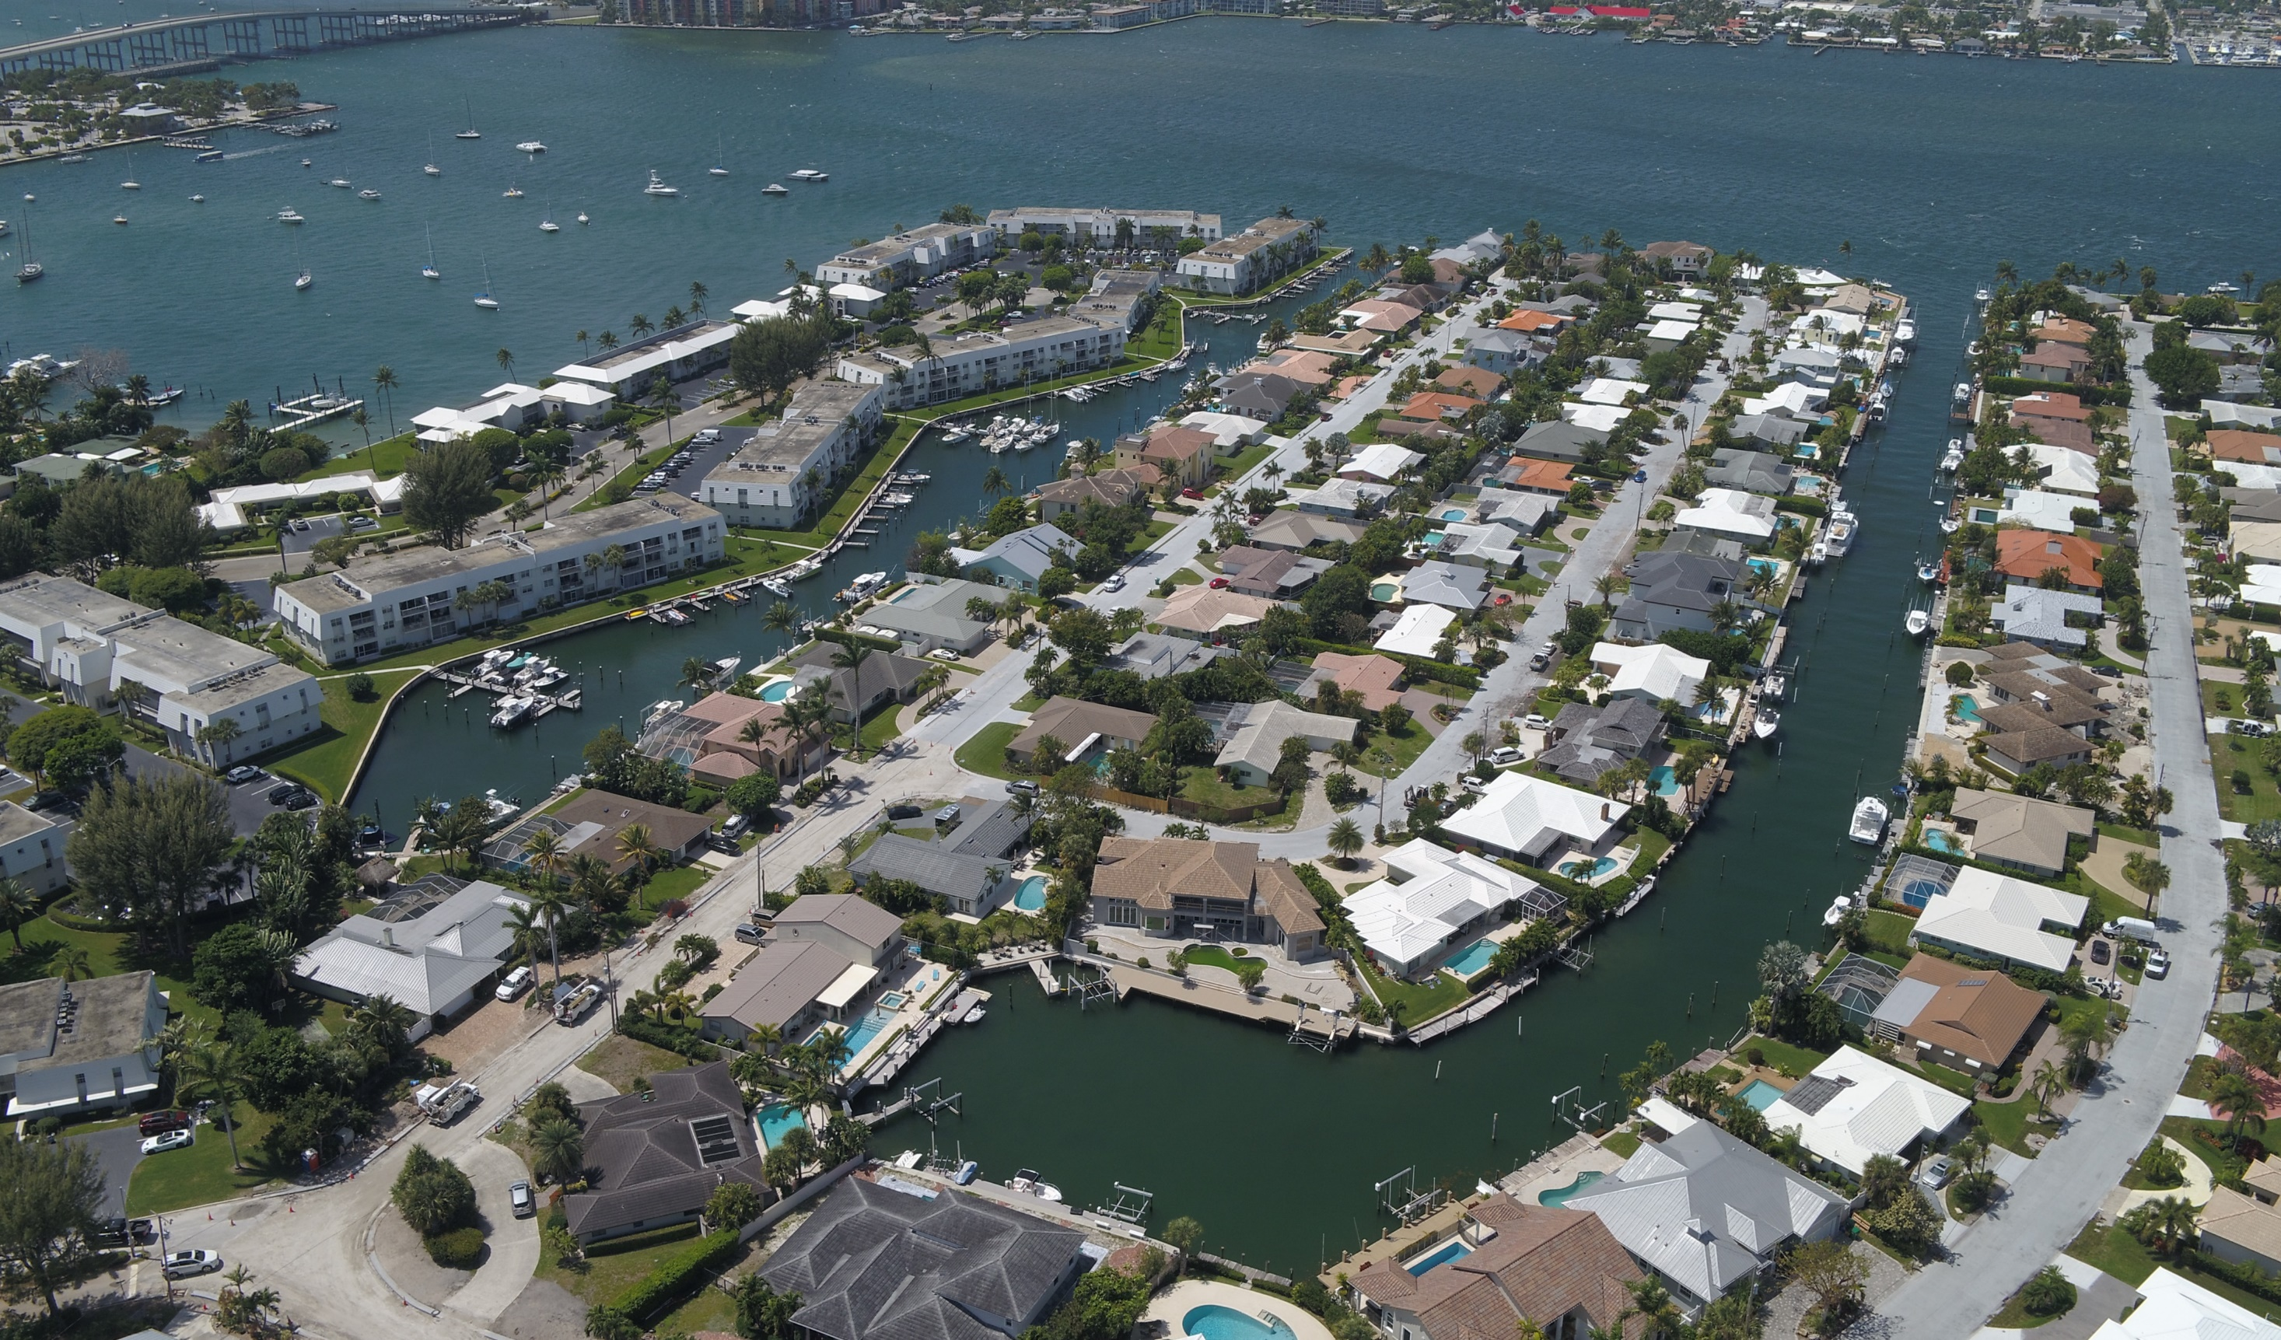




Slide 45
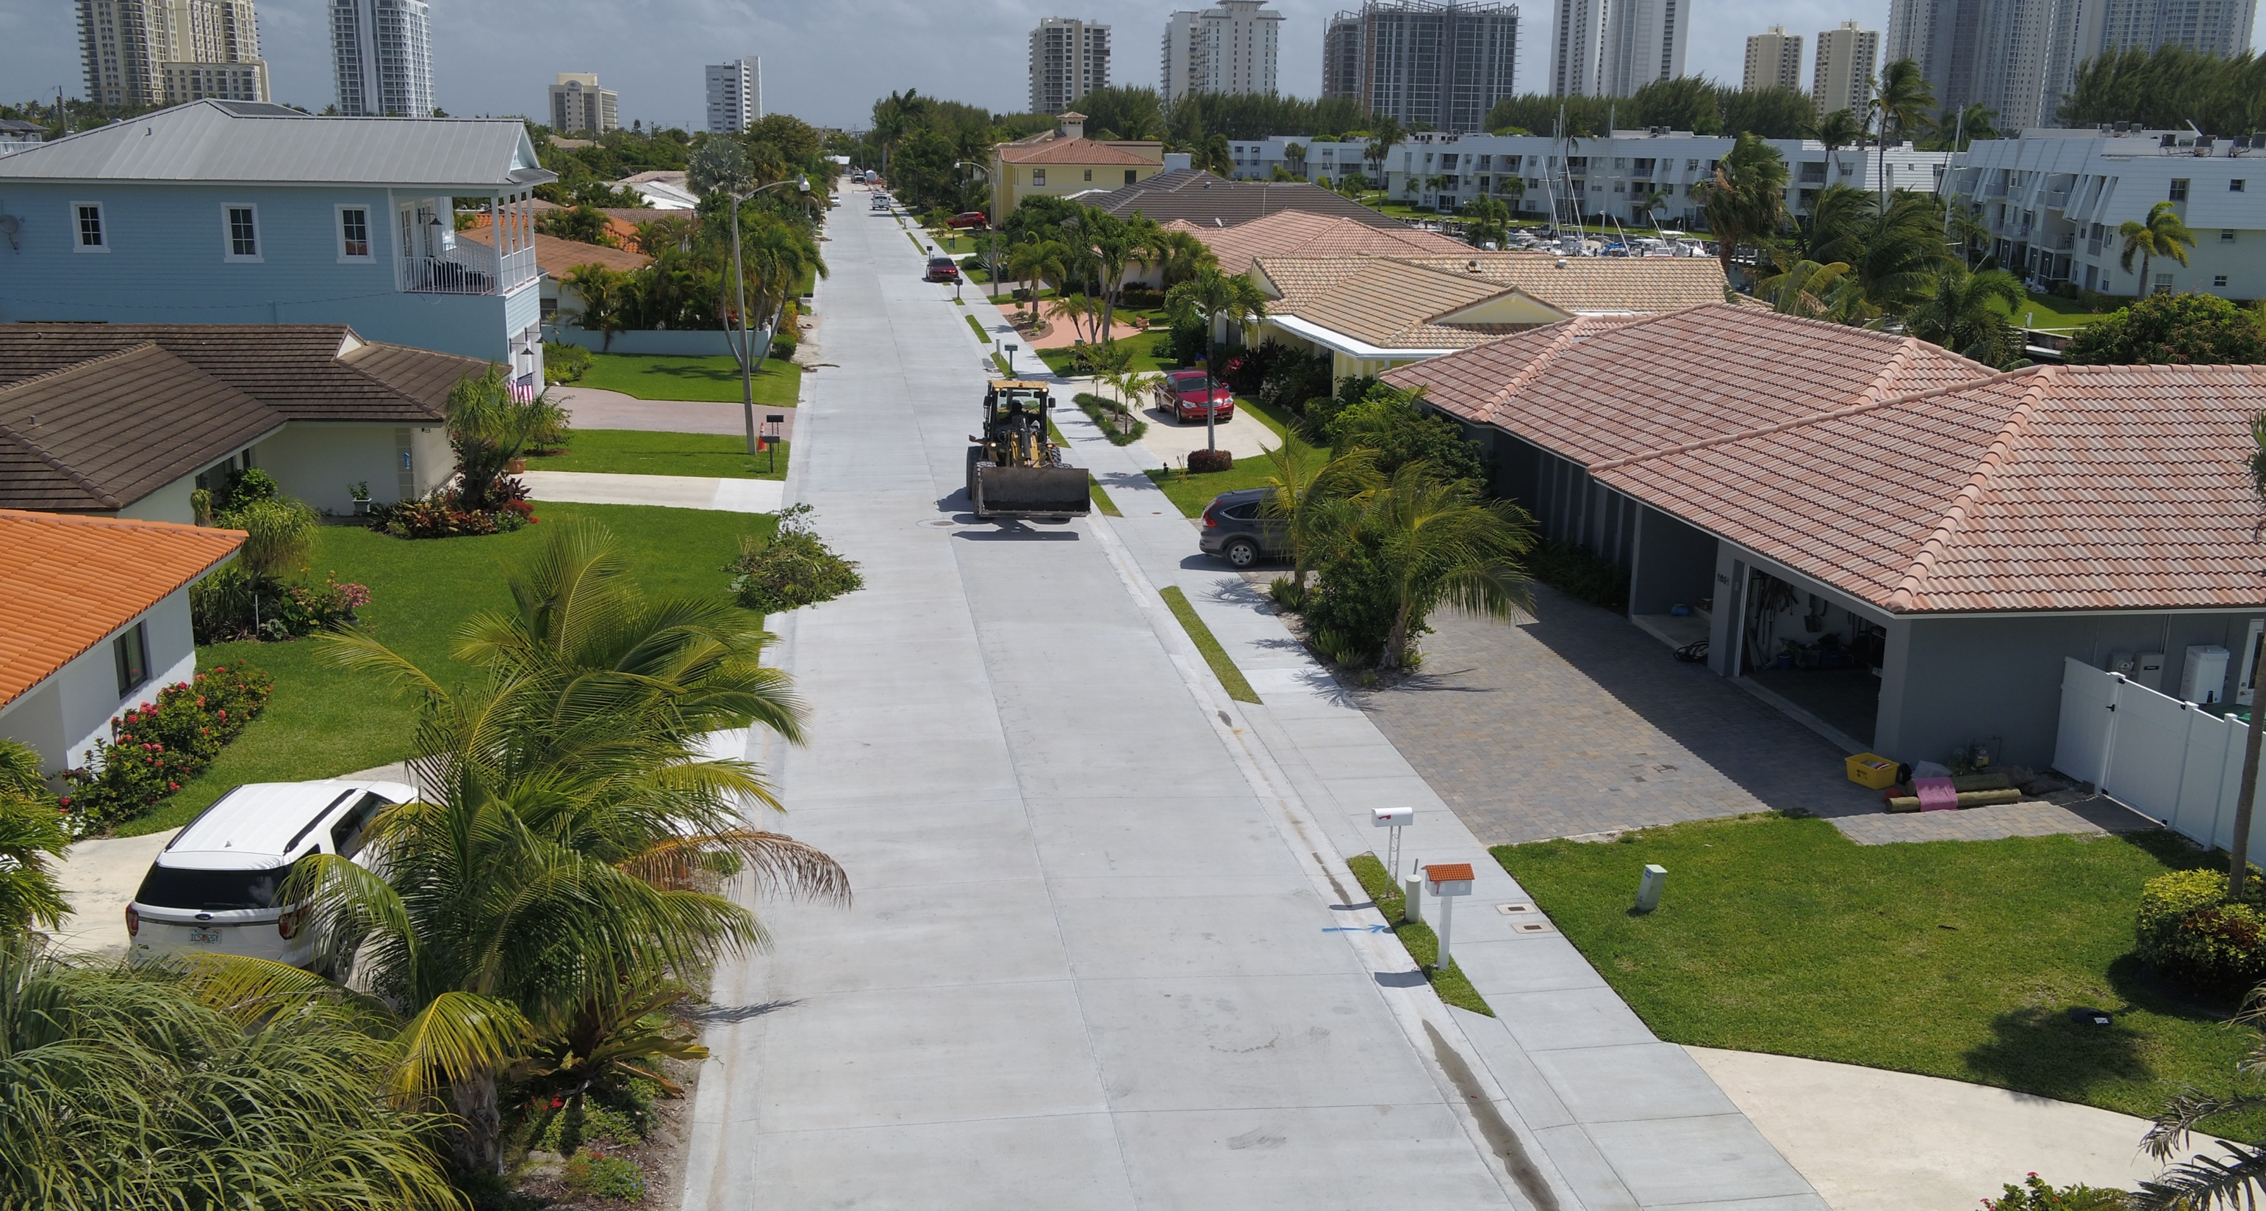
Infrastructure needs:
Water
Sewer
Drainage quality
Eliminate ponding

Slide 46



Asphalt section vs. concrete section
2” Asphalt
5” Concrete
10” Subgrade
12” Subgrade
12” Subgrade
7” thinner

Slide 47
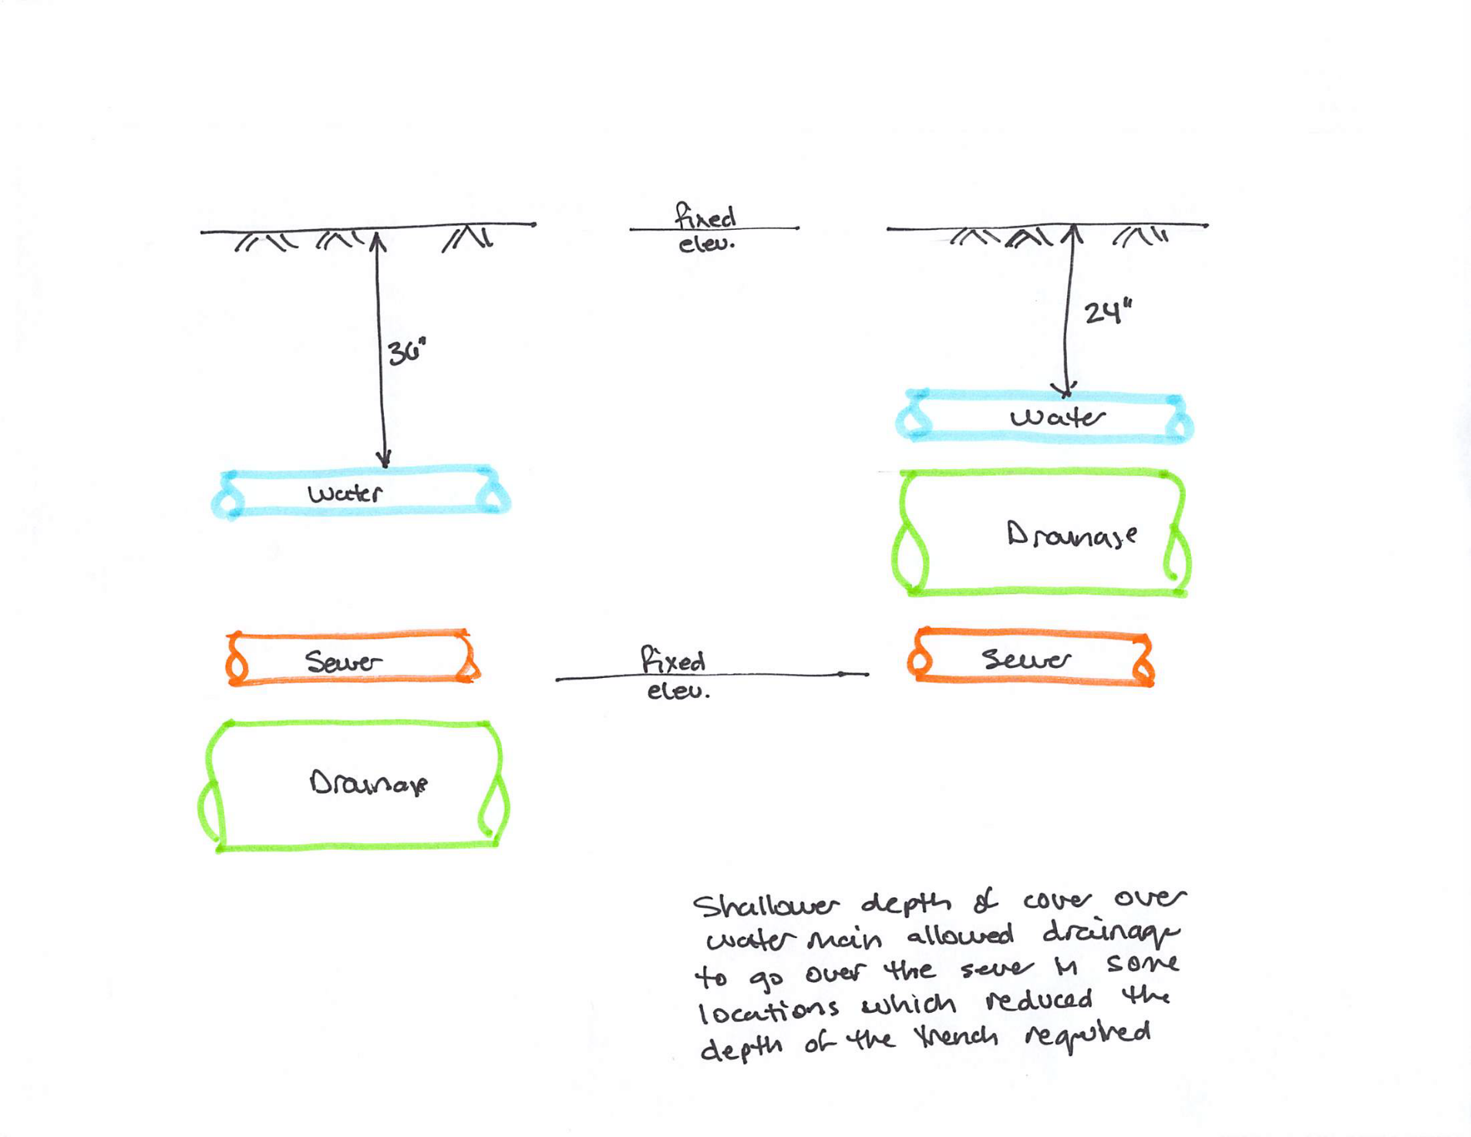
Addressing a High-Water Table
Elevation View of SR54 Viaduct
From Old SR54 Alignment, Fenwick DE
Cost = $16 M in 2001
Elevating the roadway is not cheap and it is not possible to raise all roadways

Slide 48
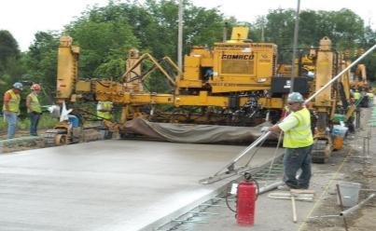
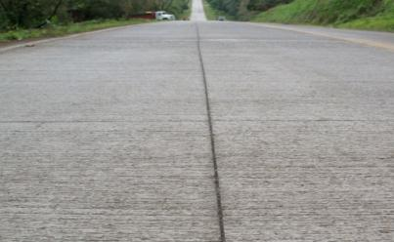
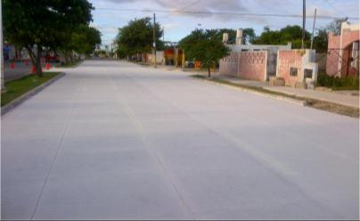
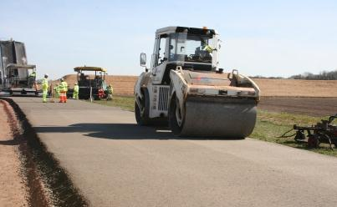
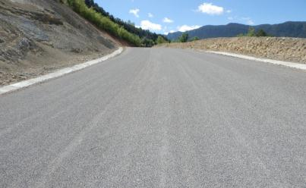
SOME RESILIENT CEMENT-BASED PAVEMENT SOLUTIONS THAT CAN BE USED AS HARDENING TECHNIQUES
Conventional Concrete Pavement
Thin Concrete Pavement
Concrete Overlays
Roller Compacted Concrete (RCC)
Full Depth Reclamation (FDR) w/ Cement

Slide 49


CONCRETE OVERLAYS OF ASPHALT HAVE UNTIL RECENTLY BEEN CALLED “WHITETOPPING OVERLAYS”
Bonded Concrete Overlays of Asphalt Pavements (BCOA)
Small square panels reduce curling, warping, & shear stresses.
if necessary, mill to correct crown, remove surface distresses, improve bond
Need a 3-inch minimum of asphalt after milling.
Typical Thickness = 3 to 6 inches
Used since 1998
Unbonded Concrete Overlay of Asphalt Pavements
No minimum thickness of Asphalt (used only as base)
Normal to slightly smaller than normal joint spacing. Based on unbonded overlay thickness
Typical Thickness = 5 to 10+ inches
Used since 1919
Both systems bond to the underlying asphalt, but bond is not accounted for in the DESIGN for unbonded overlays

Slide 50
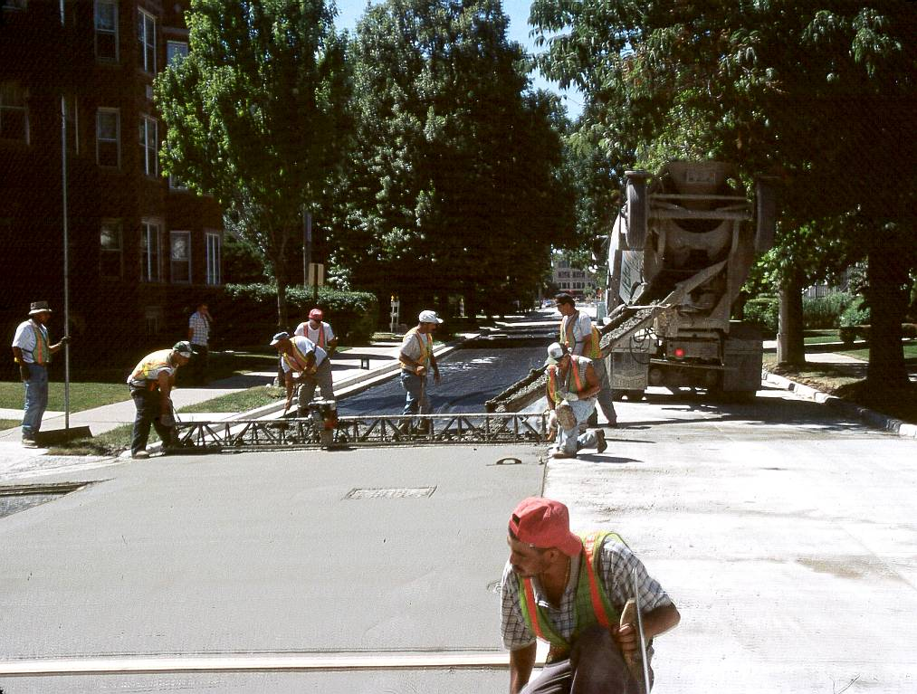
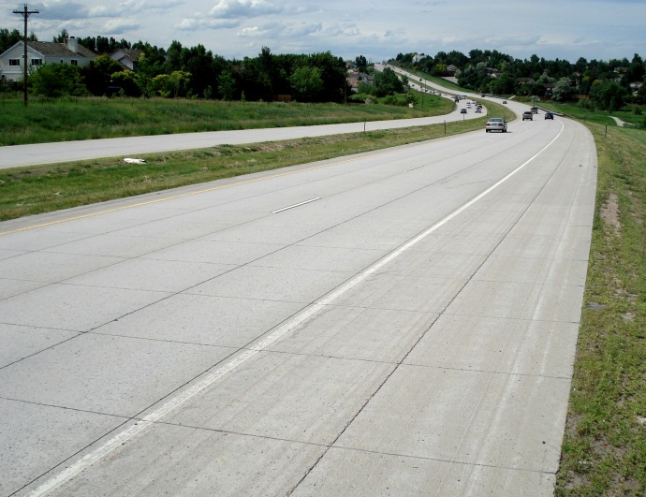
NATIONWIDE CONCRETE OVERLAY USAGE IS GROWING
BCOA Examples
Overlays as Percentage of
Total Concrete Paving, SY
Source: From data submitted by ACPA chapters/state paving associations and other sources, including Oman Systems, Bid Express and DOT websites.
Marion Street, Oak Park, Illinois
Colorado
SH-121, Wadsworth Ave
Constructed in 2001
Photo in 2013

Slide 51
HOW CONCRETE OVERLAYS IMPROVE ASPHALT PAVEMENT’S RESILIENCE TO FLOODING
7000 lbs load.
7000 lbs load.
Concrete
Asphalt
Base
Subbase
Subgrade
Pressure ~3 - 7 psi
at the top of the Asphalt layer
Base & subgrade pressures are even lower
Asphalt
Base
Subbase
Subgrade
Road Elevation raised the height of the overlay
pressure ∼ 15 - 20 psi
Concrete overlay increases both height and the structural strength of the roadway
Notes:
Need to talk about how we design roads for optimum moisture conditions and optimum density. When flooded, we lose that
Much more of the load on a rigid pavement section is carried in the pavement.
In a flexible pavement section, the base and subgrade are integral in carrying the load.

Slide 52

Bonded Concrete Overlay of Asphalt (BCOA) Design and Construction Recommendations
based on Caltrans PPRC 4.58B Project
John Harvey, Angel Mateos, Fabian Paniagua, Julio Paniagua, Rongzong Wu
University of California Pavement Research Center
Julie Vandenbossche, John DeSantis
University of Pittsburgh
Deepak Maskey
California Department of Transportation
Charles Stuart
Southwest Concrete Pavement Association

Slide 53

Introduction
4.58B Project experimental data sources:
Laboratory testing of concrete, asphalt, and concrete-asphalt interface
Monitoring the response of BCOA to the ambient environment
Heavy Vehicle Simulator testing
15 BCOA sections were built at Davis UCPRC facilities on Feb-2016
Thickness = 4.5 and 6 inches
Joint spacing and interface conditions varied
Response to ambient environment was monitored in 6 of the sections
11 of the sections were tested with the Heavy Vehicle Simulator (HVS)
6x6 slabs
12x12 slabs

Slide 54

Summary of HVS Testing at UCPRC
11 full-scale BCOA sections tested with the HVS
After testing 10 out of the 11 sections*...
No cracking at any section, no faulting, no noticeable slabs movements
To induce cracking, pavement was flooded and loaded - “wet” Loading (140,000 Reps)
One panel crack after 7.55 M ESALs (8 times the loading for a normal BCOA application)
22.5
kips
1.98 M ESALS
18 kips
18 kips
Load (single wheel)
13.5
kips
70,000 reps
70,000 reps
70,000 reps
9 kips
70,000 reps
70,000 reps
5.57 M ESALS
10 days flooding + water supply during HVS testing
“Dry” Testing With Wander
Flooded Testing
Channelized Traffic
* One section was for environment studies only
Notes:
These are single wheels, to convert to Axles multiply by 2
Using power of 4 ratio, and axle weights (Weight – 2*9=18), ESALS = 5,398,750 (TI = 11)
Wet flooded channelized ESALS = 3,854,375 ESALS (TI = 10.6)

Slide 55

CONCRETE OVERLAYS OF ASPHALT ARE COST EFFECTIVE State Highway 13 – North of the city of Craig, CO
Project Bid in December 2015 as AD/AB*
SH 13 Existing Condition before overlay
Hot Mix Asphalt (HMA) Alternative
2-in SX(75) PG 58-34 (surface AC) over 4-in of SX(75) PG 58-28 (Base AC) over 8-in of Full Depth Reclamation
Initial Const = $5,385,980.85
Rehab & Maint = $2,456,560
Users Cost = $596,170
Total Life Cycle Cost = $8,438,710.85
Concrete Alternative
6-in Unbonded Concrete Overlay on Asphalt
Initial Const = $5,338,308.82
Rehab & Maint = $1,674,060
Users Costs = $718,490
Total Life Cycle Cost = $7,730,858.82
Concrete overlay was $47k lower in Initial cost & $708k Lower in Life Cycle Costs
* AD/AB = Alternate Design / Alternate Bid: Essentially two pavement designs (1 concrete & 1 Asphalt) are developed and bid competitively against each other in order to increase competition

Slide 56

CONCRETE OVERLAY US1 New Smyrna Beach, Florida 1988
Subbase/Base:
Retain LimerockBase: 8.5 in
Mill 4 in of average 5 in asphalt
Place Type III Leveling: 1 in*
Place Type S Asphalt: 1 in
Place Slab Thickness: 6”, 7”, 8”
Transverse Joint Spacing: Varies 12’, 14’, 16’, 18’ & 20’
Longitudinal Joint Spacing: 12’ Lanes
Joints: Rectangular not skewed
Dowel Diameter: ¾” to 1”
Dowel Spacing: Variable; 3 dowels in each wheel path;
no dowels in last 5 slabs of each test section
Shoulder Design: Originally shoulders were natural soil but asphalt shoulders added later
Existing Condition before overlay
Concrete overlay was $47k lower in Initial cost & $708k Lower in Life Cycle Costs

Slide 57


CONCRETE OVERLAYS US1 New Smyrna Beach, Florida 1988
6” overlay
35 years
Evaluation 2015
Performance 6” Concrete Thickness
- 35 years
Performance 8” Concrete Thickness
- > 50 years
Existing Condition before overlay
8” overlay
50 + years

Slide 58


CONCRETE OVERLAYS US1 New Smyrna Beach, Florida 1988
Existing Condition before overlay
Performance 6” Concrete Thickness
- 35 years
Performance 8” Concrete Thickness
- > 50 years

Slide 59
SOME RESILIENT CEMENT-BASED PAVEMENT SOLUTIONS THAT CAN BE USED AS HARDENING TECHNIQUES
Conventional Concrete Pavement
Thin Concrete Pavement
Concrete Overlays
Roller Compacted Concrete (RCC)
Full Depth Reclamation (FDR) w/ Cement

Slide 60


FULL-DEPTH RECLAMATION (FDR) WITH CEMENT RECYCLES AN EXISTING DETERIORATED ASPHALT PAVEMENT INTO A NEW STABILIZED BASE The stabilized base can be topped with an asphalt or concrete surface
Utilizes In-Place Materials (reduces cost)
Saves Energy by Reducing Trucking Requirements
Increased Rigidity Spreads Loads
Minimizes Rutting
Reduced Moisture Susceptibility
Notes:
The resulting base layer is much stronger and more moisture resistant than the originally-placed base layer. Additionally, less raw materials are required to reconstruct a roadway leading to reduced cost and decreased environmental impact.

Slide 61
FULL-DEPTH RECLAMATION (FDR) Construction Process Pulverize, Shape, Add Cement, Mix In Place, Compact, and Surface
Bituminous Surfacing
New Surfacing
Granular
Base
Pulverized
Pulverized
Stabilized
Stabilized
Subgrade
Subgrade
Subgrade
Subgrade
Subgrade
Existing
road
Pulverization
to desired
depth
Removal of
excess material (if necessary)
and shaping
Addition of cement, mixing, reshaping, and compaction
Final surface application

Slide 62
FDR W/ CEMENT INCREASES RIGIDITY TO SPREADS LOADS AND REDUCES PERMEABILITY TO REDUCE MOISTURE SUSCEPTIBILITY
100 psi
100 psi
Un-stabilized Granular Base
FDR w/ Cement-Stabilized Base
15 psi
4 psi
High water table
Moisture infiltrates base
Through high water table
Capillary action
Causing softening, lower strength, and reduced modulus
Cement stabilization reduces permeability
Helps keep moisture out
Maintains high level of strength and stiffness even when saturated

Slide 63


FULL DEPTH RECLAMATION WITH CEMENT REDUCES THE STRAINS UNDER THE ASPHALT PAVEMENT
Asphalt Strain at 68° F
Tensile Strain at 68° F
Date of Testing
* FDR = 6-in aggregate base + 2-in subgrade stabilized in-place with 4% Type II Portland Cement
Structural Study of Cold Central Plant Recycling Sections at the National Center for Asphalt Technology (NCAT) Test Track,
Brian K. Diefenderfer, Ph.D., P.E., Benjamin F. Bowers, Ph.D. (VTRC), Miguel Díaz Sánchez, David H. Timm, Ph.D., P.E., Auburn University
http://www.virginiadot.org/vtrc/main/online_reports/pdf/17-r9.pdf

Slide 64

FULL-DEPTH RECLAMATION (FDR) Reduced impacts both financial & environmental
180
12
4,500
300
2,700
0
3,000
500
1 mile of 24-foot wide, 2-lane road, with a 6-inch base
Notes:
The resulting base layer is much stronger and more moisture resistant than the originally-placed base layer. Additionally, less raw materials are required to reconstruct a roadway leading to reduced cost and decreased environmental impact.

Slide 65
CONCLUSIONS
There is a need to make our infrastructure resilient “Flood Ready”
Increasing flooding events
Stipulation for funding
In areas where pavements are flood prone or at risk to become so
Use stiffer or stiffen the existing pavement
Require pavement designs be based on soaked subgrade strength
Concrete pavement/cement-based solutions have shown a remarkable resiliency to flooding
Some are also low costs, such as concrete overlays and full depth reclamation, that can be used as mitigation / hardening strategies
The concrete industry is here to help you find the right solution

Slide 66

CONCRETE OVERLAYS US1 New Smyrna Beach, Florida 1988
Existing Condition before overlay
Performance 6” Concrete Thickness
- 35 years
Performance 8” Concrete Thickness
- > 50 years
Resilient
+
Sustainable
Concrete overlay was $47k lower in Initial cost & $708k Lower in Life Cycle Costs

Slide 67




152ºF
141ºF
132ºF
Fort Lauderdale, FL
June 26, 2018 1:30pm

Slide 68

Reduce Urban Heat Islands
Pavements 10 to 20 degrees cooler
Reduced AC needs, context important
Improved air quality with lower temperatures
“Reflective pavements could offset enough CO2 to remove the equivalent of around 4 million cars from the road each year” according to MIT Concrete Sustainability Hub, Mitigating Climate Change with Reflective Pavements 2020.

Slide 69

Safety Improved visibility reduces accidents
SH 13 Existing Condition before overlay
Concrete overlay was $47k lower in Initial cost & $708k Lower in Life Cycle Costs
Notes:
Studies show 37% less lighting is needed with concrete.
*SN2458PCA

Slide 70

Safety Improved visibility / reduces accidents / reduces crime
SH 13 Existing Condition before overlay
50% of road fatalities
75% of pedestrian fatalities
Concrete overlay was $47k lower in Initial cost & $708k Lower in Life Cycle Costs
Notes:
Studies show 37% less lighting is needed with concrete.
*SN2458PCA

Slide 71


What is portland-limestone cement?
Portland-limestone cement is made by inter-grinding regular clinker with up to 15% limestone while regular portland cement contains up to 5% limestone (Type IL blended cement in ASTM C595/AASHTO M240)
Portland-limestone cement is a finer ground product than regular portland cement

Slide 72

Environmental Benefits
Reduced
CO2 by 10 - 12%
Schmidt 1992
CO2 Emissions in Concrete
Notes:
Data from Germany indicates that the impacts of using limestone are appreciable; in this case CO2 emissions are on the order of 10% lower for the manufacture of portland-limestone cements.
Schmidt, M., "Cement with Interground Additives - Capability and Environmental Relief," Zement-Kalk-Gips, Vol. 45, No. 2, 1992 pages 64 to 69; and Vol. 45, No. 6, 1992, pages 296 to 301.

Slide 73

Portland-limestone Cement
Portland-limestone Cement
5% to 15% limestone
History of use: Europe (50+ yrs), Canada (10+ yrs), US
PLCs becoming more popular in the USA
ASTM C 595 Type IL
Accepted by state DOTs
July 2018

