Slide 1

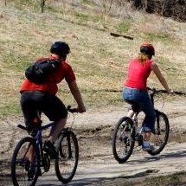

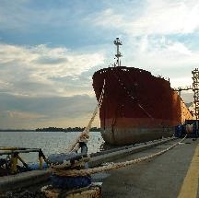
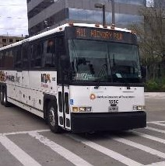
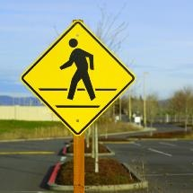

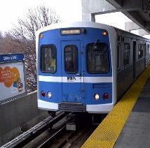

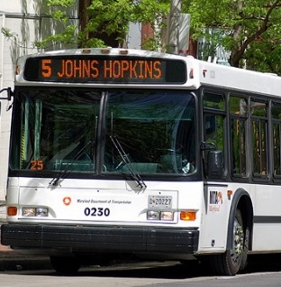

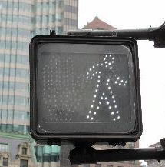
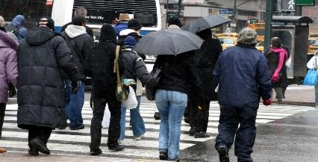


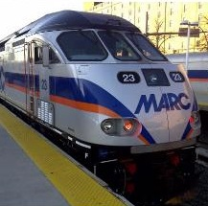
March 21, 2017
What’s New in the SHA Bridge Office

Slide 2

What’s New in the Office Structures
Glenn C Vaughan Appointed Director
BSCE from UMass Lowell 1976
Licensed Professional Engineer in Maryland
40 year experience with MD SHA Bridge Office
19 years as Deputy Director
4 years as co-chair MDQI Project Development subcommittee

Slide 3
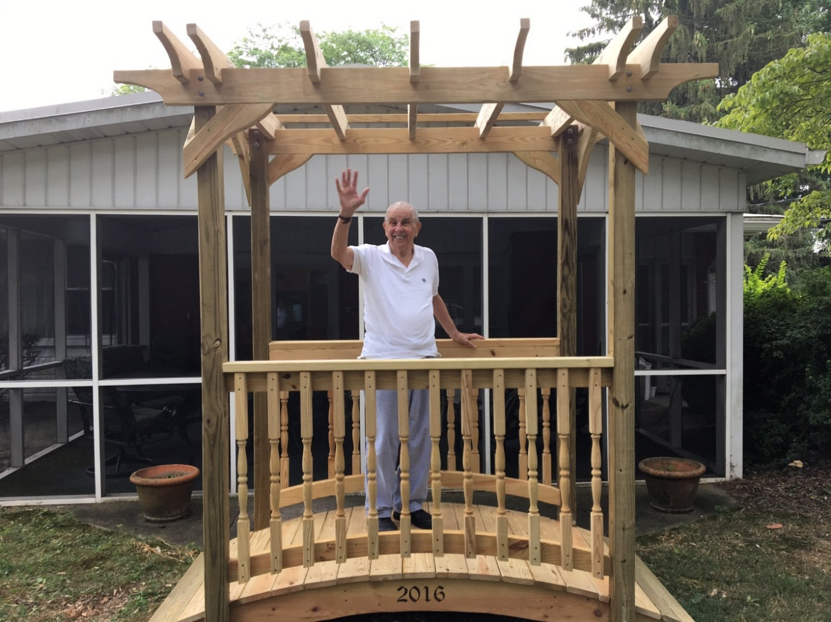
Changes in Office of Structures
Jock Freedman Retires after 66 years with SHA

Slide 4
Changes in Office of Structures
Bridge Program Performance Measures
69 Structurally Deficient Bridges (04-01-2016)
$150 M in Bridge System Preservation (FY 2016)
$60 M on Major Rehabilitations
$32 M on Minor Rehabilitation
$30 M on Inspection and Engineering
$17 M on Paint
$9 M on Overhead
$2 M on Other Phases (Utilities and ROW)

Slide 5
Changes in Office of Structures
Bridge Program Performance Measures

Slide 6
Changes in Office of Structures
Bridge Program Performance Measures

Slide 7
Changes in Office of Structures
Bridge Program Performance Measures

Slide 8
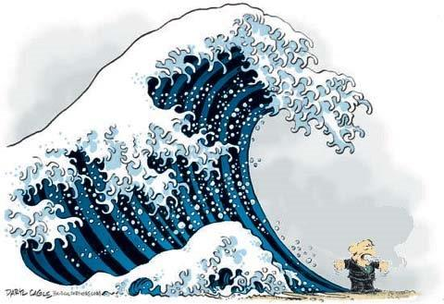
Changes in Office of Structures
Bridge Program Performance Measures

Slide 9
Changes in Office of Structures
Bridge Program Performance Measures

Slide 10
Changes in Office of Structures
Bridge Program Performance Measures
Goal: No Bridge on the Structurally Deficient list for more than 5 years, except in those cases where the deficient bridge will be addressed as part of a large capital improvement project - (I-270 / MD 85 interchange).

Slide 11
Changes in Office of Structures
Revised System for Providing Review Comments
Meeting between Designers and Bridge Management Team to Discuss TS&L Alternatives and Resolve Review Comments.
Allows instant resolution of some concerns
Allows all to be aware of the reasons behind decisions
Reduces time from submittal to comments
Allows designers to defend their recommendations

Slide 12
Changes in Office of Structures
Revised Bridge Details
Using Self Consolidating Concrete for all Precast Superstructure Elements.
Revised Traffic Barrier Attachment to Endpost.
Eliminated Overhang at End of Endpost
Field Meeting to Review Procedure for Setting Precast Plank Superstructures (slab erection, tie-rods, shear keys and concrete overlay).

