Slide 1
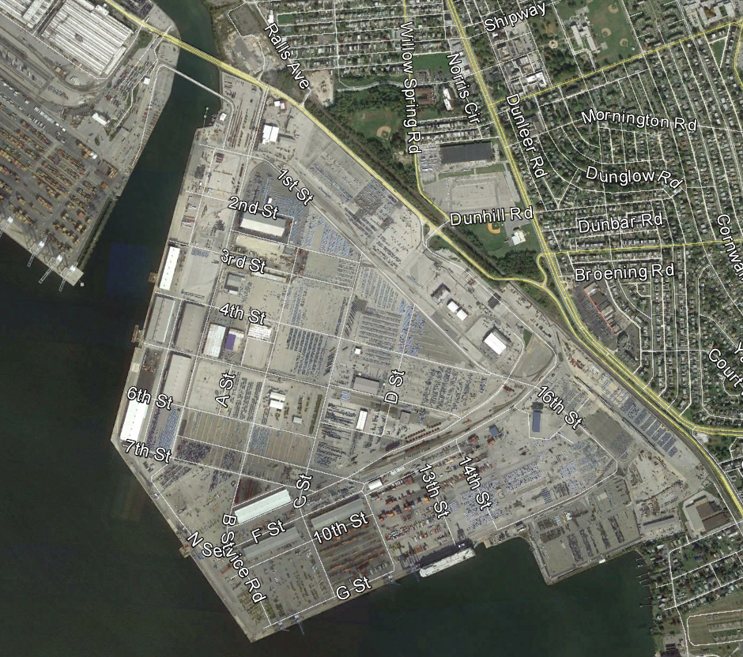
Maryland Port Administration
Design & Reconstruction of
Berth 4 at Dundalk Marine Terminal
March, 2017
MMT

Slide 2

PROJECT TEAM
Owner - Maryland Port Administration (MPA)
Engineer of Record – Moffatt & Nichol
Prime Contractor – Corman Marine Construction (CMC)
  Approx. Duration: Summer 2014 to Fall 2016

Slide 3
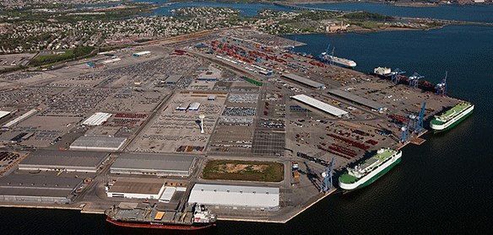
PROJECT LOCATION
Dundalk Marine Terminal

Slide 4
TERMINAL DESCRIPTION
570 Acre General Cargo Facility
13 Berths
9 Container Cranes
Proximity to Midwest US (Competitive edge for transport of farm equipment)
Direct Rail Access (Dozens of farm equipment units delivered to DMT in one trip)

Slide 5
DMT BERTH 4 USAGE
Cargo Handling
  Primarily Auto-Carrier Vessels, Roll-on/Roll-off (RoRo)
  Farm & Construction Equipment
  Dry Bulk

Slide 6
DMT BERTH 4 DESIGN CRITERIA
Primary RoRo Design Vessel
  Approximately 860’ Long x 150’ Wide
  Approximate 40’ Draft
  Displacement (Fully Loaded): 81,253 Long Tons

Slide 7
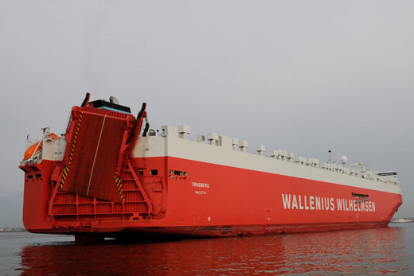
Typical RoRo Vessel

Slide 8
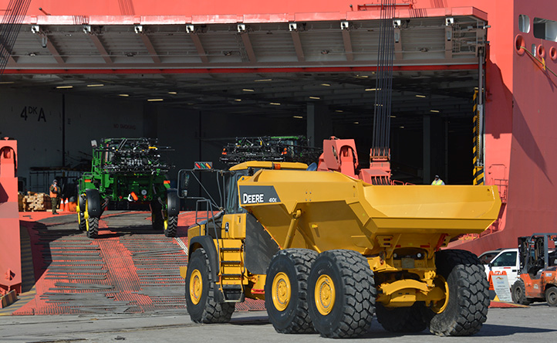
RoRo Ramp & Cargo Loading

Slide 9
DMT 1-6 RECONSTRUCTION PROGRAM
The Phased Reconstruction of DMT Berths 1-6
Approximate Total Length of 3,800 Linear Feet
2004 - Phase 1 - 1,126 Linear Feet: DMT Berths 5 & 6
2016 - Phase 2 – 706 Linear Feet: DMT Berth 4
In Design – Phases 3&4 – 1,965 Linear Feet: DMT Berth 1-3

Slide 10
RECONSTRUCTION RATIONALE
Existing Timber Pile Relieving Platform has reached end of useful service life.
Early 1900’s original construction and subsequent 1960’s -70’s retrofit program.
  Prior design criteria and standards reaching obsolescence.
Degraded/failing portions of timber cut-off wall causing backlands subsidence & material exfiltration.
  Results in Significant Areas of Load Restriction.

Slide 11
DMT 4 – PRIOR CONFIGURATION – PARTIAL PLAN
Prior Wharf Footprint: 706’ x 38’

Slide 12
DMT 4 – PRIOR CONFIGURATION - SECTION

Slide 13
DMT 4 DECK PLAN
New Wharf Footprint: 706’ x 74’

Slide 14
PRIMARY DESIGN CRITERIA
1,000 PSF Live Load Rating
140 ton Trailer Loading
250,000 # Top-Pick Axle Load
200 ton Mooring Bollard Capacity
Cooper E-80 Rail Loading – 80,000 # Axle Loads

Slide 15
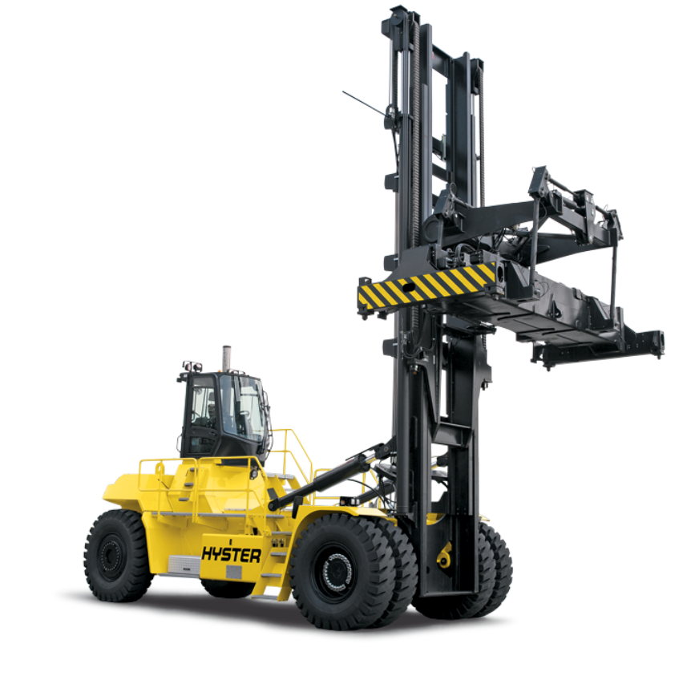
Top Pick Cargo Handler

Slide 16
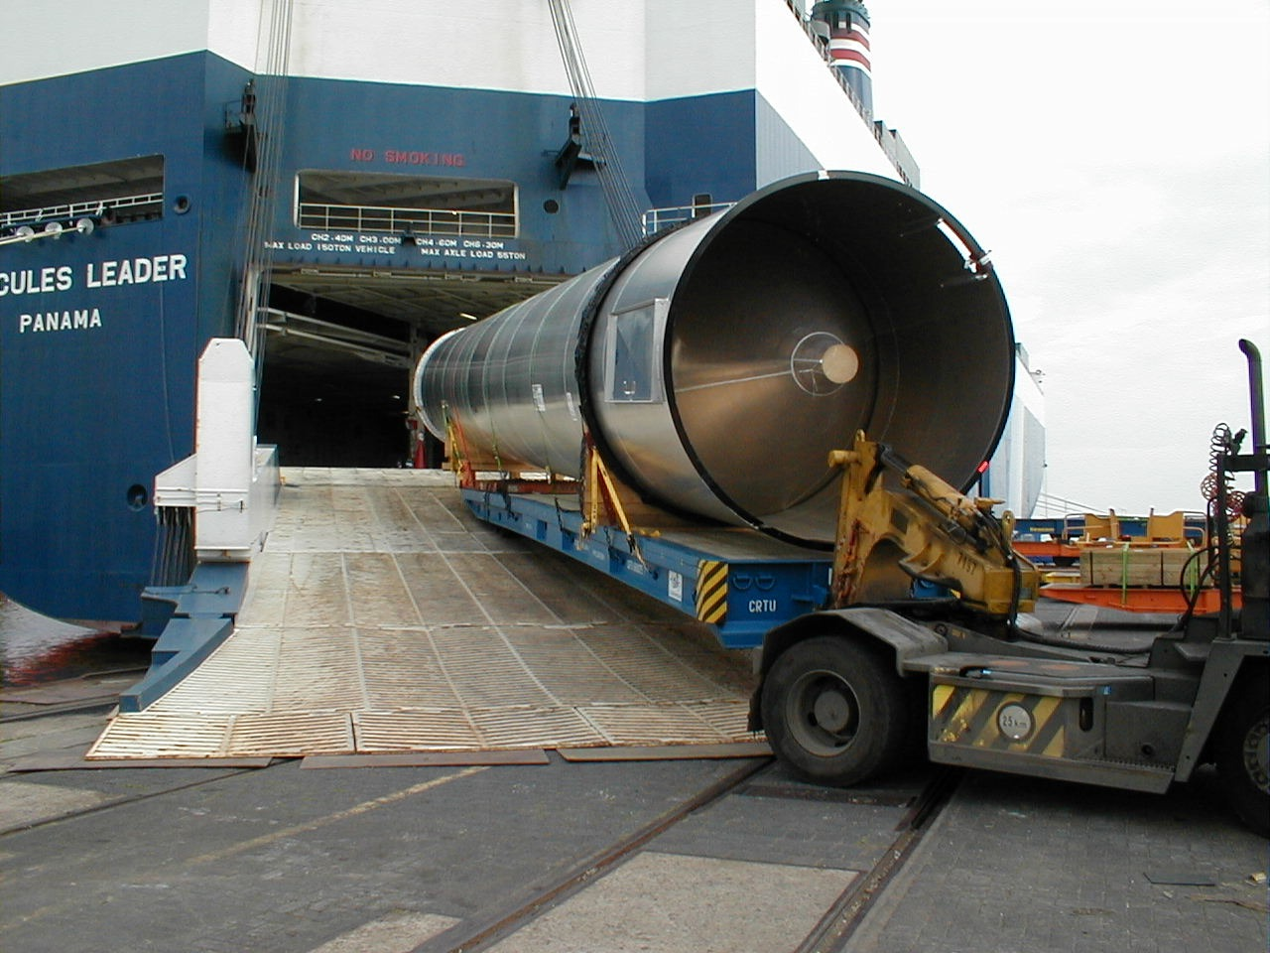
Cargo Trailer Offloading RoRo

Slide 17
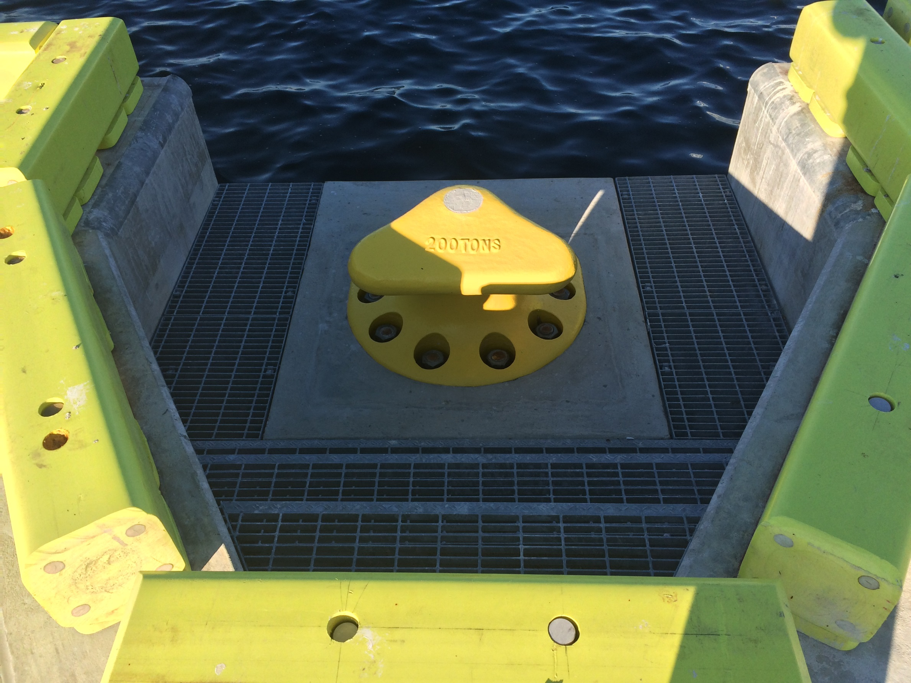
200 Ton Mooring Bollard

Slide 18
COMPOSITE SLAB DECK UNDER BALLAST
P/S CONC. PILE CAPS
PT SOIL ANCHORS
P/S CONC. PILES
COMBINATION WALL

Slide 19
POST-TENSIONED COMBINATION WALL
Combines H-Shape with Intermediate Z-Shapes.
H-Shape at 6-ft o/c.
H-Shape driven to support anchor “downdrag” and vertical service loads.
170 ton design load for H-Shape.

Slide 20
POST-TENSIONED COMBINATION WALL (Continued)
Maintain Stability of Shed 4 & Backland Soil Mass
Approx. 170 ton soil anchor design load
Primary lateral bracing system of berth
Approximate bulkhead cap volume of 753 CY

Slide 21
POST-TENSIONED COMBINATION WALL (Continued)
Develop Geotechnical Capacity in Potomac Sand & Gravels
143 Anchors at Average Length of 160 LF (45 LF Bond)

Slide 22
PRESTRESSED CONCRETE PILES
24-inch square displacement pile
Design loads range from 170 ton – 220 ton
Design to support both driving stresses and service-life loading.
Approximate total pile volume of 4295 CY using SCC.

Slide 23
PRESTRESSED CONCRETE PILE CAPS
Contractor proposed change to precast-prestressed pile caps.
Approximately 64-ft long precast-prestressed elements.
Approximate total precast cap volume of 906 CY.

Slide 24
COMPOSITE DECK SLAB
10-inch thick precast/prestressed deck planks.
8-inch thick CIP topping slab.
Approximate deck slab volume of 2903 CY.

Slide 25
SERVICE LIFE – SYSTEM PRESERVATION DESIGN
75-Year Design Service Life
  MPA Standard Concrete Mix Design
  Cathodic Protection of Bulkhead Wall
  Cathodic Protection of Concrete Piles
  Serviceability Design – Limit Crack Width Values to 0.007”
  Stringent Finish Standards – Similar Crack Width Limit

Slide 26
SERVICE LIFE – MPA STANDARD CONCRETE MIX DESIGN
MPA Standard Concrete Mix Design
  75% Type II Cement + 25% Pozzolan (Slag or Flyash)
  W/C = 0.40
  Aggregate testing to vet out ASR/ACR reactivity and/or Soundness.
  Calcium Nitrite Corrosion Inhibitor ~ 3-4 GA/CY (Passivate Ferrous Ions)
  3-Inch Cover + Corrosion Inhibitor: 75 Year Design Life

Slide 27
SERVICE LIFE – MPA STANDARD CONCRETE MIX DESIGN
STADIUM Service Life Evaluation
  (Software for Transport and Degradation In Unsaturated Materials) is a concrete service life prediction method which uses finite element software in conjunction with certified lab testing to determine the service life of exposed reinforced concrete.
  Independent Review performed by Material Scientists.
  Time-step FEM program to model progression of chloride ions to bare (black carbon) reinforcing steel.

Slide 28
SERVICE LIFE – PASSIVE CATHODIC PROTECTION
Passive (Sacrificial) Cathodic Protection System
  Sacrificial element referred to as “Anode”.
  Anode designed to corrode in preference to the more stable (inert) carbon steel matrix.
  Anode is consumed over time, requires monitoring and eventual replacement.
  Zinc or Aluminum typically selected as Anode material.
  Designed by a Corrosion Specialist PE & NACE..

Slide 29
SERVICE LIFE – PASSIVE CATHODIC PROTECTION
13 - Removable 325# Anode.
4,225 total design poundage.
Weld (electrically fuse) anode to SSP.
Formation of “circuit” in aqueous ion solution.

Slide 30
SERVICE LIFE – PASSIVE CATHODIC PROTECTION
306 - Removable 50# Anode.
15,300 total design poundage.
Wires spliced within perimeter pile reinforcing steel.
Formation of “circuit” in aqueous ion solution.
Anode performance monitored in test stations.

Slide 31
CONSTRUCTION – GENERAL SCOPE-OF-WORK
Construct PT Anchored Bulkhead to Stabilize Shed 4 Backlands
Demolition of Existing Outboard Wharf
Dredge to EL -50 (NAVD 88)
Drive Outboard Wharf Piles
Construct Outboard Subframe
Closure Pours, Ballast Fill, Surface Paving & Rail Works

Slide 32
CONSTRUCTION – GENERAL SCOPE-OF-WORK
Construct PT Anchored Bulkhead to Stabilize Shed 4 Backlands
Demolition of Existing Outboard Wharf
Dredge to EL -50 (NAVD 88)
Drive Outboard Wharf Piles
Construct Outboard Subframe
Closure Pours, Ballast Fill, Surface Paving & Rail Works

Slide 33
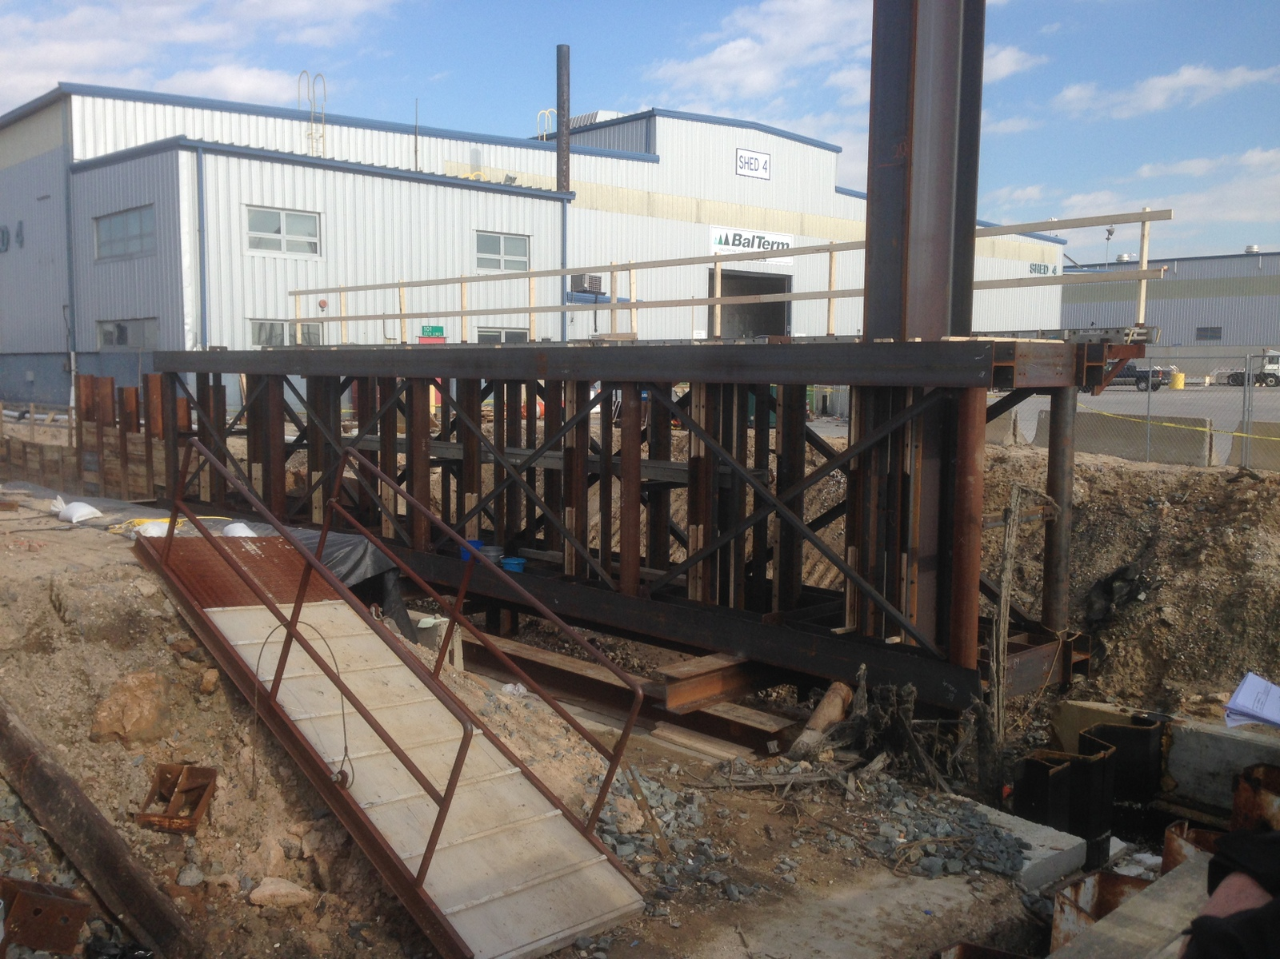
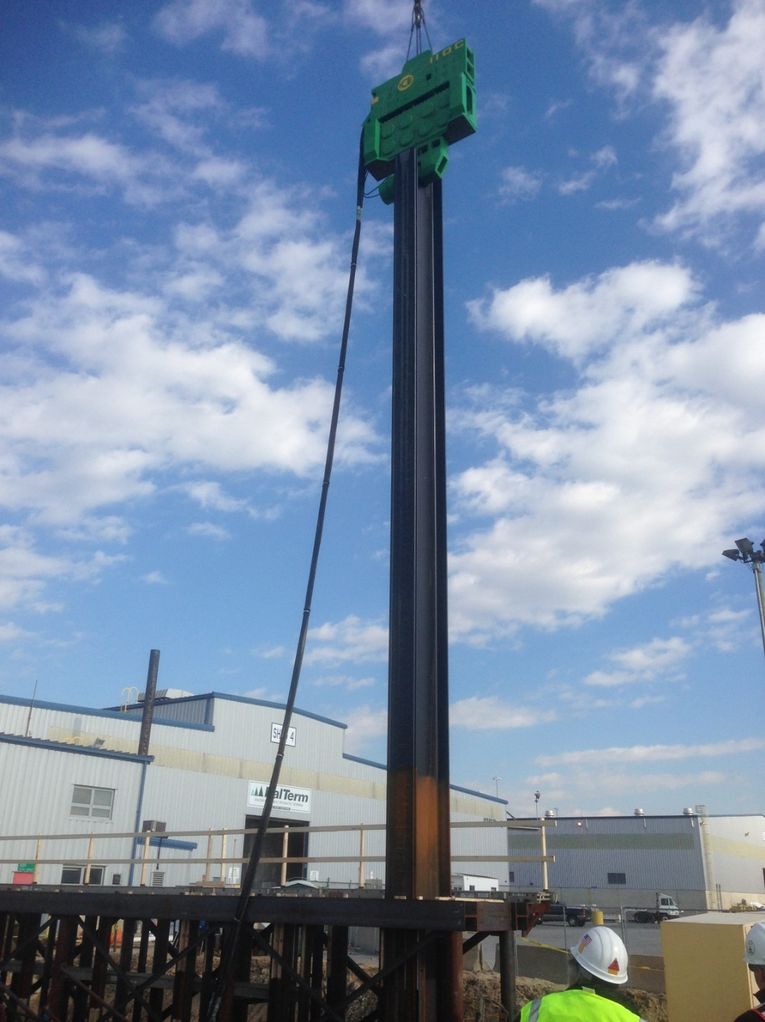
CONSTRUCTION – PT BULKHEAD WALL
Construct PT Anchored Bulkhead to Stabilize Shed 4 Backlands

Slide 34
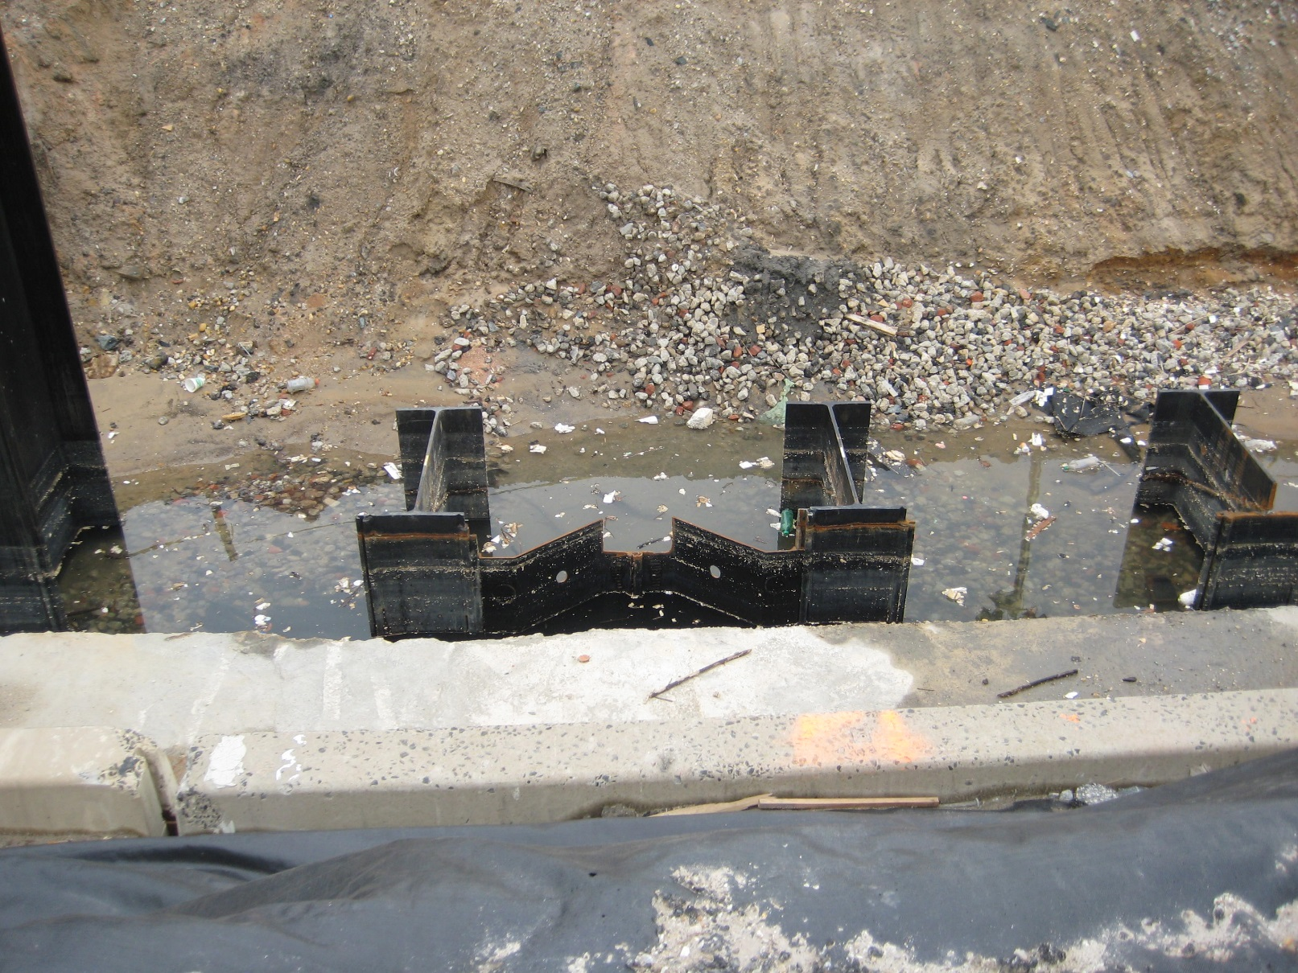
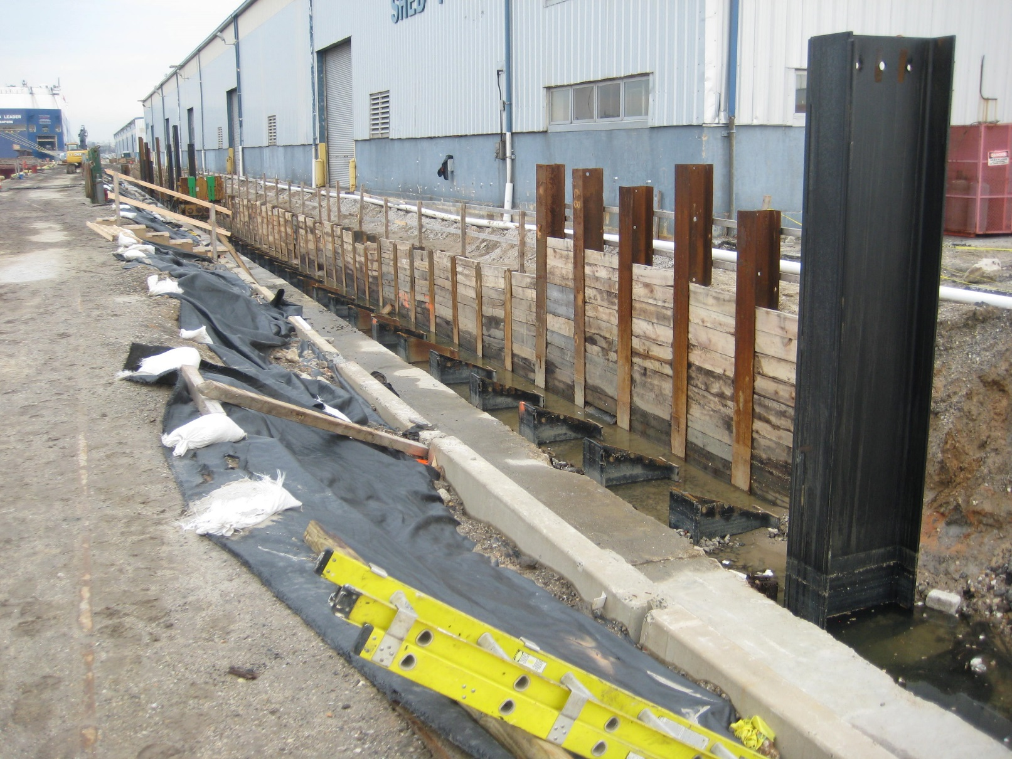
CONSTRUCTION – PT BULKHEAD WALL
Construct PT Anchored Bulkhead to Stabilize Shed 4 Backlands

Slide 35
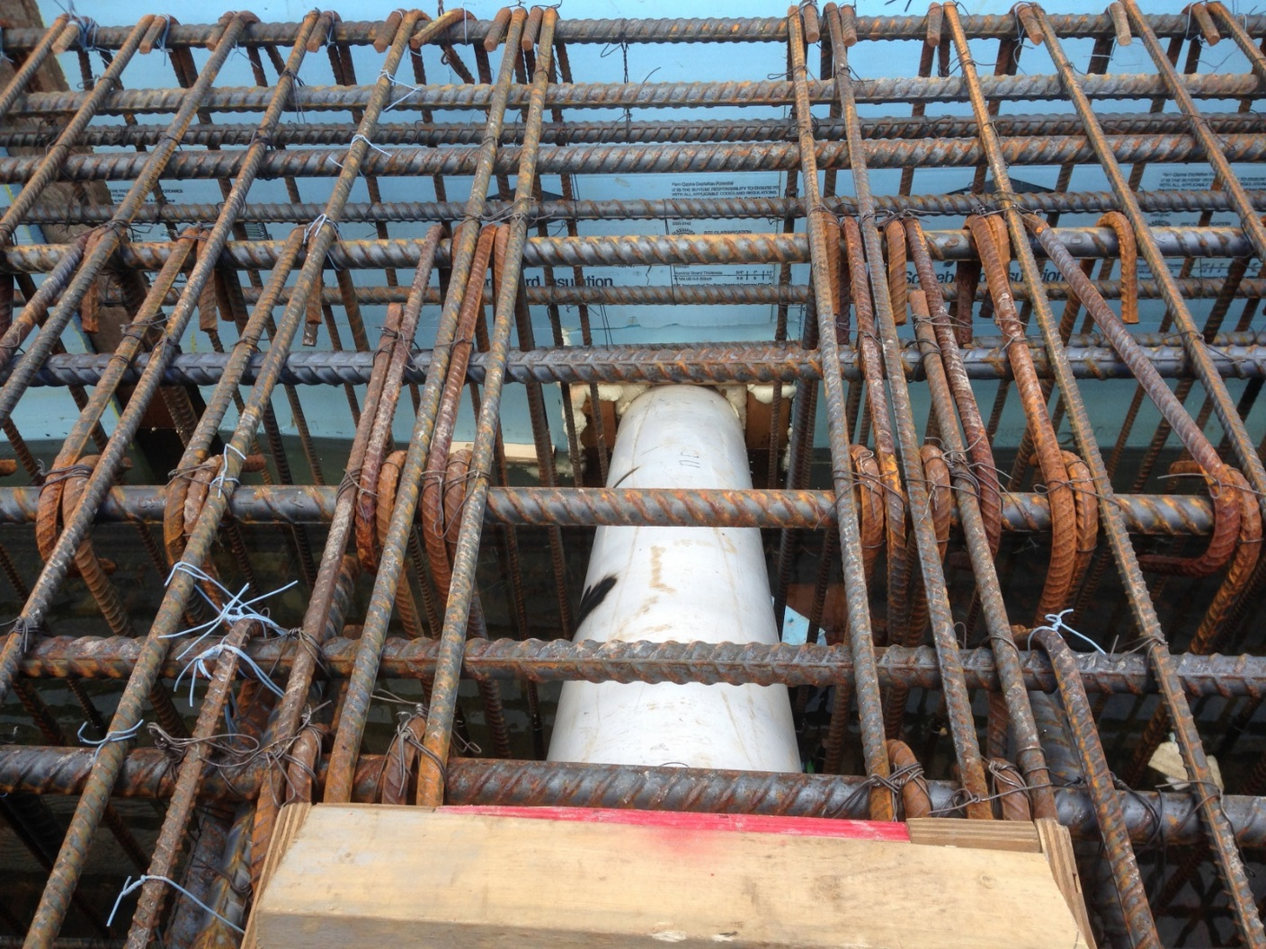
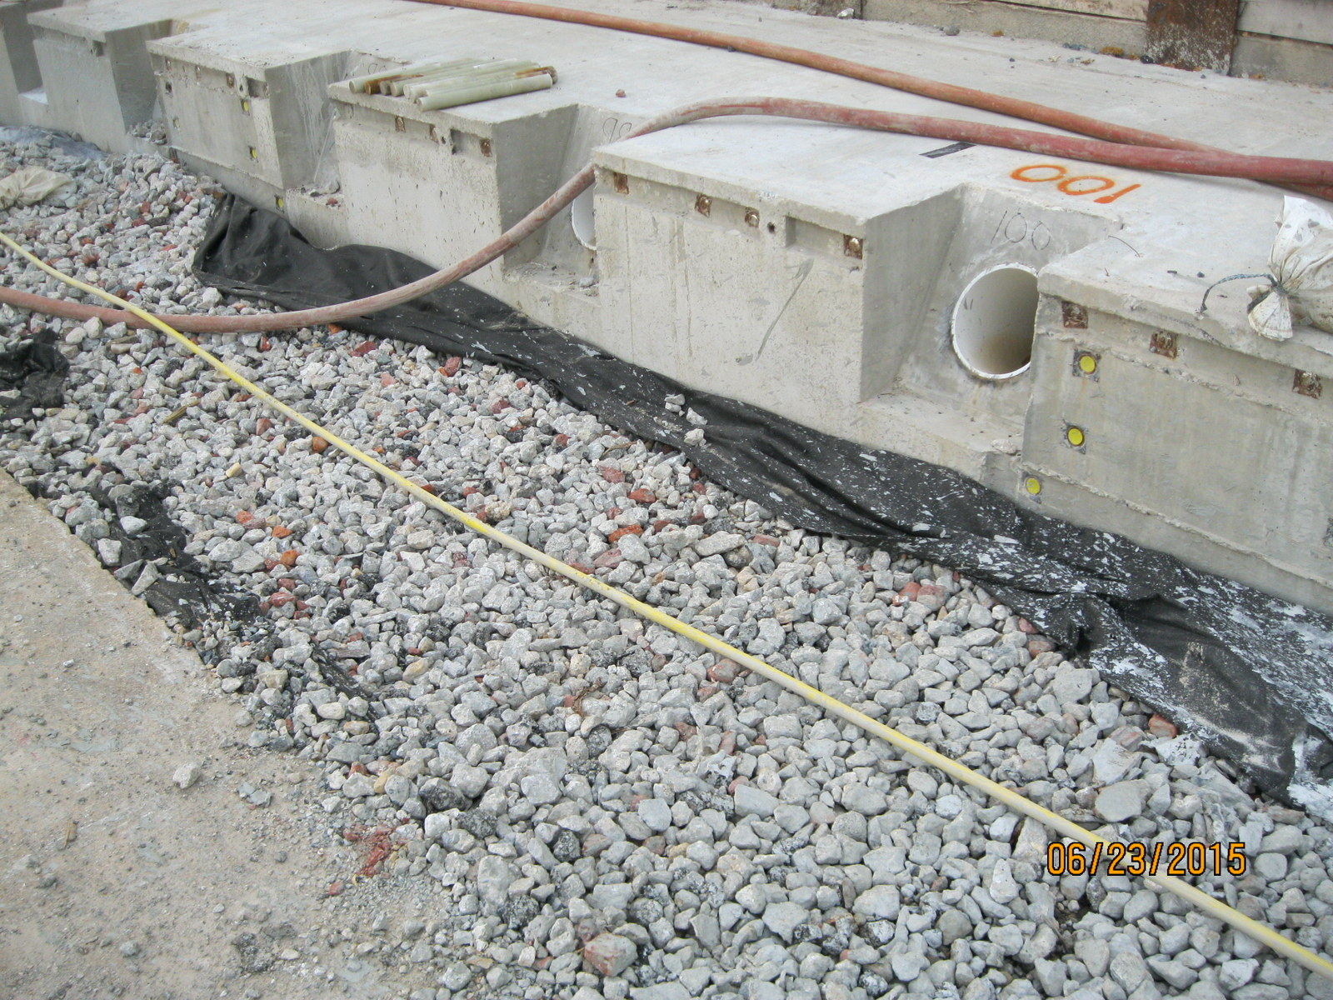
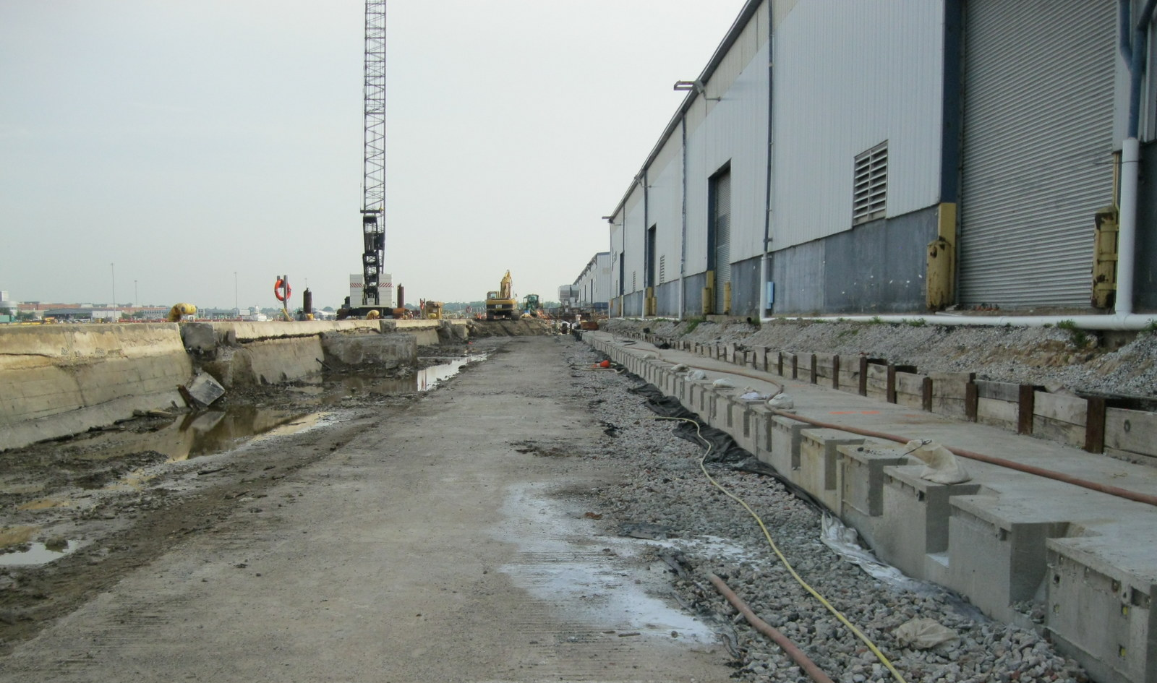
CONSTRUCTION – PT BULKHEAD WALL
Construct Bulkhead Cap

Slide 36
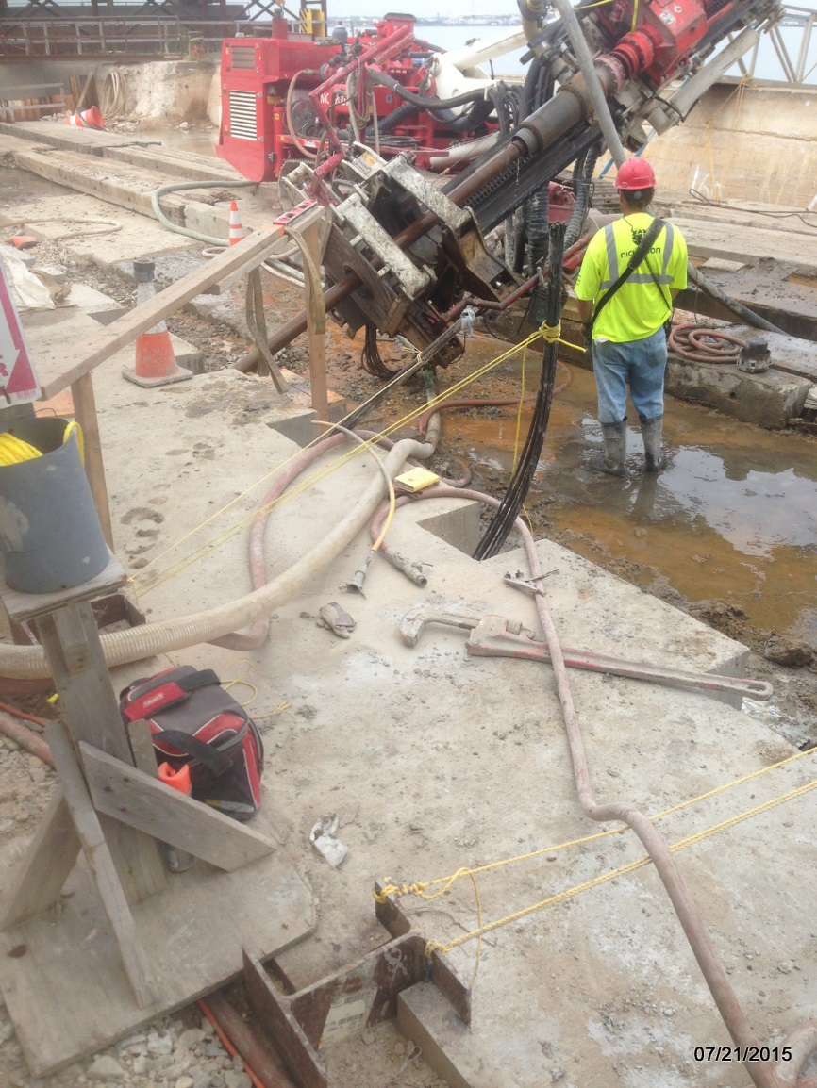
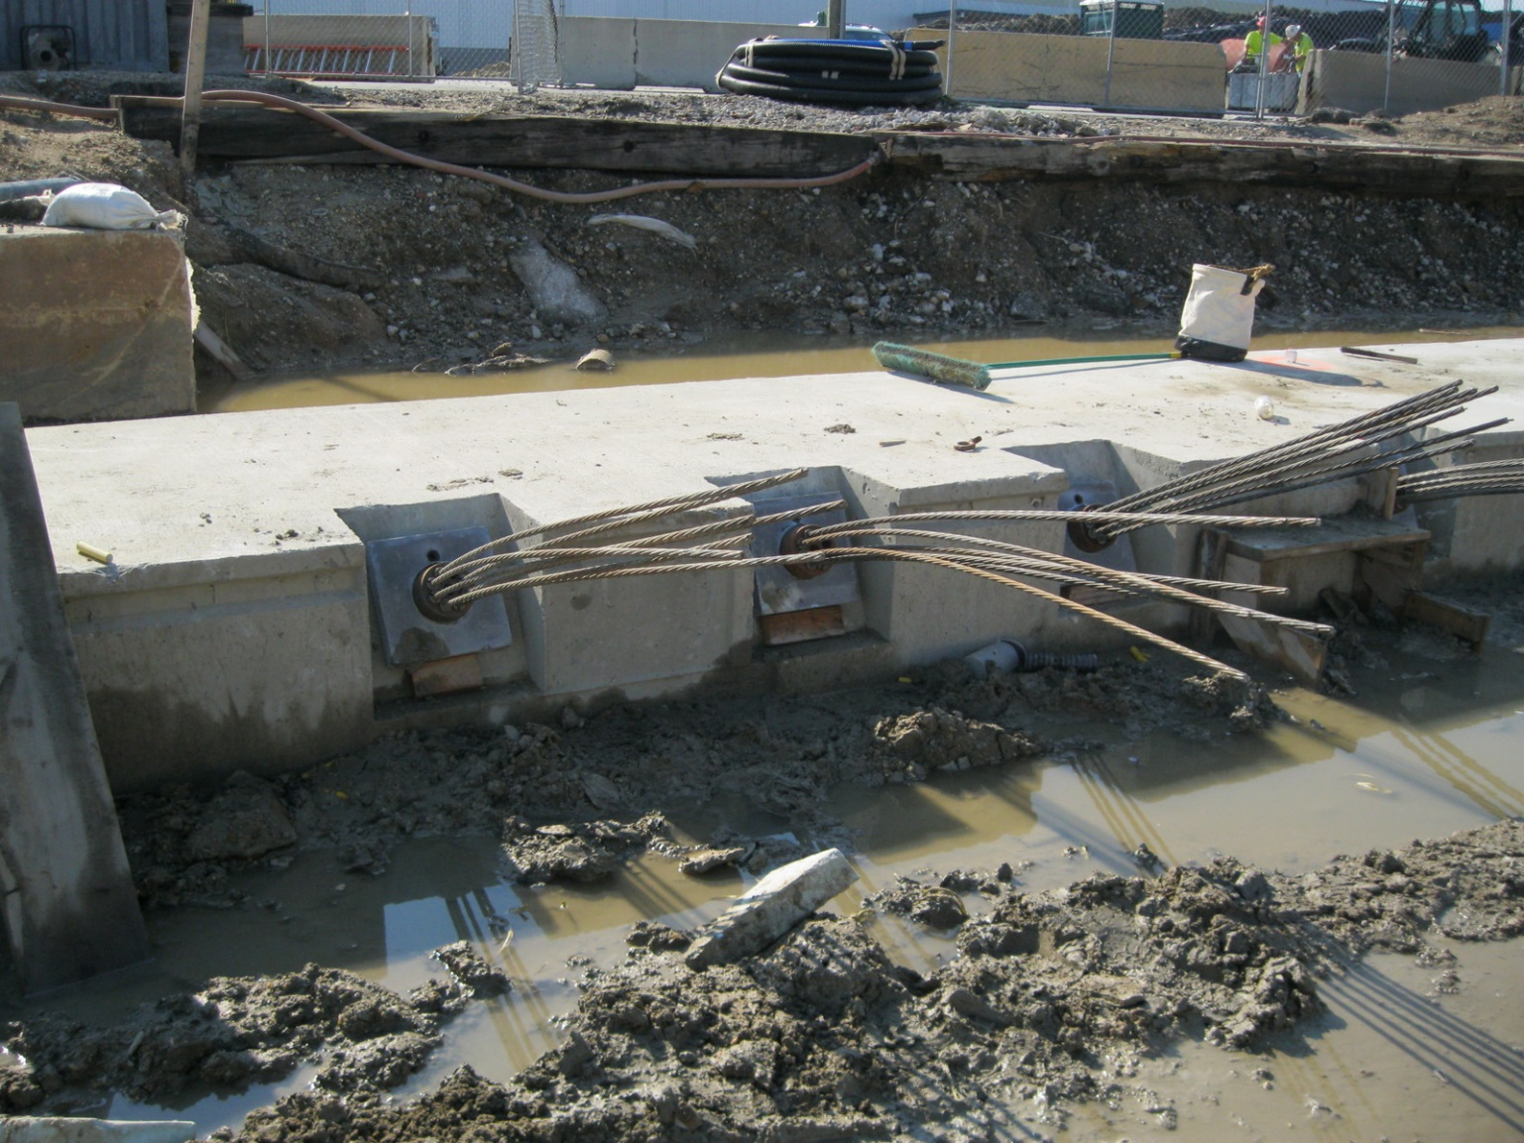
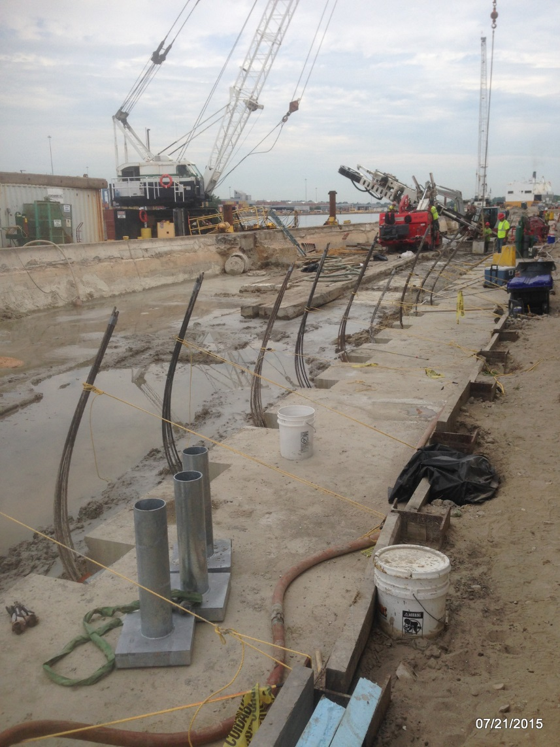
CONSTRUCTION – PT BULKHEAD WALL
Install, Tension, Lock-off Anchors

Slide 37
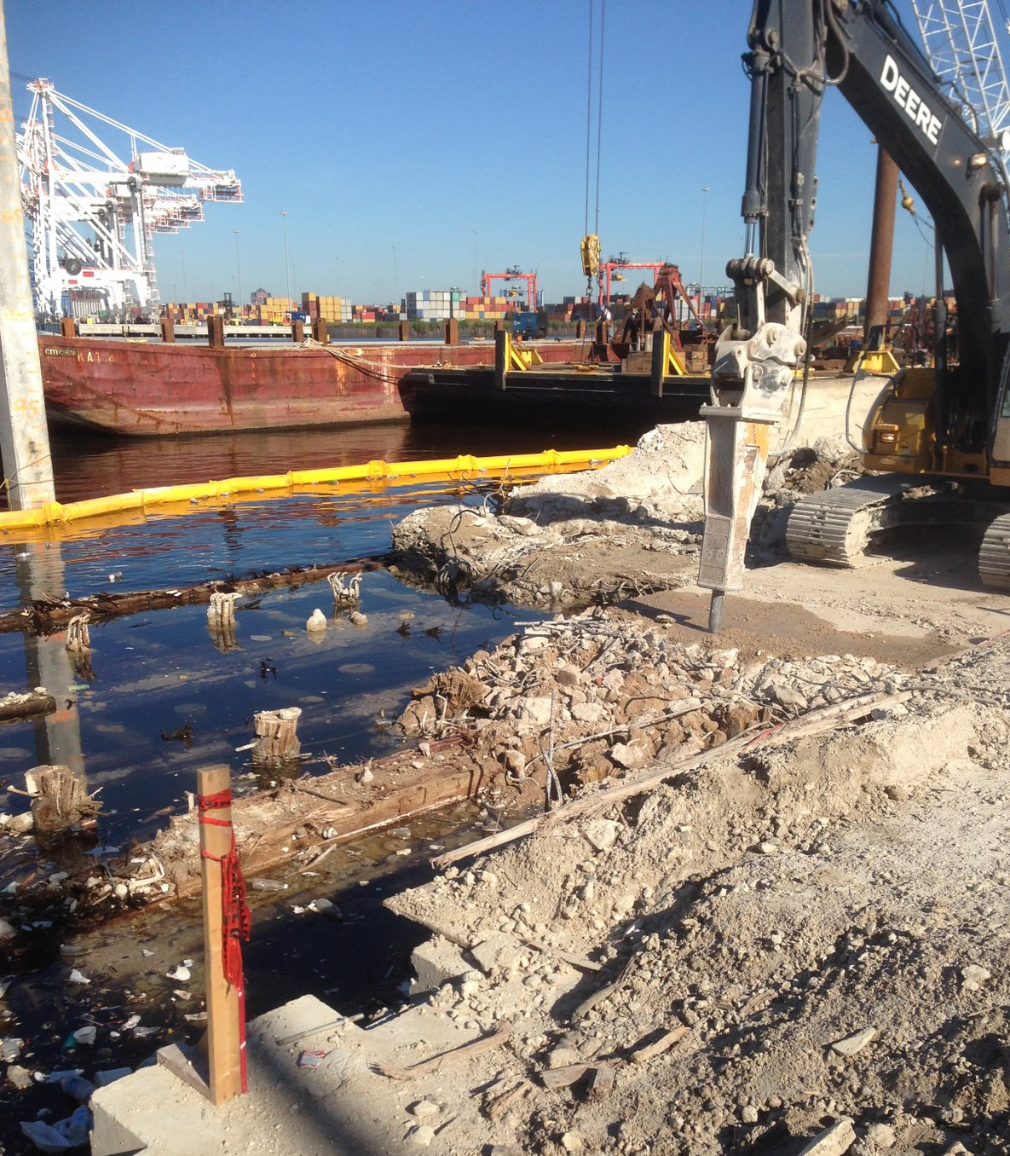
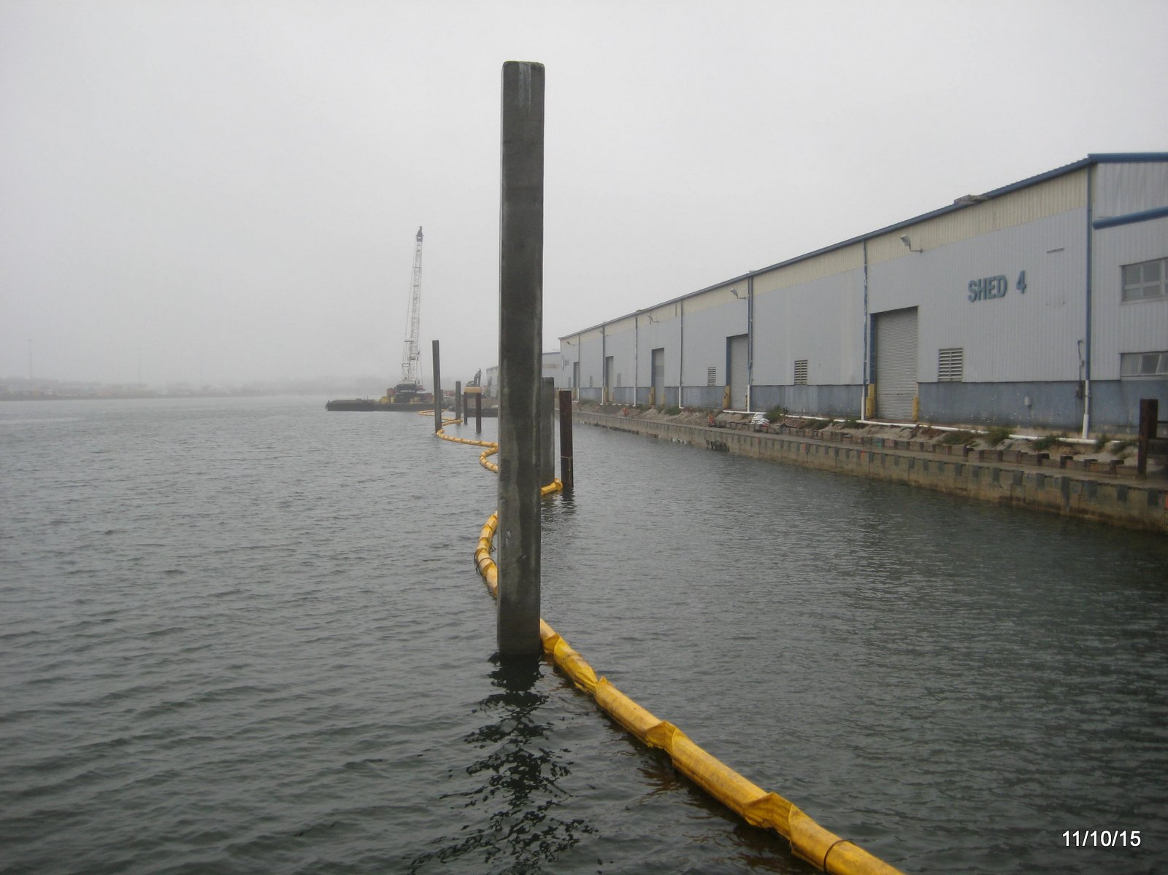
CONSTRUCTION – DEMOLISH EXISTING WHARF
Structures Now “De-Coupled”, Demolish Existing Wharf

Slide 38
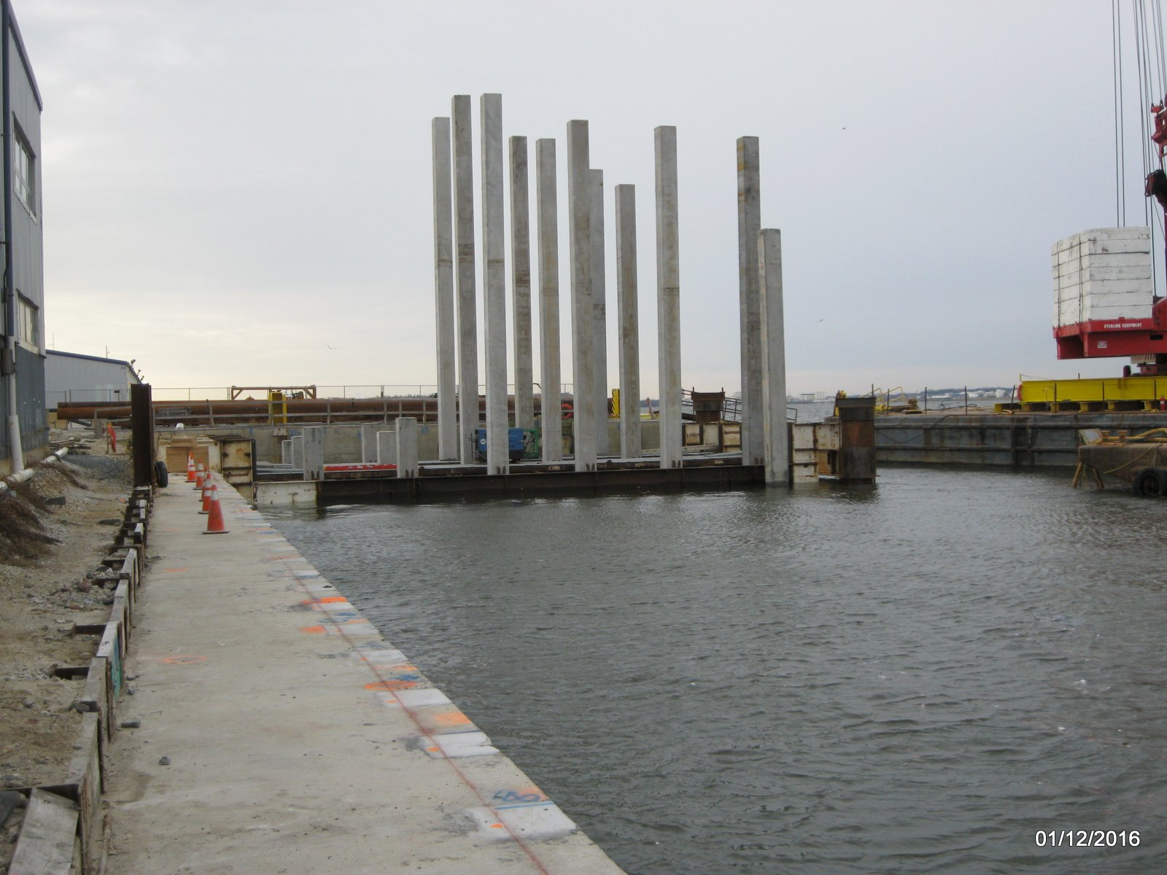
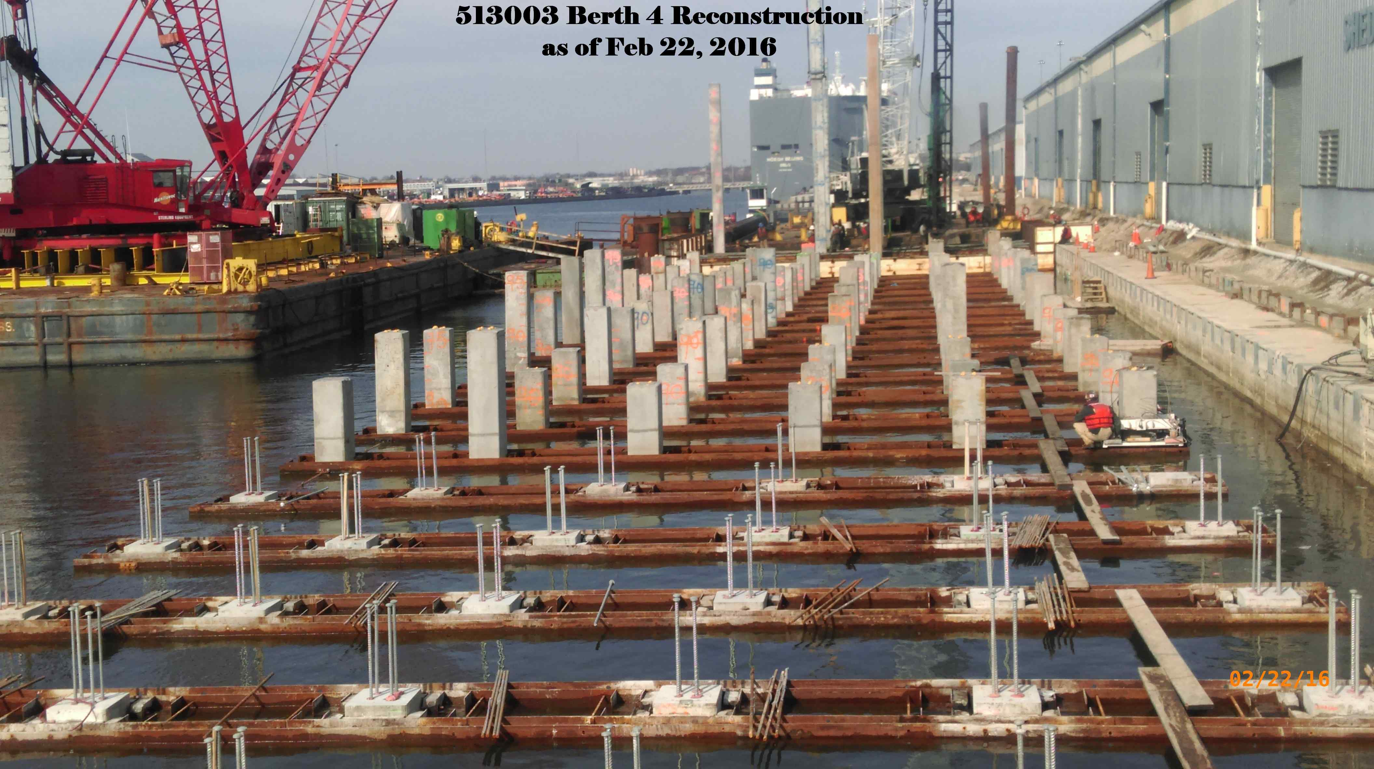
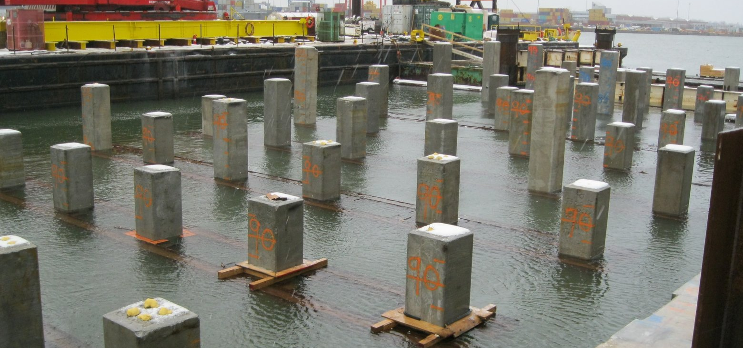
CONSTRUCTION – DRIVE NEW WHARF PILES
Drive & Brace 24” Prestressed Concrete Piles

Slide 39
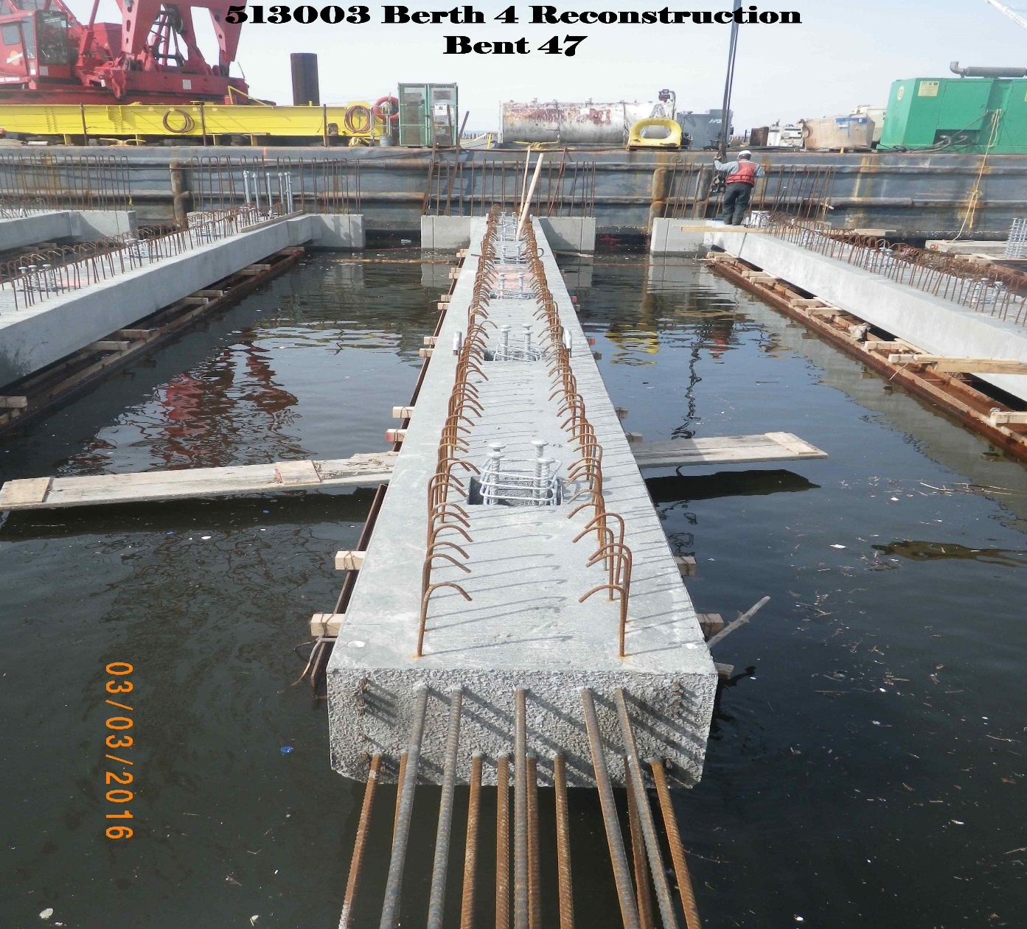
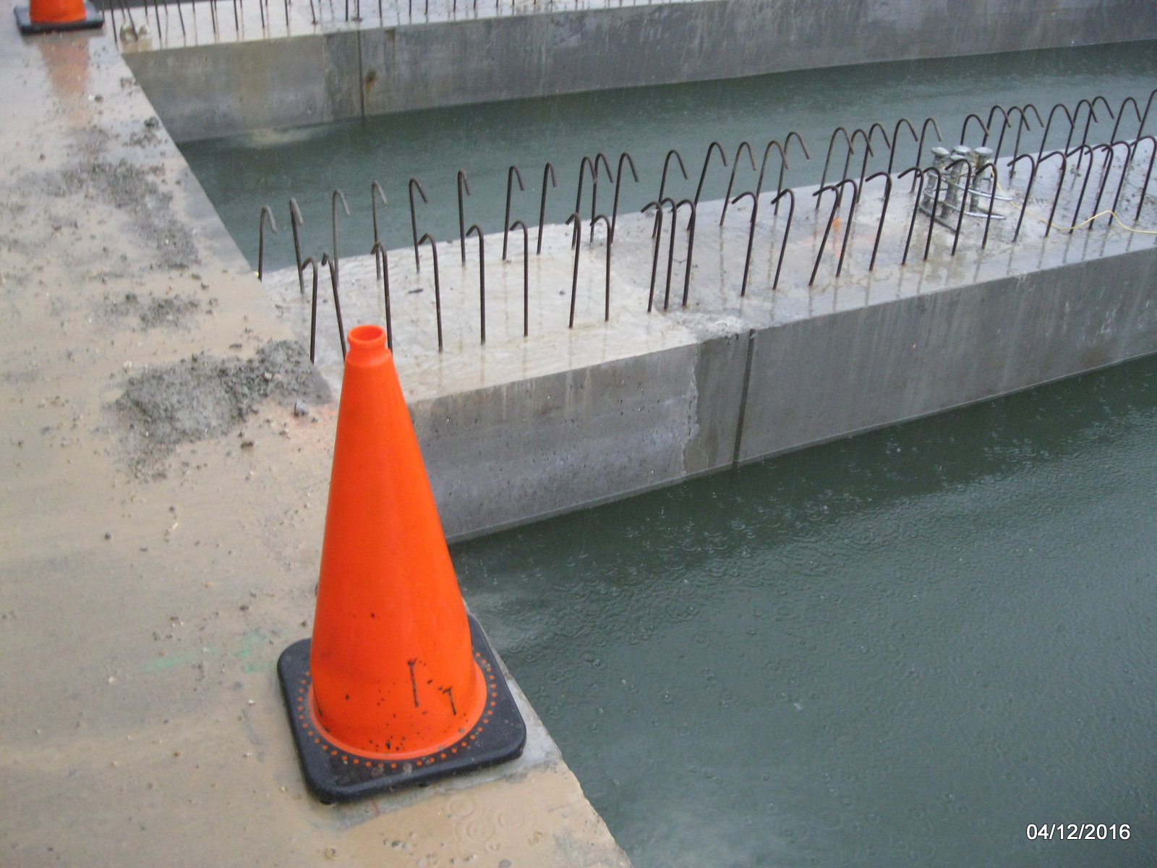
CONSTRUCTION – SUBFRAME
Place Precast/Prestressed Pile Caps and CIP Closures.
Practical Design Implementation: Use of Self-Consolidating Concrete (SCC)

Slide 40
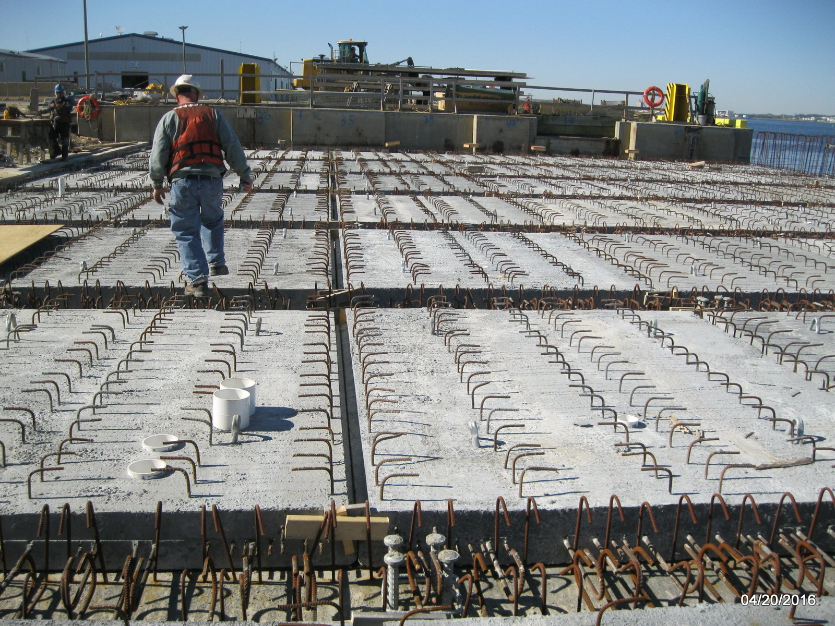
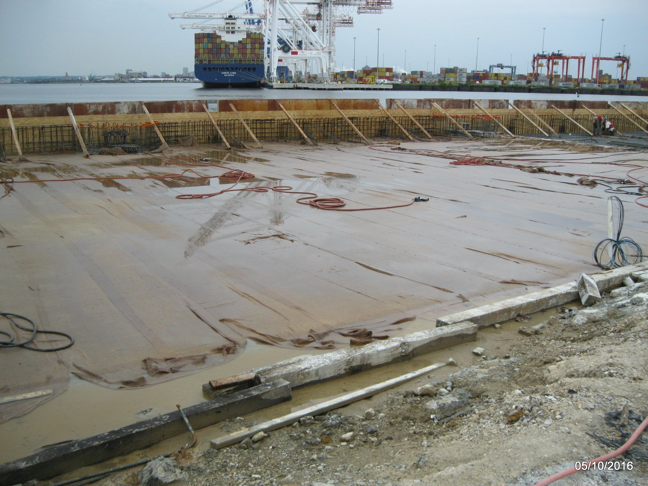
CONSTRUCTION – COMPOSITE SLAB
Place Precast/Prestressed Deck Planks & CIP Topping.
Standard Wet-Burlap Cure for CIP Slab

Slide 41
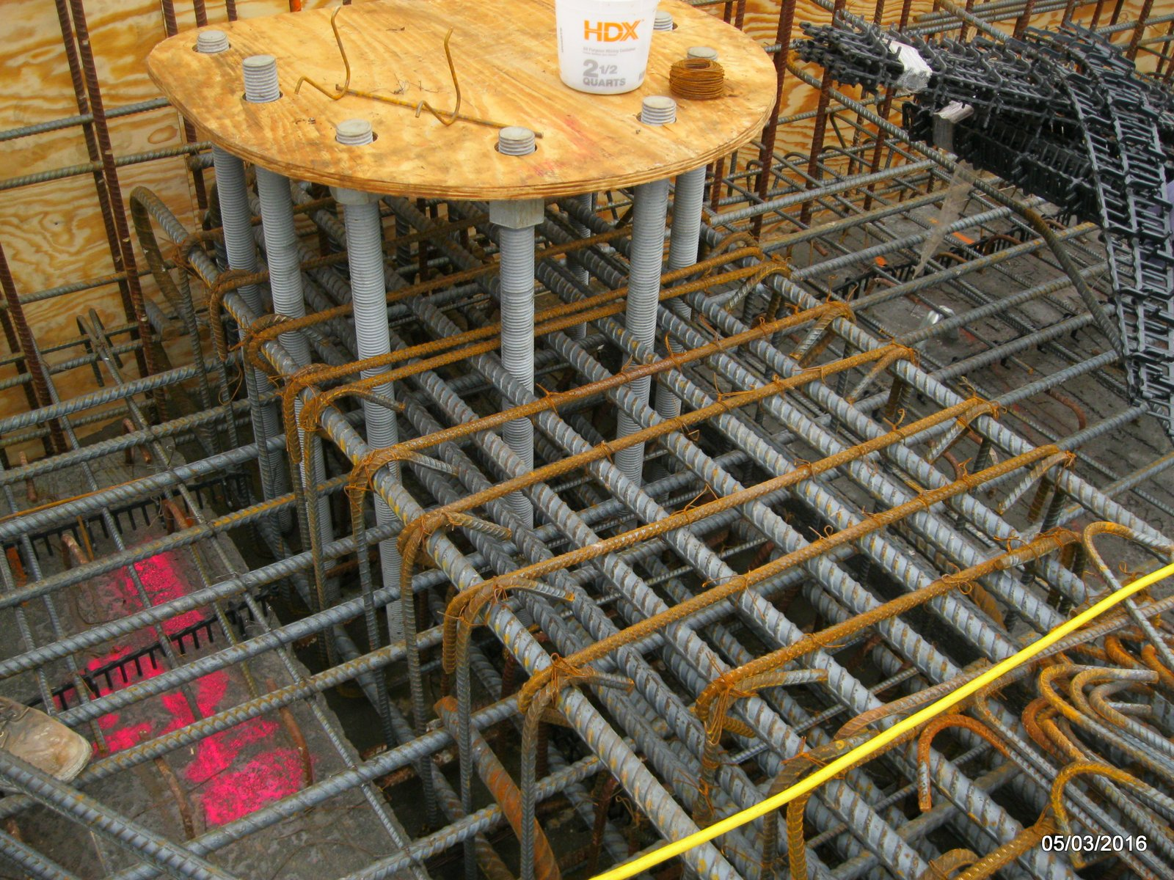
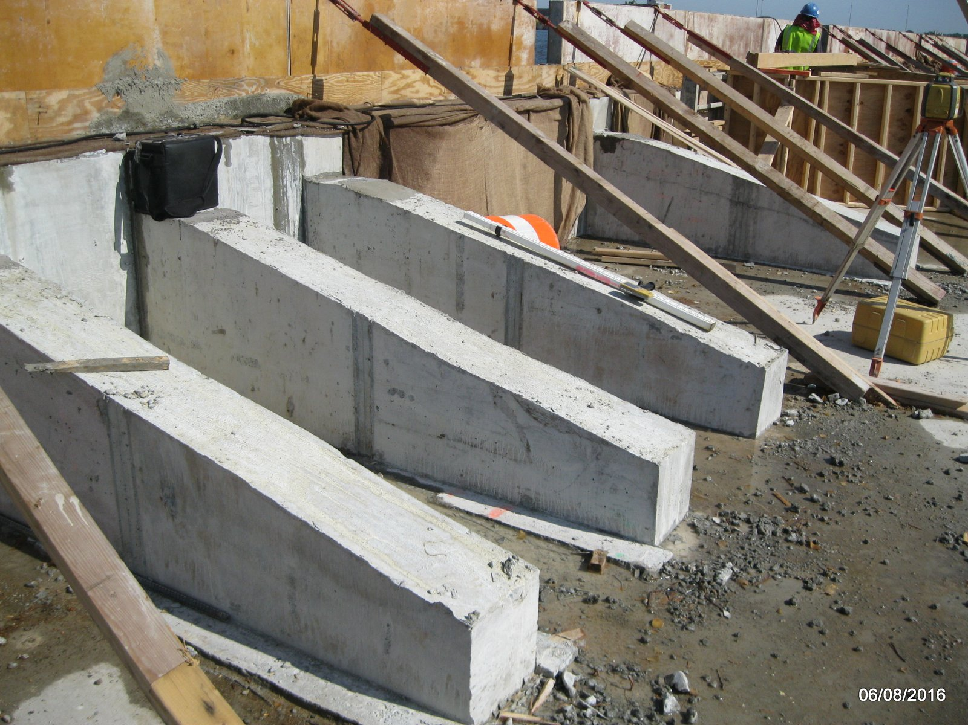
CONSTRUCTION – CIP SUPERSTRUCTURE
CIP Superstructure Elements – Mooring Bollard Framing
Fender Support Framing – Strut-work to Reinforce Fascia

Slide 42
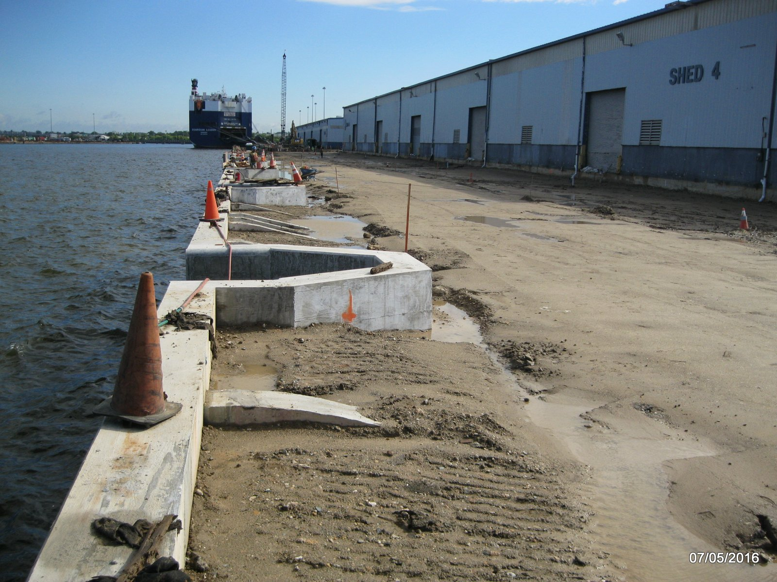
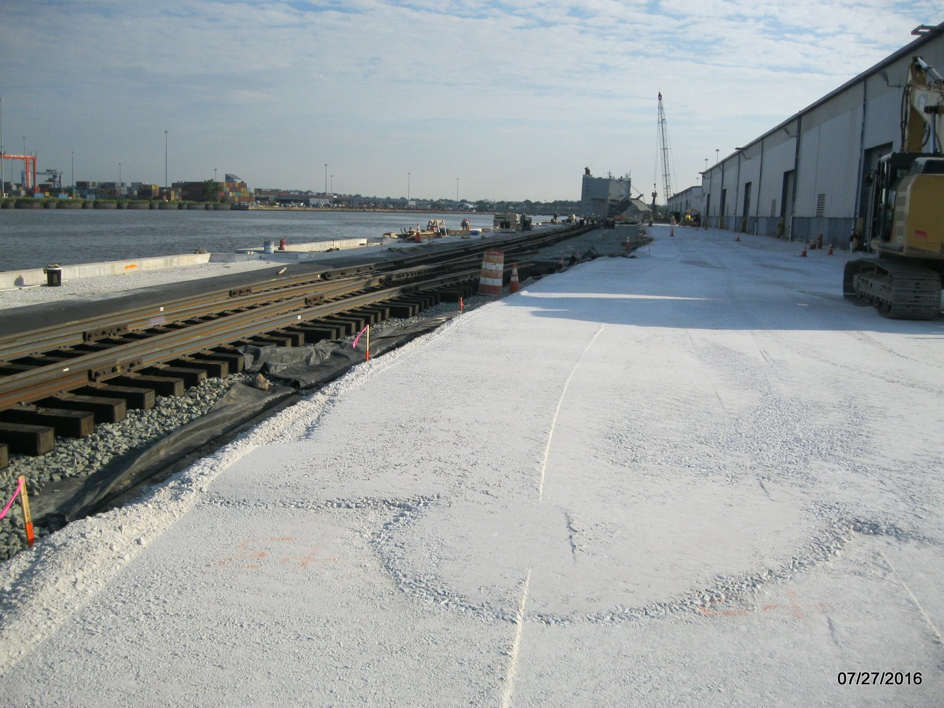
CONSTRUCTION – BALLAST & SURFACE TOPPING
Fill-in partial “concrete tub” with compacted ballast.
Construct surface paving and rail-works.

Slide 43
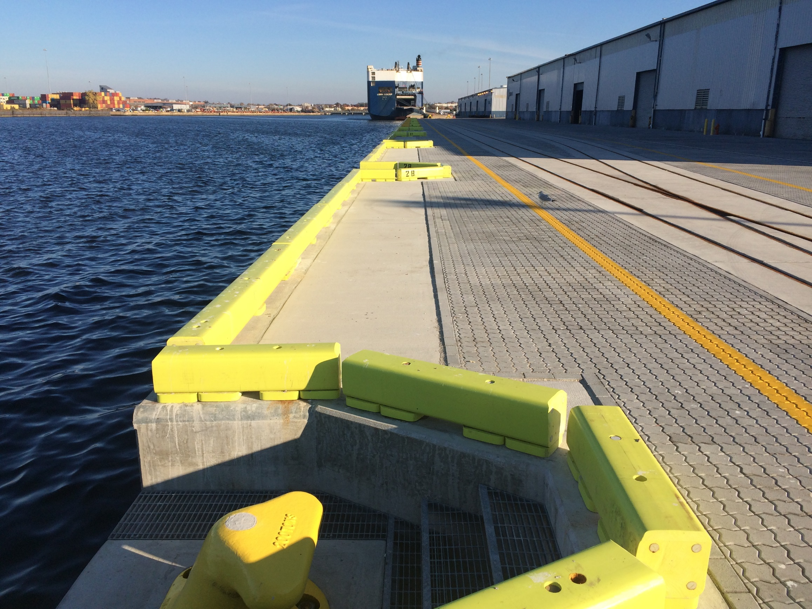
CONSTRUCTION – COMPLETE & READY FOR SERVICE
Completed Longitudinal View, Looking Northward.

Slide 44
PRIMARY OUTCOMES & LOOK AHEAD
Approximate Construction Cost: $21,500,000
Approximate Concrete Volume: 10,000 CY
Successful Practical Design Implementation
  SCC increased productivity and infill coverage.
  Investigate synergy with other system preservation measures.
  Precast/Prestressed Caps a Front-End Option for Bidders.

