Slide 1

The Concrete Industry’s Road to Quiet, Sustainable Pavement –
The Next Generation of Concrete Surfaces

Slide 2

Introduction
John H. Roberts
Executive Director - International Grooving and Grinding Association
Vice President – American Concrete Pavement Association’s Concrete Pavement Preservation Partnership

Slide 3

Looking Back In Time
In the not so distant past noise, ride quality and customer comfort (functional considerations) took a back seat to structural considerations.

Slide 4
Transportation Authorities React
Transportation Authorities now place greater emphasis on tire/pavement noise, smoothness and construction delays.
Development of tighter smoothness and new noise specifications.
Development of low noise surface treatments.
Increased use of sound walls.
Night work becomes the standard.
Safety concerns are still a priority!

Slide 5
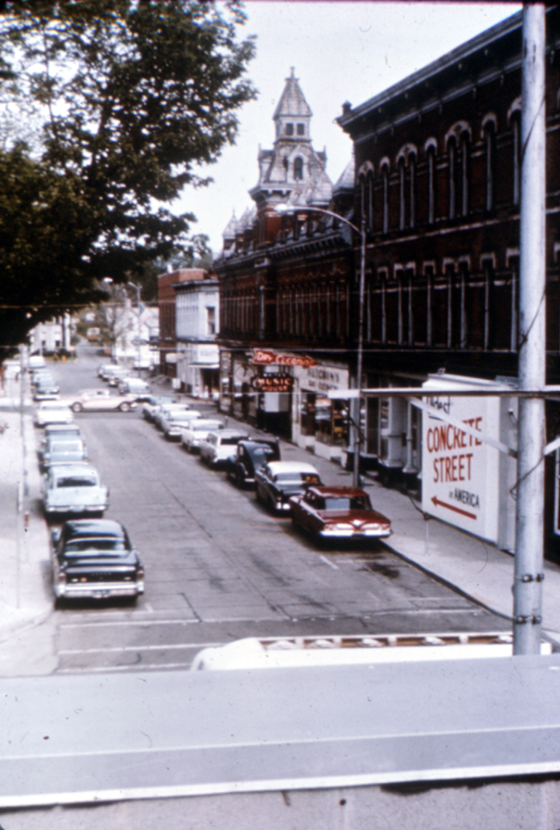
History Serves as Our Guide
The first concrete pavement constructed in US was located in Ohio, 1891
Used two lift construction
Hard aggregate on surface so horseshoes wouldn’t wear pavement.
Surface Texture was grooved in 4” squares so horses would not slip

Slide 6

Diamond Saw Cut Surface Textures
Increasingly Specifiers are utilizing diamond saw cut surfaces to reduce roughness, reduce noise and increase the friction of their pavements, bridges, tunnels and runways.
Economical
Long-lasting
Effective
Environmentally Friendly
Evergreen Floating Bridge- Washington

Slide 7
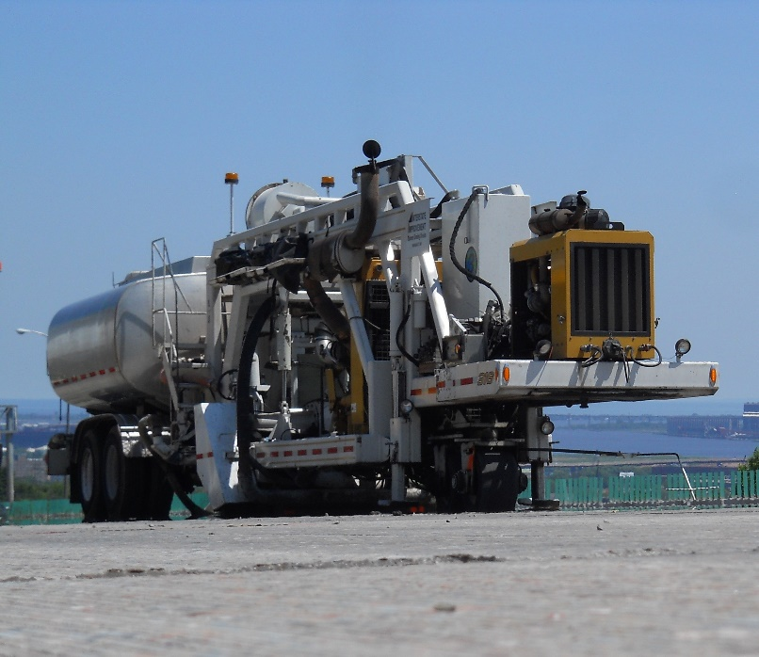
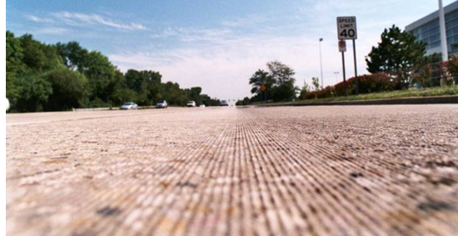
What Is Diamond Grinding
Removal of thin surface layer of hardened PCC using closely spaced diamond saw blades
Results in smooth, level pavement surface
Provides a longitudinal texture with desirable friction and low noise characteristics

Slide 8
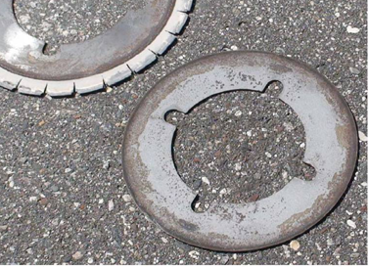
Blades and Spacers
Notes:
.

Slide 9
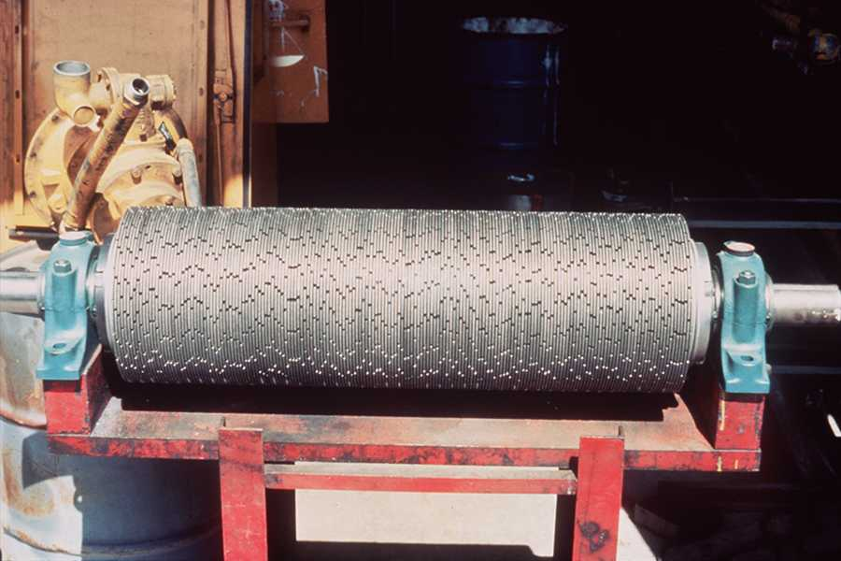
Typical Conventional Diamond Grinding Blade Configuration
Land Area 0.090 (2.3 mm)
0.125
0.125 (3.2 mm )
Saw Blade
Segment
Saw Blade Core 0.105 (2.7 mm)
Spacer 0.110 (2.8 mm)

Slide 10
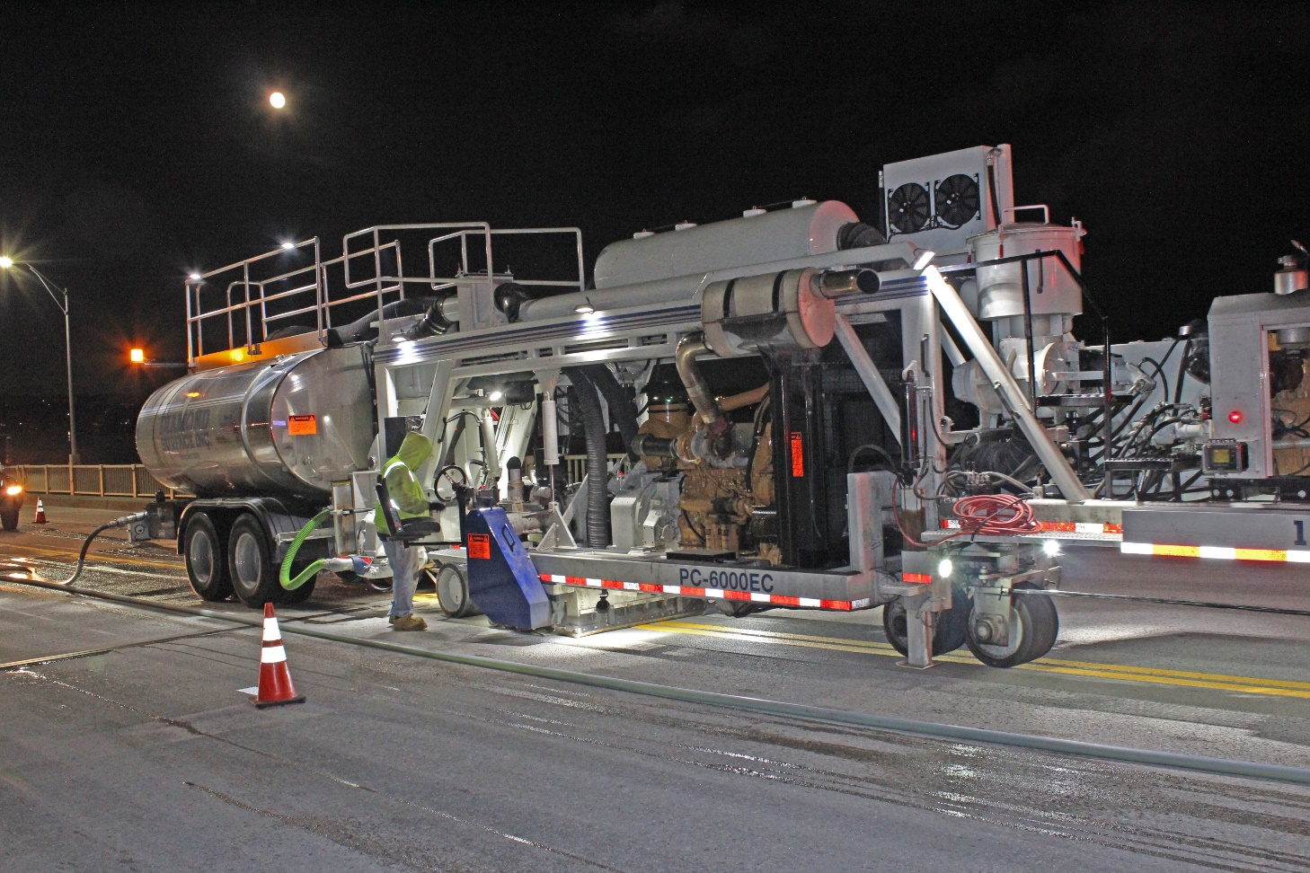
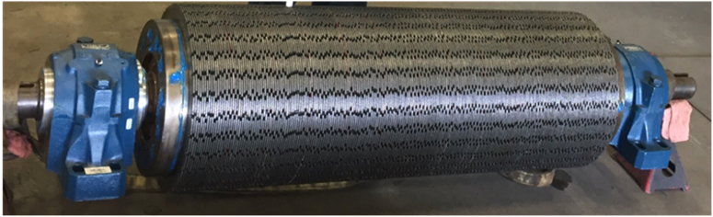
Diamond Grinding Equipment

Slide 11
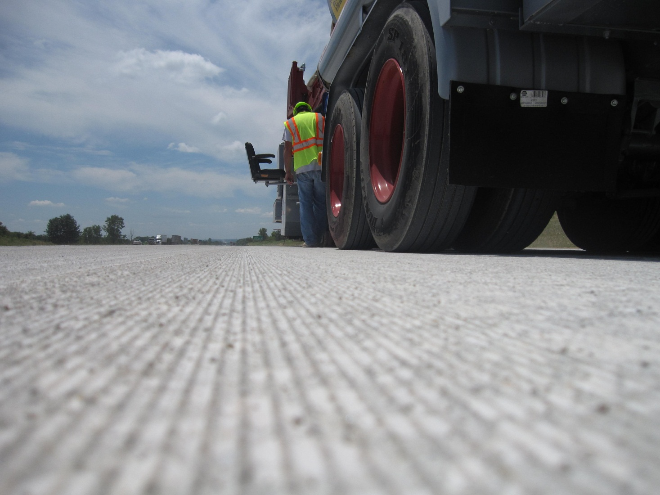
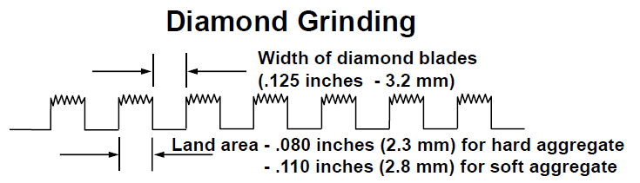
Conventional Diamond Ground Surface

Slide 12
Grinding is NOT Roto Milling

Slide 13
Milling Drums Fracture Aggregates

Slide 14
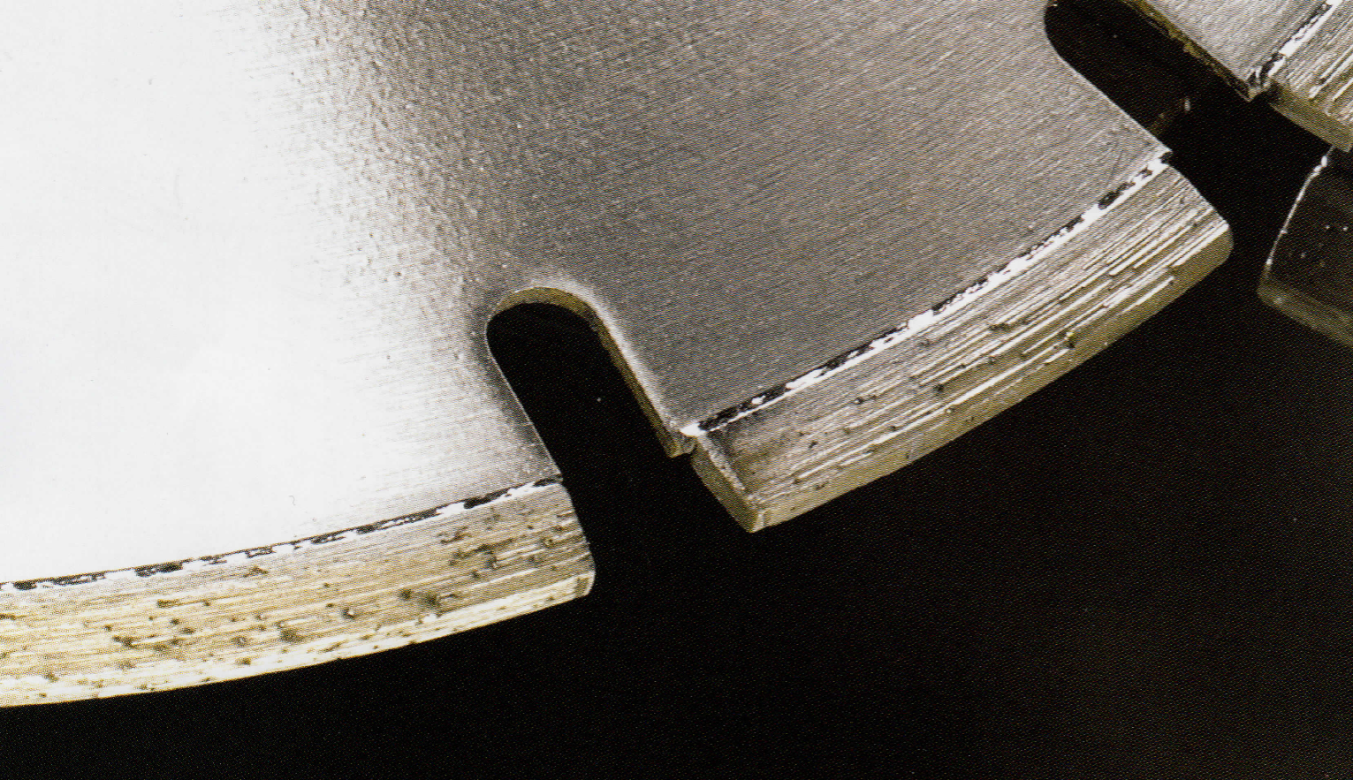

Grinding Utilizes Abrasion Not Impact
Core
Segment
Notes:
This is an individual diamond blade. The part labeled as the segment is welded onto the core. The segment holds the diamonds into the matrix. The little black specs that appear to have a trail behind them like a comment are the actual synthetic diamonds. So diamond grinding is a sawing process just like what you do with lumber. The milling uses carbide bits and is an impact process that chips away instead of saws away.

Slide 15
Advantages of Diamond Grinding
Costs substantially less than asphalt overlays
Enhances surface friction and safety
Diamond Grinding can be accomplished during off-peak hours with short lane closures
Diamond Grinding of one lane does not require grinding of the adjacent lane
Grinding does not affect overhead clearances underneath bridges, signs or tunnels
Environmentally friendly and Sustainable

Slide 16
Safety, Surface Texture and Friction
Increased macro-texture of diamond ground pavement surface provides for improved drainage of water at tire-pavement interface
Longitudinal texture provides directional stability and reduces hydroplaning (side-force friction). Grooves provide “escape route” for water trapped between tire and pavement surface
In Wisconsin, overall accident rates for ground surfaces were 40% less than for un-ground surfaces over a 6-year period, 57% in wet weather conditions

Slide 17
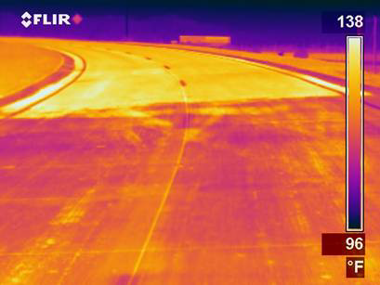
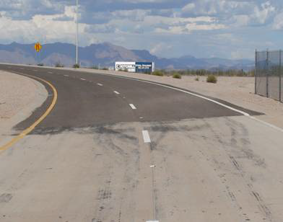
Lower Ambient Temperatures and Energy Costs
The light reflective color of PCCP means less energy required for overhead lighting and cooling in urban areas.

Slide 18
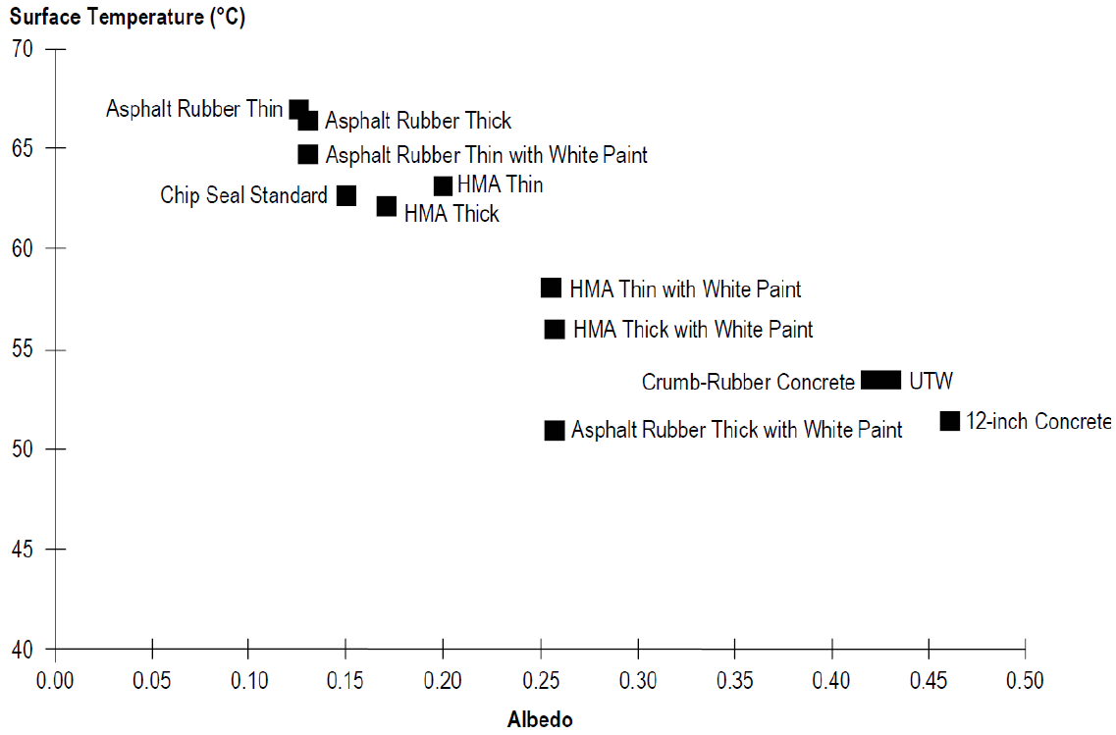
Pavement Surface Temperatures
Arizona State University

Slide 19
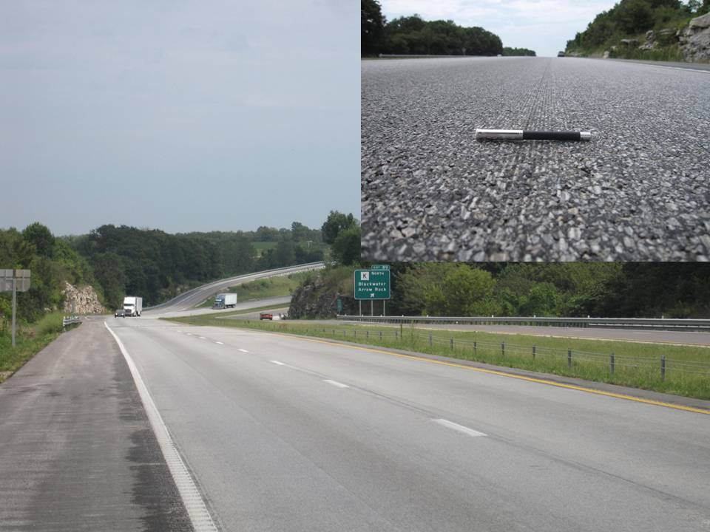
Can be used on asphalt too!
I-70 Missouri

Slide 20
Pavement Problems Addressed
Faulting/Roughness at joints and cracks
Built-in or construction roughness
Blends patching/surface irregularities into a consistent, identical surface
Polished concrete - Increases friction
Drainage modifications
Unacceptable noise level

Slide 21
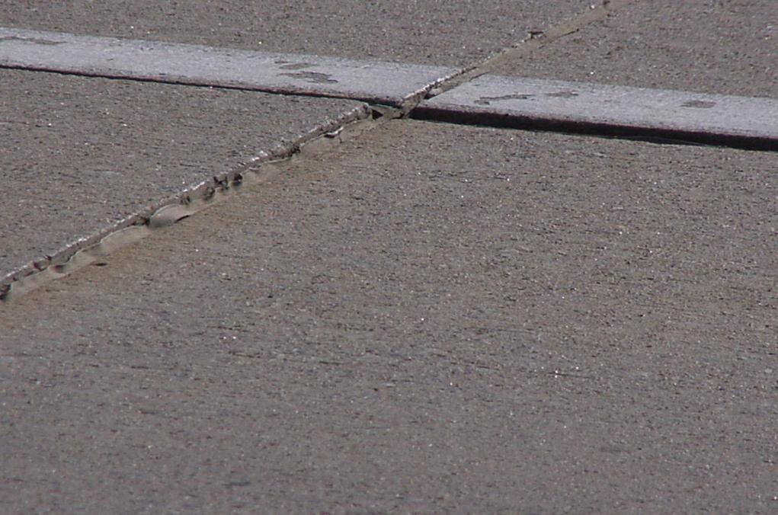
Joint Faulting and Roughness

Slide 22

Grinding Removes Faults/Roughness

Slide 23
Diamond Grinding can provide a 60% to 70% improvement over the pre-grind profile on average!
Before Grinding
After Grinding
Notes:
Typical Target setup

Slide 24
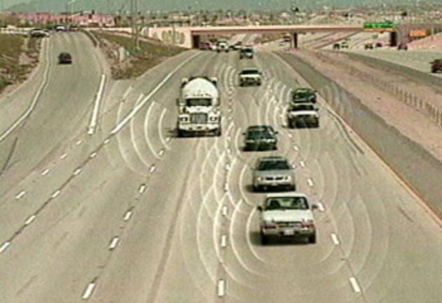
Unacceptable Noise Level

Slide 25

Noise Performance
So, what is all this noise about tire/pavement noise?!?

Slide 26
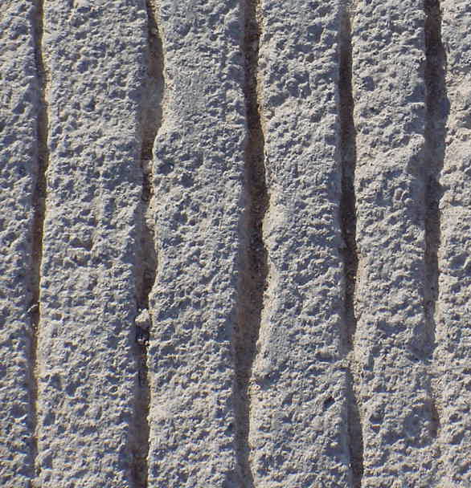
Transverse Tining
For many years the use of transverse tining created the perception that all concrete pavement is noisy.

Slide 27
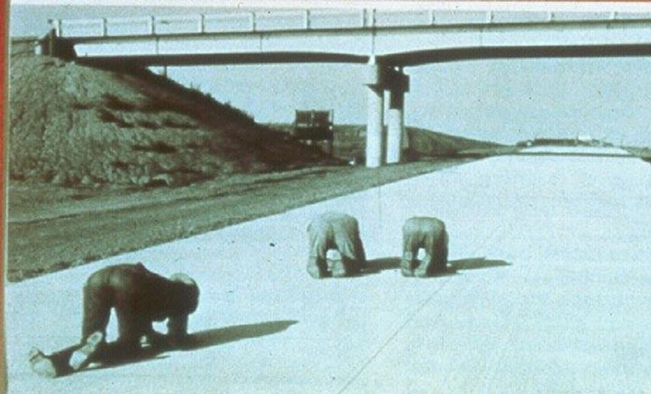

Slide 28
NCPTC OBSI Noise Testing
In 5 years the National Concrete Pavement Technology Center tested over 1500 unique textures
Transverse Tining
Longitudinal Tining
Diamond Ground
Diamond Grooved (Longitudinal, Transverse)
Exposed Aggregate
Pervious Concrete
HMA and Surface treatments
Hundreds of Miles in 20 States and 6 Countries

Slide 29
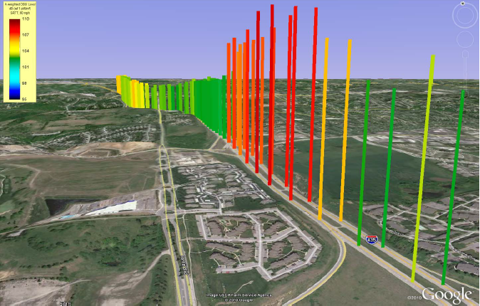
NCPTC OBSI Testing

Slide 30
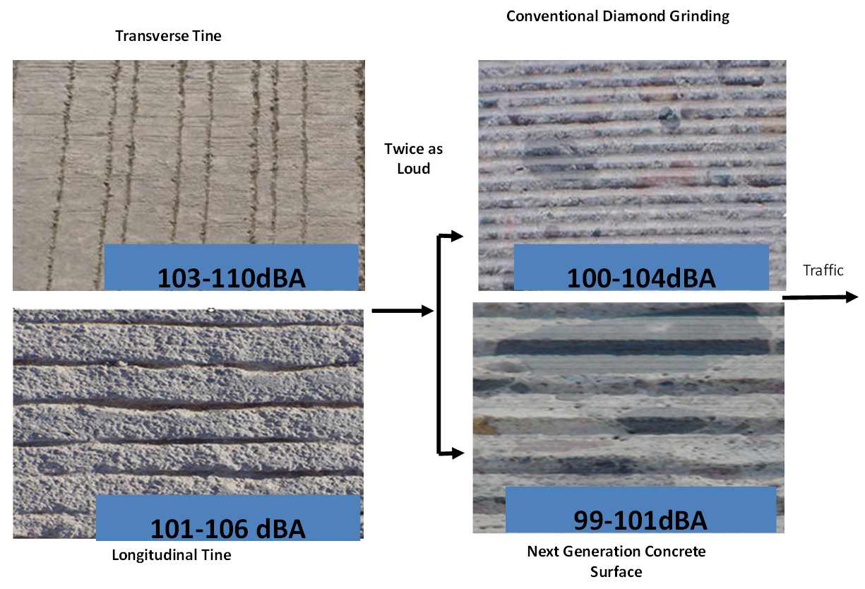

Slide 31
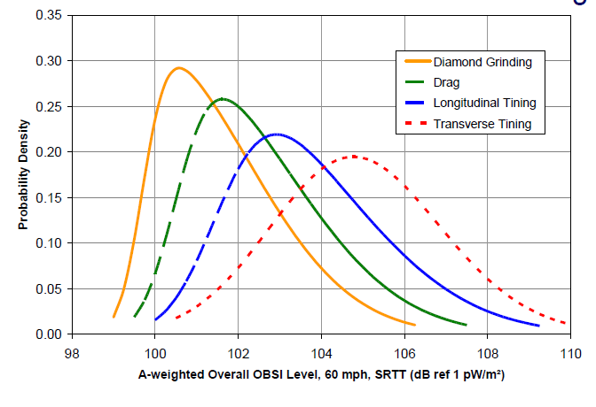
NCPTC Noise Catalogue
Research conducted by the National Concrete Pavement Technology Center shows diamond grinding as the most quiet PCCP surface texture commonly used.

Slide 32
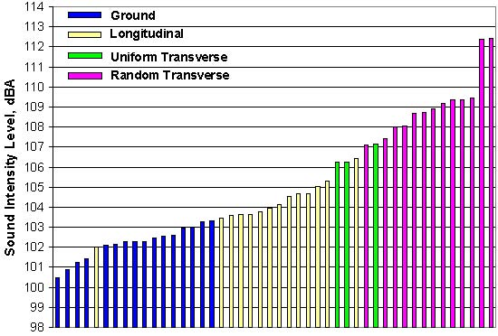
Caltrans & ADOT Testing

Slide 33
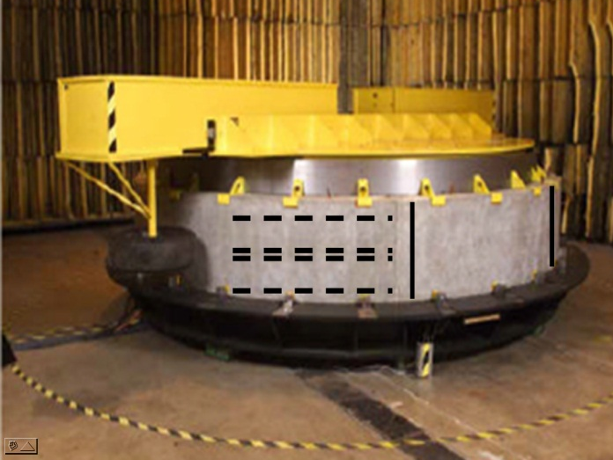
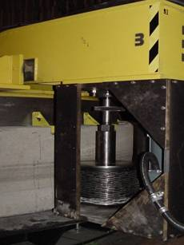
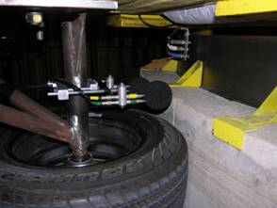
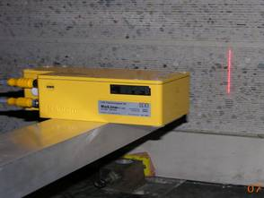
Purdue-Tire Pavement Testing Apparatus
Notes:
Here are a few pics of the Purdue TPAT.
The upper left shows a picture of the entire unit. It is essentially 12 foot diameter drum to which they affix curved concrete sections containing various textures. On top is a beam that rotates around the drum with instrumented tires mounted on each side of the beam. The TPTA is unique in that it allows testing of multiple surfaces under controlled laboratory conditions. This allows more efficient and precise testing without the expense of test section construction and attendant traffic control and safety issues.
The upper right photo is a pic of the DG unit built by IGGA members that allowed Purdue to impart saw cut textures on the curved concrete sections.
The lower left show a picture of the OBSI noise testing apparatus mounted near the test tire.
And the lower right pic shows the line laser used to measure macro texture.

Slide 34
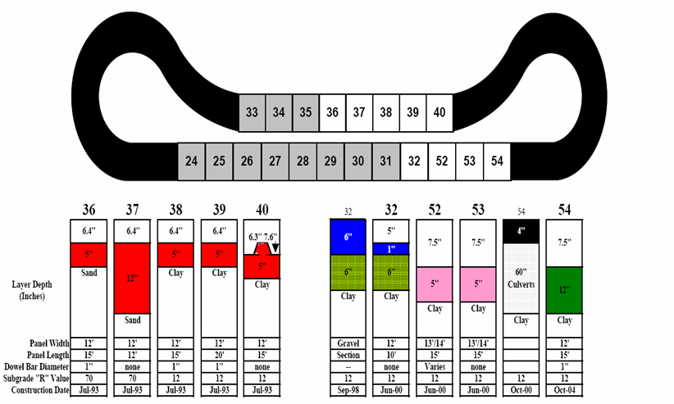
MNROAD Field Validation of TPTA
Notes:
Once the NGCS surface had been verified on the Purdue TPTA, it became necessary to verify its performance on a real road when constructed with actual diamond grinding equipment. Therefore, an agency partner was necessary.
The Minnesota Department of Transportation (MnDOT) joined the effort and provided a location on their MN ROAD low volume road test track. In the summer of 2007, the IGGA funded Diamond Surfaces, Inc. to construct the Purdue NGCS surfaces at the MnROAD’s facility. The single pass and double pass NGCS surfaces were successfully constructed and verified the efficacy of the TPTA to effectively predict the noise levels of field installations¹. The Purdue research indicated the NGCS should be approximately 3 dBA lower than the conventional diamond ground textures evaluated and the MN ROAD testing verified this finding.

Slide 35
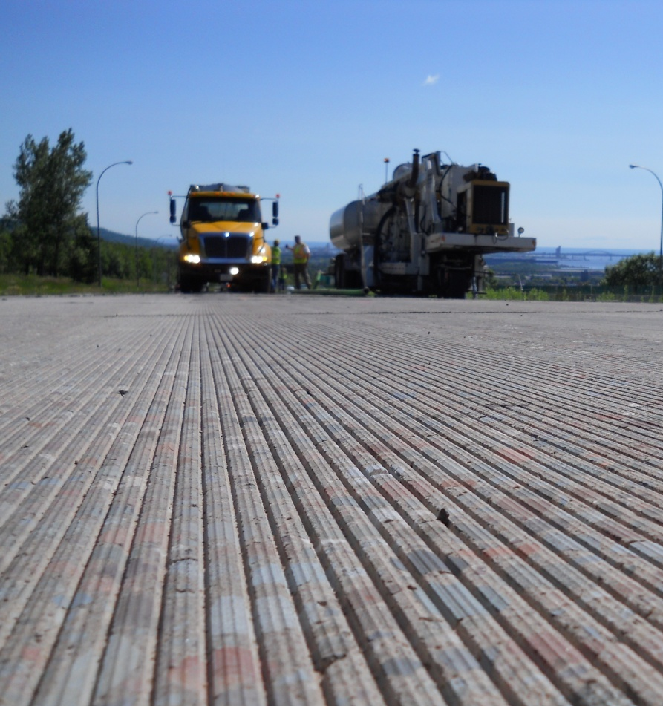
NGCS–Proof of Concept MNROAD

Slide 36
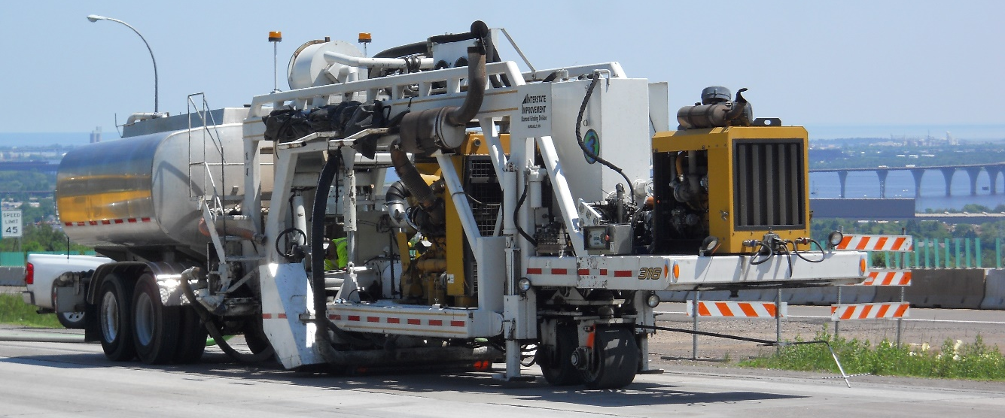
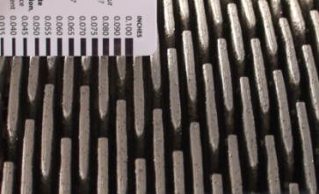
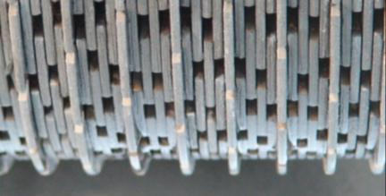
NGCS is Built Using DG Technologies
CDG
NGCS

Slide 37
Diamond Grinding
Width of diamond blades
(.125 inches)
Land area- .08 inches for hard aggregate
- .110 inches for soft aggregate
Diamond Grooving
Saw blade thickness
(.125 inches)
.75 inches
.125 inches
Notes:
The land area for grinding differs depending on the hardness of aggregate. Grooves are more widely spaced with diamond grooving.

Slide 38
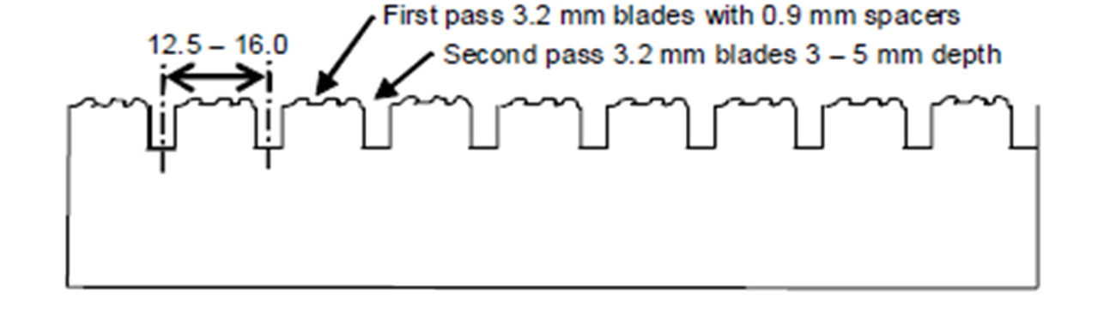
NGCS Cross Section
First Pass .125 in blades with .035 in spacers
.5 in .625 in
Second Pass .095 in blades spaced .125 -.19 in

Slide 39
Why Does NGCS Utilize Grooving?
Reduce the number of wet pavement accidents
The wet pavement accident occurs when the vehicle pavement friction demand exceeds the ability of the pavement-tire contact to produce the required amount of friction

Slide 40
Improved Internal Water Drainage
Grooves provide “escape route” for water trapped between tire and pavement surface
Increases macro-texture of pavement surface.
Reduces the potential for hydroplaning

Slide 41
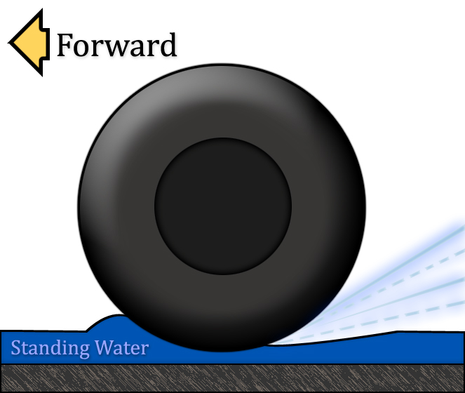
What Is Hydroplaning
Hydroplaning is When Tire is Not Contacting Pavement
Notes:
The figure indicates what happens during hydoplaning. When water is ponding on the surface, the faster you go the larger the wave in front of the tire. Eventually with sufficent water depth and speed, the tire literally lifts off the pavement and is skiing on the water. The operator of the vehicle at this point has no control over the vehicle.

Slide 42


Reduced Splash and Spray
Notes:
One of the benefits of Open Graded Friction Courses, in addition to their noise benefit, is their ability to prevent splash and spray. The RPA uses a TXDOT video that dramatically indicates the advantage of this type of treatment, when new, compared to an old concrete pavement. But it should be noted that the Texas ARFC has decidedly better drainage capability than the Arizona ARFC and these two surfaces should not be considered similar in performance. Under the NCAT Next Generation Study, the Arizona ARFC was tested and its permeability was stated as XX ft per day compared to more conventional OGFC surfaces which are in the range of XX to XX feet per day.
The photo above was taken on March 11, 2006 around 11:30 AM. This was the first rain after a record 143 days without rain. Notice the spray that is coming off the passenger vehicles. Not also the difference in drainability between the lane being driven in (photo taken from) and the section to the left which is not draining. Notice also the water in the wheelpaths of the lane the photo was taken from.
One of the marketing issues that needs to be considered is the strategy of comparing a new OGFC to an old concrete pavement. This is often done, but should be considered an unfair practice and should be noted. The OGFC and ARFC surfaces will change properties with time and this affects their noise qualities as well as their splash spray characteristics. This is analogous to comparing a new car to an old car.

Slide 43
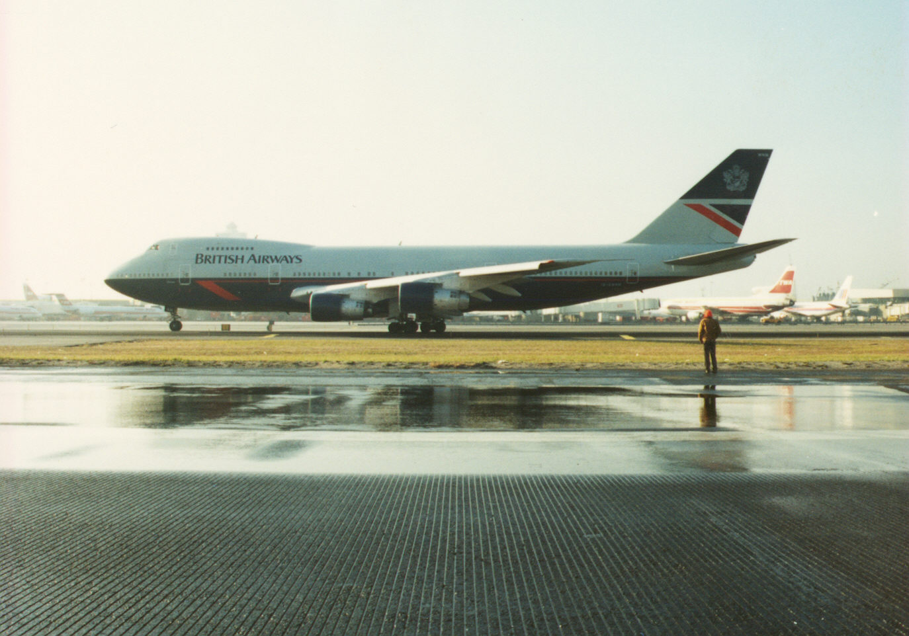

Slide 44
CALTANS Grooved Pavement Study
Study conducted over a four-year period
All grooved and un-grooved control sections located on freeways in urban Los Angeles County
Study includes 322 lane-miles of grooved pavement
Study includes 750 lane-miles of un-grooved control sections

Slide 45

CALTRANS Grooving Research

Slide 46
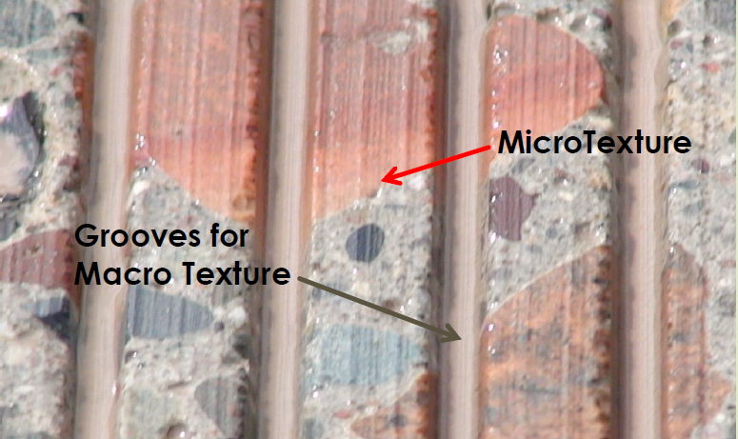

Slide 47
Mean Texture Depths – KDOT1-70
Notes:
We also have a few other surfaces we are developing including NGCS Lite, which is a renewal surface texture that can be applied to existing NGCS sections in the event that friction or noise benefit is diminished over time.

Slide 48

ASTM Locked Wheel Friction Tester

Slide 49
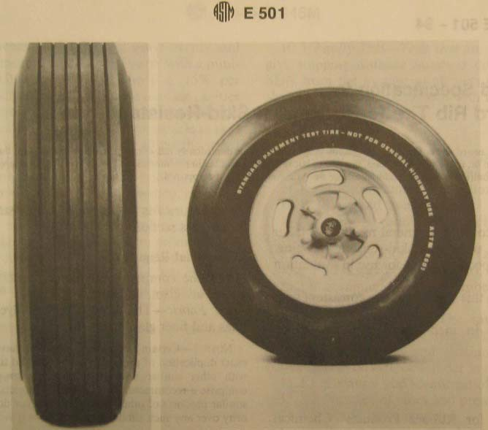
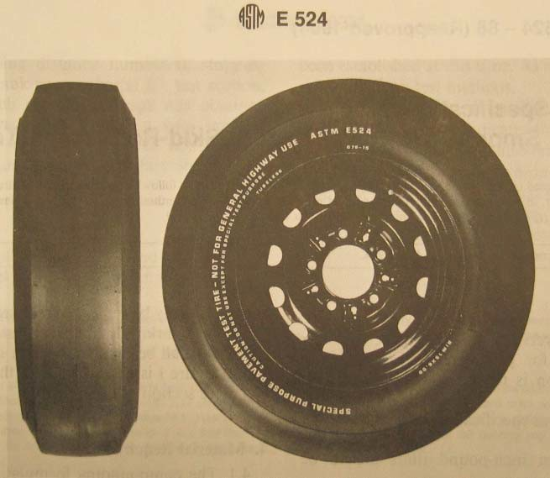
Tests Conducted With 2 Tire Types
Simulates dry weather conditions
Simulates Wet Weather Conditions

Slide 50
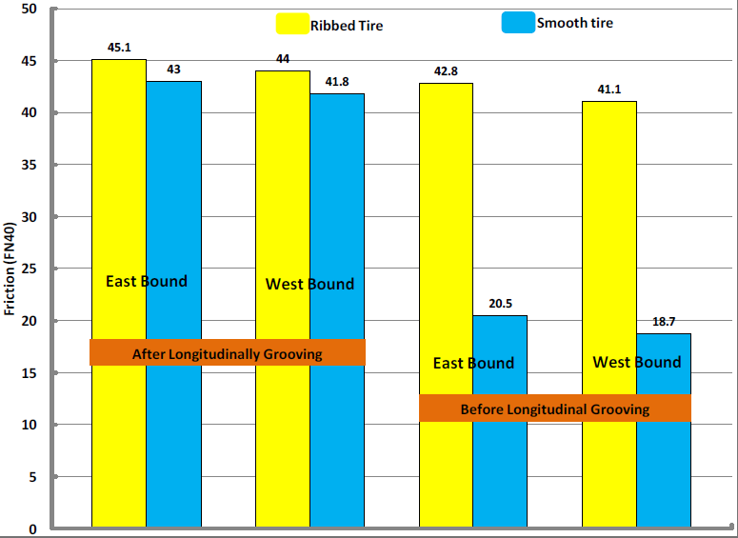
Kansas I-70 Test Section

Slide 51
KDOT I-70 Noise vs. Friction
Fn Friction Number
Notes:
Drive them to our website.

Slide 52
Kansas I-70 Results
Notes:
We also have a few other surfaces we are developing including NGCS Lite, which is a renewal surface texture that can be applied to existing NGCS sections in the event that friction or noise benefit is diminished over time.

Slide 53
NCHRP Project 10-67
Notes:
Drive them to our website.

Slide 54
NGCS Site Locations in The USA

Slide 55
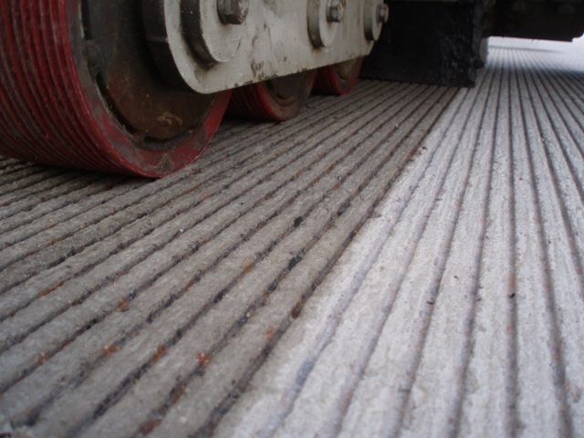
International NGCS Locations
Germany
Korea
Canada
Australia

Slide 56

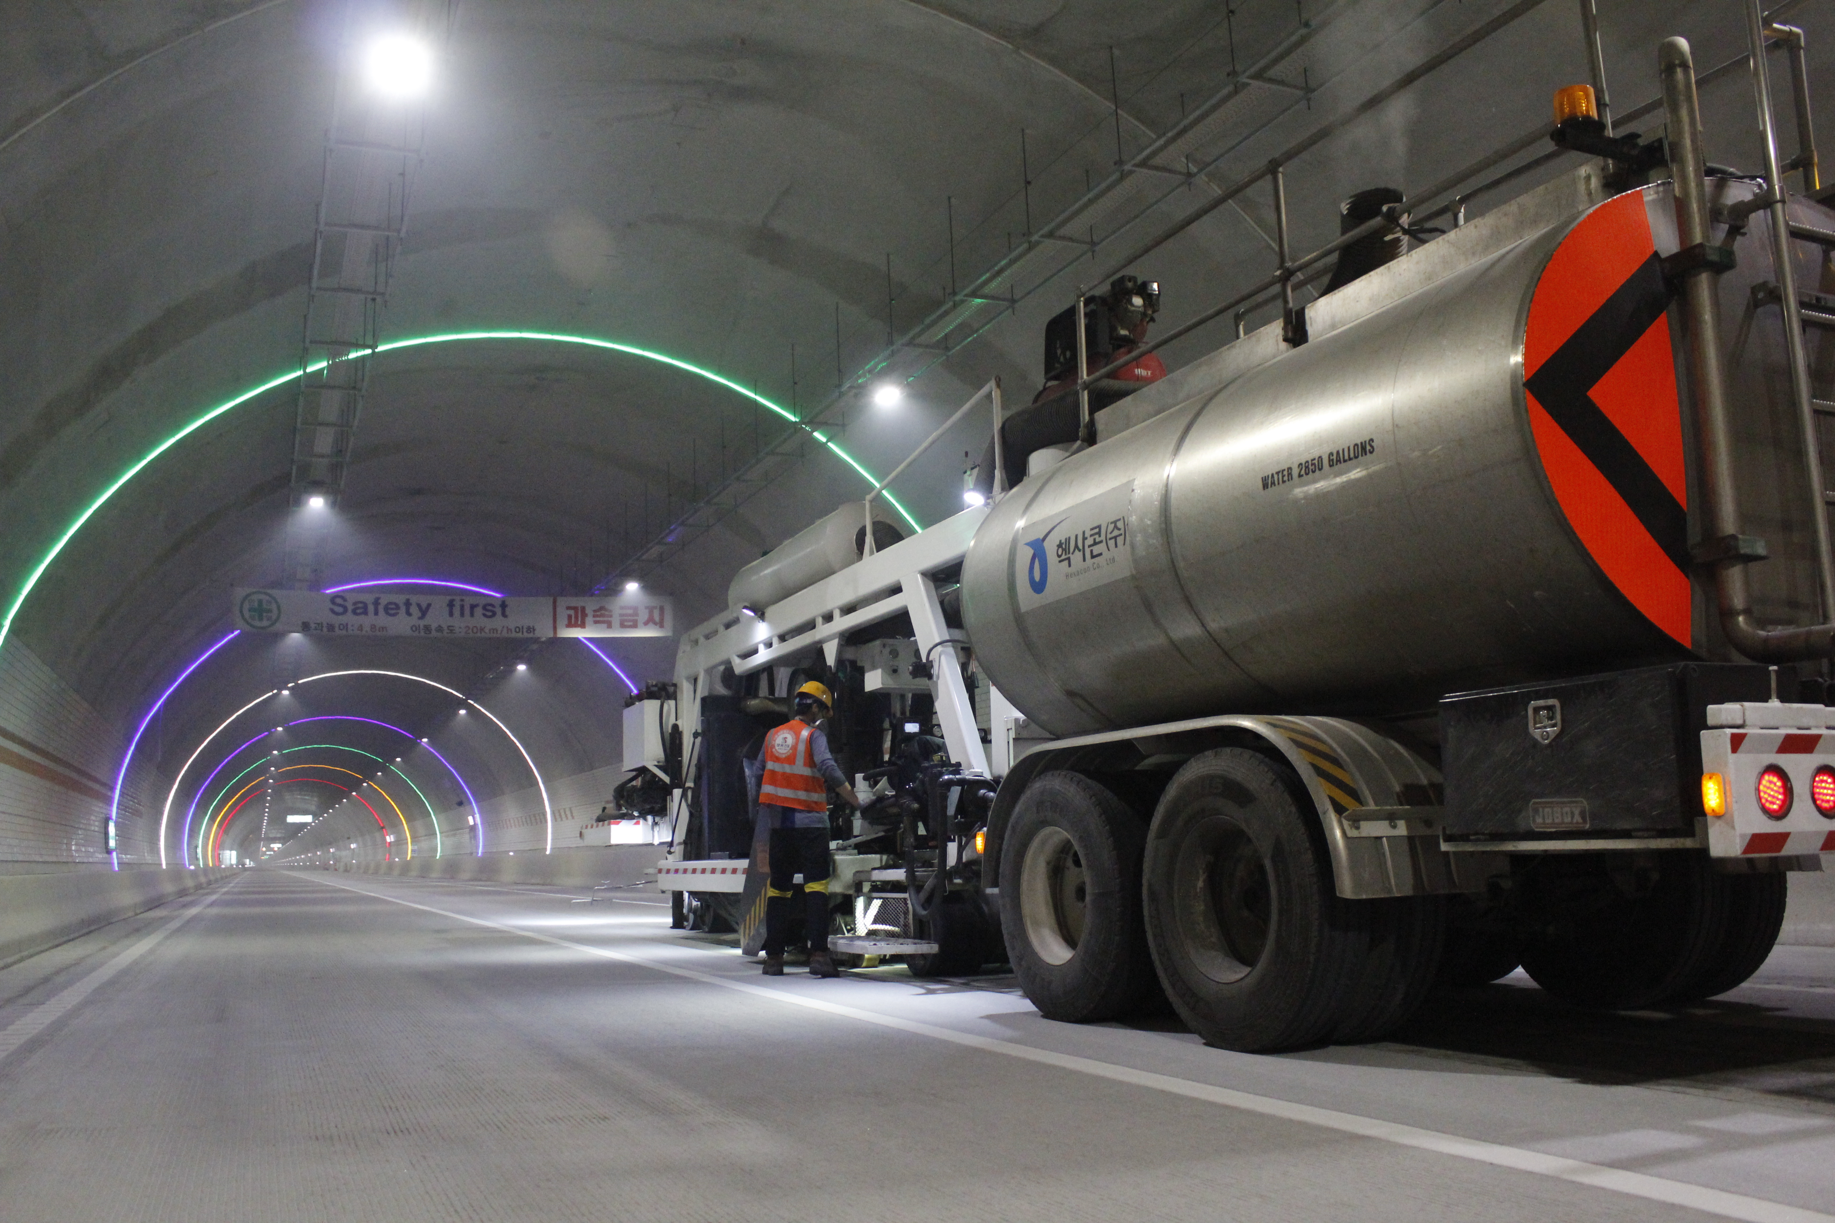
South Korea - NGCS

Slide 57
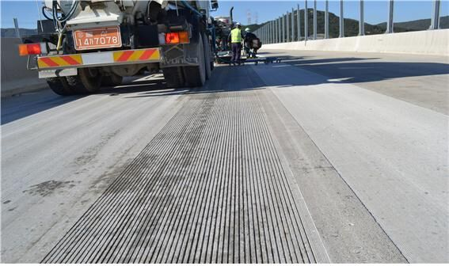
How Much Is Being Used Today? South Korea - NGCS
NGCS is used throughout South Korea on all new expressway tunnels that are 1.24 miles or more in length.
Use of the surface is now expanding to national highways and local roads as well. There are nearly 1.5 million square yards--200 lane miles--of NGCS in South Korea as of 2019.
Photo courtesy Hexacon, Inc.

Slide 58

Case Study – I-10 Houston Texas
Known as the Katy Freeway boasting 26 lanes, it claims to be the widest roadway in the USA.
Noise sensitive area – many noise complaints from homes and businesses.
Coast to coast high intensity traffic 24 hours/day.

Slide 59

Case Study – I-10 Houston Texas
TXDOT had considered an asphalt overlay but chose NGCS looking for a more permanent solution.
Approximately 630,000 sq. meters received the NGCS.(over 100 miles)
Average noise levels reduced by 75%
Average skid numbers increased by 60%
Smoothness improved by 73% to 305%
Texas is now the largest user of NGCS in the world.

Slide 60
Benefits of NGCS
Smoother Ride: The innovative texture provides for a smoother, more uniform ride.
Increased Safety: Diamond grinding/grooving provide increased macro-texture, creating a safer road in wet weather conditions.
Decreased Noise: Tests have shown a decrease in tire/pavement noise by 75%.

Slide 61
In Summary
Motorists are increasingly demanding safe, smooth, quiet and delay free roadways while funding necessary to meet these needs remains elusive.
Diamond saw-cut textures are a time proven, cost effective means of providing consistently smooth, quiet and safe textures at a competitive cost.
NGCS provides an ultra-smooth, high friction surface with acoustically durable properties, designed to last the life of the pavement.
NGCS has been constructed in 14 states and 4 countries and is THE low-noise concrete surface texture.

Slide 62
Visit Us on the Web
International Grooving and Grinding Association
at
igga.net

