Slide 1
Concrete Durability
Henry B. Prenger, P.E.

Slide 2
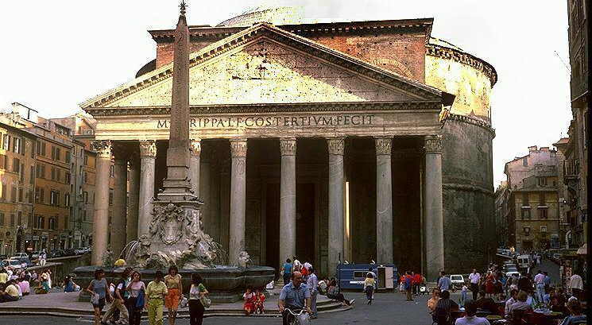

Slide 3
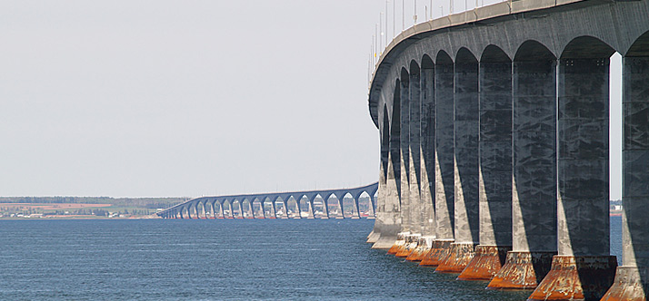

Slide 4
Build with Strength or Build with Durability

Slide 5
What do we mean by Durability?
Resistance to ASR
Resistance to sulfate attack
Thermal Control in Mass Concrete
Minimizing cracking
Low permeability / Resistance to corrosion of reinforcing steel
Resistance to freeze thaw damage / Scaling

Slide 6
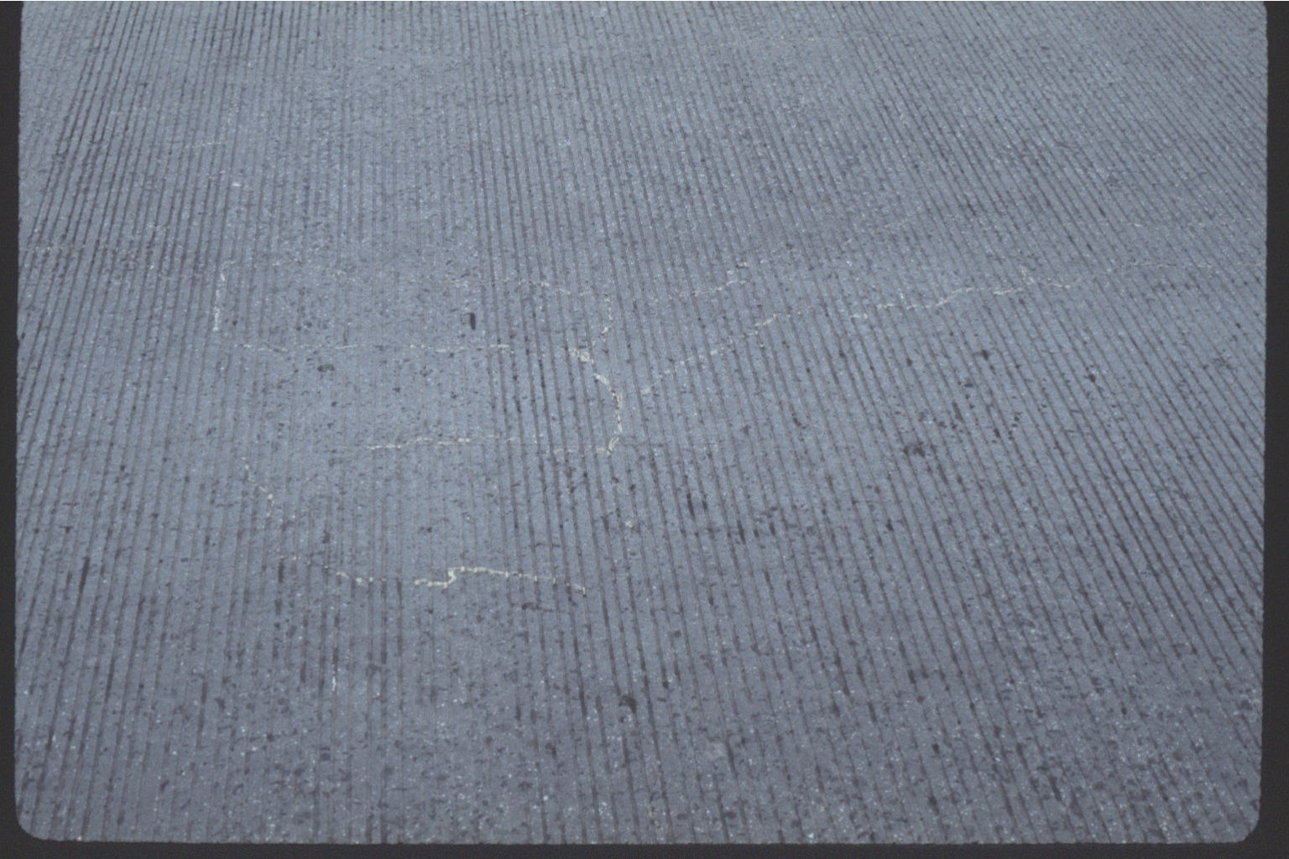
U.S. Rt. 68 and MD Rt. 55
Courtesy of Maryland State Highway Administration
Notes:
U.S. Route 68 over MD Rt. 55 is the highest inland bridge in Maryland. Ten years after the bridge was placed, cracking developed on the deck and the deck was replaced – with the same concrete mixture from the same ready mix company, same aggregate and cement. This was before Maryland thought they had a problem with ASR. Some testing on the Washington D.C. Metro showed deleterious ASR reaction and all aggs. In Maryland were tested as a result. The agg for this deck was found to be extremely reactive and the deck is already showing signs of deterioration.

Slide 7
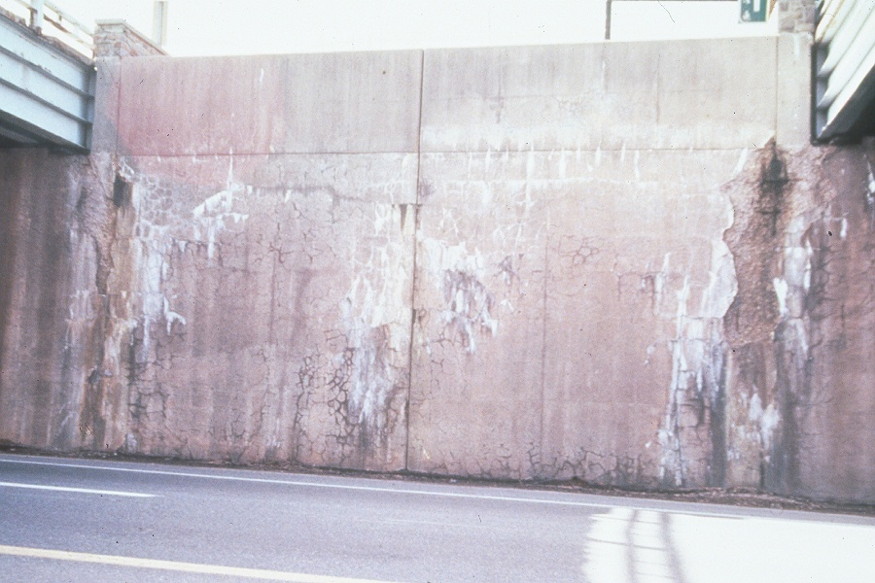
Alkali Silica Reactivity

Slide 8
Tests | Maryland Current | Maryland 2016 | Delaware | Pennsylvania Current | Pennsylvania Future | Virginia | DC DOT | ACI 301
ASTM C1260 | ≤0.10 | ≤0.10 | <0.08** | ≤0.10 | No | No | Yes (No limit set) | No
ASTM C1567 | ≤0.10 | Case by case | <0.08** | ≤0.10 | No | No | Yes (No limit set) | ≤0.10
ASTM C1293 | No | ≤0.04 | <0.04 | No | ≤0.04 | No | No | ≤0.04
ASTM C441 | No | No | No | Yes | No | No | No | No
ASTM C295 | No | No | No | No | No | No | Yes**** | No
Mitigation
Fly Ash | (% from C1567) | (% based on aggregate reactivity) | (% based on C1567 testing** or C1293 testing***) | (% based on C1567 testing expansion ≤0.10 | 15-35% based on aggregate reactivity and type of structure | 20% (cement alkalis ≤0.75%) or 25% (cement alkalis >0.75%) | 15% maximum | % based on C1567 testing expansion ≤0.10
Slag Cement | (% from C1567) | (% based on aggregate reactivity) | (% based on C1567 testing** or C1293 testing***) | (% based on C1567 testing expansion ≤0.10 | 25-65% based on aggregate reactivity and type of structure | 40% (cement alkalis ≤0.75%) or 50% (cement alkalis >0.75%) | 50% maximum | % based on C1567 testing expansion ≤0.10
Silica fume | (% from C1567) | (% based on aggregate reactivity) | (% based on C1567 testing** or C1293 testing***) | Case by case | Calculated | 7% (cement alkalis ≤0.75%) or 10% (cement alkalis >0.75%) | No | % based on C1567 testing expansion ≤0.10
Metakaolin | No | No | No | No | No | 7% (cement alkalis ≤0.75%) or 10% (cement alkalis >0.75%) | No | Yes
Lithium | No | No | (% based on cement alkalis) | No | No | No | No | No
Low alkali cement | 0.60 | No | 0.40 | 0.60 | No | No | 0.60 | No
Alkali loading | No |  | 2.5 lbs. | No | Yes (ASTM C1778) | No | No | Yes

Slide 9
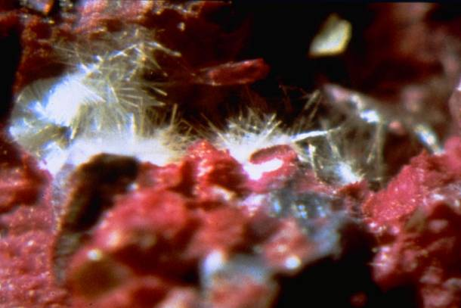
What is Sulfate Attack?
Sulfate attack occurs when hardened concrete comes into contact with water containing sulfates. Sulfates can be found in soils, in sea water, in fertilizer and in waste water.
Sulfates react with the C3A and CaOH in cement to form and expansive material called ettringite.
Notes:
Alkali Silica Reaction (ASR) is a reaction between the alkalis in portland cement and certain reactive siliceous aggregate. The reaction is fueled by water, which causes the formation an expansive gel.

Slide 10
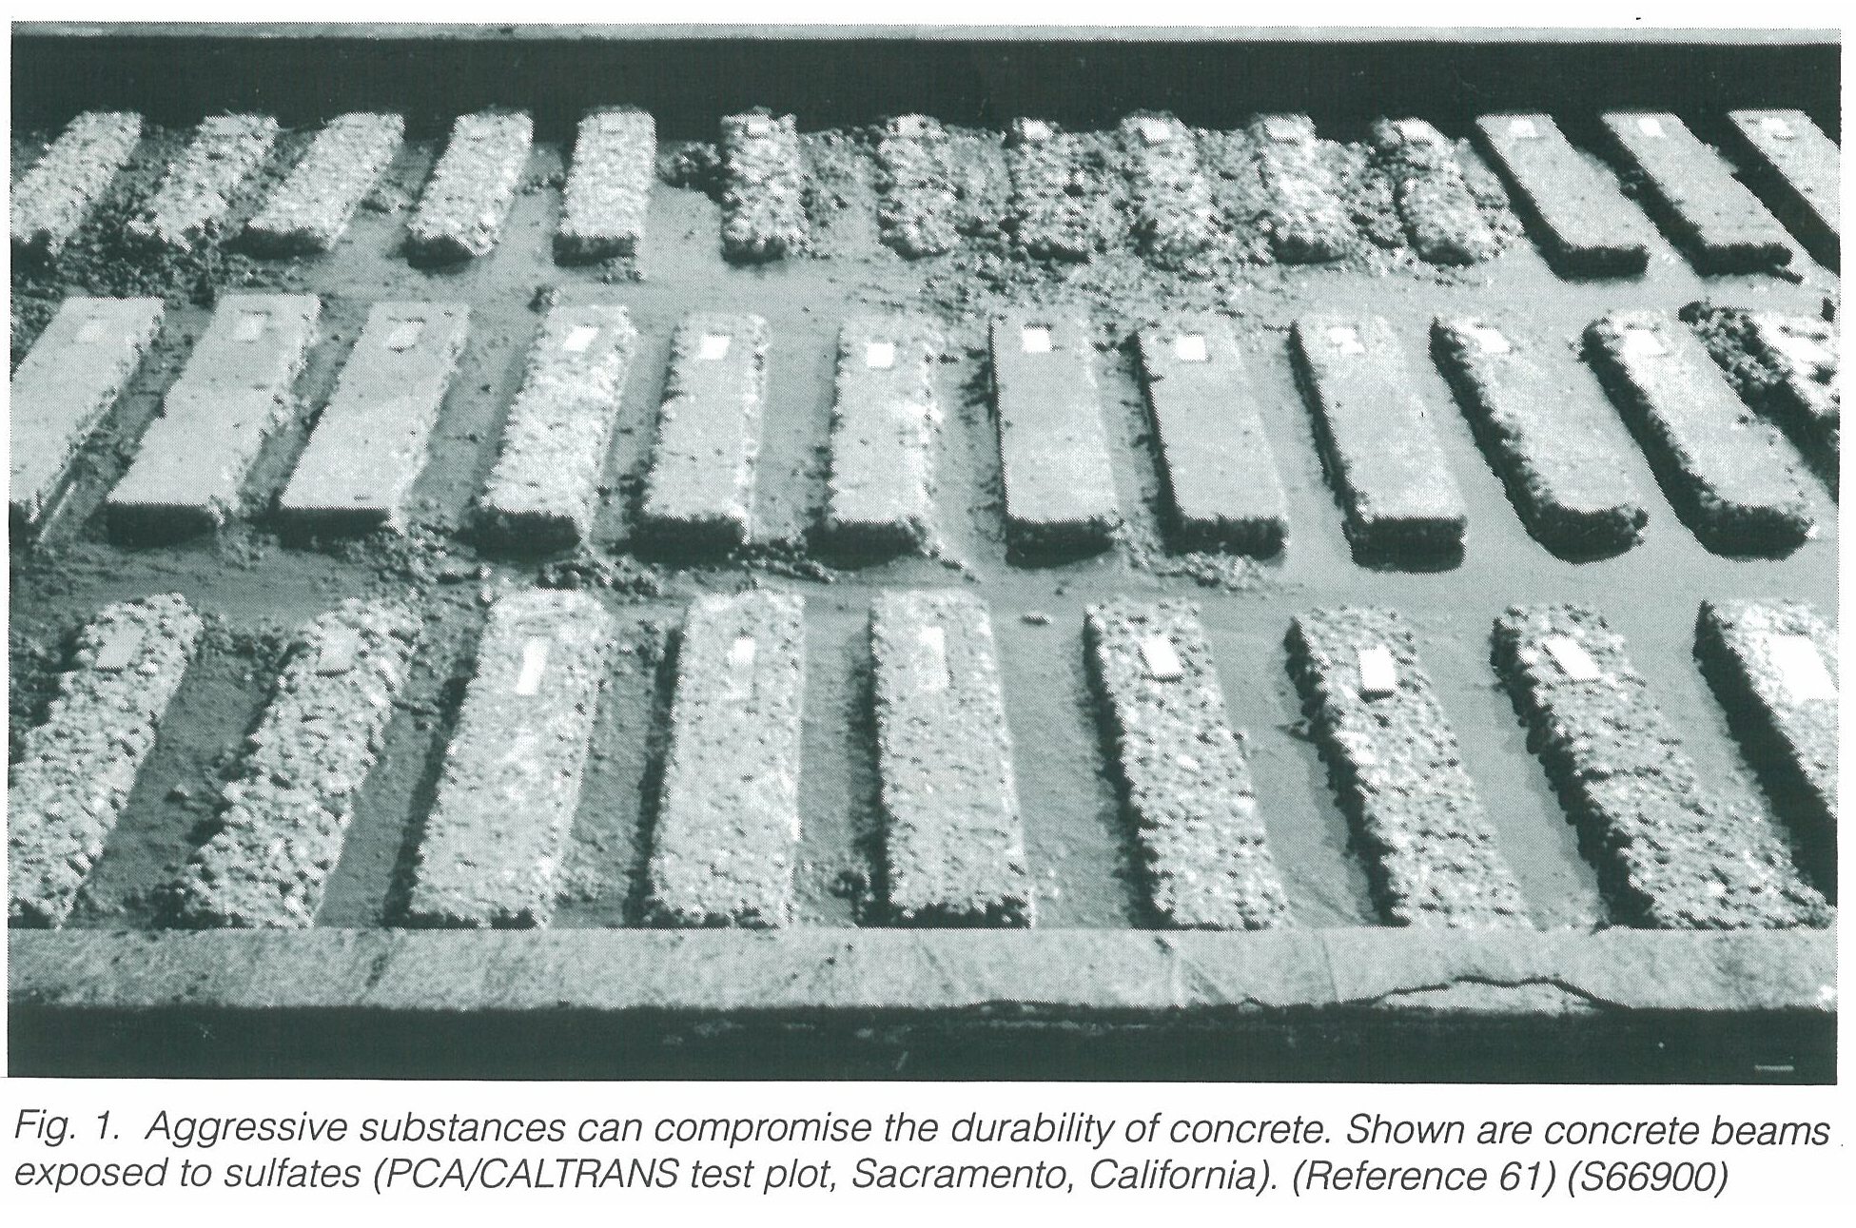

Slide 11
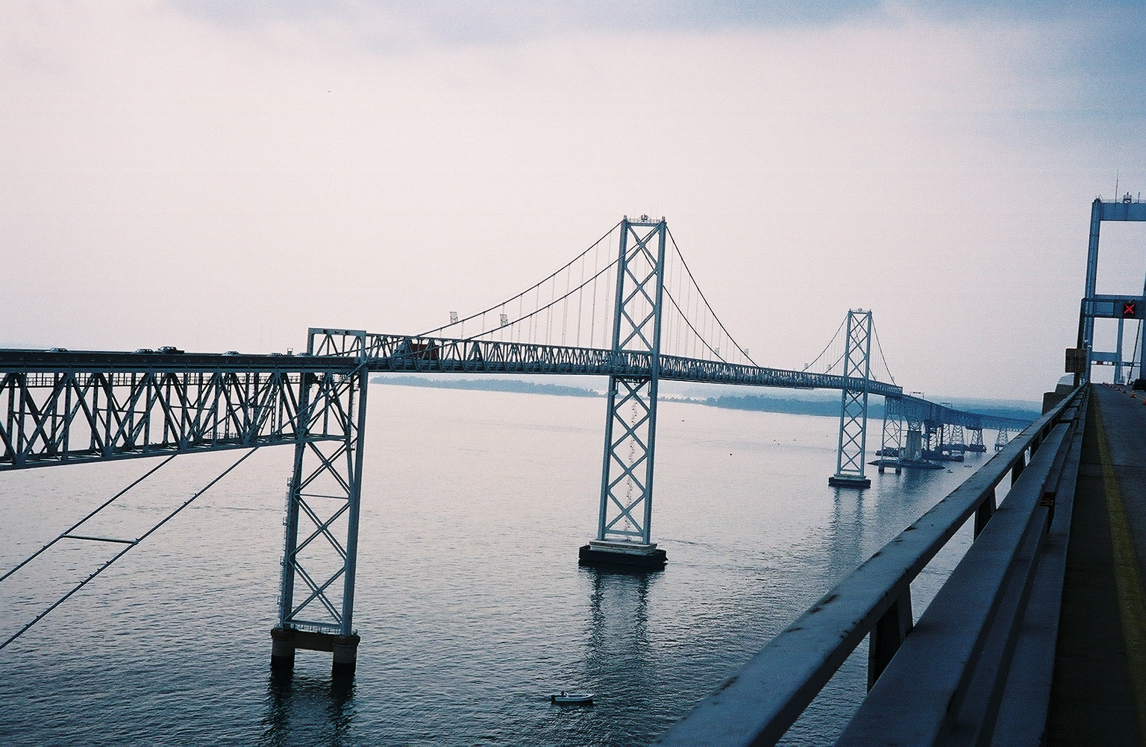
The reaction is more severe at locations where the concrete is exposed to wetting and drying, than continuously wet exposures.

Slide 12
SHA Spec
Type II Cement
Type I with Fly Ash or Slag Cement with Justifying Data

Slide 13
What is Delayed Ettringite Formation?
Concrete that undergoes high early curing temperatures form compounds that may later react in concrete, forming ettringite crystals and causing the concrete to deteriorate.

Slide 14
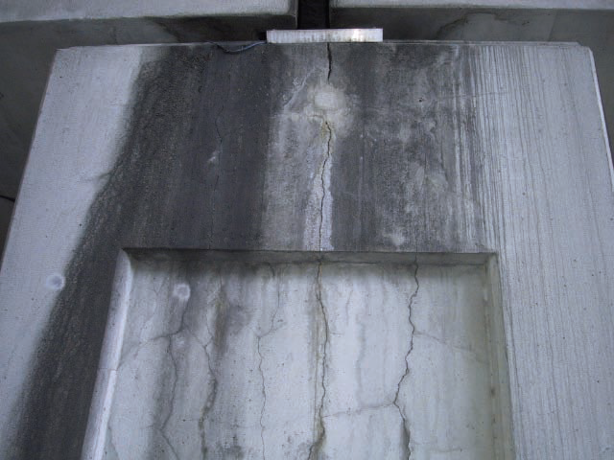
DEF in a column in San Antonio, TX
Ref: FHWA/TX-08/0-4563-1

Slide 15
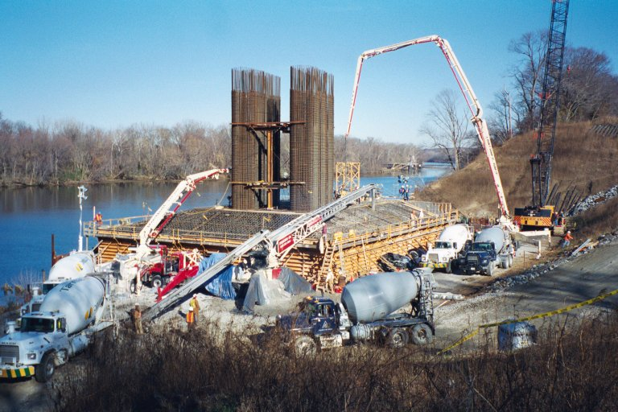
 | Initial Spec | Final Spec
Concrete Temp | 70 ºF | 90 ºF
Temp Differential | 35 ºF | Calculated
Max Temp | 135 ºF | 165 ºF

Slide 16
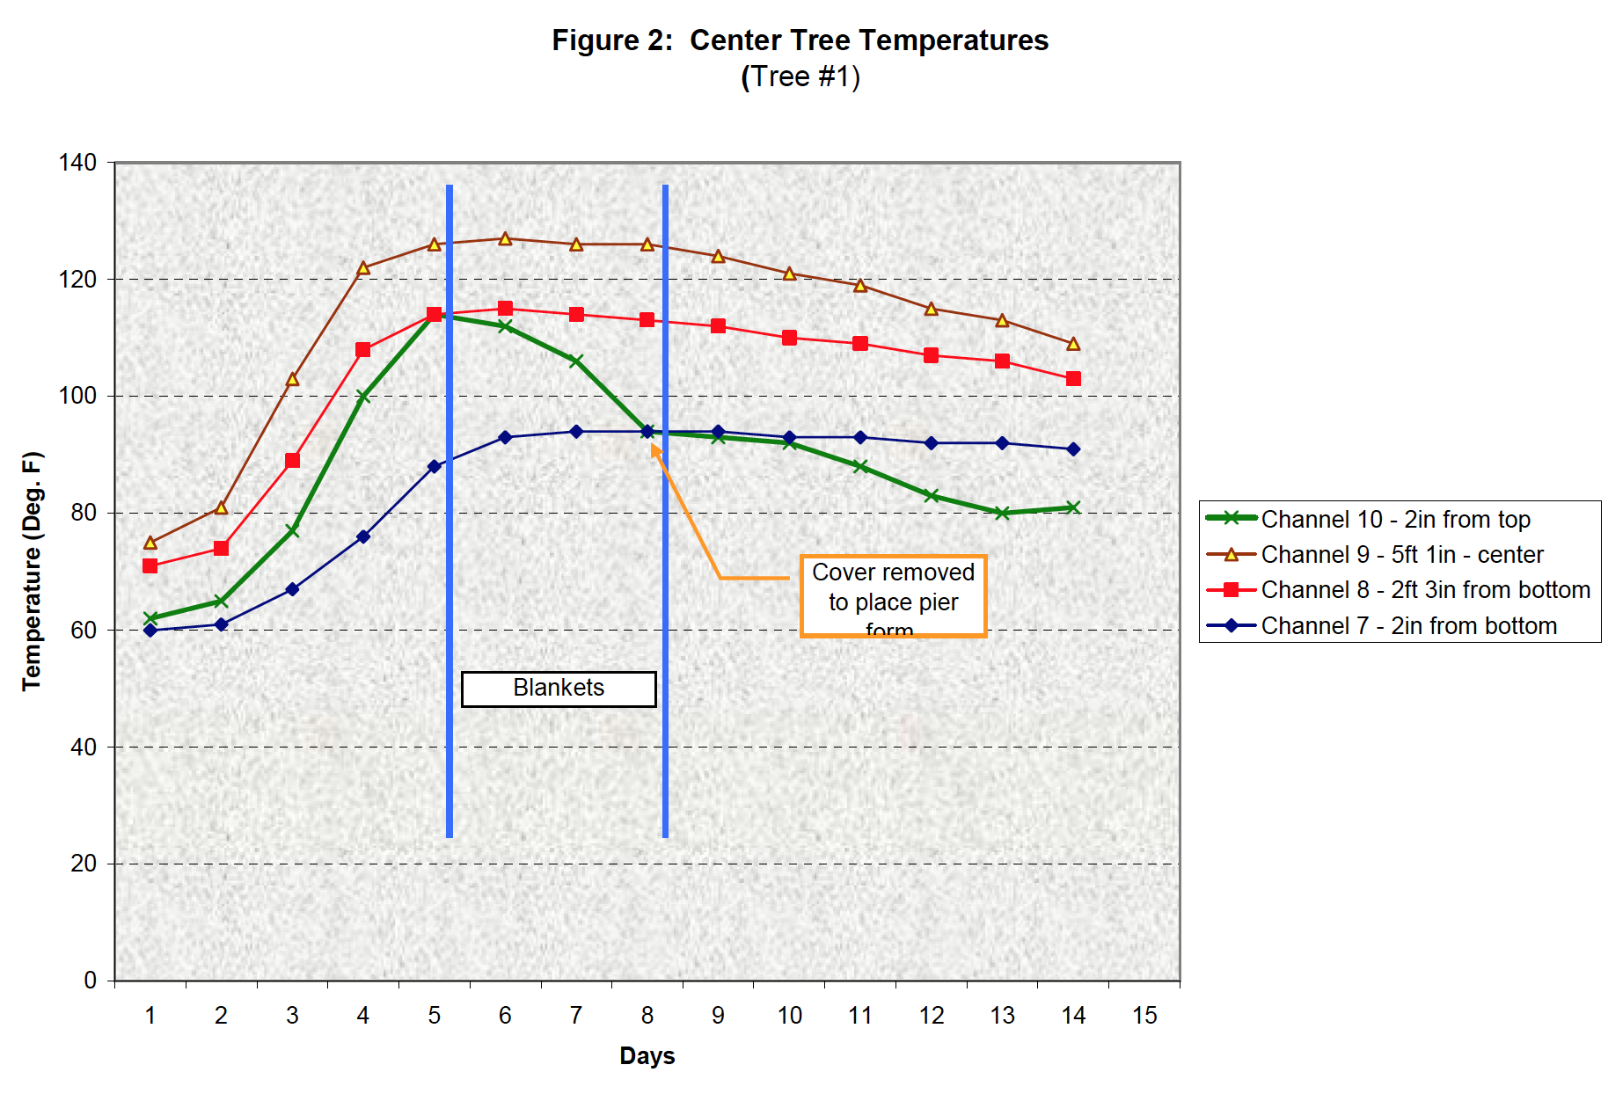
Concrete Footing
40’ x 35’ x 10’
Courtesy Swope and Associates

Slide 17
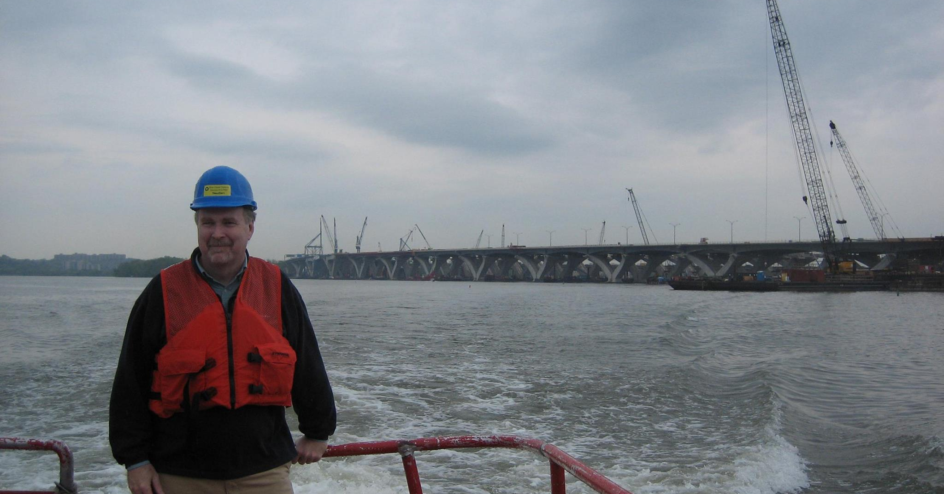
Woodrow Wilson Bridge
Original spec called for a max of 50% slag cement
Changed to 75% for mass concrete portions
56 day strengths specified
Strengths were exceeded at 28 days

Slide 18
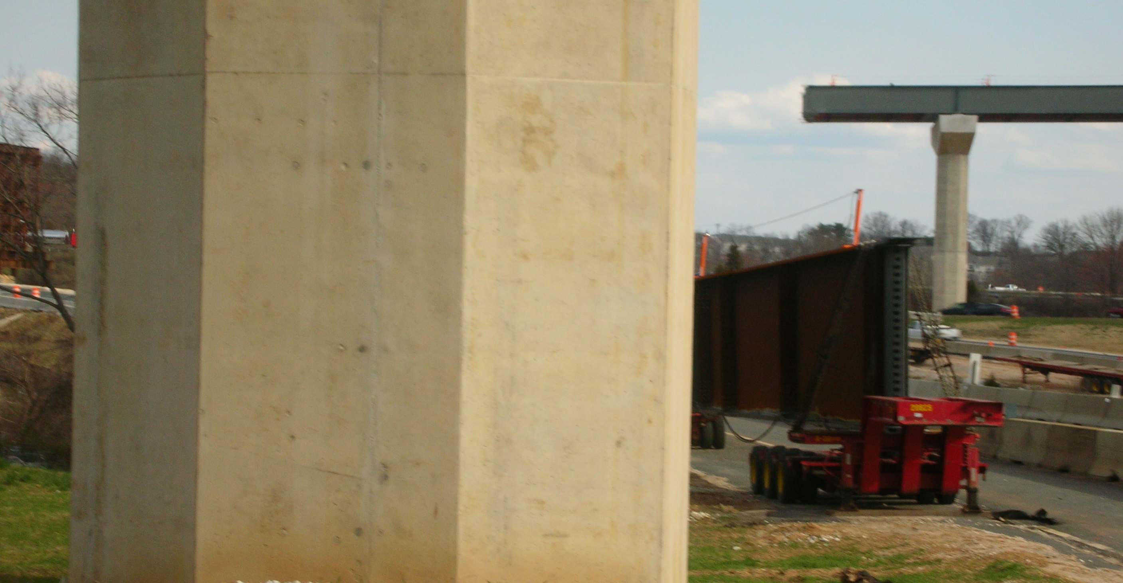
56 ºF temperature differential allowed (40 ºF observed)
Higher differential allowed due to reinforcing steel, increasing compressive forces due to column height

Slide 19
SHA Spec
Evolving
Max Temperature 158 ºF
Max Temperature Differential 35 ºF?
Thermal Control Plan

Slide 20
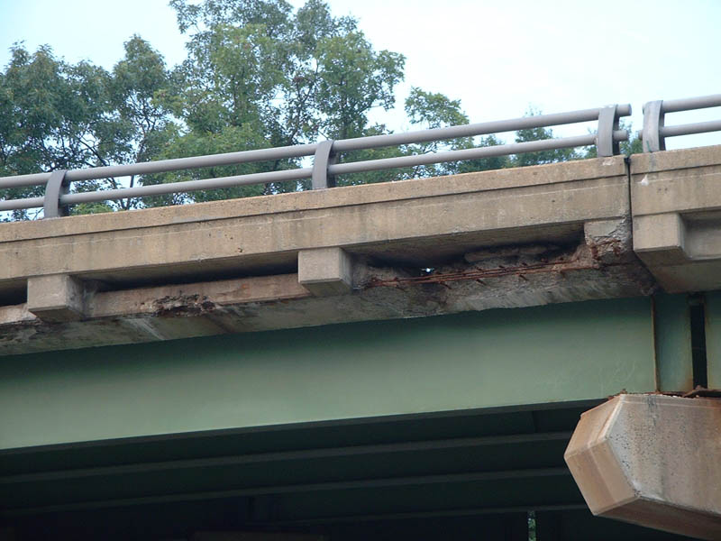
Permeability
Interstate 66 West of Washington D.C.
Notes:
You see it everywhere!
I personally took this picture and it is one of many that I could use as examples.

Slide 21

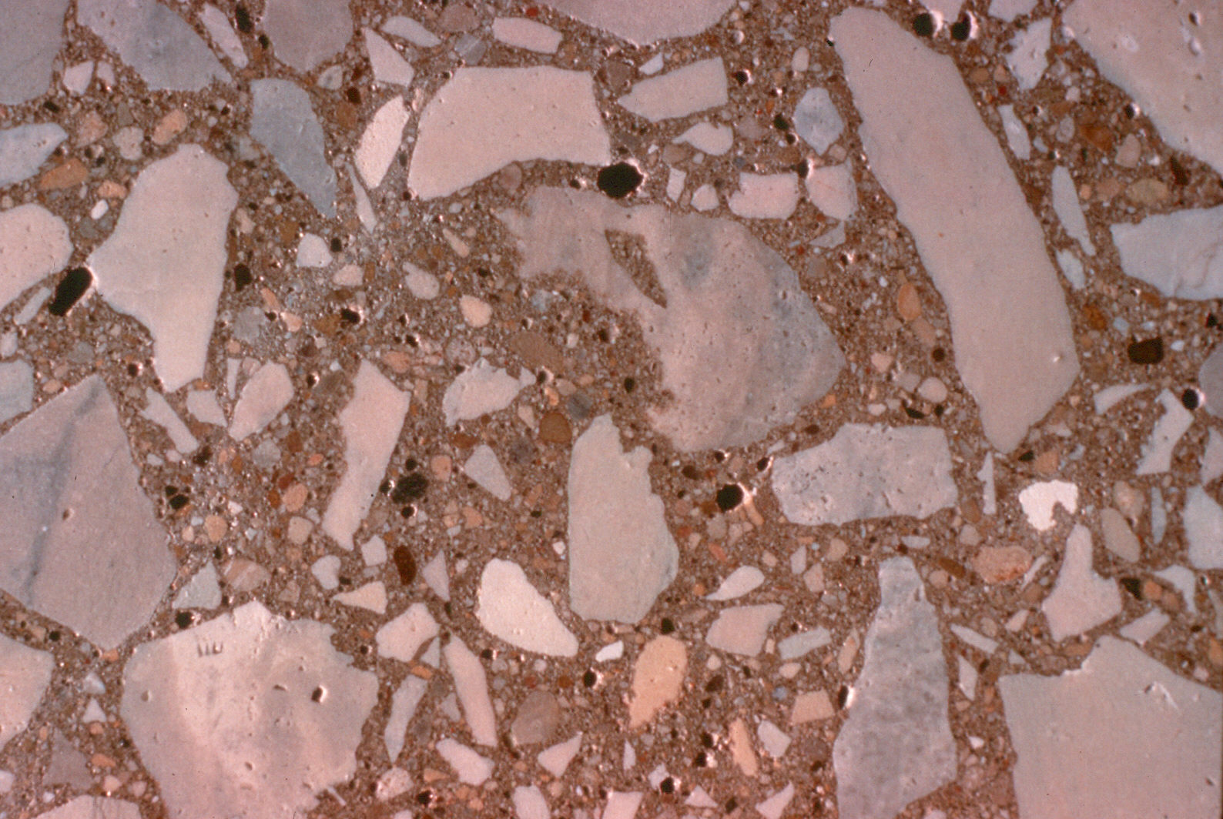
Permeability of Concrete - Corrosion
Salty Water
H₂O
Cl ⁻
Corrosion of reinforcing steel
Notes:
How corrosion forms in reinforced concrete.

Slide 22
Notes:
The permeability of concrete can be measured.
ASTM C 1202 (AASHTO T277) – “Standard Test Method for Electrical Indication of Concrete’s ability to Resist Chloride Ion Penetration” otherwise known as the Rapid Chloride Permeability Test”
Basically determines the electrical conductance of concrete, providing a rapid (~20 hours after curing) indication of the resistance to the penetration of chloride ions.
This is typical data – You should always test with actual project materials before committing to a performance standard.
The permeability will decrease with age.
Ranking per ASTM C 1202
>4K = High
2-4K = Moderate
1-2K = Low
.01-1K = Very low
<.01 = Negligible

Slide 23
SHA Spec
HPC Mix
Default due to slag cement and fly ash use

Slide 24
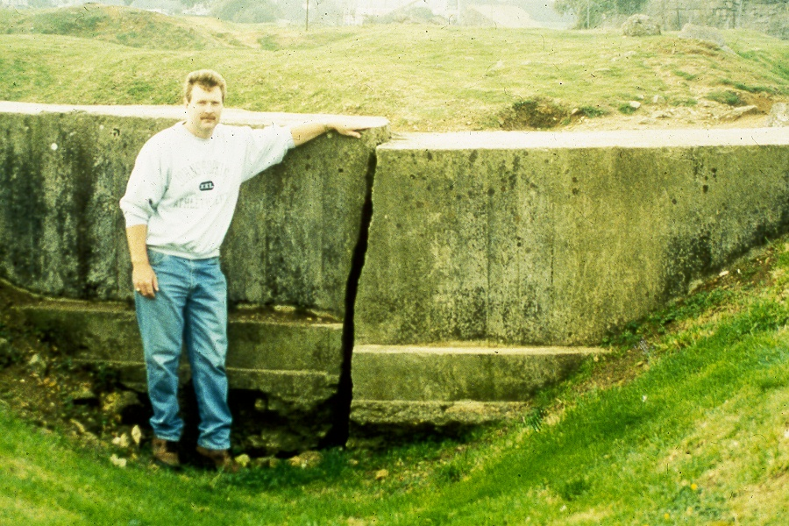
Cracking

Slide 25
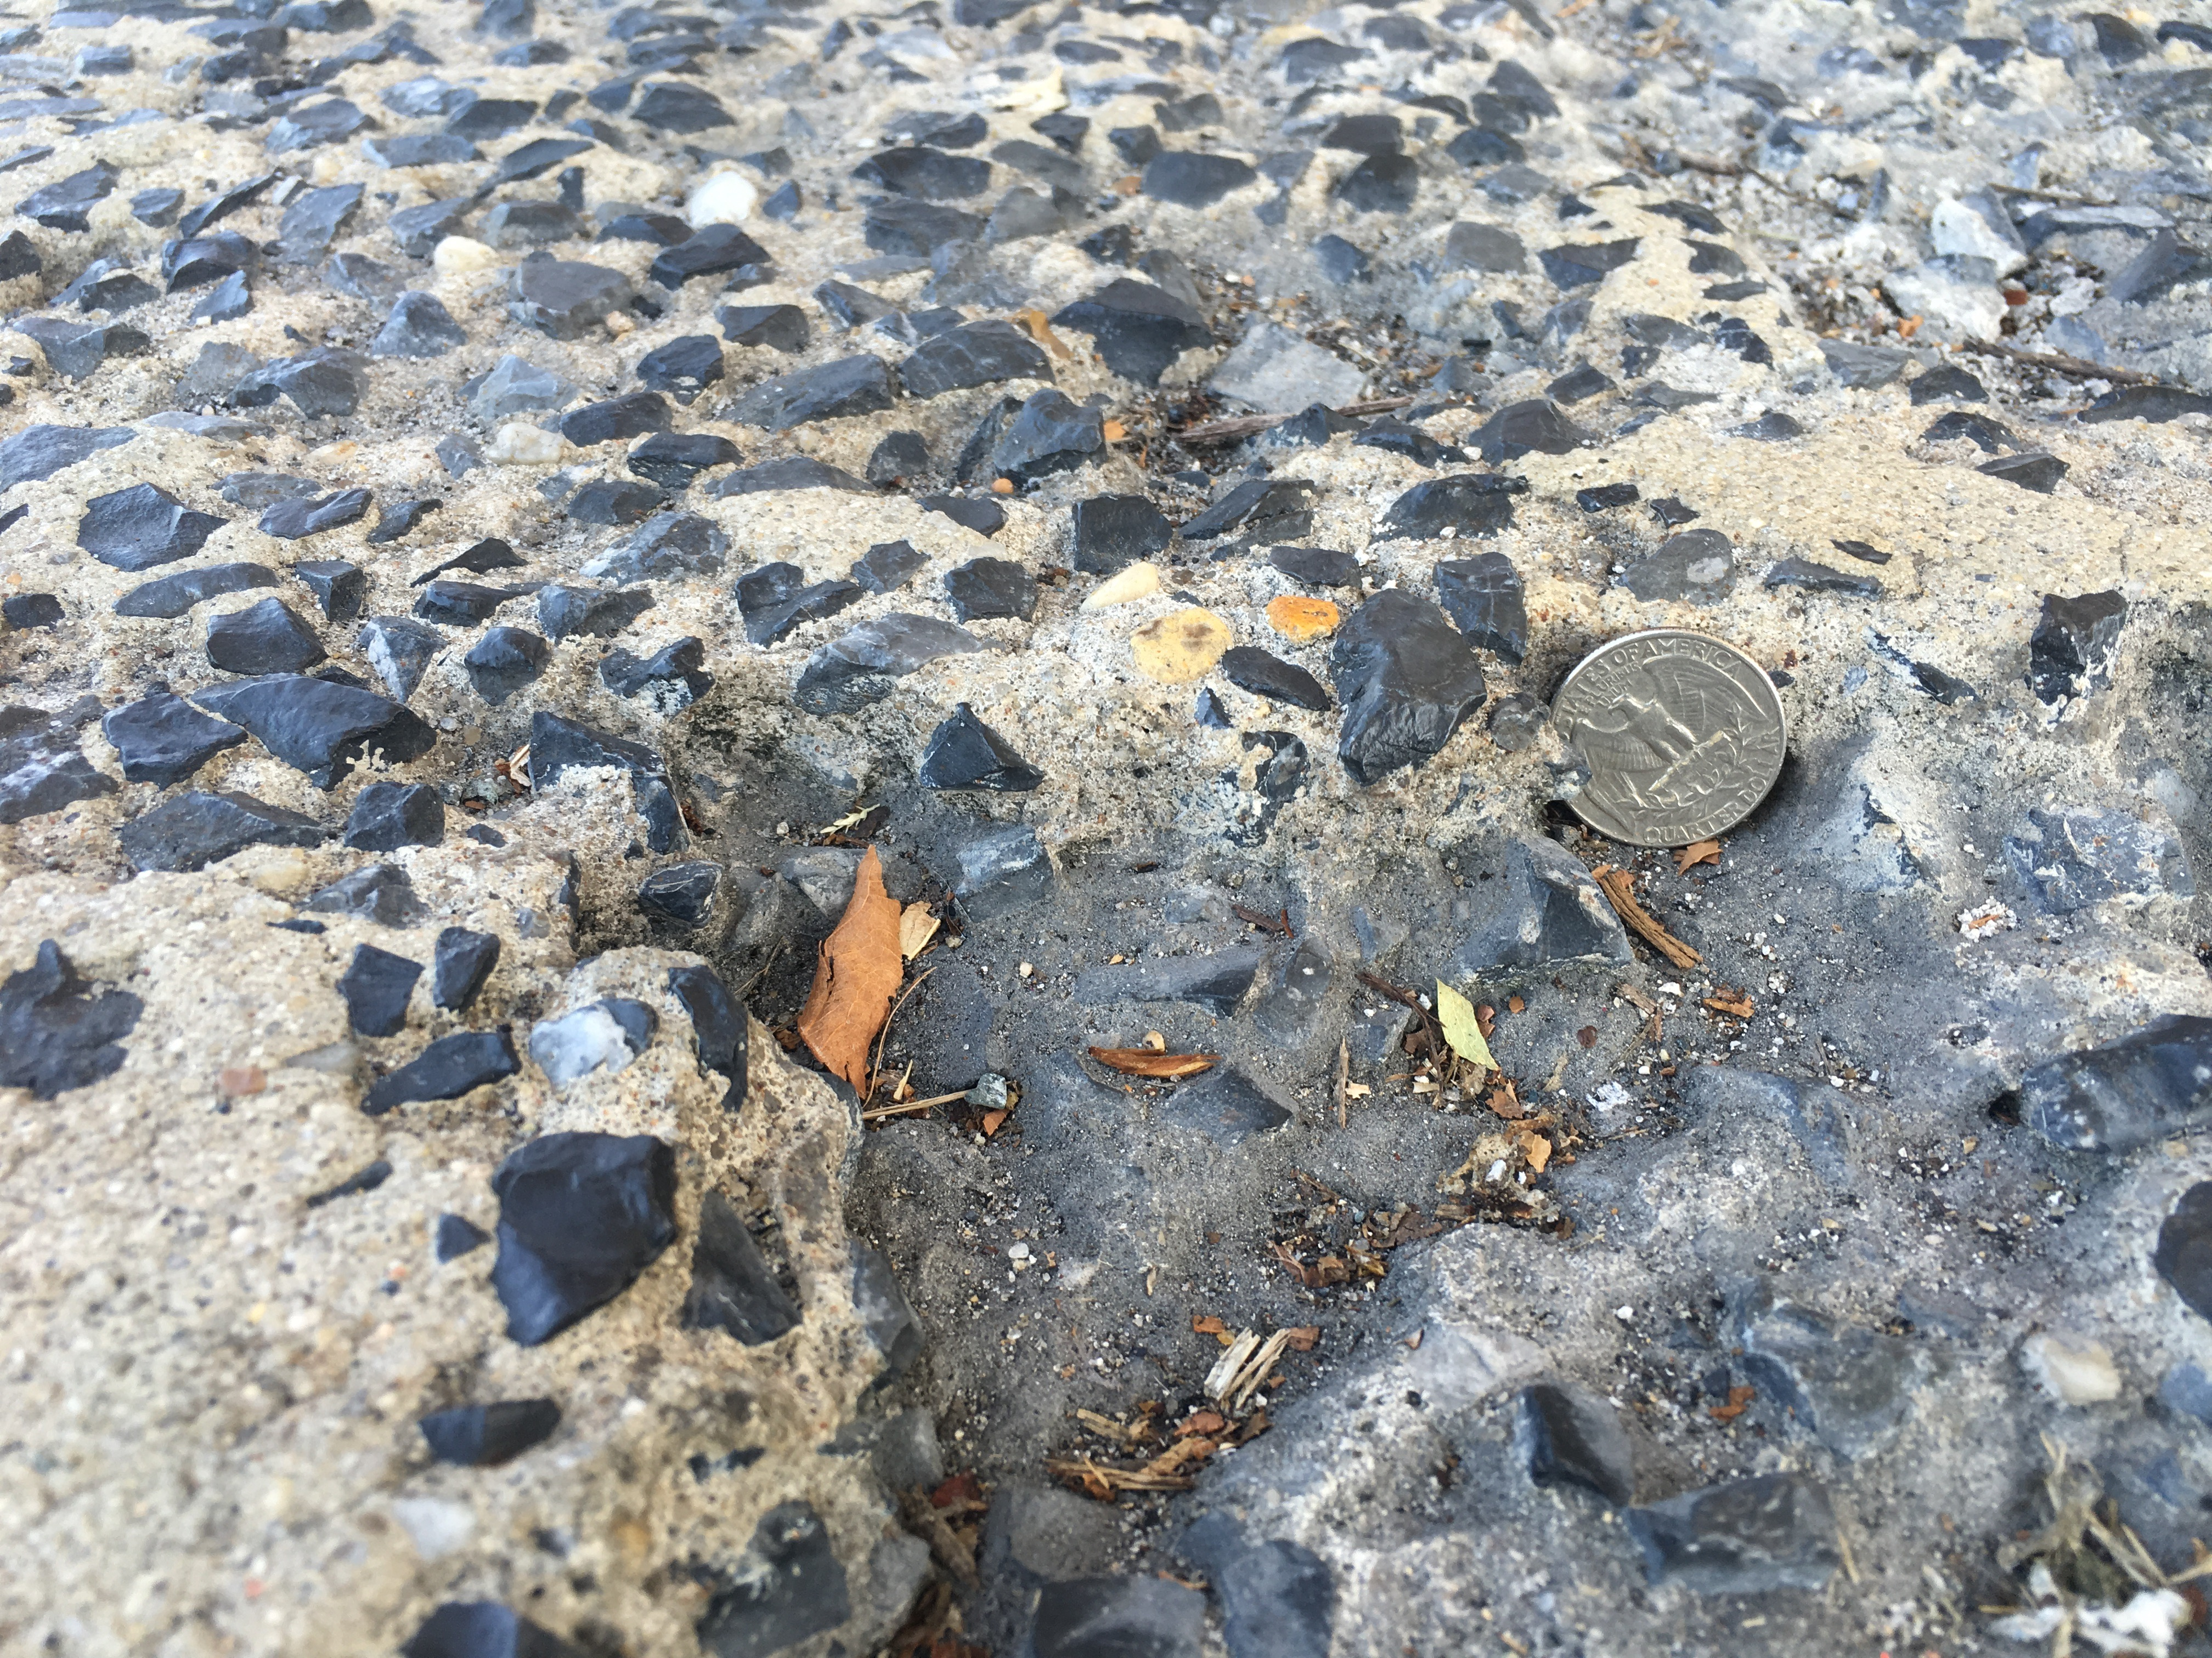
Freeze Thaw Damage

Slide 26
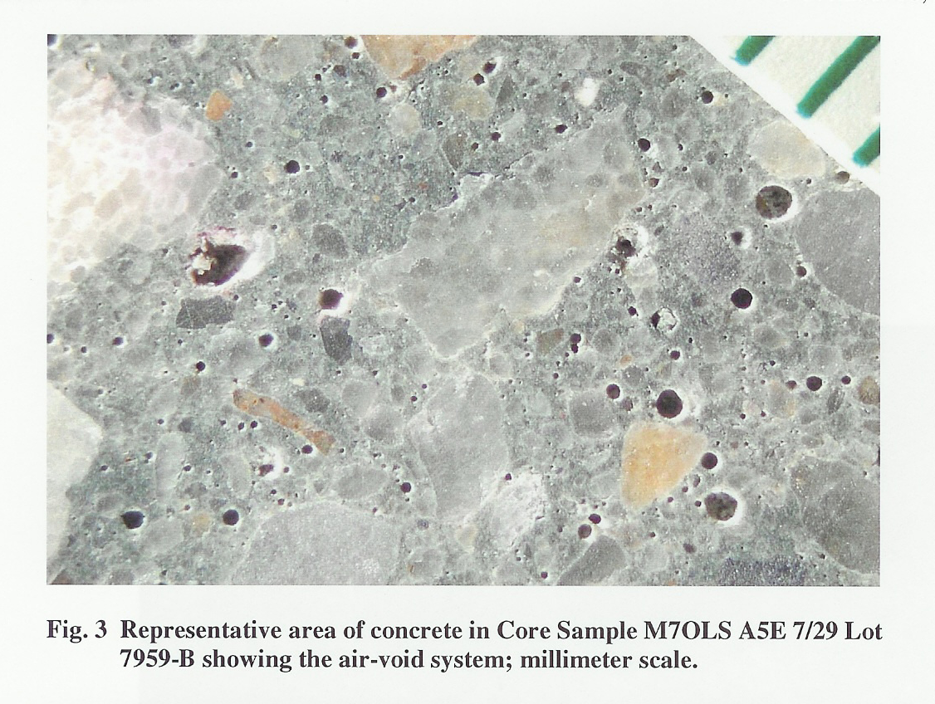
Inadequate Air Void System

Slide 27
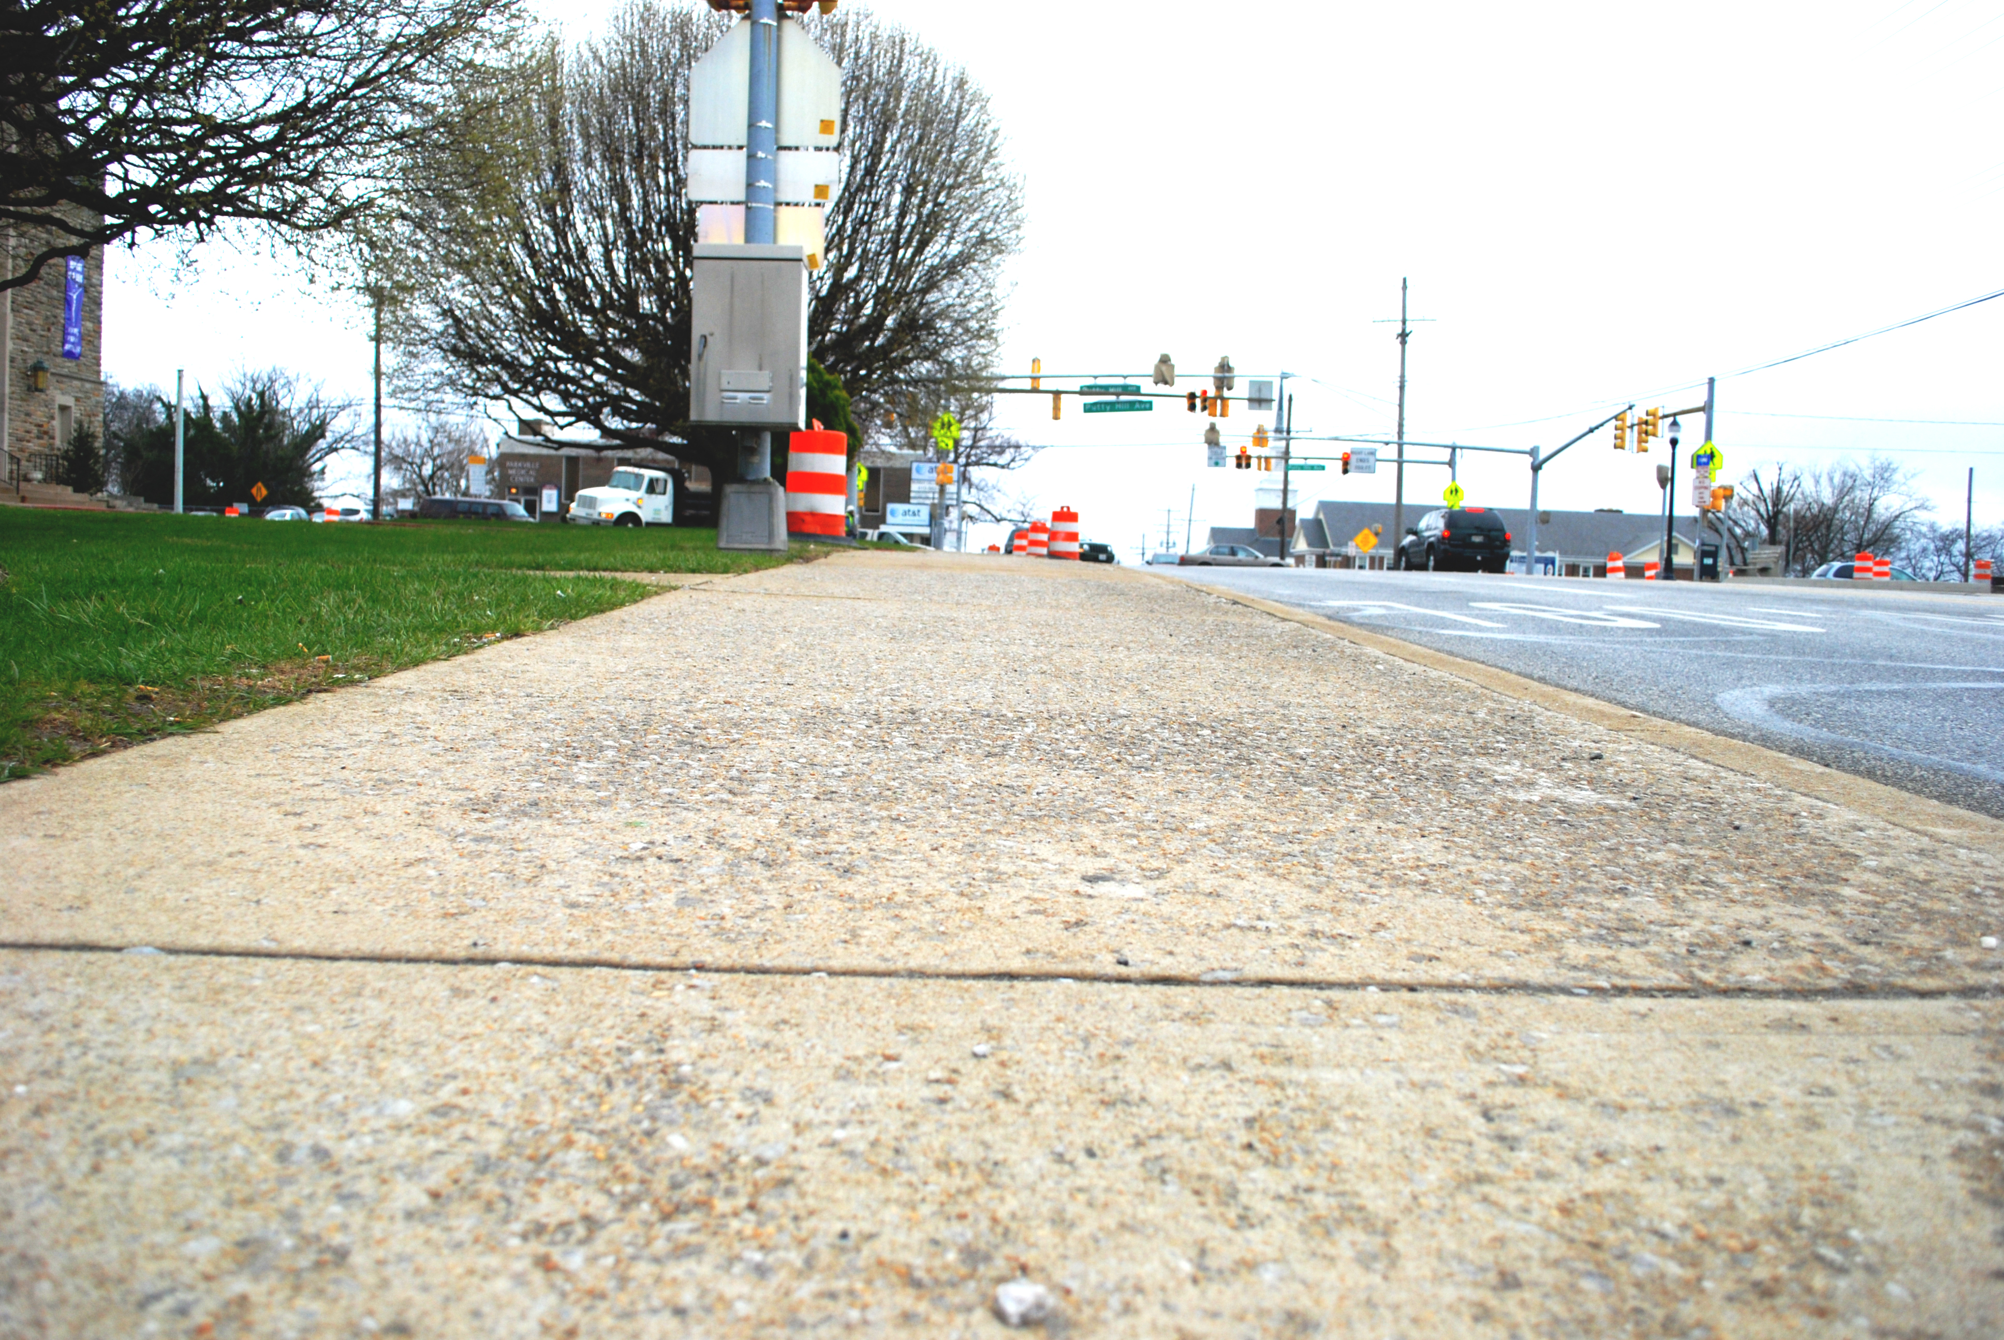
Scaling Damage

Slide 28
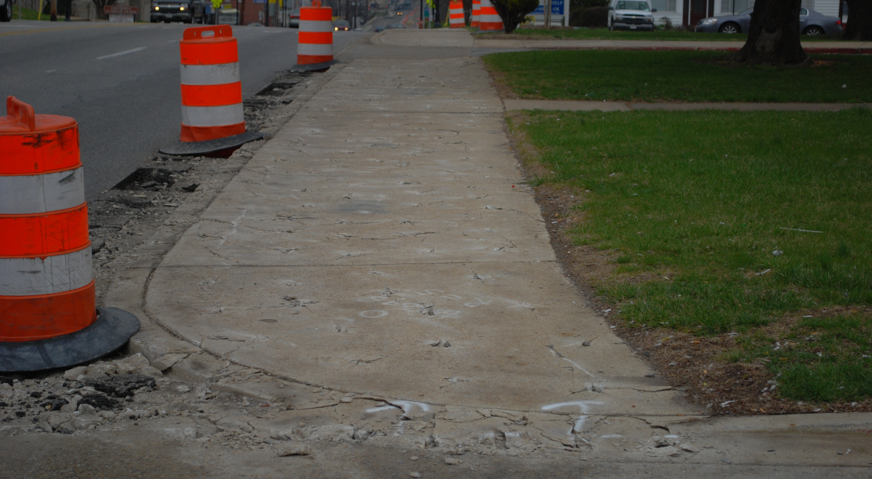

Slide 29
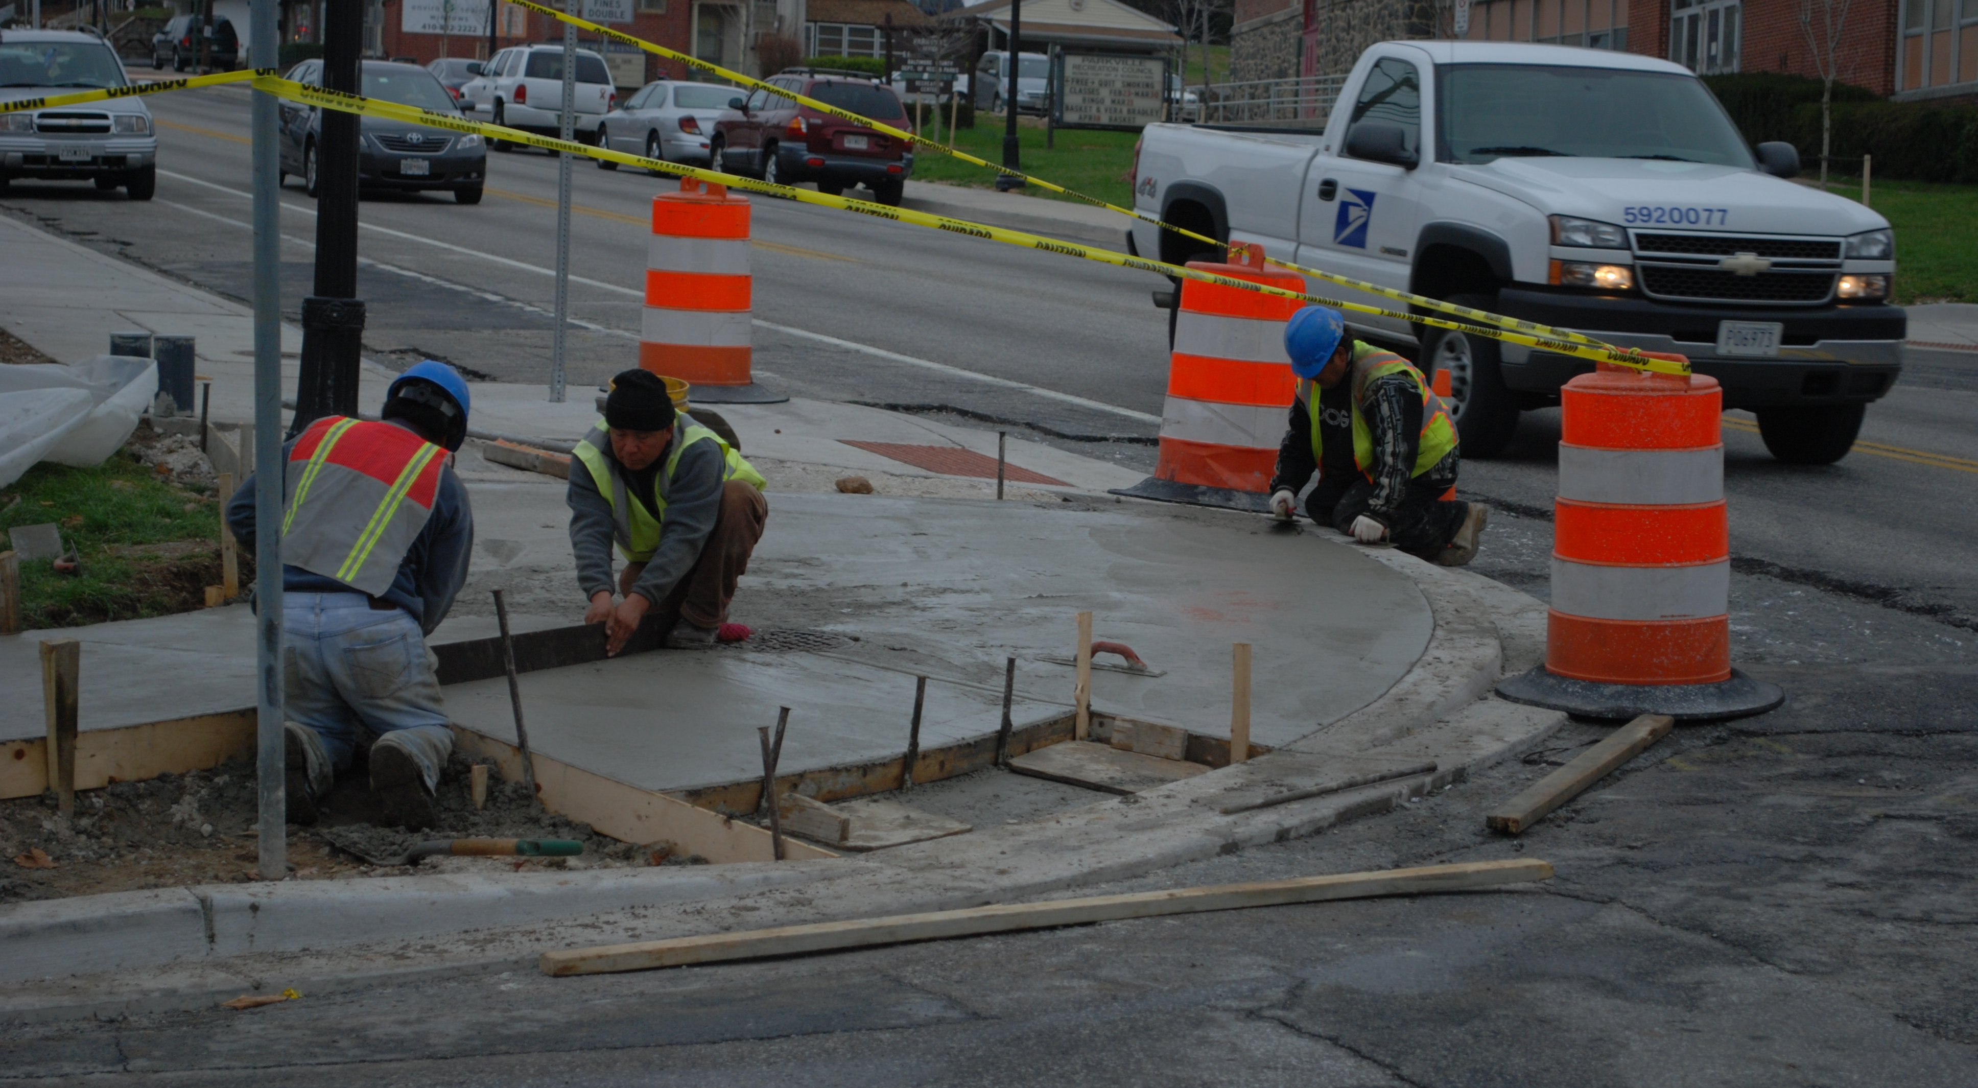

Slide 30
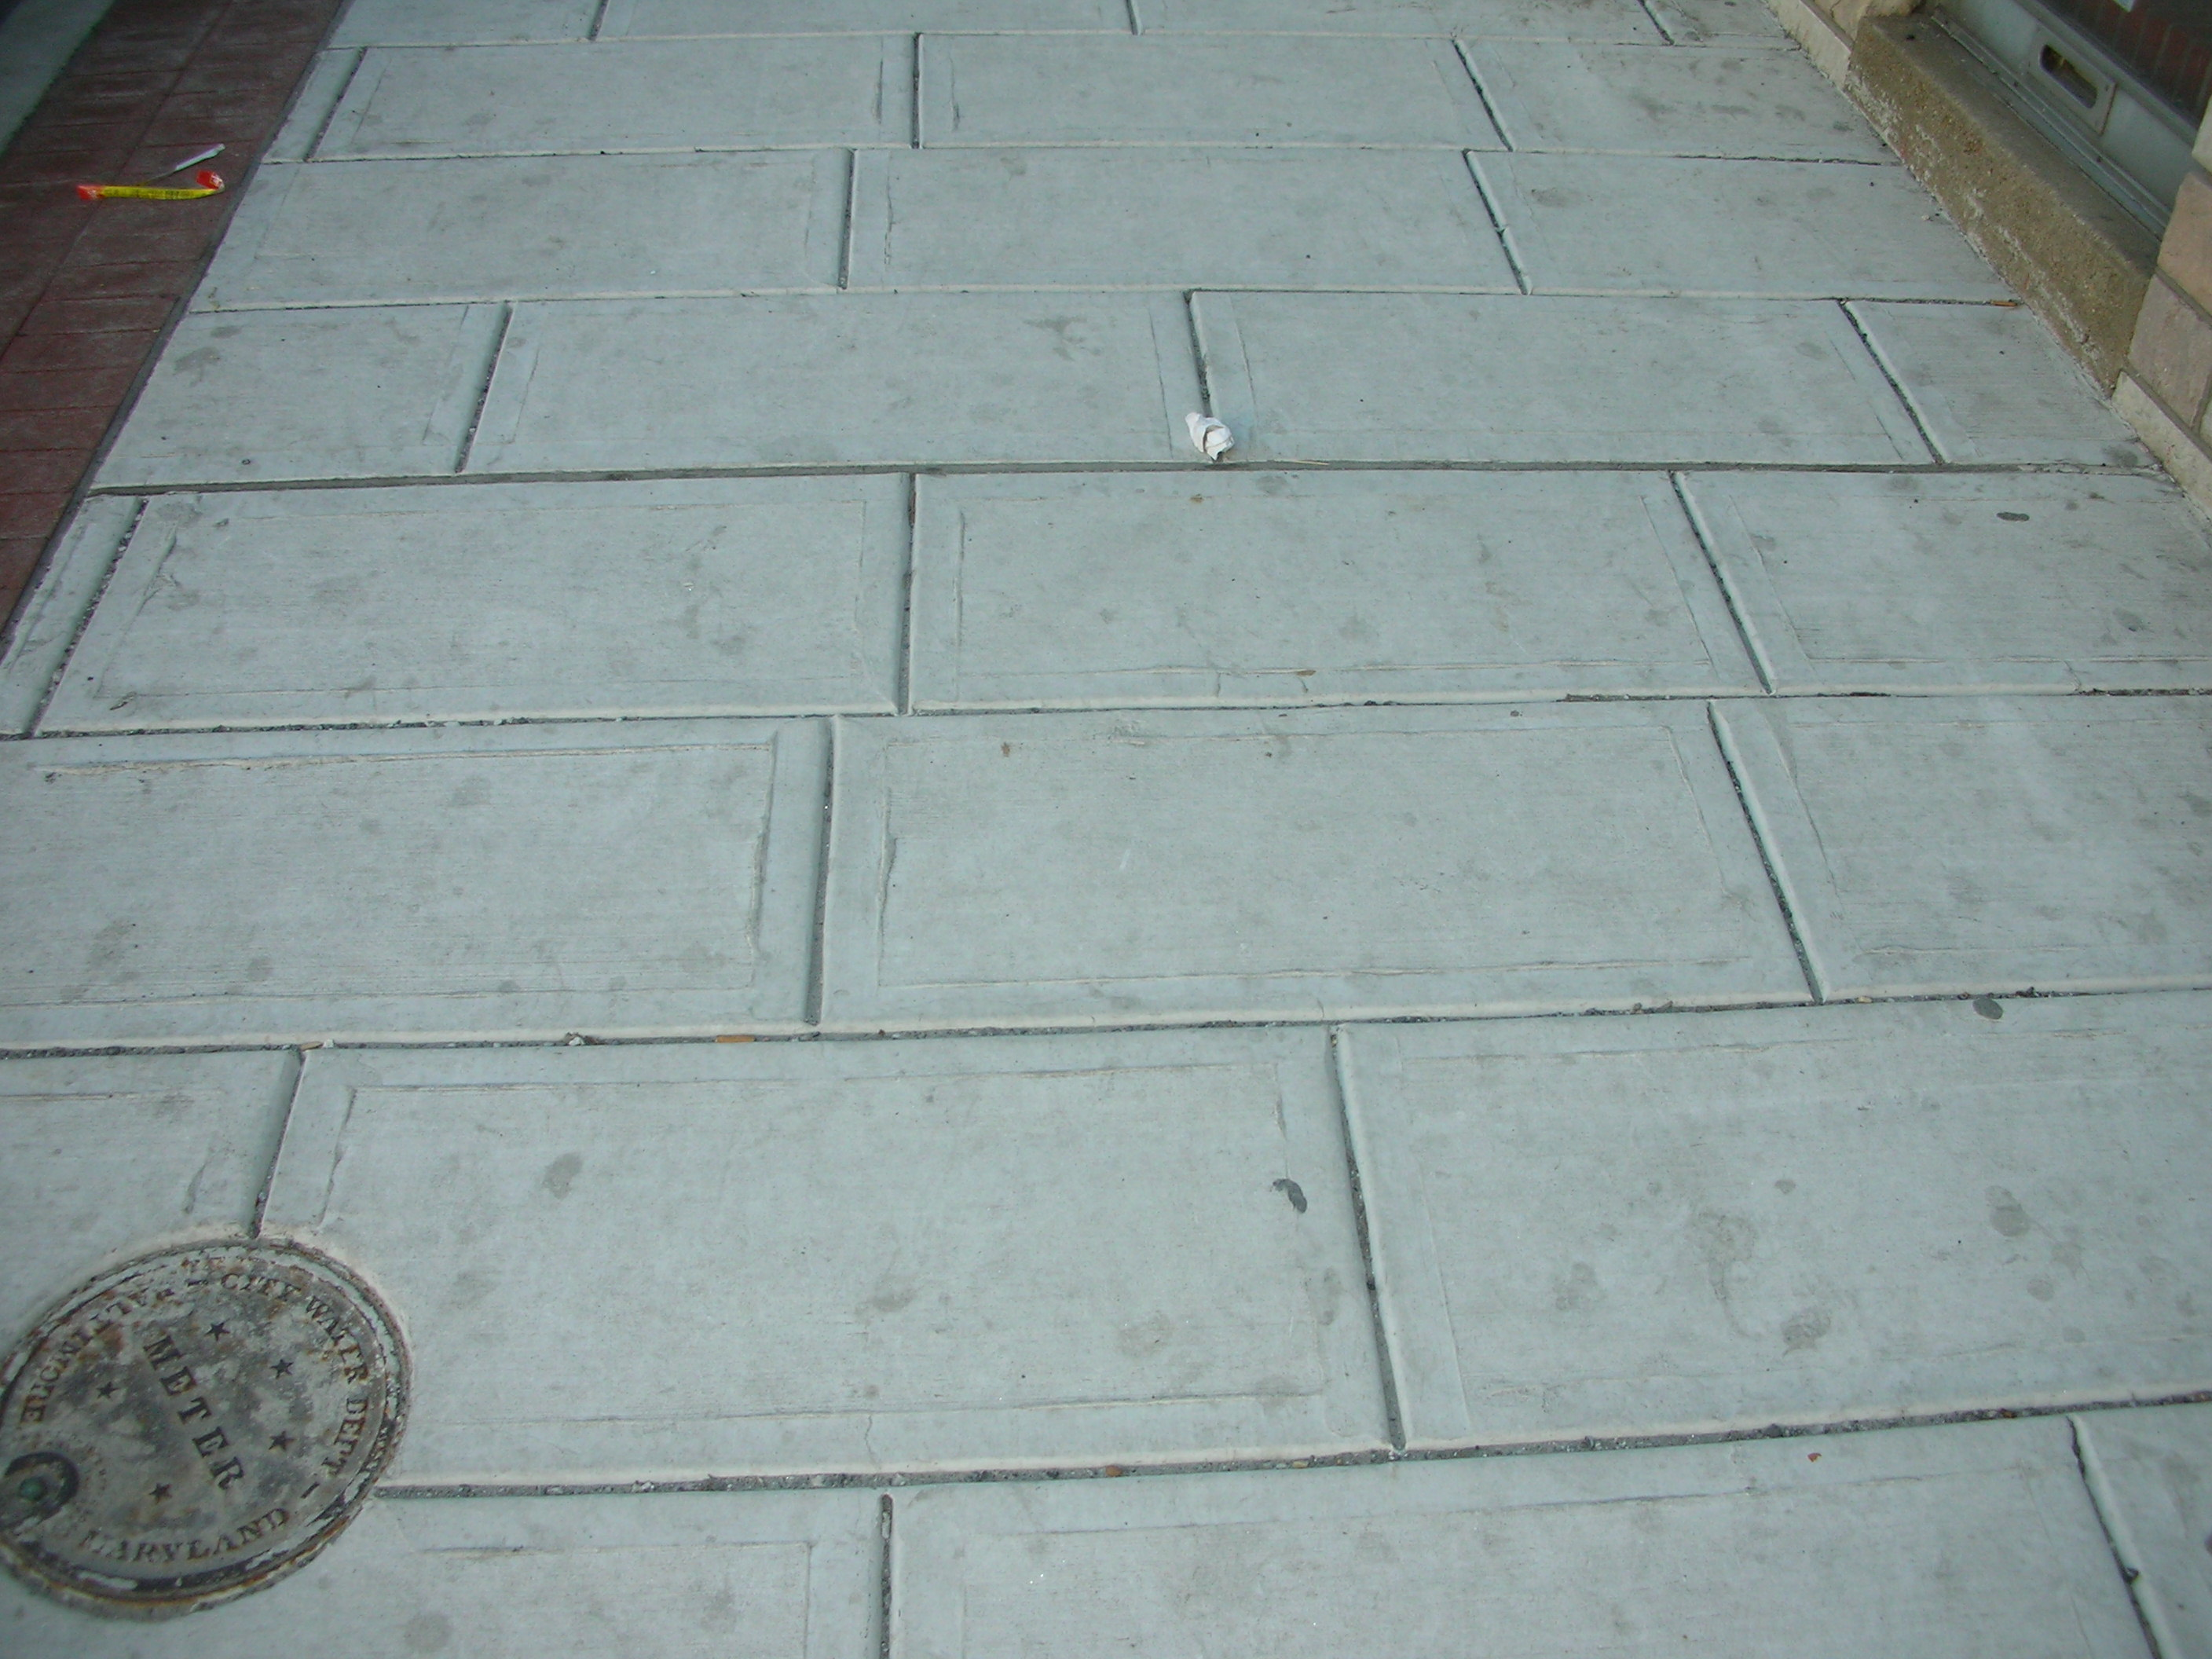

Slide 31
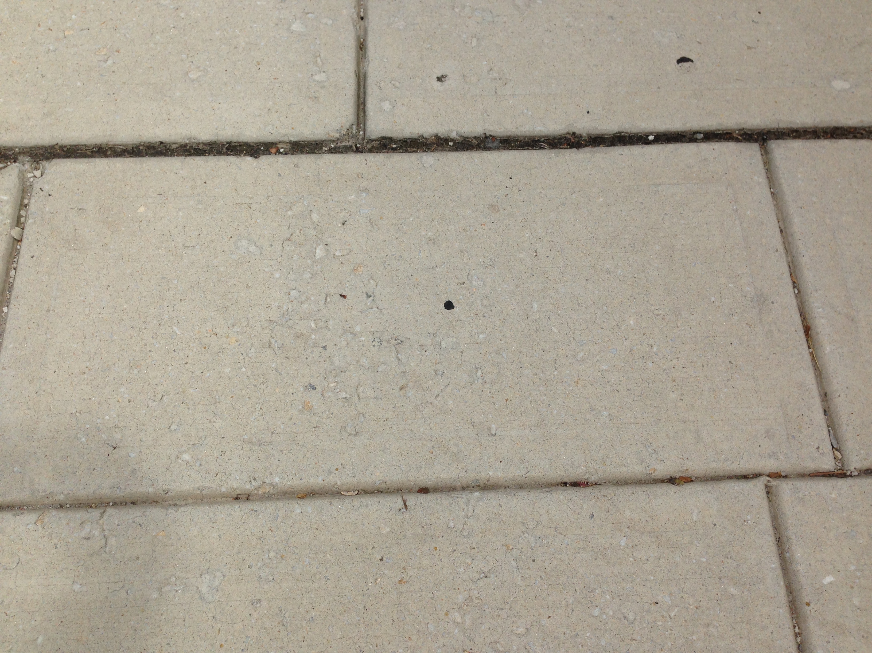

Slide 32
Does all this matter?

Slide 33
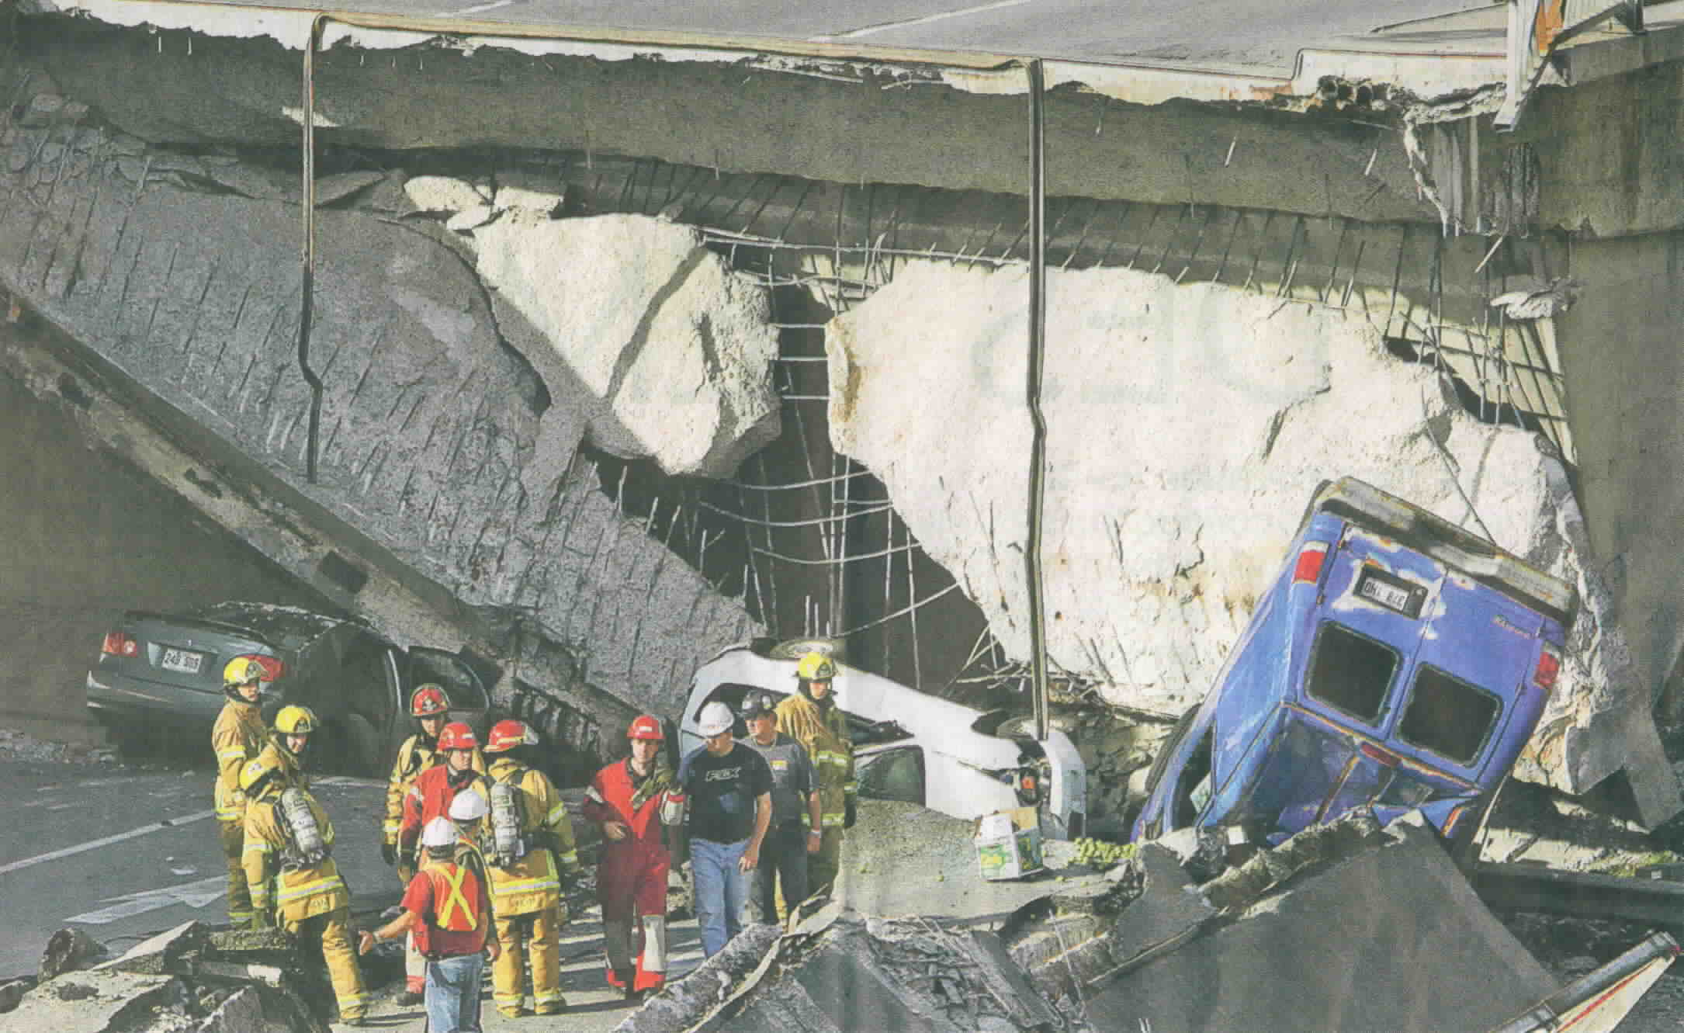
Concorde Overpass

Slide 34
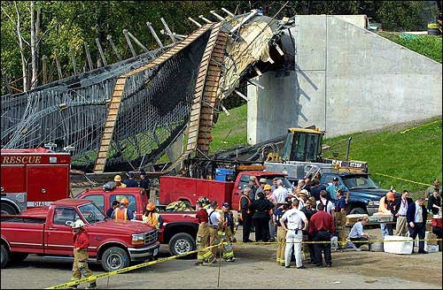
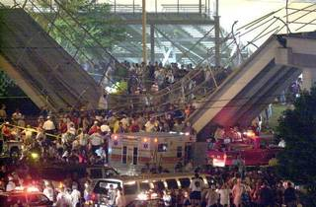
Lowes’ Motor Speedway Pedestrian Bridge
91 People Injured

Slide 35
What we need to work on
20 year old spec on HPC for Bridge Decks / is it being used / should it be updated
20 year old spec for HPC for pavements
Service life for pavements
Patching Mix
ASR / a regional spec
Mass Concrete / Partnering
Scaling / Finisher certification
Cracking
Maximum chlorides in structures

Slide 36

90 Minutes

Slide 37
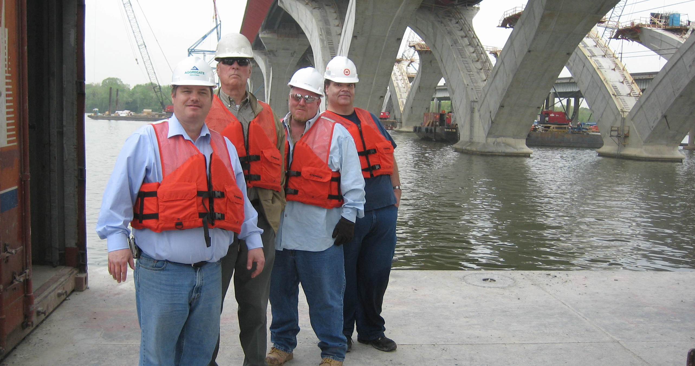

Slide 38
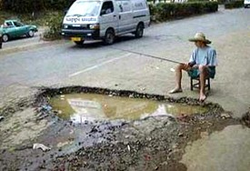
Notes:
So what can be done?
Take the day off - go fishing - think about it for awhile!
Or start designing and constructing structures that last!
This is the Confederation Bridge.
An 8-mile long bridge crossing portions of the North Atlantic Ocean to Prince Edward Island.
Under some of the harshest conditions, this bridge has a 100-year design life!!
Among design parameters, (7) different concrete mix designs were used – all of them required the incorporation of one or more Supplementary Cementitious Materials!
“Products can make the difference!!”

