Slide 1

It’s Competition!
16th Annual Concrete Conference for the Maryland Transportation Industry
Timonium, MD
March 15th, 2016
Leif G. Wathne, P.E.
American Concrete Pavement Association

Slide 2
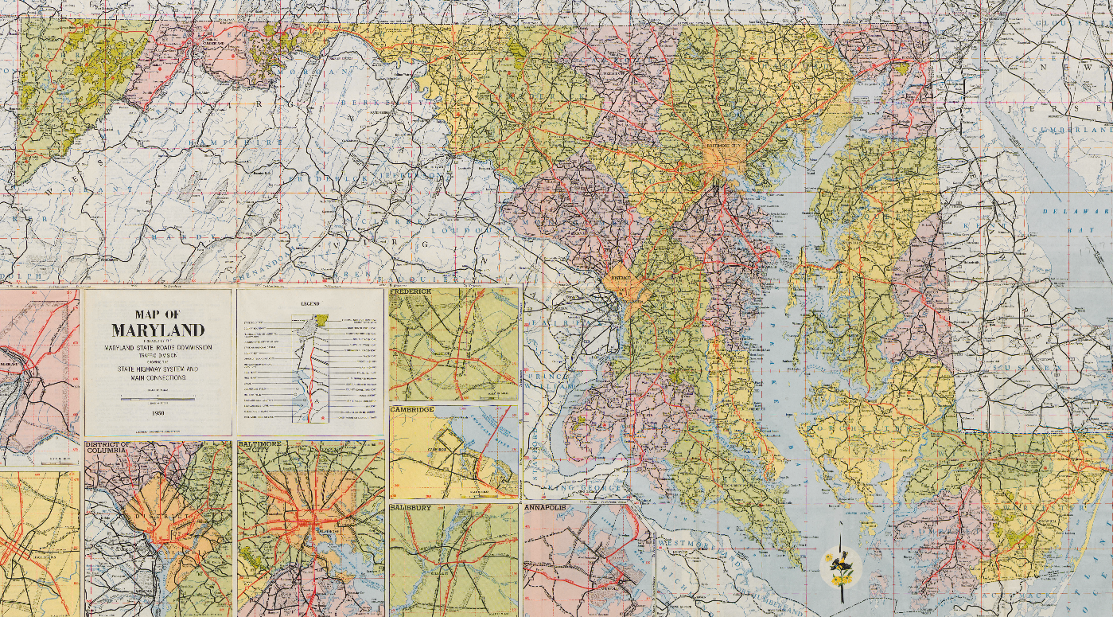
Maryland Road Test ONE-MD
Where, When, What, Why..?

Slide 4
Maryland - Transportation
Source: USDOT BTS
Miles of Public Road?
Vehicle Miles?
How far is 57B miles?

Slide 5
Maryland - Transportation
Source: USDOT BTS

Slide 6
Maryland - Transportation
Source: USDOT BTS

Slide 7
Stewardship and Asset Management:
The Role of Competition…
Probably the single-most overlooked aspect of getting the most from our pavement investment!
All about extending the purchasing power of the highway dollar
This provides VALUE to the agency/owner
Agencies benefit from presence of both pavement types!

Slide 8

Context
Over $90 billion spent on highways in U.S. every year – nearly a TRILLION dollars every decade
Agencies under enormous pressure to demonstrate good stewardship
  Magnitude of investment
  Growing needs
  Aging infrastructure
  MAP-21 perf. measures
  Additional revenues….?
However, this is nothing new…
Notes:
Even though some may claim this is unprecedented, it is nothing new…
This pressure can also be considered an opportunity…

Slide 9
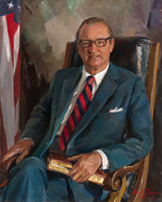
The Role of Competition
Early years of US Federal Aid Program
  Public instances of fraud, abuse, collusion…
  Congress and public lost confidence in administration of program (largest ever - $27B)
  Investigations (FBI, GAO, Blatnik)
  BPR → AASHO compelled to develop guidelines to restore confidence in program

Slide 10
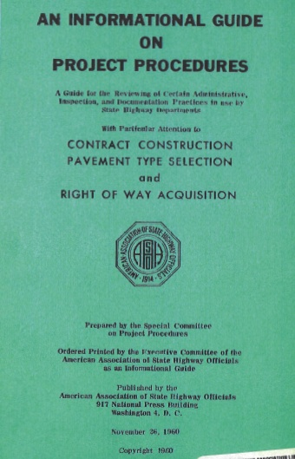
The Role of Competition
1960 AASHO Guide on Project Procedures
  Includes Pavement Type Selection…

Slide 11
1960 AASHO Guide
Covers a lot of information… aim “to assure the public of full value for their highway dollar.”
Established process based on transparency, and sound engineering while leveraging benefits of free market dynamic through healthy and spirited competition (includes host of factors)
Despite advancements in design and modeling, authors warn that PTS process only meaningful in presence of competition between industries.

Slide 12

1960 AASHO Guide
In section on cost comparisons (LCCA): doubt as to the validity [of such analysis] arises in the case where on[e] type of pavement has been given monopoly status by the long-term exclusion of a competitive type.
I.e., the cost-data is not meaningful…
“…desirable that monopoly situations be avoided…”
Often not recognized or considered appropriately by decision makers today

Slide 13
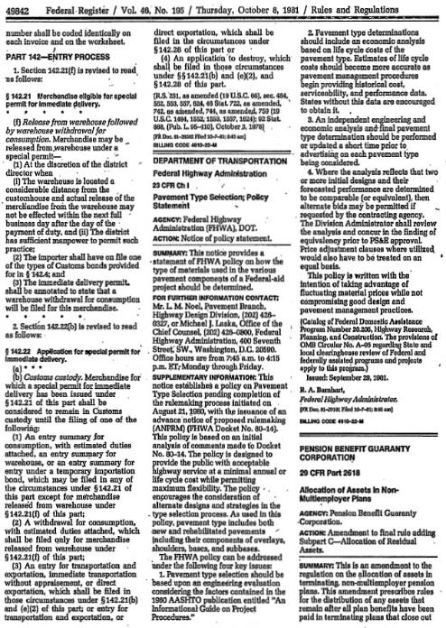
1960 AASHO Guide
Guidelines basis for:
FHWA policy,
AASHTO Design Guides
2011 NCHRP PTS guidance

Slide 14
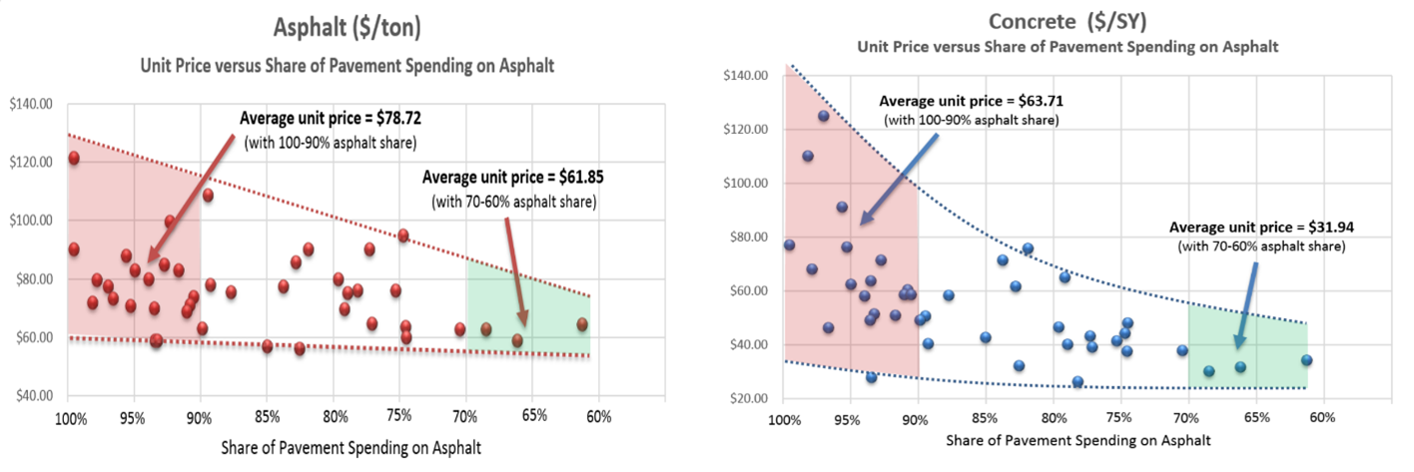
Competitive Paving Program
2013 weighted unit asphalt bid price vs. five-year average balance of DOT pavement type usage
Source: OMAN, Bid Tabs Software – Public Data.
ACPA analysis of current bid tabs confirm benefits
-------------> Increasing Competition ------------->
Notes:
Acknowledge Andy Gieraltowski – Graduate of Kellogg School of Business

Slide 15
Competitive Paving Program
Source: OMAN, Bid Tabs Software – Public Data.
ACPA analysis of current bid tabs confirm benefits
-------------> Increasing Competition ------------->
Notes:
Acknowledge Andy Gieraltowski – Graduate of Kellogg School of Business

Slide 16
The Role of Competiton
No US state spends more than 40% of paving dollar on concrete – on average
MAJORITY of US states spend less than 15% of paving dollars on concrete pavement – on average
Several US states spend no money on concrete pavement – all asphalt (no diversification – high exposure)
As competition increases between industries, unit costs drop for both, regardless of PTS process…
CONFIRMS what officials recognized 58 years ago
Notes:
Reagan National Airport – 80% of slots caused antitrust concerns…
Parallel with 401k
What can you do?
Promote and work on federal/state/local policies that create competition.
Promote solutions (concrete overlays!) to compete with asphalt solutions that agencies are spending their money on.

Slide 17
Competitive Paving Program?
0-10%
10-20%
20 + %
From 5-year rolling average balance of DOT pavement type, based on Oman Systems bid tabulations.

Slide 18
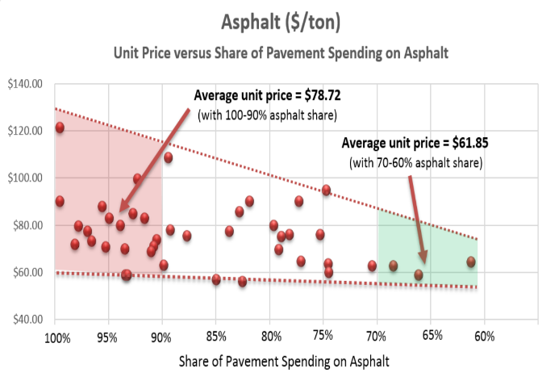
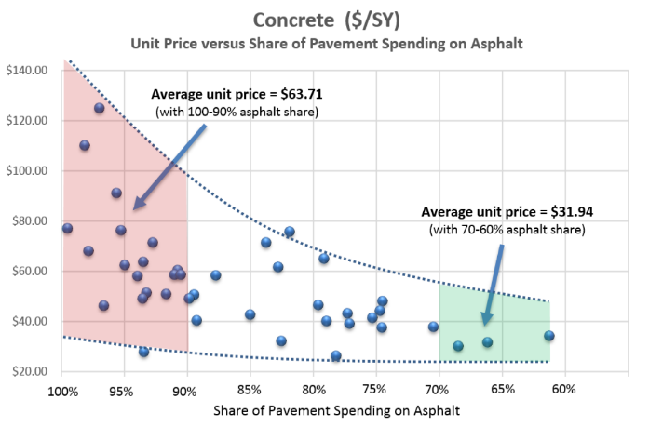
Competitive Paving Program
Same data viewed through a break-even analysis…
MORE PAVEMENT FOR SAME INVESTMENT!
Notes:
Somewhere around 17% increase in lane miles paved with SAME investment…

Slide 19
COMPETITION BETWEEN PAVEMENT INDUSTRIES ASSURES
THERE IS AN ADDITIONAL LEVEL OF COMPETITION
First Level
2nd Level
Contractor Competition
Limits competition at the supplier level, which can limits effectiveness
Paving
Project
Asphalt Contractors
Contractor 1
Contractor 2
Contractor 3
Contractor 4
etc
Asphalt Material
Suppliers
Paving
Project
Asphalt Contractors
Contractor 1
Contractor 2
Contractor 3
Contractor 4
etc
Asphalt Material
Suppliers
Industry Competition
Assures Competition happens between contractors and suppliers
Concrete Contractors
Contractor 1
Contractor 2
Contractor 3
etc
Concrete/Cement
Material Suppliers
Multiple contractors does not assure competition takes place at all levels of the supply chain

Slide 20
COMPETITION HAS BEEN SHOWN TO LOWER COSTS
29 states have used Alternate Design Alternate Bid at least once
Short Term
 | AD/AB Results
Indiana ¹ | Used on 64 projects On 26 projects evaluated between 2009 and 2011, AD/AB saved the state $13M in initial costs and an estimated $93.4M in Life Cycle Costs
Kentucky ² | Used on 44 projects, with a documented savings of $148M 32 of the 44 projects had both asphalt and concrete bidders, with two being awarded to concrete - highlighting the savings potential of increased competition
Louisiana ³ | Used AD/AB on 47 projects between 2001 and 2009 Cost savings of $120M on these 47 projects
Missouri ⁴ | Used on 124 projects through July 2009 ADAB yielded a 10% decrease in unit costs for both asphalt and concrete.
Ohio ⁵ | Used on more than 10 projects A industry study of five projects in let 2009 documented a savings of $58M
West Virginia ⁶ | WV has used AD/AB on 13 projects The state has documented a savings of $16.4M on their six most recent projects
Michigan ⁷ | On Michigan’s 1st ADAB project, the low bid was ~ $2M less than the estimate after considering costs incurred in implementing the APB process
Ontario ⁸ | Used on 6 projects between 2000-2006. Total savings were $28.5M when comparing the lowest concrete vs. the lowest asphalt bids
Alternate Bidding History and Requirements. Thomas L. Duncan, PE (FHWA) and David B. Holtz, PE (INDOT). March 2013
KYTC Alternate Bid Pavement Projects 2006-2012. Paul Looney, PE, KYTC Division of Highway Design Pavement Branch, March 2013
Alternate Design Alternate Bid - ADAB - Using Life Cycle Analysis. Bill Temple, Former Chief Engineer, LA DOTD, March 2010
MODOT Alternate Paving Approach. Dave Ahlvers, 2009 AASHTO Subcommittee on Construction, July 2009
New ODOT Policy on Alternate Bids. Roger Faulkner, PE. Director of Engineering & Promotion, Ohio Concrete. December 2010
Alternate Design Alternate Bid of Pavements in West Virginia. Joe H. Hall, PE, PS - WVDOT/DOH. December 2010
Michigan Department of Transportation (2001). “Final Report on the Alternate Bidding of Pavements on the M-6 Southbelt Project.”
Review of Alternate Bid Tenders for Canadian Highway Construction Projects with Life Cycle Cost Component, Tim Smith, P.Eng. & Rico Fung, P.Eng., Cement Association of Canada, Toronto, 2006 Annual Conference of the Transportation Association of Canada, Charlottetown, Prince Edward Island
Notes:
Sources ¹ Alternate Bidding History and Requirements. Thomas L. Duncan, PE (FHWA) and David B. Holtz, PE (INDOT). March 2013 ² KYTC Alternate Bid Pavement Projects 2006-2012. Paul Looney, PE, KYTC Division of Highway Design Pavement Branch ³ Alternate Design Alternate Bid - ADAB - Using Life Cycle Analysis. ?????. March 2010 ⁴ MODOT Alternate Paving Approach. Dave Ahlvers, 2009 AASHTO Subcommittee on Construction, July 2009 ⁵ New ODOT Policy on Alternate Bids. Roger Faulkner, PE. Director of Engineering & Promotion, Ohio Concrete. December 2010 ⁶ Alternate Design Alternate Bid of Pavements in West Virginia. Joe H. Hall, PE, PS - WVDOT/DOH. December 2010

Slide 21
LOWERING INITIAL COSTS HAS AN IMMEDIATE IMPACT
ON LOWERING THE LIFE CYCLE COSTS OF A PAVEMENT
Initial costs Accounts for ~75-95% of LCC for Concrete & ~55-75% for Asphalt
Short Term
 |  | No Competition |  |  | With Competition & 10% reduction in Paving Unit Costs
Activity | Year | NPV (Real DR=1.4%) |  |  | NPV (Real DR=1.4%)
 |  | Asphalt | Concrete |  | Asphalt | Concrete
Initial Costs | Yr 0 | $ 7,697,839 | $ 9,265,380 |  | $ 7,042,523 (save = $655k) | $ 8,448,893 (save = $816k)
Rehab 1 | Yr 14 | $ 678,262 |  |  | $ 678,262
 | Yr 22 |  | $ 592,295 |  |  | $ 592,295
Rehab 2 | Yr 24 | $ 1,815,994 |  |  | $ 1,815,994
 | Yr 32 |  | $ 1,691,829 |  |  | $ 1,691,829
Rehab 3 | Yr 34 | $ 513,616 |  |  | $ 513,616
Total Rehab NPV |  | $ 3,007,871 | $ 2,284,124 |  | $ 3,007,871 | $ 2,284,124
Total LCCA NPV |  | $ 10,75,710 | $ 11,549,504 |  | $ 10,050,394 | $ 10,733,017
 |  | ∆ = 7.9% |  |  | ∆ = 6.8%
% Reduction in LCC |  |  |  |  | 6.1% | 7.1%
For the same reduction in Life Cycle Costs, 1st Rehabiltation for Asphalt needs
to occur in Year 32 and 1st Rehabiltation for Concrete needs to occur in Year 54
Notes:
Initial LCCA Delta (AC-PCC)/AC is 7.8%. Saving from competitition is almost equal to the LCCA difference between the option

Slide 22

The Role of Competition
A competitive two-pavement system:
  Lowers prices
  Spurs innovation
  Improves quality
Allows agencies to build more pavements for same investment! Manage assets more cost efficiently…
At least half of US states can benefit significantly from instilling and enhancing competition – Maryland is likely one…
Notes:
Estimated around 17% increase in lane miles paved with SAME investment…

Slide 23
The Role of Competition
Competition represents a significant opportunity for agencies looking to extend the purchasing power of the highway dollar
Competition can be a solution for an agency
  Improve cost efficiency of program
  Improve quality
  Increase confidence in administration of program
  Support increasing revenues…
Its about enhanced stewardship… and getting more for the pavement investment.
Notes:
Plenty of people talking about problems out there… this is an opportunity to talk about a solution!

Slide 24
Competitive Paving Program
“It is imperative that all possible and proper measures be taken to ensure the tax payers of this country that they are receiving full value of every highway dollar spent “
AASHO 1960
In other words: Good Stewardship!

Slide 25

Established Alliance for Pavement Competition
Currently working with NRMCA and PCA (and others…)
  Website launched competitionpaves.org
  Extending the Purchasing Power of the Highway Dollar using Competition Between Industries is central theme
  Rollout at AASHTO 100th meeting
  Engaged MIT CSH
  NACE, APWA, media… others?
Exciting effort - Stay tuned!

Slide 26

Thank You!
www.acpa.org
apps.acpa.org | ACPA Application Library
local.acpa.org | ACPA-affiliated Chapter/States
resources.acpa.org | Resource Center
wikipave.org | ACPA’s paving wiki
Thank you to MIT and FHWA

