Slide 1


Slide 2
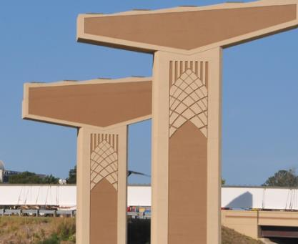
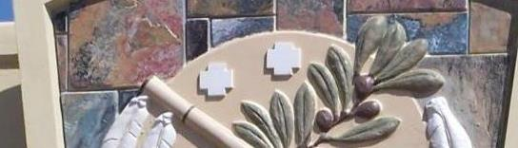
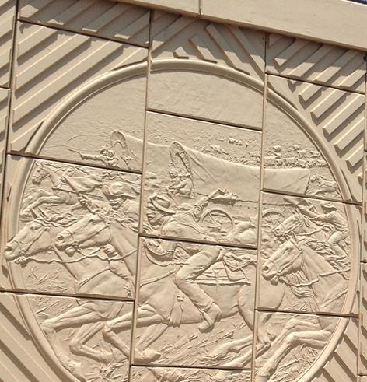
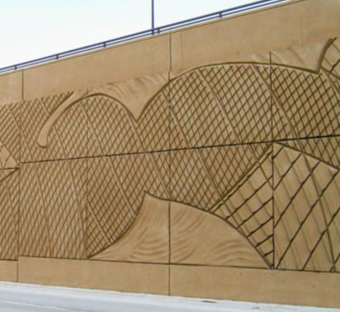
ARCHITECTURAL FINISHES
Steven Weitzman,
Creative Design Resolutions, Inc.

Slide 3

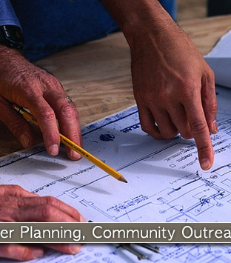
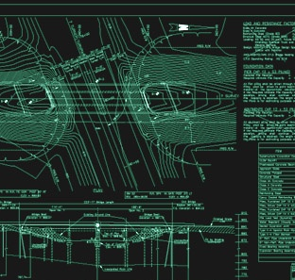
• Established in 1998
• Specializes in context sensitive solutions
• Proven shovel-ready experience
• Dedicated to community outreach
• Develops master plans, specifications,
estimates, 3D computer models and
AutoCAD plan sheets
• Consults during the design/development,
engineering, and construction phases
• Works directly with Creative Form Liners, Inc. for aesthetic treatment implementation

Slide 4
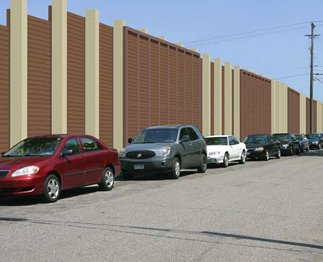
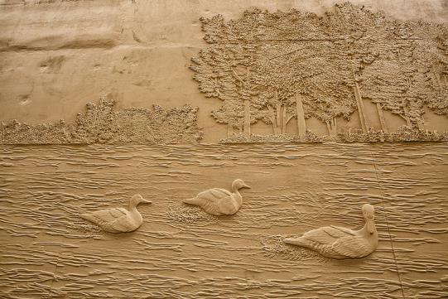
Why Incorporate Aesthetics?
Credit: City of Dublin, Ohio

Slide 5
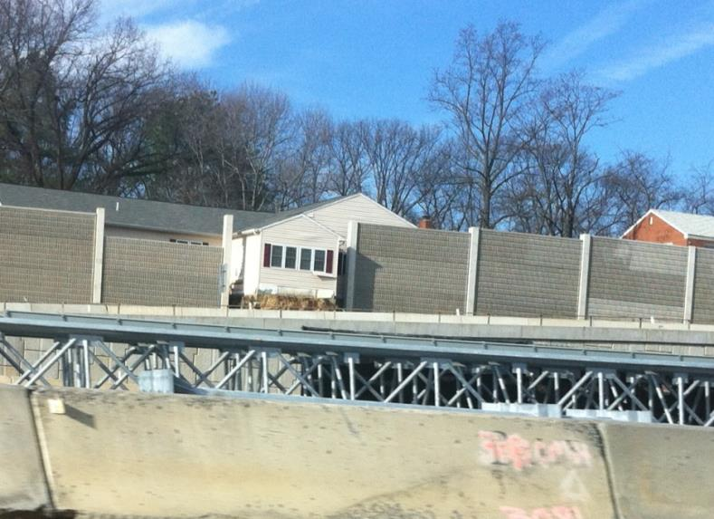
Credit: city-data.com

Slide 6
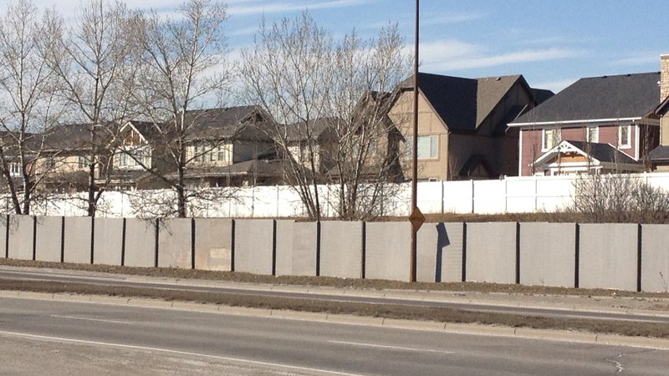
Credit: Change.org

Slide 7
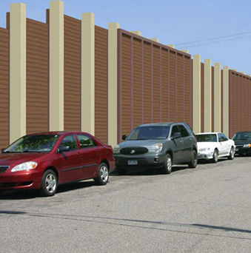
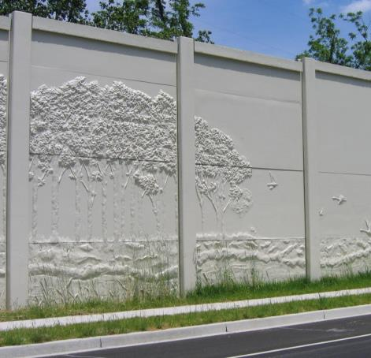
Why create a wall when you can create a window?

Slide 8
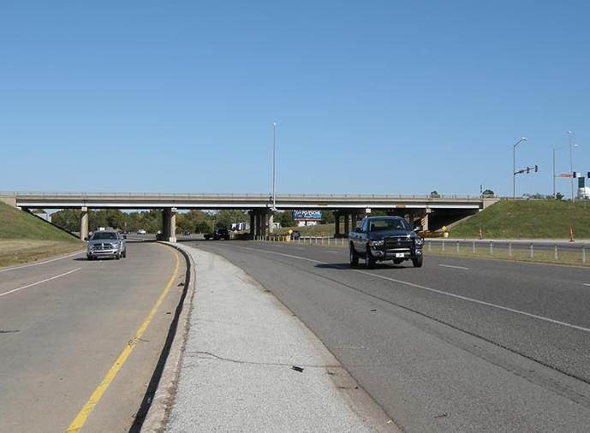
Why just a Functional Bridge?

Slide 9
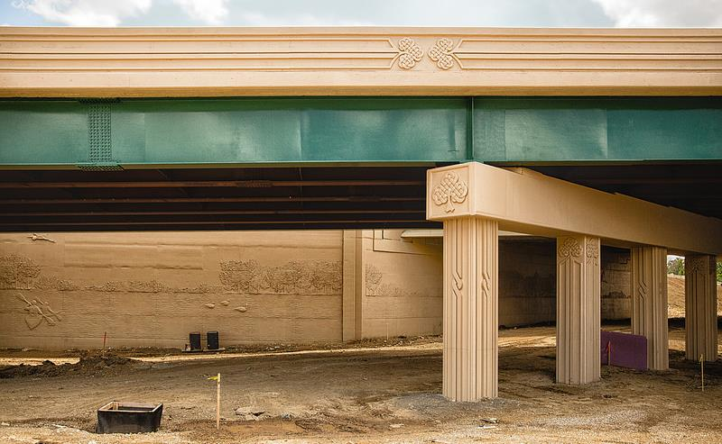
When you can tell a story?
Credit: City of Dublin, Ohio

Slide 10
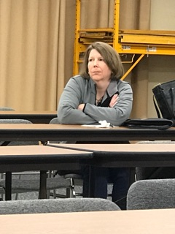
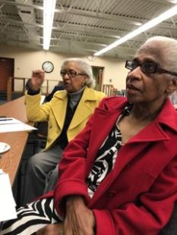
How to get buy-in from your constituents.

Slide 11
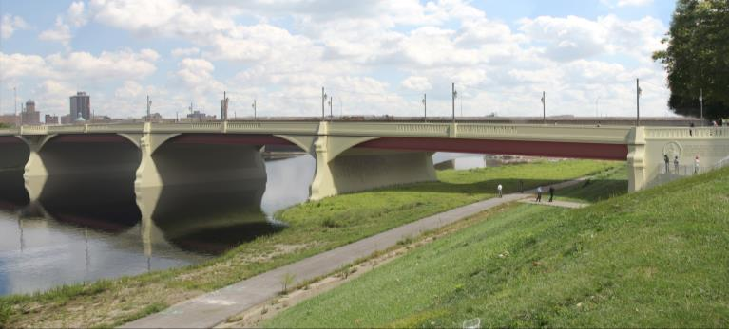
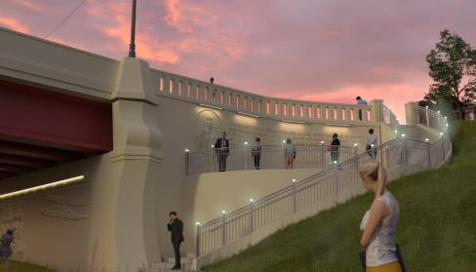
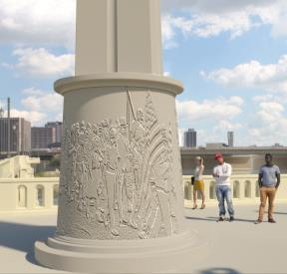
© Creative Design Resolutions, Inc. 2017, all rights reserved
Third Street Bridge – Dayton, Ohio
ODOT, Montgomery County Engineers Office, City of Dayton

Slide 12
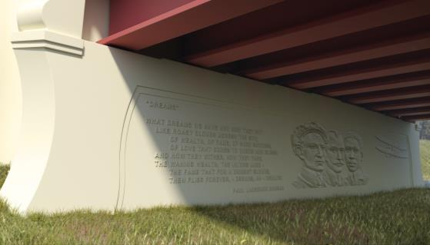
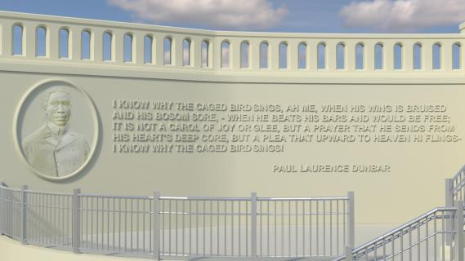
© Creative Design Resolutions, Inc. 2017, all rights reserved
Paul Laurence Dunbar bas-relief, Third Street Bridge – Dayton, Ohio
ODOT, Montgomery County Engineers Office, City of Dayton

Slide 13
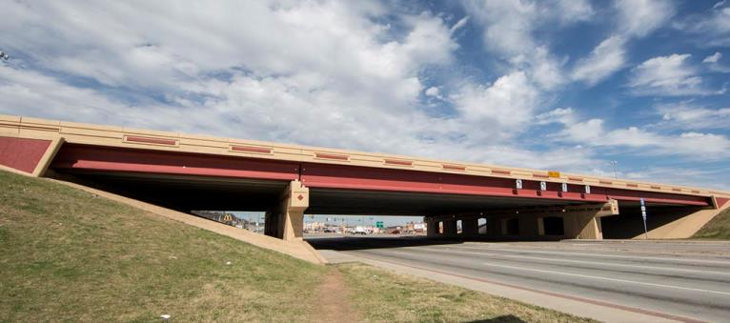
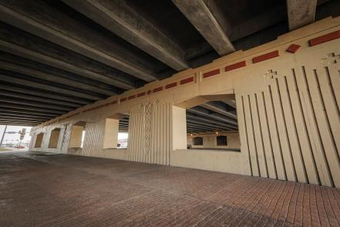
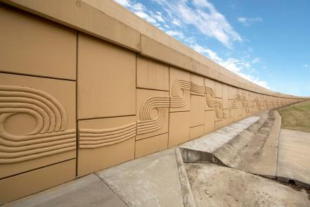
© Creative Design Resolutions, Inc. 2017, all rights reserved; Photos by Leonardo Manzo
193rd East Avenue/I-44 – 2009, Tulsa, Oklahoma
ODOT, Cherokee Nation, City of Tulsa, City of Catoosa, Benham Co, Art in Public Places Division

Slide 14
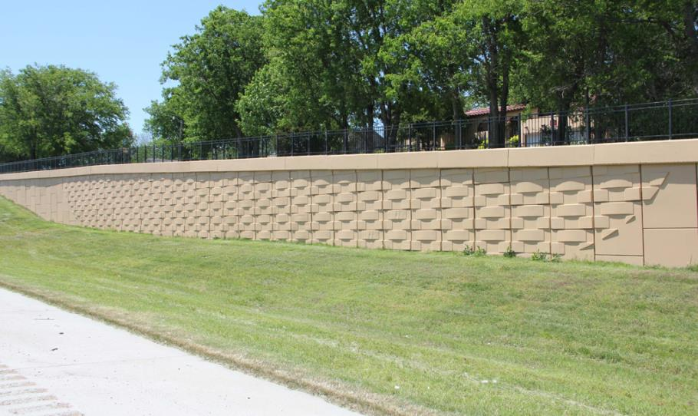
© Creative Design Resolutions, Inc. 2017, all rights reserved; Photos by Leonardo Manzo
193rd East Avenue/I-44 – 2009, Tulsa, Oklahoma
ODOT, Cherokee Nation, City of Tulsa, City of Catoosa, Benham Co, Art in Public Places Division

Slide 15
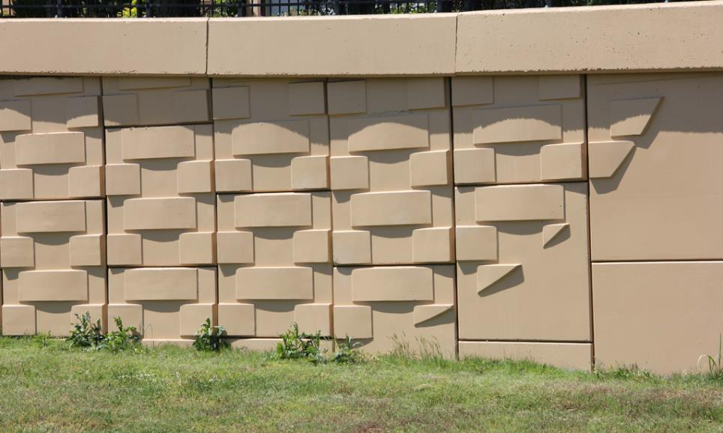
© Creative Design Resolutions, Inc. 2016, all rights reserved
193rd East Avenue/I-44 – 2009, Tulsa, Oklahoma
ODOT, Cherokee Nation, City of Tulsa, City of Catoosa, Benham Co, Art in Public Places Division

Slide 16
Who benefits from aesthetic integration?

Slide 17
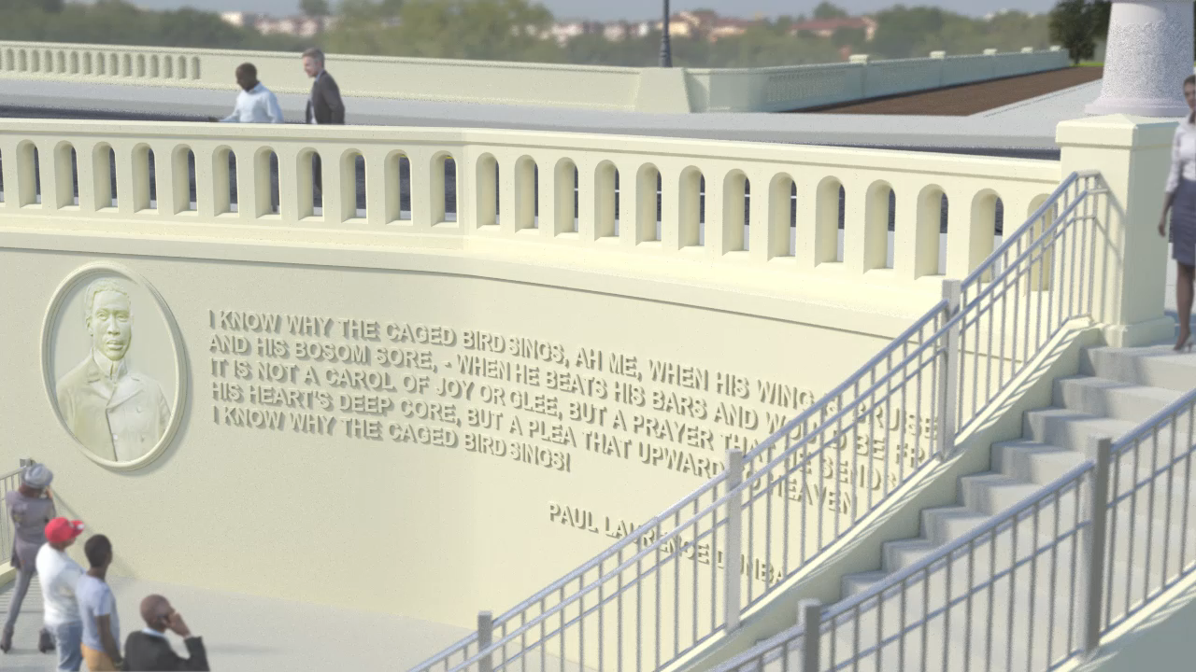
© Creative Design Resolutions, Inc. 2017, all rights reserved

Slide 18
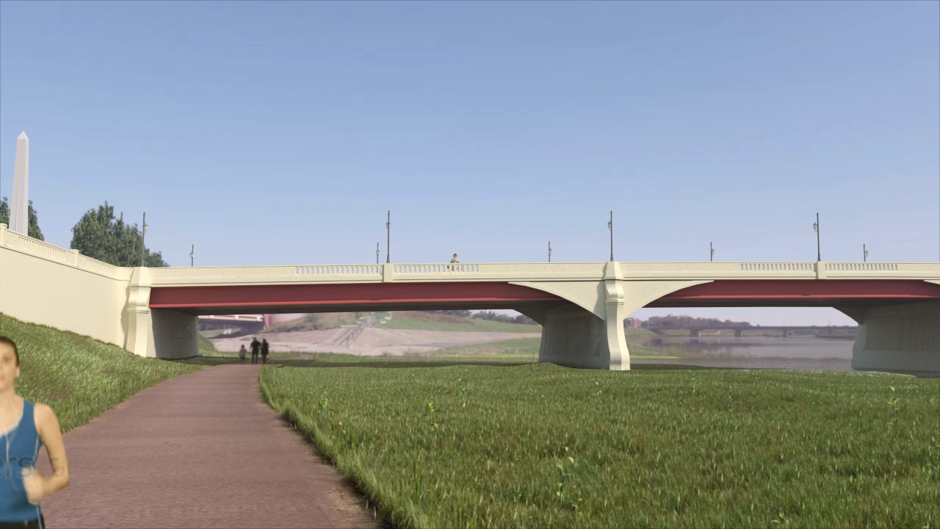
© Creative Design Resolutions, Inc. 2017, all rights reserved

Slide 19
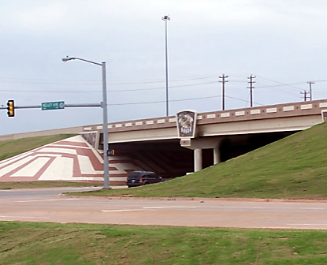
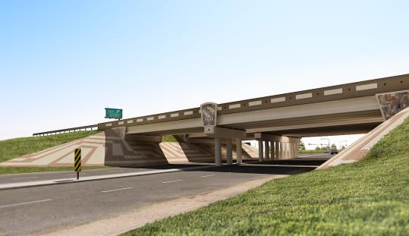
how to ensure that the build out will be equal to the approved final design?

Slide 20
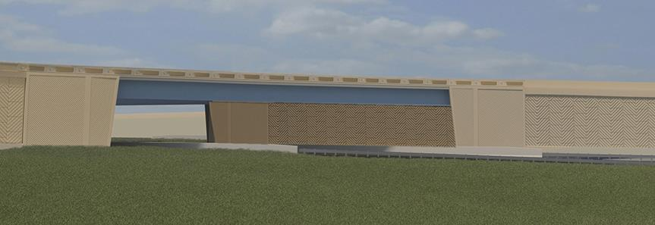
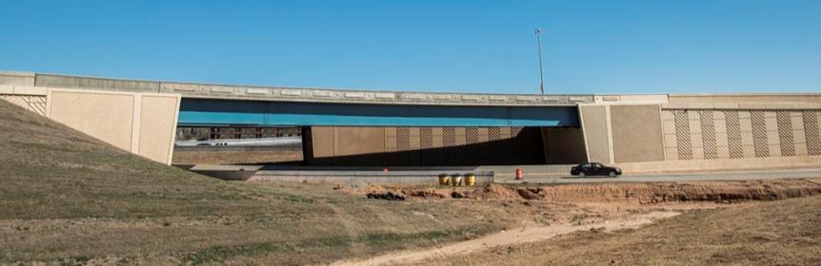
© Creative Design Resolutions, Inc. 2017, all rights reserved
Ramp 2, I-35 Corridor – 2015, Norman, Oklahoma
ODOT, City of Norman, Art in Public Places

Slide 21
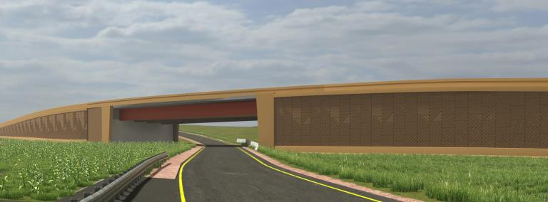
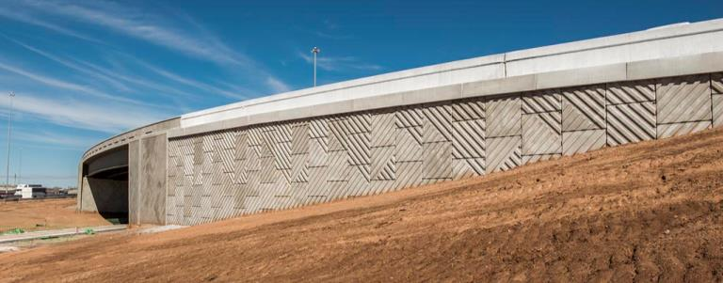
© Creative Design Resolutions, Inc. 2017, all rights reserved
Ramp 3, I-35 Corridor – 2015, Norman, Oklahoma
ODOT, City of Norman, Art in Public Places

Slide 22
What factors to keep in mind when considering aesthetic integration.

Slide 23
Context Sensitive Solutions
Context sensitive solutions (CSS) is a collaborative, interdisciplinary approach that involves all stakeholders in providing a transportation facility that fits its setting. It is an approach that leads to preserving and enhancing scenic, aesthetic, historic, community, and environmental resources, while improving or maintaining safety, mobility, and infrastructure conditions.
- Results of Joint AASHTO/FHWA Context Sensitive Solutions Strategic Planning Process, Summary Report, March 2007

Slide 24
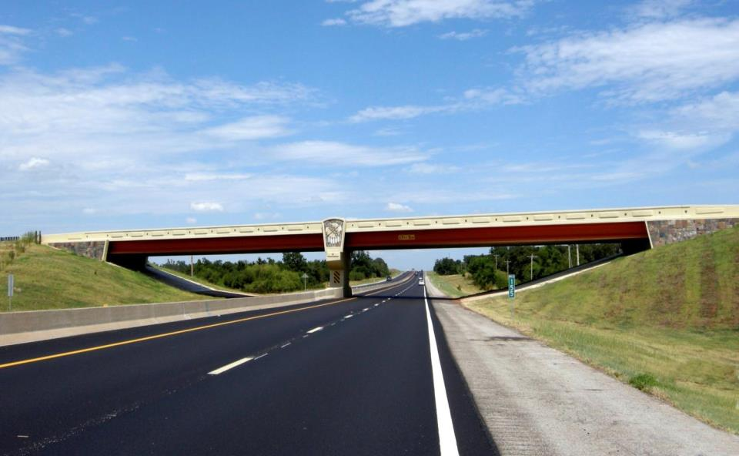
Reflect Your Community Aesthetic and Vision
© Creative Design Resolutions, Inc. 2016, all rights reserved
Heritage Bridge – 2007, Oklahoma City, Oklahoma OTA, ODOT,
Oklahoma Art in Public Places Division

Slide 25
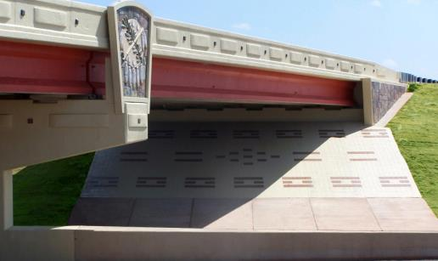
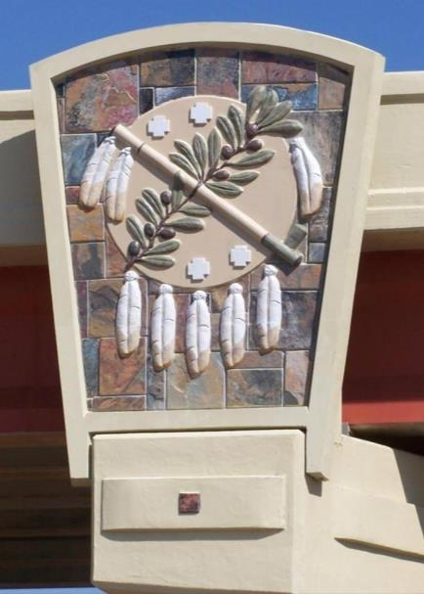
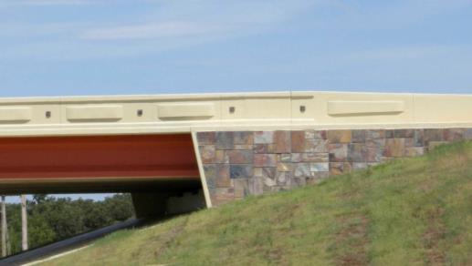
© Creative Design Resolutions, Inc. 2017, all rights reserved
Heritage Bridge – 2007, Oklahoma City, Oklahoma OTA, ODOT, Oklahoma Art in Public Places Division

Slide 26
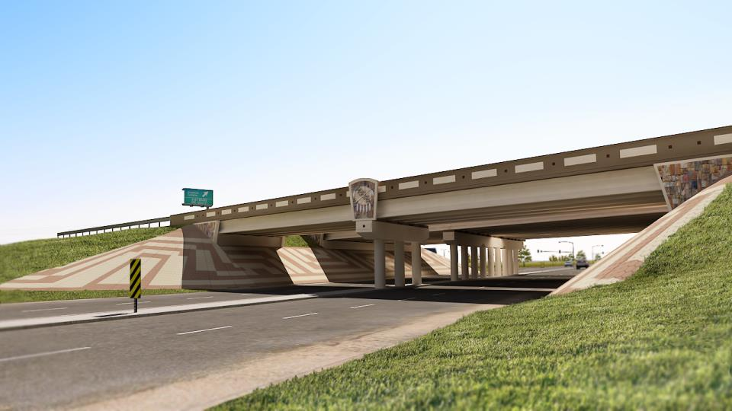
© Creative Design Resolutions, Inc. 2017, all rights reserved
Broadway Extension over Memorial Road – 2008, Edmond, Oklahoma
ODOT, Oklahoma Art in Public Places Division, Benham Companies

Slide 27
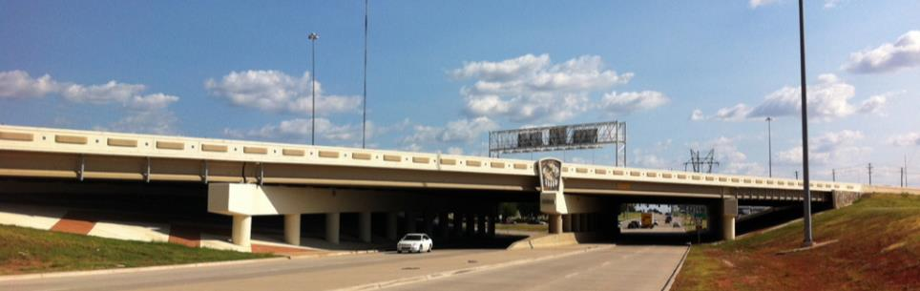
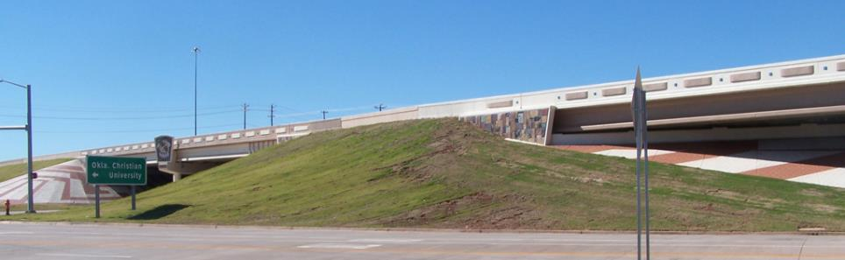
© Creative Design Resolutions, Inc. 2017, all rights reserved
Broadway Extension over Memorial Road – 2008, Edmond, Oklahoma
ODOT, Oklahoma Art in Public Places Division, Benham Companies

Slide 28
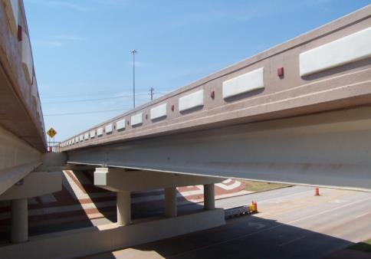
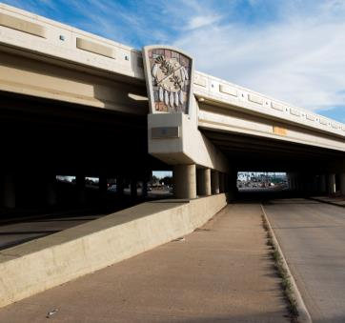
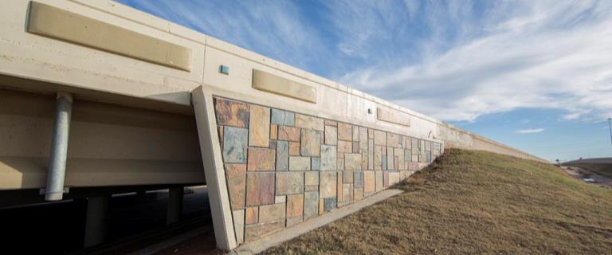
© Creative Design Resolutions, Inc. 2017, all rights reserved
Broadway Extension over Memorial Road – 2008, Edmond, Oklahoma
ODOT, Oklahoma Art in Public Places Division, Benham Companies

Slide 29
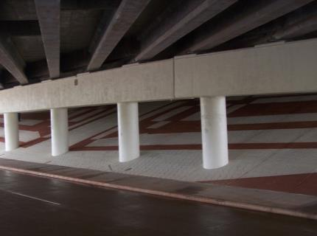
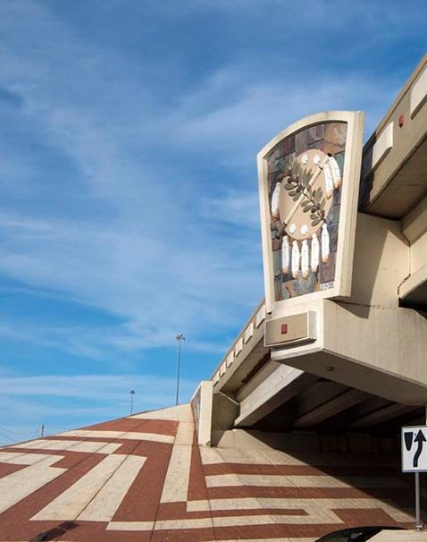
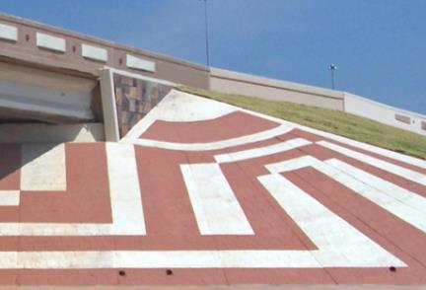
© Creative Design Resolutions, Inc. 2017, all rights reserved; Photo Credit: Leonardo Manzo
Broadway Extension over Memorial Road – 2008, Edmond, Oklahoma
ODOT, Oklahoma Art in Public Places Division, Benham Companies

Slide 30
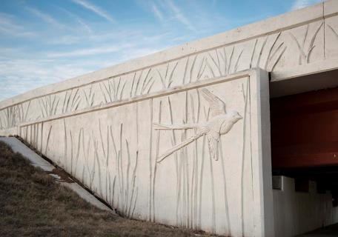
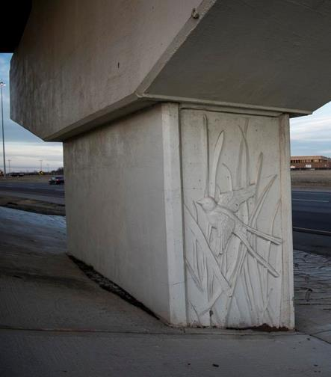
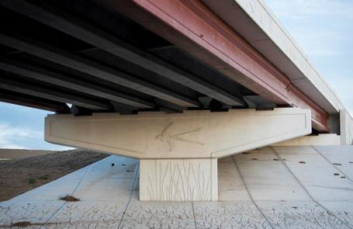
© Creative Design Resolutions, Inc. 2017, all rights reserved; Photo Credit: Leonardo Manzo
I-35 Corridor, Highway 77 Interchange – 2009, Norman, Oklahoma
ODOT, Oklahoma Art in Public Places Division, Cobb Engineering, City of Norman

Slide 31


© Creative Design Resolutions, Inc. 2016, all rights reserved
I-40 at Garth Brooks Boulevard Bridge– 2014, Canadian County
ODOT, Art in Public Places

Slide 32



© Creative Design Resolutions, Inc. 2017, all rights reserved
I-35, Winstar Boulevard Bridge – 2014, Thackerville, Oklahoma
ODOT, CP&Y, Inc, The Chickasaw Nation

Slide 33

© Creative Design Resolutions, Inc. 2017, all rights reserved; Photo Credit: Leonardo Manzo
I-35 Corridor, Rock Creek Rd. Bridge – 2009, Norman, Oklahoma
ODOT, Oklahoma Art in Public Places Division, Cobb Engineering, City of Norman

Slide 34



© Creative Design Resolutions, Inc. 2017, all rights reserved; Photos by David Cobb
I-35 Corridor, Rock Creek Rd. Bridge – 2009, Norman, Oklahoma
ODOT, Oklahoma Art in Public Places Division, Cobb Engineering, City of Norman

Slide 35

Oklahoma Department of Transportation

Slide 36


I-35 Corridor, SH-9W – 2009, Norman, Oklahoma
ODOT, Oklahoma Art in Public Places Division, City of Norman
© Creative Design Resolutions, Inc. 2017, all rights reserved; Photo by Leonardo Manzo

Slide 37

© Creative Design Resolutions, Inc. 2017, all rights reserved; Photo by Leonardo Manzo
I-35 Corridor, SH-9W – 2009, Norman, Oklahoma
ODOT, Oklahoma Art in Public Places Division, City of Norman

Slide 38


© Creative Design Resolutions, Inc. 2017, all rights reserved; Photo by Leonardo Manzo
I-35 Corridor, SH-9E Bridge – 2013, Norman, Oklahoma
ODOT, Oklahoma Art in Public Places Division, SAIC Energy, Environment & Infrastructure, City of Norman

Slide 39


© Creative Design Resolutions, Inc. 2016, all rights reserved
I-35 Corridor, Lindsey Bridge – 2014, Norman, Oklahoma
ODOT, Oklahoma Art in Public Places Division, University of Oklahoma, Poe & Associates, City of Norman

Slide 40


© Creative Design Resolutions, Inc. 2016, all rights reserved
I-35 Corridor, Lindsey Bridge – 2014, Norman, Oklahoma
ODOT, Oklahoma Art in Public Places Division, University of Oklahoma, Poe & Associates, City of Norman

Slide 41



© Creative Design Resolutions, Inc. 2017, all rights reserved
I-35 Corridor, Lindsey Bridge – 2014, Norman, Oklahoma
ODOT, Oklahoma Art in Public Places Division, University of Oklahoma, Poe & Associates, City of Norman

Slide 42

© Creative Design Resolutions, Inc. 2016, all rights reserved
I-35 Corridor, Lindsey Bridge – 2014, Norman, Oklahoma
ODOT, Oklahoma Art in Public Places Division, University of Oklahoma, Poe & Associates, City of Norman

Slide 43


© Creative Design Resolutions, Inc. 2017, all rights reserved; Photo by Leonardo Manzo
I-35 Corridor, Main Street Bridge – 2013, Norman, Oklahoma
ODOT, Oklahoma Art in Public Places Division, City of Norman

Slide 44


© Creative Design Resolutions, Inc. 2017, all rights reserved; Photo by Leonardo Manzo
I-35 Corridor, Main Street Bridge – 2013, Norman, Oklahoma
ODOT, Oklahoma Art in Public Places Division, City of Norman

Slide 45


Photo by Leonardo Manzo
© Creative Design Resolutions, Inc. 2017, all rights reserved
I-35 Corridor, Main Street Bridge – 2013, Norman, Oklahoma
ODOT, Oklahoma Art in Public Places Division, City of Norman

Slide 46


© Creative Design Resolutions, Inc. 2017, all rights reserved; Photo by Leonardo Manzo
I-35 Corridor, Three Single Span Bridges & Ramp Walls – 2014, Norman, Oklahoma
ODOT, Oklahoma Art in Public Places Division, University of Oklahoma, Poe & Associates, City of Norman

Slide 47


© Creative Design Resolutions, Inc. 2017, all rights reserved; Photos by Leonardo Manzo
I-35 Corridor, Three Single Span Bridges & Ramp Walls – 2014, Norman, Oklahoma
ODOT, Oklahoma Art in Public Places Division, University of Oklahoma, Poe & Associates, City of Norman

Slide 48



© Creative Design Resolutions, Inc. 2017, all rights reserved
Delta Bridge at I-5 French Camp Road - 2014, Stockton, California
City of Stockton, Caltrans, HDR

Slide 49



© Creative Design Resolutions, Inc. 2017, all rights reserved;
Photos by Pima County Department of Transportation
La Cholla Bridge – 2015, Tucson, Arizona
Pima Arts Council, Pima County DOT, URS

Slide 50



© Creative Design Resolutions, Inc. 2017, all rights reserved;
Photos by Pima County Department of Transportation
La Cholla Bridge – 2015, Tucson, Arizona
Pima Arts Council, Pima County DOT, URS

Slide 51


© Creative Design Resolutions, Inc. 2017, all rights reserved
I-270 Pedestrian Bike Bridge – 2002, Rockville, Maryland
City of Rockville

Slide 52



© Creative Design Resolutions, Inc. 2017, all rights reserved
Virginia Tech University Southgate Bridge – 2013, Blacksburg, Virginia
VDOT, Virginia Tech University, AMT Engineering

Slide 53


© Creative Design Resolutions, Inc. 2017, all rights reserved
I-630/I-430 Interchange – 2010, Little Rock, Arkansas
Arkansas Highway and Transportation Department, Bridgefarmer & Associates

Slide 54

© Creative Design Resolutions, Inc. 2017, all rights reserved
Time Passages – 2001, Wichita, Kansas
Kansas State Highway Administration

Slide 55

© Creative Design Resolutions, Inc. 2017, all rights reserved
Sabino Canyon Road Bridge Design, Kolb Road Expansion Project ― 2011
Pima Arts Council, Tucson DOT, PSOMAS

Slide 56



© Creative Design Resolutions, Inc. 2017, all rights reserved
23rd Street Parkway Bridge – 2002, Prince George’s County, Maryland
PG County Dept. of Public Works and Transportation

Slide 57


© Creative Design Resolutions, Inc. 2017, all rights reserved
Racetrack Road Gateway Bridge – 2004, Bowie, Maryland
PG County Dept. of Public Works and Transportation

Slide 58

Retaining Walls
Rethink Rebar, Redesign Retaining Walls

Slide 59




© Creative Design Resolutions, Inc. 2017, all rights reserved
US 54 – 2002-2005, Wichita, Kansas
Kansas State Highway Administration, Cook Flatt Strobel Engineers

Slide 60


© Creative Design Resolutions, Inc. 2017, all rights reserved
I-270 and US-33 Interchange – Dublin, Ohio
City of Dublin, ODOT, CH2M Hill, Inc.

Slide 61



© Creative Design Resolutions, Inc. 2017, all rights reserved
US 19 & SR 60 Overpass – 2013, Clearwater, Florida
City of Clearwater, FDOT, Hubbard

Slide 62

Aesthetics Integrated into
Normal Construction Environments
Time Passages – 2001, Wichita, Kansas
Kansas State Highway Administration, Cook Flatt Strobel Engineers

Slide 63

Time Passages – 2001, Wichita, Kansas
Kansas State Highway Administration, Cook Flatt Strobel Engineers

Slide 64

Time Passages – 2001, Wichita, Kansas
Kansas State Highway Administration, Cook Flatt Strobel Engineers

Slide 65

Time Passages – 2001, Wichita, Kansas
Kansas State Highway Administration, Cook Flatt Strobel Engineers

Slide 66

Time Passages – 2001, Wichita, Kansas
Kansas State Highway Administration, Cook Flatt Strobel Engineers

Slide 67

Time Passages – 2001, Wichita, Kansas
Kansas State Highway Administration, Cook Flatt Strobel Engineers

Slide 68

© Creative Design Resolutions, Inc. 2017, all rights reserved
Time Passages – 2001, Wichita, Kansas
Kansas State Highway Administration, Cook Flatt Strobel Engineers

Slide 69

© Creative Design Resolutions, Inc. 2017, all rights reserved
Time Passages – 2001, Wichita, Kansas
Kansas State Highway Administration, Cook Flatt Strobel Engineers

Slide 70

© Creative Design Resolutions, Inc. 2017, all rights reserved
Time Passages – 2001, Wichita, Kansas
Kansas State Highway Administration, Cook Flatt Strobel Engineers

Slide 71

© Creative Design Resolutions, Inc. 2017, all rights reserved
Wright B. Flyer – 2002, Dayton, Ohio
Ohio Department of Transportation, CH2M Hill

Slide 72

© Creative Design Resolutions, Inc. 2017, all rights reserved
Wright B. Flyer – 2002, Dayton, Ohio
Ohio Department of Transportation, CH2M Hill

Slide 73

© Creative Design Resolutions, Inc. 2017, all rights reserved
Wright B. Flyer – 2002, Dayton, Ohio
Ohio Department of Transportation, CH2M Hill

Slide 74






© Creative Design Resolutions, Inc. 2017, all rights reserved
I-630/I-430 Interchange – 2010, Little Rock, Arkansas
Arkansas Highway and Transportation Department, Bridgefarmer & Associates

Slide 75
© Creative Design Resolutions, Inc. 2017, all rights reserved
I-630/I-430 Interchange – 2010, Little Rock, Arkansas
Arkansas Highway and Transportation Department, Bridgefarmer & Associates

Slide 76

© Creative Design Resolutions, Inc. 2017, all rights reserved
I-630/I-430 Interchange – 2010, Little Rock, Arkansas
Arkansas Highway and Transportation Department, Bridgefarmer & Associates

Slide 77
© Creative Design Resolutions, Inc. 2017, all rights reserved
I-630/I-430 Interchange – 2010, Little Rock, Arkansas
Arkansas Highway and Transportation Department, Bridgefarmer & Associates

Slide 78


© Creative Design Resolutions, Inc. 2017, all rights reserved
I-630/I-430 Interchange – 2010, Little Rock, Arkansas
Arkansas Highway and Transportation Department, Bridgefarmer & Associates

Slide 79

Sound Barriers
The only time art should be a barrier ™

Slide 80



Turn your “concrete canyons” into scenic highways.
™
Standard Sound Barriers
Maryland SH 216

Slide 81
MODULARITY IN
ITS
TRUEST
FORM
LINERS

Slide 82


















Slide 84

© Creative Design Resolutions, Inc. 2017, all rights reserved
Maryland Route 216 – 2002, Howard County, Maryland
Maryland State Highway Administration

Slide 85

© Creative Design Resolutions, Inc. 2017, all rights reserved
Maryland Route 216 – 2002, Howard County, Maryland
Maryland State Highway Administration

Slide 86

© Creative Design Resolutions, Inc. 2017, all rights reserved
Maryland Route 216 – 2002, Howard County, Maryland
Maryland State Highway Administration

Slide 87

© Creative Design Resolutions, Inc. 2017, all rights reserved
Maryland Route 216 – 2002, Howard County, Maryland
Maryland State Highway Administration

Slide 88

© Creative Design Resolutions, Inc. 2017, all rights reserved
Maryland Route 216 – 2002, Howard County, Maryland
Maryland State Highway Administration

Slide 89

© Creative Design Resolutions, Inc. 2017, all rights reserved
Maryland Route 216 – 2002, Howard County, Maryland
Maryland State Highway Administration

Slide 90
DIFFERENT PIER TYPES

Slide 91




Slide 92



Slide 93




Slide 94



Slide 95



Slide 96



Slide 97



Slide 98



Slide 99
DIFFERENT STYLES OF MSE WALLS PANELS

Slide 100



Slide 101





Slide 102




Slide 103

© Creative Design Resolutions, Inc. 2016, all rights reserved
193rd East Avenue/I-44 – 2009, Tulsa, Oklahoma
ODOT, Cherokee Nation, City of Tulsa, City of Catoosa, Benham Co, Art in Public Places Division

Slide 104

FŌTERA
™
Precast Color in Structural Concrete
Detail of tile for Chesapeake Journey – 2007, National Harbor, Maryland
The Peterson Companies

Slide 105

© Creative Design Resolutions, Inc. 2017, all rights reserved
Chesapeake Journey – 2007, National Harbor, Maryland
The Peterson Companies

Slide 106




© Creative Design Resolutions, Inc. 2015, all rights reserved
© Creative Design Resolutions, Inc. 2017, all rights reserved
Chesapeake Journey – 2007, National Harbor, Maryland
The Peterson Companies

Slide 107

© Creative Design Resolutions, Inc. 2017, all rights reserved
History Colorado Center - Denver, Colorado – 2011, Tryba Architects, State of Colorado, Colorado Creative Industries

Slide 108




© Creative Design Resolutions, Inc. 2017, all rights reserved
History Colorado Center - Denver, Colorado – 2011, Tryba Architects, State of Colorado, Colorado Creative Industries

Slide 109




© Creative Design Resolutions, Inc. 2017, all rights reserved
Largo Town Center (Metro) – 2005, Largo, Maryland
PG County Department of Public Works and Transportation, Jacobs, JMT

Slide 110




© Creative Design Resolutions, Inc. 2017, all rights reserved
Ralph David Abernathy Blvd. – West End Project – 2011, Atlanta, Georgia City of Atlanta

Slide 111

© Creative Design Resolutions, Inc. 2017, all rights reserved
Goddard Sculpture Project – 2008, Roswell, New Mexico
Roswell Museum and Art Center, Morrow Reardon Wilkinson Miller, Ltd.

Slide 112


© Creative Design Resolutions, Inc. 2017, all rights reserved
Alice – 1988, Germantown, Maryland
Waters Landing Elementary School

Slide 113




© Creative Design Resolutions, Inc. 2017, all rights reserved
Triad of Medicine – 2005, Tallahassee, Florida
Florida State University

Slide 114

© Creative Design Resolutions, Inc. 2017, all rights reserved
Cornerstones of History – 2007, Washington, D.C.
DDOT, DC Commission on the Arts and Humanities

Slide 115

© Creative Design Resolutions, Inc. 2017, all rights reserved
Detail of tile for Cornerstones of History – 2007, Washington, D.C.
DDOT, DC Commission on the Arts and Humanities

Slide 116

© Creative Design Resolutions, Inc. 2017, all rights reserved
Heritage Bridge – 2007, Oklahoma City, Oklahoma OTA, ODOT, Oklahoma Art in Public Places Division

Slide 117


