Slide 1
Concrete Conference
For the Maryland Transportation Industry
2017
Welcome
You are a PIECE of the Pie

Slide 2
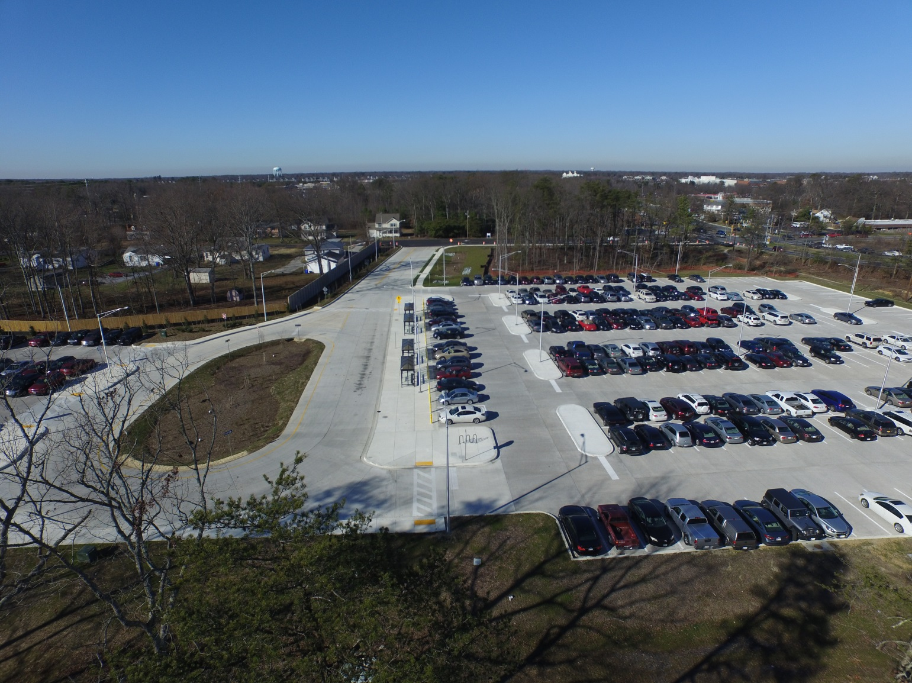
Thank you
Sponsors and Exhibitors!

Slide 3
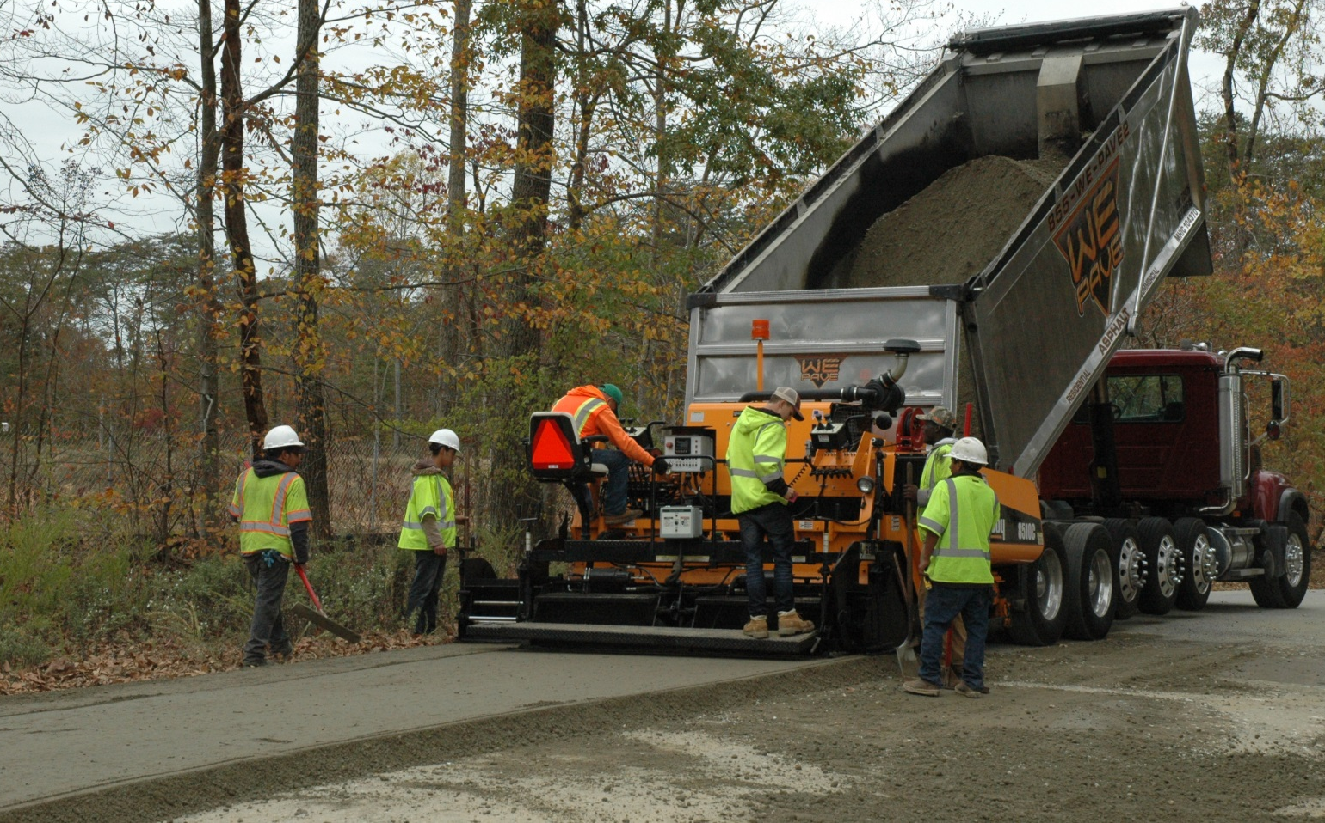
GOLD SPONSORS
Thank you for paving the way…
for the 2017 Concrete Conference!

Slide 4
Gold Sponsor

Slide 5
Gold Sponsor

Slide 6
Gold Sponsor

Slide 7
Gold Sponsor

Slide 8
Gold Sponsor

Slide 9
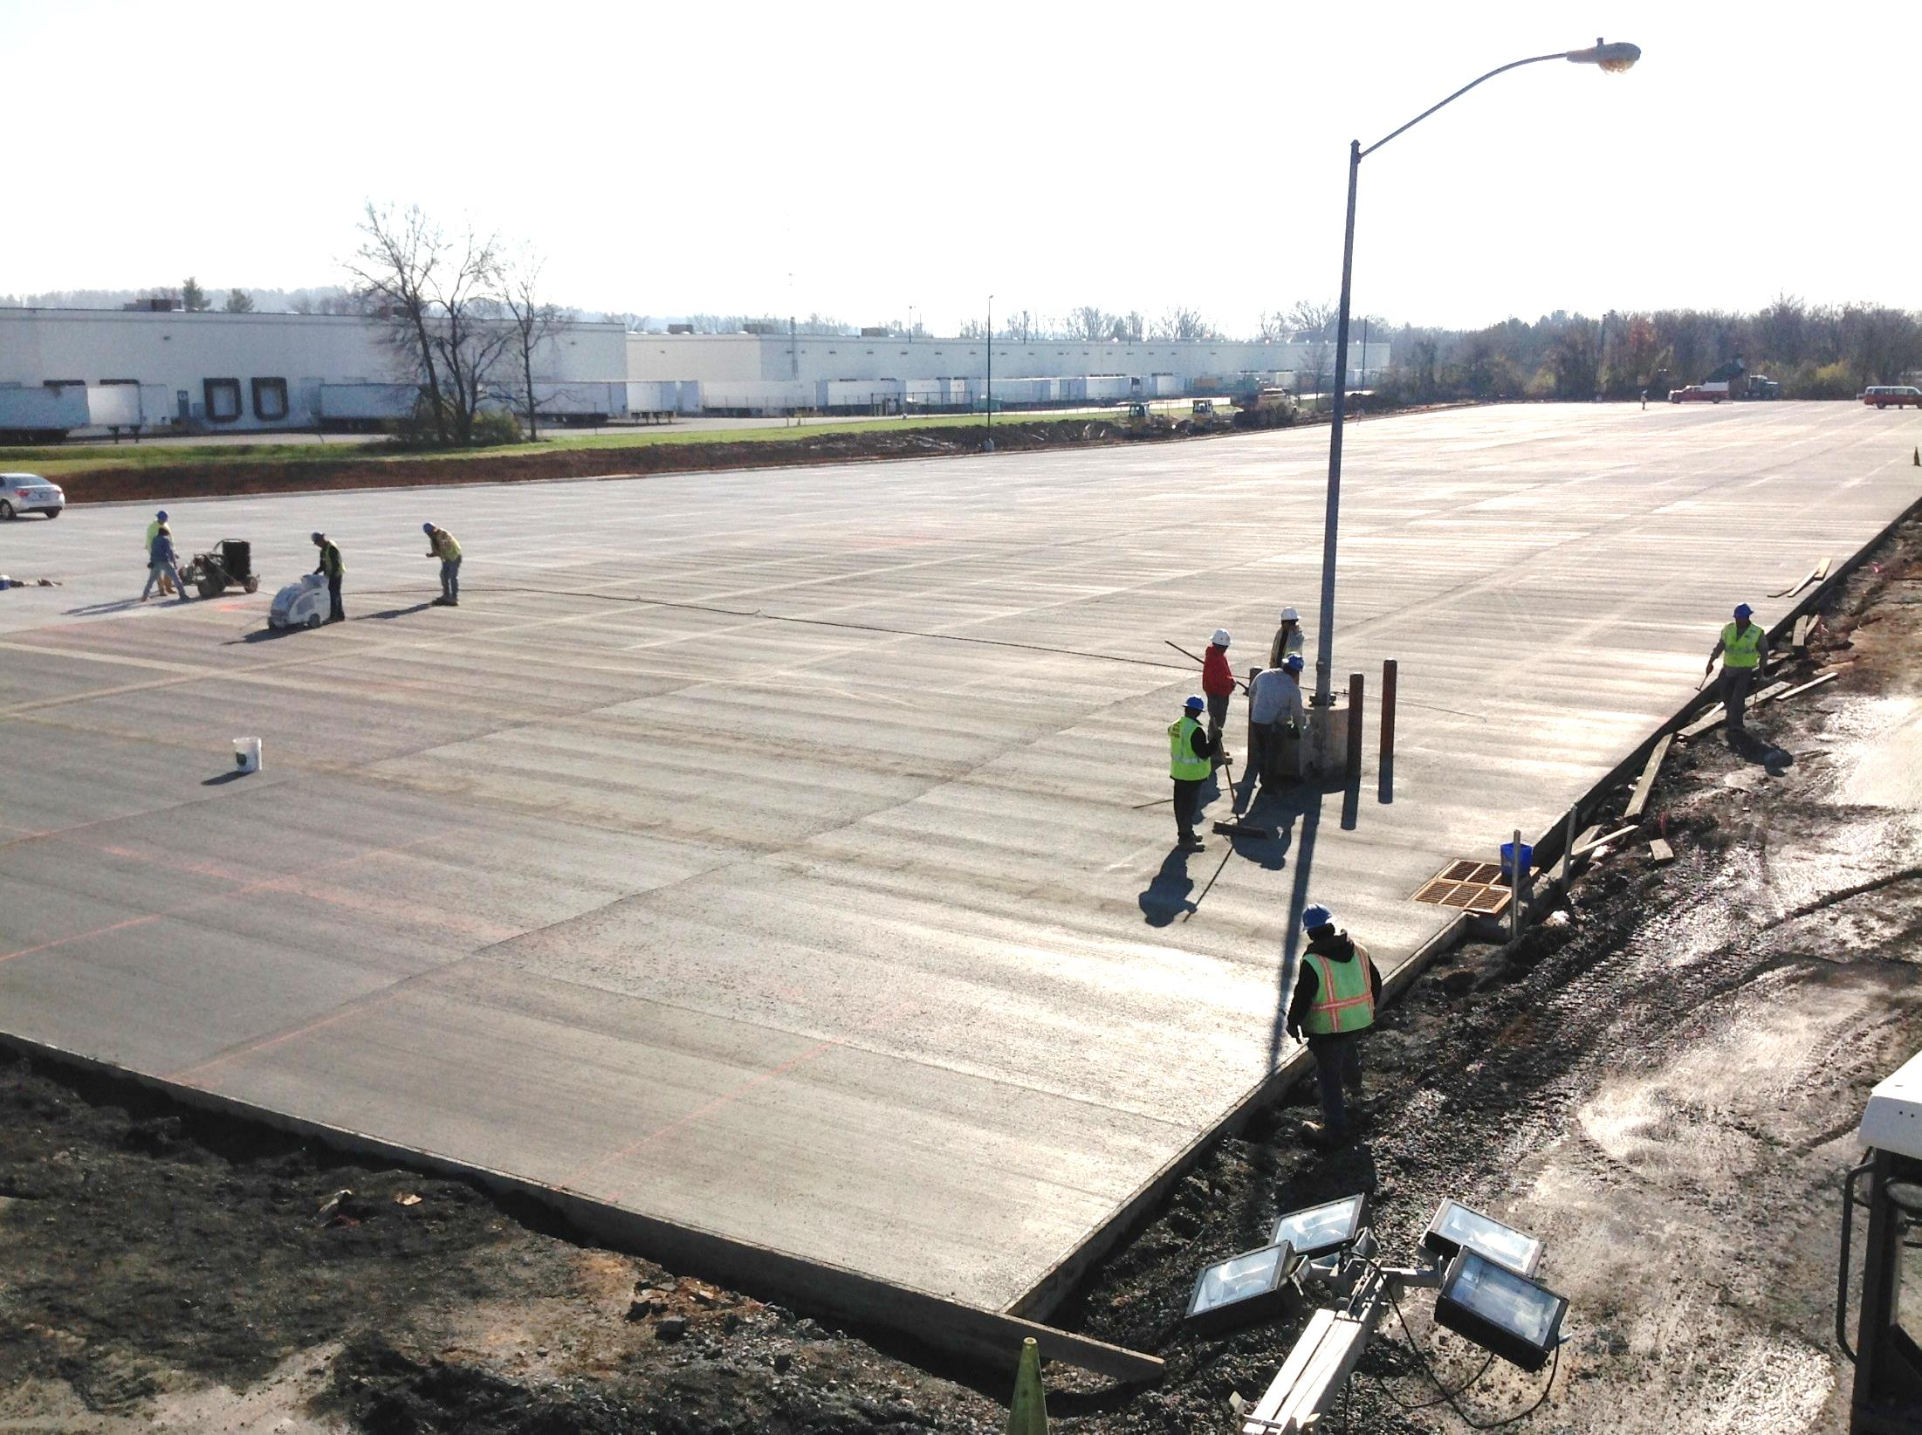
SILVER SPONSORS
Thank you for your support of the 2017 Concrete Conference!

Slide 10
Silver Sponsors

Slide 11
Silver Sponsors

Slide 12
Silver Sponsors

Slide 13
Visit the Exhibitors!

Slide 14
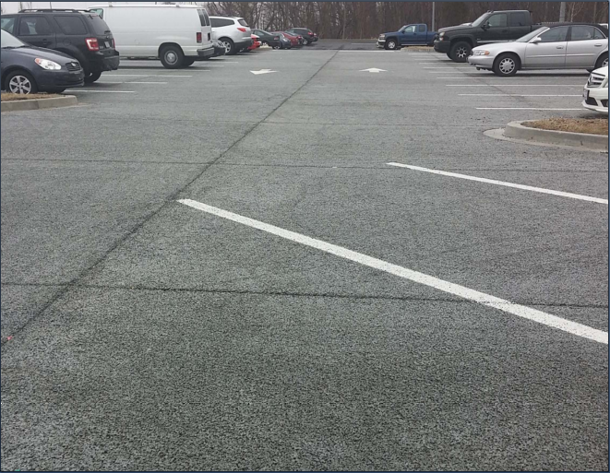
Thank you
Sponsors and Exhibitors!

Slide 15
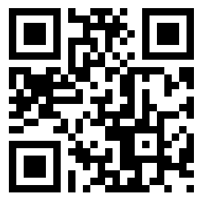
Go Green with the Conference App
Schedule
Speaker Information
Exhibitor Information
Download at
Or scan:

