Slide 1
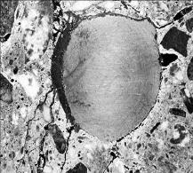
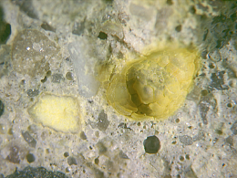

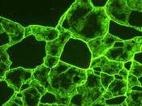
High Performance Concrete for Extended Service Life Applications:
What Does 100 Year Service Life Mean?
Matthew D. D’Ambrosia, Ph.D., P.E.
  Principal Engineer, Materials and Mechanics mdambrosia@ctlgroup.com
  (630)-240-4118

Slide 2




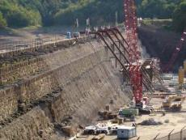
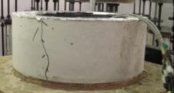
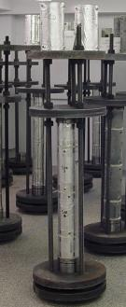
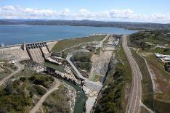
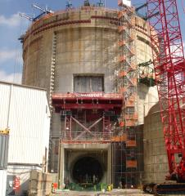
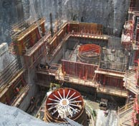
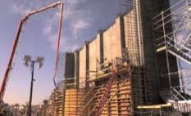
Service Life of RC
Aging infrastructure crisis
Repairs and funding needed
Extended design life (+50 yr)
Lack of validation data for +50 yr
Sustainability vs durability

Slide 3
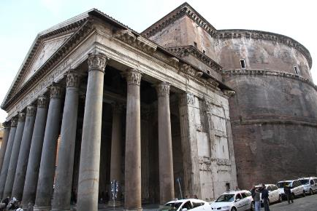

Roman Concrete in 126 AD
Almost two thousand years after it was built, the Pantheon's dome is still the world's largest unreinforced concrete dome

Slide 4
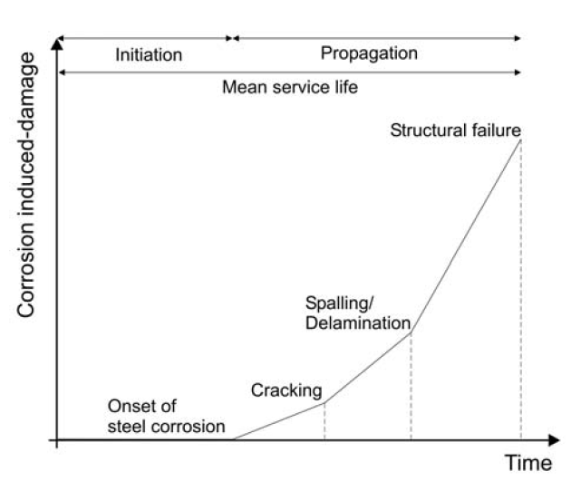

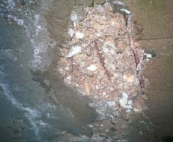
Service Life Evaluation

Slide 5
Projects Considering Service Life
Illinois Tollway Move Illinois Program
Large International Design Build Projects
Many Large Bridge and Tunnel Structures (AASHTO LRFD)
  Tappan Zee Replacement (The New NY Bridge)
  Ohio River Bridges
  Goethals Bridge
  Bayonne Bridge
  Norfolk Midtown Tunnel
Energy (Nuclear), Desalination, Wastewater Plants
Dairy Milking Platforms and Clocks

Slide 6
Pitfalls of Service Life Requirements
Clear Design Requirements a Must!!
  Define “service life”
  Define testing and validation requirements
  If possible, identify specific modeling requirements
  Define resolution protocol
  Address cracking
  Address durability concerns other than corrosion

Slide 7
Sustainable Concrete Must Meet Multiple Objectives
Mechanical Properties
Constructability
Durability
Compressive Strength
Tensile Strength
Flexural Strength
Elastic Modulus
Fracture Toughness
Sustainability
  Workability
  Flowability
  Slump Loss
  Finishability
  Setting
Cracking
Corrosion
ASR
DEF
F-T
Notes:
What are the relevant performance criteria?
Mechanical Properties
Strength, minimum, age?
Other: Elastic modulus, split tensile strength?
Durability
Chemical: ASR, DEF, corrosion
Physical: Freeze-thaw, volume change, cracking, permeability
Constructability
Workability, flowability, and slump loss
Finishability
Setting, strength development

Slide 8
How do we design for durability?
ACI 318 - Corrosion exposure classes
Notes:
As discussed in Module 30, the new 318 requirements have three exposure classes: NA (dry), Moderate (moist), and Severe (chloride)

Slide 9
Prescriptive Durability per ACI 318
VERY General – minimum requirements
  No specific service life given
  No concentration of chlorides in service
  No mention of SCMs
  Does not address type of steel
  Mitigation methods are not mentioned (corrosion inhibitors, coatings, cathodic protection, etc)
  What about ASR, freeze-thaw, deicer scaling?

Slide 10
Performance Specifications Needed
Prescriptive specifications limit innovation, drive the contractor and supplier to focus primarily on early strength
Performance specifications allow new materials, new design approaches, and focus on durability
Can be a less expensive solution for the owner, IF they know what performance is needed
Approach should consider mechanical properties, durability, and constructability

Slide 11

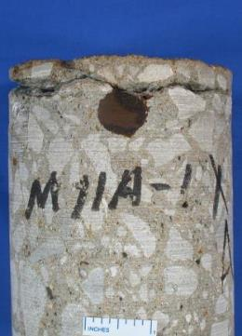
Considerations for Service Life
Corrosion
Carbonation
Cracking
Alkali-Silica Reactivity (ASR)
Freeze-Thaw Deterioration (F-T)
Delayed Ettringite Formation (DEF)
Sulfate, Magnesium, and Physical Salt Attack
Acids, Abrasion, MIC, Radiation, Fire, Other

Slide 12
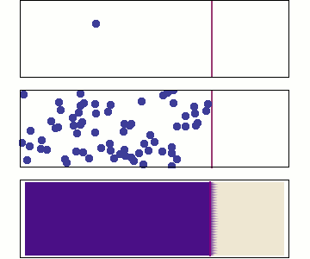
Physical Transport Mechanisms
Three mechanisms:
  Permeation: pressure gradient
  Absorption: capillary suction
  Diffusion: concentration gradient
Primary mechanism is diffusion, not permeation
Significant importance for freeze-thaw damage, alkali-silica reaction, sulfate attack, and chloride penetration
Influenced by microstructure: size distribution of pores, pore connectivity, tortuosity
Improved with w/cm and SCMs, aging, lower paste%

Slide 13
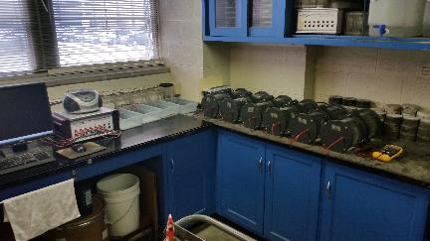
Evaluation of Transport Properties
Available Test Methods (common)
  Chloride Ponding (AASHTO T259/ASTM C1543)
  Rapid Penetrability (AASHTO T277/ASTM C1202)
Other Available Test Methods
  Bulk resistivity
  Surface resistivity
  Ion Migration Testing
  Diffusion Coefficient

Slide 14
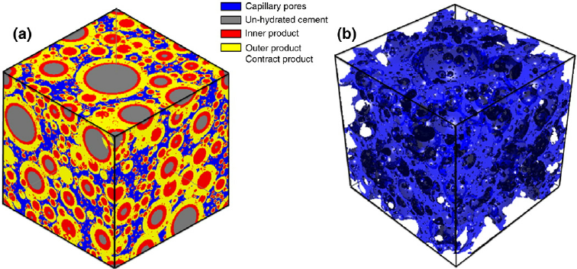
Optimization of Transport Properties
Minimize interconnected pore space
  Low w/cm
  Minimum paste content to meet workability needs
  Minimize total water content and maximize SCMs
Van Bruegel et al

Slide 15
Service Life Limitations
How does cracking impact service life?
  Shortcut to steel
  Allows water and salt ingress
  Low transport concrete between the cracks
Concrete must have minimal cracking to maintain resistance to chlorides!
Current research in literature is lacking information for effects of cracking on transport
What about other degradation mechanisms?

Slide 16
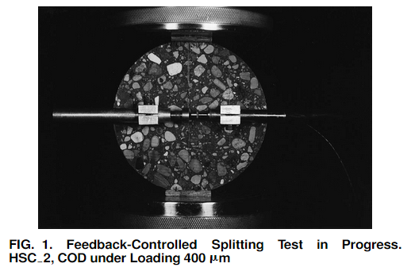
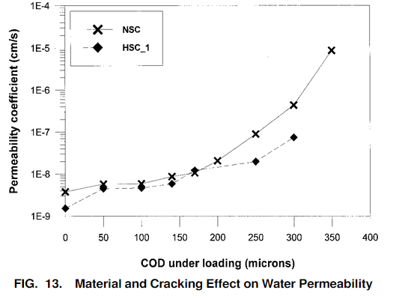
Crack Width vs. Permeability
Corina-Aldea, Shah, and Karr, EFFECT OF CRACKING ON WATER AND CHLORIDE PERMEABILITY OFCONCRETE, J.MAT.CE, AUG 1999, p.181

Slide 17
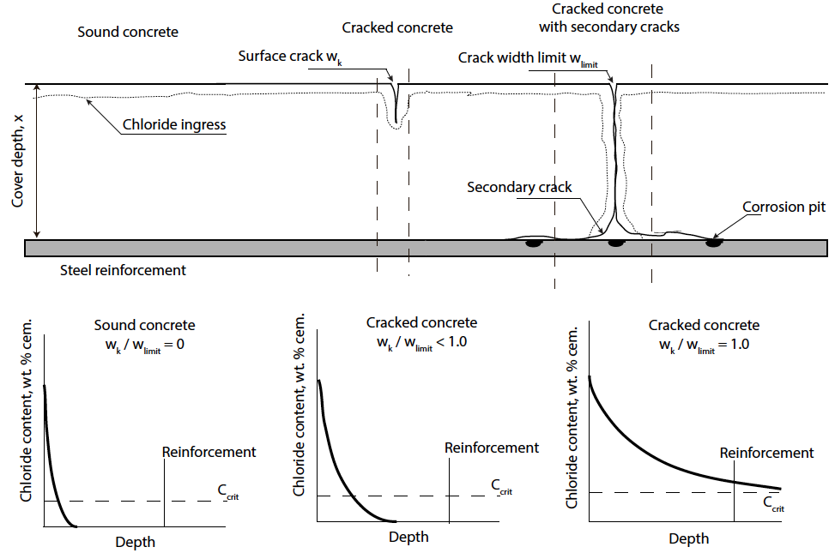
Reinforcement Corrosion in Cracked Concrete
Cracks facilitate ingress of Cl, O₂, CO₂
Time to corrosion (t_{i}) is significantly reduced
Service life models do not account for cracks in concrete
Recent efforts aim to simulate the effect of cracks on corrosion propagation
Corrosion of reinforcement in cracked concrete is dependent on concrete composition, crack width and moisture.
J. Pacheco (2015). Corrosion of steel in cracked concrete. Delft University of Technology
http://repository.tudelft.nl/view/ir/uuid%3Abc726ead-0999-4fe4-bad1-5c26c0e50405/

Slide 18
What is needed?
A practical methodology to predict the susceptibility of concrete mixtures to early age cracking
Suggestions for monitoring of laboratory and field samples for cracking tendency
Mitigation methods for early cracking
Cracking mitigation experience includes projects for:
  PCA R&D
  IDOT
  CDOT
  Illinois Tollway
  MassDOT
  VTRC
  WSDOT
  INDOT
  KTRC
  HawaiiDOT
  NYDOT
  NVDOT
  Caltrans
  Manitoba (MIT)

Slide 19
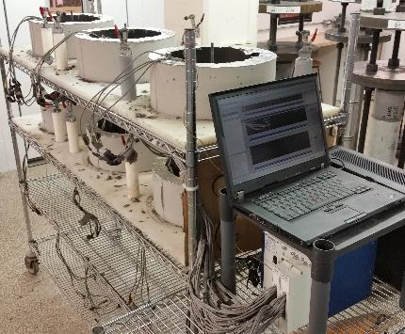
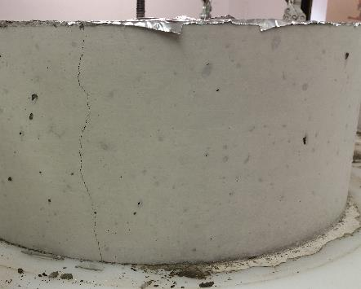

Restrained Ring Testing
ASTM C1581 vs AASHTO T334
Carlson, R. W., 1937
Grzybowski, M. and Shah, S. P.,1990
Krauss, P.D. and Rogalla, E.A., 1996
Whiting, D. A., Detwiler, R. J. and Lagergren, E. S., 2000
Attiogbe, E. K., See, H. T. and Miltenberger, M. A, 2001
Hossain A. B., Pease B. and Weiss W. J, 2003
Lange, D’Ambrosia, Grasley, et al., 2003

Slide 20
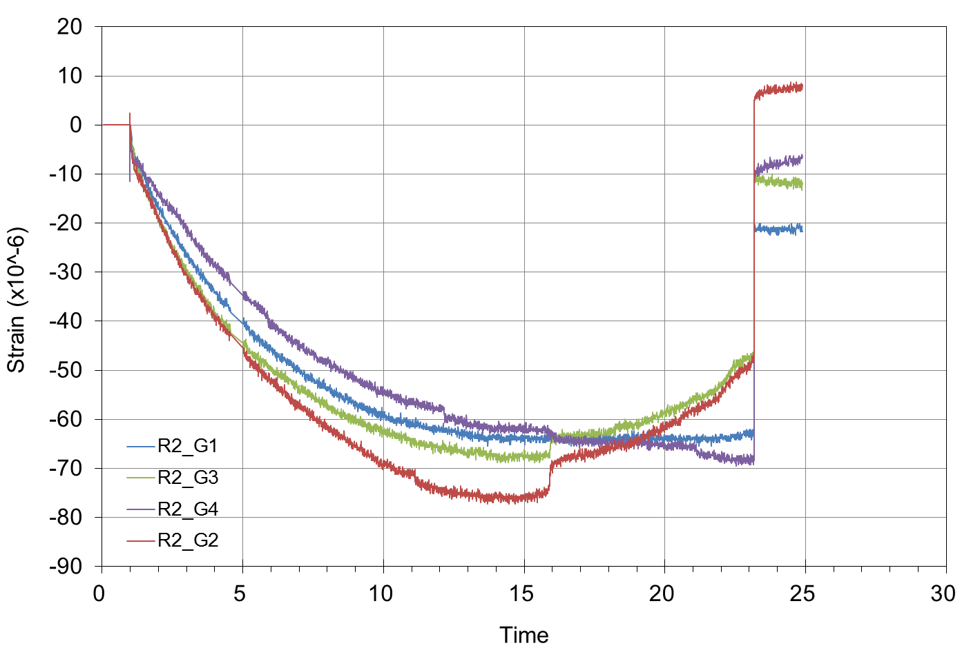
What does the ring test tell us?
Illustration from ASTM C1581

Slide 21
Ring test gives relative cracking tendency
Allows for cracking risk assessment between different mixture strategies
Incorporates the influence of rate of stress development vs tensile strength
Starts immediately after casting – HPC can not benefit from 7-28 day soak of ASTM C157
Accounts for effect of modulus increase with HPC
Accounts for creep relaxation, or lack thereof

Slide 22
Recommended ring test specification limits
High early strength, patching, low restraint, prestressed beams
  10 days minimum time to cracking has correlated with minimal to no shrinkage cracking in patch mixtures
High restraint, long service life, or mass concrete applications
  28 days minimum time to cracking correlates to minimal to no shrinkage cracking in bridge decks and mass concrete

Slide 23
Service Life for Freeze-thaw Resistance
Transport properties critical (w/cm, SCMs)
Number of cycles/level of saturation
Performance testing (correlation to field)
Sealers and coatings
Volume of air? Hypothetically: Increase 1% for every 25 years of service life, max 12%
Maintain proper spacing

Slide 24
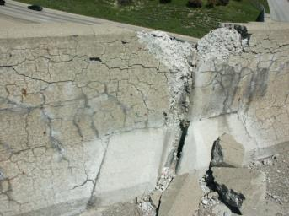
Alkali–Silica Reactivity (ASR)
Caused by a reaction between alkalis (high pH) in concrete pore solution and reactive silica in aggregate
Manifest as map cracking. Exudate is common, as is expansion of the structure
Commonly manifest within 5 to 15 years

Slide 25
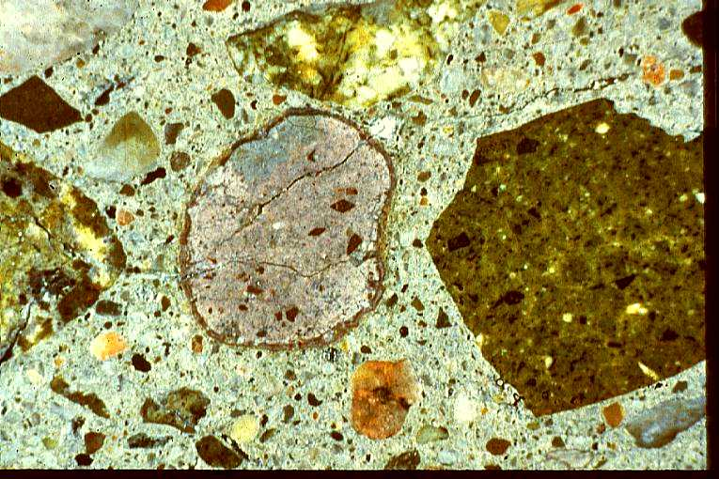
ASR in Concrete Polished Section
Cement
paste
Reactive
aggregate
Reaction
product
Notes:
Under a microscope, ASR presents a characteristic pattern readily identified by experienced concrete petrographers. Reactive aggregates have a reactive rim, and cracks extend from the aggregate into the paste. Note that not all of the aggregate particles are reactive, although damage can occur with some aggregates with as little as 5% of the aggregate particles being reactive.

Slide 26
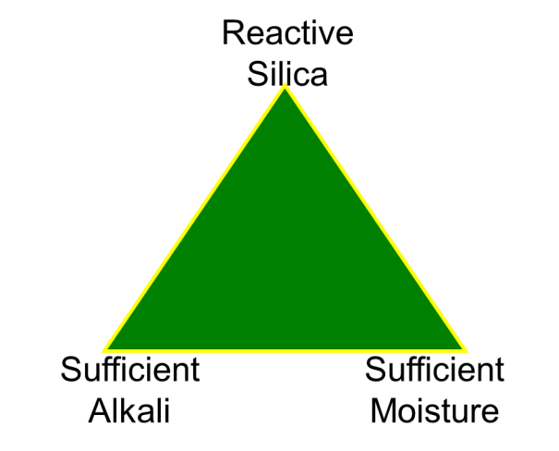
Required for ASR to Occur:
Reactive aggregate
  Sufficient reactivity and quantity to cause damage
Sufficient alkalinity
  High alkali cements, high alkali fly ash, and/or high cement contents
  Total alkalinity is important
Water
  Typically above 80% saturation

Slide 27
Alkali-Silica Reaction (ASR)
How do we evaluate service life?
Cusatis et al., Lattice Discrete Particle Modeling (LDPM) of Alkali Silica Reaction (ASR) Deterioration of Concrete Structures, 2013

Slide 28
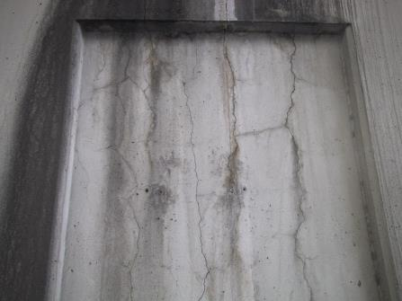
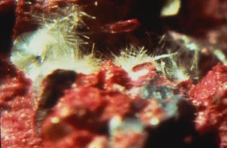
Delayed Ettringite Formation
A form of sulfate attack by which hardened concrete is damaged by internal expansion caused by the later age formation of ettringite
Not likely unless concrete reaches temperatures of 158ºF (70ºC) or greater during curing
Less likely to occur in concrete made with pozzolan or slag cement
Residual expansion testing is proposed to determine risk of continued DEF

Slide 29
Prevention of DEF
Maximum Concrete Temperature (T) | Level of Prevention Required
T < 158 ºF (70 ºC) | No prevention required
158 ºF < T < 185 ºF (70 ºC < T < 85 ºC) | Use one of the following approaches to minimize the risk of expansion: Use portland cement that meets the requirements of ASTM C150 for Type II, IV or Type V cement and has a fineness value < 430 m²/kg Use portland cement with a 1-day mortar strength (ASTM C109) < 20 Mpa Use the following proportions of pozzolan or slag cement in combination with any portland cement: > 25% fly ash meeting the requirements of ASTM C618 for Class F fly ash > 35% fly ash meeting the requirements of ASTM C618 for Class C fly ash > 35% slag cement meeting the requirements of ASTM C989 > 5% silica fume (meeting ASTM C1240) in combination with at least 25% slag cement > 5% silica fume (meeting ASTM C1240) in combination with at least 20% Class F fly ash > 10% metakaolin meeting ASTM C618
T > 185 ºF (85 ºC) | The internal concrete temperature should not exceed 185 ºF (85 ºC) under any circumstances

Slide 30
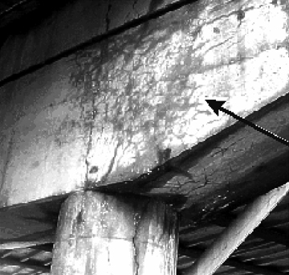
Delayed Ettringite Formation (DEF)
Degradation occurs when:
  Concrete temperature exceeds ~160°F
  Cementitious materials have a particular chemistry
  External water available during service life
Expansion and cracking
Loss of stiffness and strength
What is the remaining service life for
a DEF affected structure?
Notes:
Ettringite is normally formed during the hydration and hardening of concrete. However if the concrete is cured above a certain critical temperature the ettringite does not form. Under moist conditions during later service life the ettringite forms and might cause expansion and cracking and deterioration of the hardened concrete.
This is known as delayed ettringite formation DEF

Slide 31
Case Study A: Illinois Tollway Bridge Decks

Slide 32
Case Study B: Desalination Plant
50 year design life requirement in 3x salinity
Coatings used but only guaranteed for 5 years
Designer wanted to follow the “code”
No code requirements to address service life
Additional design help was suggested, STADIUM
Later testing and validation needed to substantiate already placed concrete

Slide 33
Case Study C: Major Bridge Projects
Designers using Euro fib MC-34
Testing required is NT Build 492
Aging neglected with fib approach
Local labs do not have test equipment
Correlation with ASTM C1202 can be used for construction

Slide 34
Case Study D: Design Build Project
Owner wants 100 year service life for project
Owner requires 1000 coulomb limit in ASTM C1202 but does not specify an age for testing
ASTM C1202 without a specified testing age has no design significance
Owner rejects design build team mixes and forces contractor to use silica fume despite significant testing and modeling efforts to validate service life
Silica fume leads to cracking
Cracking leads to chloride ingress…

Slide 35
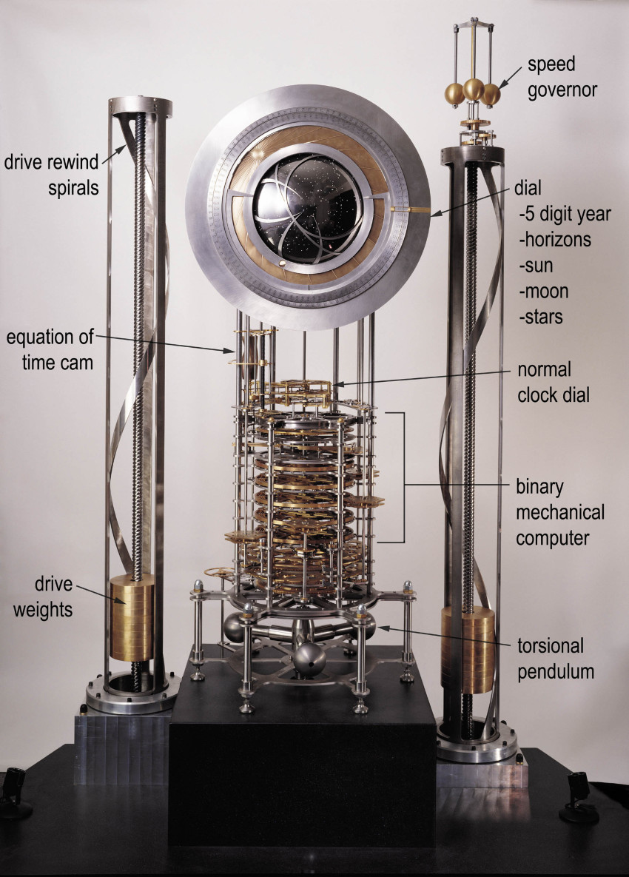
Case Study E: 10,000 Clock Project
Also called “Clock of the Long Now”
Located in west Texas high desert
Funded by Jeff Bezos, Amazon
Unique and ambitious project to create a lasting structure with symbolic message
Stainless steel used for clock components
Concrete service life issues include reinforcement, shotcrete, exposure to aggressive soil chemistry

Slide 36
Concluding Remarks
Reaching or exceeding the design life is essential for sustainability
Material degradation is a leading cause of early failure in concrete structures
Material selection, mixture proportioning, and construction all influence durability
Appropriate use of specifications and testing is critical

