Slide 1
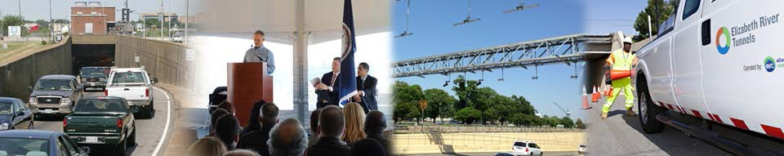



The Elizabeth River Tunnels Project
The Virginia Concrete Conference
Richmond, VA • March 5, 2015

Slide 2


Slide 3

Mid Town Tunnel

Slide 4
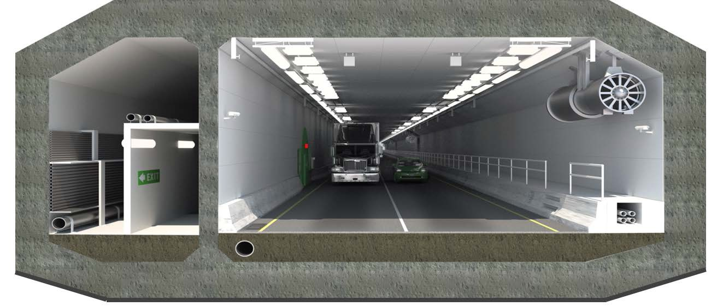
New MTT: Final Concept
Concrete shell, Immerse Tube Tunnel (ITT)
Westbound tube connecting Norfolk to Portsmouth
Two vehicular lanes and an egress corridor
Utility Corridor
Deluge System
Jet Fans
Egress Corridor
Promat

Slide 5
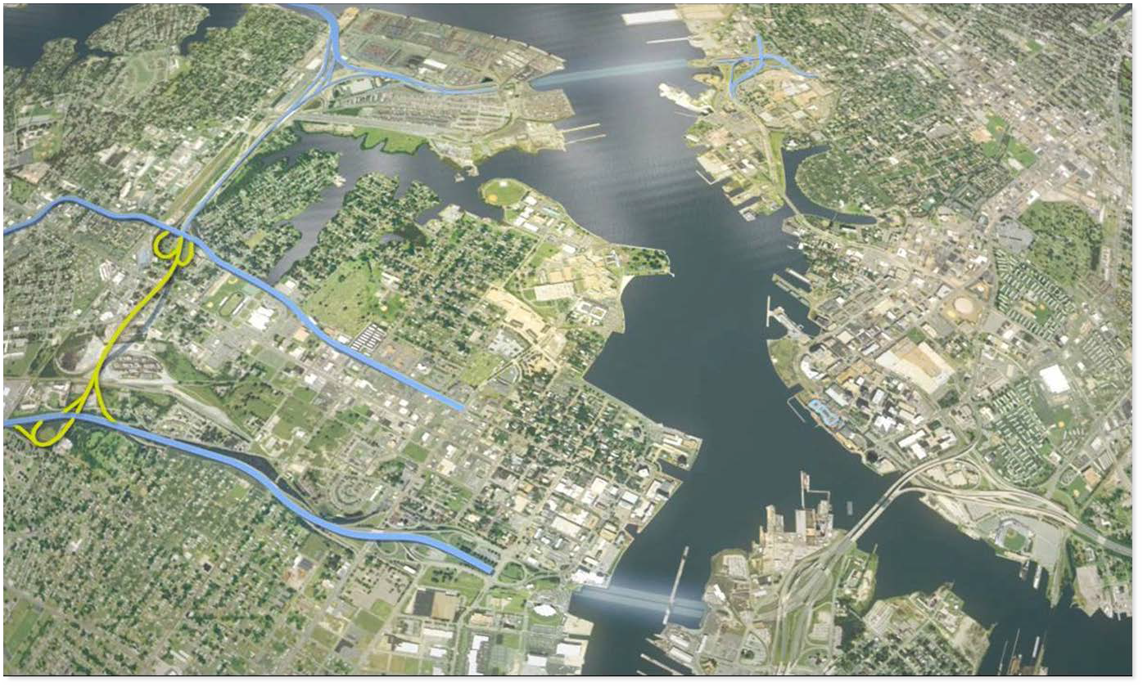
ERT Project Scope
New, two-lane, WB tunnel
Brambleton Ave. / Hampton Blvd. interchange modifications
Rehab and life- safety improvements of existing MTT
Norfolk
Extending MLK to I-264, High St. interchange
Rehab and life- safety improvements of existing DTT (EB
& WB tubes)
Portsmouth
5
USA Civil Southeast Q3 Update

Slide 6



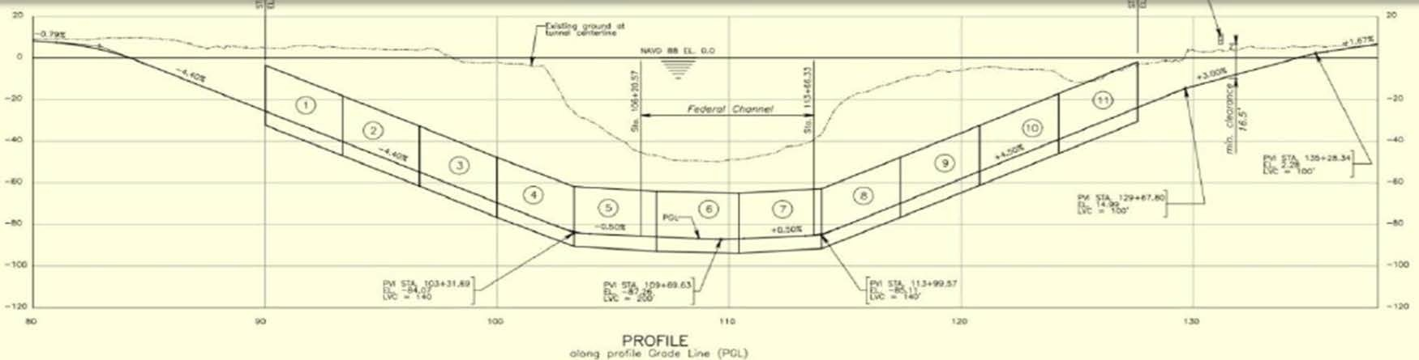

Slide 7


Slide 8
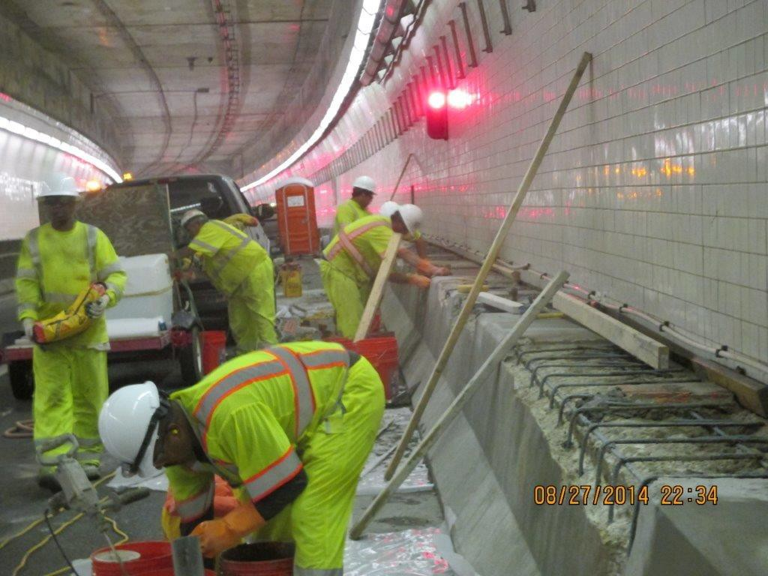


Slide 9
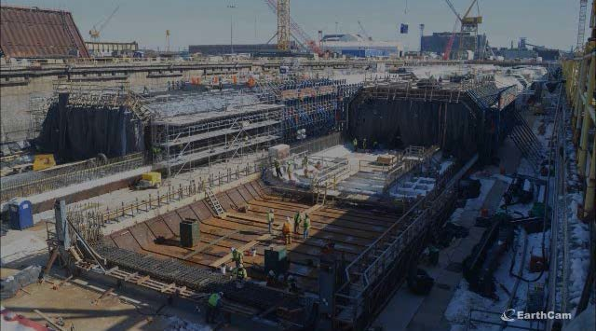

Slide 10
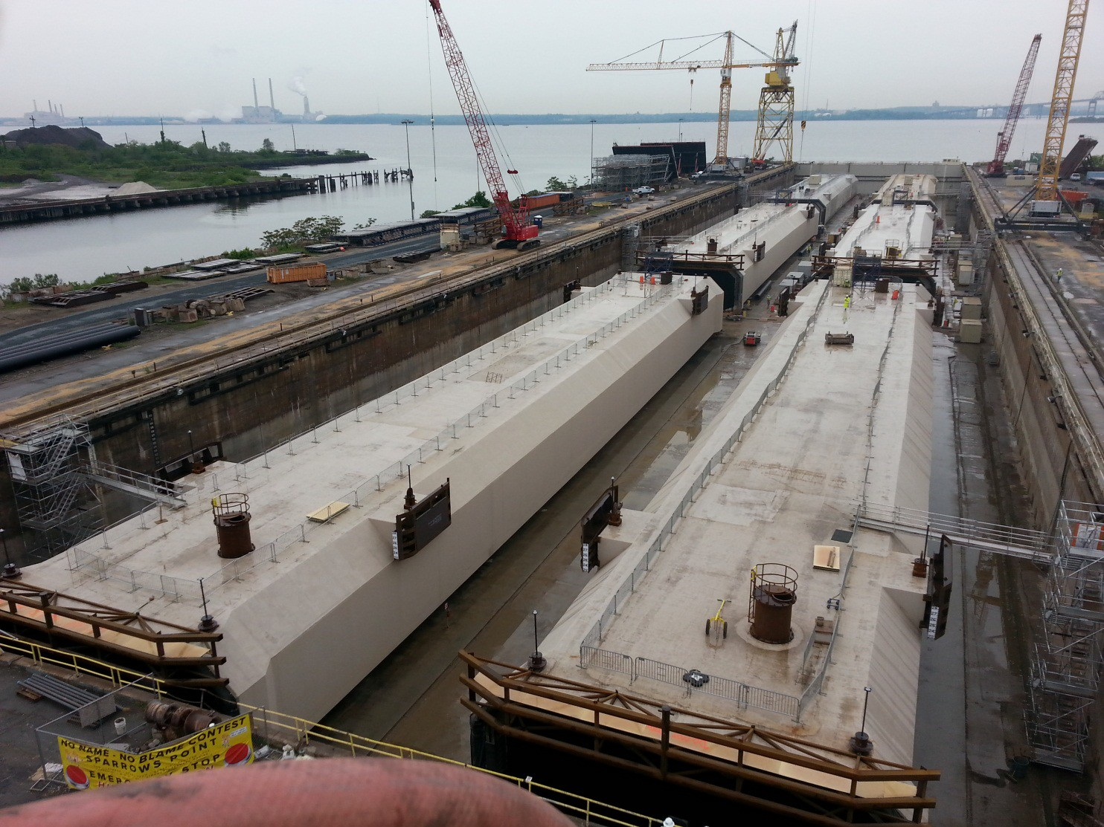


Slide 11
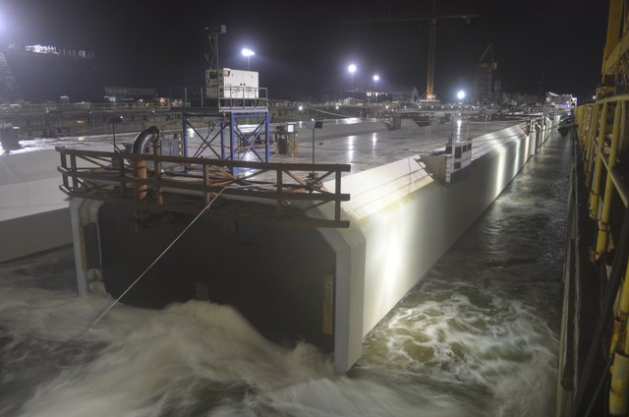


Slide 12

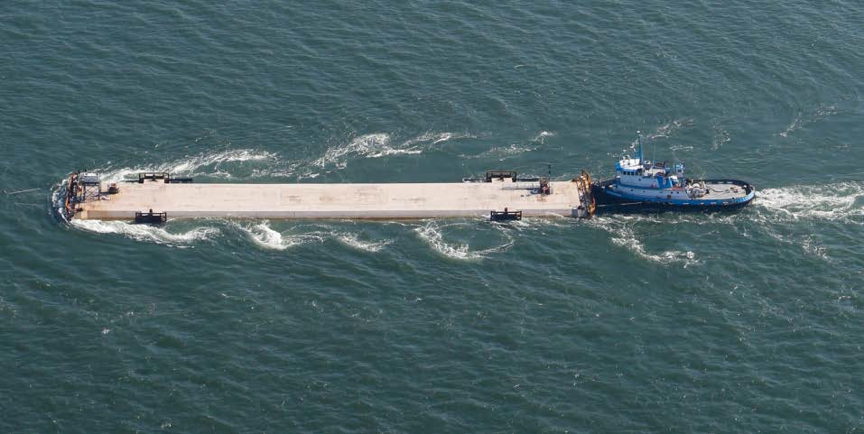
New MTT: Element Tow Down

Slide 13

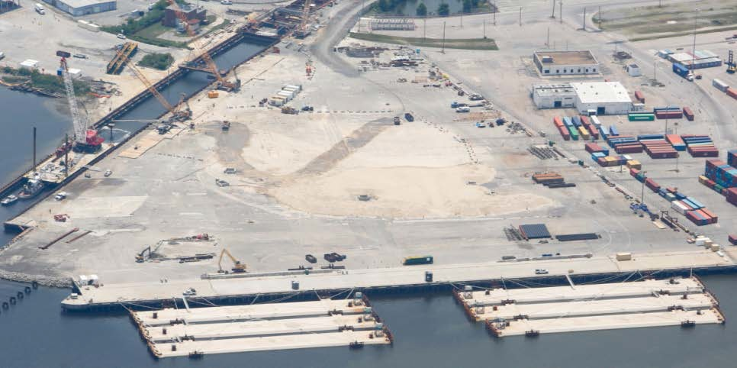
New MTT: Elements Moored in Portsmouth

Slide 14
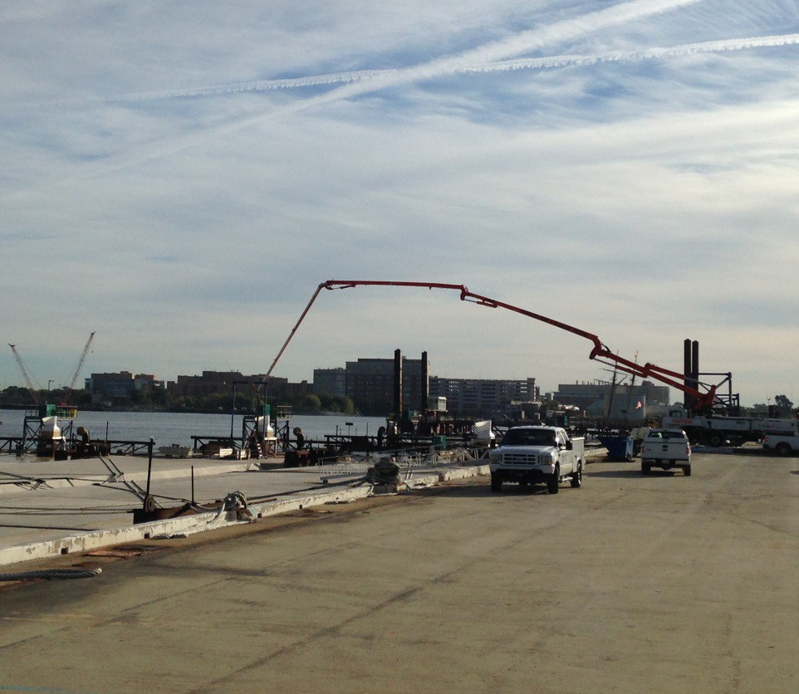


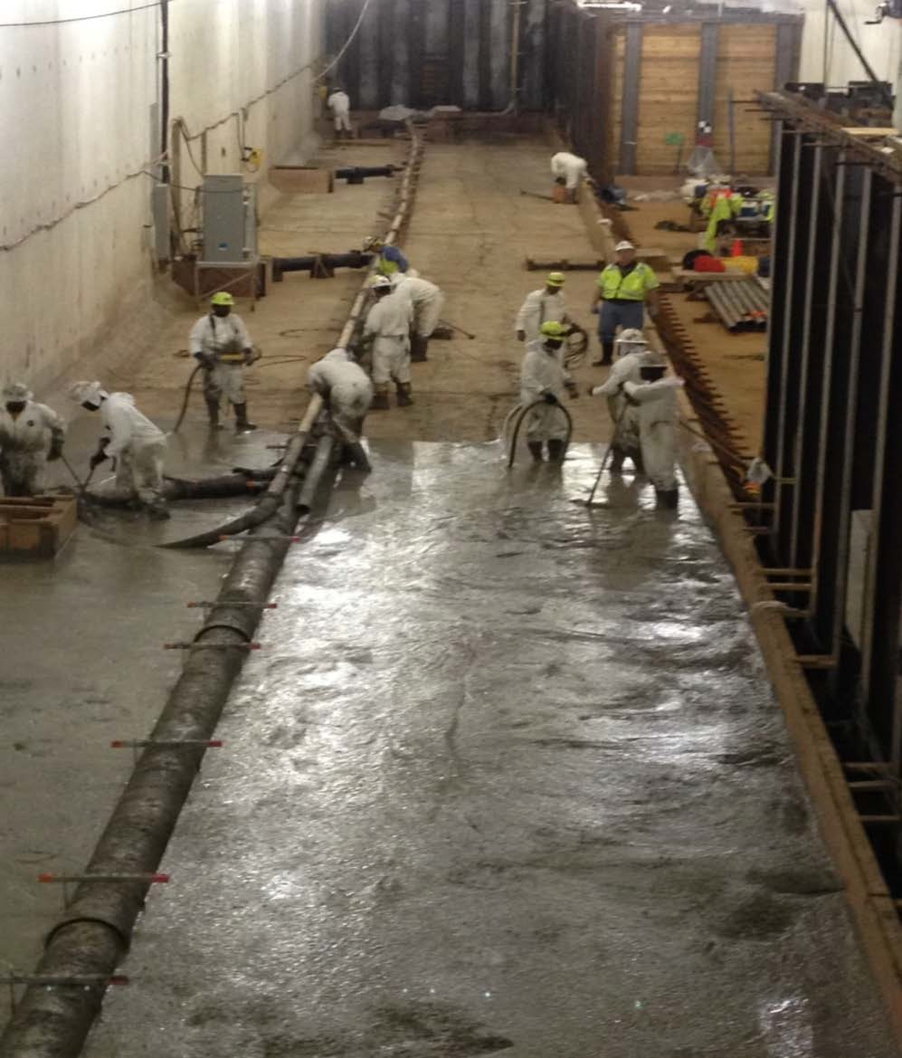
New MTT: Ballast Concrete Placement

Slide 15

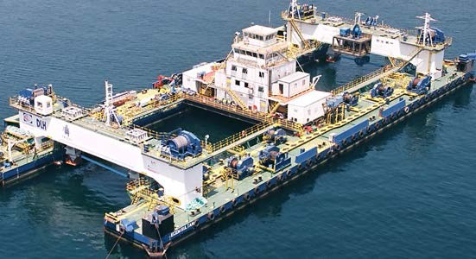
New MTT: Lay Barge

Slide 16

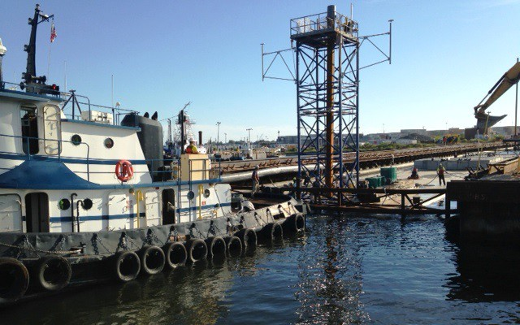
New MTT: Movement of Element into Slot

Slide 17

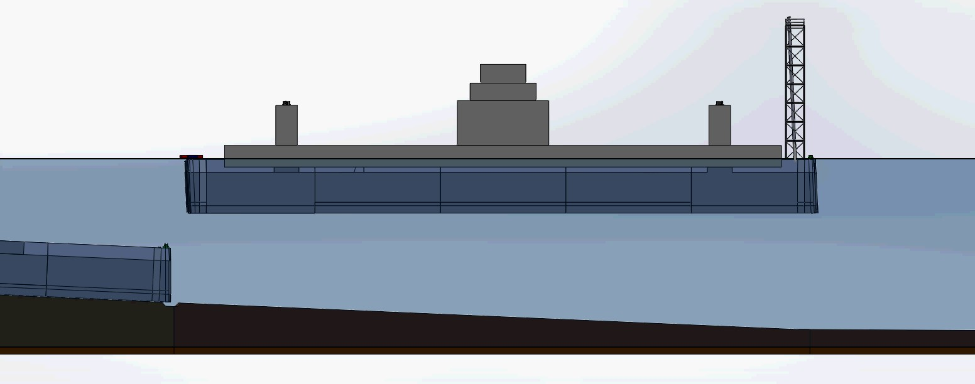
New MTT: Element Immersion
Existing MTT Approach
New MTT Approach

Slide 18
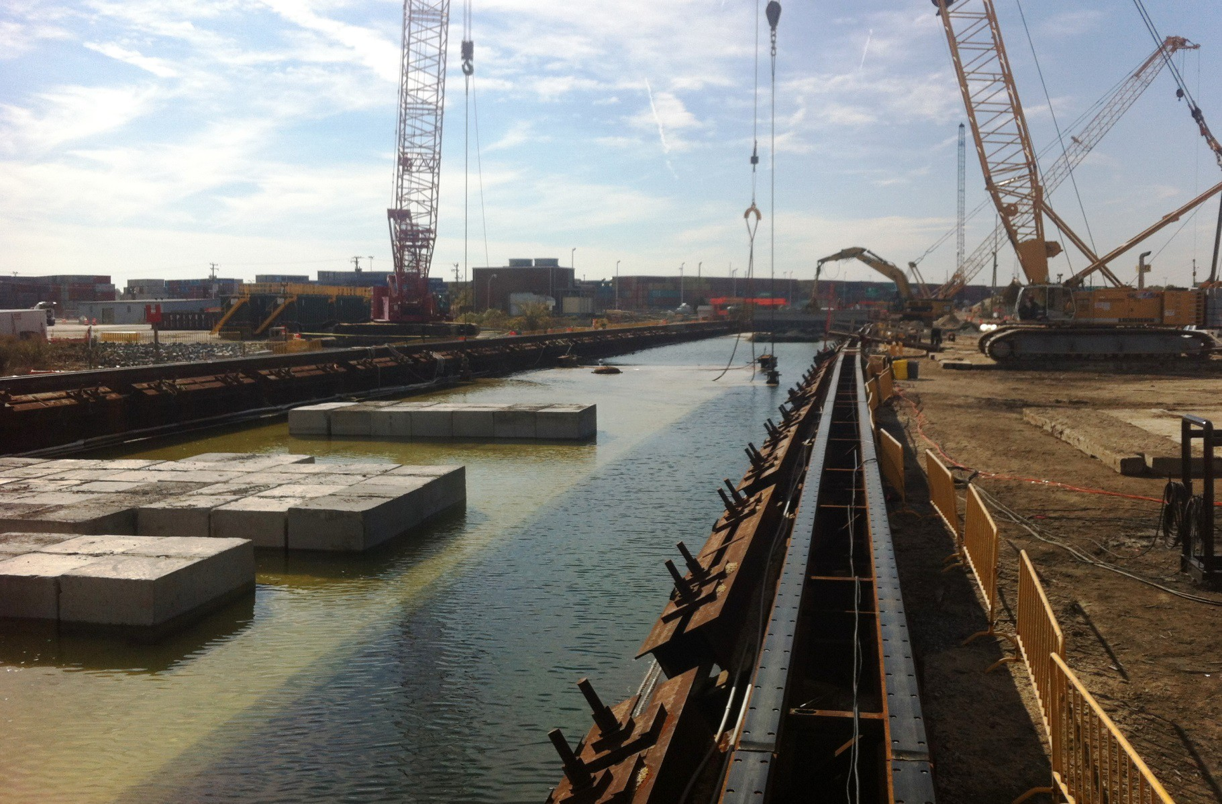

New MTT: Immersion of Element in Slot

Slide 19
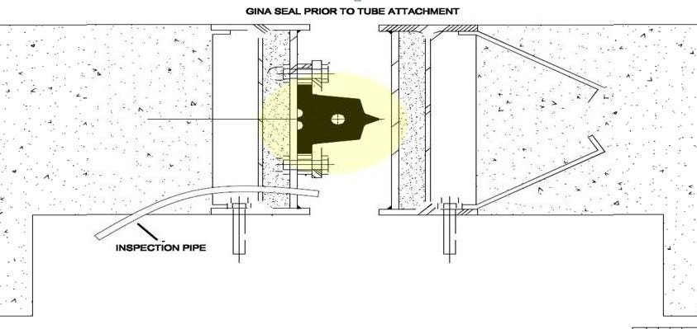
New MTT: Element Seals
Seals between Elements
  Gina Joint (gasket type)
  Omega Seal (inner connection)
Elements to connect to Cast in Place Approach work

Slide 20
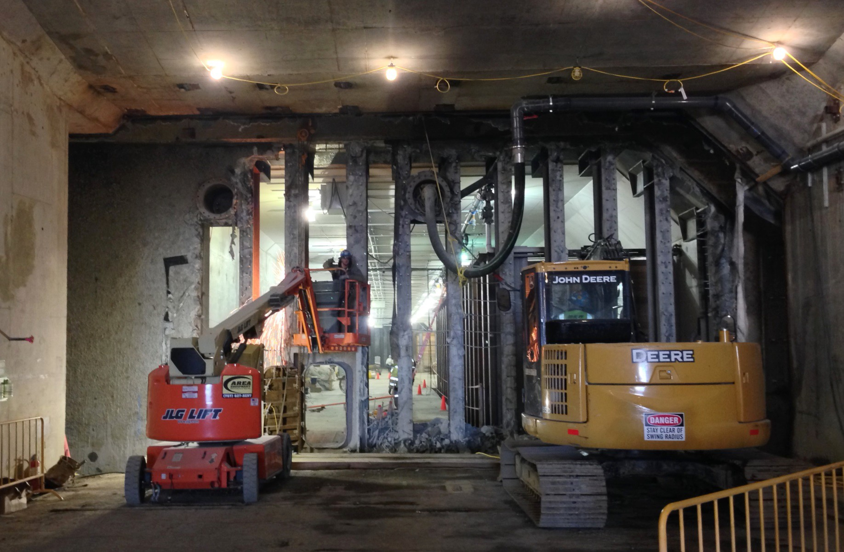
New MTT: Removal of Temporary Bulkheads

Slide 21

Major Concrete Challenge / 120 Year Service Life

Slide 22
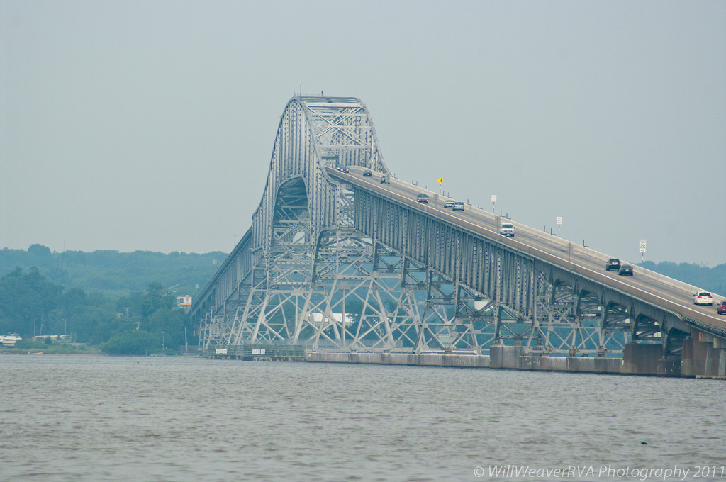

Slide 23
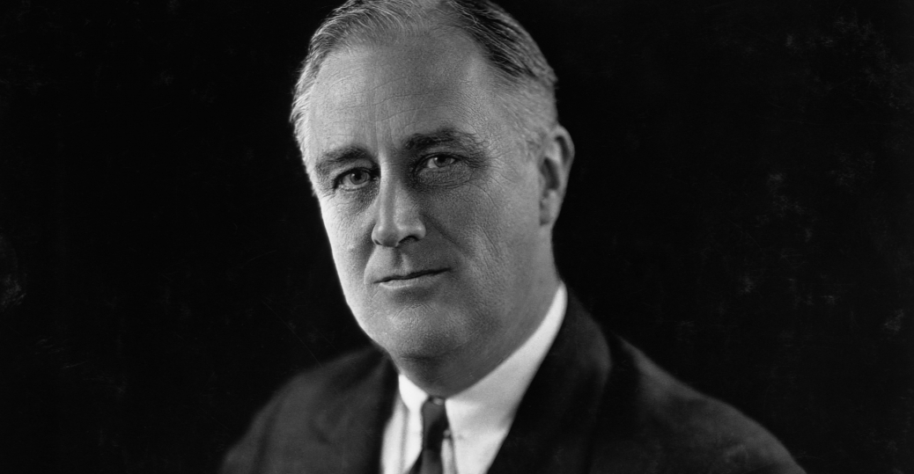

Slide 24


Slide 25


Slide 26









Owner
Equity / Sponsors
Developer
Lenders
Bank/Bond/TIFIA
Design-Build Contractor
Operations & Maintenance
Tolling Contractor
3M
Designers
4

Slide 27
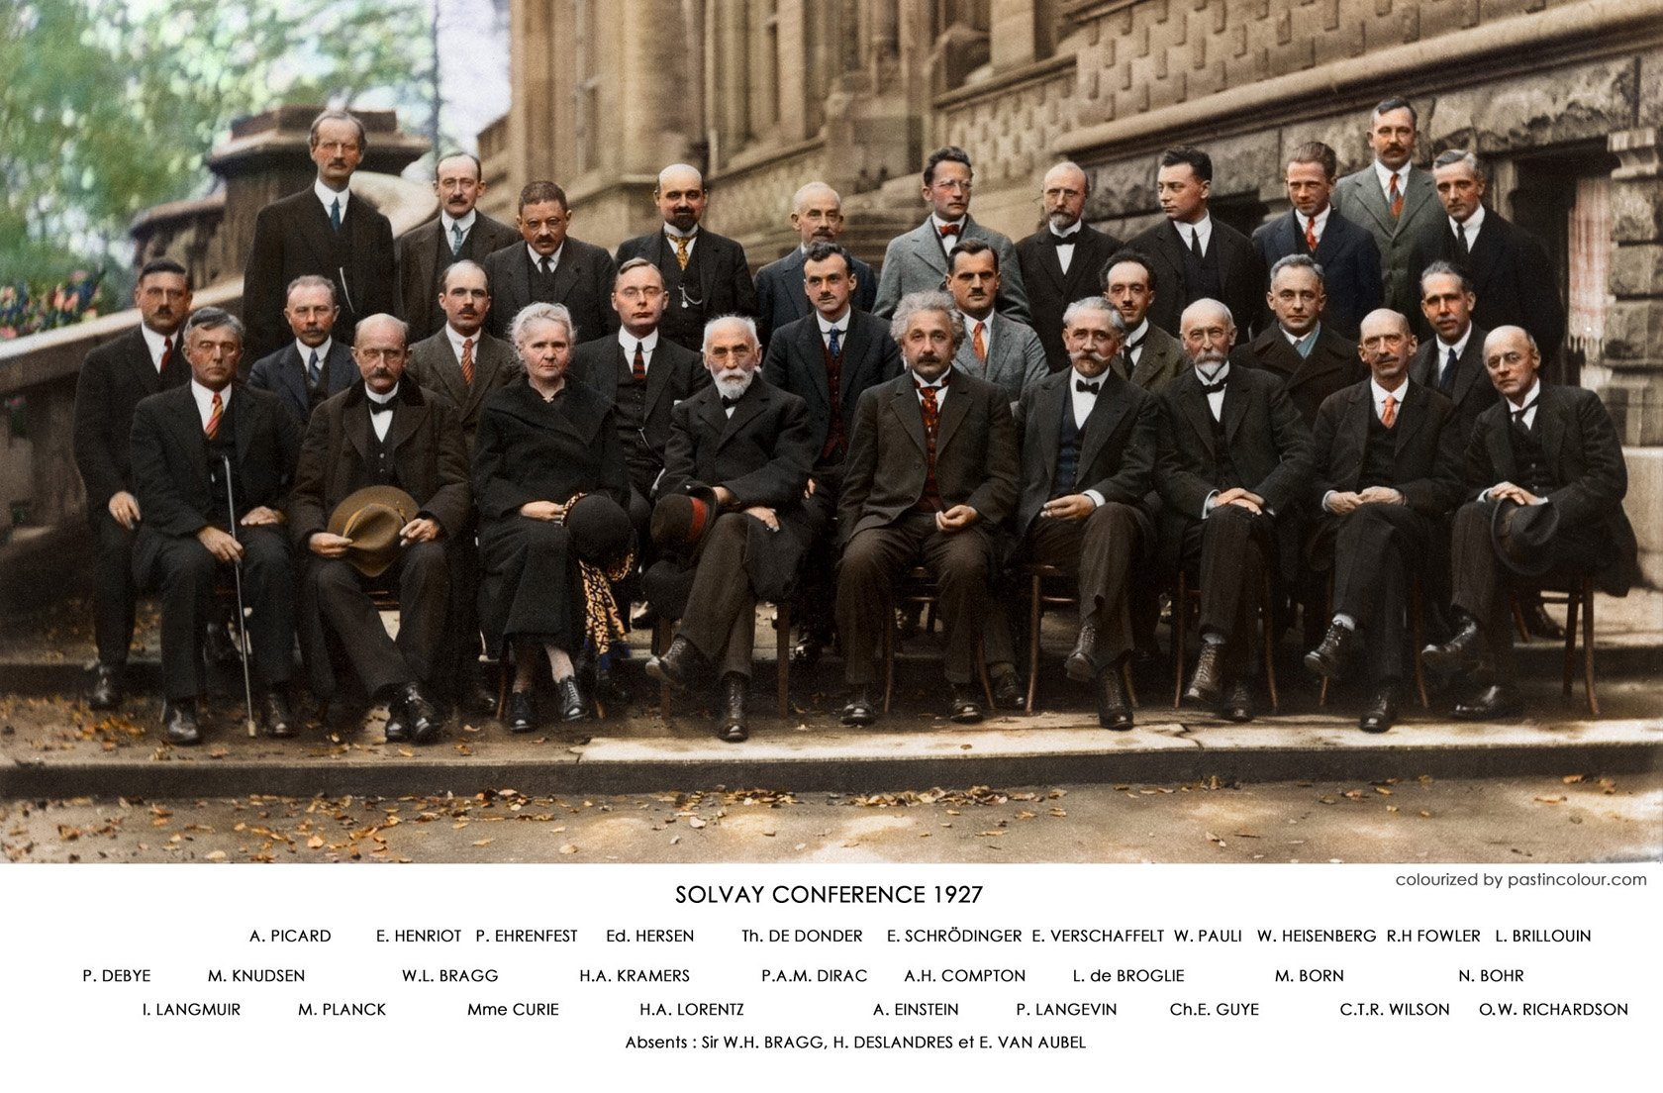

Slide 28

Concrete Specifications

Slide 29
Transition Here to Henry’s Thoughts for What They are Worth

Slide 30
How do you Design for 120 Years
Look at environmental parameters (brackish water, temperatures, etc.)
Look at the geometry of the structure
Look at rebar cover
Apply a whole bunch of models (scm replacement levels, corrosion inhibitors, black steel vs. coated, etc.)
Run a ton of trial batches

Slide 31
120 Year Service Life (cont.)
Models Drive Concrete Towards
  Corrosion Inhibitor
150
Silica Fume
Low w/cm
High SCMs
Time to Propagation (years)
140
65% Slag
130
70% Slag
120
Also Important
  Low Paste Content
  Cracking
110
100
90
80
70
0.32
0.34
0.36
w/cm
0.38
0.4
0.42

Slide 32
120 Plus
Over 100 trial batches
Use fly ash for low heat, or
Change the fineness of the local slag cement, or
Use a coarser ground slag cement, and
Use blends of multiple aggregates for optimal gradation
SCC
Batching requirements tighter than C-94

Slide 33

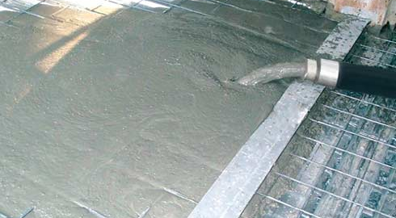
Agilia

Slide 34
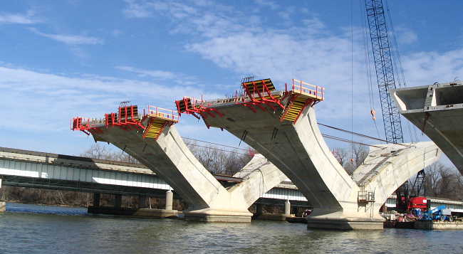

Slide 35
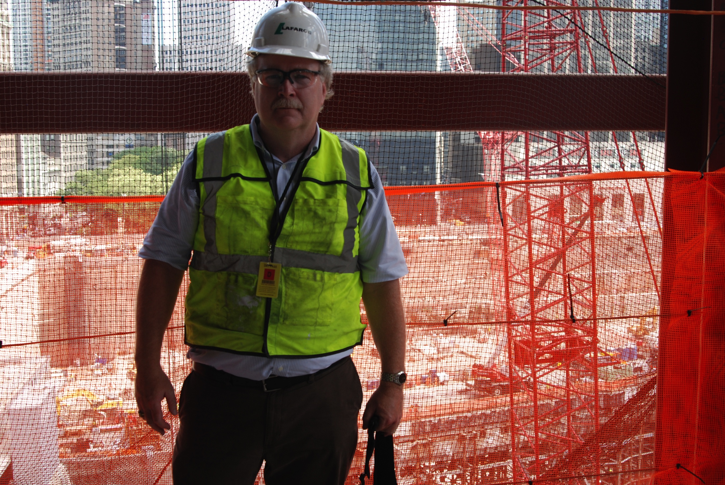

Slide 36


Slide 37
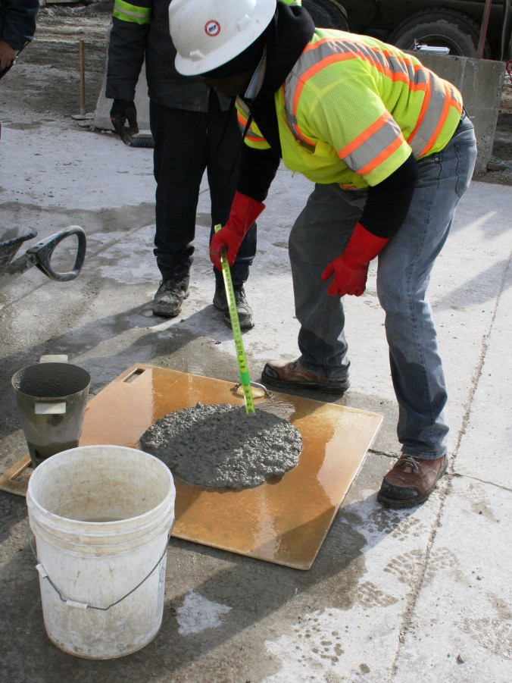

Concrete Mix Development
>100 Trial Batches by Lafarge for Final Mix
Optimized Aggregate Blend
Cementitious
  65% Grade 120+ Slag Cement
  35% Type I/II Portland Cement
Low Water Content
Shrinkage Reducing Admixture

Slide 38
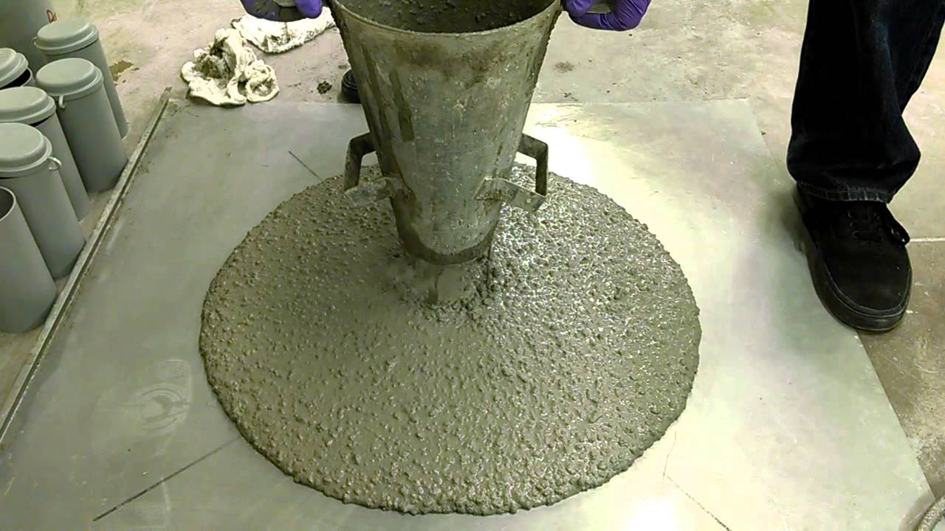
14” – 20” for Inverts
16” – 22” for Doghouse

Slide 39
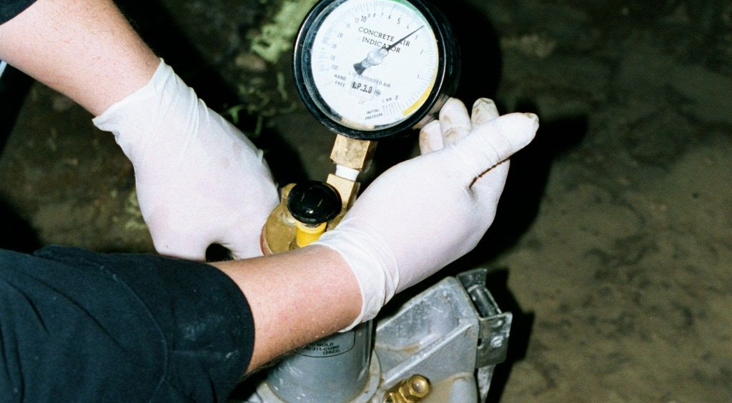
4% to 8% Air

Slide 40
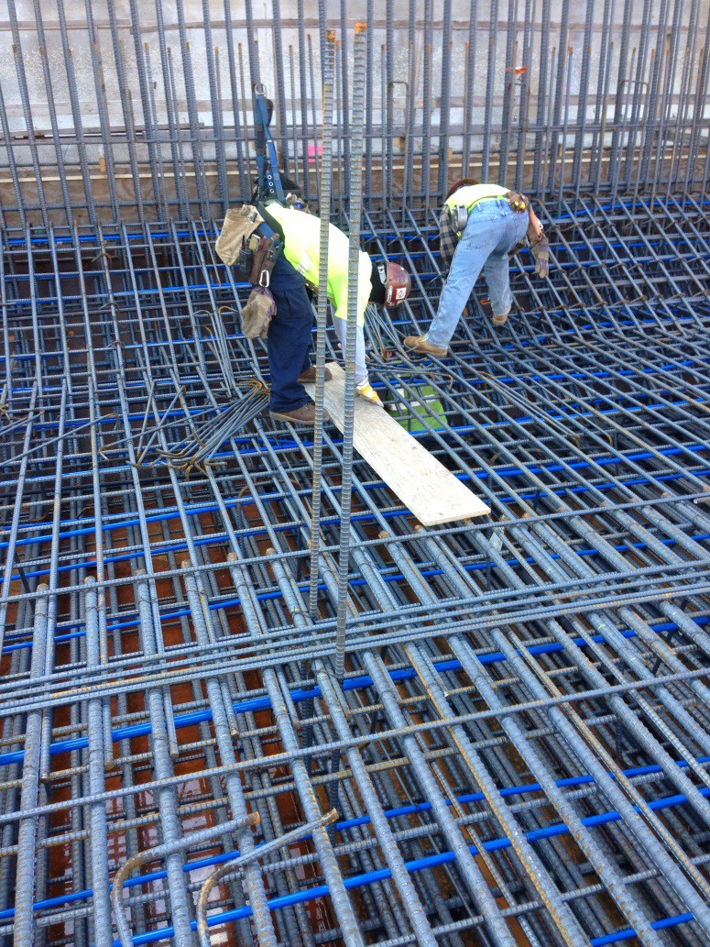

Address Differential Thermal Movement
Concrete Mix
  SRA to Reduce Autogenous Shrinkage
  Other changes Reduce the Service Life and/or Placeability
Concrete
  Precool to Reduce Max. Temperature
  Curing Compound to Reduce Drying Shrinkage
Cooling Pipes
  Reduce Temperature Rise of Concrete
Heat Existing Concrete
  Pre-Expand to Reduce Stresses
  New and Existing Cool at same Rate

Slide 41


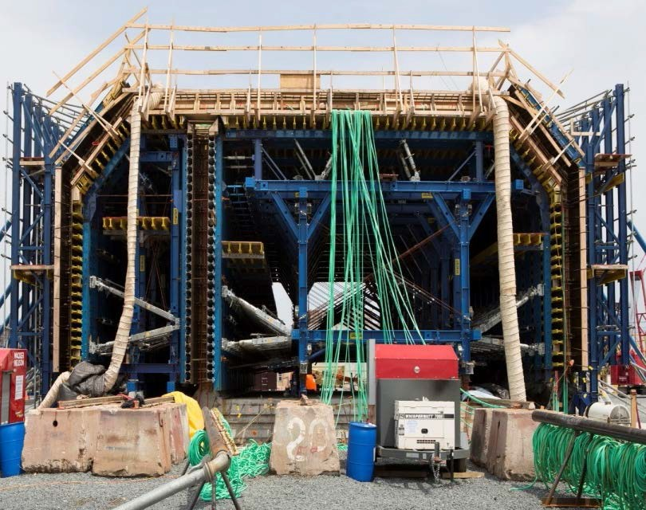
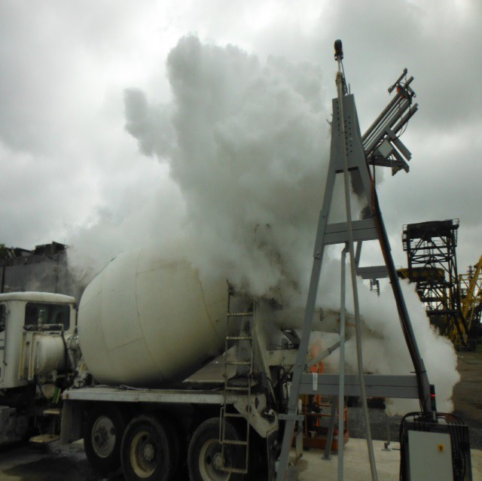
Addressing Restraint and Differential Thermal Movement was a Major Challenge!

Slide 42
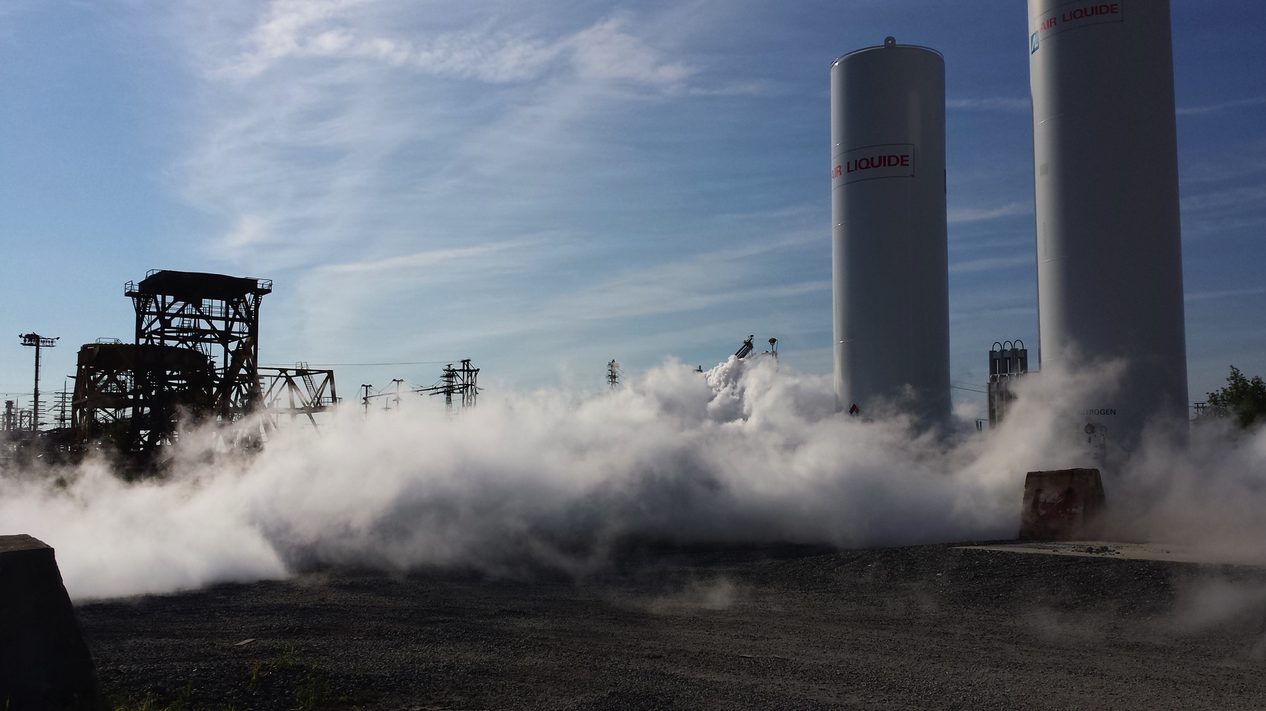

Slide 43
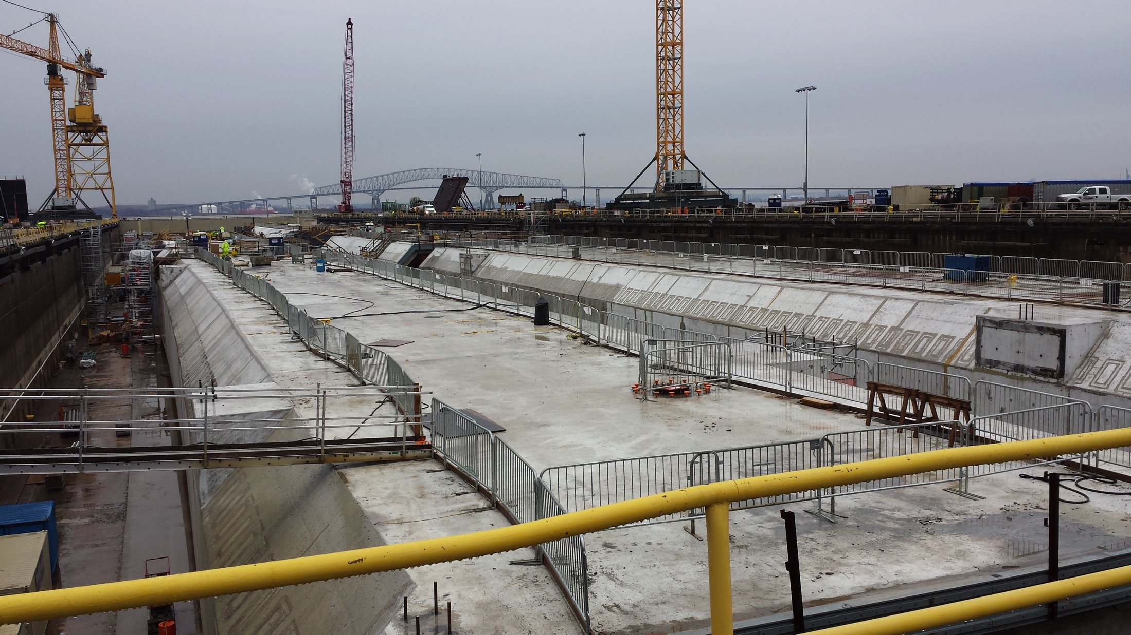

Slide 44
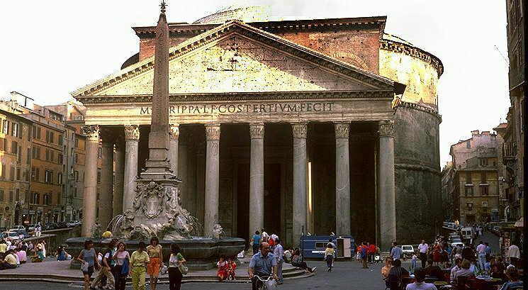
Pantheon – 2000 Years and Counting

Slide 45
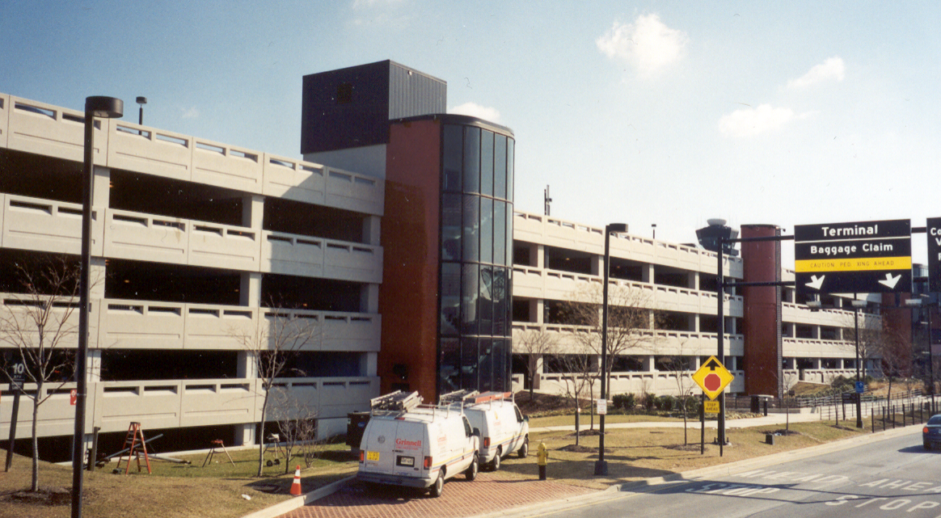
Air / Point of discharge, point of placement, hardened air, etc.

Slide 46

Shrinkage

Slide 47
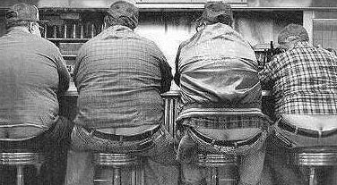
Avoiding Cracks

Slide 48
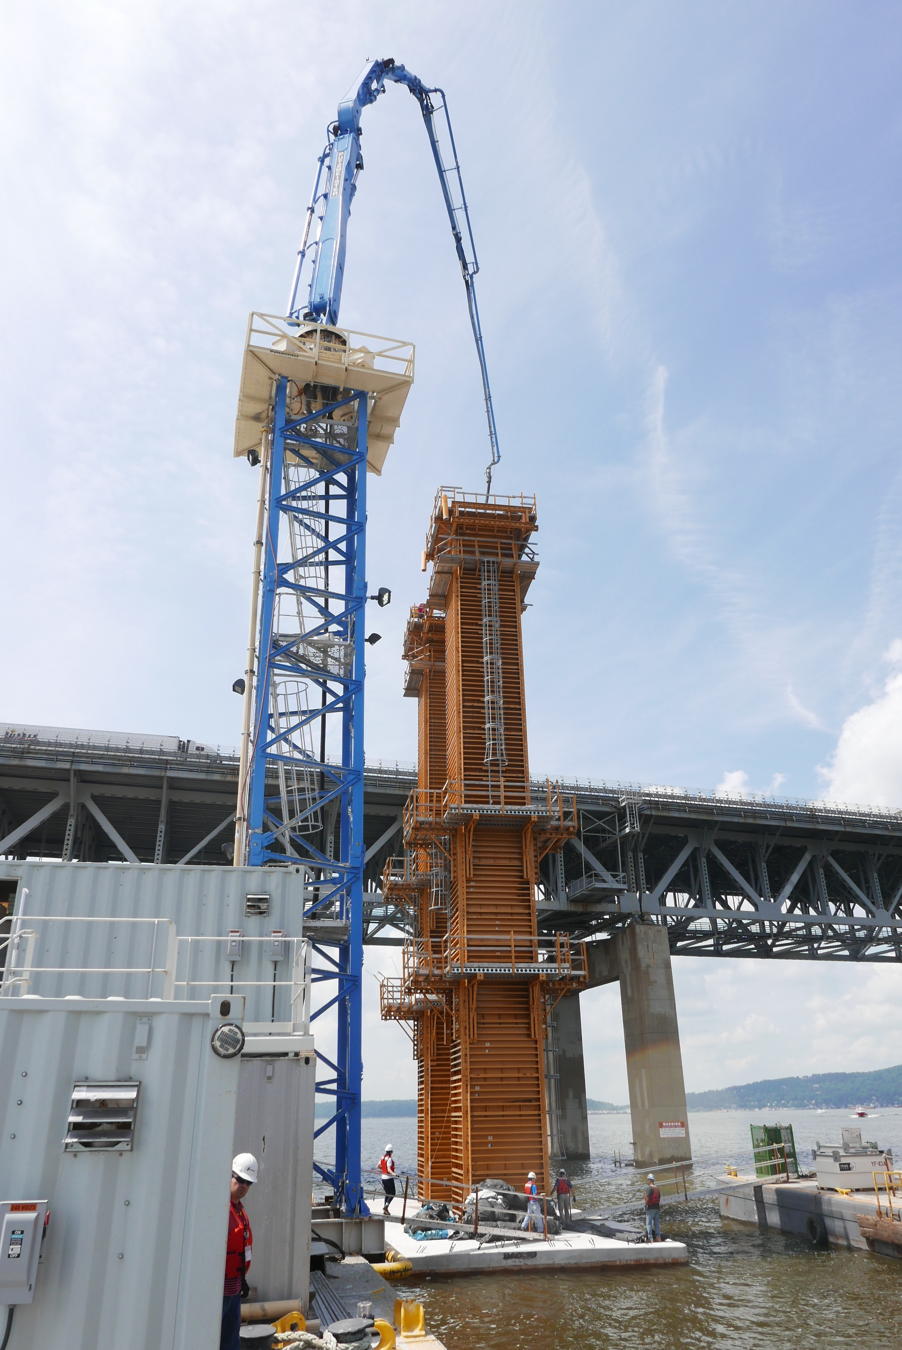

Pumping Bubblegum

Slide 49
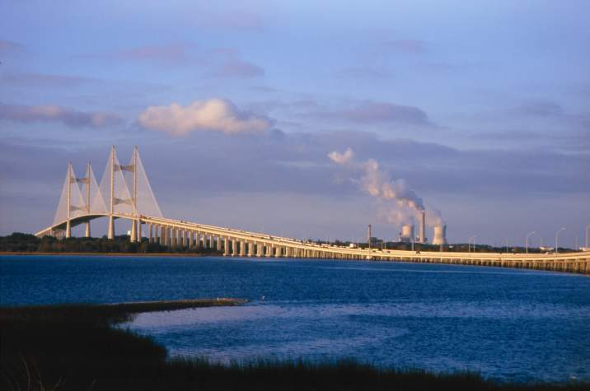
Mass Concrete / Slag Replacement Percentages

Slide 50
Heat of Hydration

Slide 51
Effect of Slag Replacement Levels on Concrete Temperatures in Mass Concrete

Slide 52
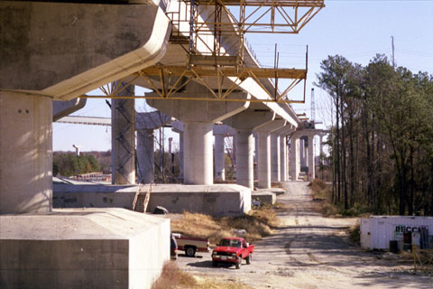
Curing Cylinders / Match Cure and Proper Protection of Green Concrete

Slide 53
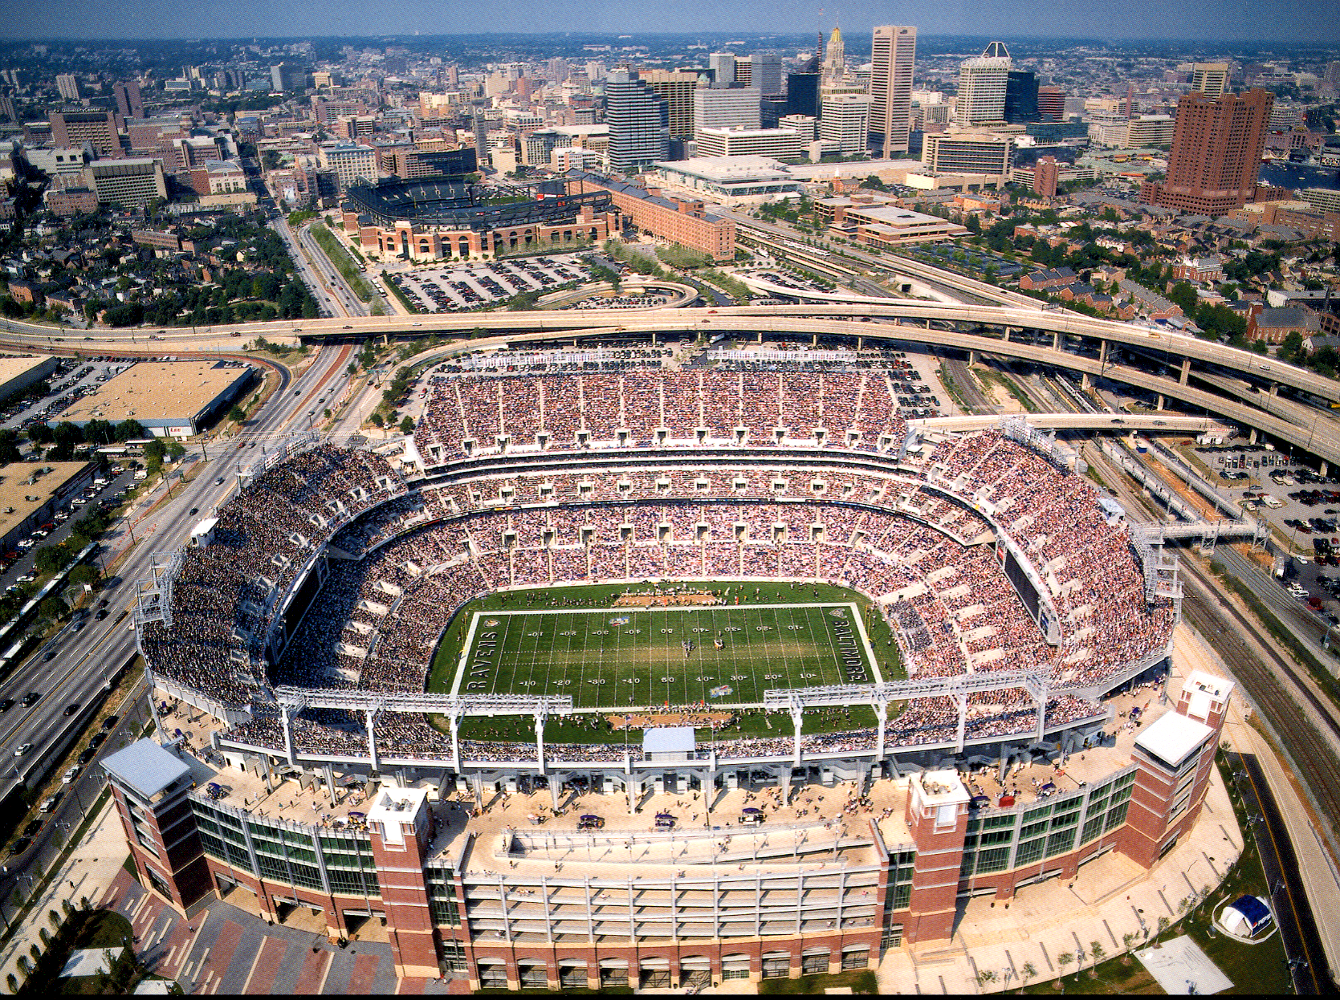
Slag Cement Replacement Levels

Slide 54
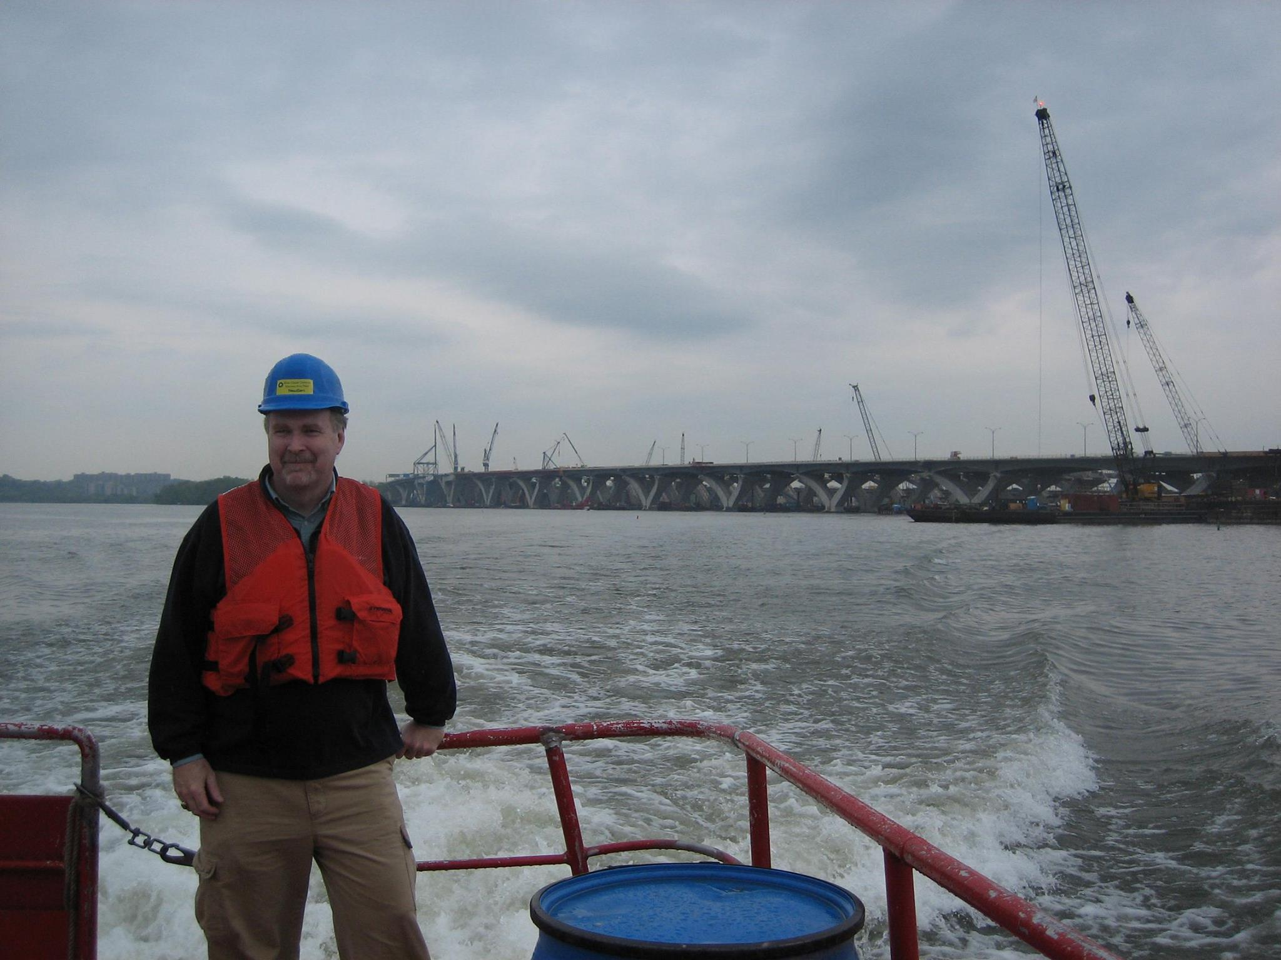
Curing Temperatures

Slide 55
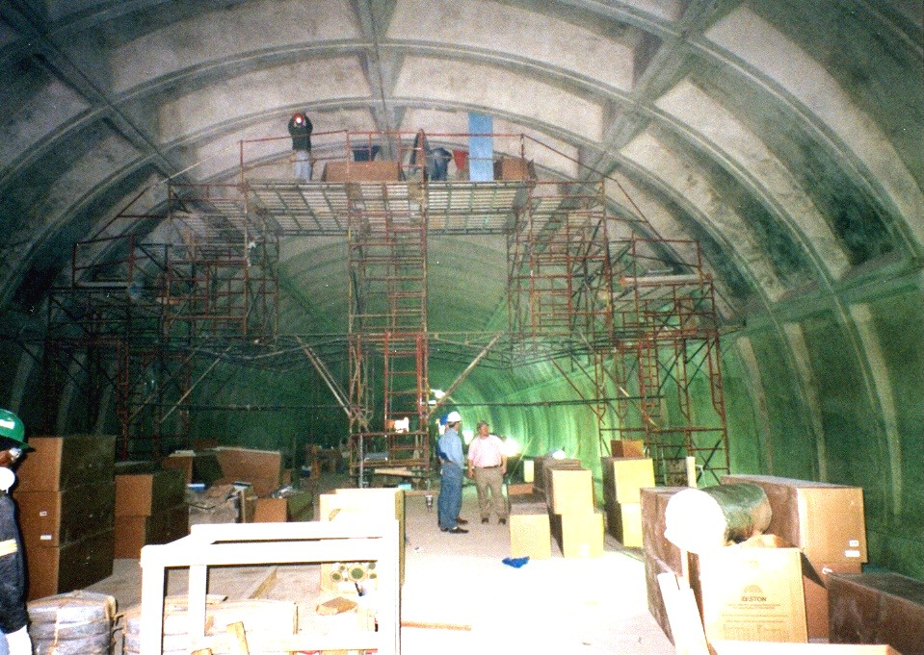
Concrete Color

Slide 56
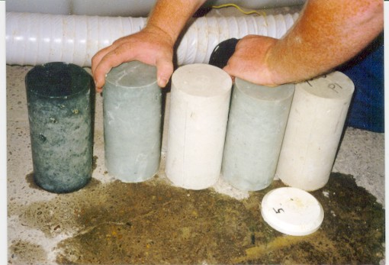

Slide 57
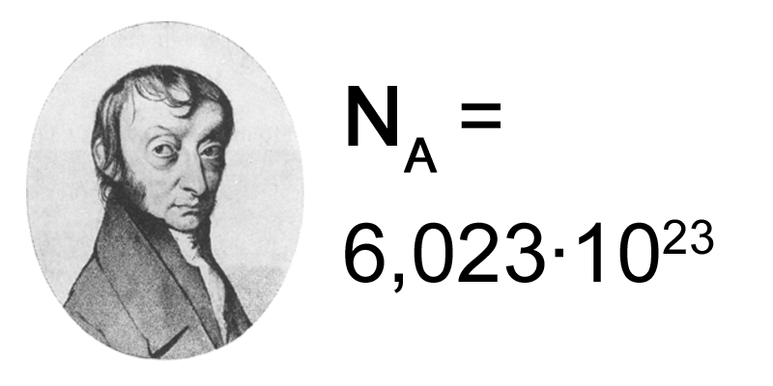
Molar Ratio

Slide 58
Price Adjustment
902.10.10 Price Adjustment. A price adjustment will be based on the Contract unit price per cubic yard of concrete. If the unit is a lump sum item, the price per cubic yard for the concrete will be determined by dividing the cubic yards into the Contract lump sum price.

Slide 59
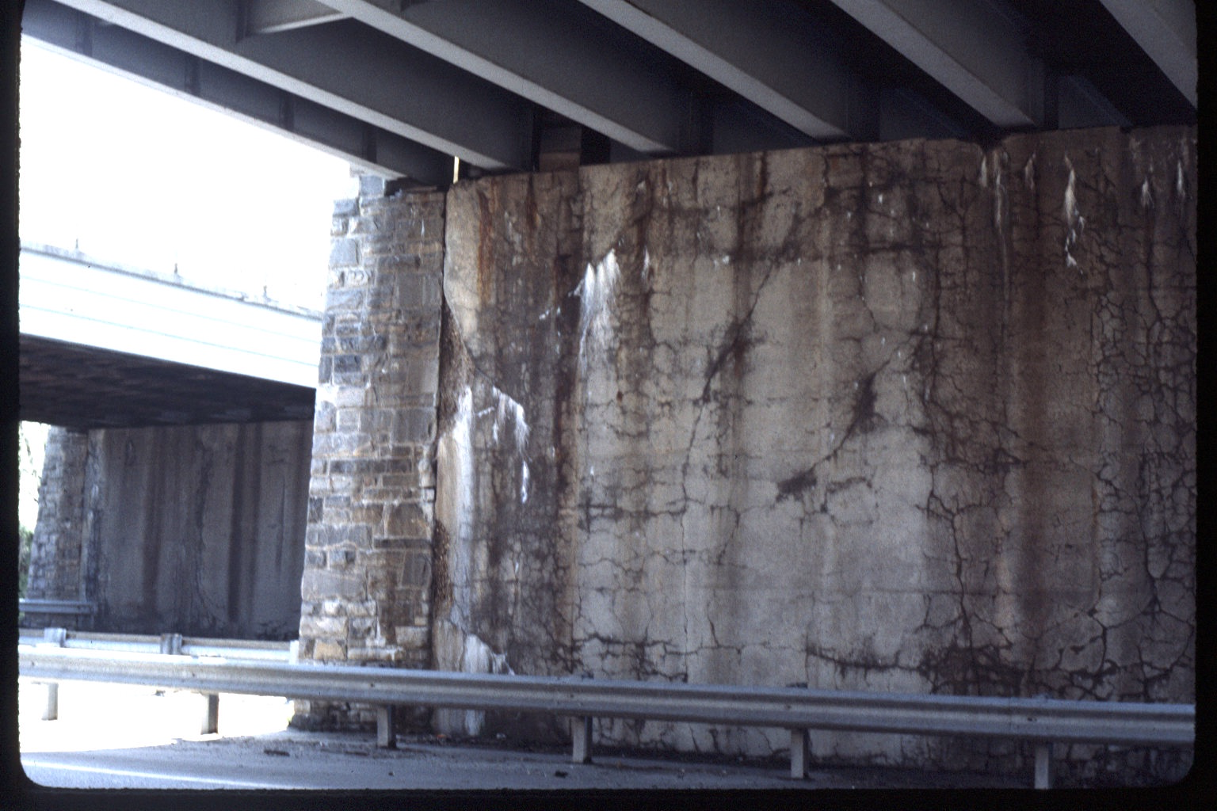
US 50 and 301

Slide 60
What is the science behind the classifications of the different reactivity's, R0 – R3?
Aggregate Reactivity Class | Description of Aggregate Reactivity | 14 Day Expansion in C1260 | 1 Year Expansion in C1293
R0 | Non Reactive | ≤0.10 | ≤0.04
R1 | Moderately Reactive | >0.10 ≤0.30 | >0.04≤0.12
R2 | Highly Reactive | >0.30 ≤0.45 | >0.12≤0.24
R3 | Very Highly Reactive | >0.45 | >0.24

Slide 61
Where did we come up with the levels. Is there science behind them?
Size and Exposure Condition | Aggregate – Reactivity Class
 | R0 | R1 | R2 | R3
Non-massive concrete in a dry environment | Level 1 | Level 1 | Level 2 | Level 3
Massive elements in a dry environment | Level 1 | Level 2 | Level 3 | Level 4
All concrete exposed to humid air, buried or immersed | Level 1 | Level 3 | Level 4 | Level 5
All concrete exposed to alkalis in service | Level 1 | Level 4 | Level 5 | Level 6
Notes:
Is there any science behind these levels?

Slide 62
Is there science behind the service life predictions?
SC3
SC4
Significant safety, economic, or environmental consequences if minor damage
Serious safety, economic, or environmental consequences if minor damage
Minor risk of ASR may be acceptable
ASR cannot be tolerated
Pavements
Foundations elements
Retaining walls
Culverts
Highway barriers
Rural, low-volume roads
Precast elements in which economic costs of replacement are severe
Service life normally 40 to 74 years
Major bridges
Power plants
Dams
Nuclear facilities
Water treatment facilities Waste water treatment facilities Tunnels
Critical elements that are very difficult to inspect or repair
Service life normally more than 75 years

Slide 63
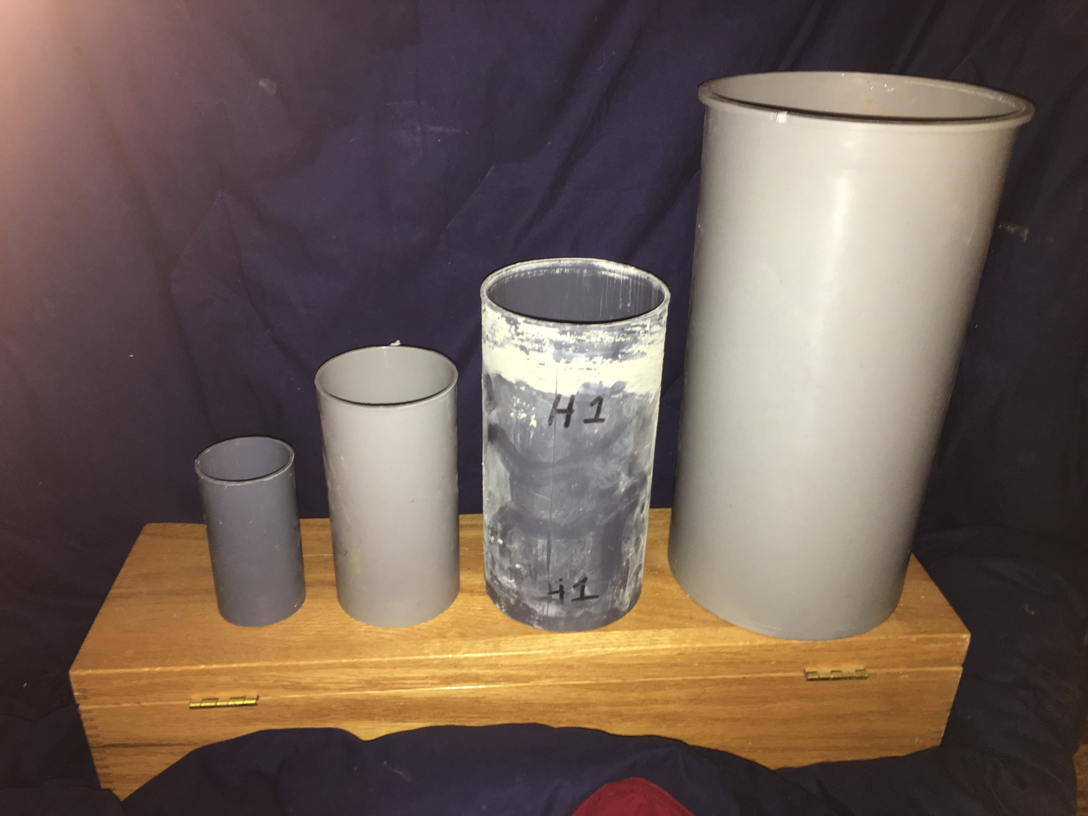
Size Doesn’t Matter

Slide 64
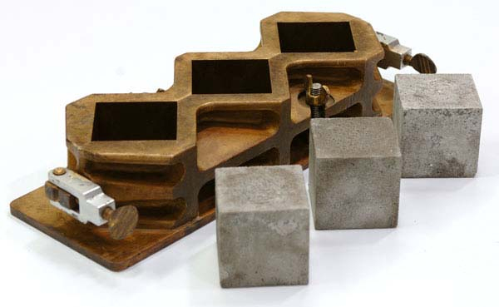
Cubes for Grout??????????????

Slide 65
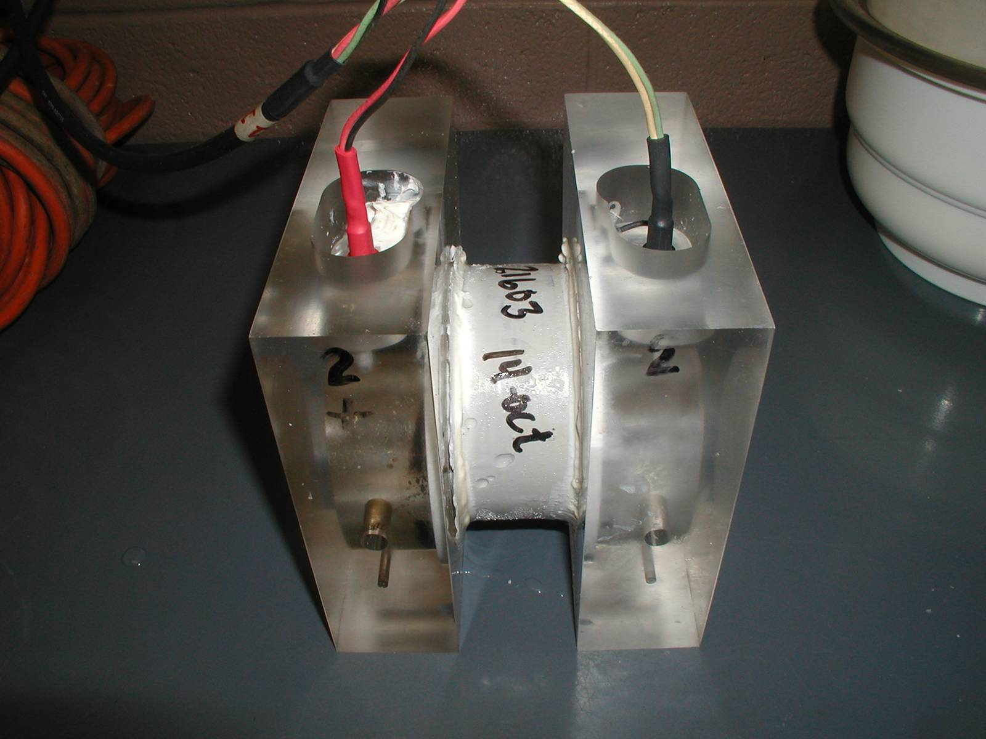
Measuring Permeability

Slide 66
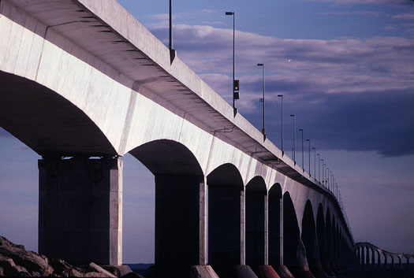

Slide 67


