Slide 1

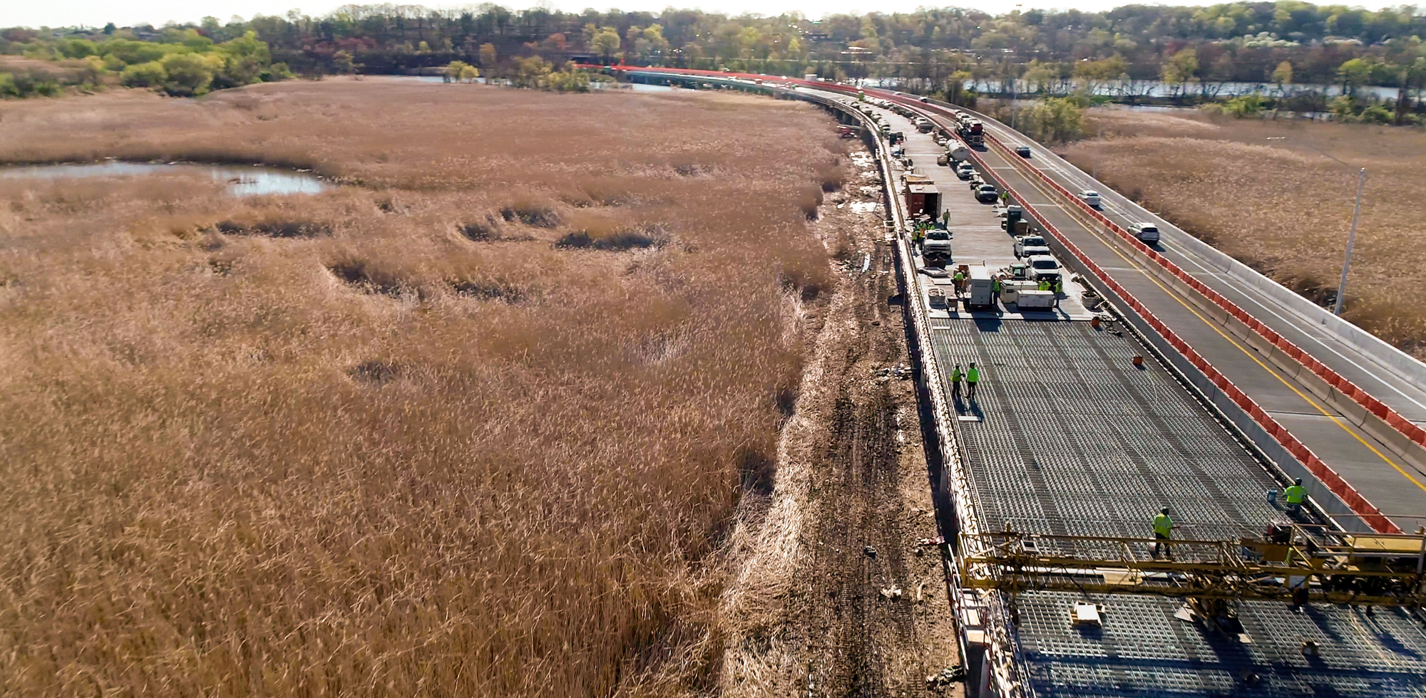




March 10, 2020
Superstructure Replacement Of
I-895, Baltimore Harbor Tunnel Thruway
Over
Patapsco River Flats
All‐lightweight Concrete Filled Grid Deck
Tony Tabasco, MDTA
Shilpa Kodkani, PE, RK&K
Joe Hoffmann, PE, McLean
Teck Chua, PE, Vulcan

Slide 2
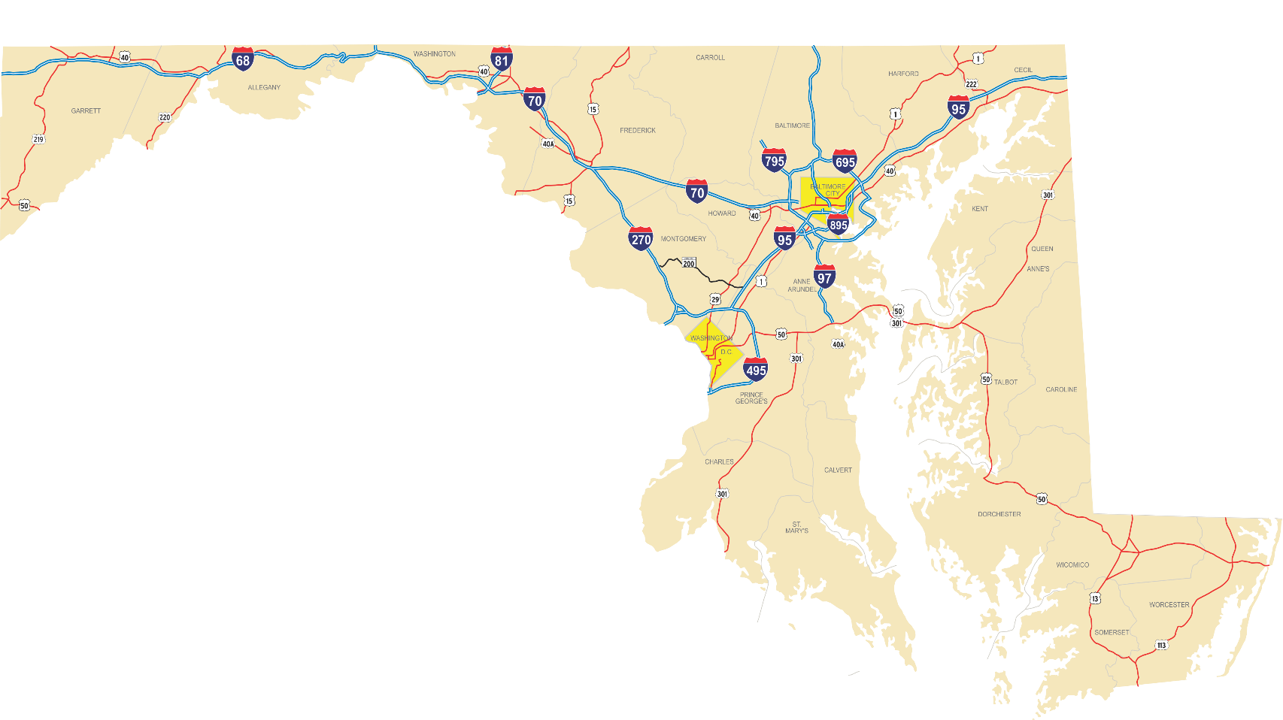
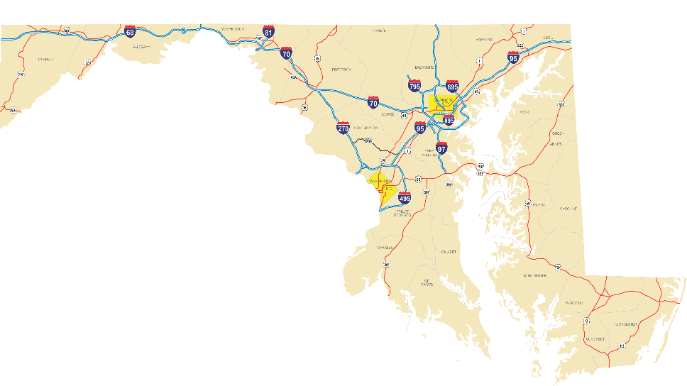
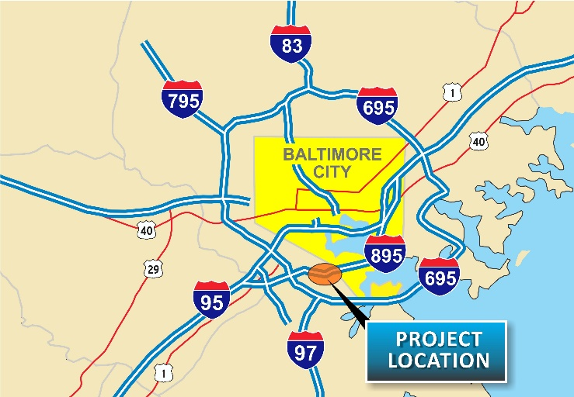
Project Location
PROJECT
LOCATION

Slide 3
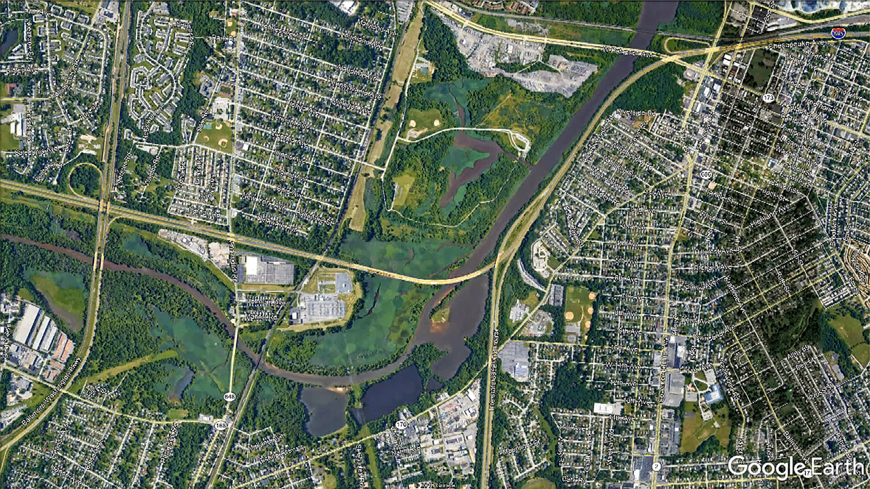





Project Location
PROJECT
LOCATION

Slide 4
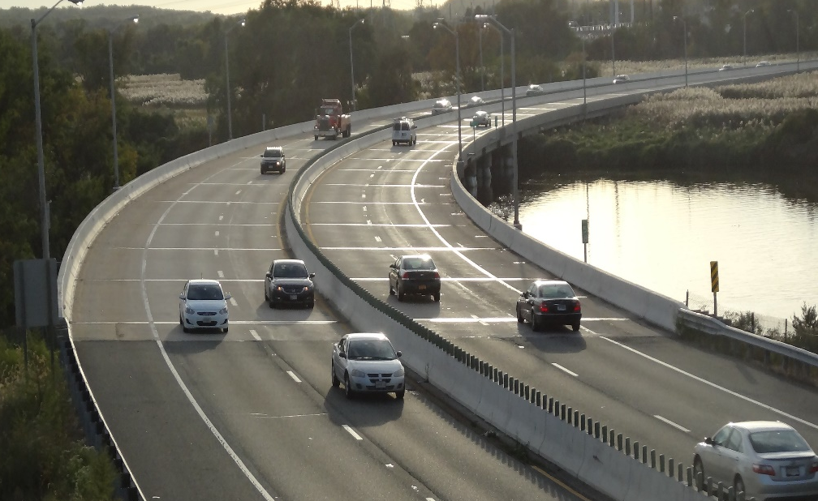
Overview
Existing dual bridge steel beam with concrete-filled steel grid deck
Carries I-895 over Patapsco River Flats
Built in 1957, LMC overlay and widened in 1984
About 2380’ long in each direction with 42 simply supported spans

Slide 5
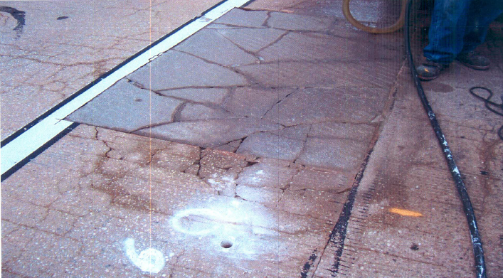
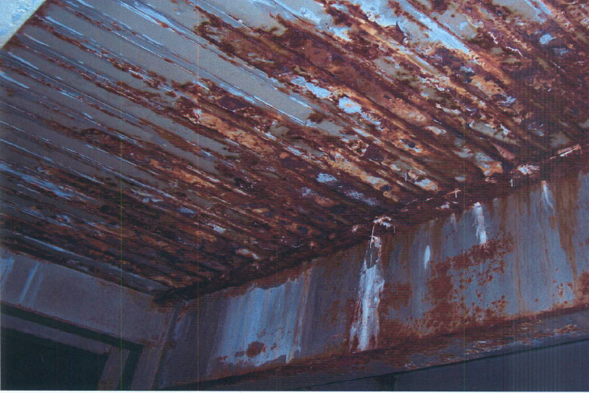
Condition of the Existing Bridge
Existing deck in poor condition

Slide 6
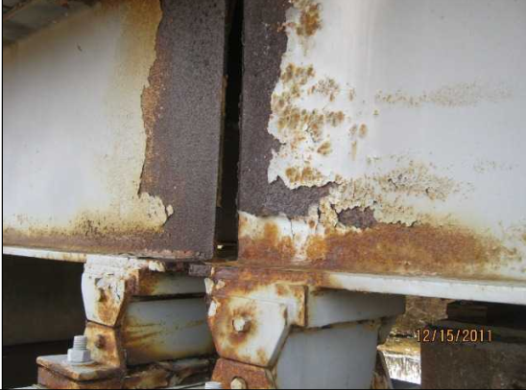
Condition of the Existing Bridge
Existing superstructure in poor condition

Slide 7
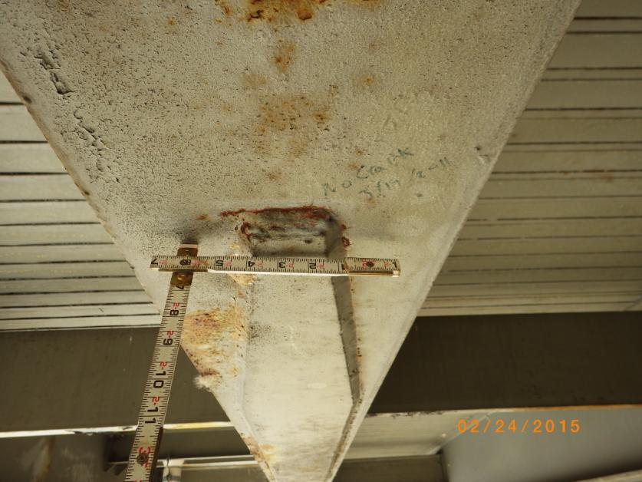
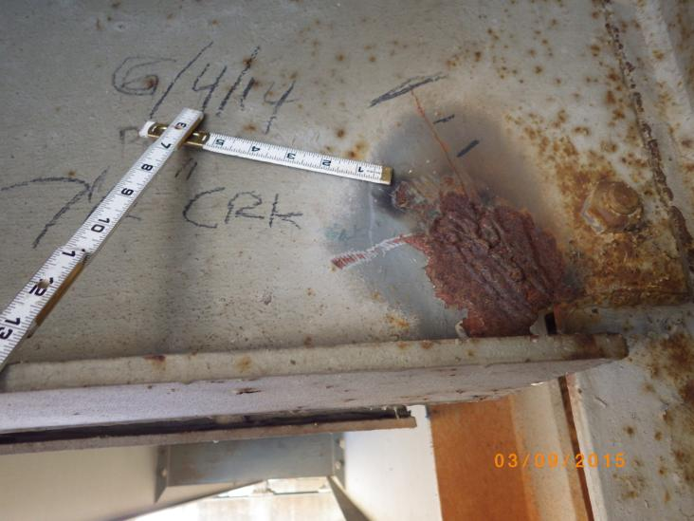
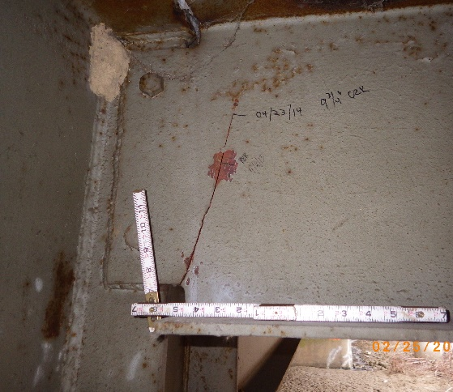
Condition of the Existing Bridge
Existing superstructure in poor condition

Slide 8
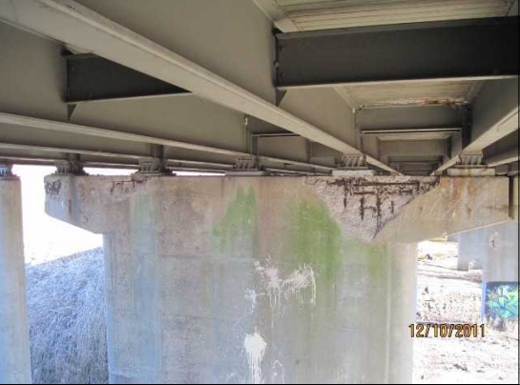
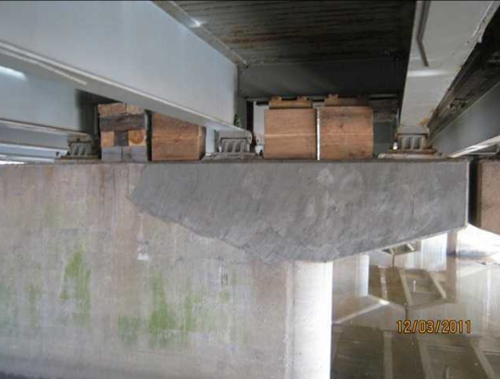
Condition of the Existing Bridge
Existing substructure in fair condition
Substructure rehabilitation contract (HT-2454) completed, raising the rating to satisfactory condition

Slide 9
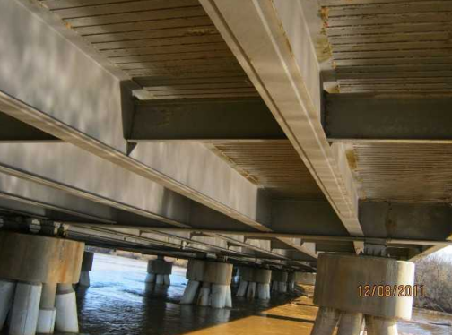
Typical Existing Superstructure
42 span steel multi- beam
Concrete filled steel grid deck

Slide 10
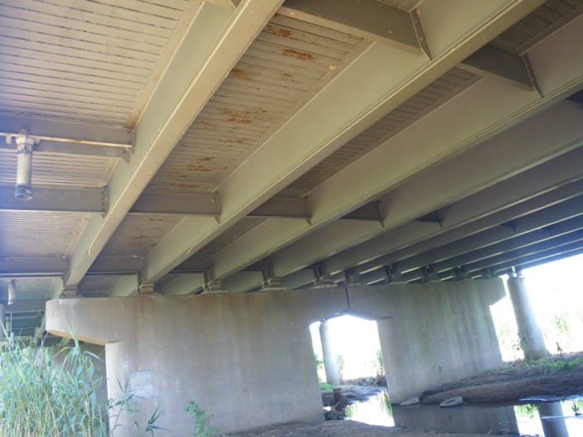
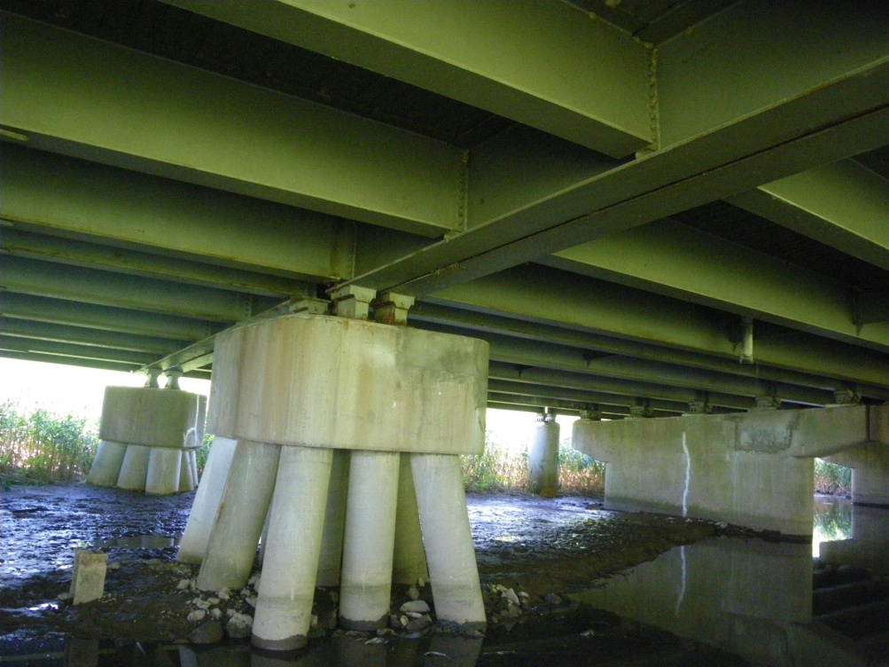
Typical Existing Substructure
Hammer Head Pier and Column
Pile Bent

Slide 11
Superstructure Rehabilitation Study
RK&K performed a MOTAA and Superstructure Rehabilitation Study in November 2012
Study evaluated
  Replacement options
  Sequence of construction
  MOTAA during the replacement

Slide 12
Replacement Options
Deck replacement with superstructure rehabilitation
  Rehabilitation-painting, intermediate diaphragms, bearings, cover plates, plating
  Deck replacement
    Normal weight concrete
    Lightweight concrete
    Steel grid deck partially filled with lightweight concrete
Superstructure replacement
  Concrete beams
  Simple and two span continuous steel girders

Slide 13
Rehabilitation Study - Sequence of Construction
  1A - Maintain one lane of traffic in each direction at all times, both lanes on one bridge
  1B - Maintain one lane of traffic in each direction at all times, one lane on each bridge
  2 – Close the bridge and detour all traffic
  3 – Maintain two lanes of traffic in each direction
  4 – Detour any one direction of traffic

Slide 14
MOTAA During Replacement
MOTAA
  Work zone traffic analysis
    Capacity analysis
  Construction & user cost analysis
    Construction cost, road user cost and loss of revenue
Selected Alternative 1 A- One lane of traffic each direction on one bridge

Slide 15
Superstructure Rehabilitation Study – Constraints/Goals
Capacity of the existing substructure
Evaluate continuity for live load
Reduce number of joints
Replacement structure shall not exceed capacity of the existing substructure and piles
Upgrade existing 2’-10” barriers to 42” deep, TL-5 standard barriers

Slide 16
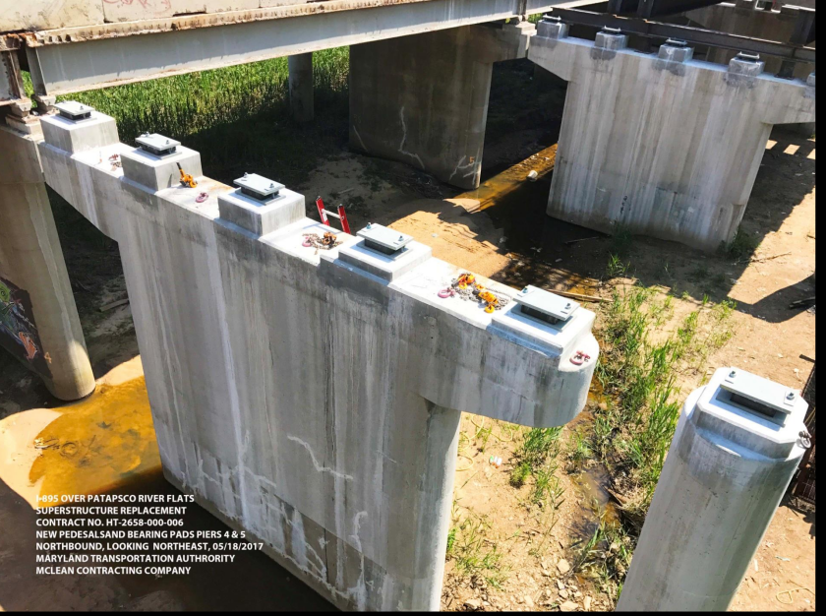
Substructure Evaluation
Existing hammer head pier was analyzed using RC Pier and STAAD
Existing cross-girder and pile bents were analyzed using STAAD
Pile capacities were limited to those indicated on as-built drawings
HS-20 Live Load was used for superstructure design

Slide 17
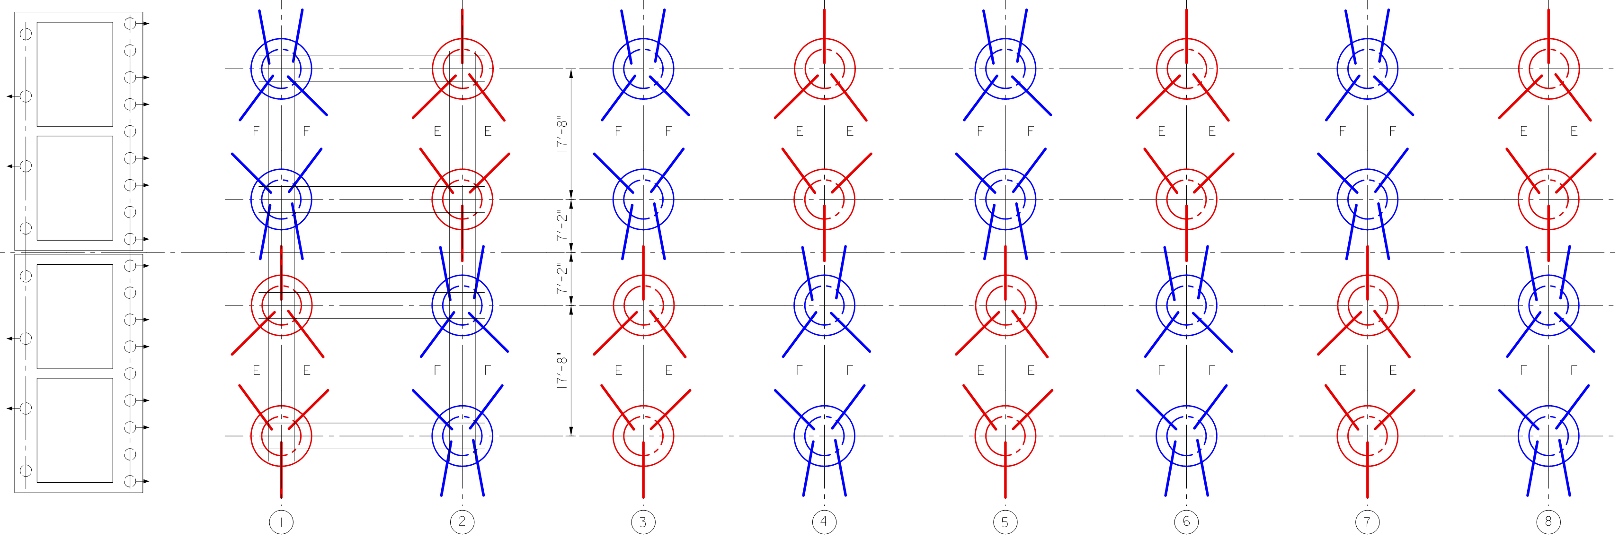
Pile Layout
Expansion Pier
Fixed Pier

Slide 18
Superstructure Rehabilitation Constraint
Deck Option | Slab Thickness | Load Intensity
Conventional Concrete | 8” | 115 psf
Light Weight Concrete (118 pcf) | 8” | 93.7 psf
Existing Grid Deck Filled with Conventional Concrete | 7” | 88.5 psf
Proposed Steel Grid Deck Partially Filled with All-lightweight Concrete (100 pcf) | 7 3/16” | 50.0 psf

Slide 19
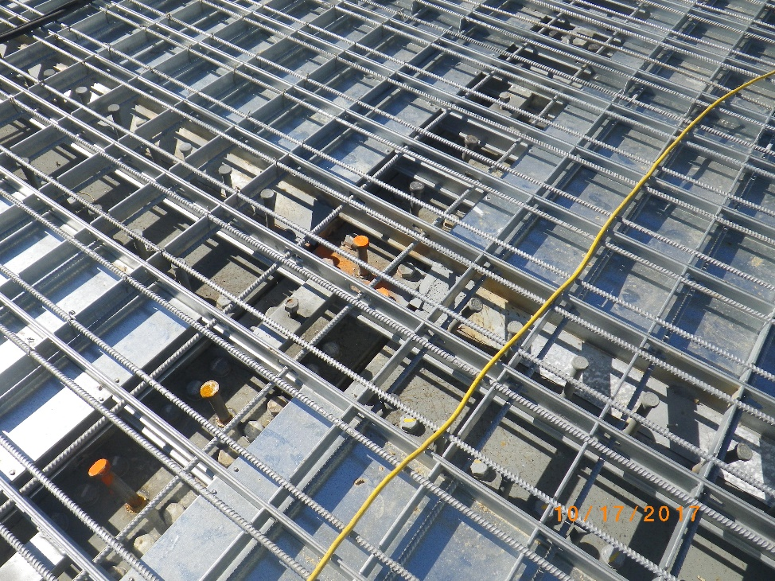
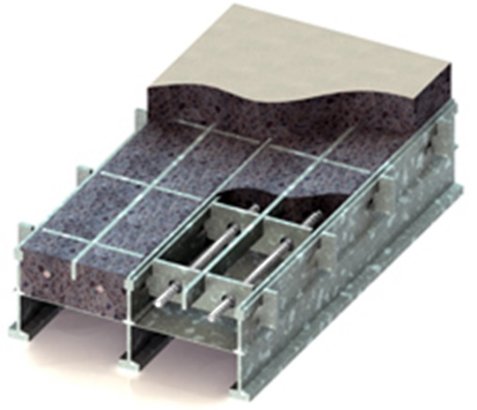
Proposed Bridge Replacement
  Galvanized steel grid deck
  Partially filled with all-lightweight concrete
  Using Sequence of Construction 1A
  2 span continuous segments
  42” barriers to meet TL-5 requirements

Slide 20
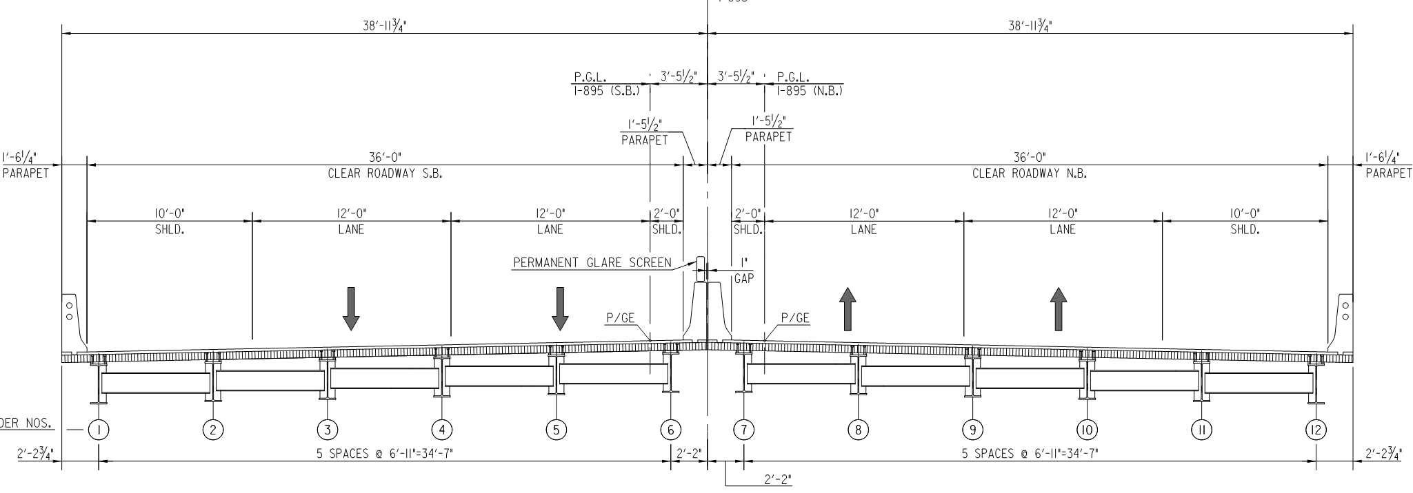
Design Phase
Typical Bridge Section

Slide 21

Design Phase - Grid Deck
Galvanized steel grid deck with galvanized reinforcing steel
Stainless Steel Reinforcing Steel was used in the barriers
Overall Depth of 7 3/16”
  5 3/16” Grid Deck
  2 1/2” Concrete Infill
  2” Integral Concrete Overfill
Full Pour Over Girders
3/8” Maximum Aggregate Size
Designed by Contractor

Slide 22
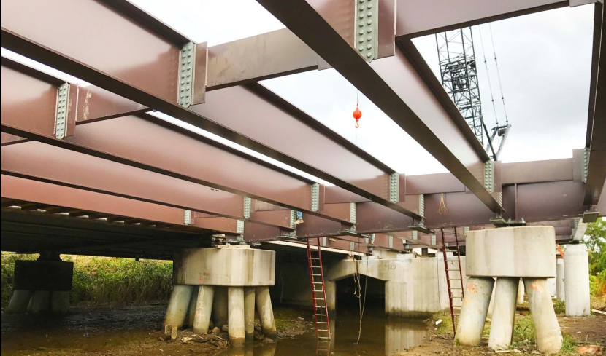
Design Phase - Superstructure
Steel Plate Girder
Shop Painted
30” to 32” Total Girder Depth
Optional Field Splice
Contractor elected not to use splices
96’ to 120’ Span Lengths
Elastomeric Bearings

Slide 23
Design Phase - All Lightweight Concrete
LW Fine Aggregate
LW Coarse Aggregate
All-Lightweight Concrete

Slide 24
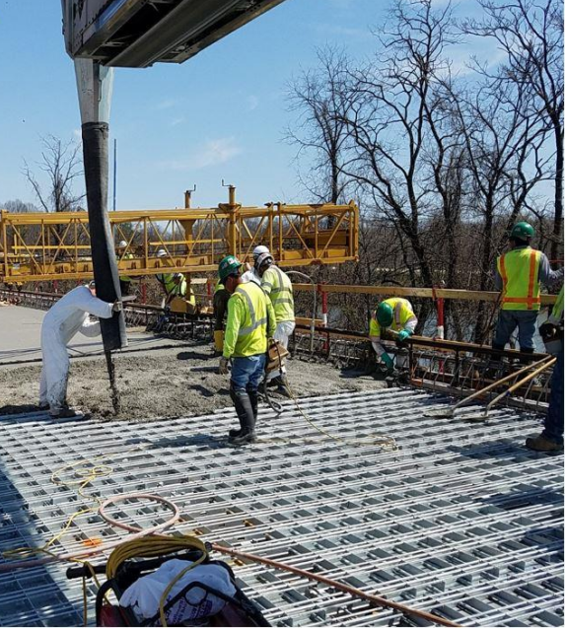
Design Phase – All-Lightweight Concrete
Equilibrium Density of 100 pcf
28-days Compressive Strength of 4,500 psi
Greater absorption than regular aggregates
Prewetting is required
Single sourcing of aggregates
Communication

Slide 25
Project Background
Low Bidder: McLean Contracting Company - $48.5 Million (Construction)
Schedule:
  Advertised: December, 2, 2015
  Bids taken: February 18, 2016 (10 bidders)
  Construction NTP: July 11, 2016
  Construction duration: 3+ years
  Substantial Completion: September 30, 2019
Bridge Cost: $220/sq. ft.
Delivery Method: Design-Bid-Build

Slide 26
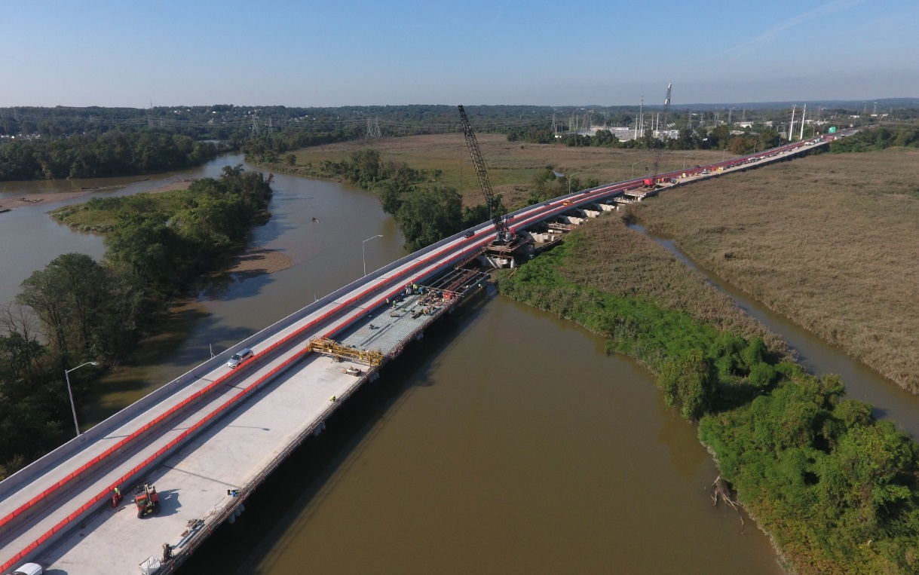
Construction Phase

Slide 27
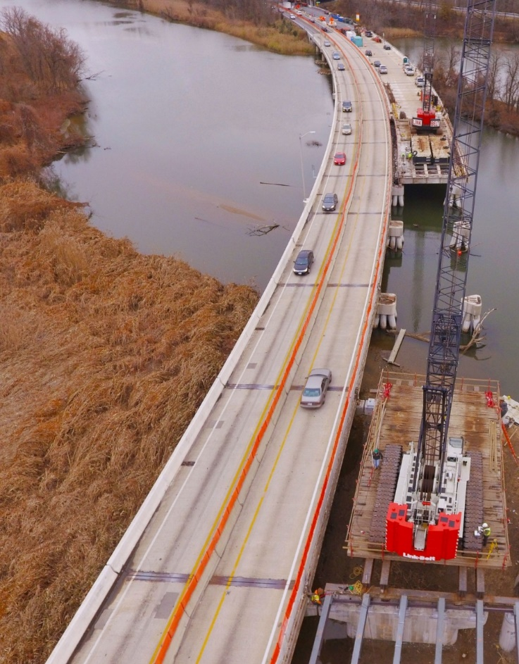
Construction Phase
Challenges
  Access
  Schedule
  Materials
Our Approach
  Sequential timing
  Crane selection
Lightweight Concrete
  Supply
  Placement

Slide 28
Work Plan

Slide 29
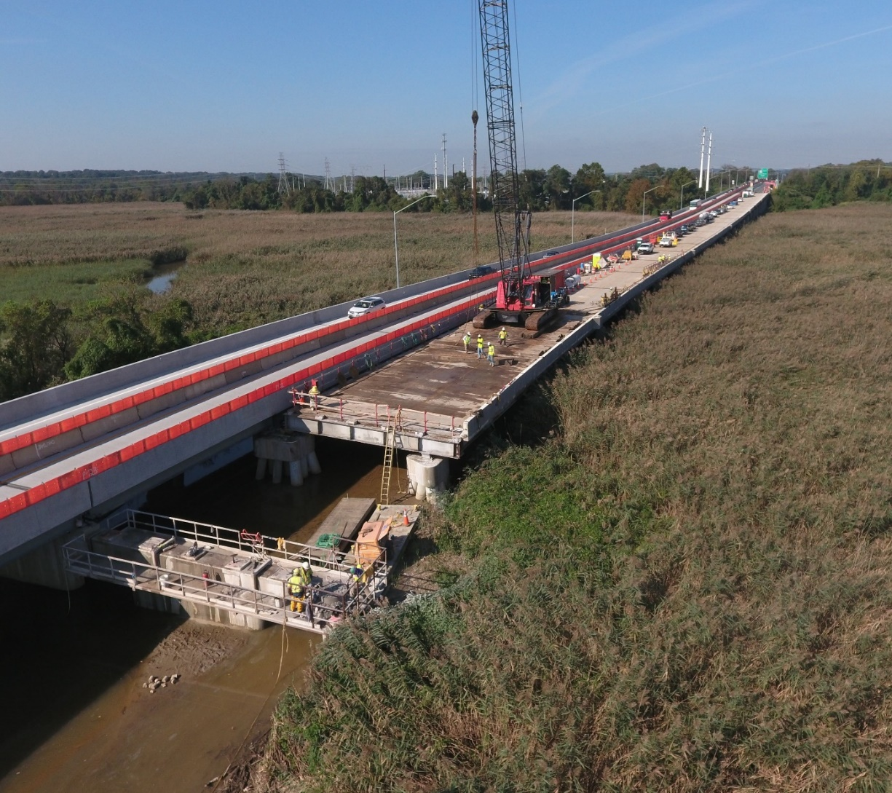
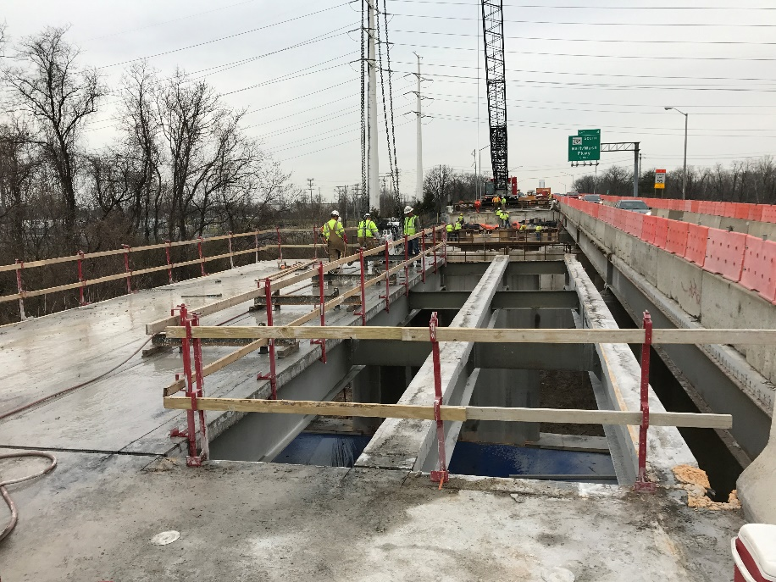
Demolition

Slide 30
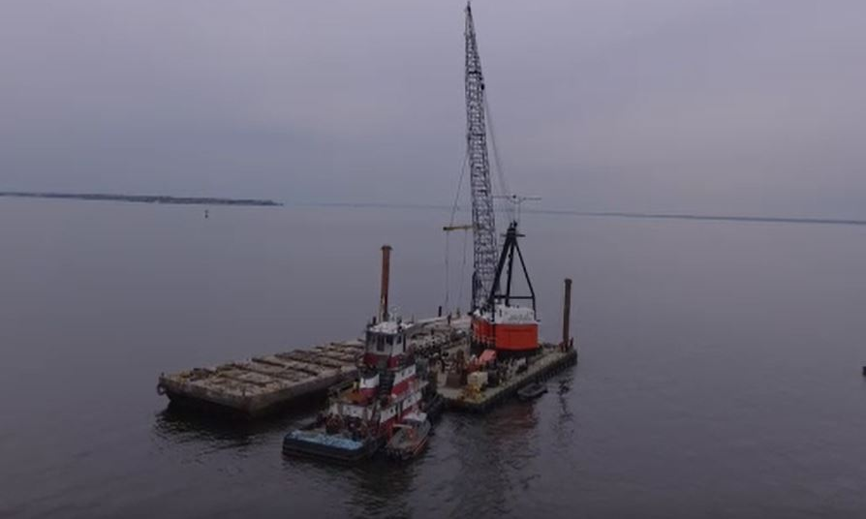
Demolition Disposal
Girders: Recycled
Existing grid deck: Chesapeake Bay Artificial Reef Program
Love Point, Maryland
Chesapeake Bay

Slide 31
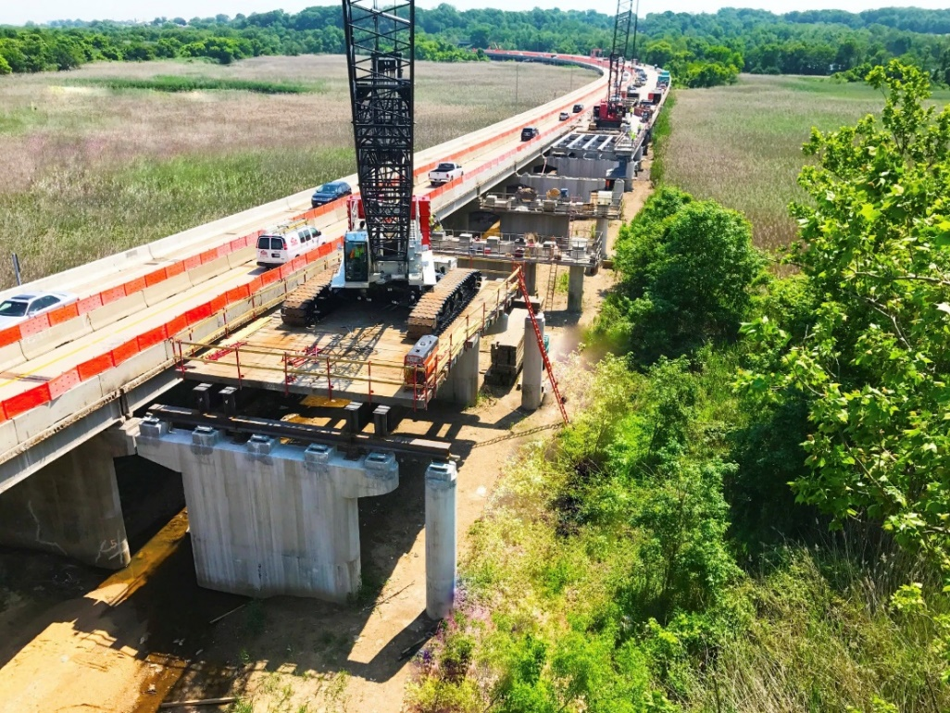
Construction

Slide 32
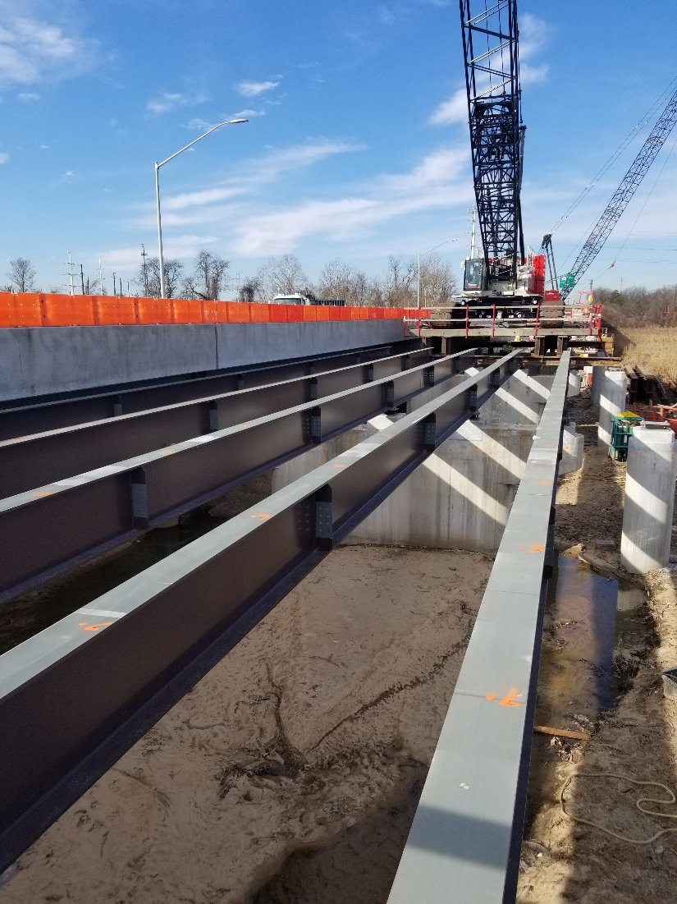
Girder Erection
Steel plate girders
Two-Span Units
Hammer Head Pier & Column
  No Field Splices
Pile Bents
  Framed Cross Girders

Slide 33
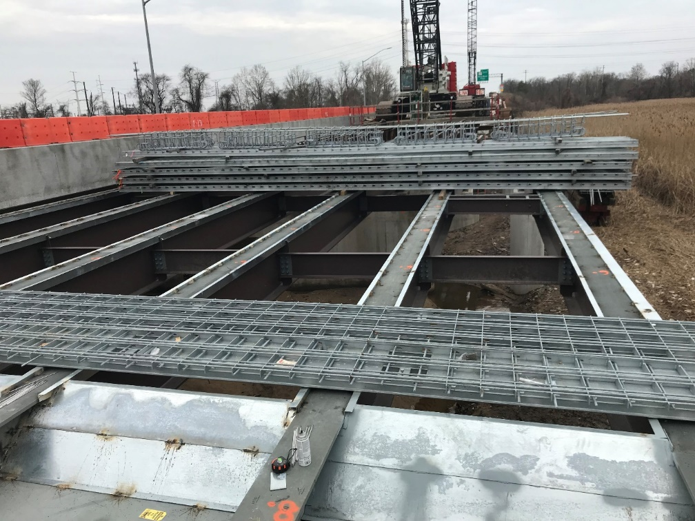
Grid Deck Assembly
Average cycle time for grid deck unit was 11 days
Estimated cycle time for conventional bridge deck unit was 18 days

Slide 34
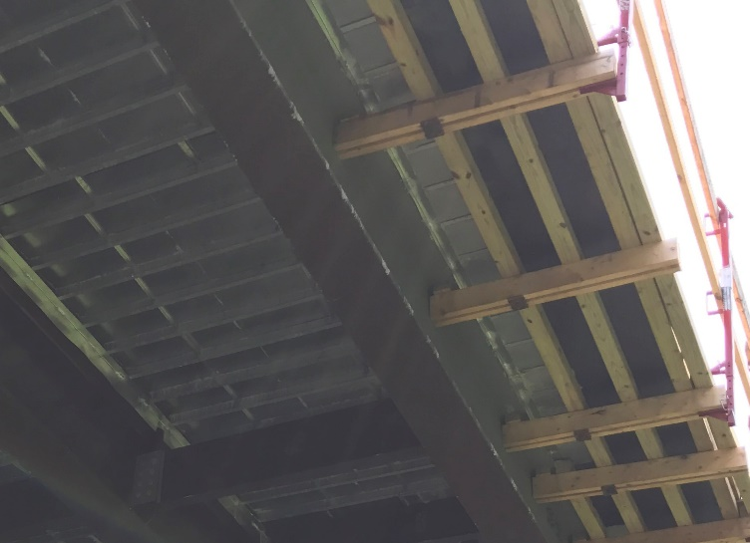
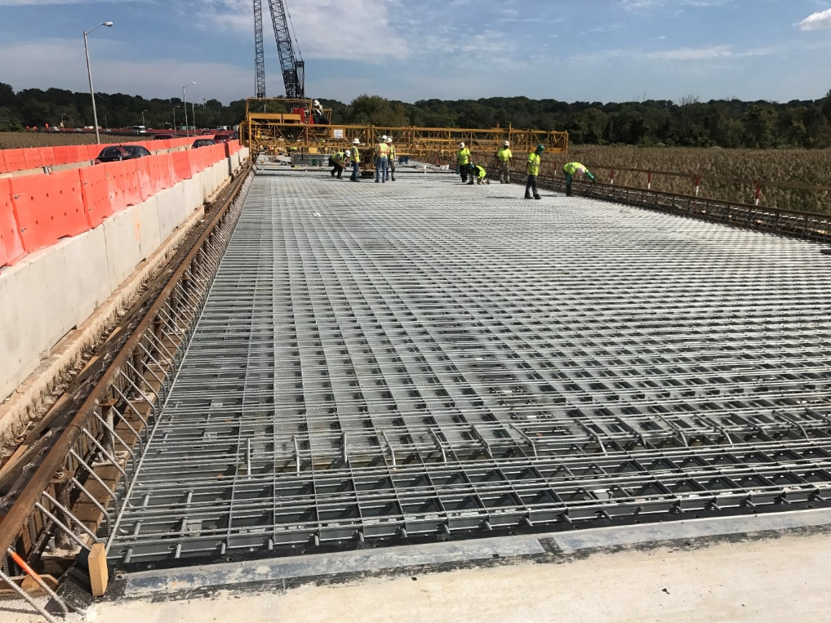
Deck Construction

Slide 35
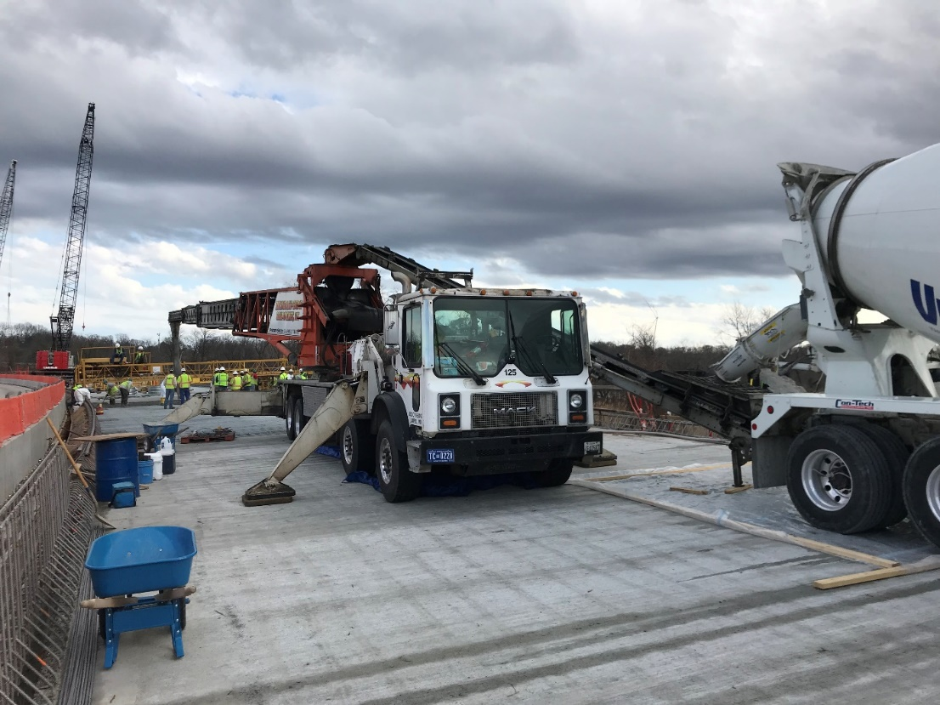
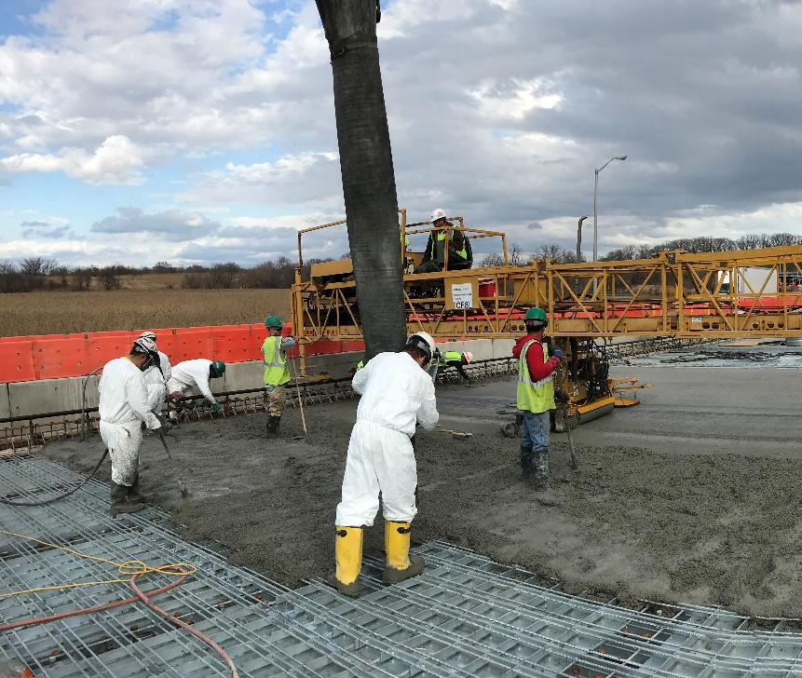
Concrete
Placement

Slide 36
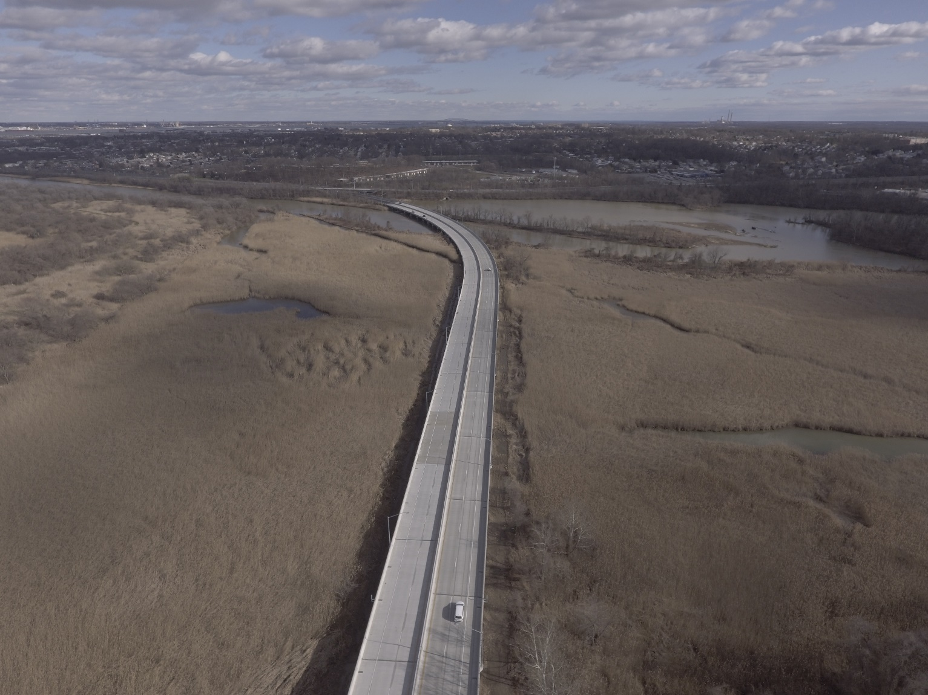
Completed Structures
January 26, 2020

Slide 37
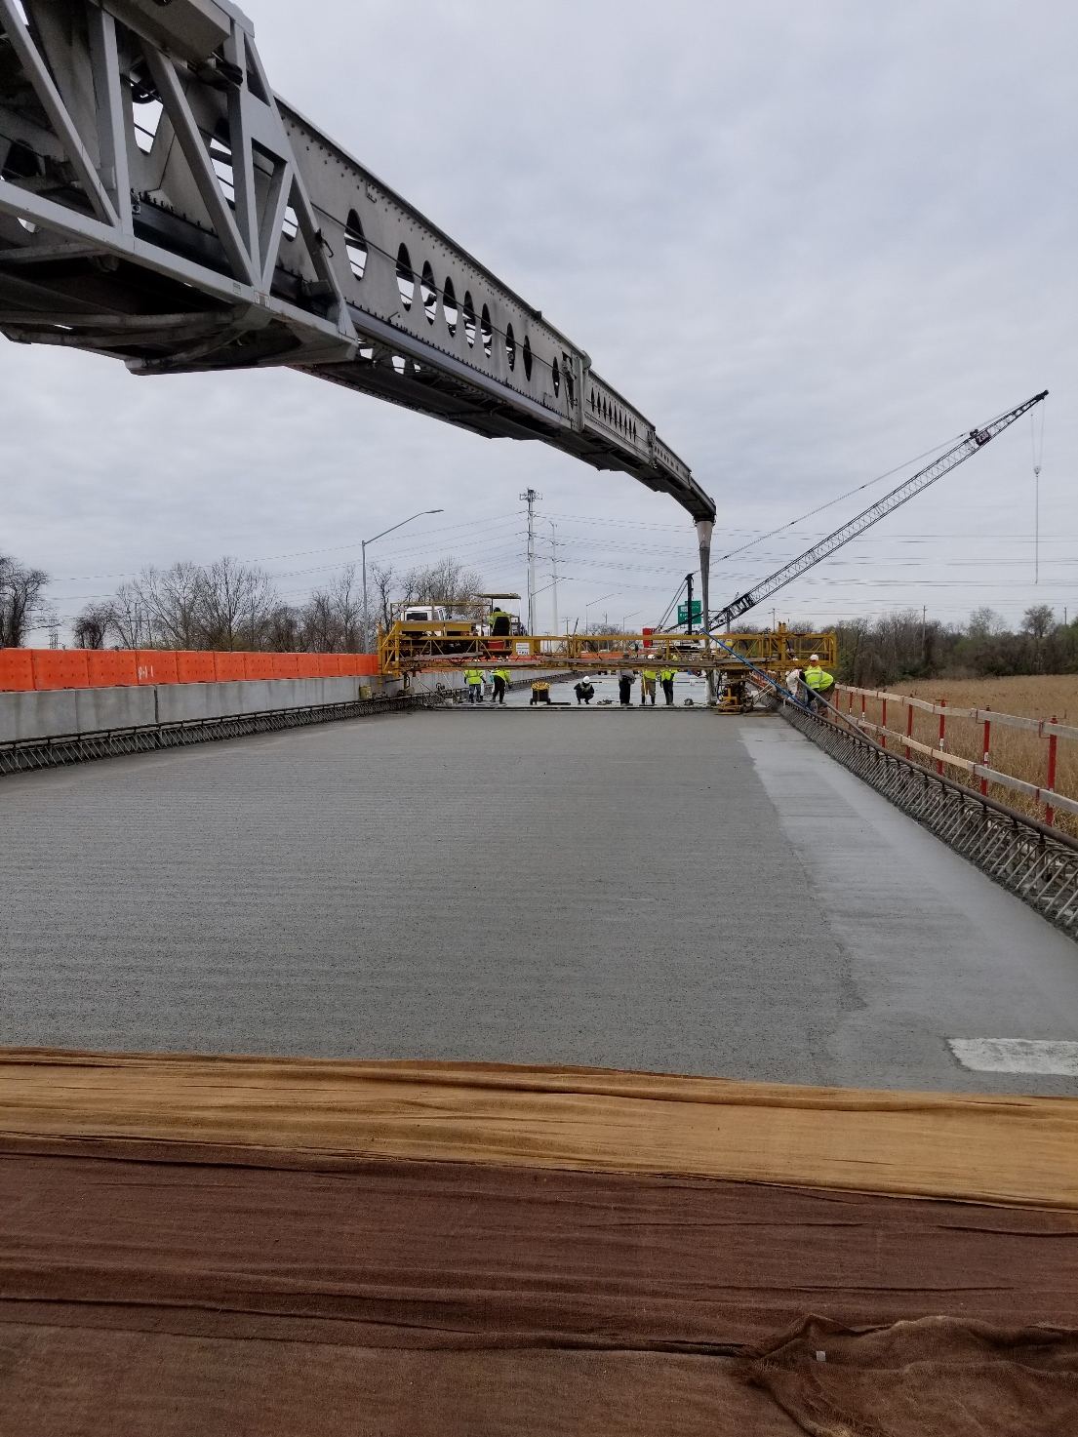
Concrete
Vulcan Materials:
Concrete Production & QC/QA

Slide 38
Concrete
Telebelt conveyor: can’t pump the mix

Slide 39
100pcf – Wet vs “Dry” Density
ASTM C567-14 – “Dry” density is “equilibrium” density
3.2.1 equilibrium density, the density . . . (at) constant mass.
(NOTE 1) . . . Decrease in density . . . is due to moisture loss . . . For most structural lightweight concretes, equilibrium density is approached at about 90 days
5.1 . . . U.O.W, determine equilibrium density by calculation using the procedures in 9.2.

Slide 40
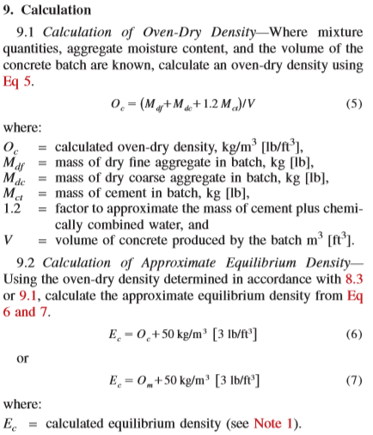
100pcf “dry”: What’s the equivalent “wet” Density in the field?
The correlation is in ASTM C567.
No cylinders

Slide 41
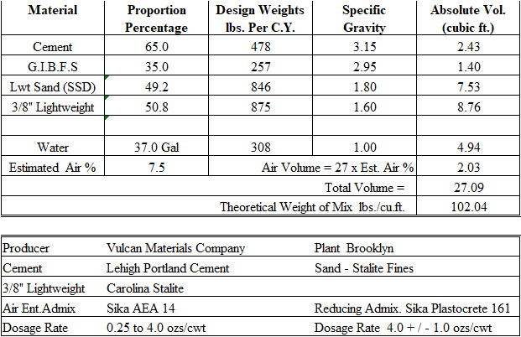
Mix Proportions

Slide 42
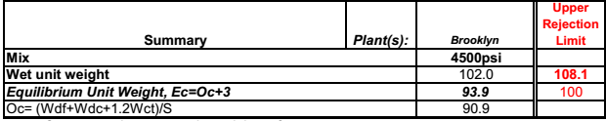
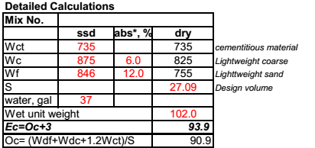
Allowable wet density <107pcf
102.0 – 93.9 =8.1 pcf,
100.0 + 8.1 =108.1 pcf
Safety margin = 1.1 pcf

Slide 43
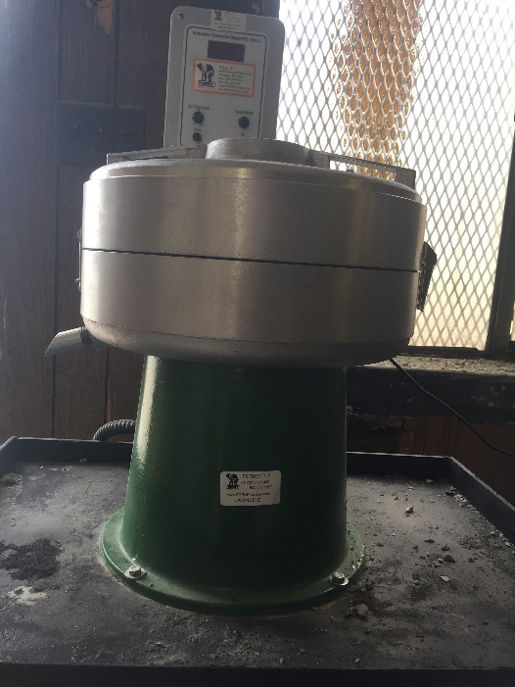
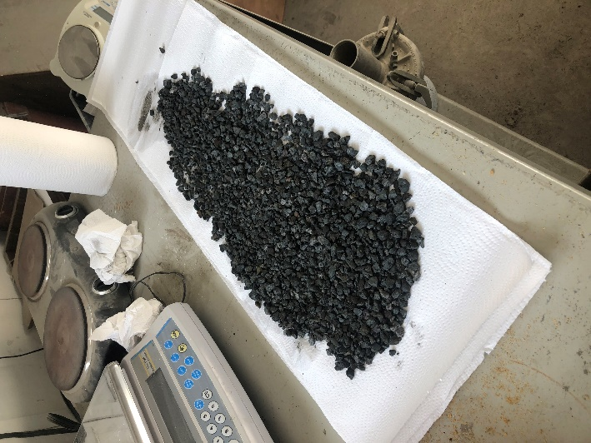

Free Moisture in the LW Aggregates
Coarse: towel dry to SSD
Fine: Centrifuge @3000rpm for 3 min.

Slide 44
Conclusion
Collaboration with the Material Manufacturers during design phase
Understanding Material Constraints
The specifications should require the presence of the lightweight aggregate manufacturer, ready mix producer, design engineer and the contractor at the deck pour meeting
Use of grid deck accelerated construction
Construction duration for deck placement was reduced by about 38% in comparison to conventional concrete deck

Slide 45
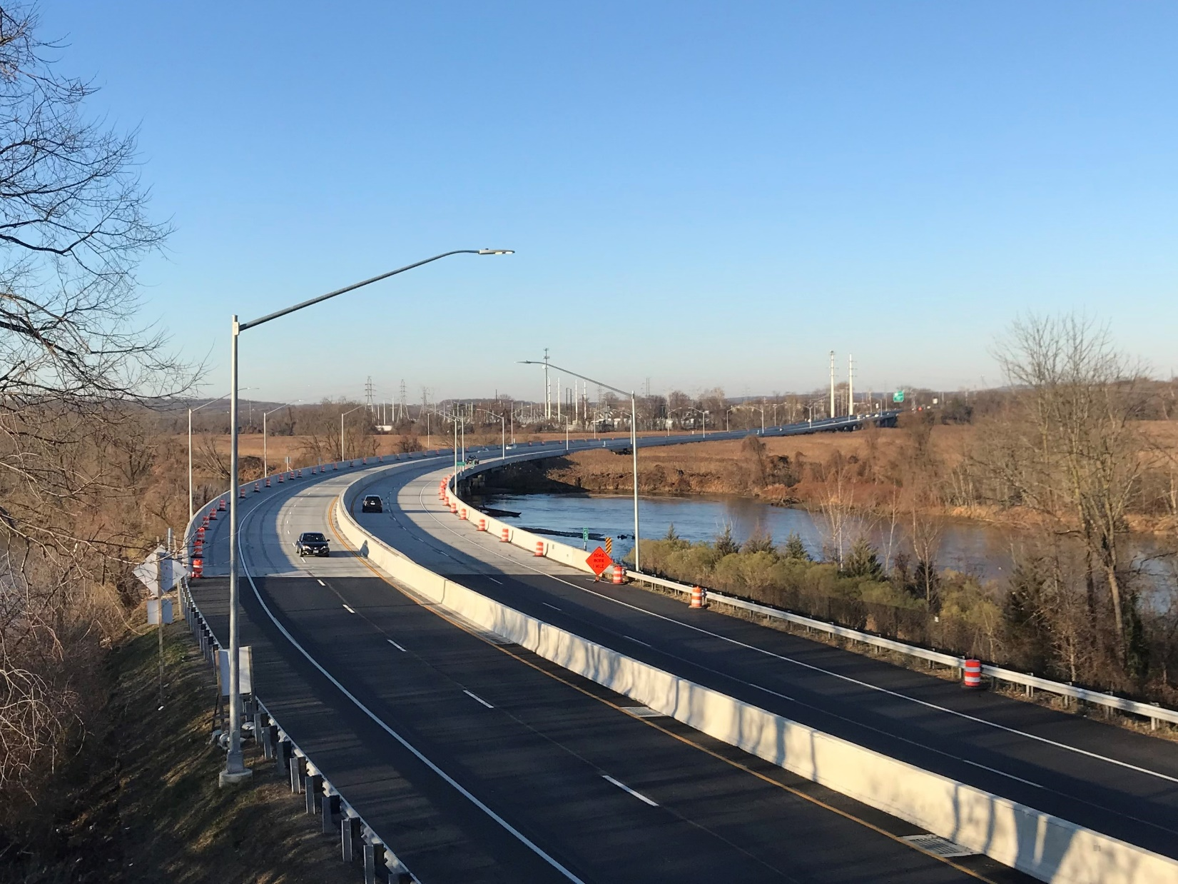
Questions?

