Slide 1


Reducing the Carbon Footprint of Concrete
Shannon Seipel
Technical Services Manager
Simply better concrete.
Notes:
Thank you for taking the time to meet with us today!
CarbonCure is a company that is leading an initiative to reduce the carbon footprint of concrete. As you may be aware, concrete is made of cement, which is a large contributor of greenhouse gasses, particularly carbon dioxide – also known as CO2. CarbonCure has developed a technology that repurposes waste carbon dioxide to make greener, stronger concrete.
CarbonCure is currently available for any kind of concrete product including ready mix concrete, precast and block. The CarbonCure Technology has been installed by __ (your name).

Slide 2
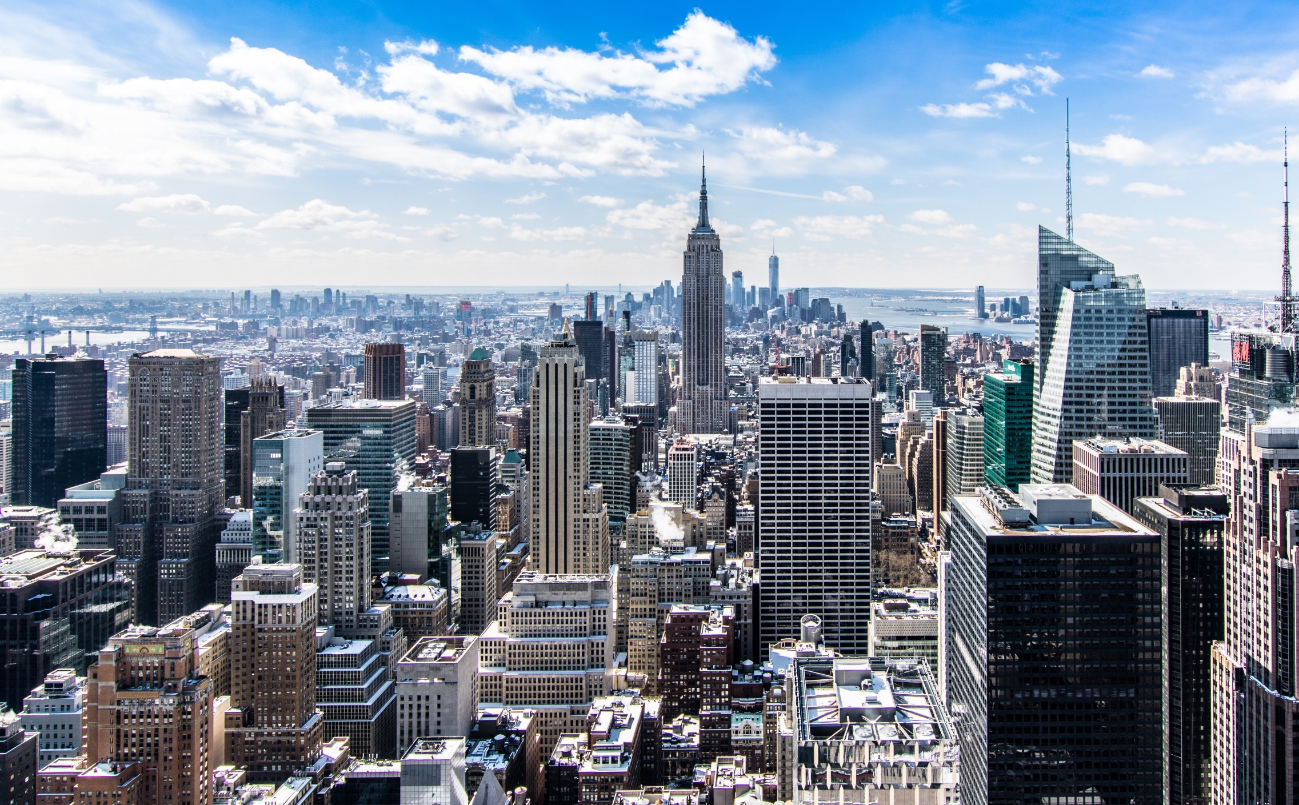
Projected Carbon Emissions of New Construction 2020-2050
Did You Know?
The world’s building stock is expected to double by the year 2060. This means we’re building an entire New York City every month for the next 40 years.
Embodied Carbon
The carbon released through the manufacturing of building products through the construction of the building.
Source: Architecture 2030

Slide 3
The Global 2050 Challenge
A multi-disciplinary challenge to achieve net zero embodied carbon by 2050.
Mission alignment with:
Notes:
"A multidisciplinary challenge to reduce embodied carbon is gaining traction with specifiers. The challenge started with Architecture2030 and grew to include other members of the design and build community, including contractors and engineers. All of these organizations are aligned on the overall ambitious goal of eliminating embodied carbon by the year 2050. Whether that's attainable is to be determined, but the key point to consider is that there are a lot of organizations who have signed onto these challenges, like Architecture2030 and SE2050, or have created their own version, such as Skanska's embodied carbon reduction mission. These organizations are actively looking for solutions to reduce embodied carbon, and there aren't a lot of those kinds of solutions available - at least not the kind that make practical sense for large structures. CarbonCure customers can say that they help organizations work towards the 2050 challenge to reduce embodied carbon.

Slide 4
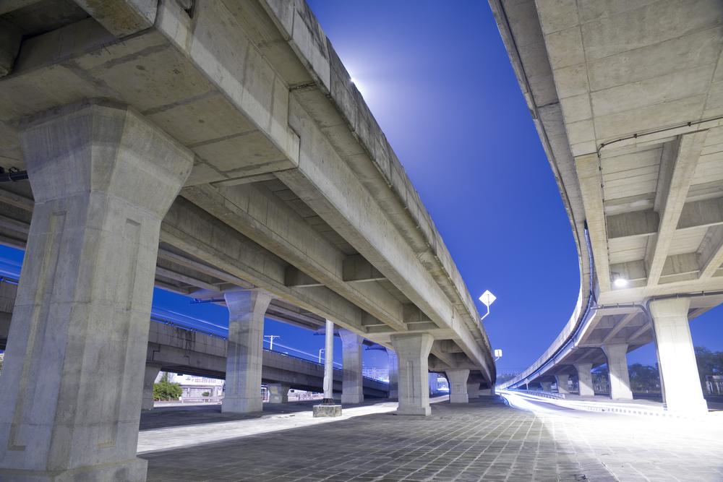
Concrete is the most abundant man-made material in the world.
As a result, cement production creates ~7% of the world’s CO₂ emissions and is the largest contributor to embodied carbon
in the built environment.

Slide 5



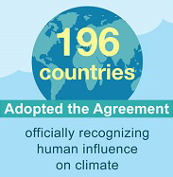
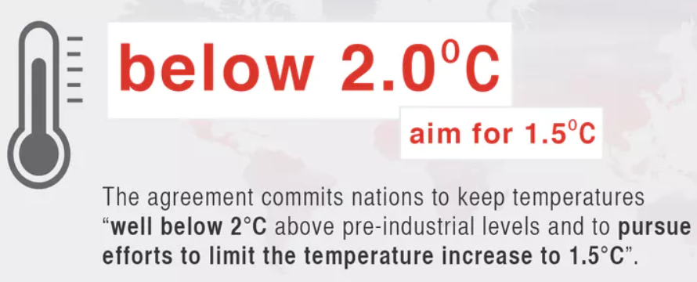
Global Sustainability Goals
Reducing the Carbon Footprint of Concrete
5

Slide 6

Cement Sustainability Goals
2 degree scenario @ 2050 targets an annual 618 Mt CO₂ emission reduction beyond the reference baseline with 48% coming from CCUS
CarbonCure’s mission is to deliver 500 Mt CO₂
Reducing the Carbon Footprint of Concrete
6

Slide 7
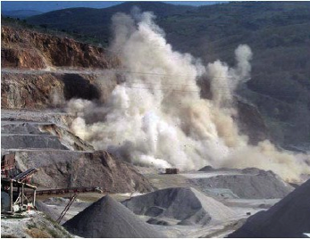
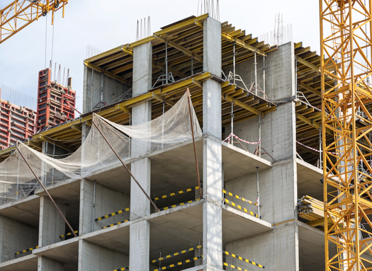
The Life Cycle of Concrete
1
Limestone
2
Cement
Limestone (CaCO₃), clay and other materials are mined from a quarry. .
The materials are crushed, then heated in a kiln at 2,700 ºF, releasing CO₂ and other gases.
3
Concrete
4
Structure
The cement is mixed with other materials at the concrete plant to create ready mix concrete.
The concrete is delivered to job sites by truck, where it becomes a structure such as a building.
Notes:
In order to understand the challenge faced by the concrete industry, we must first understand the problem, which brings us to how cement and concrete are made.
The most important raw material in cement production is limestone, which in chemistry terms is calcium carbonate, CaCO3. Limestone is extracted from the ground. It is then heated in a cement factory and used to make cement. This process releases carbon dioxide, CO2. The cement is then taken to a concrete plant, whether it’s a block plant or poured concrete facility, where it is mixed with other ingredients such as water and sand, and is turned into concrete.

Slide 8
Developer and engineers choose concrete
Because concrete is…
Proven
Durable
Strong
Sound-reducing
Versatile
Thermal-insulating
Beautiful
Resilient
Reducing the Carbon Footprint of Concrete
8
Notes:
There’s a reason why concrete is so abundant. We need concrete to create the strong, resilient buildings and infrastructure that surround us. It is the backbone of modern society. Without concrete, we couldn’t build bridges or skyscrapers that can keep us safe and warm and protect us from the elements.
When it comes to creating sustainable structures, there is nothing more sustainable than building to last. It doesn’t make any sense to use the greenest materials you can find, if you’re only going to tear it down and rebuild in the next 20 years. Concrete structures are built to last. It’s inherently the most sustainable building material in the world, except for its carbon footprint that comes from cement production. And we’re working hard across the industry and here at ___ (your name) to reduce that impact.

Slide 9
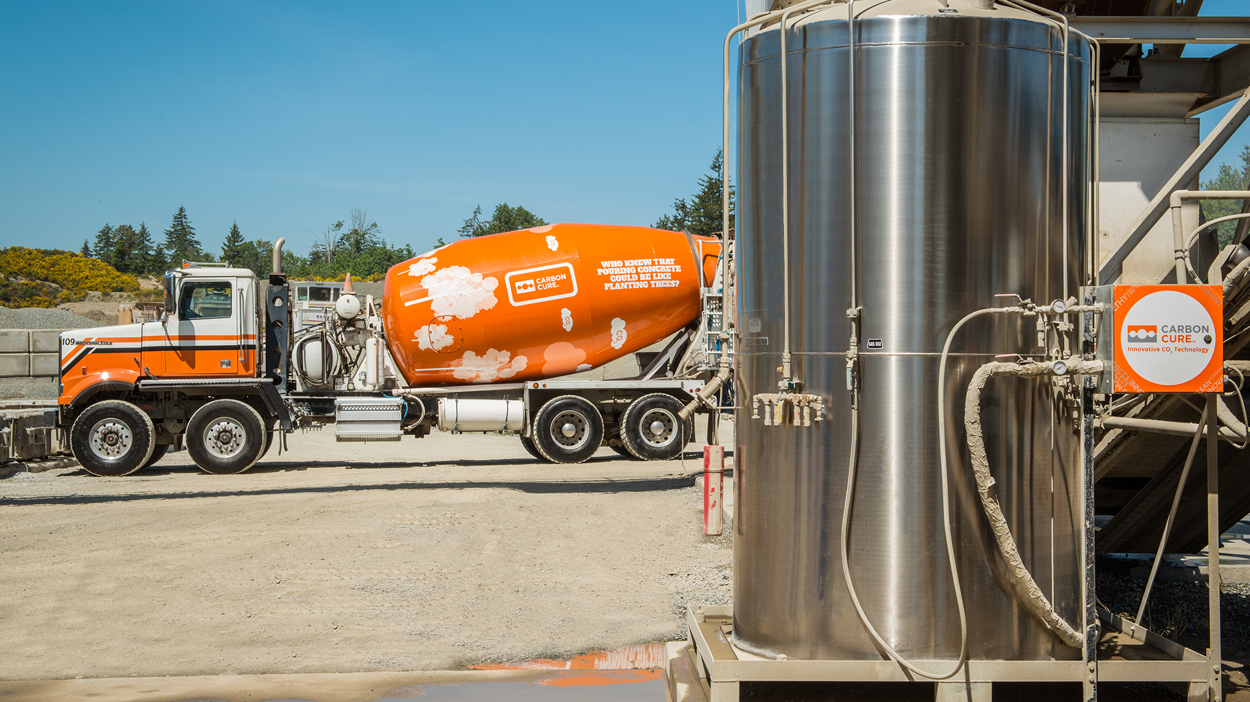
CO₂ UTILIZATION IN CONCRETE
The CarbonCure Technology beneficially repurposes carbon dioxide (CO₂) to reduce the carbon footprint of concrete without compromising concrete performance.
Notes:
The CarbonCure Technology is a solution we’ve incorporated in order to reduce our carbon footprint. The technology injects carbon dioxide (CO2) that’s captured from industrial emitters into our concrete during mixing. For those of you familiar with concrete operations, it operates just like an admixture. The CO2 is stored in this big tank, as you can see, in a liquefied state. The CarbonCure technology, which is retrofitted to our plants, injects a precise dose of CO2. Once introduced to the concrete mix, the CO2 chemically converts to a mineral and is permanently trapped in the concrete. This process actually improves the concrete’s strength, which allows us to optimize our mixes. We’ll go into the process in more detail throughout the presentation.

Slide 10
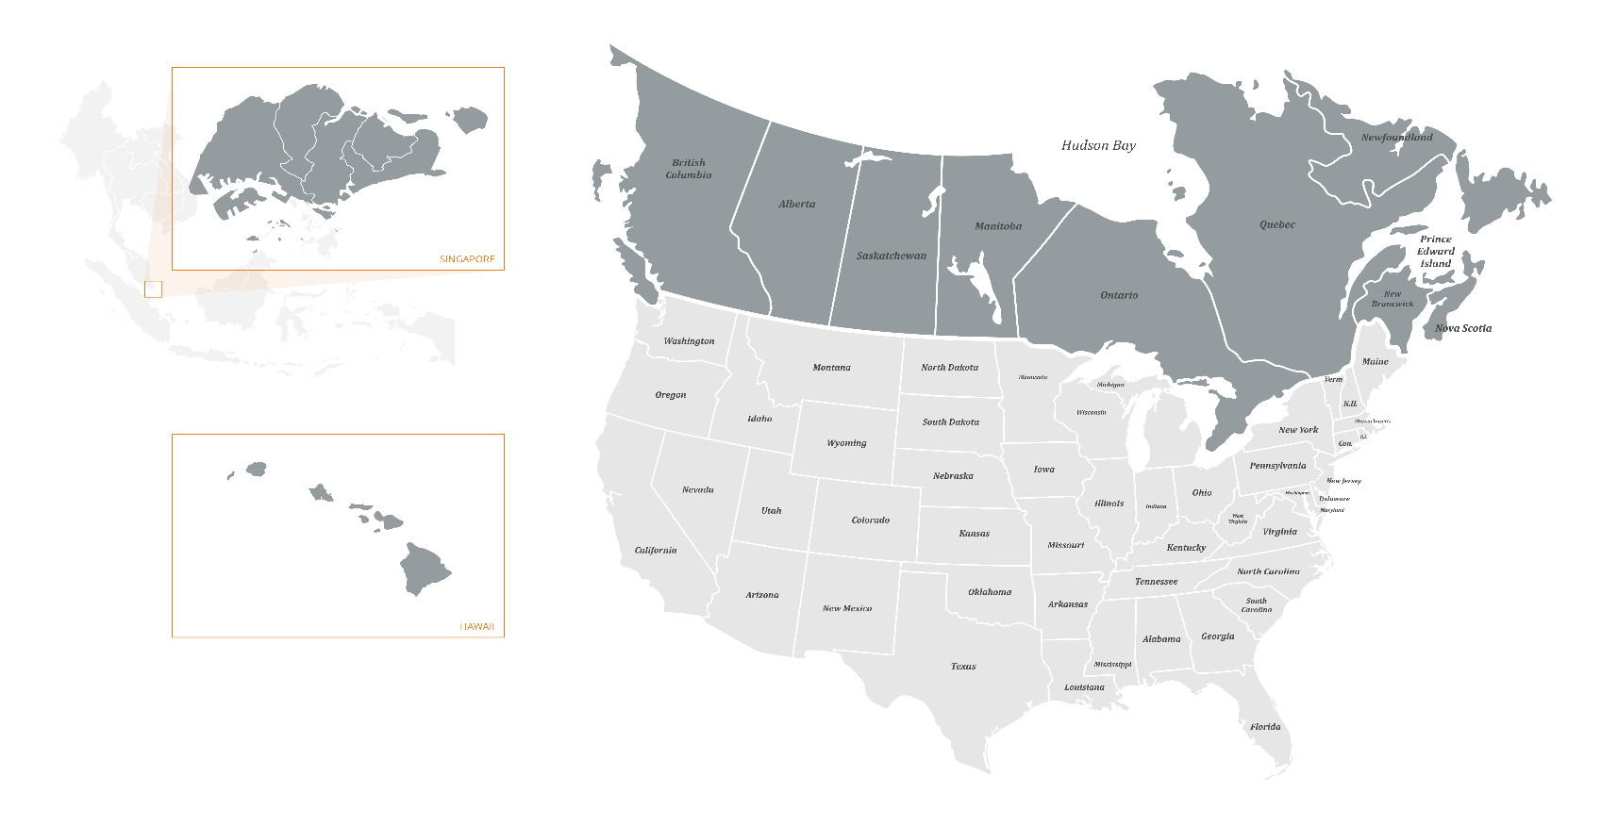
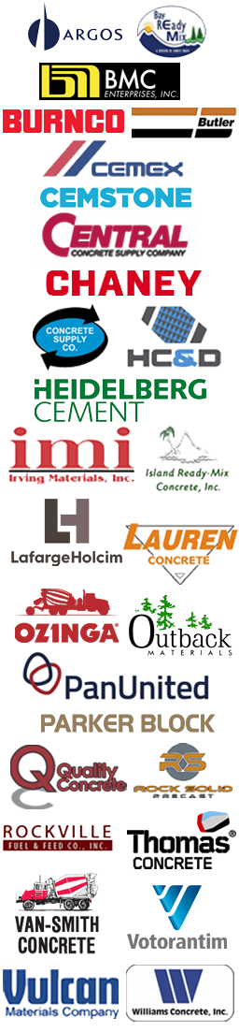
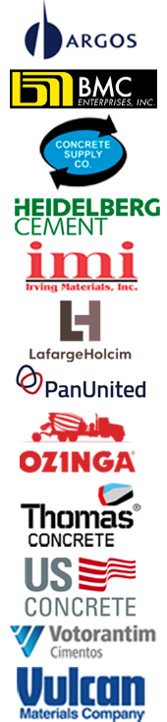


Validated from Coast to Coast
160+ concrete plants operating across the US, Canada and Singapore
> 4 million yd³ of concrete produced
CARBONCURE PRODUCER MAP
CARBONCURE PRODUCERS
Reducing the Carbon Footprint of Concrete
10
Notes:
The CarbonCure Technology is currently available in nearly 150 concrete plants across Canada, the US, and recently in Southeast Asia. More than 2.7 million cubic metres (4 million cubic yards) have been produced with CarbonCure to date.
It’s rapidly gaining traction across the industry as more concrete producers have validated that it works.

Slide 11



Award-Winning Innovation
Reducing the Carbon Footprint of Concrete
11

Slide 12
CarbonCure’s Value to Concrete Producers
Strength
enhancement from
CO₂ nanomaterial
Cement reduction
Material cost savings
Profitable returns
Ability to attract green design business
Environmental
benefit from CO₂ reduction
Reducing the Carbon Footprint of Concrete

Slide 13
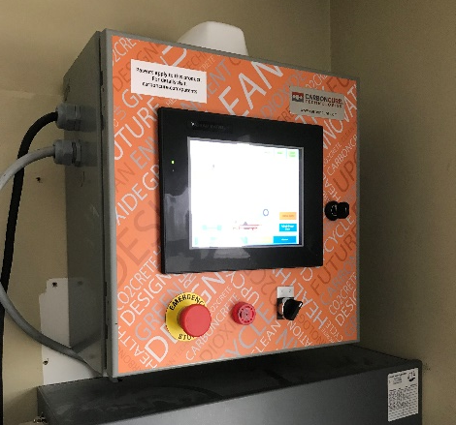
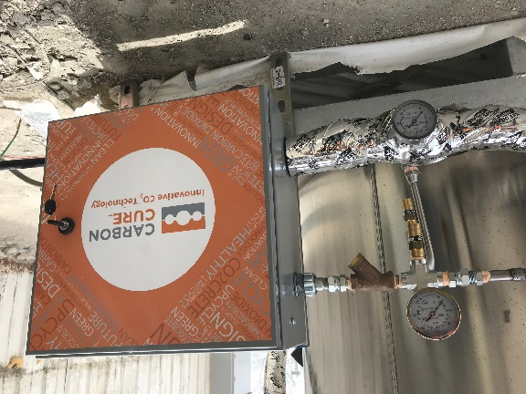
How It Works: Overview
CarbonCure engineers installs its patented technology into ready mix concrete plants
The equipment injects a precise dosage of CO₂ into fresh concrete as it mixes
The CO₂ chemically converts into a mineral and improves the compressive strength of the concrete
This enables mix design adjustments and the reduction of cementitious material
CarbonCure monitors the performance of the technology via telemetry
CARBONCURE EQUIPMENT
The CarbonCure control box seamlessly integrates with the plant’s batching software
The CarbonCure valve box injects the CO₂ into the concrete during mixing
Reducing the Carbon Footprint of Concrete
13
Notes:
When we first install the equipment at any given plant, CarbonCure works with us to undergo an extensive testing and validation process. The equipment injects the CO2 into fresh concrete as it mixes – either into the central mixer or into the mixing drum on the truck depending on the process. It’s all integrated with our batching software and it’s automated. It does not affect the cycle time, so there are no impacts on the construction schedule.
Once injected, the CO2 chemically converts into a mineral and improves the compressive strength of the concrete, allowing us to adjust our mix designs.

Slide 14
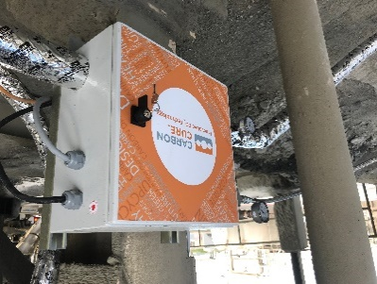
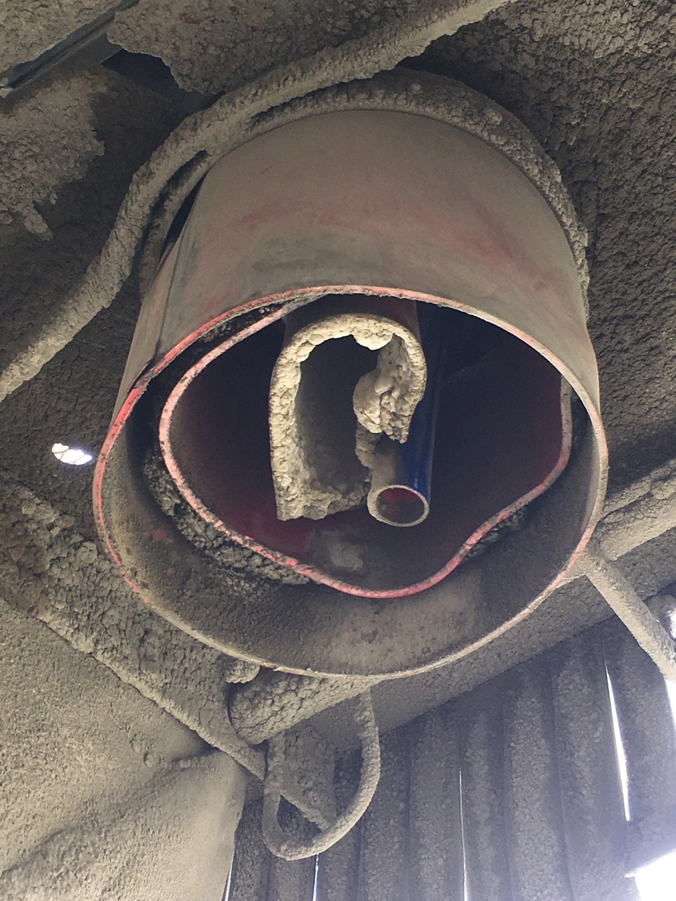
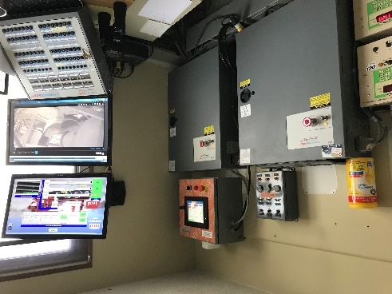

How It Works: Technology
Installation, injection, integration and support
01.
Installation
CarbonCure installs its proprietary
retrofit equipment (1 day)
CarbonCure optimizes CO₂ injection rate
02.
Injection
Central mix: CO₂ snow injected
into mixer during batching sequence
Dry batch: CO₂ snow injected
into mouth of truck during trim
water application
03.
Integration
Batching integrated with batch operations system
Automated CO₂ dosage
04.
Support
Remote telemetry for customer support
Real-time system monitoring
Toll-free technical support line
Reducing the Carbon Footprint of Concrete
14
Notes:
Data based on 2013 system research

Slide 15
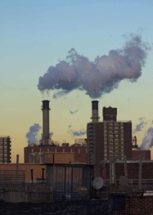
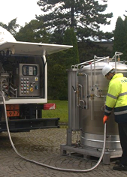
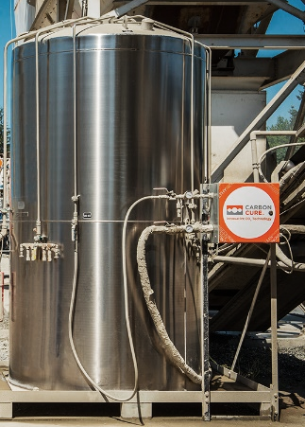
CO₂ Supply
CO₂ is captured and distributed to concrete plants by industrial gas suppliers
Collection
Purification
Delivery
Storage
CO₂ is collected from large
emitters
CO₂ gas is purified
by industrial suppliers
CO₂ is delivered to concrete plants by industrial suppliers
The CO₂ is stored at concrete plants in pressurized tanks
Reducing the Carbon Footprint of Concrete
15
Notes:
Let’s walk through the process of how this technology works from the beginning, starting with the CO2 supply.
CO2 is a very natural substance. As humans we breath in oxygen and breathe out CO2. Trees breathe in CO2 and breathe out oxygen. The problem with CO2 is that we produce too much of it through manufacturing, energy and transportation, and it’s hurting our ozone.
So the CO2 is collected from large industrial sources such as fertilizer and ethanol plants. CarbonCure does not collect or supply the CO2 and our customers will source their CO2, as a separate agreement, with companies like Praxair, Air Liquide and Linde. These companies collect CO2 from waste sources, purify it, and then sell it to the market.
This CO2 gas industry is big and there are local CO2 suppliers everywhere. CO2 is most commonly used for carbonated beverages, or cooling mechanisms. It’s important to note that from an environmental perspective, this CO2 is being collected and re-used for other purposes, but it eventually makes its way into the atmosphere. For example, if the CO2 goes into a can of coca cola, when you open the can, you hear a fizz, and that’s CO2 going back into the atmosphere. When we introduce CO2 to concrete, it chemically converts into a mineral, which means it will never go back into the atmosphere because it no longer exists!
These industrial gas suppliers deliver the CO2 to the concrete plant where it is stored in pressurized tanks that are permanently installed on site. The CO2 suppliers will refill those tanks as required; typically about once a month if running at full capacity.
The cost of CO2 can range depending on your location and proximity to a distribution facility – CarbonCure can help you get a quote and negotiate a favorable price using our strong national relationships with CO2 suppliers. CarbonCure will also help by calculating the amount of CO2 you will use on a monthly basis and provide our equipment engineering requirements so that CO2 suppliers are able to provide the appropriate equipment. Your tank size will vary based on your monthly usage, but tanks are normally about 8-10 feet tall and 5 feet in diameter.

Slide 16

Converting CO₂ to a Mineral
Heat (+) calcination reaction
CO₂
Reverse calcination reaction
CaO
CaCO₃
CaCO₃
Concrete
Limestone
(Calcium
carbonate)
Carbonated
Cement
Add aggregate, water & chemicals
Reducing the Carbon Footprint of Concrete
16
Notes:
To understand the chemical reaction that’s happening when CO2 is introduced to the mix, we first need to understand how cement is made.
Cement starts with mining limestone, aka calcium carbonate (CaCO3) from a querry. The CaCO3 is heated to really high temperatures where the molecule splits in half. This process is called calcination. One half is CO2, which is released into the atmosphere as a waste byproduct. This is why cement production creates so much CO2. The other half is Calcium Oxide (CaO) which is the critical binding material used to make cement. The cement is then shipped to the concrete plant where it’s mixed with sand, stone, water and chemicals known as admixtures.

Slide 17
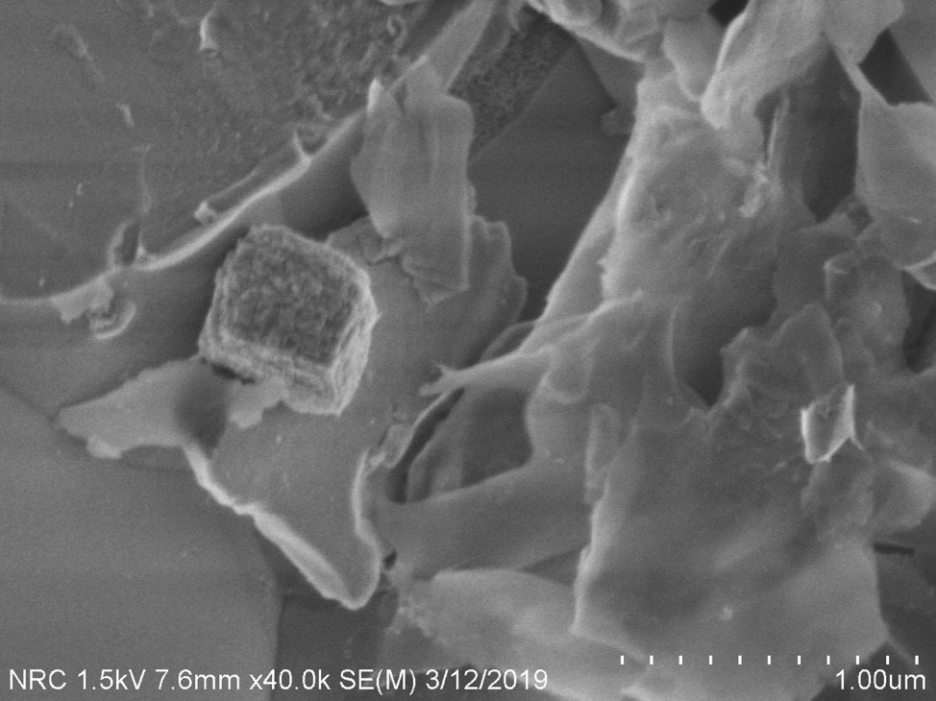
Converting CO₂ to a Mineral
Carbonate product formed, about 400 nm dimension
Nano-calcium carbonate particles
act as nucleation
sites for hydration. Results in 10% compressive strength improvement at 28 days.
+ CO₂
Reducing the Carbon Footprint of Concrete
17
Notes:
You can really see the nano sized minerals in this photos. These nano calcium carbonate particles are finer than silica fume. They surround the cement grain and increase the surface area on which the hydration reaction will take place - Ultimately, this mechanism results in increased compressive strength.

Slide 18
Compressive Strength Effects
Industrial Trial Average Results
Conclusion: The formation of a calcium carbonate nanomaterial improves the compressive strength of ready mix concrete.
Reducing the Carbon Footprint of Concrete
18

Slide 19
Mix Adjustment Potential
Conclusion: CarbonCure enables concrete producers to
reduce cement content without sacrificing strength.
Reducing the Carbon Footprint of Concrete
19

Slide 20
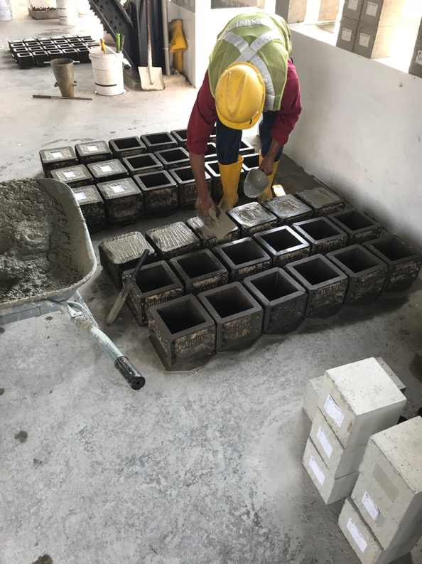
CO₂ has a neutral impact on…
Fresh Properties
Setting time
Workability/slump
Concrete pumping
Air content
Temperature
Finishing
Hardened Properties
Freeze-thaw
pH
Density
Durability
Color
Texture
*Peer reviewed papers are available to support the above information.
www.carboncure.com/technical-data-library
Reducing the Carbon Footprint of Concrete
20

Slide 21
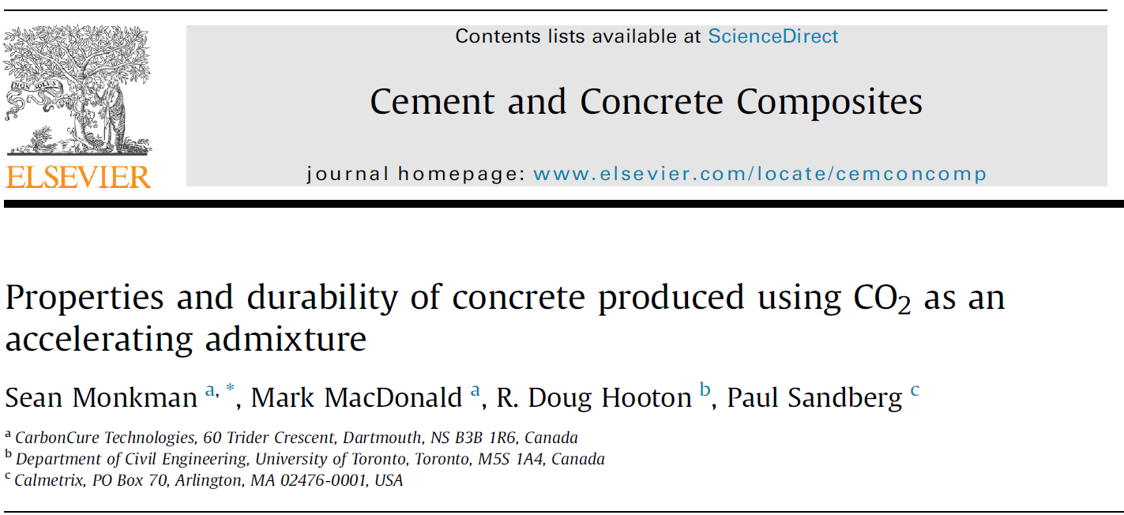
Durability Testing
Third party testing of typical concrete properties plus 6 durability properties conducted on concrete mixes batched at ready mix plant in Toronto, Canada
“The durability testing showed that the CO₂-injection process had a neutral to positive effect on concrete durability.”
Reducing the Carbon Footprint of Concrete
21

Slide 22
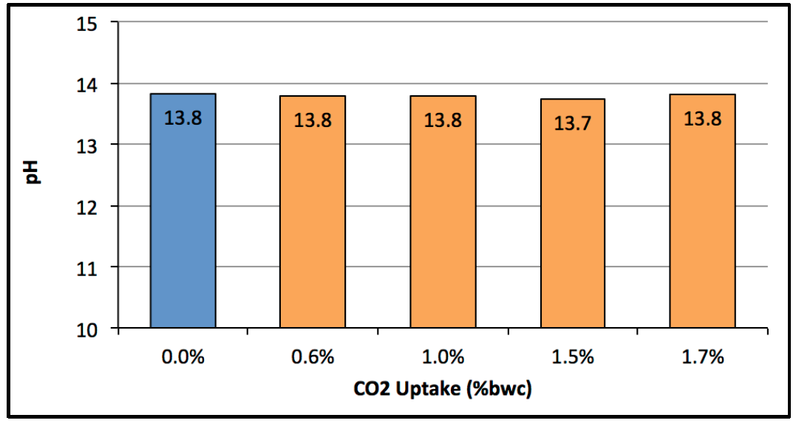
Carbonation vs Corrosion
Early carbonation and atmospheric carbonation are not the same.
Testing has shown that early carbonation has no impact on the pH of concrete, and therefore has no impact on corrosion.
Impact of CO₂ Injection on the pH of Pore Solution Extracted from Carbonated Paste Samples at 28 days
13.8
Reducing the Carbon Footprint of Concrete
22
Notes:
It is the high pH that protects the steel – the pH would have to fall below 11.5 or even lower for the passive layer to become destabilized. t is the high pH that protects the steel – the pH would have to fall below 11.5 or even lower for the passive layer to become destabilized.

Slide 23

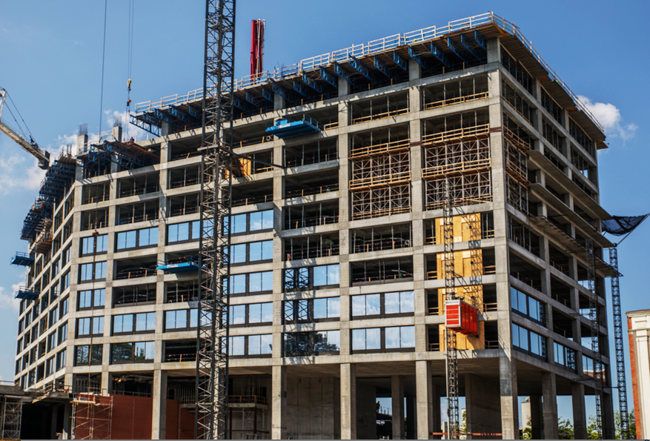
How Much CO₂ Can Be Saved?
~ 25 lbs CO₂ reduced per yd³
  ~ 1 lb sequestered
  ~ 20-40 lbs avoided through
  cement reduction
725 Ponce
Notes:
At the end of the day the process reduces approximately 25 lbs of CO2 per cubic yard (20kg CO2 per cubic meter) of concrete. This figured can vary quite a bity depending on the mix design. The highest CO2 reduction of concrete delivered to a job site reduced 92 lbs CO2 per cubic yard. Regardless of the mix, the CO2 impact becomes very significant for any given projects. Many commercial developments can save over 1,000,000 lbs CO2.

Slide 24
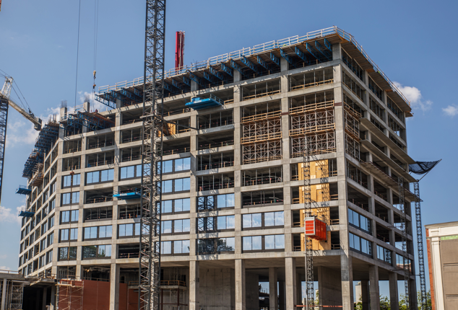
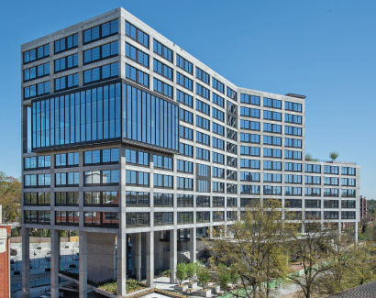





725 Ponce – Atlanta, GA
360,000 square foot commercial high-rise
Supplier Thomas Concrete
Architect Cooper Carry
Engineer Uzun+Case
Contractor Brasfield & Gorrie
CO₂ Savings 1.5 million lbs
“Uzun+Case, with input from Thomas Concrete, specified the CarbonCure Technology to reduce the carbon footprint of 725 Ponce. We’re proud to have saved 1.5 million lbs of CO₂ while maintaining our high-quality standards for concrete.”
-Rob Weilacher
Engineer of Record, Uzun+Case
Reducing the Carbon Footprint of Concrete
24
Notes:
CarbonCure concrete has been delivered to hundreds of projects across North America. Here’s one example of a project by Thomas Concrete, a producer in Atlanta Georgia. In this project, every square inch of concrete in this building used CarbonCure – a total of 48,000 cy. In total the project team reduced 1.5 million pounds of CO2, which is the same amount of CO2 as 800 acres of trees will sequester over a year. And that’s just one medium sized building.

Slide 25
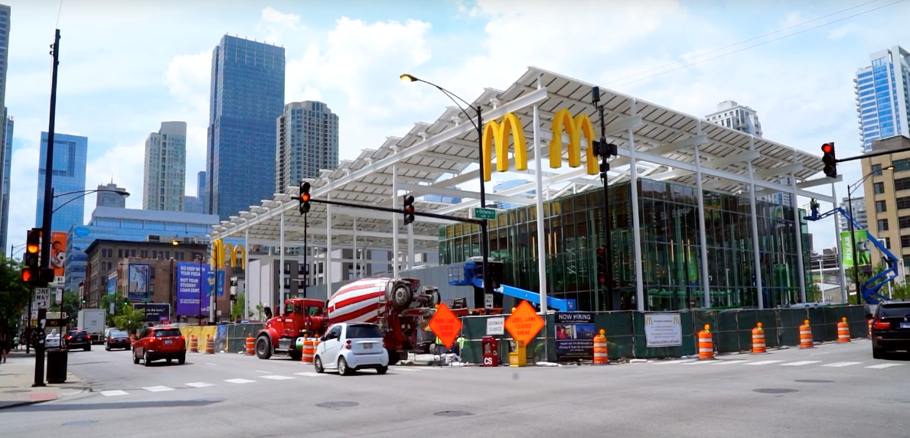





McDonald’s Flagship – Chicago, IL
‘Experience the Future’ restaurant
Supplier Ozinga
Project Size 19,000 square feet
Architect Ross Barney Architects
CO₂ Savings 30,000 lbs
“From the beginning, McDonald’s knew they wanted this project to be sustainable. CarbonCure turned out to be a great answer to McDonald’s.”
-Carol Ross Barney
Principal Designer, Ross Barney Architects
Reducing the Carbon Footprint of Concrete
25
Notes:
This project was not large but perhaps a recognizable building. CarbonCure was specified by McDonalds and the architectural team to reduce the carbon footprint of its flagship restaurant in downtown Chicago. It’s called the Experience of the Future McDonalds. CarbonCure reduced 30,000 lbs of CO2 from this building.

Slide 26
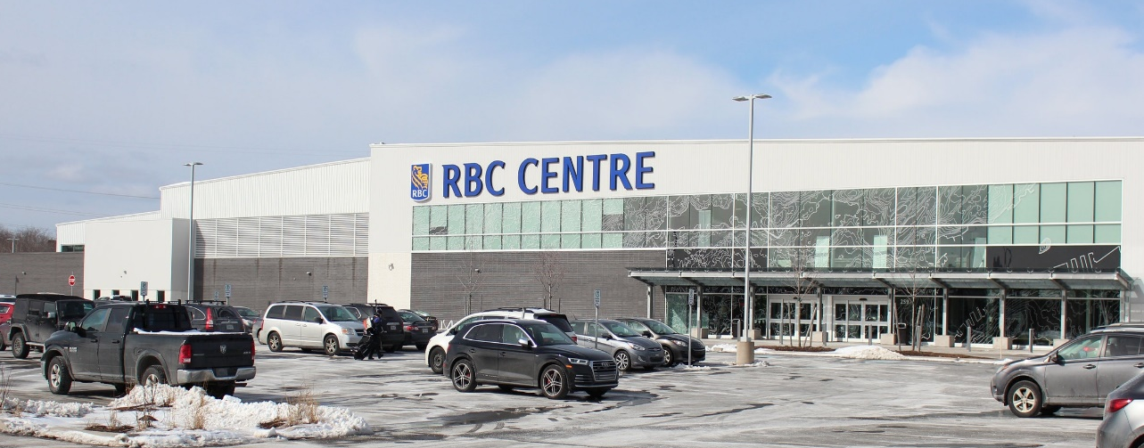


RBC Centre – Halifax, NS
175,000 square foot sports complex
Supplier Quality Concrete
Architect Architecture49
Contractor Ellis Don
CO₂ Savings 200,000 lbs
“The CarbonCure concrete that arrived at the Multi-Pad Arena had an excellent finish and met all of our fresh properties criteria.”
-Roland Doucet, P.Eng., LEED AP
Construction Manager, Ellis Don
Reducing the Carbon Footprint of Concrete
26
Notes:
This Multi Pad Arena (RBC Centre) in Nova Scotia is a good example to bring up. Firstly, the concrete was poured in Canada in the winter. It used high entrainment and lots of admixtures and CO2 did not impact the process. Secondly, the project team was very concerned about finish-ability because the floor pad of the ice surface needed to be perfectly smooth. The project team was very pleased with the finishability of the concrete.

Slide 27
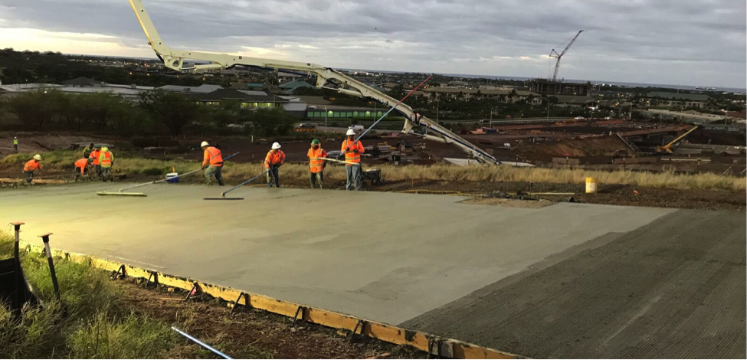

Kapolei Interchange – Honolulu, HI
Concrete paving, Department of Transportation highway
Reducing the Carbon Footprint of Concrete
27
“Linkedin is proud to support environmental consciousness in the built environment. The design of our new headquarters campus incorporates sustainable concrete solutions, including CarbonCure Technologies through our local concrete experts, Central Concrete.“
-Jennifer Mitchell
Senior Project Manager, GWS Design + Build Team at LinkedIn
“I am pleased to see HDOT moving ahead with CarbonCure, local concrete companies, and Hawaii Gas to reduce the levels of carbon dioxide emitted during the construction process.”
-Hawaii’an Governor David Ige
Reducing the Carbon Footprint of Concrete
27

Slide 28
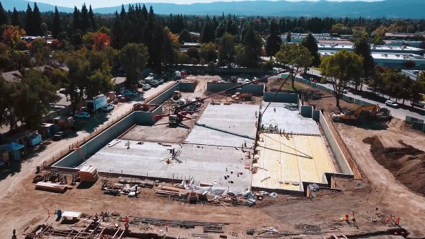


LinkedIn – Mountain View, CA
Campus headquarters
AS SEEN IN GATES NOTES VIDEO
“Linkedin is proud to support environmental consciousness in the built environment. The design of our new headquarters campus incorporates sustainable concrete solutions, including CarbonCure Technologies through our local concrete experts, Central Concrete.“
-Jennifer Mitchell
Senior Project Manager, GWS Design + Build Team at LinkedIn
“I am pleased to see HDOT moving ahead with CarbonCure, local concrete companies, and Hawaii Gas to reduce the levels of carbon dioxide emitted during the construction process.”
-Hawaii’an Governor David Ige
Reducing the Carbon Footprint of Concrete
28

Slide 29
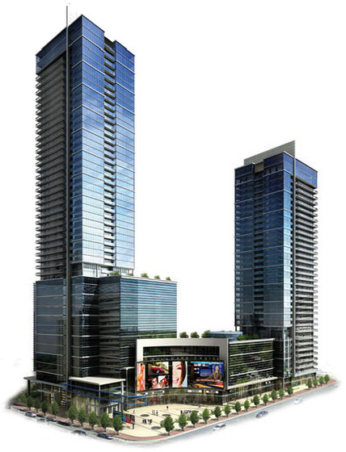
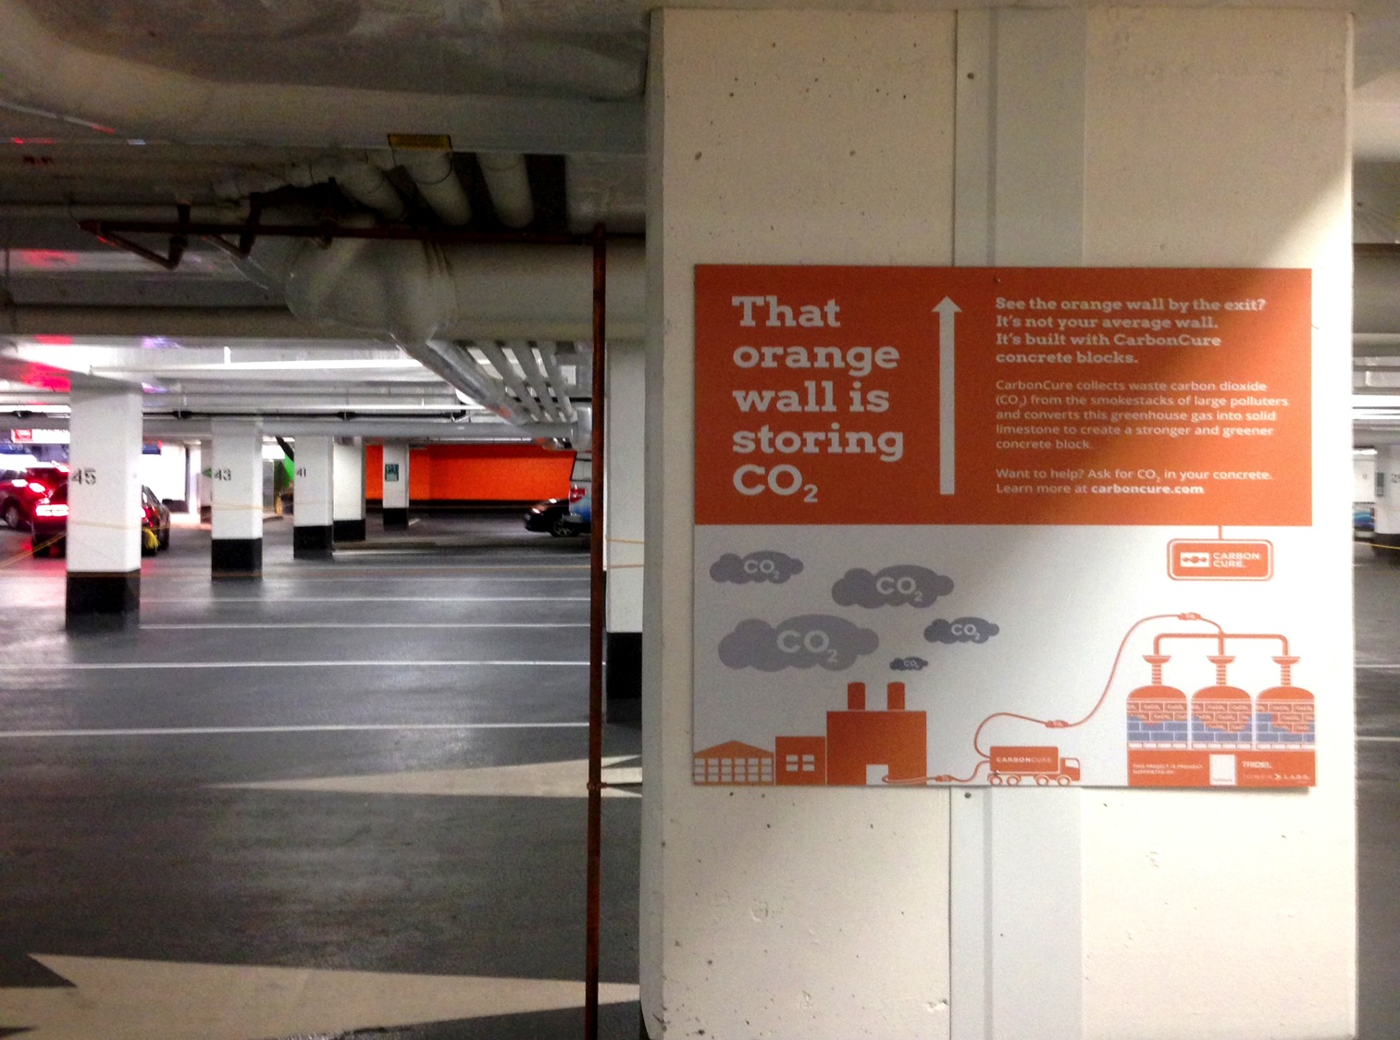
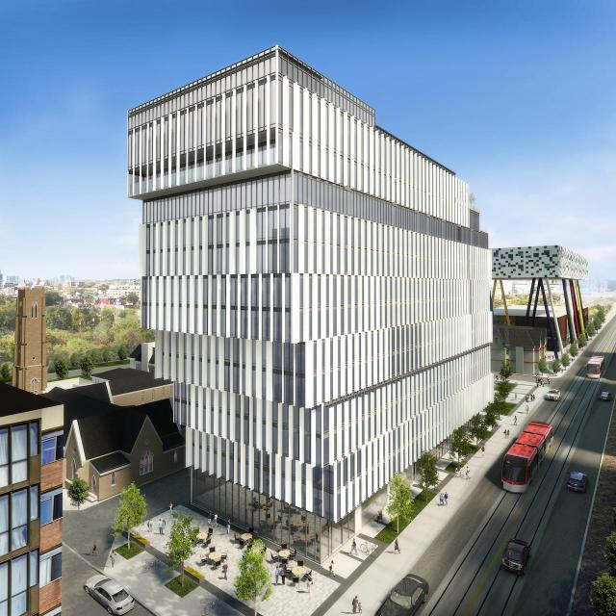
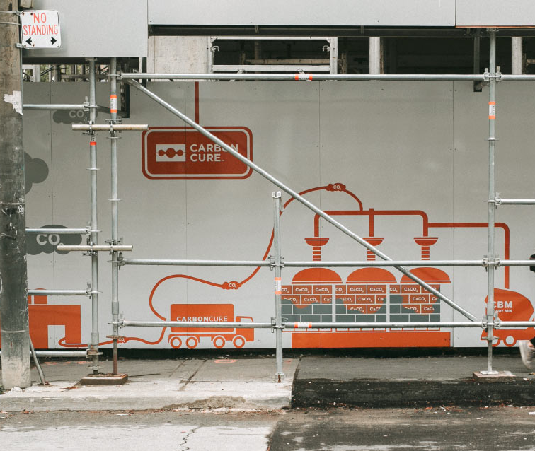
Creative Marketing Opportunities
Developer Tridel marketed their use of CarbonCure concrete for the construction of the Hullmark Centre and FORM Condos in Toronto, ON
Hullmark Centre – Toronto, ON
FORM Condos – Toronto, ON
Notes:
In a large condo building in Toronto, the developer team used creative marketing strategies to show their commitment to sustainability to their tenants. They painted concrete walls in the parking garage orange and put up signs saying “that orange wall is storing CO2”. It’s a neat example of how building developers can take advantage of the carbon footprint reduction we can provide to showcase their sustainability commitment.

Slide 30
Application to LEED
CarbonCure helps to reduce all impact categories, including CO₂e
Materials & Resources
Focuses on minimizing embodied environmental impacts to support a life-cycle approach that improves performance.
Option 4: Whole Building Life Cycle Assessment (1-4 points)
Conduct a life cycle assessment and show a 10% impact reduction in embodied CO₂ emissions + 2 other impact categories shown on an Environmental Product Declaration
Reducing the Carbon Footprint of Concrete
30

Slide 31
Concrete Specs & Sustainability
Some prescriptive specs may inhibit the ability to reduce the concrete’s environmental impact
To improve concrete performance and sustainability, the NRMCA recommends considering alternatives to commonly used prescriptive specs.
Consider alternatives to minimum cement content
Consider alternatives to maximum SCM content
Consider alternatives to maximum w/cm ratio
A shift to performance-based specifications for concrete, with a focus on innovation, quality, and customer satisfaction.
Reducing the Carbon Footprint of Concrete
31
Notes:
The challenge we may come up against in this process is that we will need to work with the structural engineering team to approve our optimized mix design. This may including looking at cementitious content requirements or water to cementitious ratio requirements and seeing if we can meet the desired performance criteria while optimizing the mix with the CarbonCure system.

Slide 32
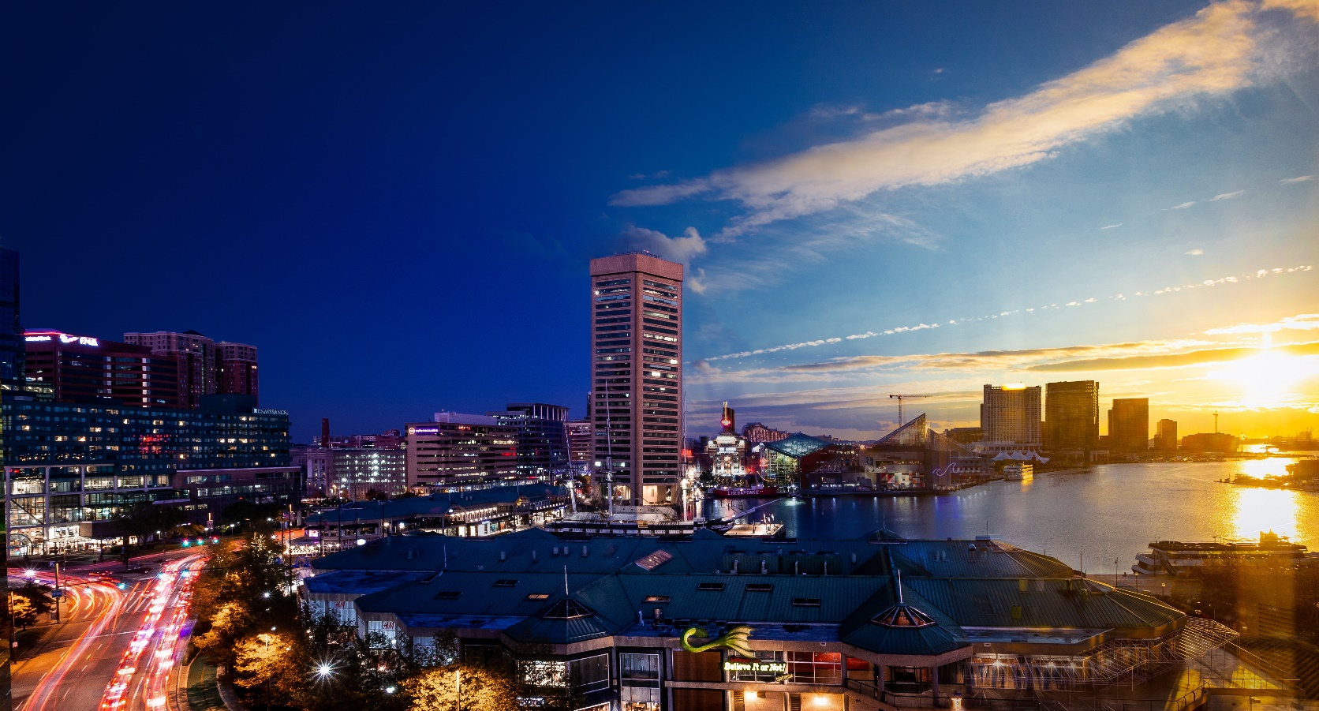

Carbon Savings Potential
Reducing the Carbon Footprint of Concrete
32
Notes:
Annual concrete used in Maryland annually
Carbon savings potential
Equivalent to acres of trees absorbing carbon
Cars off the road for a year

Slide 33





Build for the Future.
Build with CarbonCure.
A building or infrastructure project may save as much CO₂
as 100s if not 1000s of acres of trees absorb over a year.
Who knew that building with concrete could be like planting trees?
Shannon Seipel
Technical Services Manager
sseipel@carboncure.com
www.carboncure.com
@CarbonCure
CarbonCure-Technologies
CarbonCure.Technologies
Simply better concrete.
Notes:
At the end of the day, building with CarbonCure concrete means doing something right for the environment. The concrete used in a typical small commercial development for example can save as much CO2 as an acre of trees would sequester over 100 years. Who know that building with concrete could be like planting trees?

